Slide 1
Acute Kidney Injury
KDIGO 2012 Clinical Practice Guideline

Slide 2
Section 1: Introduction & Methodology

Slide 3
KDIGO AKI Guideline Work Group
Work Group Co-Chairs
John A Kellum
Pittsburgh, PA
Norbert Lameire
Ghent, Belgium
Work Group
Peter Aspelin
Stockholm, Sweden
Rashad S Barsoum
Cairo, Egypt
Emmanuel A Burdmann
São Paulo, Brazil
Stuart L Goldstein
Cincinnati, OH, USA
Charles A Herzog
Minneapolis, MN, USA
Michael Joannidis
Innsbruck, Austria
Andreas Kribben
Essen, Germany
Andrew S Levey
Boston, MA, USA
Alison M MacLeod
Aberdeen, UK
Ravindra L Mehta
San Diego, CA, USA
Patrick T Murray
Dublin, Ireland
Saraladevi Naicker
Jo’burg, South Africa
Steven M Opal
Pawtucket, RI, USA
Franz Schaefer
Heidelberg, Germany
Miet Schetz
Leuven, Belgium
Shigehiko Uchino
Tokyo, Japan

Slide 4
CKD Evidence Review Team
Tufts Center for Kidney Disease Guideline Development & Implementation
Tufts Medical Center, Boston, MA, USA
Katrin Uhlig, MD, MS, Project Director; Director, Guideline Development
Jose Calvo-Broce, MD, MS, Nephrology Fellow
Aneet Deo, MD, MS, Nephrology Fellow
Amy Earley, BS, Project Coordinator
In addition, support and supervision were provided by:
Ethan M Balk, MD, MPH, Program Director, Evidence Based Medicine

Slide 5
Section 2: AKI Definition

Slide 6
AKI Definition
2.1.1: AKI is defined as any of the following (Not Graded):
Increase in SCr by ≥ 0.3 mg/dl (≥ 26.5 µmol/l) within 48 hours; or
Increase in SCr to ≥ 1.5 times baseline, which is known or presumed to have occurred within the prior 7 days; or
Urine volume <0.5 ml/kg/h for 6 hours

Slide 7
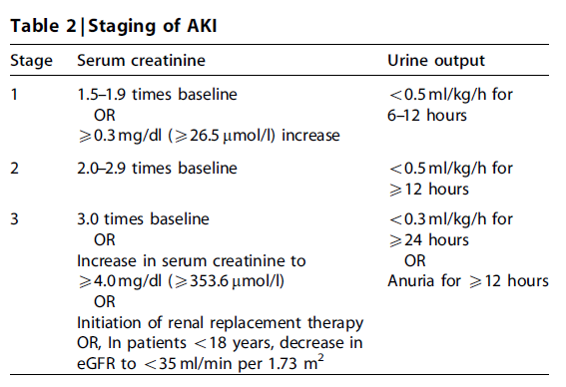
Staging of AKI
2.1.2: AKI is staged for severity according to the following criteria (Not Graded):
2.1.3: The cause of AKI should be determined whenever possible. (Not Graded)

Slide 8
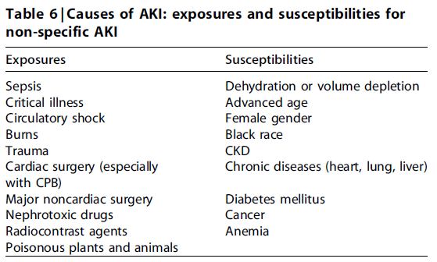
Causes of AKI

Slide 9
Risk Assessment
2.2.1: We recommend that patients be stratified for risk of AKI according to their susceptibilities and exposures. (1B)
2.2.2: Manage patients according to their susceptibilities and exposures to reduce the risk of AKI (see relevant guideline sections). (Not Graded)
2.2.3: Test patients at increased risk for AKI with measurements of SCr and urine output to detect AKI. (Not Graded) Individualize frequency and duration of monitoring based on patient risk and clinical course. (Not Graded)

Slide 10
Evaluation & General Management
2.3.1: Evaluate patients with AKI promptly to determine the cause, with special attention to reversible causes. (Not Graded)
2.3.2: Monitor patients with AKI with measurements of SCr and urine output to stage the severity, according to Recommendation 2.1.2. (Not Graded)
2.3.3: Manage patients with AKI according to the stage (see Figure 4) and cause. (Not Graded)
2.3.4: Evaluate patients 3 months after AKI for resolution, new onset, or worsening of pre-existing CKD. (Not Graded)
If patients have CKD, manage these patients as detailed in the KDOQI CKD Guideline (Guidelines 7–15). (Not Graded)
If patients do not have CKD, consider them to be at increased risk for CKD and care for them as detailed in the KDOQI CKD Guideline 3 for patients at increased risk for CKD. (Not Graded)

Slide 11
AKI Stage
High Risk
1
2
3
Discontinue all nephrotoxic agents when possible
Ensure volume status and perfusion pressure
Consider functional hemodynamic monitoring
Monitor Serum creatinine and urine output
Avoid hyperglycemia
Consider alternatives to radiocontrast procedures
Non-invasive diagnostic workup
Consider invasive diagnostic workup
Check for changes in drug dosing
Consider Renal Replacement Therapy
Consider ICU admission
Avoid subclavian catheters if possible

Slide 12
Section 3: Prevention & Treatment of AKI

Slide 13
Hemodynamic Monitoring
3.1.1: In the absence of hemorrhagic shock, we suggest using isotonic crystalloids rather than colloids (albumin or starches) as initial management for expansion of intravascular volume in patients at risk for AKI or with AKI. (2B)
3.1.2: We recommend the use of vasopressors in conjunction with fluids in patients with vasomotor shock with, or at risk for, AKI. (1C)
3.1.3: We suggest using protocol-based management of hemodynamic and oxygenation parameters to prevent development or worsening of AKI in high-risk patients in the perioperative setting (2C) or in patients with septic shock (2C).

Slide 14
Glycemic Control & Nutritional Support
3.3.1: In critically ill patients, we suggest insulin therapy targeting plasma glucose 110–149mg/dl (6.1–8.3mmol/l). (2C)
3.3.2: We suggest achieving a total energy intake of 20–30 kcal/kg/d in patients with any stage of AKI. (2C)
3.3.3: We suggest to avoid restriction of protein intake with the aim of preventing or delaying initiation of RRT. (2D)
3.3.4: We suggest administering 0.8–1.0 g/kg/d of protein in noncatabolic AKI patients without need for dialysis (2D), 1.0–1.5 g/kg/d in patients with AKI on RRT (2D), and up to a maximum of 1.7 g/kg/d in patients on continuous renal
replacement therapy (CRRT) and in hypercatabolic patients. (2D)
3.3.5: We suggest providing nutrition preferentially via the enteral route in patients with AKI. (2C)

Slide 15
The Use of Diuretics in AKI
3.4.1: We recommend not using diuretics to prevent AKI. (1B)
3.4.2: We suggest not using diuretics to treat AKI, except in the management of volume overload. (2C)

Slide 16
Vasodilator Therapy
3.5.1: We recommend not using low-dose dopamine to prevent or treat AKI. (1A)
3.5.2: We suggest not using fenoldopam to prevent or treat AKI. (2C)
3.5.3: We suggest not using atrial natriuretic peptide (ANP) to prevent (2C) or treat (2B) AKI.

Slide 17
Growth Factor Intervention & Adenosine Receptor Antagonists
3.6.1: We recommend not using recombinant human (rh)IGF-1 to prevent or treat AKI. (1B)
3.7.1: We suggest that a single dose of theophylline may be given in neonates with severe perinatal asphyxia, who are at
high risk of AKI. (2B)

Slide 18
Prevention of Aminoglycoside- and Amphotericin-Related AKI
3.8.1: We suggest not using aminoglycosides for the treatment of infections unless no suitable, less nephrotoxic, therapeutic alternatives are available. (2A)
3.8.2: We suggest that, in patients with normal kidney function in steady state, aminoglycosides are administered as a single dose daily rather than multiple-dose daily treatment regimens. (2B)
3.8.3: We recommend monitoring aminoglycoside drug levels when treatment with multiple daily dosing is used for more than 24 hours. (1A)
3.8.4: We suggest monitoring aminoglycoside drug levels when treatment with single-daily dosing is used for more than 48 hours. (2C)

Slide 19
Prevention of Aminoglycoside- and Amphotericin-Related AKI
3.8.5: We suggest using topical or local applications of aminoglycosides (e.g., respiratory aerosols, instilled antibiotic beads), rather than i.v. application, when feasible and suitable. (2B)
3.8.6: We suggest using lipid formulations of amphotericin B rather than conventional formulations of amphotericin B. (2A)
3.8.7: In the treatment of systemic mycoses or parasitic infections, we recommend using azole antifungal agents and/or the echinocandins rather than conventional amphotericin B, if equal therapeutic efficacy can be assumed. (1A)

Slide 20
Other Methods of Prevention of AKI in the Critically Ill
3.9.1: We suggest that off-pump coronary artery bypass graft surgery not be selected solely for the purpose of reducing perioperative AKI or need for RRT. (2C)
3.9.2: We suggest not using NAC to prevent AKI in critically ill patients with hypotension. (2D)
3.9.3: We recommend not using oral or i.v. NAC for prevention of postsurgical AKI. (1A)

Slide 21
Section 4: Contrast-Induced AKI

Slide 22
CI-AKI: Definition, Epidemiology & Prognosis
4.1: Define and stage AKI after administration of intravascular contrast media as per Recommendations 2.1.1–2.1.2. (Not Graded)
4.1.1: In individuals who develop changes in kidney function after administration of intravascular contrast media, evaluate for CI-AKI as well as for other possible causes of AKI. (Not Graded)

Slide 23
Assessment of the Population at Risk for CI-AKI
4.2.1: Assess the risk for CI-AKI and, in particular, screen for pre-existing impairment of kidney function in all patients who are considered for a procedure that requires intravascular (i.v. or i.a.) administration of iodinated contrast
medium. (Not Graded)
4.2.2: Consider alternative imaging methods in patients at increased risk for CI-AKI. (Not Graded)

Slide 24
Nonpharmacological Prevention Strategies of CI-AKI
4.3.1: Use the lowest possible dose of contrast medium in patients at risk for CI-AKI. (Not Graded)
4.3.2: We recommend using either iso-osmolar or low-osmolar iodinated contrast media, rather than high-osmolar iodinated contrast media in patients at increased risk of CI-AKI. (1B)

Slide 25
Pharmacological Prevention Strategies of CI-AKI
4.4.1: We recommend i.v. volume expansion with either isotonic sodium chloride or sodium bicarbonate solutions, rather than no i.v. volume expansion, in patients at increased risk for CI-AKI. (1A)
4.4.2: We recommend not using oral fluids alone in patients at increased risk of CI-AKI. (1C)
4.4.3: We suggest using oral NAC, together with i.v. isotonic crystalloids, in patients at increased risk of CI-AKI. (2D)
4.4.4: We suggest not using theophylline to prevent CI-AKI. (2C)
4.4.5: We recommend not using fenoldopam to prevent CI-AKI. (1B)

Slide 26
Effects of Hemodialysis or Hemofiltration
4.5.1: We suggest not using prophylactic intermittent hemodialysis (IHD) or hemofiltration (HF) for contrast-media removal in patients at increased risk for CI-AKI. (2C)

Slide 27
Section 5: Dialysis Interventions for Treatment of AKI

Slide 28
Timing of Renal Replacement Therapy
5.1.1: Initiate RRT emergently when life-threatening changes in fluid, electrolyte, and acid-base balance exist. (Not Graded)
5.1.2: Consider the broader clinical context, the presence of conditions that can be modified with RRT, and trends of laboratory tests—rather than single BUN and creatinine thresholds alone—when making the decision to start RRT. (Not Graded)

Slide 29
Criteria for Stopping Renal Replacement Therapy
5.2.1: Discontinue RRT when it is no longer required, either because intrinsic kidney function has recovered to the point that it is adequate to meet patient needs, or because RRT is no longer consistent with the goals of care. (Not Graded)
5.2.2: We suggest not using diuretics to enhance kidney function recovery, or to reduce the duration or frequency of RRT. (2B)

Slide 30
Anticoagulation
5.3.1: In a patient with AKI requiring RRT, base the decision to use anticoagulation for RRT on assessment of the patient’s potential risks and benefits from anticoagulation (see Figure 17). (Not Graded)
5.3.1.1: We recommend using anticoagulation during RRT in AKI if a patient does not have an increased bleeding risk or impaired coagulation and is not already receiving systemic anticoagulation. (1B)
5.3.2: For patients without an increased bleeding risk or impaired coagulation and not already receiving effective systemic anticoagulation, we suggest the following:
5.3.2.1: For anticoagulation in intermittent RRT, we recommend using either unfractionated or low-molecular-weight heparin, rather than other anticoagulants. (1C)
5.3.2.2: For anticoagulation in CRRT, we suggest using regional citrate anticoagulation rather than heparin in patients who do not have contraindications for citrate. (2B)

Slide 31
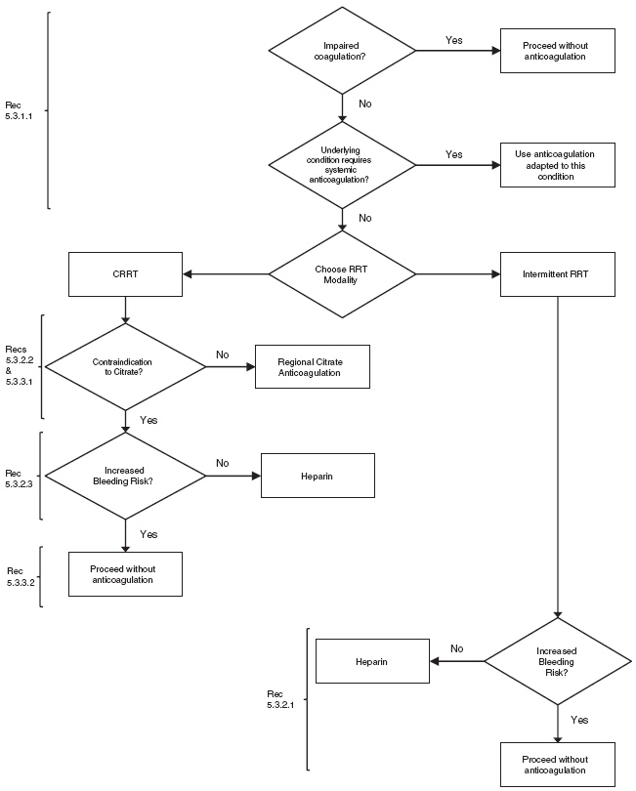
Figure 17

Slide 32
Anticoagulation
5.3.2 (cont’d): For patients without an increased bleeding risk or impaired coagulation and not already receiving effective systemic anticoagulation, we suggest the following:
5.3.2.3: For anticoagulation during CRRT in patients who have contraindications for citrate, we suggest using either unfractionated or low-molecular-weight heparin, rather than other anticoagulants. (2C)
5.3.3: For patients with increased bleeding risk who are not receiving anticoagulation, we suggest the following for anticoagulation during RRT:
5.3.3.1: We suggest using regional citrate anticoagulation, rather than no anticoagulation, during CRRT in a patient without contraindications for citrate. (2C)
5.3.3.2: We suggest avoiding regional heparinization during CRRT in a patient with increased risk of bleeding. (2C)

Slide 33
Anticoagulation
5.3.4: In a patient with heparin-induced thrombocytopenia (HIT), all heparin must be stopped and we recommend using direct thrombin inhibitors (such as argatroban) or Factor Xa inhibitors (such as danaparoid or fondaparinux) rather than other or no anticoagulation during RRT. (1A)
5.3.4.1: In a patient with HIT who does not have severe liver failure, we suggest using argatroban rather than other thrombin or Factor Xa inhibitors during RRT. (2C)

Slide 34
Vascular Access for RRT in AKI
5.4.1: We suggest initiating RRT in patients with AKI via an uncuffed nontunneled dialysis catheter, rather than a tunneled catheter. (2D)
5.4.2: When choosing a vein for insertion of a dialysis catheter in patients with AKI, consider these preferences (Not Graded):
First choice: right jugular vein;
Second choice: femoral vein;
Third choice: left jugular vein;
Last choice: subclavian vein with preference for the dominant side.
5.4.3: We recommend using ultrasound guidance for dialysis catheter insertion. (1A)

Slide 35
Vascular Access for RRT in AKI
5.4.4: We recommend obtaining a chest radiograph promptly after placement and before first use of an internal jugular or subclavian dialysis catheter. (1B)
5.4.5: We suggest not using topical antibiotics over the skin insertion site of a nontunneled dialysis catheter in ICU patients with AKI requiring RRT. (2C)
5.4.6: We suggest not using antibiotic locks for prevention of catheter-related infections of nontunneled dialysis catheters in AKI requiring RRT. (2C)

Slide 36
Dialyzer Membranes for RRT in AKI
5.5.1: We suggest to use dialyzers with a biocompatible membrane for IHD and CRRT in patients with AKI. (2C)

Slide 37
Modality of RRT for Patients with AKI
5.6.1: Use continuous and intermittent RRT as complementary therapies in AKI patients. (Not Graded)
5.6.2: We suggest using CRRT, rather than standard intermittent RRT, for hemodynamically unstable patients. (2B)
5.6.3: We suggest using CRRT, rather than intermittent RRT, for AKI patients with acute brain injury or other causes of increased intracranial pressure or generalized brain edema. (2B)

Slide 38
Buffer Solutions for RRT in Patients with AKI
5.7.1: We suggest using bicarbonate, rather than lactate, as a buffer in dialysate and replacement fluid for RRT in patients with AKI. (2C)
5.7.2: We recommend using bicarbonate, rather than lactate, as a buffer in dialysate and replacement fluid for RRT in patients with AKI and circulatory shock. (1B)
5.7.3: We suggest using bicarbonate, rather than lactate, as a buffer in dialysate and replacement fluid for RRT in patients with AKI and liver failure and/or lactic acidemia. (2B)
5.7.4: We recommend that dialysis fluids and replacement fluids in patients with AKI, at a minimum, comply with American Association of Medical Instrumentation (AAMI) standards regarding contamination with bacteria and endotoxins. (1B)

Slide 39
Dose of RRT in AKI
5.8.1: The dose of RRT to be delivered should be prescribed before starting each session of RRT. (Not Graded) We recommend frequent assessment of the actual delivered dose in order to adjust the prescription. (1B)
5.8.2: Provide RRT to achieve the goals of electrolyte, acid-base, solute, and fluid balance that will meet the patient’s needs. (Not Graded)
5.8.3: We recommend delivering a Kt/V of 3.9 per week when using intermittent or extended RRT in AKI. (1A)
5.8.4: We recommend delivering an effluent volume of 20–25 ml/kg/h for CRRT in AKI. (1A) This will usually require a higher prescription of effluent volume. (Not Graded)

Slide 40
FOLLOW KDIGO
www.kdigo.org
Facebook.com/goKDIGO
Twitter.com/goKDIGO

