Slide 1
KDIGO 2017 Clinical Practice Guideline Update
Diagnosis, Evaluation, Prevention, and Treatment of CKD-MBD
Speaker’s Guide

Slide 2

Summary of KDIGO CKD-MBD Guideline Recommendations
This Speaker’s Guide combines the new recommendation statements (noted in green) from the KDIGO 2017 Clinical Practice Guideline Update for the Diagnosis, Evaluation, Prevention, and Treatment of Chronic Kidney Disease - Mineral and Bone Disorder (CKD-MBD) with those that remained unchanged from the 2009 KDIGO Clinical Practice Guideline for the Diagnosis, Evaluation, Prevention, and Treatment of CKD-MBD.
This Educational tool was support by an independent, educational grant from
Notes:
The 2013 Controversies Conference provided a suggested roadmap for the guideline update group by identifying:
which recommendations potentially warrant revisions (or deletions); and
what new scope topics or recommendations could be considered in guideline update systematic review.

Slide 3
Contents
Introduction
Methodological Approach
Diagnosis of CKD-MBD:
  Biochemical Abnormalities
  Bone
  Vascular Calcification
Treatment of CKD-MBD:
  Lowering High Serum Phosphate and Maintaining Serum Calcium
  Treatment of Abnormal PTH
  Treatment of Bone Disease
Evaluation and Treatment
of Kidney Transplant
Bone Disease
Key Messages

Slide 4
KDIGO 2017 Guideline Update Contributors
Guideline Work Group
Markus Ketteler (Germany) – Co-chair
Mary B. Leonard (USA) – Co-chair
Geoffrey Block (USA)
Pieter Evenepoel (Belgium)
Masafumi Fukagawa (Japan)
Charles A. Herzog (USA)
Linda McCann (USA)
Sharon M. Moe (USA)
Rukshana Shroff (UK)
Marcello A. Tonelli (Canada)
Nigel D. Toussaint (Australia)
Marc G. Vervloet (The Netherlands)
Evidence Review Team
Johns Hopkins University
Karen A. Robinson, Casey Rebholz,
Lisa M. Wilson, Ermias Jirru,
Marisa Chi Liu, Jessica Gayleard,
Allen Zhang
Notes:
The Work Group included individuals with expertise in internal medicine, adult and pediatric nephrology, cardiology, hematology, oncology, hypertension, pathology, pharmacology, epidemiology, and endocrinology.
The ERT consisted of physician-methodologists with expertise in nephrology and evidence-based clinical practice guideline development, along with support staff, from Johns Hopkins University.

Slide 5
Chapter 1:
Introduction

Slide 6
Introduction (2009 Guideline)
Definition: mineral, bone, and calcific cardiovascular abormalities that develop as a complication of CKD.
Guideline development process
  Formation of international Work Group
  Definition of end points
  Evidence review and grading
  Writing recommendation statements and rationale
  Public review
  Revision of draft and recommendations for research
  Publication of final Guideline
Notes:
Development of the 2009 CKD-MBD guideline involved multiple, well-defined stages, coordinated by the Work Group, ERT, and KDIGO staff. The 2017 update followed a similar process.

Slide 7
Chapter 2:
Methodological Approach

Slide 8
Overview of Methodology
(Work Group & Evidence Review Team)
Develop topics, define populations, interventions/predictors, and outcomes.
Create standardized quality assessment and literature extraction forms.
Run literature searches, screen articles, extract data, and perform critical appraisal.
Grade quality of outcomes for each study.
Prepare summary tables.
Grade quality of evidence and prepare evidence profiles.
Develop guideline document (see previous slide).

Slide 9
Chapter 3.1:
Diagnosis of CKD-MBD:
Biochemical Abnormalities
Notes:
The 2009 CKD-MBD Guideline Chapters 1 and 2 provide the Introduction and Methodological Approach, respectively. Therefore, guideline recommendations begin from Chapter 3.1.

Slide 10
Assessment
3.1.1: We recommend monitoring serum levels of calcium, phosphate, PTH, and alkaline phosphatase activity beginning in CKD G3a (1C). In children, we suggest such monitoring beginning in CKD G2 (2D).
3.1.2: In patients with CKD G3a–G5D, it is reasonable to base the frequency of monitoring serum calcium, phosphate, and PTH on the presence and magnitude of abnormalities, and the rate of progression of CKD (Not Graded).
Notes:
3.1.1 – 3.1.2: From the 2009 KDIGO Clinical Practice Guideline for the Diagnosis, Evaluation, Prevention, and Treatment of Chronic Kidney Disease-Mineral and Bone Disorder (CKD-MBD).

Slide 11
Assessment
3.1.2 (cont’d.): Reasonable monitoring intervals would be:
  In CKD G3a–G3b: for serum calcium and phosphate, every 6–12 months; and for PTH, based on baseline level and CKD progression.
  In CKD G4: for serum calcium and phosphate, every 3–6 months; and for PTH, every 6–12 months.
  In CKD G5, including G5D: for serum calcium and phosphate, every 1–3 months; and for PTH, every 3–6 months.
  In CKD G4–G5D: for alkaline phosphatase activity, every 12 months, or more frequently in the presence of elevated PTH (see Chapter 3.2).
In CKD patients receiving treatments for CKD-MBD, or in whom biochemical abnormalities are identified, it is reasonable to increase the frequency of measurements to monitor for trends and treatment efficacy and side effects (Not Graded).
Notes:
3.1.2: From the 2009 KDIGO Clinical Practice Guideline for the Diagnosis, Evaluation, Prevention, and Treatment of Chronic Kidney Disease-Mineral and Bone Disorder (CKD-MBD).

Slide 12
Assessment
3.1.3: In patients with CKD G3a–G5D, we suggest that 25(OH)D (calcidiol) levels might be measured, and repeated testing determined by baseline values and therapeutic interventions (2C).
We suggest that vitamin D deficiency and insufficiency be corrected using treatment strategies recommended for the general population (2C).
3.1.4: In patients with CKD G3a–G5D, we recommend that therapeutic decisions be based on trends rather than on a single laboratory value, taking into account all available CKD-MBD assessments (1C).
Notes:
3.1.3 – 3.1.4: From the 2009 KDIGO Clinical Practice Guideline for the Diagnosis, Evaluation, Prevention, and Treatment of Chronic Kidney Disease-Mineral and Bone Disorder (CKD-MBD).

Slide 13
Assessment
3.1.5: In patients with CKD G3a–G5D, we suggest that individual values of serum calcium and phosphate, evaluated together, be used to guide clinical practice rather than the mathematical construct of calcium-phosphate product (Ca x P) (2D).
3.1.6: In reports of laboratory tests for patients with CKD G3a–G5D, we recommend that clinical laboratories inform clinicians of the actual assay method in use and report any change in methods, sample source (plasma or serum), or handling specifications to facilitate the appropriate interpretation of biochemistry data (1B).
Notes:
3.1.5 – 3.1.6: From the 2009 KDIGO Clinical Practice Guideline for the Diagnosis, Evaluation, Prevention, and Treatment of Chronic Kidney Disease-Mineral and Bone Disorder (CKD-MBD).

Slide 14
Chapter 3.2:
Diagnosis of CKD-MBD:
Bone

Slide 15
Testing for CKD-MBD
New 3.2.1: In patients with CKD G3a-G5D with evidence of CKD-MBD and/or risk factors for osteoporosis, we suggest bone mineral density (BMD) testing to assess fracture risk if results will impact treatment decisions (2B).
Old 3.2.2: In patients with CKD G3a–G5D with evidence of CKD-MBD, we suggest that BMD testing not be performed routinely, because BMD does not predict fracture risk as it does in the general population, and BMD does not predict the type of renal osteodystrophy (2B).
Notes:
New 3.2.1: From the KDIGO 2017 Clinical Practice Guideline Update for the Diagnosis, Evaluation, Prevention, and Treatment of Chronic Kidney Disease - Mineral and Bone Disorder (CKD-MBD).
Old 3.2.2: From the 2009 KDIGO Clinical Practice Guideline for the Diagnosis, Evaluation, Prevention, and Treatment of Chronic Kidney Disease – Mineral and Bone Disorder (CKD-MBD).

Slide 16
Rationale for Update
Multiple new prospective studies have documented that lower dual-energy X-ray absorptiometry (DXA) BMD predicts incident fractures in patients with CKD G3a–G5D.
The order of these first two recommendations was changed, since a DXA BMD result might impact the decision to do a bone biopsy.

Slide 17
Testing for CKD-MBD
New 3.2.2: In patients with CKD G3a–G5D, it is reasonable to perform a bone biopsy if knowledge of the type of renal osteodystrophy will impact treatment decisions (Not Graded).
Old 3.2.1: In patients with CKD G3a–G5D, it is reasonable to perform a bone biopsy in various settings including, but not limited to: unexplained fractures, persistent bone pain, unexplained hypercalcemia, unexplained hypophosphatemia, possible aluminum toxicity, and prior to therapy with bisphosphonates in patients with CKD-MBD (Not Graded).
Notes:
New 3.2.2: From the KDIGO 2017 Clinical Practice Guideline Update for the Diagnosis, Evaluation, Prevention, and Treatment of Chronic Kidney Disease – Mineral and Bone Disorder (CKD-MBD).
Old 3.2.1: From the 2009 KDIGO Clinical Practice Guideline for the Diagnosis, Evaluation, Prevention, and Treatment of Chronic Kidney Disease – Mineral and Bone Disorder (CKD-MBD).

Slide 18
Rationale for Update
The primary motivation for this revision was the growing experience with osteoporosis medications in patients with CKD, low BMD, and a high risk of fracture.
The lack of ability to perform a bone biopsy may not justify withholding antiresorptive therapy to patients at high risk of fracture.
The order of these first two recommendations was changed, since a DXA BMD result might impact the decision to do a bone biopsy.

Slide 19
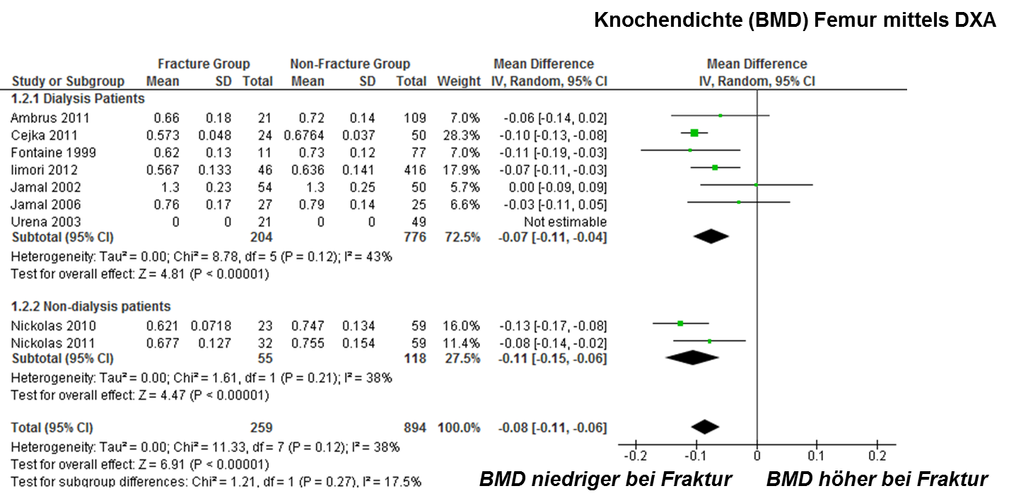
Meta-Analysis
DEXA-determined femoral BMD
BMD low
in case of fracture
BMD high
in case of fracture
Notes:
DXA BMD predicts fracture risk in advanced CKD, similar to prediction in the normal population. However, it does not predict bone pathology/renal osteodystrophy.

Slide 20
Assessment
3.2.3: In patients with CKD G3a–G5D, we suggest that measurements of serum PTH or bone-specific alkaline phosphatase can be used to evaluate bone disease because markedly high or low values predict underlying bone turnover (2B).
3.2.4: In patients with CKD G3a–G5D, we suggest not routinely measuring bone-derived turnover markers of collagen synthesis (such as procollagen type I C-terminal propeptide) and breakdown (such as
type I collagen cross-linked telopeptide, cross-laps, pyridinoline, or deoxypyridinoline) (2C).
3.2.5: We recommend that infants with CKD G2–G5D have their length measured at least quarterly, while children with CKD G2–G5D should be assessed for linear growth at least annually (1B).
Notes:
3.2.3 – 3.2.5: From the 2009 KDIGO Clinical Practice Guideline for the Diagnosis, Evaluation, Prevention, and Treatment of Chronic Kidney Disease-Mineral and Bone Disorder (CKD-MBD).

Slide 21
Case Study: “Sam”
55-y.o. male, 9 months following successful kidney transplantation.
Routine DEXA demonstrated a T-score of –2.6 at the femoral neck.
He is on low-dose prednisone, tacrolimus, and MMF. In addition, he uses vitamin D supplements.
Lab values:
  PTH: 140 pg/mL (15 pmol/L)
  Calcium: 8.8 mg/dL (2.2 mmol/L)
  Phosphate: 3.0 mg/dL (1.0 mmol/L)

Slide 22
Case Study: “Sam”
What would you do next?
Initiate bisphosphonate therapy
Refer for subtotal parathyroidectomy
Wait and see as appropriate
Lower the dose of prednisone
Notes:
Correct. After kidney transplantation, fracture risk is high especially with low BMD score. In general, treatment can be as for the general population.
Persistent hyperparathyroidism can resolve completely after 12-18 months following kidney transplantation. Frequently, a slightly increased PTH persists which, in the absence of hypercalcemia, is of uncertain clinical implication.
In kidney transplant recipients (KTR) DEXA result predicts fracture risk. In addition, risk in KTR is usually increased due to persistent bone disease and use of steroids; therefore, this patient is at risk for incident fractures. Fall prevention and pharmacotherapy to raise BMD is appropriate.
In the last decades, the cumulative dose of steroids after kidney transplantation has declined. This patient currently is using low-dose prednisone, combined with low doses of CNI and MMF. Further lowering of prednisone may increase the risk of rejection.

Slide 23
Chapter 3.3:
Diagnosis of CKD–MBD:
Vascular Calcification

Slide 24
Assessment
3.3.1: In patients with CKD G3a–G5D, we suggest that a lateral abdominal radiograph can be used to detect the presence or absence of vascular calcification, and an echocardiogram can be used to detect the presence or absence of valvular calcification, as reasonable alternatives to computed tomography-based imaging (2C).
3.3.2: We suggest that patients with CKD G3a–G5D with known vascular or valvular calcification be considered at highest cardiovascular risk (2A).
It is reasonable to use this information to guide the management of CKD-MBD (Not Graded).
Notes:
3.3.1 – 3.3.2: From the 2009 KDIGO Clinical Practice Guideline for the Diagnosis, Evaluation, Prevention, and Treatment of Chronic Kidney Disease-Mineral and Bone Disorder (CKD-MBD).

Slide 25
Chapter 4.1:
Treatment of CKD–MBD: Targeted at Lowering High Serum Phosphate and Maintaining Serum Calcium

Slide 26
Phosphate and Calcium
New 4.1.1: In patients with CKD G3a–G5D, treatments of CKD-MBD should be based on serial assessments of phosphate, calcium and PTH levels, considered together (Not Graded).
Notes:
New 4.1.1: From the KDIGO 2017 Clinical Practice Guideline Update for the Diagnosis, Evaluation, Prevention, and Treatment of Chronic Kidney Disease - Mineral and Bone Disorder (CKD-MBD).

Slide 27
Rationale for Update
This new recommendation was provided in order to emphasize the complexity and interaction of CKD-MBD laboratory parameters.
Notes:
Serum phosphate, calcium, and PTH concentrations are all routinely measured and clinical decisions are often made based on these values. Clinical decision making should not be based on a single result, but rather on the trends. Recent post-hoc analyses of large dialysis cohorts suggest that the prognostic implications of individual biochemical components of CKD-MBD largely depend on their context with regard to constellations of the full array of MBD biomarkers.
Furthermore, therapeutic maneuvers aimed at improving one parameter often have unintentional effects on other parameters. Therefore, the Work Group considered it reasonable to take the context of therapeutic interventions into account when assessing values of phosphate, calcium, and PTH, and felt that it was important to emphasize the interdependency of these biochemical parameters for clinical therapeutic decision making.

Slide 28
Phosphate and Calcium
New 4.1.2: In patients with CKD G3a–G5D, we suggest lowering elevated phosphate levels toward the normal range (2C).
Old 4.1.1: In patients with CKD G3a–G5, we suggest maintaining serum phosphate in the normal range (2C). In patients with CKD G5D, we suggest lowering elevated phosphate levels toward the normal range (2C).
Notes:
New 4.1.2: From the KDIGO 2017 Clinical Practice Guideline Update for the Diagnosis, Evaluation, Prevention, and Treatment of Chronic Kidney Disease – Mineral and Bone Disorder (CKD-MBD).
Old 4.1.1: From the 2009 KDIGO Clinical Practice Guideline for the Diagnosis, Evaluation, Prevention, and Treatment of Chronic Kidney Disease – Mineral and Bone Disorder (CKD-MBD).

Slide 29
Rationale for Update
There is an absence of data that efforts to maintain phosphate in the normal range are of benefit to CKD G3a–G4 patients, including some safety concerns.
Treatment should aim at overt hyperphosphatemia.

Slide 30
Phosphate and Calcium
New 4.1.3: In adult patients with CKD G3a–G5D, we suggest avoiding hypercalcemia (2C).
In children with CKD G3a–G5D, we suggest maintaining serum calcium in the age-appropriate normal range (2C).
Old 4.1.2: In patients with CKD G3a–G5D, we suggest maintaining serum calcium in the normal range (2D).
Notes:
New 4.1.3: From the KDIGO 2017 Clinical Practice Guideline Update for the Diagnosis, Evaluation, Prevention, and Treatment of Chronic Kidney Disease – Mineral and Bone Disorder (CKD-MBD).
Old 4.1.2: From the 2009 KDIGO Clinical Practice Guideline for the Diagnosis, Evaluation, Prevention, and Treatment of Chronic Kidney Disease – Mineral and Bone Disorder (CKD-MBD).

Slide 31
Rationale for Update
Mild and asymptomatic hypocalcemia (e.g., in the context of calcimimetic treatment) can be tolerated in order to avoid inappropriate calcium loading in adults.
Notes:
The Work Group emphasizes an individualized approach to the treatment of hypocalcemia rather than recommending the correction of hypocalcemia for all patients.

Slide 32
CKD-MBD Phenotype and Adjusted Risk of Death or CV Hospitalization
PTH high
Ca, P high
Ca, P target
Block GA et al. Clin J Am Soc Nephrol. 2013;8:2132-2140.
Notes:
Hazard ratios (HRs) of death and the composite end point by CKD–mineral and bone disorder phenotype. The reference group is the target low PTH (PTH 150–300 pg/ml [16-32 pmol/l]), target serum calcium (8.2–10.2 mg/dl [2.1-2.6 mmol/l]), and target serum phosphate (3.5–5.5 mg/dl [1.1-1.8 mmol/l]). Whiskers depict the 95% confidence intervals (95% CIs). Ca, calcium; P, phosphate; PTH, parathyroid hormone.

Slide 33
Pediatric Perspective
Childhood and adolescence are critical periods for bone mass accrual. A prospective pediatric cohort study showed lower serum calcium levels were independently associated with lower cortical volumetric BMD Z-scores, which predicted future fractures.
The Work Group recognizes the higher calcium requirements of the growing skeleton and suggests that serum calcium levels are maintained in the age-appropriate normal range.
Notes:
Epidemiological evidence linking higher calcium concentrations to increased mortality in adults with CKD has accumulated since the 2009 KDIGO guideline; in addition, studies linking higher concentrations of serum calcium to nonfatal cardiovascular events provides justification for the evidence upgrade from 2D to 2C.

Slide 34
Phosphate and Calcium
New 4.1.4: In patients with CKD G5D, we suggest using a dialysate calcium concentration between 1.25 and 1.50 mmol/l (2.5 and
3.0 mEq/l) (2C).
Old 4.1.3: In patients with CKD G5D, we suggest using a dialysate calcium concentration between 1.25 and 1.50 mmol/l (2.5 and
3.0 mEq/l) (2D).
Notes:
New 4.1.4: From the KDIGO 2017 Clinical Practice Guideline Update for the Diagnosis, Evaluation, Prevention, and Treatment of Chronic Kidney Disease – Mineral and Bone Disorder (CKD-MBD).
Old 4.1.3: From the 2009 KDIGO Clinical Practice Guideline for the Diagnosis, Evaluation, Prevention, and Treatment of Chronic Kidney Disease – Mineral and Bone Disorder (CKD-MBD).

Slide 35
Rationale for Update
Additional studies of better quality are available; however, they do not allow discrimination of benefits and harm between calcium dialysate concentrations of 1.25 and 1.50 mmol/l (2.5 and 3.0 mEq/l).
Hence, the wording is unchanged but evidence grade is upgraded from 2D to 2C.
Notes:
Two additional studies: Ok et al. JASN 2016; 7: 2475-2486 and Spasovski et al. Bone 2007; 41: 698-703.

Slide 36
Phosphate and Calcium
New 4.1.5: In patients with CKD G3a–G5D, decisions about phosphate-lowering treatment should be based on progressively or persistently elevated serum phosphate (Not Graded).
Old 4.1.4: In patients with CKD G3a–G5 (2D) and G5D (2B), we suggest using phosphate-binding agents in the treatment of hyperphosphatemia.
It is reasonable that the choice of phosphate binder takes into account CKD stage, presence of other components of CKD-MBD, concomitant therapies, and side effect profile (Not Graded).
Notes:
New 4.1.5: From the KDIGO 2017 Clinical Practice Guideline Update for the Diagnosis, Evaluation, Prevention, and Treatment of Chronic Kidney Disease – Mineral and Bone Disorder (CKD-MBD).
Old 4.1.4: From the 2009 KDIGO Clinical Practice Guideline for the Diagnosis, Evaluation, Prevention, and Treatment of Chronic Kidney Disease – Mineral and Bone Disorder (CKD-MBD).

Slide 37
Rationale for Update
The update emphasizes the perception that early “preventive” treatment of hyperphosphatemia is currently not supported by data (see Rec. 4.1.2).

Slide 38
Phosphate and Calcium
New 4.1.6: In adult patients with CKD G3a–5D receiving phosphate-lowering treatment, we suggest restricting the dose of calcium-based phosphate binders (2B).
In children with CKD G3a–G5D, it is reasonable to base the choice of phosphate-lowering treatment on serum calcium levels (Not Graded).
Old 4.1.5: In patients with CKD G3a–G5D and hyperphosphatemia, we recommend restricting the dose of calcium-based phosphate binders and/or the dose of calcitriol or vitamin D analog in the presence of persistent or recurrent hypercalcemia (1B).
In patients with CKD G3a–G5D and hyperphosphatemia, we suggest restricting the dose of calcium-based phosphate binders in the presence of arterial calcification (2C) and/or adynamic bone disease (2C) and/or if serum PTH levels are persistently low (2C).
Notes:
New 4.1.6: From the KDIGO 2017 Clinical Practice Guideline Update for the Diagnosis, Evaluation, Prevention, and Treatment of Chronic Kidney Disease – Mineral and Bone Disorder (CKD-MBD).
Old 4.1.5: From the 2009 KDIGO Clinical Practice Guideline for the Diagnosis, Evaluation, Prevention, and Treatment of Chronic Kidney Disease – Mineral and Bone Disorder (CKD-MBD).

Slide 39
Rationale for Update
New evidence from three randomized control trials (RCTs) supports a more general recommendation to restrict calcium-based phosphate binders in hyperphosphatemic patients of all severities of CKD.
Notes:
The 2009 KDIGO Guideline commented that available phosphate binders are all effective in the treatment of hyperphosphatemia, and that there is evidence that calcium-free binders may favor halting progression of vascular calcifications vs. calcium-containing binders.
But concerns about calcium balance, uncertainties about phosphate lowering in CKD patients not on dialysis, additional hard endpoint RCTs and a systematic review (effects on mortality comparing calcium-free vs. calcium containing phosphate binders) prompted the decision to re-evaluate this recommendation.
The three RCTs are: Block et al. 2012; 23: 1407-1415; Di Iorio B. et al. Clin J Am Soc Nephrol 2012; 7: 487-493; Di Iorio B. et al. Am J Kidney Dis 2013; 62: 771-778.
Di Iorio et al. published RCTs on both predialysis and dialysis patients showing significant survival benefits for patients treated with sevelamer vs. patients on calcium containing binders over follow-ups of 3 years, respectively. Overall, the findings from all identified studies seemed to show either a potential for benefit or an absence of harm associated with calcium-free phosphate-binding agents to treat hyperphosphatemia compared with calcium-based agents.

Slide 40
Phosphate and Calcium
4.1.7: In patients with CKD G3a–G5D, we recommend avoiding the long-term use of aluminum-containing phosphate binders, and in patients with CKD G5D, avoiding dialysate aluminum contamination to prevent aluminum intoxication (1C).
Notes:
4.1.7: From the 2009 KDIGO Clinical Practice Guideline for the Diagnosis, Evaluation, Prevention, and Treatment of Chronic Kidney Disease-Mineral and Bone Disorder (CKD-MBD).

Slide 41
Phosphate Binders in Moderate CKD
Active
Placebo
Lanthanum
Sevelamer
Calcium
Placebo
Block G et al. J Am Soc Nephrol. 2012;23:1407-1415.
Notes:
Biochemical changes on study by treatment arm: Change in median (interquartile range [IQR]) serum phosphate.
Vascular calcification and bone mineral density changes on study by treatment arm; thoracic aorta calcium volume scores among active- and placebo-treated patients.

Slide 42
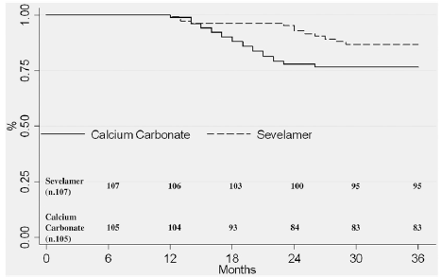
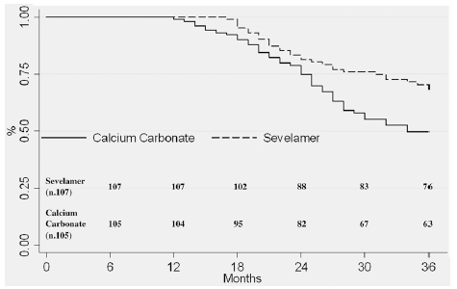
Phosphate Binders and Mortality
All-Cause Mortality
Dialysis Inception
Di Iorio B et al. Clin J Am Soc Nephrol 2012;7:487-493
Notes:
All-cause mortality in patients randomized either to sevelamer (dotted line) or calcium carbonate (continuous line). The all-cause mortality rate was significantly higher (P < 0.05) among patients receiving calcium carbonate. Numbers indicate patients at risk for each time period.
Inception to dialysis in patients randomized either to sevelamer (dotted line) or calcium carbonate (continuous line). Numbers indicate patients at risk for each time period.

Slide 43
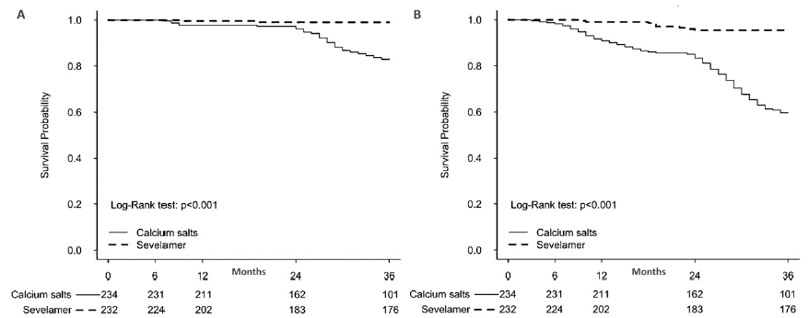
Sevelamer vs. Calcium
Arrythmias
Cardiovascular Mortality
Di Iorio B et al. Am J Kidney Dis. 2013;62:771-778
Notes:
Sevelamer-treated patients experienced lower cardiovascular (CV) mortality due to cardiac arrhythmias compared to patients treated with calcium carbonate (HR, 0.06; 95% CI, 0.01-0.25; P < 0.001). Similar results were noted for all-cause CV mortality and all-cause mortality, but not for non-CV mortality. Adjustments for potential confounders did not affect results.

Slide 44
Pediatric Perspective
Concerns regarding the adverse effects of exogenous calcium may not be generalizable to children.
Studies of calcium- and non–calcium-containing binders and other therapies that impact calcium balance should consider the needs of the developing skeleton.
The observation that serum calcium levels were positively associated with increases in BMD in children with CKD, and this association was significantly more pronounced with greater linear growth velocity, illustrates the unique needs of the growing skeleton.
Notes:
In light of the lack of data suggesting adverse effects of exogenous calcium in children, the Work Group concluded that there was insufficient evidence to change this recommendation in children, who may be uniquely vulnerable to calcium restriction.

Slide 45
Phosphate
New 4.1.8: In patients with CKD G3a–G5D, we suggest limiting dietary phosphate intake in the treatment of hyperphosphatemia alone or in combination with other treatments (2D).
It is reasonable to consider phosphate source (e.g., animal, vegetable, additives) in making dietary recommendations (Not Graded).
Old 4.1.7: In patients with CKD G3a–G5D, we suggest limiting dietary phosphate intake in the treatment of hyperphosphatemia alone or in combination with other treatments (2D).
Notes:
New 4.1.8: From the KDIGO 2017 Clinical Practice Guideline Update for the Diagnosis, Evaluation, Prevention, and Treatment of Chronic Kidney Disease – Mineral and Bone Disorder (CKD-MBD).
Old 4.1.7: From the 2009 KDIGO Clinical Practice Guideline for the Diagnosis, Evaluation, Prevention, and Treatment of Chronic Kidney Disease – Mineral and Bone Disorder (CKD-MBD).

Slide 46
Rationale for Update
New data on phosphate sources were included as an additional qualifier for the previous recommendation.
These sources included: natural phosphorus (as cellular and protein constituents) contained in raw or unprocessed foods; phosphorus added to foods during processing; and phosphorus in dietary supplements or medications.
Notes:
Only two studies on this topic (in dialysis patients) fulfilled the evidence review criteria. (Karavetian M et al. Patient Educ Couns 2015; 98: 1116-1122; Lou LM et al. Clin Nephrol 2012; 77: 476-483).
Both studies investigated the impact of intensified versus routine dietary counseling on serum phosphate levels after follow-up of 6 months.
In both studies, the intensified groups more successfully reached the laboratory targets. However, no hard endpoints were documented, so the quality of evidence for outcome had to be rated as very low.

Slide 47
Phosphate
4.1.9: In patients with CKD G5D, we suggest increasing dialytic phosphate removal in the treatment of persistent hyperphosphatemia (2C).
Notes:
4.1.9: From the 2009 KDIGO Clinical Practice Guideline for the Diagnosis, Evaluation, Prevention, and Treatment of Chronic Kidney Disease-Mineral and Bone Disorder (CKD-MBD).

Slide 48
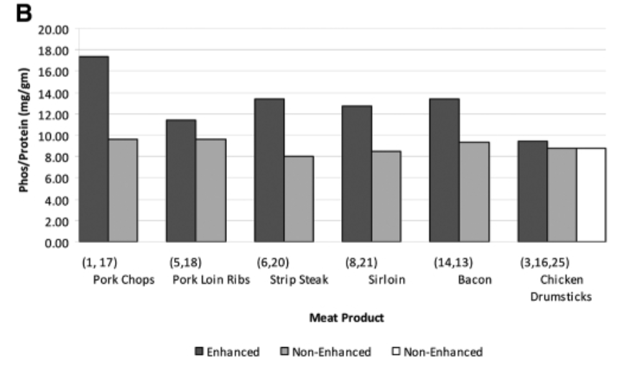
“Hidden” Phosphate
Sherman RA et al. Clin J Am Soc Nephrol. 2009;4:1370-1373
Notes:
Phosphate-protein ratios for enhanced and regular, matched food products. The numbers in parentheses on the abscissa refer to those in Table 1 in the cited publication. Two different nonenhanced chicken drumstick products were analyzed. Products that reported the use of additives had an average phosphate-protein ratio 28% higher than additive-free products; the content ranged up to almost 100% higher.

Slide 49
Case Study: “Nicky”
67-y.o. female on HD for 2 years.
Admitted for back pain, due to impression fracture of the tenth thoracic vertebra.
On daily cholecalciferol (1,000 U), low-dose alfacalcidol, and sevelamer carbonate.
Lab results:
  Calcium: 9.0 mg/dL (2.3 mmol/L)
  Phosphate: 5.7 mg/dL (1.8 mmol/L)
  PTH: 450 pg/mL (48 pmol/L)
  Alkaline phosphatase: 140 U/L

Slide 50
Case Study: “Nicky”
What would you do next?
Perform DEXA to estimate additional fracture risk.
Increase the dose of sevelamer carbonate.
Start denosumab.
Initiate cinacalcet.
Add calcium-containing phosphate binder.
Notes:
DEXA results may assist in estimating fracture risk across all stages of CKD and, as such, guide management to prevent fractures. However, this patient likely has secondary hyperparathyroidism, a setting in which risk prediction by DEXA is very limited.
In general, this is a reasonable approach to improve control of hyperphosphatemia. In this patient, it is possible that part of hyperphosphatemia may be due to hyperparathyroidism, and targeting PTH first may be more effective.
There is no evidence that denosumab increases BMD in end-stage kidney disease, even though it probably does. For this patient, fracture risk may be more the consequence of hyperparathyroidism. Denosumab would put this patient at risk for hypocalcemia.
Correct. The combination of low-dose active vitamin D and calcimimetics is effective in controlling hyperparathyroidism. In addition, fracture risk in this patient may be due to SHPT. Finally, phosphate control usually follows PTH control.
This is a reasonable approach, in general, to improve phosphate concentration. However it is likely that hyperphosphatemia in this patient is attributed in part to the consequence of SHPT. Although increasing calcium intake may lower PTH to some extent, it is unknown if this improves BMD. Calcium-containing binders as monotherapy are associated with increased mortality, compared with sevelamer monotherapy according to several meta-analyses.

Slide 51
Chapter 4.2:
Treatment of Abnormal PTH Levels in CKD-MBD

Slide 52
Assessment of PTH
New 4.2.1: In patients with CKD G3a–G5 not on dialysis, the optimal PTH level is not known. However, we suggest that patients with levels of intact PTH progressively rising or persistently above the upper normal limit for the assay be evaluated for modifiable factors, including hyperphosphatemia, hypocalcemia, high phosphate intake, and vitamin D deficiency (2C).
Old 4.2.1: In patients with CKD G3a–G5 not on dialysis, the optimal PTH level is not known. However, we suggest that patients with levels of intact PTH above the upper normal limit of the assay are first evaluated for hyperphosphatemia, hypocalcemia, and vitamin D deficiency (2C).
It is reasonable to correct these abnormalities with any or all of the following: reducing dietary phosphate intake and administering phosphate binders, calcium supplements, and/or native vitamin D (Not Graded).
Notes:
New 4.2.1: From the KDIGO 2017 Clinical Practice Guideline Update for the Diagnosis, Evaluation, Prevention, and Treatment of Chronic Kidney Disease – Mineral and Bone Disorder (CKD-MBD).
Old 4.2.1: From the 2009 KDIGO Clinical Practice Guideline for the Diagnosis, Evaluation, Prevention, and Treatment of Chronic Kidney Disease – Mineral and Bone Disorder (CKD-MBD).

Slide 53
Rationale for Update
The Work Group felt that modest increases in PTH may represent an appropriate adaptive response to declining kidney function and have revised this statement to include “persistently” above the upper normal PTH level as well as “progressively rising” PTH levels, rather than “above the upper normal limit”. That is, treatment should not be based on a single elevated value.
Although the optimal PTH is not known, the Work Group felt that rising PTH levels in CKD G3a-G5 warrant examination of modifiable factors:
  Vitamin D insufficiency/deficiency
  Hypocalcemia
  Hyperphosphatemia
  High phosphate intake
Notes:
Since the 2009 KDIGO guideline there are still no RCTs that define an optimal PTH level for patients with CKD G3a-G5, or clinical endpoints of hospitalization, fracture or mortality.
The Work Group also added “high phosphate intake”, because of the increasing recognition that excess phosphate intake does not always result in hyperphosphatemia, especially in early stages of CKD, and that high phosphate could promote secondary hyperparathyroidism (SHPT).

Slide 54
Calcitriol and Vitamin D
New 4.2.2: In adult patients with CKD G3a–G5 not on dialysis, we suggest calcitriol and vitamin D analogs not be routinely used (2C). It is reasonable to reserve the use of calcitriol and vitamin D analogs for patients with CKD G4–G5 with severe and progressive hyperparathyroidism (Not Graded).
In children, calcitriol and vitamin D analogs may be considered to maintain serum calcium levels in the age-appropriate normal range (Not Graded).
Old 4.2.2: In patients with CKD G3a–G5 not on dialysis, in whom serum PTH is progressively rising and remains persistently above the upper limit of normal for the assay despite correction of modifiable factors, we suggest treatment with calcitriol or vitamin D analogs (2C).
Notes:
New 4.2.2: From the KDIGO 2017 Clinical Practice Guideline Update for the Diagnosis, Evaluation, Prevention, and Treatment of Chronic Kidney Disease – Mineral and Bone Disorder (CKD-MBD).
Old 4.2.2: From the 2009 KDIGO Clinical Practice Guideline for the Diagnosis, Evaluation, Prevention, and Treatment of Chronic Kidney Disease – Mineral and Bone Disorder (CKD-MBD).

Slide 55
Rationale for Update
Suppression of PTH via calcitriol and other vitamin D analogs have been the therapeutic mainstay for the treatment of secondary hyperparathyroidism (SHPT). Multiple RCTs cited in the 2009 Guideline reported benefits of these agents on improving biochemical endpoints, and adverse effects of hypercalcemia were also noted.
Two trials, PRIMO and OPERA, demonstrated significantly increased risk of hypercalcemia in patients treated with paricalcitol, compared with placebo, in the absence of beneficial effects on surrogate cardiac endpoints.

Slide 56
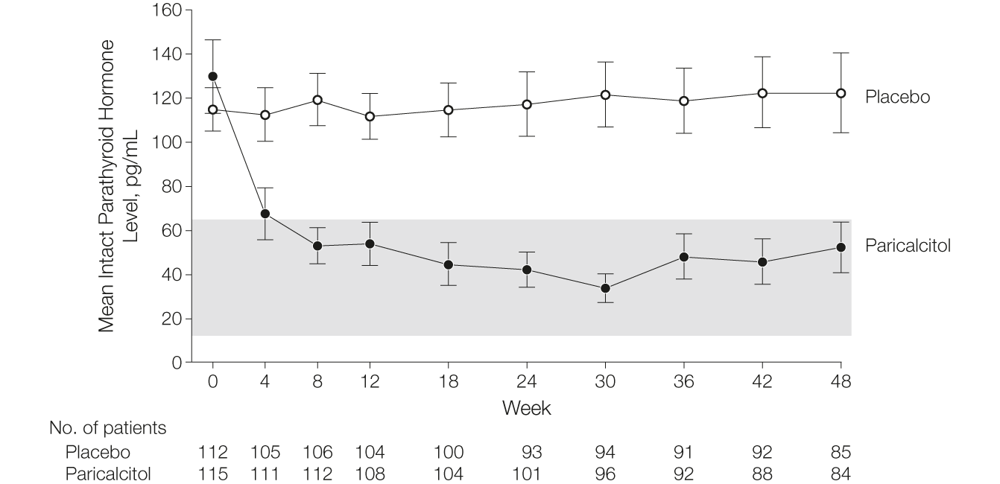
The PRIMO Trial
Thadani R et al. JAMA. 2012;307:674-684
Notes:
PRIMO examined patients with CKD G3-G4, mild to moderate left ventricular hypertrophy (LVH), and PTH levels between 50 and 300 pg/ml (5.3–32 pmol/l) who were assigned to placebo (n = 112) or paricalcitol (n = 115). This trial is designed to test the primary hypothesis that paricalcitol will reduce left ventricular mass index (LVMI) over a 48 month interval. Paricalcitol was administered at a dose of 2 μg/day, with protocol-specified dose reduction to 1 μg/day, if the serum calcium was > 11 mg/dl (2.75 mmol/l). Baseline PTH levels were approximately 1.5 times the upper limit of normal.
“Treatment with paricalcitol reduced parathyroid hormone levels within 4 weeks and maintained levels within the normal range throughout the study duration. At 48 weeks, the change in left ventricular mass index did not differ between treatment groups. Episodes of hypercalcemia were more frequent in the paricalcitol group compared with the placebo group.”

Slide 57
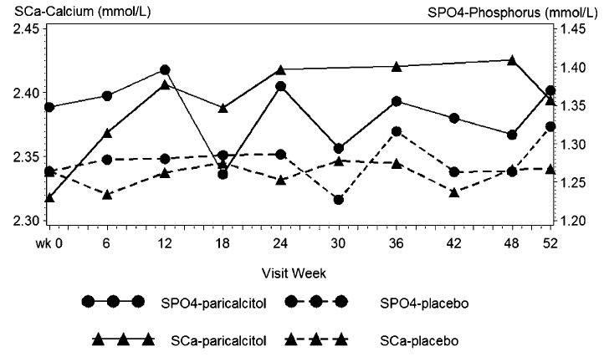
The OPERA Trial
Wang A et al. J Am Soc Nephrol. 2014;25:175-186
Notes:
The OPERA study is a double-blind RCT that examined patients with CKD G3-G5, LVH, and PTH ≥ 55 pg/ml (5.83 pmol/l). They were randomly assigned to receive paricalcitol (n = 30) or placebo (n = 30). The primary endpoint was change in LVMI over 52 weeks. Baseline PTH levels were approximately twice the upper limit of normal.
“Paricalcitol treatment significantly reduced intact parathyroid hormone (P < 0.001) and alkaline phosphatase (P = 0.001) levels, as well as the number of cardiovascular-related hospitalizations compared with placebo. In conclusion, 52 weeks of treatment with oral paricalcitol (1 mg one time daily) significantly improved SHPT but did not alter measures of LV structure and function in patients with severe CKD.”

Slide 58
Maintaining/Lowering PTH
4.2.3: In patients with CKD G5D, we suggest maintaining intact PTH levels in the range of approximately 2 to 9 times the upper normal limit for the assay (2C).
We suggest that marked changes in PTH levels in either direction within this range prompt an initiation or change in therapy to avoid progression to levels outside of this range (2C).
Notes:
4.2.3: From the 2009 KDIGO Clinical Practice Guideline for the Diagnosis, Evaluation, Prevention, and Treatment of Chronic Kidney Disease – Mineral and Bone Disorder (CKD-MBD).

Slide 59
Maintaining/Lowering PTH
New 4.2.4: In patients with CKD G5D requiring PTH-lowering therapy, we suggest calcimimetics, calcitriol, or vitamin D analogs, or a combination of calcimimetics with calcitriol or vitamin D analogs (2B).
Old 4.2.4: In patients with CKD G5D and elevated or rising PTH, we suggest calcitriol, or vitamin D analogs, or calcimimetics, or a combination of calcimimetics and calcitriol or vitamin D analogs be used to lower PTH (2B).
It is reasonable that the initial drug selection for the treatment of elevated PTH be based on serum calcium and phosphorus levels and other aspects of CKD-MBD (Not Graded).
It is reasonable that calcium or non-calcium-based phosphate binder dosage be adjusted so that treatments to control PTH do not compromise levels of phosphorus and calcium (Not Graded).
Notes:
New 4.2.4: From the KDIGO 2017 Clinical Practice Guideline Update for the Diagnosis, Evaluation, Prevention, and Treatment of Chronic Kidney Disease – Mineral and Bone Disorder (CKD-MBD).
Old 4.2.4: From the 2009 KDIGO Clinical Practice Guideline for the Diagnosis, Evaluation, Prevention, and Treatment of Chronic Kidney Disease – Mineral and Bone Disorder (CKD-MBD).

Slide 60
Maintaining/Lowering PTH
Old 4.2.4 (cont’d.):
We recommend that, in patients with hypercalcemia, calcitriol or another vitamin D sterol be reduced or stopped (1B).
We suggest that, in patients with hyperphosphatemia, calcitriol or another vitamin D sterol be reduced or stopped (2D).
We suggest that, in patients with hypocalcemia, calcimimetics be reduced or stopped depending on severity, concomitant medications, and clinical signs and symptoms (2D).
We suggest that, if the intact PTH levels fall below two times the upper limit of normal for the assay, calcitriol, vitamin D analogs, and/or calcimimetics be reduced or stopped (2C).

Slide 61
Rationale for Update
Recommendation 4.2.4 originally had not been identified for an update. However, due to a subsequent series of secondary and post-hoc publications of the EVOLVE trial, the Work Group decided to re-evaluate it.
Although EVOLVE did not meet its primary endpoint, the majority of the Work Group were reluctant to exclude potential benefits of calcimimetics for CKD G5D patients, based on subsequent prespecified analyses.
No PTH-lowering treatment was prioritized at this time, since calcimimetics, calcitriol, and vitamin D analogs are all acceptable first-line options in CKD G5D patients.
Notes:
The Work Group explicitly endorses the presence of clinical equipoise and the need to conduct placebo-controlled trials with calcimimetics vs. standard therapy for the treatment of SHPT in patients with CKD G5D. The emphasis should be on those at greatest risk (e.g., older patients, presence of CVD).
There was a lack of uniform consensus among the Work Group in their interpretation of these data with regard to establishing cinacalcet as the recommended first-line therapy for patients with CKD G5D requiring PTH-lowering therapy. While some felt that only the primary analysis should be used to interpret the outcome, others were equally convinced that the secondary analyses strongly suggested a benefit of treatment with cinacalcet on important patient-level outcomes.

Slide 62
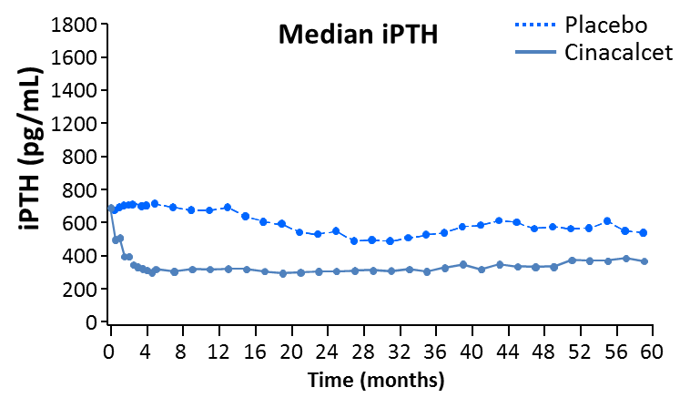
EVOLVE: Lowering PTH
Chertow GM, et al. N Engl J Med. 2012;367:2482-2494
Notes:
This clinical trial examined 3,883 patients with moderate-to-severe secondary hyperparathyroidism (median level of iPTH 693 pg/ml [73 pmol/l]) who were undergoing hemodialysis, randomized to receive either cinacalcet or placebo.
It evaluated the effect of cinacalcet versus placebo on patient-level outcomes using a composite endpoint of all-cause mortality, no-fatal myocardial infarction, hospitalization for unstable angina, congestive heart failure, and peripheral vascular events.
Secondary endpoints included individual components of the primary endpoint, clinical fracture, stroke, parathyroidectomy, and cardiovascular events and cardiovascular death.

Slide 63
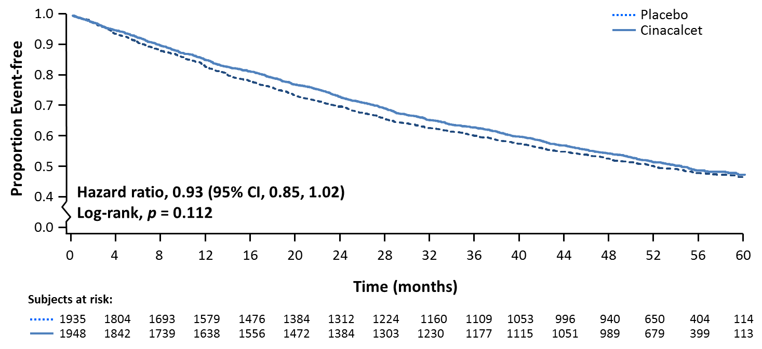
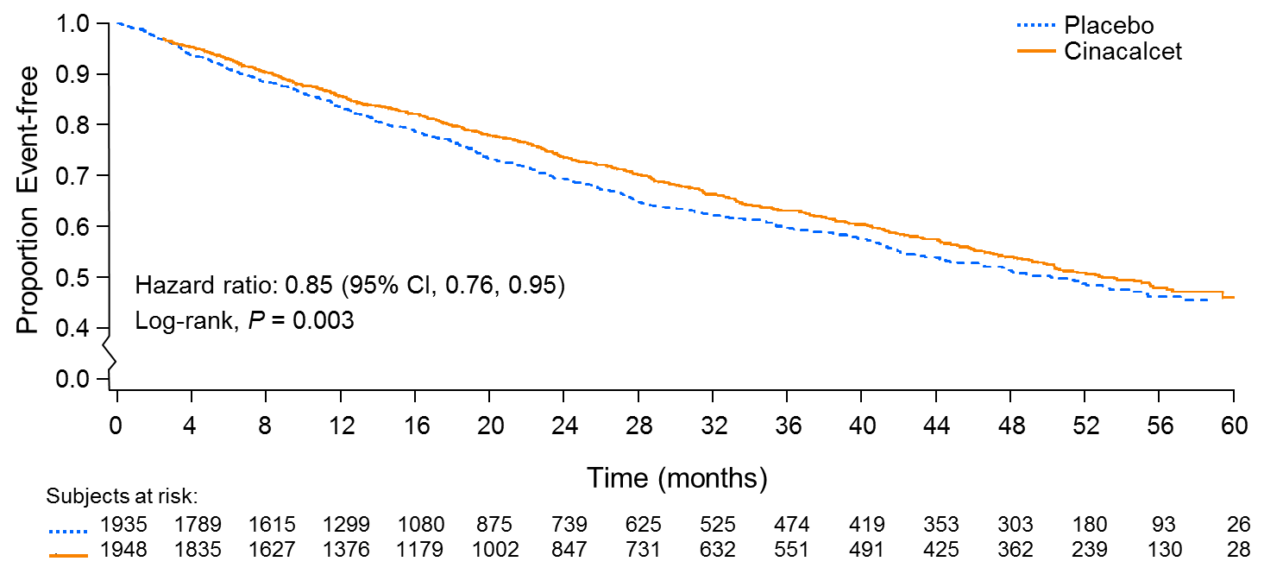
EVOLVE Study: Cinacalcet
Chertow GM, et al. N Engl J Med. 2012;367:2482-2494
Notes:
The unadjusted primary composite endpoint showed a nonsignificant reduction (HR 0.93, P = 0.112) with cinacalcet use. However, analyses adjusted for imbalances in baseline characteristics demonstrated a nominally significant reduction in the primary composite endpoint (HR 0.88, P = 0.008) as did sensitivity analyses accounting for patient nonadherence to randomized study medication (HR 0.77, 95% CI 0.70-0.92) or when patients were censored at the time of kidney transplant, parathyroidectomy, or the use of commercial cinacalcet (HR 0.84, P ≤ 0.001).
A significant treatment-age interaction (P = 0.04) led to the speculation that cinacalcet may be effective predominantly in older dialysis patients. Approximately 1/3 of the EVOLVE participants were under the age of 55. Prespecified analyses that evaluated subjects above or below age 65 demonstrated a significant reduction in risk associated with use of cinacalcet for both the primary endpoint (HR 0.74, P ≤ 0.001) and all-cause mortality (HR 0.73, P ≤ 0.001) for those aged above 65.

Slide 64

Time to First Episode of Severe Unremitting HPT
(Intent-to-Treat Analysis)
1.0
0.9
Severe, unremitting HPT
Prespecified and defined as
    PTH > 1000 pg/ml (106.0 pmol/l) with serum calcium > 10.5 mg/dl (2.6 mmol/l) on 2 consecutive occasions OR
    PTH > 1000 pg/ml with serum calcium >10.5 mg/dl on a single occasion and subsequent commercial cinacalcet use within 2 months of the laboratory assessment OR
    parathyroidectomy
0.8
0.7
Proportion Event-free
0.6
0.5
Placebo
Cinacalcet
Hazard ratio, 0.43 (95% CI, 0.37, 0.50)
0.4
Log-rank, p<0.001
0.0
0
4
8
12
16
20
24
28
32
36
40
44
48
52
56
60
Time (months)
Chertow GM, et al. N Engl J Med. 2012;367:2482-2494
Notes:
Time to unremitting severe SHPT is from randomization date to the first of the following for subjects who had an event:
PTH > 1000 pg/ml (106.0 pmol/l) with serum calcium >10.5 mg/dl (2.6 mmol/l) on 2 consecutive occasions
PTH > 1000 pg/ml (106.0 pmol/l) with serum calcium > 10.5 mg/dl (2.6 mmol/l) on a single occasion and subsequent commercial cinacalcet use within 2 months of the laboratory assessment; or
Parathyroidectomy. Data for subjects who did not have an event prior to study termination date are censored at study termination date or the date on which the subject ended the study, whichever is earlier.

Slide 65
Pediatric Perspective
Studies of cinacalcet in children are limited to case reports, case series, a single-center experience (with 4 to 28 patients), and an open label study of a single dose in 12 children on dialysis.
In recognition of the unique calcium demands of the growing skeleton, PTH-lowering therapies should be used with caution in children to avoid hypocalcemia. Future studies are needed in children before issuing pediatric-specific recommendations.

Slide 66
Severe Hyperparathyroidism
4.2.5: In patients with CKD G3a–G5D with severe hyperparathyroidism (HPT) who fail to respond to medical or pharmacological therapy, we suggest parathyroidectomy (2B).
Notes:
4.2.5: From the 2009 KDIGO Clinical Practice Guideline for the Diagnosis, Evaluation, Prevention, and Treatment of Chronic Kidney Disease – Mineral and Bone Disorder (CKD-MBD).

Slide 67
Case Study: “Toby”
67-y.o. lean male on with eGFR of 25 ml/min/1.73 m², hypertension, ACR (albumin-creatinine ratio) 120 mg/g (1.2 mg/mmol).
Seen on scheduled outpatient visit.
Well-controlled blood pressure on lisinopril and metoprolol, besides sodium restriction.
Lab results:
  Calcium: 9.6 mg/dL (2.4 mmol/L) [corrected for albumin]
  PTH: 160 pg/mL (17 pmol/L)
  Phosphate: 4.2 mg/dL (1.4 mmol/L)

Slide 68
Case Study: “Toby”
What is the best next step?
Advise the patient to start a phosphate-restricted diet.
Measure concentration of 25(OH) vitamin D.
Initiate active vitamin D.
Measure FGF23 to estimate phosphate burden.
Notes:
There is no evidence that supports initiation of a phosphate-restricted diet in the absence of overt hyperphosphatemia. Moreover, dietary phosphate restriction generally does not impact serum concentration.
Correct. Although the optimal PTH in predialysis CKD is unknown, elevated concentrations may indicate nutritional vitamin D deficiency.
The optimal concentration of PTH is unknown. Initiating active vitamin D increases the risk of hypercalcemia, and may increase phosphate concentration. Clinical trials with cardiac clinical endpoints in this setting comparing active vitamin D with placebo were negative.
The concept of phosphate exposure as a risk factor, in the absence of hyperphosphatemia, is unproven. Although FGF23 is an independent risk factor for poor outcomes (including progression of CKD, cardiovascular events and mortality), it is unclear if directly targeting FGF23 is of any benefit.

Slide 69
Chapter 4.3:
Treatment of Bone with Bisphosphonates, other Osteoporosis Medications, and Growth Hormone

Slide 70
Treatment Options
4.3.1: In patients with CKD G1–G2 with osteoporosis and/or high risk of fracture, as identified by World Health Organization criteria, we recommend management as for the general population (1A).
4.3.2: In patients with CKD G3a–G3b with PTH in the normal range and osteoporosis and/or high risk of fracture, as identified by World Health Organization criteria, we suggest treatment as for the general population (2B).
Notes:
4.3.1 – 4.3.2: From the 2009 KDIGO Clinical Practice Guideline for the Diagnosis, Evaluation, Prevention, and Treatment of Chronic Kidney Disease – Mineral and Bone Disorder (CKD-MBD).

Slide 71
Treatment Options
New 4.3.3: In patients with CKD G3a–G5D with biochemical abnormalities of CKD-MBD and low BMD and/or fragility fractures, we suggest that treatment choices take into account the magnitude and reversibility of the biochemical abnormalities and the progression of CKD, with consideration of a bone biopsy (2D).
Old 4.3.3: In patients with CKD G3a–G3b with biochemical abnormalities of CKD-MBD and low BMD and/or fragility fractures, we suggest that treatment choices take into account the magnitude and reversibility of the biochemical abnormalities and the progression of CKD, with consideration of a bone biopsy (2D).
Notes:
New 4.3.3: From the KDIGO 2017 Clinical Practice Guideline Update for the Diagnosis, Evaluation, Prevention, and Treatment of Chronic Kidney Disease – Mineral and Bone Disorder (CKD-MBD).
Old 4.3.3: From the 2009 KDIGO Clinical Practice Guideline for the Diagnosis, Evaluation, Prevention, and Treatment of Chronic Kidney Disease – Mineral and Bone Disorder (CKD-MBD).

Slide 72
Treatment Options
New 4.3.3: In patients with CKD G3a–G5D with biochemical abnormalities of CKD-MBD and low BMD and/or fragility fractures, we suggest that treatment choices take into account the magnitude and reversibility of the biochemical abnormalities and the progression of CKD, with consideration of a bone biopsy (2D).
Old 4.3.4: In patients with CKD G4–G5D having biochemical abnormalities of CKD-MBD, and low BMD and/or fragility fractures, we suggest additional investigation with bone biopsy prior to therapy with antiresorptive agents (2C).
Notes:
New 4.3.3: From the KDIGO 2017 Clinical Practice Guideline Update for the Diagnosis, Evaluation, Prevention, and Treatment of Chronic Kidney Disease – Mineral and Bone Disorder (CKD-MBD).
Old 4.3.4: From the 2009 KDIGO Clinical Practice Guideline for the Diagnosis, Evaluation, Prevention, and Treatment of Chronic Kidney Disease – Mineral and Bone Disorder (CKD-MBD).

Slide 73
Rationale for Update
Rec. 3.2.2 now addresses the indications for a bone biopsy prior to antiresorptive and other osteoporosis therapies. Therefore, the old Rec. 4.3.4 was removed, and Rec. 4.3.3 was broadened from CKD G3a-G3b to CKD G3a-G5D.

Slide 74
Treatment Options
4.3.4: In children and adolescents with CKD G2–G5D and related height deficits, we recommend treatment with recombinant human growth hormone when additional growth is desired, after first addressing malnutrition and biochemical abnormalities of CKD-MBD (1A).
Notes:
4.3.4: From the 2009 KDIGO Clinical Practice Guideline for the Diagnosis, Evaluation, Prevention, and Treatment of Chronic Kidney Disease – Mineral and Bone Disorder (CKD-MBD).

Slide 75
Chapter 5:
Evaluation and Treatment of Kidney Transplant Bone Disease

Slide 76
Assessment
5.1: In patients in the immediate post–kidney transplant period, we recommend measuring serum calcium and phosphate at least weekly, until stable (1B).
5.2: In patients after the immediate post–kidney transplant period, it is reasonable to base the frequency of monitoring serum calcium, phosphate, and PTH on the presence and magnitude of abnormalities, and the rate of progression of CKD (Not Graded).
Notes:
5.1 – 5.2: From the 2009 KDIGO Clinical Practice Guideline for the Diagnosis, Evaluation, Prevention, and Treatment of Chronic Kidney Disease – Mineral and Bone Disorder (CKD-MBD).

Slide 77
Assessment
5.2 (cont’d.): Reasonable monitoring intervals would be:
  In CKD G1T–G3bT, for serum calcium and phosphate, every 6–12 months; and for PTH, once, with subsequent intervals depending on baseline level and CKD progression.
  In CKD G4T, for serum calcium and phosphate, every 3–6 months; and for PTH, every 6–12 months.
  In CKD G5T, for serum calcium and phosphate, every 1–3 months; and for PTH, every 3–6 months.
  In CKD G3aT–G5T, measurement of alkaline phosphatases annually, or more frequently in the presence of elevated PTH (see Chapter 3.2).
In CKD patients receiving treatments for CKD-MBD, or in whom biochemical abnormalities are identified, it is reasonable to increase the frequency of measurements to monitor for efficacy and side effects (Not Graded).
It is reasonable to manage these abnormalities as for patients with CKD G3a–G5 (see Chapters 4.1 and 4.2) (Not Graded).
Notes:
5.2: From the 2009 KDIGO Clinical Practice Guideline for the Diagnosis, Evaluation, Prevention, and Treatment of Chronic Kidney Disease – Mineral and Bone Disorder (CKD-MBD).

Slide 78
Assessment/Treatment
5.3: In patients with CKD G1T–G5T, we suggest that 25(OH)D (calcidiol) levels might be measured, and repeated testing determined by baseline values and interventions (2C).
5.4: In patients with CKD G1T–G5T, we suggest that vitamin D deficiency and insufficiency be corrected using treatment strategies recommended for the general population (2C).
Notes:
5.3 – 5.4: From the 2009 KDIGO Clinical Practice Guideline for the Diagnosis, Evaluation, Prevention, and Treatment of Chronic Kidney Disease – Mineral and Bone Disorder (CKD-MBD).

Slide 79
Assessment
New 5.5: In patients with CKD G1T–G5T with risk factors for osteoporosis, we suggest that BMD testing be used to assess fracture risk if results will alter therapy (2C).
Old 5.5: In patients with an estimated glomerular filtration rate greater than approximately 30 ml/min per 1.73 m², we suggest measuring BMD in the first 3 months after kidney transplant if they receive corticosteroids, or have risk factors for osteoporosis as in the general population (2D).
Notes:
New 5.5: From the KDIGO 2017 Clinical Practice Guideline Update for the Diagnosis, Evaluation, Prevention, and Treatment of Chronic Kidney Disease – Mineral and Bone Disorder (CKD-MBD).
Old 5.5: From the 2009 KDIGO Clinical Practice Guideline for the Diagnosis, Evaluation, Prevention, and Treatment of Chronic Kidney Disease – Mineral and Bone Disorder (CKD-MBD).

Slide 80
Assessment
New 5.5: In patients with CKD G1T–G5T with risk factors for osteoporosis, we suggest that BMD testing be used to assess fracture risk if results will alter therapy (2C).
Old 5.7: In patients with CKD G4T–5T, we suggest that BMD testing not be performed routinely, because BMD does not predict fracture risk as it does in the general population and BMD does not predict the type of kidney transplant bone disease (2B).
Notes:
New 5.5: From the KDIGO 2017 Clinical Practice Guideline Update for the Diagnosis, Evaluation, Prevention, and Treatment of Chronic Kidney Disease – Mineral and Bone Disorder (CKD-MBD).
Old 5.7: From the 2009 KDIGO Clinical Practice Guideline for the Diagnosis, Evaluation, Prevention, and Treatment of Chronic Kidney Disease – Mineral and Bone Disorder (CKD-MBD).

Slide 81
Rationale for Update
2009 Rec. 5.5 (addressing CKD transplant patients with eGFR > 30 ml/min/1.73 m²) and Rec. 5.7 (addressing CKD G4T-G5T) were combined to yield 2017 Rec. 5.5.
There is growing evidence that DXA BMD predicts fractures in patients with CKD across the spectrum of CKD data.

Slide 82
Treatment
New 5.6: In patients in the first 12 months after kidney transplant with an estimated glomerular filtration rate greater than approximately 30 ml/min per 1.73 m² and low BMD, we suggest that treatment with vitamin D, calcitriol/alfacalcidol, and/or antiresorptive agents be considered (2D).
  We suggest that treatment choices be influenced by the presence of CKD-MBD, as indicated by abnormal levels of calcium, phosphate, PTH, alkaline phosphatases, and 25(OH)D (2C).
  It is reasonable to consider a bone biopsy to guide treatment (Not Graded).
There are insufficient data to guide treatment after the first 12 months.
Notes:
New 5.6: From the KDIGO 2017 Clinical Practice Guideline Update for the Diagnosis, Evaluation, Prevention, and Treatment of Chronic Kidney Disease – Mineral and Bone Disorder (CKD-MBD).

Slide 83
Treatment
Old 5.6: In patients in the first 12 months after kidney transplant with an estimated glomerular filtration rate greater than approximately 30 ml/min per 1.73 m² and low BMD, we suggest that treatment with vitamin D, calcitriol/alfacalcidol, or bisphosphonates be considered (2D).
  We suggest that treatment choices be influenced by the presence of CKD–MBD, as indicated by abnormal levels of calcium, phosphorus, PTH, alkaline phosphatases, and 25(OH)D (2C).
  It is reasonable to consider a bone biopsy to guide treatment, specifically before the use of bisphosphonates due to the high incidence of adynamic bone disease (Not Graded).
There are insufficient data to guide treatment after the first 12 months.
Notes:
Old 5.6: From the 2009 KDIGO Clinical Practice Guideline for the Diagnosis, Evaluation, Prevention, and Treatment of Chronic Kidney Disease – Mineral and Bone Disorder (CKD-MBD).

Slide 84
Rationale for Update
The second bullet is revised, consistent with the new bone biopsy recommendation (i.e., 2017 Rec. 3.2.2).

Slide 85
Treatment
5.7: In patients with CKD G4T–G5T with known low BMD, we suggest management as for patients with CKD G4–G5 not on dialysis, as detailed in Chapters 4.1 and 4.2 (2C).
Notes:
5.7: From the 2009 KDIGO Clinical Practice Guideline for the Diagnosis, Evaluation, Prevention, and Treatment of Chronic Kidney Disease – Mineral and Bone Disorder (CKD-MBD).

Slide 86
Key Messages
Prospective studies evaluating BMD testing in adults with CKD represent a substantial advance since the original guideline from 2009, making a reasonable case for BMD testing if the results will impact future treatment.
It is important to emphasize the interdependency of serum calcium, phosphate, and PTH for clinical therapeutic decision-making.
Phosphate-lowering therapies may only be indicated in the case of “progressive or persistent hyperphosphatemia”.
New evidence suggests that excess exposure to exogenous calcium in adults may be harmful in all severities of CKD, regardless of other risk markers.

Slide 87
Key Messages
It is reasonable to limit dietary phosphate intake, when considering all sources of dietary phosphate (including “hidden” sources).
The PRIMO and OPERA studies failed to demonstrate improvements in clinically relevant outcomes but did demonstrate increased risk of hypercalcemia. Accordingly, routine use of calcitriol or its analogs in CKD G3a-G5 is no longer recommended.
No consensus was reached to recommend cinacalcet as first-line therapy for lowering PTH in all patients with SHPT and CKD G5D.

Slide 88





FOLLOW KDIGO
www.kdigo.org
/goKDIGO
@goKDIGO
@goKDIGO

