Slide 1
KDIGO 2021 Clinical Practice Guideline for the Management of Glomerular Diseases
KDIGO Guideline Co-Chairs:
Jürgen Floege, MD
Brad H. Rovin, MD, FACP, FASN

Slide 2
Presenter Note
This slide deck is a comprehensive document covering all diseases presented in the KDIGO 2021 Clinical Practice Guideline for the Management of Glomerular Diseases
Customization of this deck for your use is encouraged.
However, the guideline statements are presented verbatim from the final publication and any edits to these statements is strongly discouraged.

Slide 3
Table of contents
Introduction
Guideline development process
Guideline statements and rationale from:
Chapter 1. General principles for the management of glomerular disease
Chapter 2. Immunoglobulin A nephropathy (IgAN)/Immunoglobulin A vasculitis (IgAV)
Chapter 3. Membranous nephropathy
Chapter 4. Nephrotic syndrome in children
Chapter 5. Minimal change disease (MCD) in adults
Chapter 6. Focal segmental glomerulosclerosis (FSGS) in adults
Chapter 7. Infection-related glomerulonephritis
Chapter 8. Immunoglobulin- and complement-mediated glomerular diseases with a membranoproliferative (MPGN) pattern of injury
Chapter 9. Antineutrophil cytoplasmic antibody (ANCA)-associated vasculitis
Chapter 10. Lupus nephritis
Chapter 11. Anti-glomerular basement membrane (Anti-GBM) antibody glomerulonephritis

Slide 4
KDIGO Programs
Guidelines
KDIGO’s core mission. KDIGO is the only organization developing global guidelines in nephrology.
Controversies Conferences
International conferences that examine significant topics in nephrology and related disciplines that are not fully resolved. Results in a published paper, usually in Kidney International. Often, a Controversies Conference will prompt development of a guideline or a guideline update.
Implementation Activities
Dissemination and implementation of KDIGO guidelines
Controversies Conference reports and observations
Live Clinical Practice conferences – usually with a nephrology society to bring global KDIGO’s work to local audiences, using case studies
Implementation Summits bring local experts together to discuss local or regional barriers and opportunities
Core Implementation Kits – educational materials including Speaker’s Guides, Key Takeaways, Reference Tools, and Case Studies to assist with implementation of all KDIGO publications

Slide 5
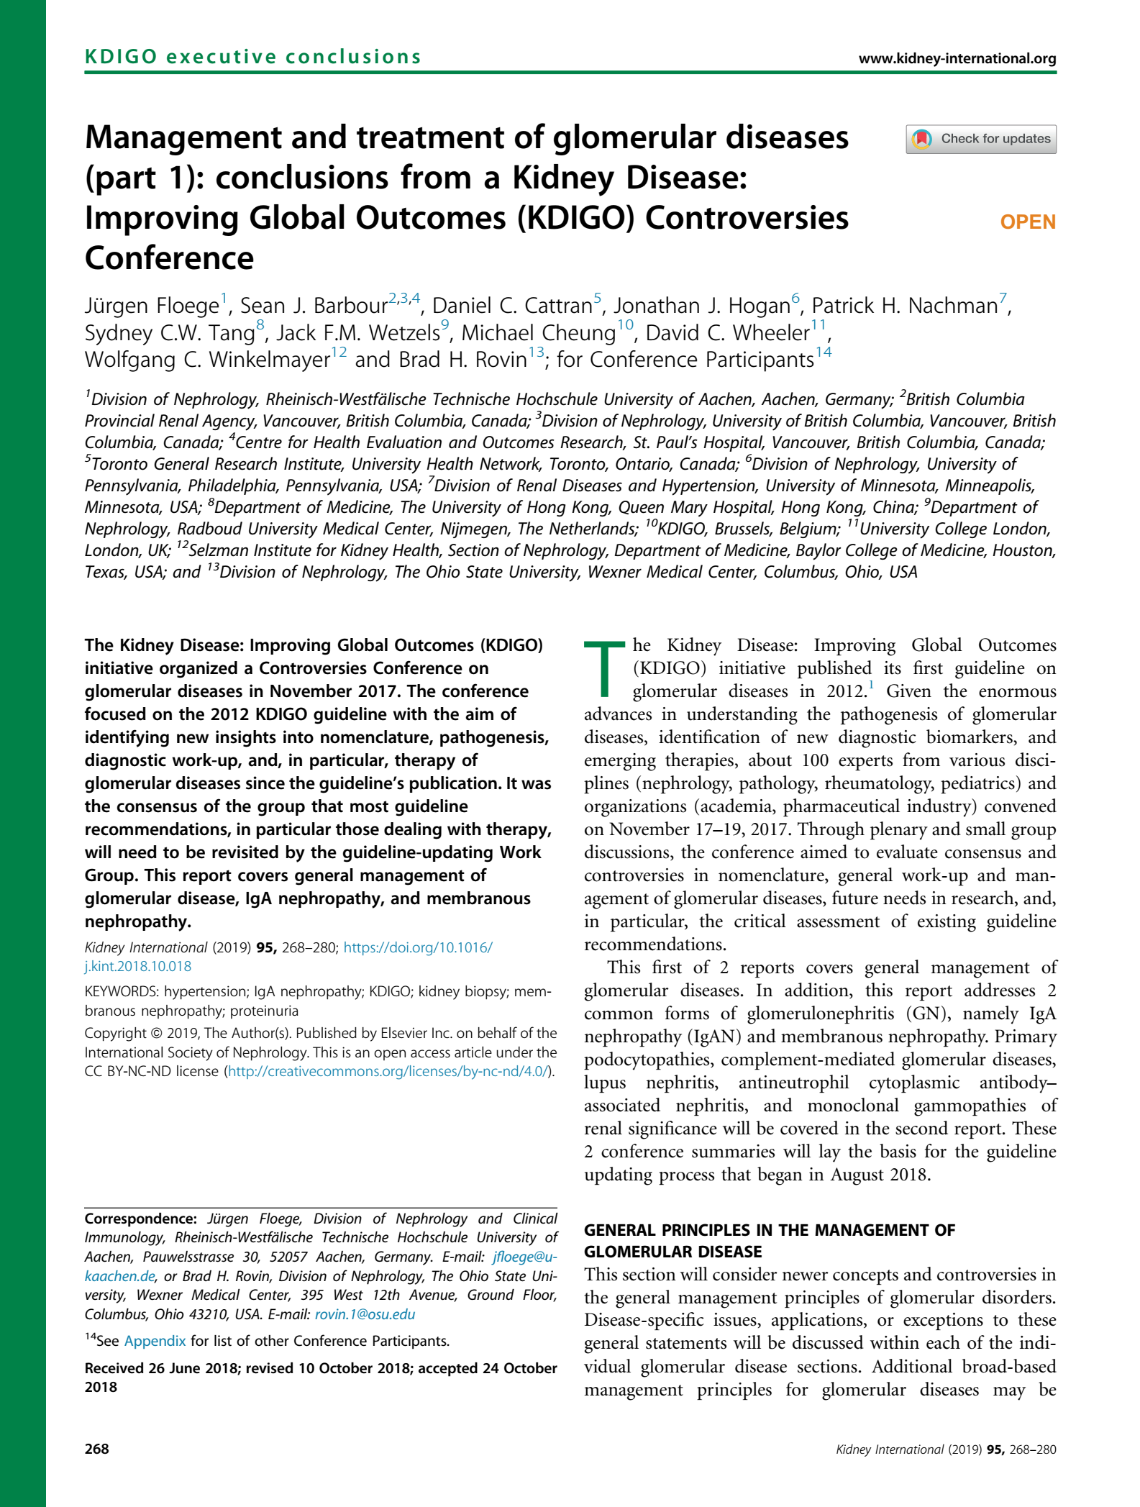
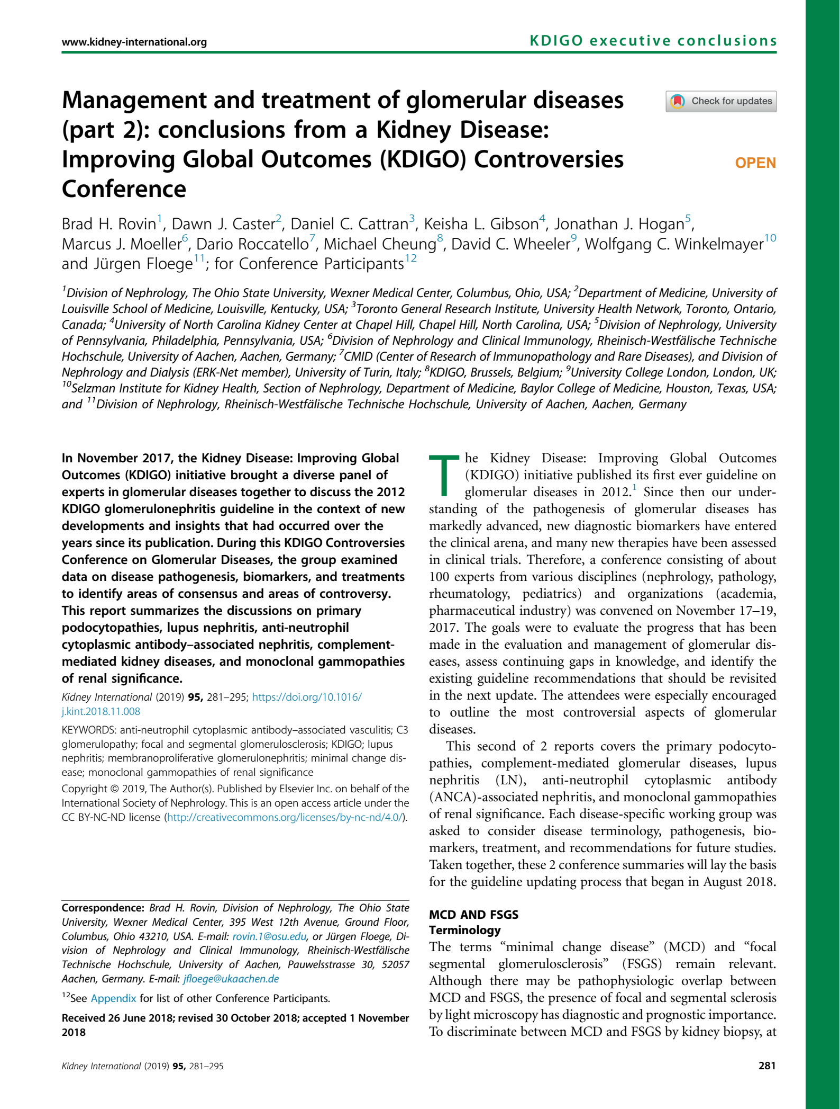
KDIGO Controversies Conference on Glomerular Diseases
November 2017 (Singapore)
Topics:
General principles, Nephrotic syndrome, Membranoproliferative GN (MPGN), C3 glomerulonephritis (C3GN)
IgA Nephropathy
Membranous GN
Minimal change disease (MCD) and Focal Segmental Glomerulosclerosis (FSGS)
Lupus nephritis (LN) and ANCA vasculitis
Report published in Kidney International (2019)
Led to initiation of the update of the KDIGO guideline

Slide 6
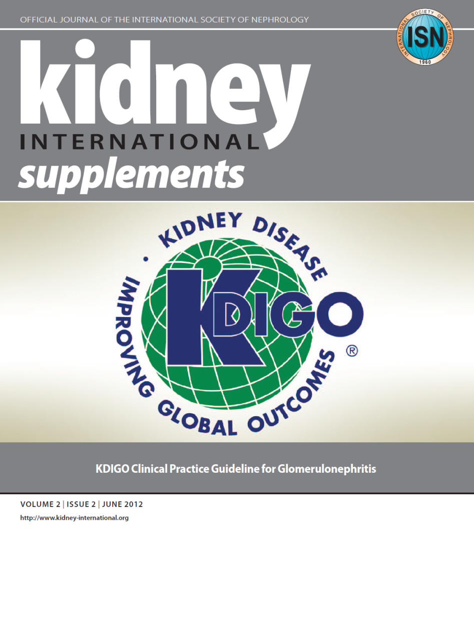
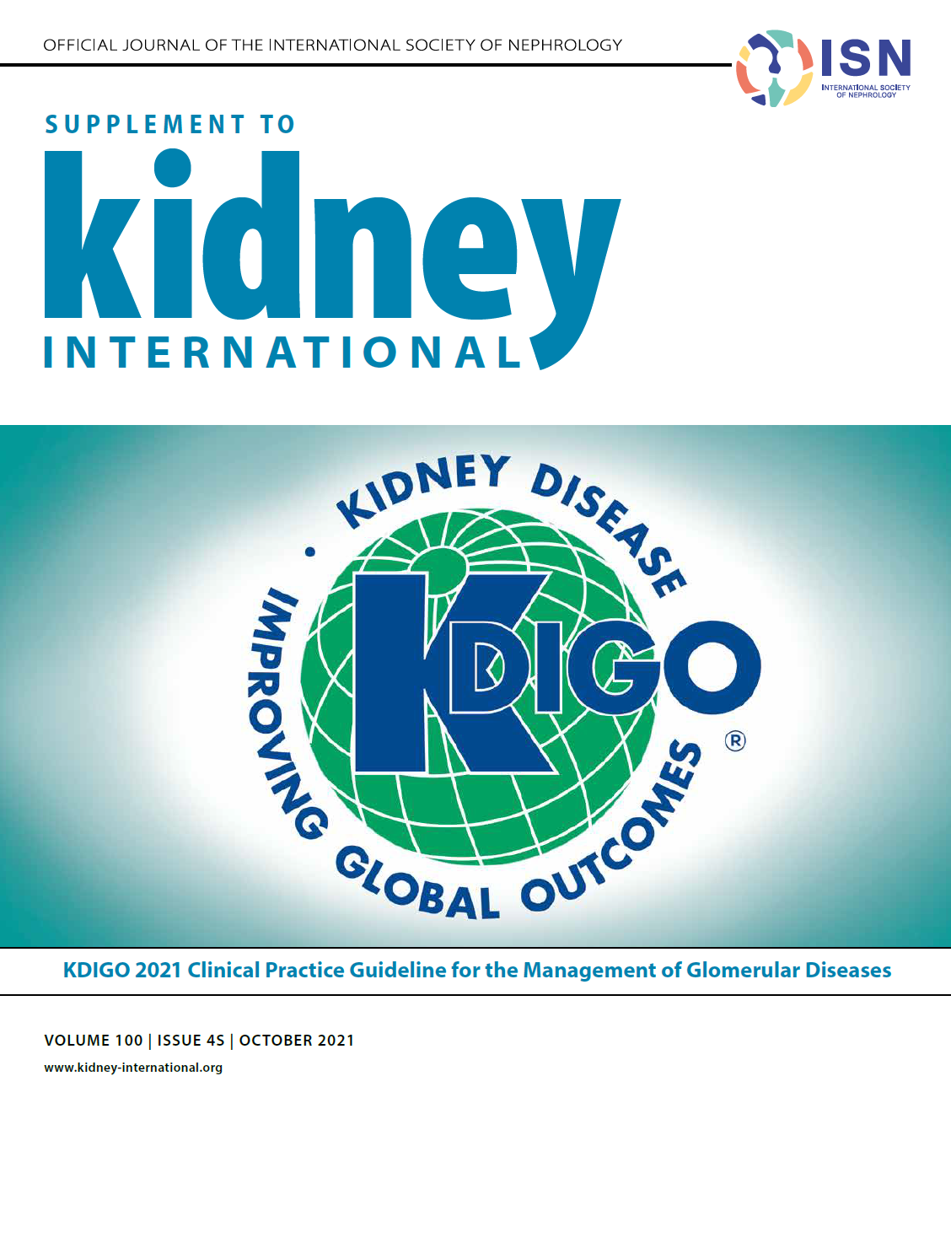
KDIGO 2012 Guideline: The Beginning
KDIGO 2021 Guideline: The Update

Slide 7
Timeline of Guideline for Management of GD

Slide 8
Scope of the Clinical Practice Guideline
Include:
General principles for the management of all glomerular disease (GD) patients
Adult and pediatric glomerulonephritides (IgAN, membranous nephropathy, nephrotic syndrome, including MCD and FSGS, and infection-related glomerulonephritis [GN]) and systemic immunologic diseases (antineutrophil cytoplasmic antibody [ANCA]-associated vasculitis, lupus nephritis, and anti-glomerular basement membrane [GBM] antibody GN).
Immunoglobulin- and complement-mediated glomerular diseases with an MPGN pattern of injury
Exclude:
Very rare GN types of diseases, such as fibrillary GN, immunotactoid GN, and IgM GN.
Amyloidosis and immunoglobulin deposition diseases, Alport syndrome, thrombotic microangiopathies

Slide 9
Guideline Goals
Generate a useful resource for clinicians and patients
Address relevant questions with actionable recommendations
Take on controversial topics when sufficient evidence
Communicate clearly
Target audience: Primarily clinicians treating patients with glomerular diseases
Stay true to evidence, where available
Propose research questions
Be mindful of implications for policy and payment

Slide 10
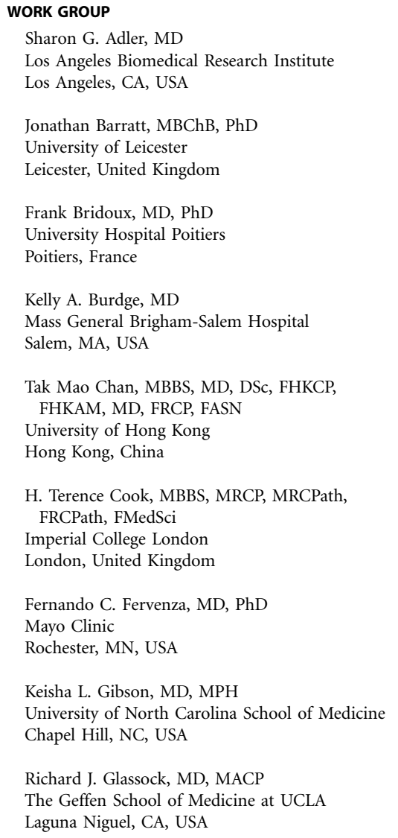
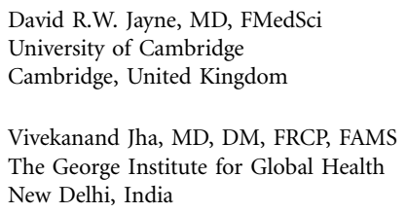
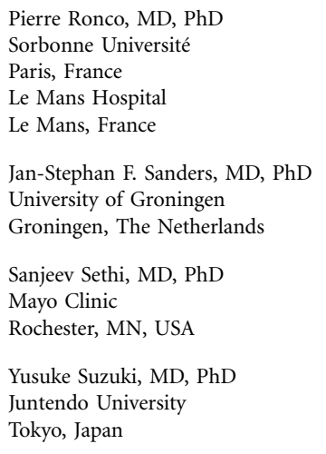
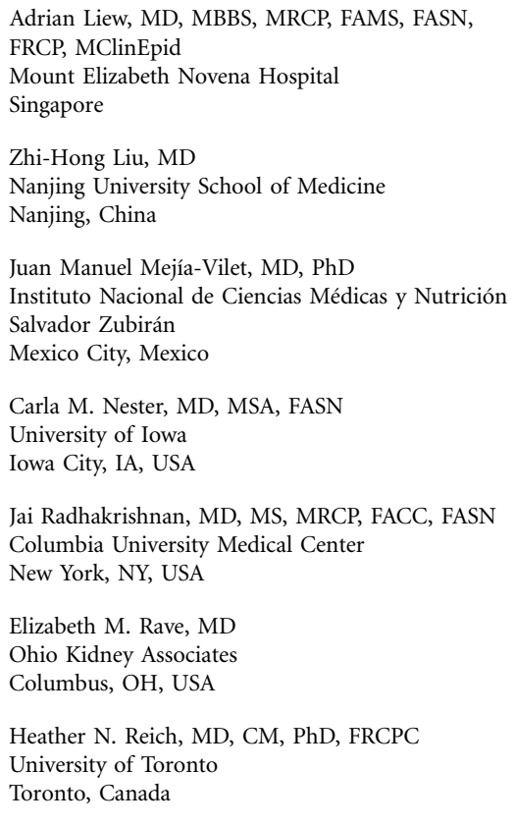
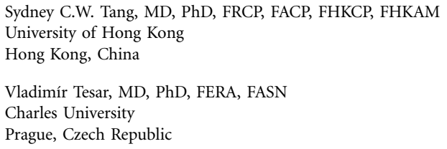
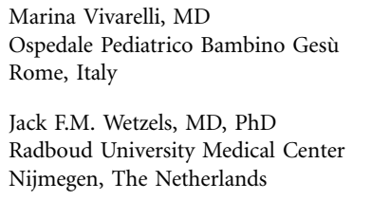
Work Group
Worldwide scope
Prior GL WG Members
Deep experience
Evidence Review Team

Slide 11
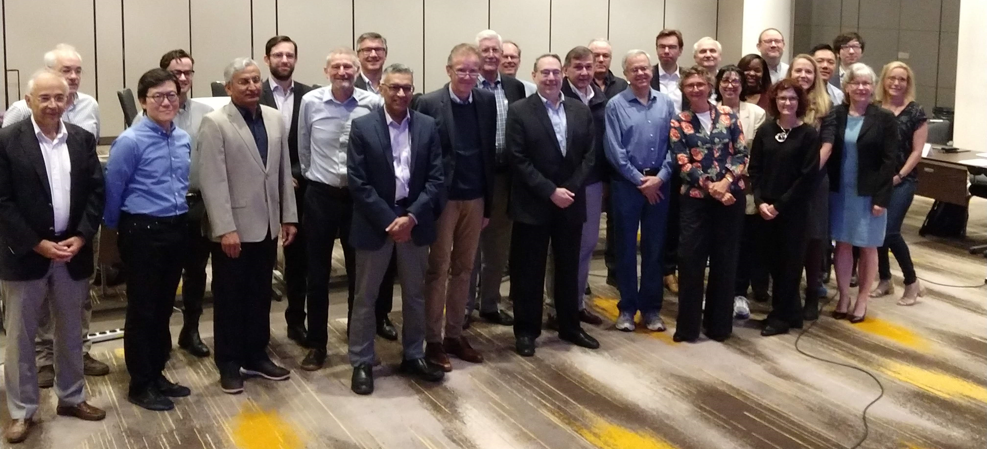
Work Group

Slide 12
What Is New Since the 2012 KDIGO Guideline
General principles chapter discusses supportive therapies appropriate for all GD that supplement the more specific immunosuppressive treatments for each disease.
Membranous nephropathy chapter now provides an in-depth discussion of monitoring pathogenic autoantibodies in disease management.
MPGN chapter was replaced with a new chapter entitled Immunoglobulin- and complement-mediated glomerular diseases with an MPGN pattern of injury.
ANCA-associated vasculitis chapter compares and contrasts B cell–targeted therapies with traditional cytotoxic drugs.
FSGS chapter has been reorganized to help clinicians more accurately differentiate between FSGS mediated by a soluble factor that may be amenable to immunosuppression, and conditions with FSGS-like histology, for which immunosuppression should not be used.
Chapter on nephrotic syndrome in children takes advantage of several new trials that have defined duration of immunosuppression, and has been written to closely align with the International Pediatric Nephrology Association (IPNA) guideline.

Slide 13
Evidence Review
ERT - Cochrane Kidney Transplant
Existing Population, Intervention, Comparator, Outcome, Study design (PICOS) questions and new PICOS questions developed
Clinical and important outcomes identified
The critical and important outcomes were voted on by the Work Group using an adapted Delphi process (1–9 Likert scale). Critical outcomes were rated 7–9, and important outcomes were rated 4–6 on the 9-point scale.
Critical outcomes | Important outcomes
All-cause mortality Kidney failure (ESKD) ≥50% loss of GFR Infection Glucocorticoid-related adverse events Malignancy | Complete remission or relapse Annual GFR loss (minimum 3 years follow-up)
ESKD, end-stage kidney disease; GFR, glomerular filtration rate

Slide 14
PICOS Questions
Focus on RCTs - mapped to existing Cochrane Systematic reviews
New systematic reviews undertaken as required
Focused observational study reviews
Key question | Population | Factor of interest | Outcome | Study design
Chapter 1: General principles in the management of glomerular disease
In patients with glomerular diseases, what are patient preferences and values for immunosuppressive and non- immunosuppressive therapy? | Patients with glomerular disease | Values and preferences for immunosuppressive or non-immunosuppressive therapy | Values and preferences | All study types

Slide 15
Key question | Population | Intervention | Comparator | Outcome | Study design
Chapter 2: IgA nephropathy/IgA vasculitis
In patients with biopsy-proven IgAN, what non-immunosuppressive agents improve efficacy outcomes and reduce adverse effects? | Patients with IgAN | Fish oil, anticoagulants or antiplatelets, antioxidants, tonsillectomy, statins, traditional Chinese medicine, vitamin D, vitamin E, allopurinol, etc. | Placebo or no treatment | Critical and important outcomes | RCTs
In patients with biopsy-proven IgAN, what immunosuppressive agents improve efficacy outcomes and reduce adverse effects? | Patients with IgAN | Immunosuppressive therapy
In patients with biopsy-proven IgAV (Henoch-Schönlein purpura nephritis), what immunosuppressive agents improve efficacy outcomes and reduce adverse effects? | Patients with IgAV (HSP nephritis) | Immunosuppressive therapy | Placebo, no treatment, or standard of care | Critical and important outcomes, BMI | RCTs

Slide 16
Key question | Population | Intervention | Comparator | Outcome | Study design
Chapter 3: Membranous nephropathy
In adults with biopsy-proven MN and NS, what immunosuppressive agents improve efficacy outcomes and reduce adverse effects? | Adults with MN and NS | Immunosuppressive therapy | Placebo, no treatment, or other immunosuppressive therapies | Critical and important outcomes | RCTs

Slide 17
Key question | Population | Intervention | Comparator | Outcome | Study design
Chapter 4: NS in children
In children with SSNS, what glucocorticoid therapy regimens improve efficacy outcomes and reduce adverse effects? | Children (3-18 years of age) with SSNS | Glucocorticoid therapy | Placebo, no treatment, or standard of care | Critical and important outcomes | RCTs
In children with SSNS, what non-glucocorticoid immunosuppressive regimens improve efficacy outcomes and reduce adverse effects? | Children (3-18 years of age) with SSNS | Non-glucocorticoid immunosuppressive therapy
In children (3–18 years of age) with SRNS, what immunosuppressive therapy, improves efficacy outcomes and reduces adverse effects? | Children (3-18 years of age) with SRNS | Immunosuppressive therapy | No treatment, placebo, or other immunosuppressive therapies (including glucocorticoids) | Critical and important outcomes | RCTs

Slide 18
Key question | Population | Intervention | Comparator | Outcome | Study design
Chapter 5: MCD in adults
In adults with biopsy-proven MCD and NS, what immunosuppressive agents improve efficacy outcomes and reduce adverse effects? | Adults with biopsy-proven MCD and NS | Immunosuppressive therapy | No treatment, placebo, or other immunosuppressive therapies | Critical and important outcomes | RCTs
Chapter 6:FSGS in adults
In adults with biopsy-proven FSGS, what immunosuppressive agents improve efficacy outcomes and reduce adverse effects? | Adults with biopsy-proven FSGS and NS | Immunosuppressive therapy | No treatment, placebo, or other immunosuppressive therapies | Critical and important outcomes | RCTs

Slide 19
Key question | Population | Intervention | Comparator | Outcome | Study design
Chapter 7: Infection-related GN
In adult patients with HBV- or HCV-related GN, what antiviral treatment therapy improves efficacy outcomes and reduces adverse effects? | Adults with HBV- or HCV-related GN | Antiviral treatment therapy | Placebo, no treatment, or standard of care | Critical and important outcomes | RCTs
In patients with HIV-associated nephropathy, what antiretroviral treatment improves efficacy outcomes and reduces adverse effects? | Patients with HIV-associated nephropathy | Highly active antiretroviral therapy (HAART; alone or combined with antihypertensive agents, glucocorticoids, and immunosuppressive therapies)

Slide 20
Key question | Population | Intervention | Comparator | Outcome | Study design
Chapter 8: Immunoglobulin- and complement-mediated glomerular diseases with an MPGN pattern of injury
In patients with complement-mediated disease, what immunosuppressive agents improve efficacy outcomes and reduce adverse effects? | Patients with C3-mediated GN, C3 DDD, CFHR5 nephropathy, C4-mediated GN, idiopathic MPGN | Immunosuppressive therapy | Placebo, no treatment, or standard of care | Critical and important outcomes | RCTs and observational studies
In adults with proliferative GN (monoclonal immunoglobulin deposits [monoclonal immunoglobulin deposition disease], immunotactoid GN, fibrillary GN, cryoglobulinemia-related kidney disease), does immunosuppressive therapy improve clinically relevant outcomes and decrease harms? | Adults with proliferative GN kidney with monoclonal immunoglobulin deposits, immunotactoid GN, fibrillary GN, cryoglobulinemia-related kidney disease |  |  | Mortality, kidney failure, complete kidney remission, hematologic response, adverse events

Slide 21
Key question | Population | Intervention | Comparator | Outcome | Study design
Chapter 9: ANCA-associated vasculitis
In adults with AAV, what immunosuppressive agents improve clinical efficacy outcomes and reduce adverse effects? | Adults with ANCA-associated vasculitis | Immunosuppressive therapy | Placebo, no treatment, or other immunosuppressive therapies | Critical and important outcomes | RCTs

Slide 22
Key question | Population | Intervention | Comparator | Outcome | Study design
Chapter 10: Lupus nephritis
In patients with biopsy-proven LN, does antimalarial therapy improve clinical efficacy outcomes and reduce adverse effects? | Patients with biopsy-proven LN | Antimalarial therapy | Placebo, no treatment, or standard of care | Critical and important outcomes | RCTs and observational studies
In patients with nonproliferative LN, what immunosuppressive agents improve efficacy outcomes and reduce adverse effects? | Patients with biopsy-proven nonproliferative (Class I, II, V, or VI) LN | Immunosuppressive therapy | No treatment, placebo, or other immunosuppressive therapies |  | RCTs
In patients with biopsy-proven proliferative LN, what immunosuppressive agents improve clinical efficacy outcomes and reduce adverse effects? | Patients with biopsy-proven proliferative (Class I, II, V, or VI) LN

Slide 23
Key question | Population | Intervention | Comparator | Outcome | Study design
Chapter 11: Anti-GBM antibody GN
In patients with biopsy-proven anti-GBM, what immunosuppressive agents improve outcomes and reduce adverse effects? | Patients with biopsy-proven anti-GBM | Immunosuppressive therapy | Placebo, no treatment, or other immunosuppressive therapies | Critical and important outcomes | RCTs

Slide 24
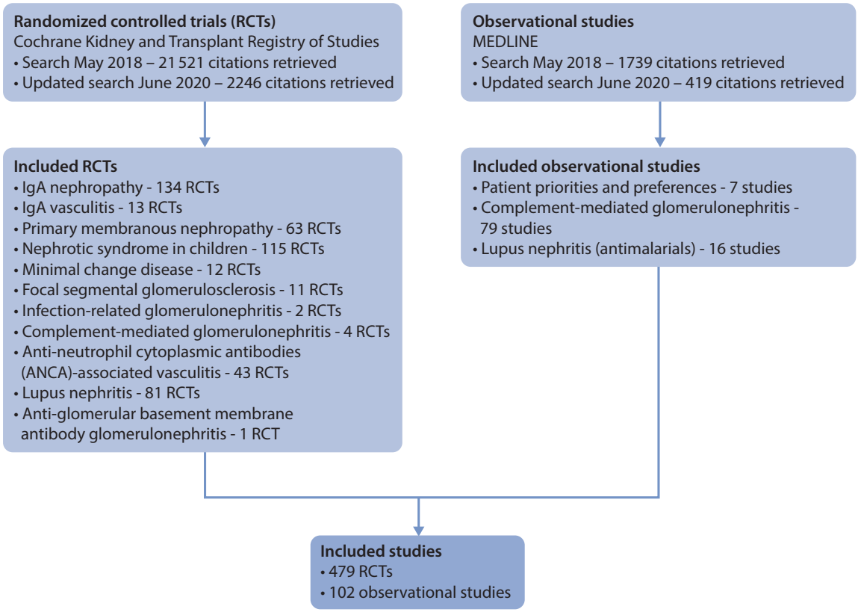
Literature Search October 2018 Supplemented with additional studies until September 2019; Updated in June 2020

Slide 25
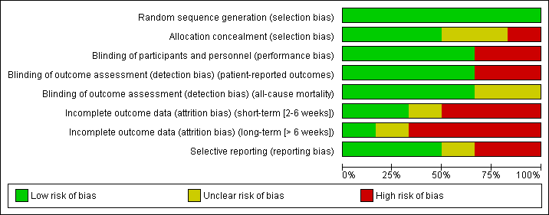
Evidence Synthesis
Risk of bias graph example
Standard Cochrane methods – Two independent reviewers
Data abstraction
Critical appraisal – using validated tools
Data-analysis
Random effects meta-analysis and generic inverse variance
Relative risk for dichotomous outcomes
Mean difference for continuous outcomes
Heterogeneity assessed using the I² statistic
Forest plot example

Slide 26
Grading Recommendations
GRADE methodology
The quality of the evidence – Level A, B, C, D
Study limitations
Inconsistency
Indirectness
Imprecision
Publication bias
Strength of the recommendation – Level 1 (Strong), “We recommend”
or Level 2 (Weak), “We suggest”
Two face-to-face meetings – Amsterdam in August 2018 and Budapest in June 2019
Balance of benefits and harms
Quality of the evidence
Patient values and preferences
Resources and other considerations

Slide 27
Guideline Format
KDIGO guidelines continue to use the Grading of Recommendations Assessment, Development, Evaluation (GRADE) methodology, but we have strengthened the link between the recommendation statements and underlying evidence base.
Guidelines now include a mix of recommendations and “practice points” to help clinicians better evaluate and implement the guidance from the expert Work Group.
All recommendations follow a consistent and structured format and are similar in style to previous KDIGO recommendations.
Practice points are a new addition to KDIGO guidance, and may be formatted as a table, a figure, or an algorithm to make them easier to use in clinical practice.

Slide 28
Guideline Format
How should I use practice points when caring for my patients?
Practice points are consensus statements about a specific aspect of care and supplement recommendations for which a systematic review was conducted.
Note that practice points represent the expert judgment of the guideline Work Group, but may also be based on limited evidence.
Unlike recommendations, practice points are not graded for strength of recommendation or quality of the evidence.
Users should consider the practice point as expert guidance, and use it as they see fit to inform the care of patients.
New guideline disseminated
Start with recommendations
Consider relevant practice points

Slide 29
Glomerular Diseases Guideline Contents
Chapter 1. General principles for the management of glomerular disease
Chapter 2. Immunoglobulin A nephropathy (IgAN)/Immunoglobulin A vasculitis (IgAV)
Chapter 3. Membranous nephropathy
Chapter 4. Nephrotic syndrome in children
Chapter 5. Minimal change disease
Chapter 6. FSGS
Chapter 7. Infection-related glomerulonephritis
Chapter 8. Immunoglobulin- and complement-mediated glomerular diseases with a MPGN pattern of injury
Chapter 9. ANCA-associated vasculitis
Chapter 10. Lupus nephritis
Chapter 11. Anti-GBM antibody glomerulonephritis

Slide 30
Chapter 1. General Principles for the Management of Glomerular Disease

Slide 31
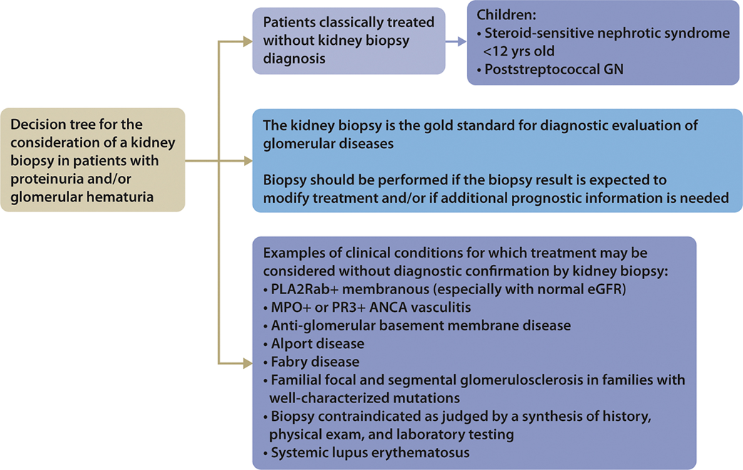
Kidney Biopsy
Practice Point 1.1.1: The kidney biopsy is the “gold standard” for the diagnostic evaluation of glomerular diseases. However, under some circumstances, treatment may proceed without a kidney biopsy confirmation of diagnosis.
Notes:
Here, KDIGO emphasizes the role of the kidney biopsy, which is still considered the “gold standard” for the diagnostic evaluation of glomerular diseases.

Slide 32
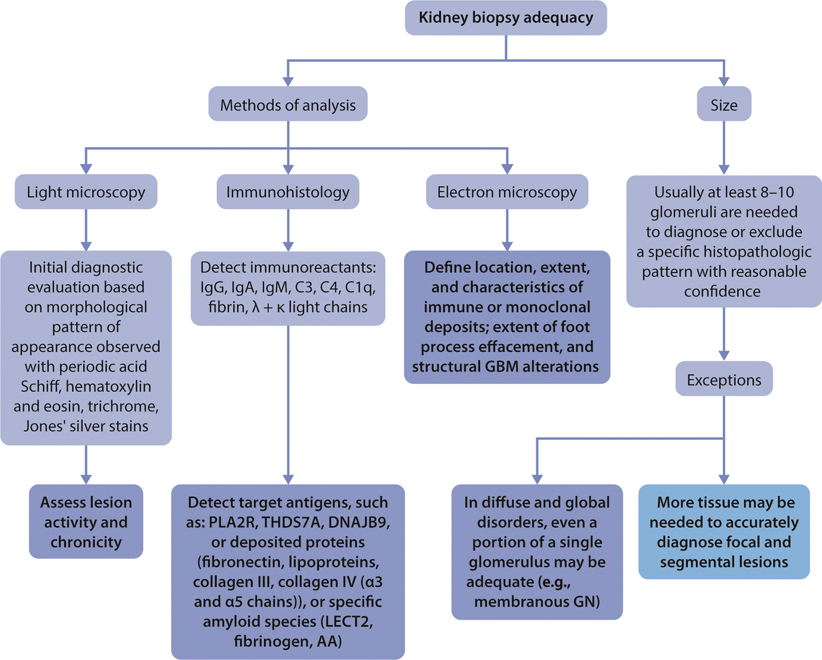
Kidney Biopsy
Practice Point 1.1.2: The evaluation of kidney tissue should meet standards of biopsy adequacy.
Notes:
Serologic studies and genetic testing (e.g., whole exome sequencing) in selected cases may enhance the interpretation and the utility of the kidney biopsy in the future.

Slide 33
Kidney Biopsy
Practice Point 1.1.3: Repeat kidney biopsy should be performed if the information will potentially alter the therapeutic plan or contribute to the estimation of prognosis.
Notes:
Please read this slide

Slide 34
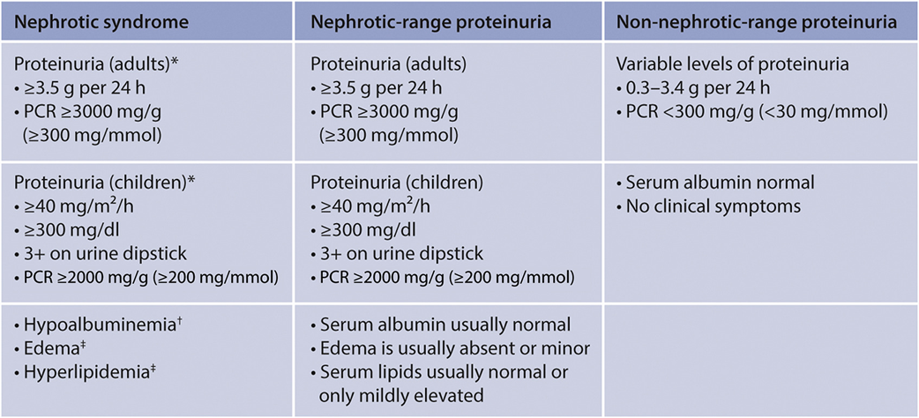
Assessment of Kidney Function
Practice Point 1.2.1: Obtain 24-hour urine collection to determine total protein excretion in patients with glomerular disease for whom initiation or intensification of
immunosuppression is necessary, or who have a change in clinical status.
Practice Point 1.2.2: For pediatrics, 24-hour urine collection is not ideal as it may not be accurate and is cumbersome to collect. Instead, monitor first morning protein–
creatinine ratio (PCR).
Notes:
To assess total urinary protein excretion in patients with GN, a 24-hour urine collection should be obtained.
In children, a first morning protein-creatinine ratio (PCR) is more appropriate.

Slide 35
Assessment of Kidney Function
Practice Point 1.2.3: Random “spot” urine collections for PCR are not ideal as there is variation over time in both protein and creatinine excretion.
Practice Point 1.2.4: First morning urine collections may underestimate 24-hour protein excretion in orthostatic proteinuria.
Practice Point 1.2.5: When feasible, a reasonable compromise is to collect an “intended” 24-hour urine sample and measure PCR in an aliquot of the collection.
Notes:
When feasible, a reasonable compromise is to collect an “intended” 24-hour urine sample and measure PCR in an aliquot of the collection.

Slide 36
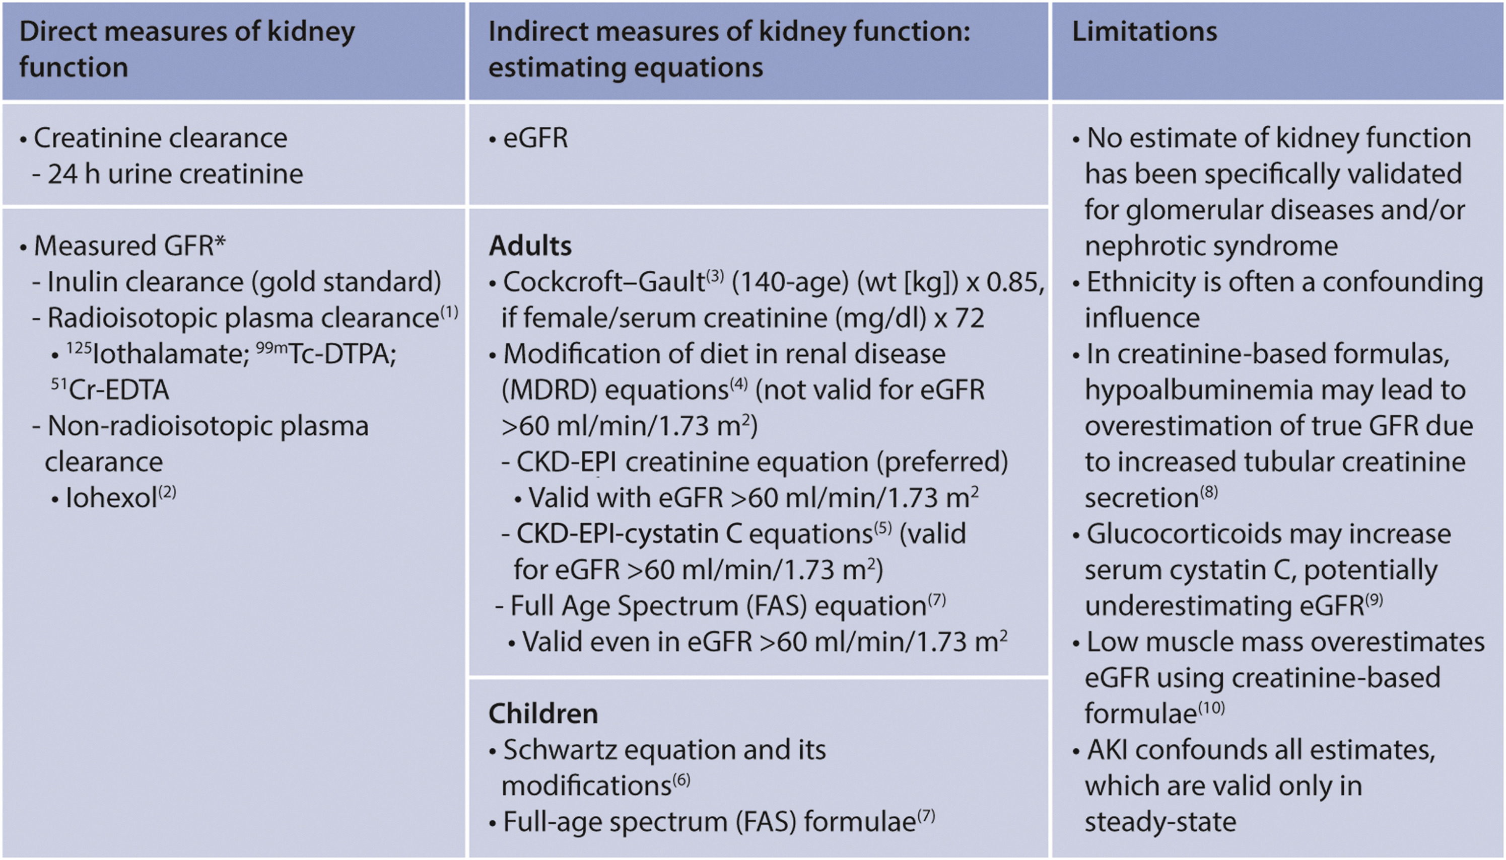
Assessment of Kidney Function
Practice Point 1.2.6: There is no need to simultaneously and routinely quantify sodium excretion on each timed urinary collection, unless there is reason to suspect a failure
to adhere to suggestions regarding dietary sodium restriction (Practice Points 1.4.2 and 1.5.9).
Notes:
Please read slide and describe table

Slide 37
Assessment of Kidney Function
Practice Point 1.2.7: Quantify proteinuria in glomerular disease, as it has disease-specific relevance for prognosis and treatment decision-making. Qualitative assessment of proteinuria may be useful in selected instances.
Practice Point 1.2.8: In children, quantify proteinuria, but goals of treatment should not be different between disease etiologies. A PCR of <200 mg/g (<20 mg/mmol) or <8 mg/
m2/hour in a 24-hour urine should be the goal for any child with glomerular disease. Acceptance of a baseline higher than this should come only with kidney biopsy evidence of kidney scarring.
Practice Point 1.2.9: The Chronic Kidney Disease Epidemiology Collaboration (CKD-EPI) estimated glomerular filtration rate (eGFR) creatinine equation is preferred in adult
patients with glomerular disease, and the modified Schwartz equation is preferred in children. The Full Age Spectrum (FAS) equation may be used in both adults and children.
Notes:
To assess estimated glomerular filtration rate (eGFR), the Chronic Kidney Disease Epidemiology Collaboration (CKD-EPI) creatinine equation is preferred in adult patients with GN and the modified Schwartz equation in children.
Issues of race in these formulae have been clarified by the National Kidney Foundation-American Society of Nephrology Task Force.
The Full Age Spectrum (FAS) equation may be used in both adults and children.

Slide 38
Evaluation of Hematuria
Practice Point 1.3.1: Routine evaluation of urine sediment for erythrocyte morphology and the presence of red cell casts and/or acanthocytes is indicated in all forms of
glomerular disease.
Practice Point 1.3.2: Monitoring of hematuria (magnitude and persistence) may have prognostic value in many forms of glomerular disease. This is particularly applicable to
immunoglobulin A nephropathy (IgAN) and vasculitis (IgAV; Chapter 2).
Notes:
Please read this slide

Slide 39
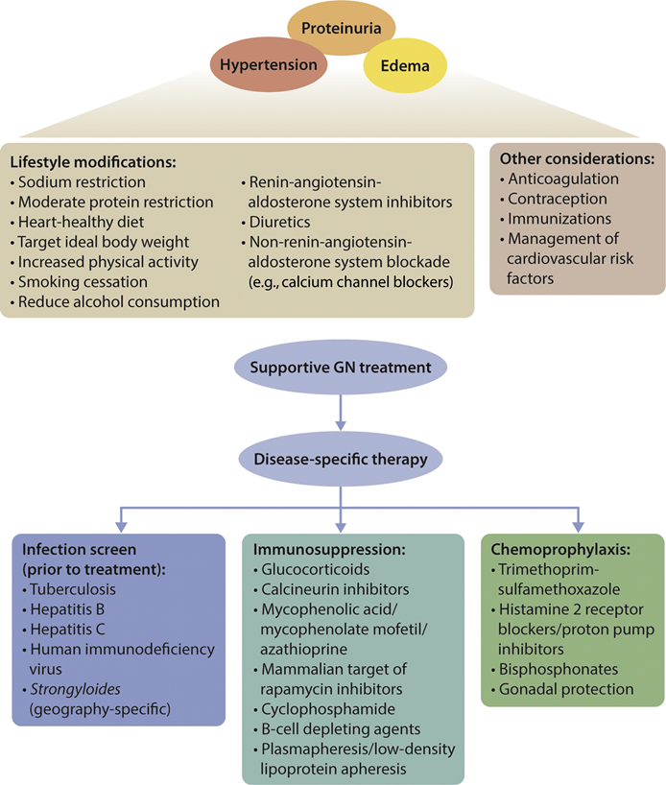
Management of Complications of GD
Notes:
A number of complications of glomerular disease are a consequence of the clinical presentation rather than the specific histopathologic pattern.
Active management of such complications should always be considered to have a positive impact on the natural history of the disease and to significantly improve morbidity and even mortality.

Slide 40
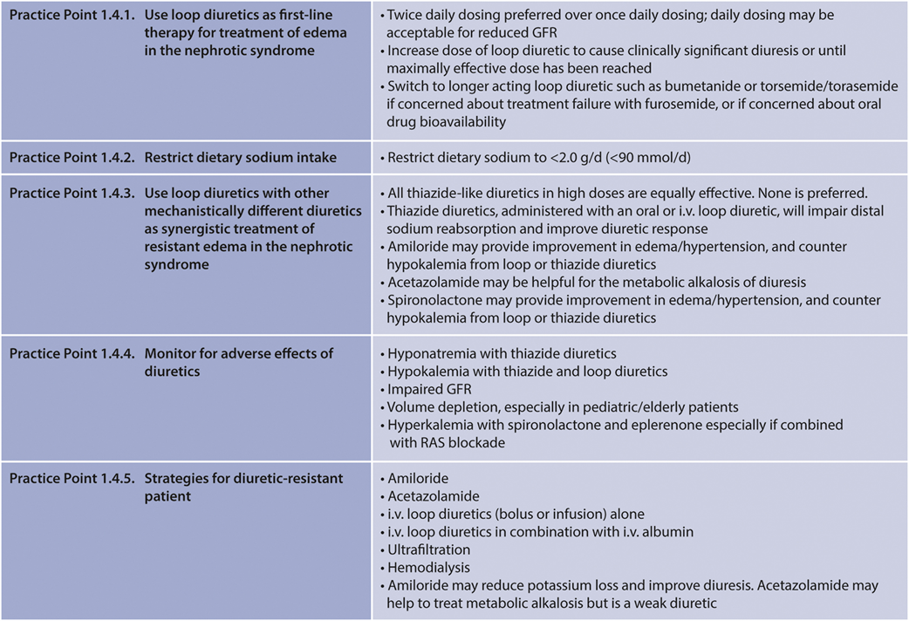
Management of Complications of GD
Notes:
Edema management in nephrotic syndrome (NS) has not changed significantly from the 2012 guideline version.
Loop diuretics are the preferred agents, as is restriction of dietary sodium intake.
If diuretic response is insufficient, other mechanistically different diuretics should be added.
In such cases, particular attention to adverse effects of the diuretics is necessary, including hyponatremia, hypokalemia, glomerular filtration rate (GFR) reduction, and volume depletion.

Slide 41
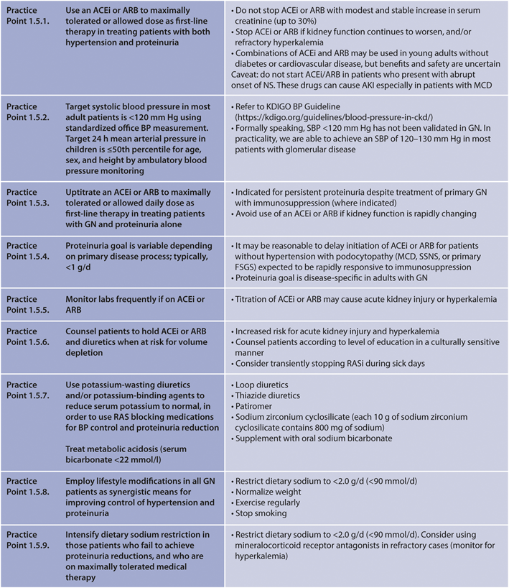
Management of Hypertension and Proteinuria Reduction in GD
Notes:
Management of hypertension and proteinuria in GN also has experienced few changes.
Angiotensin-converting enzyme inhibitors (ACEi) or angiotensin II receptor blockers (ARBs) should be used at maximally tolerated or allowed dose as first-line in treating patients with both hypertension and proteinuria.

Slide 42
Management of Hypertension and Proteinuria Reduction in GD
Notes:
Management of hypertension and proteinuria in GN also has experienced few changes.
Angiotensin-converting enzyme inhibitors (ACEi) or angiotensin II receptor blockers (ARBs) should be used at maximally tolerated or allowed dose as first-line in treating patients with both hypertension and proteinuria.

Slide 43
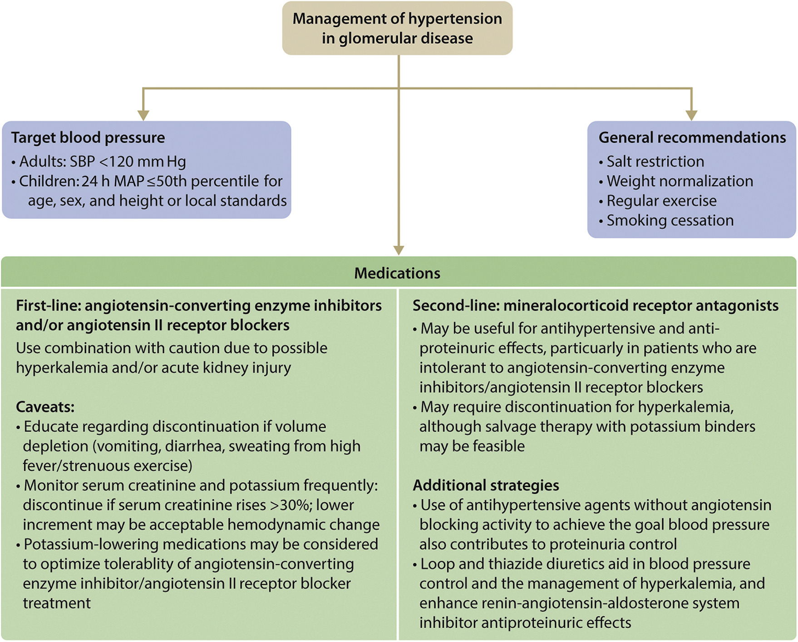
Management of Hypertension and Proteinuria Reduction in GD
Notes:
Target systolic blood pressure in most adult patients should be <120 mm Hg, using standardized office BP measurement only.
Targets may be variable depending on the GN-type (see individual chapters).
If needed, potassium-wasting diuretics and/or potassium-binding agents can be used to reduce serum potassium to normal, in order to allow the use of RAS inhibitors for blood pressure control and proteinuria reduction.

Slide 44
Management of Hyperlipidemia in GD
Notes:
Treatment of dyslipidemia may be considered in patients with the NS, particularly for patients with other cardiovascular risk factors, including hypertension and diabetes.
Lifestyle modifications are important in all patients with persistent dyslipidemia and glomerular disease.
Consider starting a statin drug as first-line therapy for persistent dyslipidemia in patients with glomerular disease and consider initiation of non-statin therapy in those individuals who cannot tolerate a statin, or who are at high atherosclerotic cardiovascular disease risk and fail to achieve low-density lipoprotein cholesterol or triglyceride goals despite maximally tolerated statin dose.

Slide 45
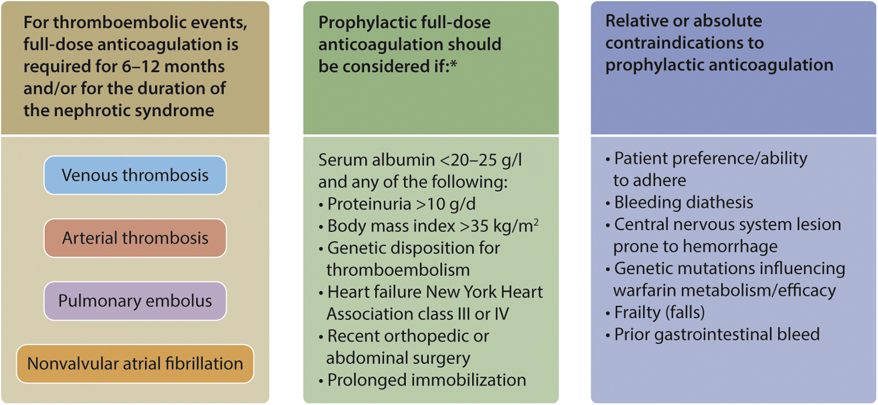
Hypercoagulability and thrombosis
Practice Point 1.7.1: Full anticoagulation is indicated for patients with thromboembolic events occurring in the context of nephrotic syndrome. Prophylactic anticoagulation should be employed in patients with nephrotic syndrome when the risk of thromboembolism exceeds the estimated patient-specific risks of an anticoagulation-induced serious bleeding event.
Notes:
Prophylactic anticoagulation should be employed in patients with NS when the risk of thromboembolism exceeds the estimated patient-specific risks of an anticoagulation-induced serious bleeding event.
A particular high-risk situation is membranous nephropathy (MN) with NS.

Slide 46
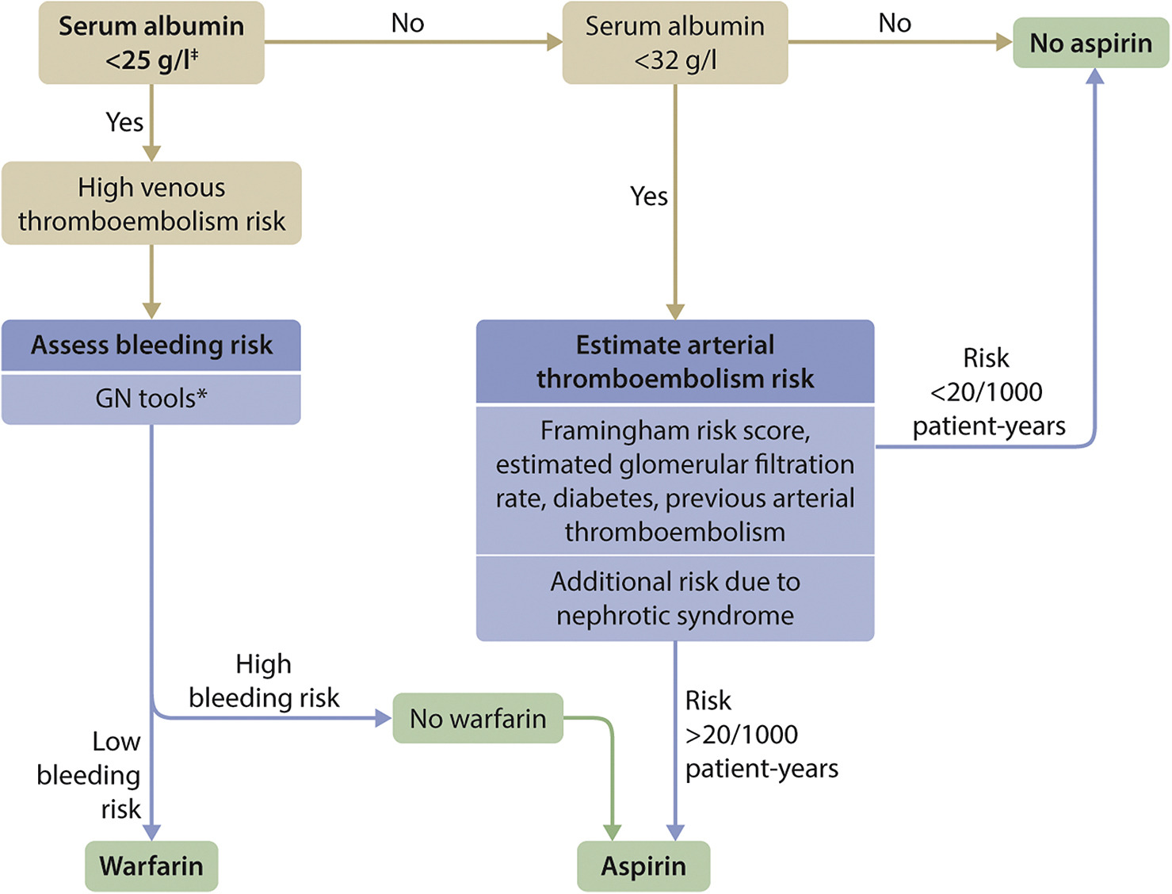
Hypercoagulability and thrombosis
Practice Point 1.7.2: Anticoagulant dosing considerations in patients with nephrotic syndrome.
Notes:
Please read this slide and present this decision algorithm

Slide 47
Hypercoagulability and thrombosis
Notes:
Anticoagulant dosing considerations in patients with NS

Slide 48
Risks of Infections
Practice Point 1.8.1: Use pneumococcal vaccine in patients with glomerular disease and nephrotic syndrome, as well as patients with chronic kidney disease (CKD). Patients and
household contacts should receive the influenza vaccine. Patients should receive herpes zoster vaccination (Shingrix).
Practice Point 1.8.2: Screen for tuberculosis (TB), hepatitis B virus (HBV), hepatitis C virus (HCV), human immunodeficiency virus (HIV), and syphilis in clinically appropriate patients (Chapter 7).
Practice Point 1.8.3: Strongyloides superinfection should be considered in patients receiving immunosuppression who once resided in endemic tropical environments and who have eosinophilia and elevated serum immunoglobulin E (IgE) levels.
Practice Point 1.8.4: Prophylactic trimethoprim–sulfamethoxazole (TMP-SMX) should be considered in patients receiving high-dose prednisone or other immunosuppressive agents (rituximab, cyclophosphamide)
Notes:
To prevent infections in GN patients with impaired immunity, pneumococcal vaccine should be administered to those with NS and/or chronic kidney disease (CKD).
Patients and household contacts should receive the influenza vaccine.
Screening for tuberculosis (TB), hepatitis B virus (HBV), hepatitis C virus (HCV), human immunodeficiency virus (HIV), and syphilis in clinically appropriate patients is suggested.
Prophylactic trimethoprim-sulfamethoxazole should be considered in patients receiving high-dose prednisone or other immunosuppressive agents (rituximab, cyclophosphamide).
Meningococcal vaccine and prophylaxis are necessary in patients with complement deficiencies or treated with complement inhibitors.

Slide 49
Outcome Measures
Practice Point 1.9.1: Goals for proteinuria reduction with treatment vary among the various specific causes of glomerular disease.
Practice Point 1.9.2: A ≥40% decline in eGFR from baseline over a 2–3-year period has been suggested as a surrogate outcome measure for kidney failure.
Notes:
Outcome measures, such as treatment goals for proteinuria reduction, vary between the specific causes of GN.
A reduction in the slope of decline in GFR can be taken as a favorable surrogate outcome of treatment.
A 40% or greater decline in eGFR from baseline over a 2- to 3-year period has been suggested as a surrogate outcome measure for kidney failure in clinical trials.

Slide 50
Impact of Age, Sex, Ethnicity, and Genetic Background Genomic, transcriptomics, proteomics, metabolomics
[No recommendations or practice points for these sections]
Notes:
The evolving focus on “personalized” or “precision” medicine has brought the diverse fields of genomics, transcriptomics, proteomics, and metabolomics to center stage in the field of management of glomerular disease.
As yet, these developments are preliminary and at a “proof-of concept” stage.
Nevertheless, the evidence for an important impact on management and treatment decisions is emerging and rapidly growing, both in quality and quantity.
Patients with GN should be offered participation in a disease registry and clinical trials, whenever available.

Slide 51
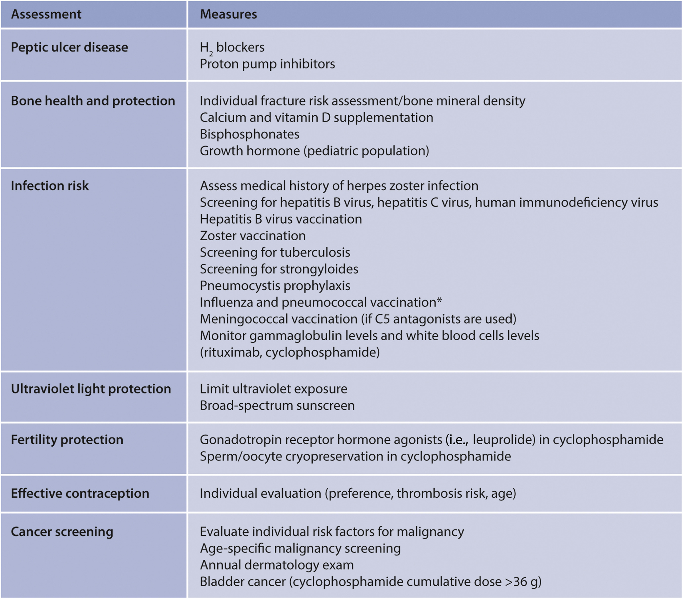
Use of Glucocorticoids and Immunosuppressive Therapy
[Please refer to individual chapters for further information]
Notes:
With more intensive immunosuppressive regimens, prophylaxis may be required to minimize possible adverse effects.
The figure presents screening/prophylaxis for all patients with glomerular disease on immunosuppression.
Influenza and pneumoccal vaccination are not recommended while being treated with moderate to high immunosuppression (e.g., prednisone 10 mg/d) because of reduced antibody response

Slide 52
Pharmacologic Aspects of Immunosuppression
Notes:
These are suggestions to minimize immunosuppression-related adverse effects

Slide 53
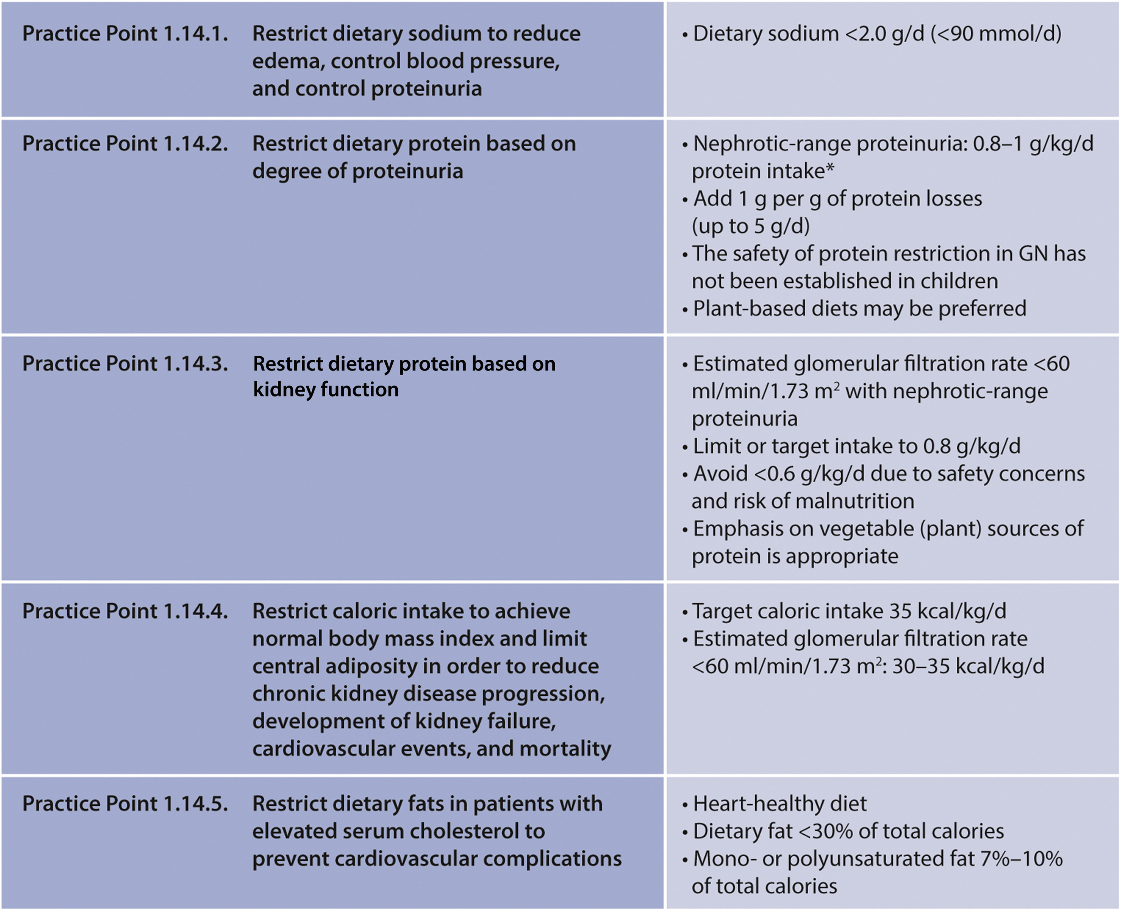
Dietary Management of Glomerular Disease
Notes:
Dietary modifications and regular physical activity to normalize body mass index, limit central obesity, and decrease cardiovascular disease risk factors are appropriate.
Patients should be counseled to restrict dietary sodium to reduce edema, control blood pressure, and control proteinuria.

Slide 54
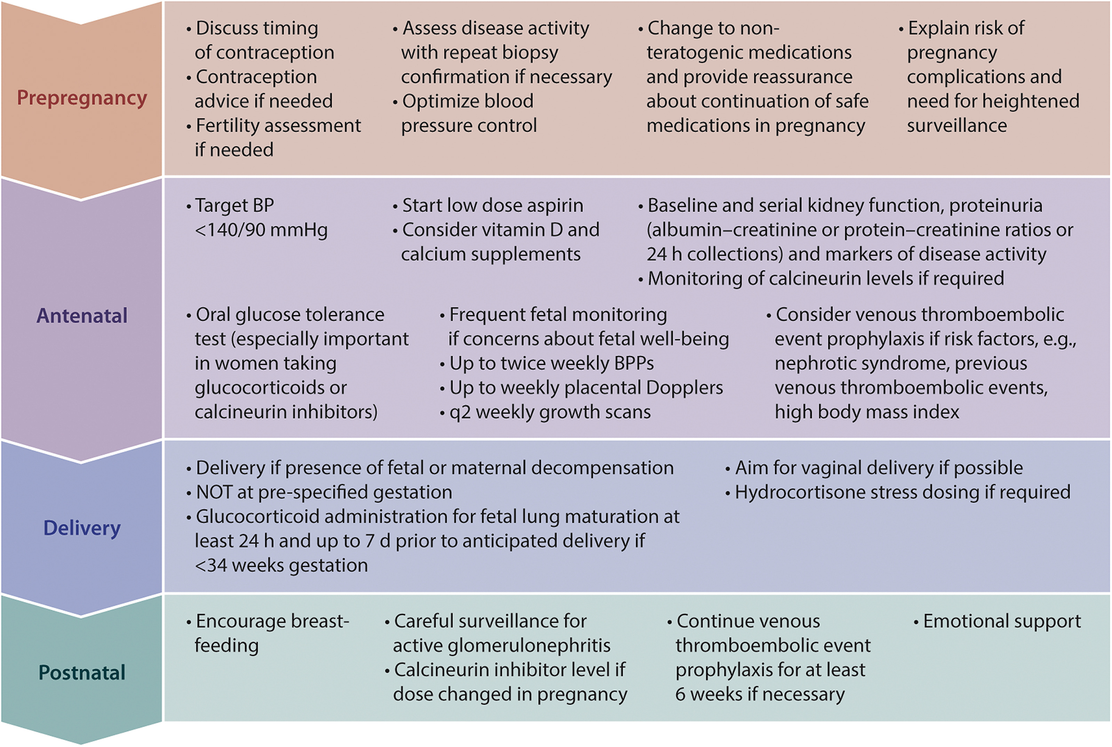
Pregnancy & Reproductive Health in Women with GD
Practice Point 1.15.1: Care for the pregnant patient with glomerular disease needs coordination between nephrology and obstetrics, and ideally, such planning should be
considered before pregnancy.
Notes:
Care for pregnant patients with GN needs coordination between nephrology and obstetrics, and ideally, planning for pregnancy should be considered.

Slide 55
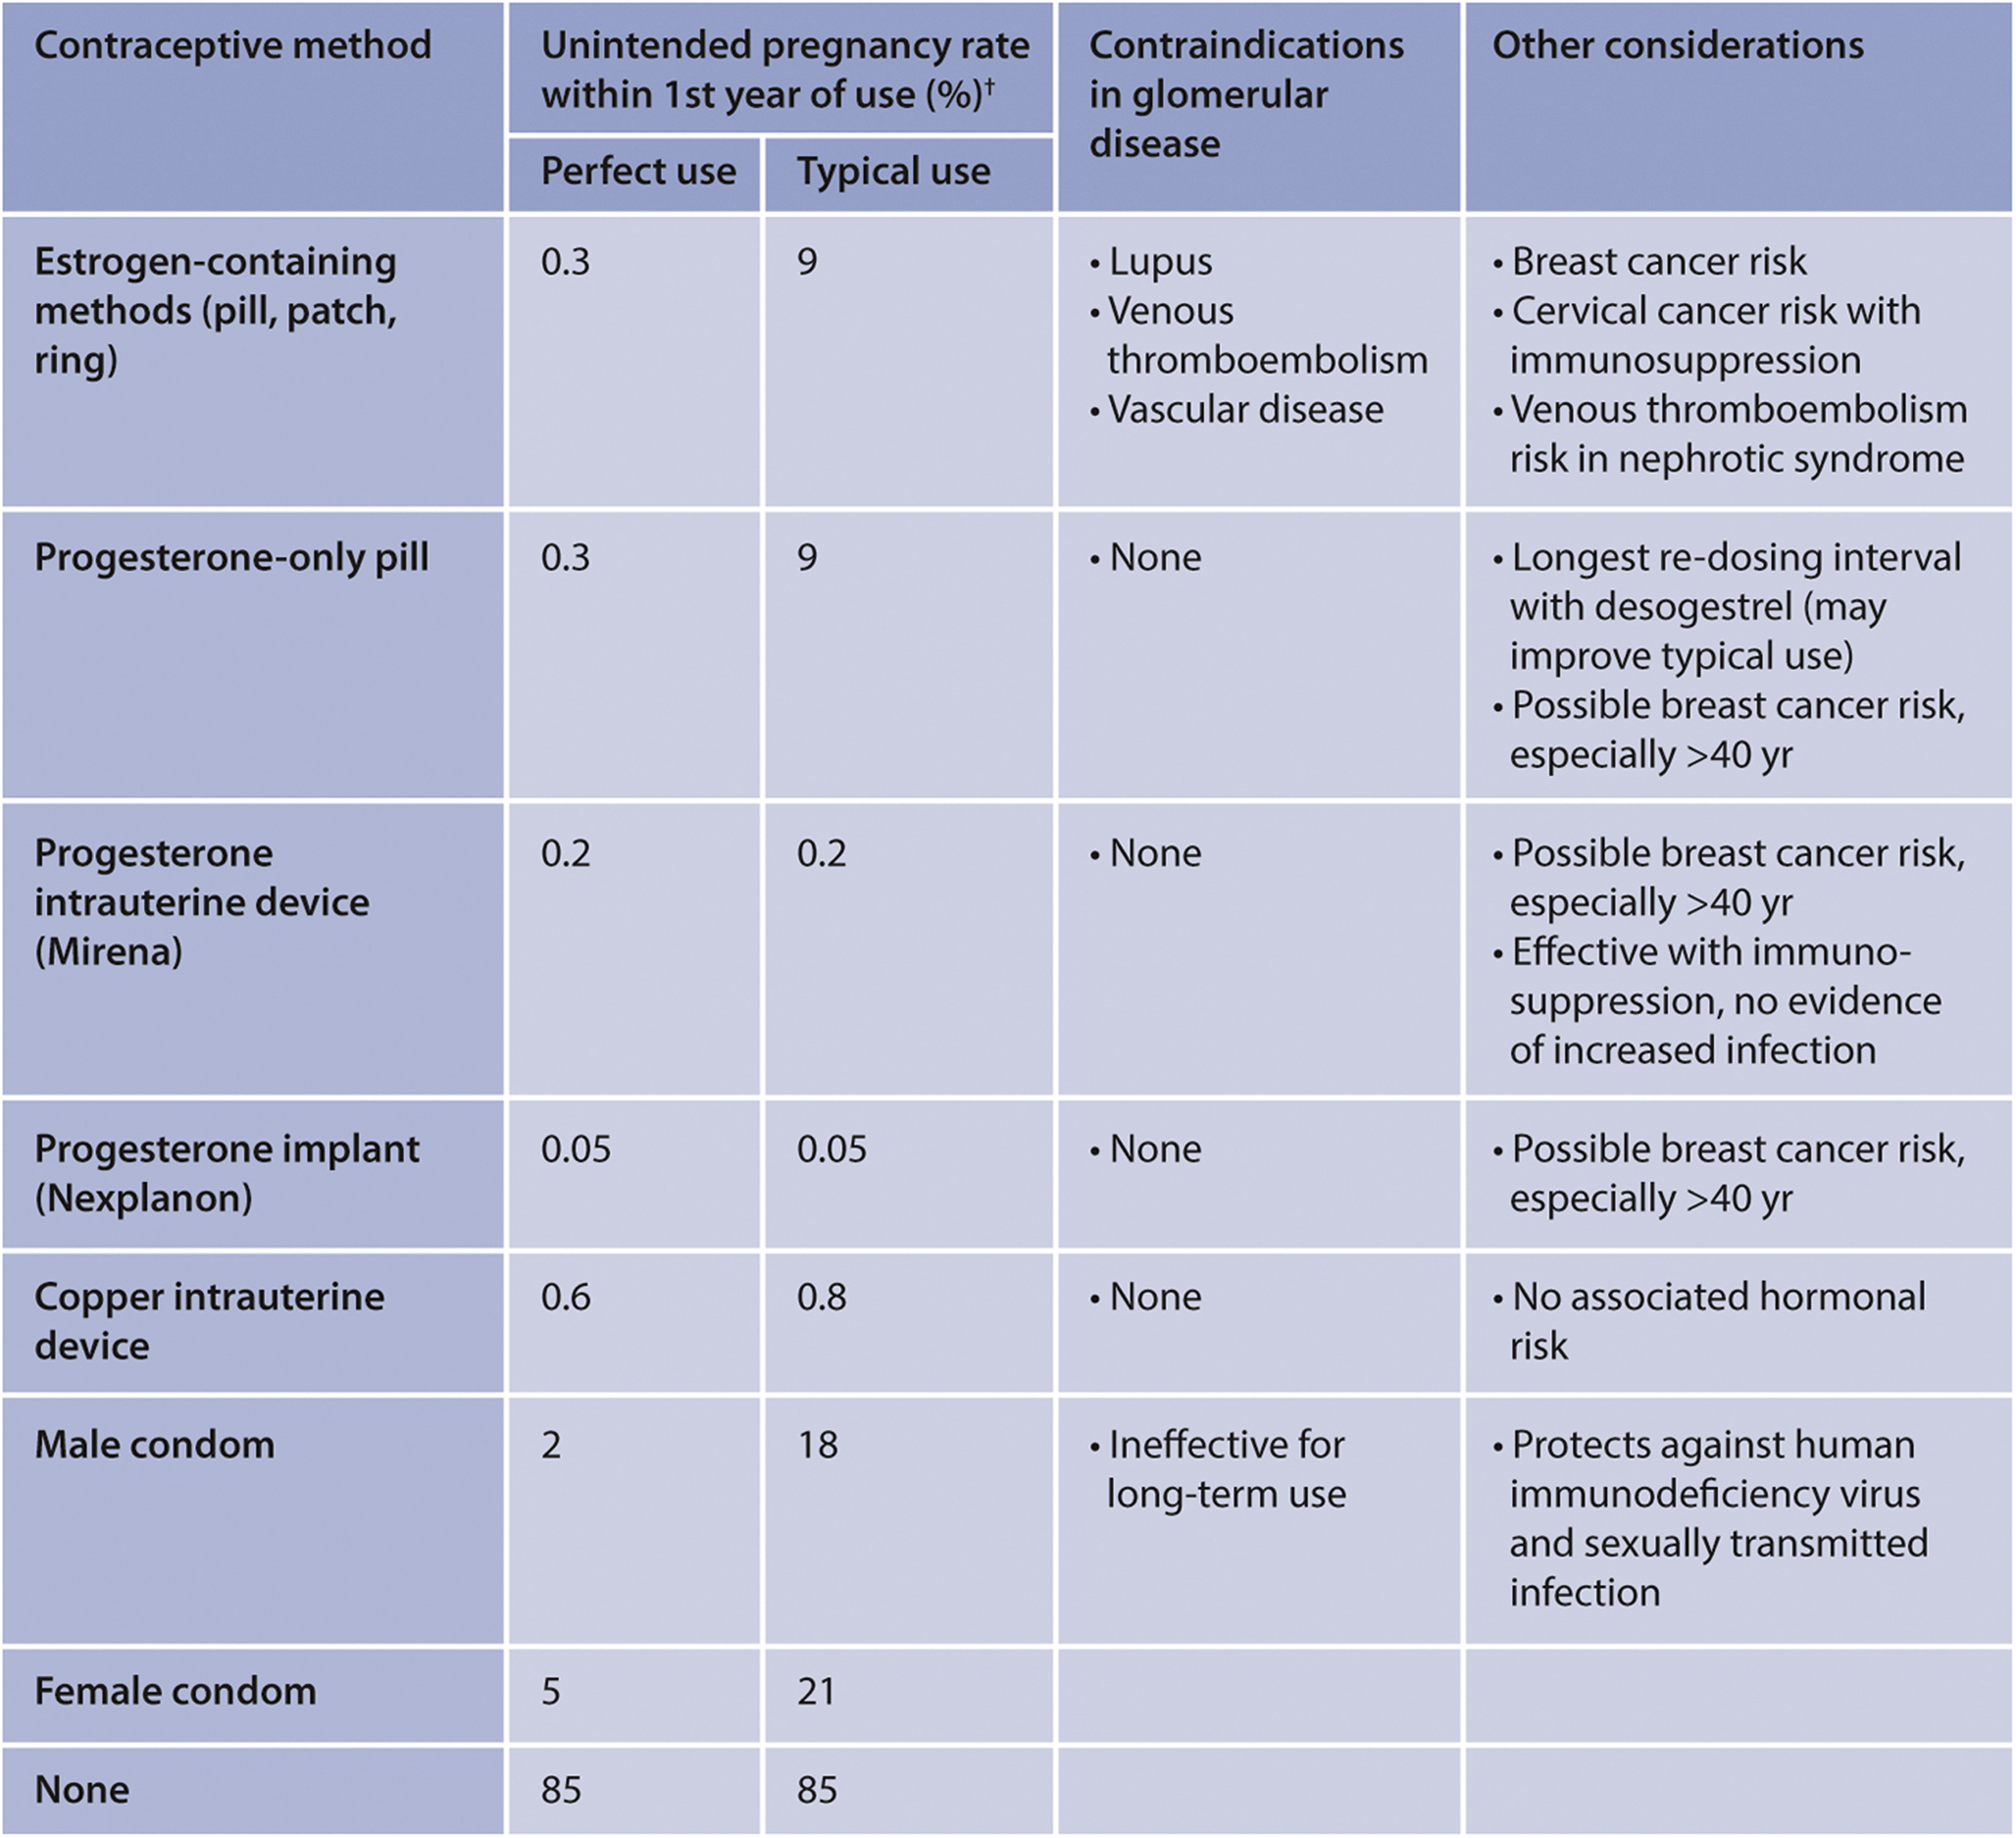
Pregnancy and Reproductive Health in Women with GD
Notes:
Contraception in women with glomerular disease

Slide 56
Pregnancy and Reproductive Health in Women with GD
Notes:
An overview of the impact of glomerular disease in women

Slide 57
Pregnancy and Reproductive Health in Women with GD
Notes:
An overview of the impact of glomerular disease in women

Slide 58
Treatment Costs and Related Issues
Practice Point 1.16.1: Patients with glomerular disease should be offered participation in a disease registry and clinical trials, whenever available.
Notes:
Please read slide

Slide 59
Goals of Glomerular Disease Treatment Post-Transplantation GN
[No recommendations or practice points for this section]
[Please refer to individual chapters for further information]
Notes:
The overall goals of treatment of glomerular disease are: 1. To secure a lasting remission of the clinical manifestations of glomerular disease. 2. To secure the above benefits in ways that avoid or minimize the development of treatment-related adverse events, particularly those that are potentially life-threatening or those that can adversely affect the patient’s quality of life. 3. To administer therapy in ways that maximize patient comfort and quality of life.
Virtually all of the histologic variants discussed in this guideline (with the possible exception of MCD) may recur after transplantation.
Attempts should be made to assess the risk of recurrent disease prior to transplantation, as this might influence the choice of donor and post-transplant management.
Where there are specific recommendations in particular variants of glomerular disease that relate to management before transplantation, they are discussed in each relevant Chapter.

Slide 60
Chapter 2. Immunoglobulin A Nephropathy (IgAN)/Immunoglobulin A Vasculitis (IgAV)

Slide 61
IgAN - Diagnosis
Practice Point 2.1.1: Considerations for the diagnosis of immunoglobulin A nephropathy (IgAN):
IgAN can only be diagnosed with a kidney biopsy.
Determine the MEST-C score (mesangial [M] and endocapillary [E] hypercellularity, segmental sclerosis [S], interstitial fibrosis/tubular atrophy [T], and crescents [C]) according to the revised Oxford Classification.
There are no validated diagnostic serum or urine biomarkers for IgAN.
Assess all patients with IgAN for secondary causes
Notes:
Following the biopsy-confirmed diagnosis of IgAN, including histologic scoring via the MEST-C (mesangial [M] and endocapillary [E] hypercellularity, segmental glomerulosclerosis [S], interstitial fibrosis/tubular atrophy [T], and crescents [C]) system, it is essential to assess disease prognosis.

Slide 62
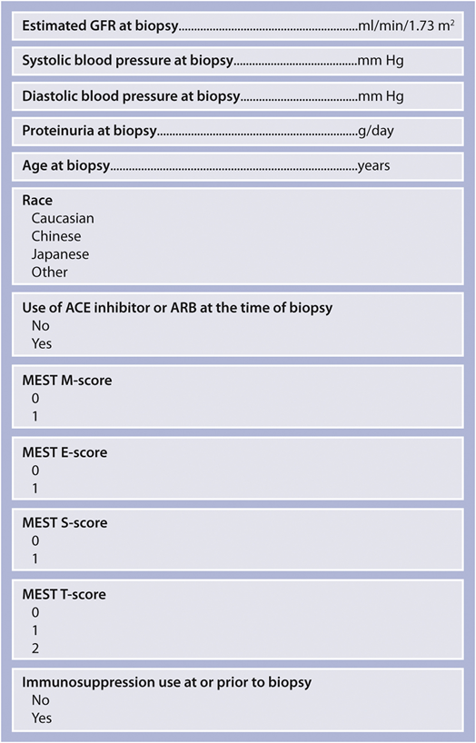
IgAN - Prognosis
Practice Point 2.2.1: Considerations for the prognostication of primary IgAN:
Clinical and histologic data at the time of biopsy can be used to risk stratify patients.
The International IgAN Prediction Tool is a valuable resource to quantify risk of progression and inform shared decision-making with patients.
Calculate by QxMD
The International IgAN Prediction Tool incorporates clinical information at the time of biopsy and cannot be used to determine the likely impact of any particular treatment regimen.
There are no validated prognostic serum or urine biomarkers for IgAN other than eGFR and proteinuria.
Notes:
A valuable resource is the International IgAN Prediction Tool available at Calculate by QxMD.
It is important to realize however that neither this calculator nor the MEST-C score nor the presence or number of crescents can presently be used to determine the likely impact of any particular treatment regimen.

Slide 63
IgAN - Treatment
Practice Point 2.3.1: Considerations for treatment of all patients with IgAN who do not have a variant form of primary IgAN:
The primary focus of management should be optimized supportive care.
Assess cardiovascular risk and commence appropriate interventions as necessary.
Give lifestyle advice, including information on dietary sodium restriction, smoking cessation, weight control, and exercise, as appropriate.
Other than dietary sodium restriction, no specific dietary intervention has been shown to alter outcomes in IgAN.
Variant forms of IgAN: IgA deposition with minimal change disease (MCD), IgAN with acute kidney injury (AKI), and IgAN with rapidly progressive glomerulonephritis (RPGN) may require specific immediate treatment.
Notes:
As in the 2012 guideline version, the primary focus of IgAN management should be multifaceted, optimized supportive care, including RAS blockade as much as tolerated or allowed, blood pressure control, cardiovascular risk minimization, adherence to lifestyle advice, including dietary counselling, smoking cessation, weight control, and exercise as appropriate.

Slide 64
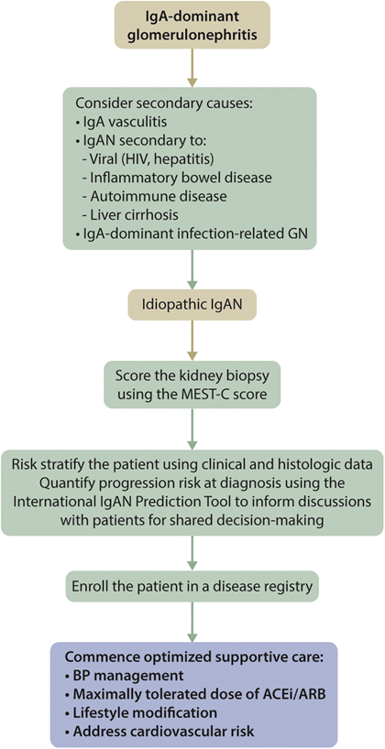
IgAN - Treatment
Practice Point 2.3.2: Algorithm for the initial assessment and management of the patient with IgAN
Notes:
Please read slide and present the algorithm.

Slide 65
IgAN - Treatment
Recommendation 2.3.1: We recommend that all patients have their blood pressure managed, as described in Chapter 1. If the patient has proteinuria >0.5 g/d, we recommend that initial therapy be with either an angiotensin-converting enzyme inhibitor (ACEi) or angiotensin II receptor blocker (ARB) (1B).
Recommendation 2.3.2: We recommend that all patients with proteinuria >0.5 g/d, irrespective of whether they have hypertension, be treated with either an ACEi or ARB (1B).
Notes:
RAS blockade should be instituted irrespective of hypertension if the patient has proteinuria >0.5 g/d (Grade 1B)
Rec 2.3.1: This recommendation is based on an extensive body of evidence showing that hypertension and proteinuria are major risk factors for progression of CKD and that treatment of hypertension and reduction of proteinuria reduce the risk of progression to kidney failure. Data specifically in IgAN, while not extensive, are consistent with these observations. There are no studies to show dual blockade with an ACEi and ARB is superior to single blockade in IgAN. A post hoc analysis of the STOP-IgAN trial demonstrated no additional benefit with dual blockade. In the judgment of the Work Group, a strong recommendation is warranted because of the consistency of the benefits for treatment of hypertension and proteinuria observed across the spectrum of kidney diseases, the generally low risk of harm for hypertension and antiproteinuric treatment, and the lack of rationale for a different recommendation for IgAN specifically
Rec 2.3.2: This recommendation is based on the extensive body of evidence across all types of proteinuric glomerular disease, including IgAN, that higher levels of proteinuria are associated with worse kidney outcomes and that a reduction in proteinuria, independent of changes in BP control, is associated with improved kidney outcome. There are no studies to show that dual blockade with an ACEi or ARB is superior to single blockade in IgAN. A post hoc analysis of the STOP-IgAN trial demonstrated no additional benefit with dual blockade. In the judgment of the Work Group, a strong recommendation is warranted because of the consistency of the benefit for treatment of proteinuria observed across the spectrum of kidney diseases, the generally low risk of harm of antiproteinuric treatment, and the lack of rationale for a different recommendation for IgAN specifically.

Slide 66
IgAN – Treatment of Patients with IgAN who are at High Risk of Progressive CKD despite Maximal Supportive Care
Practice Point 2.3.1.1: Considerations for treatment of patients with IgAN who are at high risk of progressive CKD despite maximal supportive care.
High risk of progression in IgAN is currently defined as proteinuria >0.75–1 g/d despite ≥90 days of optimized supportive care.
Immunosuppressive drugs should be considered only in patients with IgAN who remain at high risk of progressive CKD despite maximal supportive care (The patients enrolled in the only large RCT suggesting benefit of immunosuppression had an average of 2.4 g/d of proteinuria).
In view of the current uncertainty over the safety and efficacy of existing immunosuppressive treatment choices, all patients who remain at high risk of progressive CKD despite maximal supportive care should be offered the opportunity to take part in a clinical trial.
In all patients in whom immunosuppression is being considered, a detailed discussion of the risks and benefits of each drug should be undertaken with the patient recognizing that adverse treatment effects are more likely in patients with an eGFR <50 ml/min per 1.73 m².
There is insufficient evidence to support the use of the Oxford Classification MEST-C score in determining whether immunosuppression should be commenced in IgAN.
There is insufficient evidence to base treatment decisions on the presence and number of crescents in the kidney biopsy.
The International IgAN Prediction Tool cannot be used to determine the likely impact of any particular treatment regimen.
Dynamic assessment of patient risk over time should be performed, as decisions regarding immunosuppression
may change.
Notes:
If proteinuria stays above 0.75–1 g/d despite at least 90 days of optimized supportive care, the patient has a high risk of progressive loss of kidney function and may be considered for a 6-month course of glucocorticoid therapy (Grade 2B), or preferably, the opportunity to take part in a therapeutic clinical trial.

Slide 67
IgAN – Treatment of Patients with IgAN who are at High Risk of Progressive CKD despite Maximal Supportive Care
Practice Point 2.3.1.2: Proteinuria reduction to under 1 g/d is a surrogate marker of improved kidney outcome in IgAN, and reduction to under 1 g/d is a reasonable treatment target.
Recommendation 2.3.1.1: We suggest that patients who remain at high risk of progressive CKD despite maximal supportive care be considered for a 6-month course of glucocorticoid therapy. The important risk of treatment-emergent toxicity must
be discussed with patients, particularly those who have an eGFR <50 ml/min per 1.73 m² (2B).
Notes:
Rec 2.3.1.1: In the absence of a rapidly progressive loss of kidney function, supportive therapy is the mainstay of treatment for adults with IgAN. Following 6 months of optimization of supportive therapy, a substantial proportion of patients with >1 g/d of proteinuria considered for enrollment into clinical trials no longer qualify for randomization due to reduction in proteinuria. Shorter periods of 3 months may be considered in patients already receiving RAS blockade prior to biopsy diagnosis.
The largest available RCT of glucocorticoids is the TESTING study; investigators halted enrollment prematurely due to safety concerns in the glucocorticoid-treated group. Patients in this study had an average level of proteinuria of 2.4 g/d despite intensive conservative therapy; this level is notably higher than that in the patients enrolled in the STOP-IgAN study, in which patients had 1.6–1.8 g of proteinuria per day. Early analysis suggested efficacy of glucocorticoids, and this underlies the recommendation to consider use of this medication in IgAN. However, there were serious adverse events, including 2 deaths related to infectious complications. In discussion with clinicians, patients may choose not to receive glucocorticoids due to risk.

Slide 68
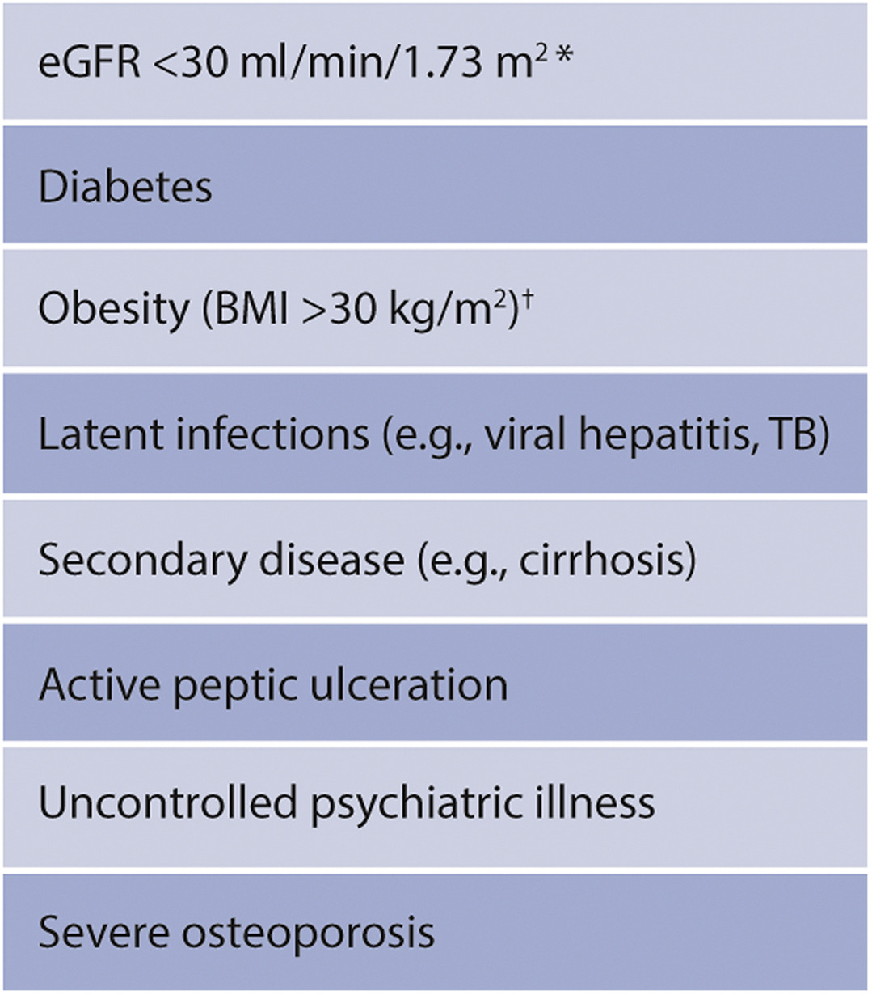
IgAN – Treatment of Patients with IgAN who are at High Risk of Progressive CKD despite Maximal Supportive Care
Practice Point 2.3.1.3: Use of glucocorticoids in IgAN:
Clinical benefit of glucocorticoids in IgAN is not established and should be given with extreme caution or avoided entirely in situations listed in the figure.
There is insufficient evidence to support the use of the Oxford Classification MEST-C score in determining when any glucocorticoid therapy should be commenced.
There are no data to support efficacy or reduced toxicity of alternate-day glucocorticoid regimens, or dose-reduced protocols.
Where appropriate, treatment with glucocorticoid (prednisone equivalent ≥0.5 mg/kg/d) should incorporate prophylaxis against Pneumocystis pneumonia along with gastroprotection and bone protection, according to local guidelines.
Notes:
Because the clinical benefit of glucocorticoids in IgAN is not established, they should be given with extreme caution or avoided entirely in patients with: an eGFR <30 ml/min/1.73 m², diabetes, obesity, latent infections (e.g., viral hepatitis, tuberculosis), secondary disease (e.g., liver cirrhosis), active peptic ulceration, uncontrolled psychiatric disease, or severe osteoporosis.

Slide 69
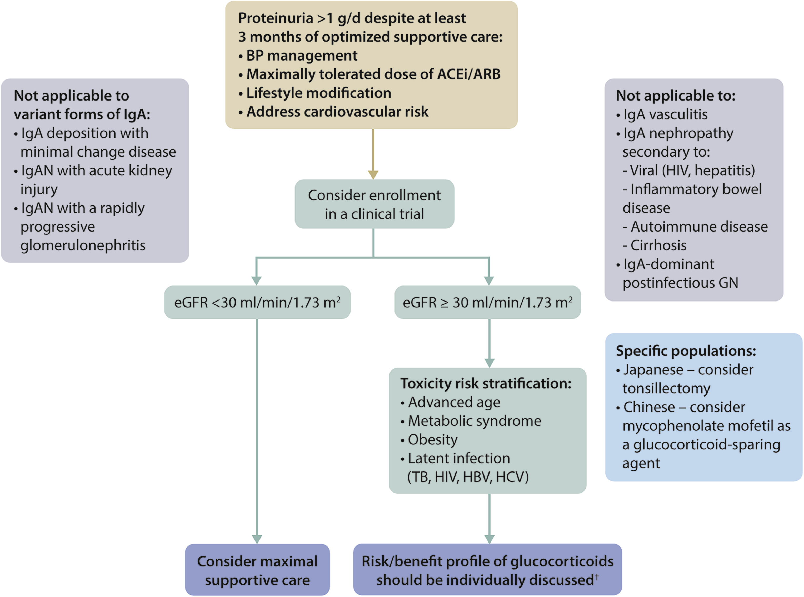
IgAN – Treatment of Patients with IgAN who are at High Risk of Progressive CKD despite Maximal Supportive Care
Practice Point 2.3.1.4: Management of patients with IgAN who remain at high risk for progression after maximal supportive care
Notes:
Management of the patient with IgAN who remains at high risk for progression after maximal supportive care is illustrated in this slide
Proteinuria reduction to under 1 g/d is a surrogate marker of improved kidney outcome in IgAN, and hence a reasonable treatment target.

Slide 70
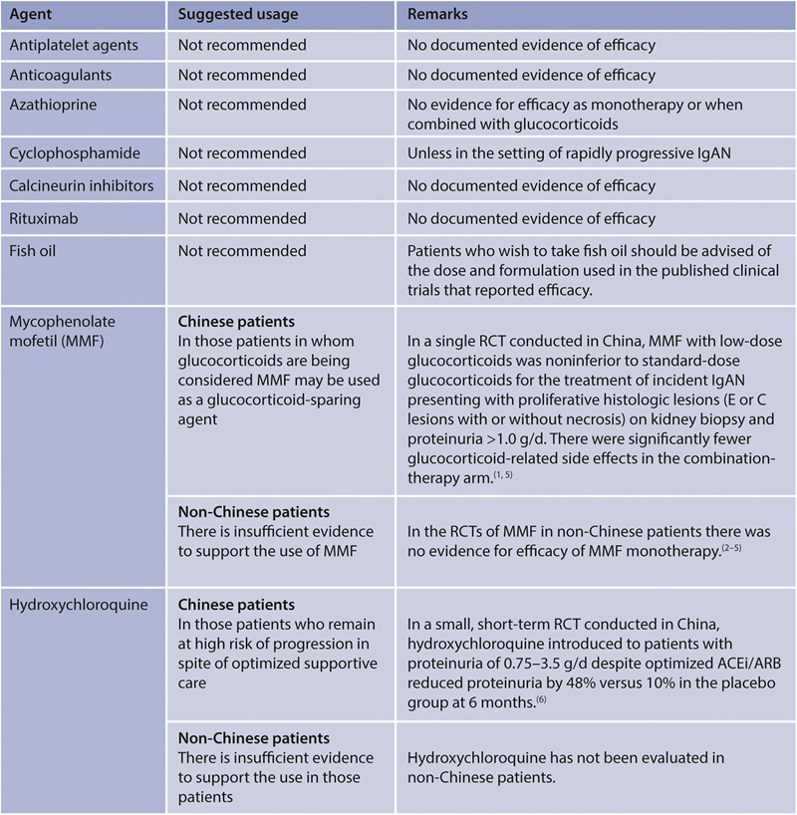
IgAN – Treatment of Patients with IgAN who are at High Risk of Progressive CKD despite Maximal Supportive Care
Practice Point 2.3.1.5: Other pharmacologic therapies evaluated in IgAN
Notes:
Beyond glucocorticoids, other immunosuppressive therapies are not recommended in IgAN, including azathioprine, cyclophosphamide (except in the setting of rapidly progressive IgAN), calcineurin inhibitors (CNIs), and rituximab.
The use of mycophenolate mofetil (MMF) in IgAN is not recommended in non-Chinese patients, whereas it may be used as a glucocorticoid-sparing agent in Chinese patients.
If immunosuppression is being considered, a detailed discussion of the risks and benefits of each drug should be undertaken with the patient, recognizing that adverse treatment effects are more likely in patients with an eGFR.
A number of new therapies for high-risk IgAN patients are currently being evaluated (not in this slide), including drugs that may augment the supportive care approach (sodium-glucose cotransporter-2 [SGLT2] inhibitors, sparsentan, atrasentan, hydroxychloroquine) or more specific approaches (e.g., enteric-coated budesonide, various complement inhibitors, therapies targeting B-cell development).

Slide 71
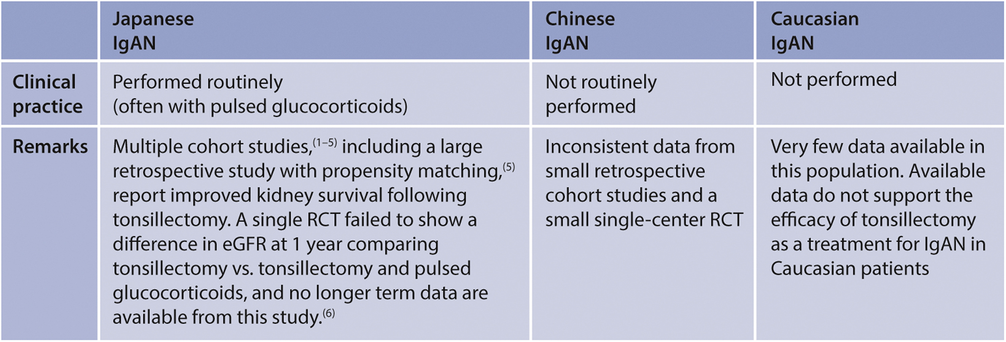
IgAN – Treatment of Patients with IgAN who are at High Risk of Progressive CKD despite Maximal Supportive Care
Practice Point 2.3.1.6: Tonsillectomy in IgAN:
Tonsillectomy should not be performed as a treatment for IgAN in Caucasian patients.
Tonsillectomy is suggested in some national guidelines for the treatment of recurrent tonsillitis in patients with IgAN.
Multiple studies from Japan have reported improved kidney survival and partial or complete remission of hematuria and proteinuria following tonsillectomy alone or with pulsed glucocorticoids
Notes:
In non-Japanese patients there are no data to support the routine use of tonsillectomy in high risk IgAN patients.

Slide 72
IgAN – Special Situations
Practice Point 2.4.1: IgAN with nephrotic syndrome:
Rarely, patients with IgAN present with the nephrotic syndrome (including edema and both hypoalbuminemia and nephrotic-range proteinuria >3.5 g/d).
In these cases, mesangial IgA deposition can be associated with light and electron microscopy features otherwise consistent with a podocytopathy resembling MCD.
It is unclear whether this is a specific podocytopathic variant of IgAN or the existence of MCD in a patient with IgAN.
Patients with a kidney biopsy demonstrating mesangial IgA deposition and light and electron microscopy features otherwise consistent with MCD should be treated in accordance with the guidelines for MCD (Chapter 5).
Patients with nephrotic syndrome whose kidney biopsy has coexistent features of a mesangioproliferative glomerulonephritis (MPGN) should be managed in the same way as those patients at high risk of progressive CKD despite maximal supportive care.
Nephrotic-range proteinuria without nephrotic syndrome may also be seen in IgAN, and this commonly reflects coexistent secondary focal segmental glomerulosclerosis (FSGS) (e.g., obesity, uncontrolled hypertension) or development of extensive glomerulosclerosis and tubulointerstitial fibrosis.
Notes:
Special situations in IgAN include the presence of NS.
Patients with a kidney biopsy demonstrating mesangial IgA deposition and histologic features consistent otherwise with minimal change disease (MCD) should be treated in accordance with the guidelines for MCD.
Patients with NS whose kidney biopsy has coexistent features of a mesangioproliferative GN should be managed in the same way as high-risk IgAN patients.
Finally, nephrotic range proteinuria without NS may be seen in IgAN, and this commonly reflects coexistent secondary focal segmental glomerulosclerosis (FSGS) (e.g., obesity, uncontrolled hypertension) or development of extensive glomerulosclerosis and tubulointerstitial fibrosis.

Slide 73
IgAN – Special Situations
Practice Point 2.4.2: IgAN with AKI:
AKI can occur in patients with IgAN in the context of severe visible hematuria, commonly in association with an upper respiratory tract infection. A repeat kidney biopsy should be considered in patients who fail to show improvement in kidney function within 2 weeks following cessation of the hematuria. Immediate management of AKI with visible hematuria should focus on supportive care for AKI.
IgAN may also present with AKI either de novo or during its natural history due to an RPGN with extensive crescent formation, commonly in the absence of visible hematuria. In the absence of visible hematuria and when other causes of an RPGN (e.g., antineutrophil cytoplasmic antibody [ANCA]-associated vasculitis [AAV], anti-glomerular basement membrane [GBM] disease) and reversible causes (e.g., drug toxicity, common pre- and post-kidney causes) have been excluded, a kidney biopsy should be performed as soon as possible.
Notes:
IgAN can also lead to acute kidney injury (AKI) from severe visible hematuria, in which case management should focus on supportive care for AKI.
A repeat kidney biopsy should be considered in patients who fail to show improvement in kidney function within 2 weeks following cessation of the hematuria.

Slide 74
IgAN – Special Situations
Practice Point 2.4.3: IgAN with RPGN:
Rapidly progressive IgAN is defined as a ≥50% decline in eGFR over ≤3 months, where other causes of an RPGN (e.g., AAV, anti-GBM disease) and reversible causes (e.g., drug toxicity, common pre- and post-kidney causes) have been excluded.
A kidney biopsy is essential in these cases and will commonly demonstrate mesangial and endocapillary hypercellularity, and a high proportion of glomeruli affected by crescents with areas of focal necrosis.
The presence of crescents in a kidney biopsy in the absence of a concomitant change in serum creatinine (SCr) does not constitute rapidly progressive IgAN; however, these patients require close follow-up to ensure prompt detection of any GFR decline. If this occurs, a second kidney biopsy may be considered.
Patients with rapidly progressive IgAN should be offered treatment with cyclophosphamide and glucocorticoids in accordance with the guidelines for AAV (Chapter 9).
Prophylactic measures that should accompany immunosuppression are discussed in Chapter 1.
There is insufficient evidence to support the use of rituximab for the treatment of rapidly progressive IgAN.
Notes:
Alternatively, AKI can result from a rapidly progressive glomerulonephritis (RPGN) IgAN course with extensive crescent formation (usually >50% of glomeruli), commonly in the absence of visible hematuria.
Importantly, the presence of crescents in a kidney biopsy in the absence of a concomitant change in GFR does not constitute rapidly progressive IgAN; however, these patients require close follow-up to ensure prompt detection of any GFR decline.
Patients with true rapidly progressive IgAN should be offered treatment with cyclophosphamide and glucocorticoids in accordance with the guidelines for antineutrophil cytoplasmic antibody (ANCA)–associated vasculitis.

Slide 75
IgAN – Special Situations
Practice Point 2.4.4: IgAN and pregnancy planning:
IgAN is a disease predominantly of young adults, and all women of childbearing potential should be offered preconception counseling when appropriate.
Preconception counseling should include a discussion on cessation of renin–angiotensin system (RAS) blockade. Blood pressure control should be optimized with alternative antihypertensive medications prior to conception.
In those women at high risk of progressive CKD (Recommendation 2.3.1.1) despite maximal supportive care, a trial of immunosuppression to optimize immunologic activity and reduce proteinuria prior to conception may be preferable to emergent initiation of immunosuppression during pregnancy
Notes:
There are insufficient data currently to recommend that post-pubertal children be managed as adults with IgAN.

Slide 76
IgAN – Special Situations
Practice Point 2.4.5: IgAN in children:
General considerations
For the purposes of this practice point, children are defined as those aged <18 years. It is acknowledged that post-pubertal children in some respects may have a similar course and response to treatment as adults with IgAN, but there are insufficient data currently to recommend that they be managed as adults with IgAN.
Visible hematuria is more frequent in children than in adults, and this may account for earlier diagnosis in children.
Children generally have higher eGFR, lower urine protein excretion, and more hematuria than adults at diagnosis.
Kidney biopsy in children
A kidney biopsy is usually performed at presentation of symptoms (hematuria, proteinuria, normal C3) in order to confirm the diagnosis (and rule out other diagnoses) and assess the degree of inflammation/presence of necrosis.
Inflammation, mesangial, and endocapillary hypercellularity tend to be more prevalent in kidney biopsies of IgAN in children than in those of adults.
Notes:
Please read this slide

Slide 77
IgAN – Special Situations
Practice Point 2.4.5: IgAN in children (continued):
Treatment
There is strong evidence suggesting a benefit of RAS blockade in children. All children with IgAN and proteinuria >200 mg/d or PCR >200 mg/g (>20 mg/mmol) should receive ACEi or ARB blockade, advice on a low-sodium diet, and optimal lifestyle and blood pressure control (systolic blood pressure [SBP] <90th percentile for age, sex, and height).
It is widely acknowledged that treatment of IgAN with immunosuppression differs between adults and children, and that in children, the use of immunosuppressants is more widespread, particularly the use of glucocorticoids. However, RCTs and specific expert consensus-driven indications are lacking.
Evidence derived mostly from retrospective studies suggests that treatment with glucocorticoids (plus second-line immunosuppression) leads to improved kidney survival.
In children with proteinuria >1 g/d or PCR >1 g/g (100 mg/mmol) and/or mesangial hypercellularity, most pediatric nephrologists will treat with glucocorticoids in addition to RAS blockade from time of diagnosis. Duration of treatment is not established, but usually 4 weeks of 1–2 mg/kg/d of oral prednisolone (or equivalent) followed by alternate-day tapering over 4–6 months is employed. Regimens including intravenous methylprednisolone are also used.
Evidence for the use of non-glucocorticoid immunosuppressants in addition to glucocorticoids is scarce, but this approach may be considered in more severe cases.
As for adults, IgAN with MCD may be found, and it should be treated as steroid-sensitive nephrotic syndrome (SSNS; Chapter 4).
As in adults, children with rapidly progressive IgAN have a poor outcome, and despite limited evidence, this subgroup should be offered treatment with glucocorticoids (usually as methylprednisolone pulses) and cyclophosphamide.
Notes:
There is strong evidence suggesting a benefit of RAS blockade in children.
In children the use of immunosuppressants is more widespread, particularly the early use of glucocorticoids, but trial-based evidence that may inform recommendations is absent

Slide 78
IgAN – Special Situations
Practice Point 2.4.5: IgAN in children (continued):
Follow-up
Aim for proteinuria ≤200 mg/d (≤400 mg/1.73 m²/d) or PCR ≤200 mg/g (≤0.2 g/g [≤20mg/mmol]).
Aim for SBP at <90th percentile for age, sex, and height.
Continue to follow patients even after complete remission, as they can relapse even after many years.
Notes:
Please read this slide

Slide 79
IgAV - Diagnosis
Practice Point 2.5.1: Considerations for the diagnosis of
immunoglobulin A vasculitis (IgAV):
Unlike children, there are no internationally agreed upon criteria for the diagnosis of IgAV in adults, although a clinical diagnosis of IgAV is often made based on the criteria described for children.
In adults with a vasculitic rash typical of IgAV, a kidney biopsy should be performed in the setting of features consistent with a persistent and/or significant nephritis, RPGN, proteinuria > 1g/d, and/or impaired kidney function.
Assess all adult patients with IgAV for secondary causes.
Assess all adult patients with IgAV for malignancy, with age- and sex-appropriate screening tests.
Notes:
Unlike children, there are no internationally agreed upon criteria for the diagnosis of IgAV in adults, although a clinical diagnosis of IgAV is often made in adults based on the criteria described for children.
Adult patients with IgAV should be assessed for secondary causes and for malignancy with age- and sex-appropriate screening tests.

Slide 80
IgAV - Prognosis
Practice Point 2.6.1: Considerations for the prognostication
of IgAV:
Retrospective data from a limited number of small registries have identified uncontrolled hypertension and the amount of proteinuria at presentation, and hypertension and mean proteinuria during follow-up, as predictors of a poor kidney outcome in adults with IgAV.
The Oxford Classification has not been validated for IgAV.
The International IgAN Prediction Tool is not designed for prognostication in IgAV.
Notes:
Neither the MEST-C classification nor the International IgAN Prediction Tool has been validated in IgAV.
Supportive care measures do not differ from those in patients with IgAN.

Slide 81
IgAV – Treatment – Prevention of Nephritis in IgAV
Recommendation 2.7.1.1: We recommend not using glucocorticoids to prevent nephritis in patients with isolated extrarenal IgAV (1B).
Practice Point 2.7.1.1: Considerations for the treatment of all patients with IgAV-associated nephritis (IgAVN) who do not have an RPGN:
Assess cardiovascular risk and commence appropriate interventions as necessary.
Give lifestyle advice, including information on smoking cessation, weight control, and exercise, as appropriate.
No specific dietary intervention has been shown to alter outcomes in IgAVN.
Treat to nationally agreed-upon blood pressure targets. KDIGO suggests treating to an SBP target of <120 mm Hg measured using standardized office blood pressure measurement.
Treat with maximally tolerated dose of ACEi or ARB if proteinuria >0.5 g/d.
Offer participation in a clinical trial if one is available.
Notes:
Glucocorticoids should not be used to prevent nephritis in patients with isolated extrarenal IgAV (Grade 1B).

Slide 82
IgAN – Treatment of Patients with IgAVN who are at High Risk of Progressive CKD despite Maximal Supportive Care
Practice Point 2.7.2.1: Considerations for the treatment of patients with IgAVN who are at high risk of progressive CKD despite maximal supportive care:
There is insufficient evidence to support the use of the Oxford Classification MEST-C score in determining whether immunosuppression should be commenced in patients with IgAVN.
The presence of crescents in the kidney biopsy is not in itself an automatic indication for commencement of immunosuppression.
In all patients in whom immunosuppression is being considered, a detailed discussion of the risks and benefits of each drug should be undertaken with the patient with a recognition that adverse treatment effects are more likely in patients with an eGFR <50 ml/min per 1.73 m².
In those patients who wish to try immunosuppressive therapy, treatment with glucocorticoids is as described above for IgAN.
Notes:
In those patients who wish to try immunosuppressive therapy, treatment with glucocorticoids is as previously described for IgAN.

Slide 83
IgAN – Special Situations
Practice Point 2.8.1: IgAV with RPGN:
The potential risks and benefits of immunosuppression should be evaluated at the individual patient level and discussed with the patient.
Patients agreeing to treatment should be treated in accordance with the guidelines for AAV (Chapter 9).
IgAV with RPGN as well as other IgAVN may be associated with significant extrarenal involvement (pulmonary, gastrointestinal, and skin), which may dictate alternative immunosuppressive strategies.
There are insufficient data to determine the efficacy of plasma exchange in IgAVN with RPGN. However, uncontrolled case series describe the potential role for the addition of plasma exchange to glucocorticoid therapy to accelerate recovery in patients with life- or organ-threatening extrarenal complications of IgAV. Clinicians are referred to the guidelines of the American Society for Apheresis regarding recommendations regarding plasma exchange for IgAV.
Notes:
IgAV nephritis (IgAVN) with RPGN may also be associated with significant extrarenal involvement (e.g., pulmonary, gastrointestinal, and skin), which may dictate alternative immunosuppressive strategies.
Uncontrolled case series describe the potential role for the addition of plasma exchange to glucocorticoid therapy to accelerate recovery in patients with life- or organ-threatening extrarenal complications of IgAV.

Slide 84
IgAN – Special Situations – IgAV-Associated Nephritis in Children
Practice Point 2.8.1.1: For the purposes of this practice point, children are defined as those aged <18 years. It is acknowledged that post-pubertal children in some respects may have a similar course and response to treatment as adults with IgAN, but there are insufficient data currently
to recommend that they be managed as adults with IgAN. Indications for management of IgAVN in children have recently been published as the result of a European consortium initiative. Briefly:
There are no data supporting the use of glucocorticoids to prevent nephritis in children with IgAV but mild or absent evidence of kidney involvement.
Children >10 years of age more often present with non-nephrotic-range proteinuria and impaired kidney function, and they may suffer more chronic histologic lesions with delay in biopsy and delay in treatment longer than 30 days.
The majority of children who will develop nephritis will do so within 3 months of presentation. Urinary monitoring is necessary for ≥6 months and optimally 12 months from initial presentation of systemic disease.
Children with IgAVN and persistent proteinuria for >3 months should be treated with an ACEi or ARB. A pediatric nephrologist should be consulted.
A kidney biopsy should be performed in children with nephrotic-range proteinuria, impaired GFR, or persistent moderate (>1 g/d) proteinuria.
Oral prednisone/prednisolone or pulsed intravenous methylprednisolone should be used in children with mild or moderate IgAVN.
Children with IgAVN with nephrotic syndrome and/or rapidly deteriorating kidney function are treated in the same way as those with rapidly progressive IgAN.
Notes:
The majority of IgAV children who will develop nephritis will do so within 3 months of presentation.
Oral prednisone/ prednisolone or pulsed intravenous methylprednisolone should be used in children with mild or moderate IgAVN.
Children with IgAVN and NS and/ or rapidly deteriorating kidney function are treated in the same way as rapidly progressive IgAN.

Slide 85
Chapter 3. Membranous Nephropathy

Slide 86
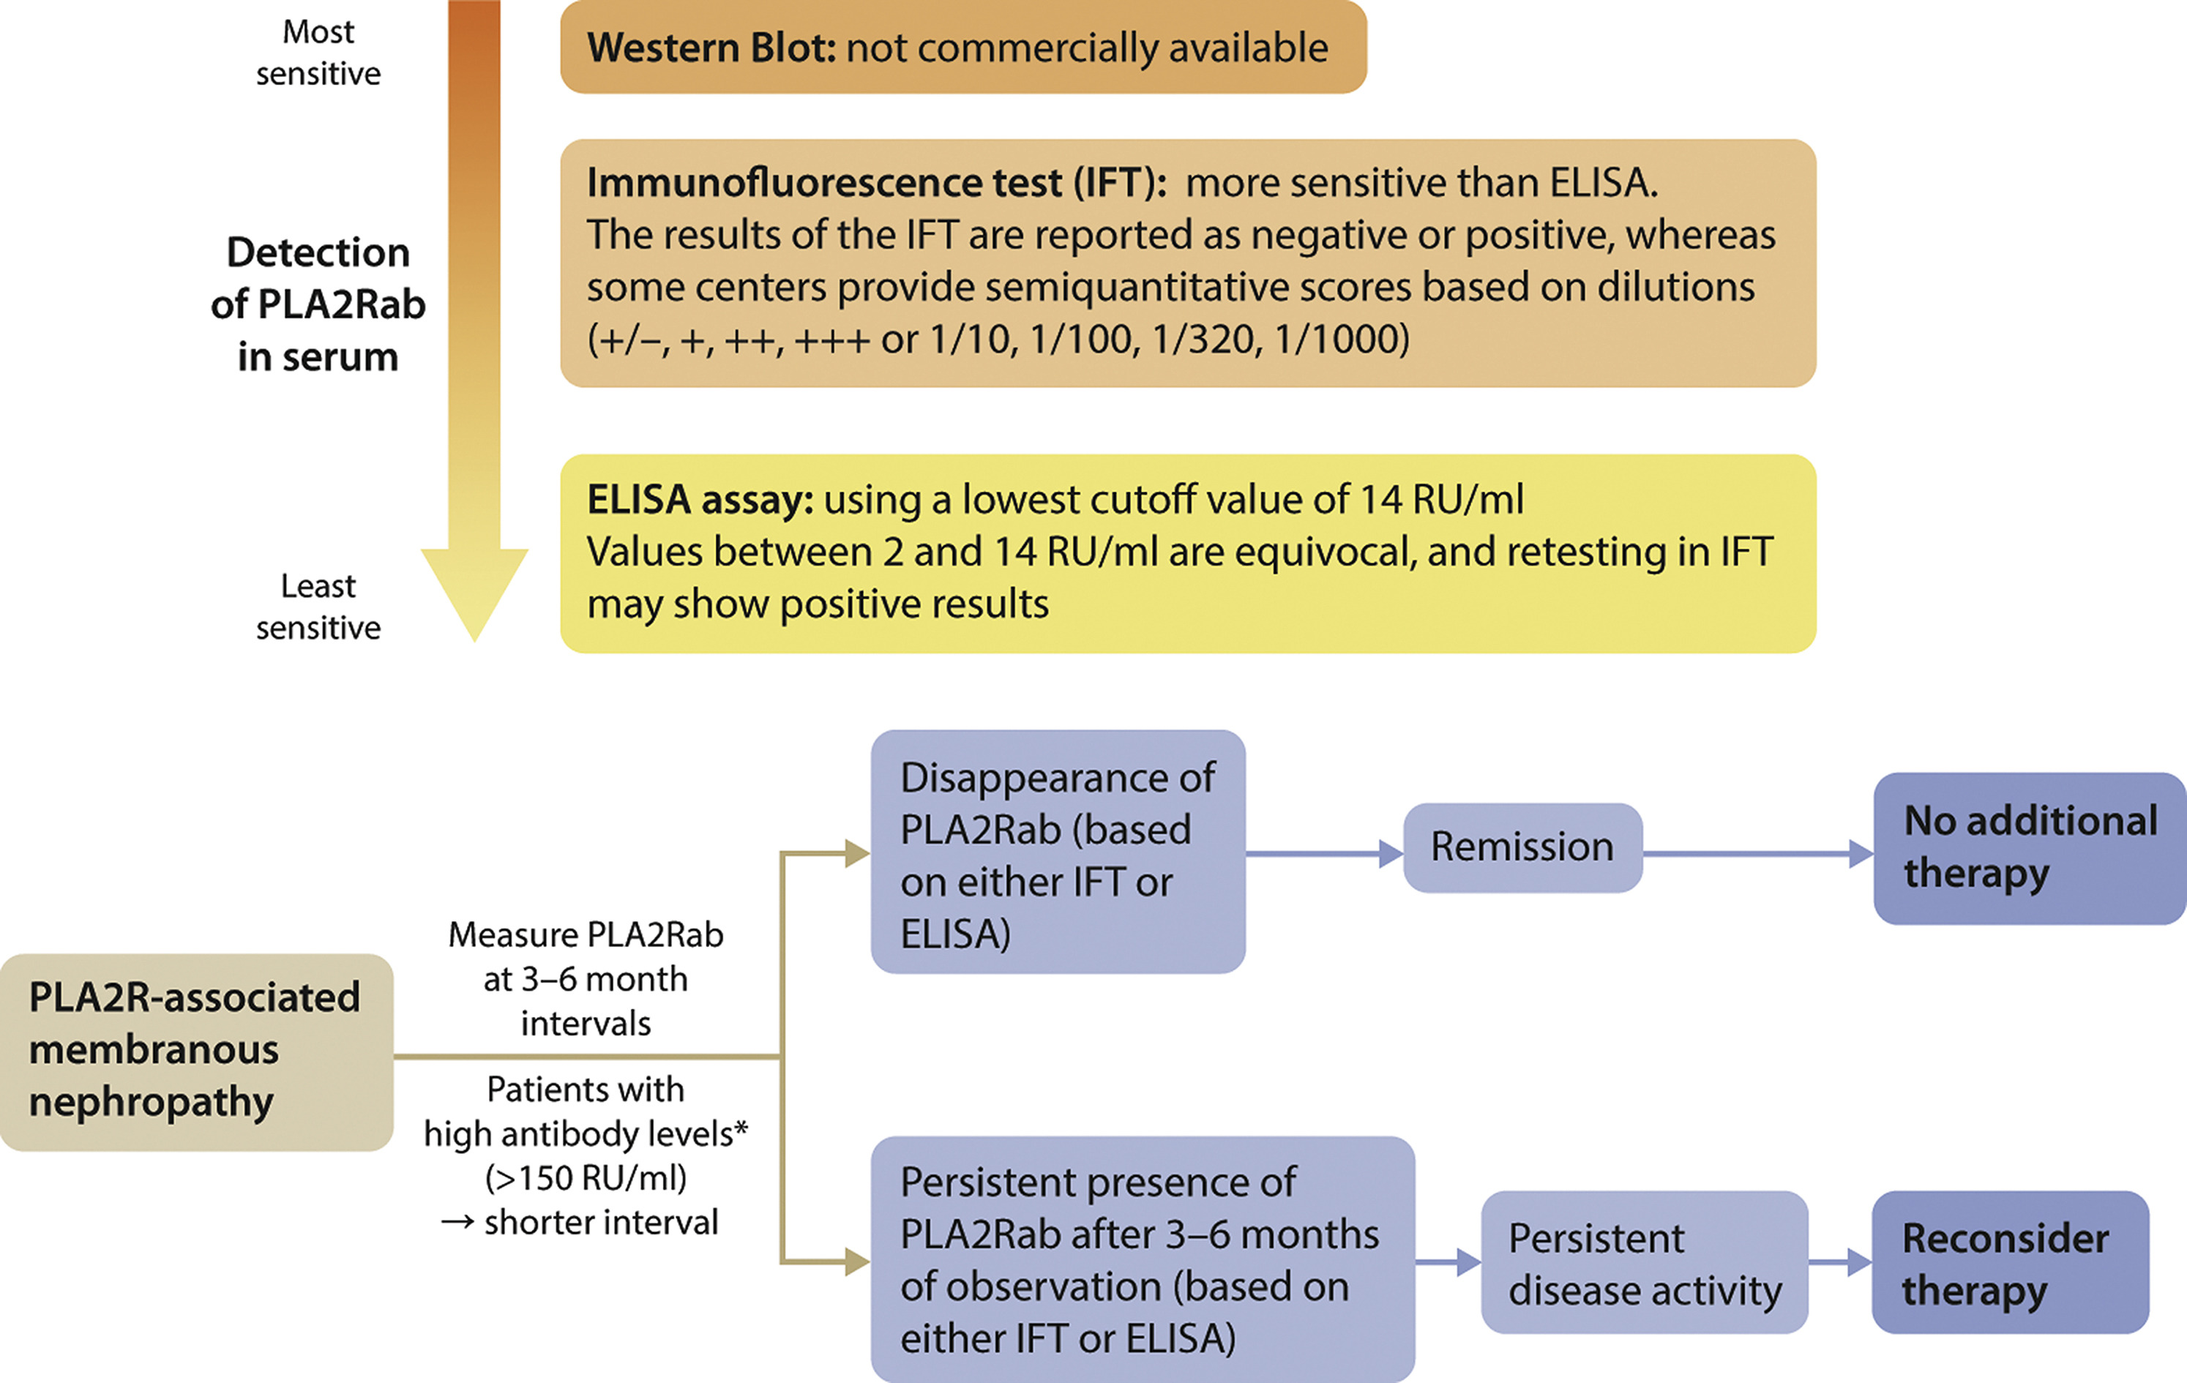
Membranous Nephropathy - Diagnosis
Practice Point 3.1.1: A kidney biopsy is not required to confirm the diagnosis of membranous nephropathy (MN) in patients with nephrotic syndrome and a positive antiPLA2R antibody test.
Notes:
In contrast to the KDIGO 2012 guidelines, a kidney biopsy is no longer required to confirm the diagnosis of MN in patients with NS and a positive anti-M-type phospholipase A2 receptor (PLA2R) antibody test.

Slide 87
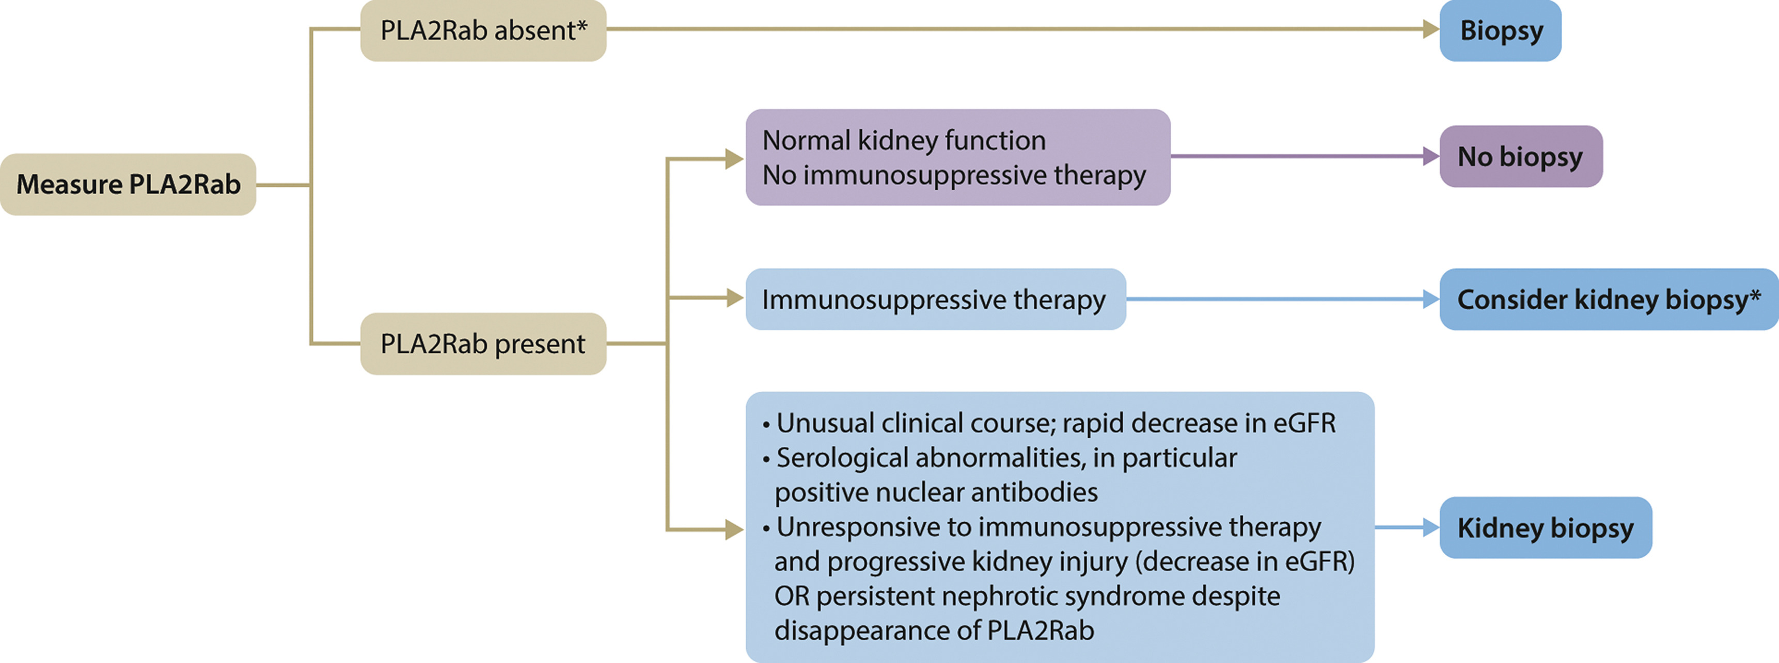
Membranous Nephropathy - Diagnosis
Notes:
Nevertheless, a kidney biopsy can provide important additional information even under these circumstances.

Slide 88
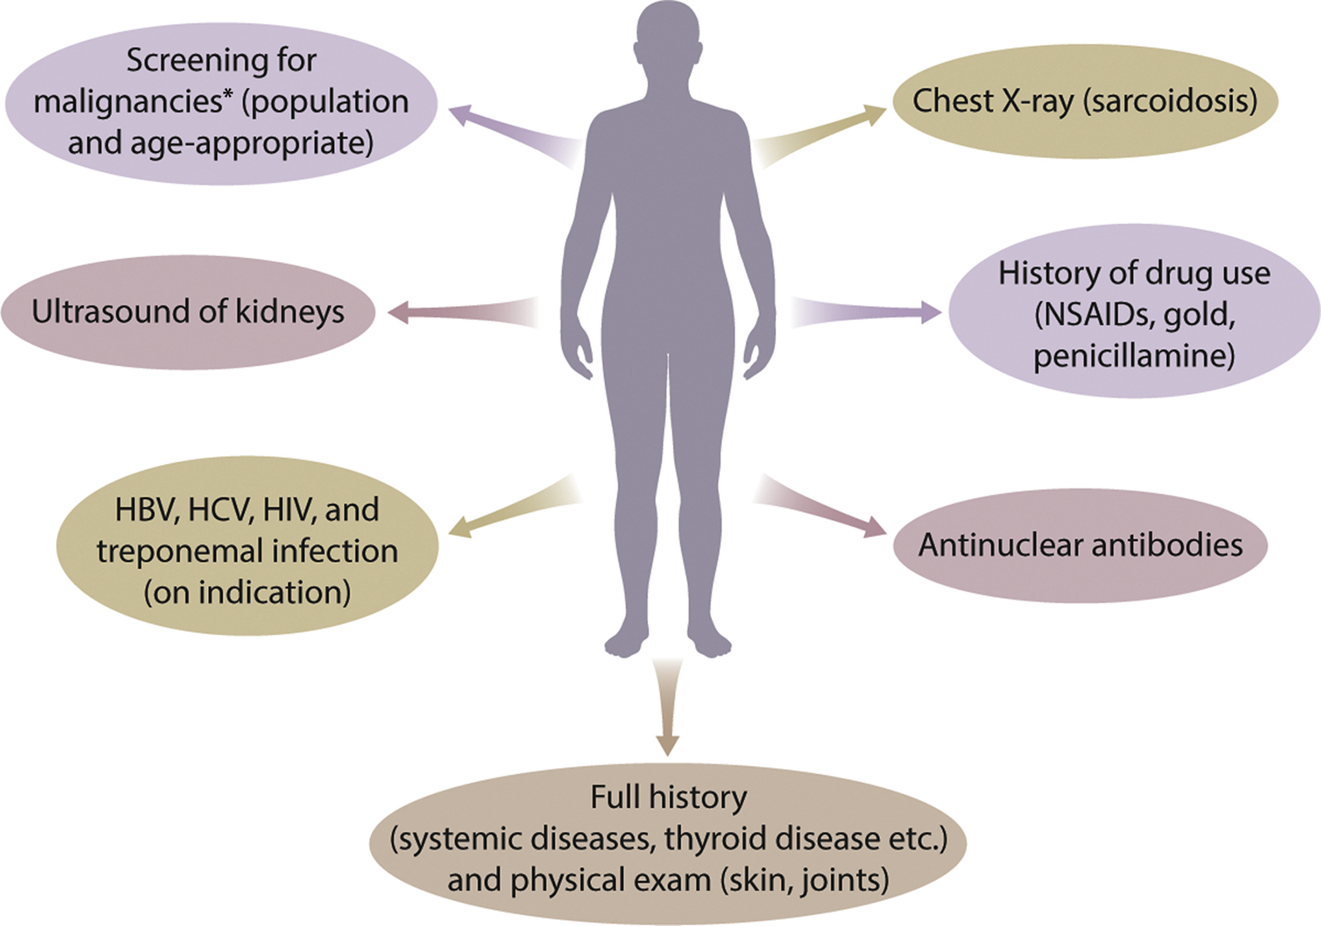
Membranous Nephropathy - Diagnosis
Practice Point 3.1.2: Patients with MN should be evaluated for associated conditions, regardless of whether antiPLA2R antibodies and/or anti-THSD7A antibodies are present or absent.
Notes:
Patients with MN should be evaluated for associated conditions (e.g., malignancy, infections, lupus, drugs), regardless of whether anti-PLA2R antibodies and/or anti–thrombospondin type-1 domain-containing 7A (THSD7A) or other antibodies are present or absent.

Slide 89
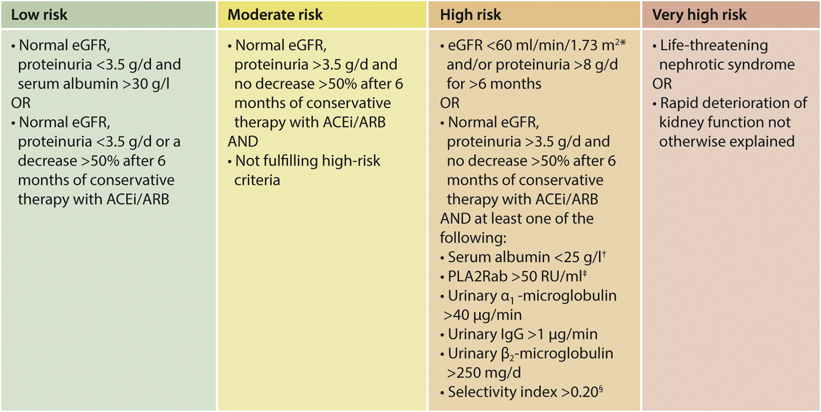
Membranous Nephropathy - Prognosis
Practice Point 3.2.1: In patients with MN, use clinical and laboratory criteria to assess the risk of progressive loss of kidney function.
Notes:
Clinical and laboratory criteria should then be used to assess the risk of progressive loss of kidney function

Slide 90
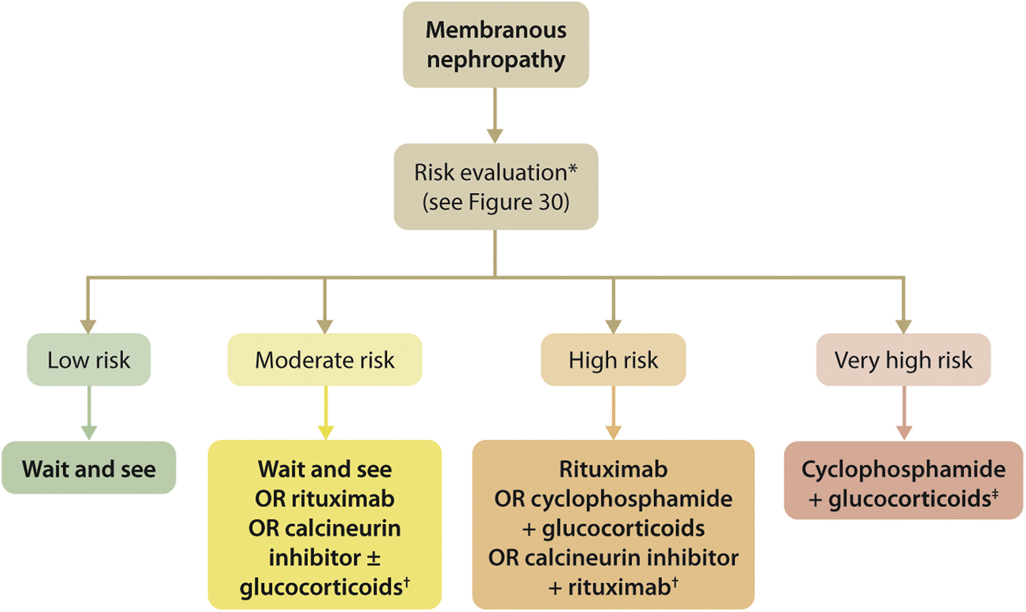
Membranous Nephropathy - Treatment
Practice Point 3.3.1: Considerations for treatment of patients with primary MN:
All patients with primary MN and proteinuria should receive optimal supportive care.
Immunosuppressive therapy should be restricted to patients considered at risk for progressive kidney injury.
Notes:
All patients with primary MN and proteinuria should receive optimal supportive care.
Immunosuppressive therapy is not required in patients with proteinuria <3.5 g/d, serum albumin >30 g/l by bromocresol purple (BCP) or immunometric assay, and eGFR >60 ml/min per 1.73 m².

Slide 91
Membranous Nephropathy - Treatment
Practice Point 3.3.2: Immunosuppressive therapy is not required in patients with MN, proteinuria <3.5 g/d, serum albumin >30 g/l by bromocresol purple (BCP) or immunometric assay, and eGFR >60 ml/min per 1.73 m².
Practice Point 3.3.3: Immunosuppressive therapy is not required in patients with MN, nephrotic syndrome, and normal eGFR, unless at least one risk factor for disease progression is present or serious complications of nephrotic syndrome (e.g., AKI, infections, thromboembolic events) have occurred.
Notes:
Immunosuppressive therapy is not required in patients with proteinuria <3.5 g/d, serum albumin >30 g/l by bromocresol purple (BCP) or immunometric assay, and eGFR >60 ml/min per 1.73 m².
Immunosuppressive therapy should be considered when at least one risk factor for disease progression is present or when serious complications of NS (e.g., AKI, infections, thromboembolic events) have occurred.

Slide 92
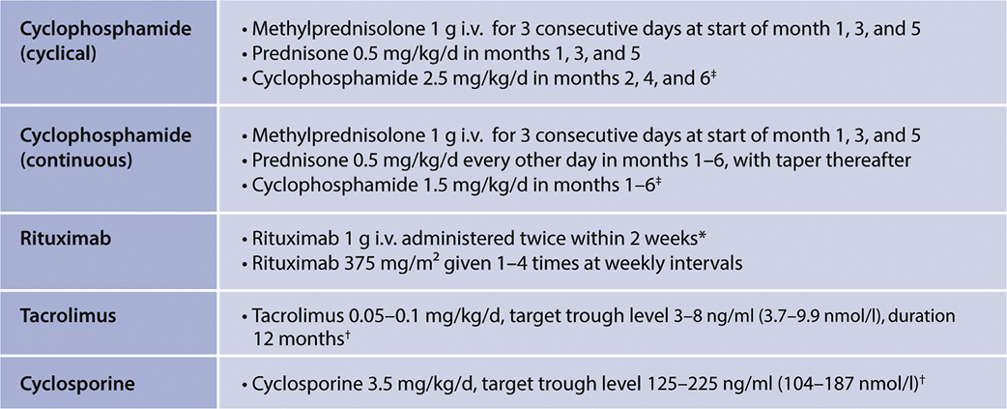
Membranous Nephropathy - Treatment
Recommendation 3.3.1: For patients with MN and at least one risk factor for disease progression, we recommend using rituximab or cyclophosphamide and alternate month glucocorticoids for 6 months, or CNI-based therapy for ≥6 months, with the choice of treatment depending on the risk estimate (1B).
Notes:
This recommendation places a relatively higher value on preventing progressive kidney failure in higher-risk patients and in reducing the complications and risk of NS, and a relatively lower value on the side effects and inconvenience associated with immunosuppressive treatment. The choice of therapy is dependent on patient characteristics, drug availability, drug efficacy, patient, physician, societal preference, reimbursement policies, and the specific side-effect profile of each drug. Details of commonly used treatment regimens are shown

Slide 93
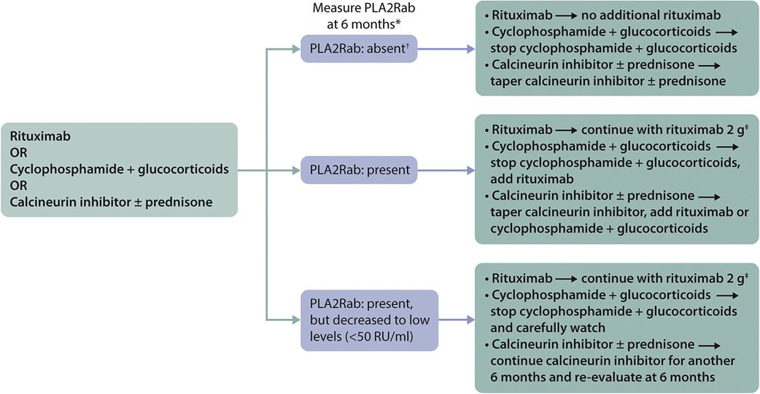
Membranous Nephropathy - Treatment
Practice Point 3.3.4: Longitudinal monitoring of antiPLA2R antibody levels at 6 months after start of therapy may be useful for evaluating treatment response in patients
with MN, and can be used to guide adjustments to therapy.
Notes:
Longitudinal monitoring of anti-PLA2R antibody levels after starting therapy may be useful for evaluating treatment response in patients with MN, and can be used to guide adjustments to therapy

Slide 94
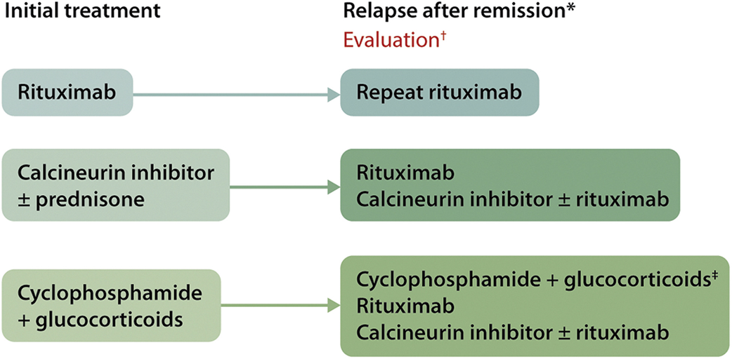
Membranous Nephropathy – Special Situations
Practice Point 3.4.1: Algorithm for the treatment of patients with MN and initial relapse after therapy
Notes:
In patients with MN and initial relapse of the NS after therapy, the initial therapy can be repeated or treatment may be switched to rituximab in those initially treated with CNIs or cyclophosphamide.

Slide 95
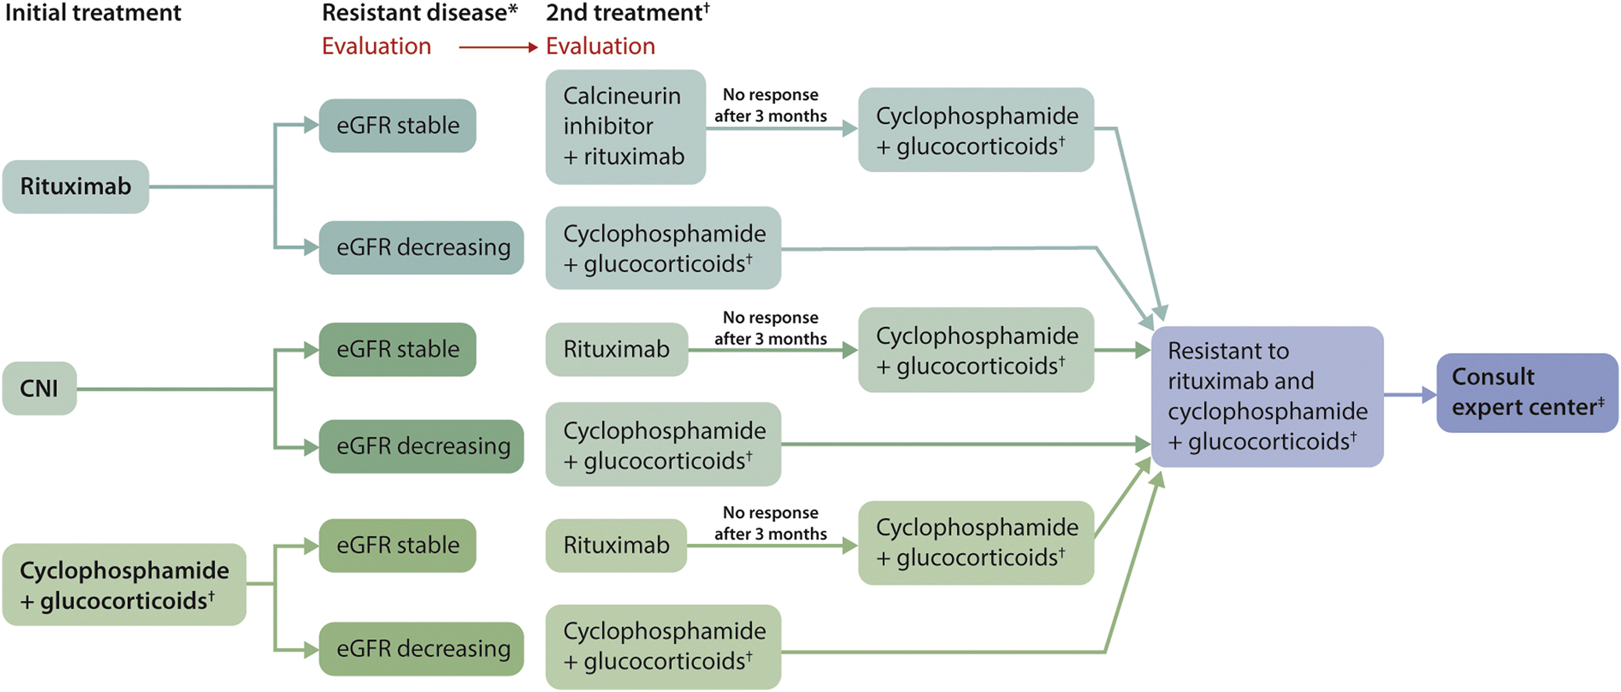
Membranous Nephropathy – Special Situations
Practice Point 3.4.2: Algorithm for management of patients with treatment-resistant MN
Notes:
Management suggestions for the patient with treatment-resistant MN are shown in this slide

Slide 96
Membranous Nephropathy – Special Situations
Practice Point 3.4.3: Evaluation of a kidney transplant recipient with MN
Notes:
Evaluation of a kidney transplant recipient with MN should include maximal efforts to ascertain if MN is associated with PLA2R antibodies, including staining the native kidney biopsy for PLA2R expression in immune deposits (enhanced PLA2R staining).
The risk of recurrence increases if PLA2R antibodies persist in the circulation despite kidney failure.
After transplantation, patients with known PLA2R antibody-associated MN should be monitored for the kinetics of antibody levels every 1–3 months with a liberal transplant biopsy in case of increasing antibodies.
Rituximab can be used in case of documented recurrent MN.

Slide 97
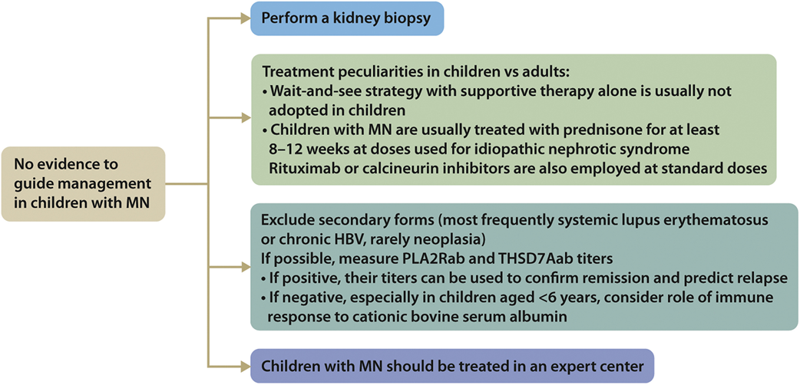
Membranous Nephropathy – Special Situations
Practice Point 3.4.4: Algorithm for management of children with MN
Notes:
MN in children is very rare and no evidence to guide management exists. Such children should be referred to an expert center.

Slide 98
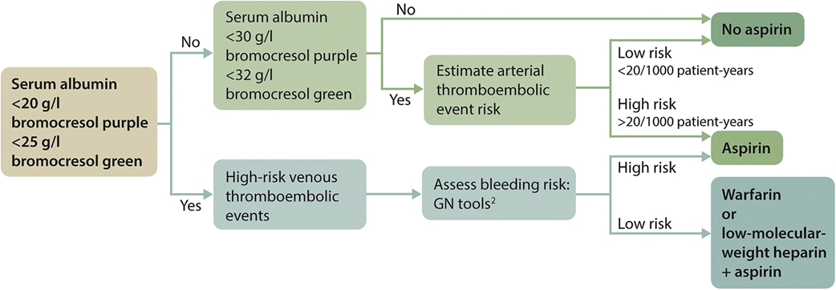
Membranous Nephropathy – Special Situations
Practice Point 3.4.5: Prophylactic anticoagulant therapy in patients with MN and nephrotic syndrome should be based on an estimate of the risk of thrombotic events and the risk of bleeding complications
Notes:
Prophylactic anticoagulant therapy in patients with MN and NS should be based on an estimate of the risk of thrombotic events and the risk of bleeding complications, as illustrated in this slide.

Slide 99
Chapter 4. Nephrotic Syndrome in Children

Slide 100
Nephrotic Syndrome in Children - Diagnosis
Practice Point 4.1.1: The definitions relating to nephrotic syndrome in children are based on the clinical characteristics outlined in the figure.
Notes:
Please read this slide

Slide 101
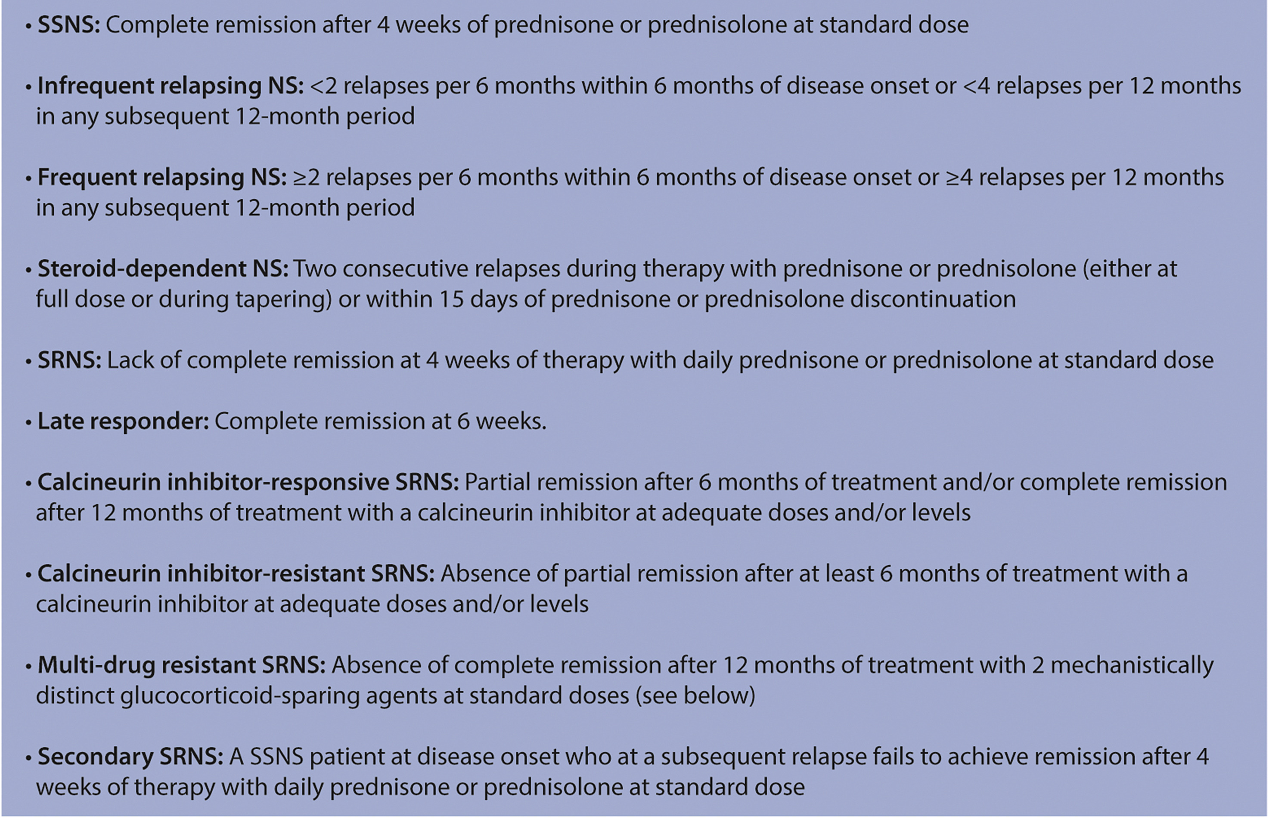
Nephrotic Syndrome in Children - Diagnosis
Practice Point 4.1.1: The definitions relating to nephrotic syndrome in children are based on the clinical characteristics outlined in the figure.
Notes:
Please read this slide

Slide 102
Nephrotic Syndrome in Children - Prognosis
Practice Point 4.2.1: The prognosis for childhood nephrotic syndrome is best predicted by the patient’s response to initial treatment and frequency of relapse during the first
year after treatment. Therefore, a kidney biopsy is not usually needed at initial presentation, and instead is reserved for children with resistance to therapy or an
atypical clinical course.
Notes:
In contrast to the management of NS in adults, a diagnostic kidney biopsy is generally not performed at presentation to establish a diagnosis in children.
Children who develop NS are generally assumed to have MCD that will respond to glucocorticoids (steroid-sensitive nephrotic syndrome [SSNS]).

Slide 103
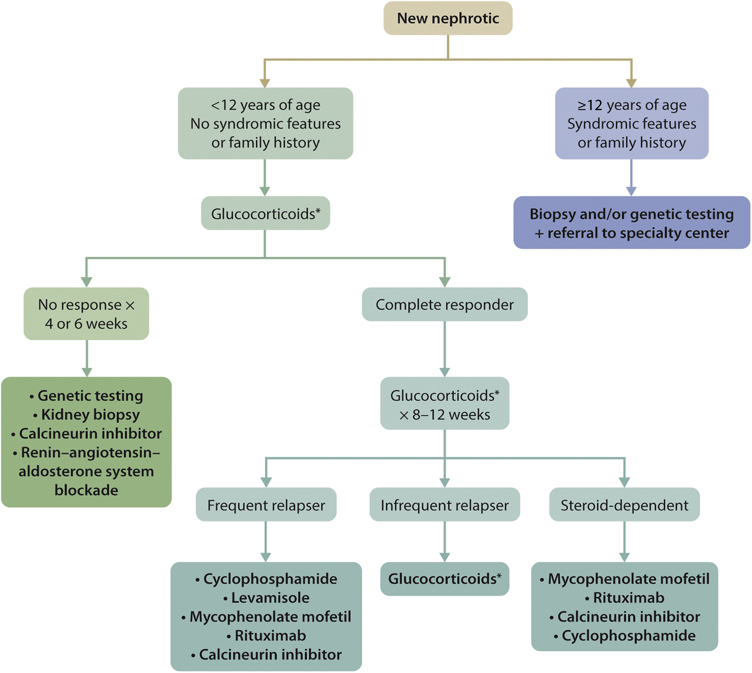
Nephrotic Syndrome in Children - Treatment
Notes:
Patients who are glucocorticoid-resistant (steroid resistant nephrotic syndrome [SRNS]) have poor long-term kidney survival, and should undergo a more extensive evaluation, including a kidney biopsy and genetic testing

Slide 104
Nephrotic Syndrome in Children – Initial Treatment
Recommendation 4.3.1.1: We recommend that oral glucocorticoids be given for 8 weeks (4 weeks of daily glucocorticoids followed by 4 weeks of alternate-day glucocorticoids) or 12 weeks (6 weeks of daily glucocorticoids followed by 6 weeks of
alternate-day glucocorticoids) (1B).
Practice Point 4.3.1.1: The standard dosing regimen for the initial treatment of nephrotic syndrome is daily oral prednisone/prednisolone 60 mg/m²/d or 2 mg/kg/d (maximum 60 mg/d) for 4 weeks followed by alternate day prednisone/prednisolone, 40 mg/m², or 1.5 mg/kg (maximum of 50 mg) for other 4 weeks, or prednisone/prednisolone 60 mg/m²/d (maximum 60 mg/d) for 6 weeks followed by alternate day prednisone/prednisolone, 40 mg/m², or 1.5 mg/kg (maximum of 50 mg), for other 6 weeks.
Notes:
Since the 2012 guideline, several trials demonstrated that a shorter initial course of glucocorticoids has comparable efficacy to a 6-month course, leading to the updated recommendation that children be treated with high-dose glucocorticoids for a total of 8–12 weeks instead of 24 weeks (Grade 1B).
This recommendation places a relatively higher value on the moderate-quality evidence of equivalent clinical outcomes and favorable safety profile associated with shorter-term (8–12 weeks) glucocorticoid treatment, and a relatively higher value on high-quality evidence suggesting prolonged (>12 weeks) glucocorticoid treatment increases the risk of adverse effects without further improving clinical outcomes in terms of relapse rate. The recommendation places a relatively lower value on low-quality evidence suggesting that prolonged glucocorticoid therapy may delay the time to first relapse as compared to 8–12 weeks of treatment.
In terms of oral glucocorticoids, prednisone and prednisolone are equivalent, used in the same dosage, and are both supported by high-quality data. All later usages of “oral glucocorticoids” refer to prednisone or prednisolone.
Recent reports suggest that it may be prudent to dose by body surface area to avoid underdosing, particularly in younger children. An RCT comparing single versus divided dose showed that the 2 are equivalent in terms of time to remission and number of subsequent relapses. Therefore, a single daily dose may be preferable to optimize adherence.
This will help to decrease treatment toxicity, especially given that SSNS often relapses and multiple glucocorticoid courses may be given to an individual.

Slide 105
Nephrotic Syndrome in Children – Prevention and Treatment of Relapses
Recommendation 4.3.2.1: For children with frequently relapsing and steroid-dependent nephrotic syndrome who are currently taking alternate-day glucocorticoids or are off glucocorticoids, we recommend that daily glucocorticoids 0.5 mg/kg/d be given during episodes of upper respiratory tract and other infections for 5–7 days to
reduce the risk of relapse (1C).
Practice Point 4.3.2.1: The initial approach to relapse should include oral prednisone/prednisolone as a single daily dose of 60 mg/m²/d or 2 mg/kg/d (maximum 60 mg/ d) until the child remits completely for ≥3 days.
Notes:
Building on the theme of lowering glucocorticoid burden, the Work Group also recommended that children who frequently relapse or who have become glucocorticoid dependent be treated for a week with 0.5 mg/kg/d of prednisone (or prednisolone) during upper respiratory infections to reduce relapse risk and the need for restarting high-dose glucocorticoids (Grade 1C).
This recommendation places a relatively higher value on the low-quality evidence that preemptive daily prednisolone reduces the risk of SSNS relapse during infection, and a relatively lower value on low-quality evidence of the potential adverse effects of immunosuppressive risk associated with treatment.

Slide 106
Nephrotic Syndrome in Children – Prevention and Treatment of Relapses
Recommendation 4.3.2.2: For children with frequently relapsing nephrotic syndrome who develop serious glucocorticoid-related adverse effects and for all children with steroid-dependent nephrotic syndrome, we recommend that glucocorticoid-sparing agents be prescribed, rather than no treatment or continuation with glucocorticoid treatment alone (1B).
Practice Point 4.3.2.5: Patients should ideally be in remission with glucocorticoids prior to the initiation of glucocorticoid-sparing agents such as oral cyclophosphamide, levamisole, mycophenolate mofetil (MMF), rituximab, or calcineurin inhibitors (CNIs). Coadministration of glucocorticoids is recommended for ‡2 weeks following
initiation of glucocorticoid-sparing treatment.
Notes:
For SSNS patients who frequently relapse and have glucocorticoid-related side effects, and all glucocorticoid-dependent patients, glucocorticoid-sparing agents should be given rather than no treatment or continued treatment with glucocorticoids alone (Grade 1B).
This recommendation places a relatively high value on observational data and extensive clinical experience that demonstrate substantial risk of side effects associated with long-term glucocorticoids and efficacy of glucocorticoid-sparing agents in preventing relapse, compared with no treatment.

Slide 107
Nephrotic Syndrome in Children – Prevention and Treatment of Relapses
Practice Point 4.3.2.6: Choosing the most appropriate glucocorticoid-sparing agent from among oral cyclophosphamide, levamisole, MMF, rituximab, and CNI is a decision that requires careful consideration of specific patient-related issues such as resources, adherence, adverse effects, and patient preferences. Oral cyclophosphamide and levamisole may be preferable glucocorticoid-sparing therapies in frequently relapsing nephrotic syndrome. MMF, rituximab, CNIs, and to a lesser extent, oral cyclophosphamide may be preferable to glucocorticoid-sparing therapies in children with steroid-dependent nephrotic syndrome.
Notes:
Please read this slide

Slide 108
Nephrotic Syndrome in Children – Prevention and Treatment of Relapses
Notes:
A variety of glucocorticoid-sparing agents have been used in SSNS is shown in this slide.
Recent encouraging results have indicated that a therapeutic agent that is unavailable in many countries, levamisole, may be an effective, safe, and inexpensive option, especially in frequently relapsing forms of NS, and the effectiveness of rituximab in both frequently relapsing and steroid-dependent forms suggests a pivotal role of B cells in this disease.

Slide 109
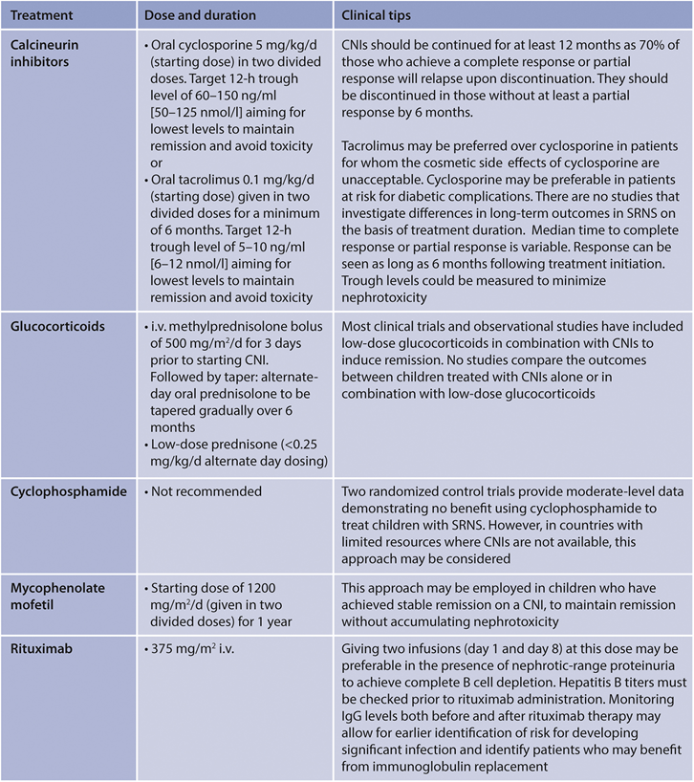
Steroid-Resistant Nephrotic Syndrome in Children - Treatment
Recommendation 4.4.1: We recommend using cyclosporine or tacrolimus as initial second-line therapy for children with steroid-resistant nephrotic syndrome (1C).
Notes:
For children with SRNS, CNIs are recommended as the initial therapy after glucocorticoid failure (Grade 1C).
This recommendation places a relatively higher value on data suggesting that CNIs are more likely to induce remission than cyclophosphamide, MMF, or rituximab in treatment of children with SRNS. Conversely, it places a relatively lower value on evidence suggesting that prolonged exposure to CNIs may lead to significant nephrotoxicity.
Cyclophosphamide should be used only if CNIs are not available in low-resource settings, and the role of rituximab seems to be limited.
For patients who do respond to a CNI, a switch to MMF to maintain remission should be considered to avoid long-term CNI toxicity.
Importantly, genetic testing may help clarify the use of immunosuppressive agents in SRNS.
Although some podocyte mutations may respond to a CNI or other interventions, the vast majority will not, and knowing this may provide justification to reduce the exposure of a child to a potentially toxic medication.

Slide 110
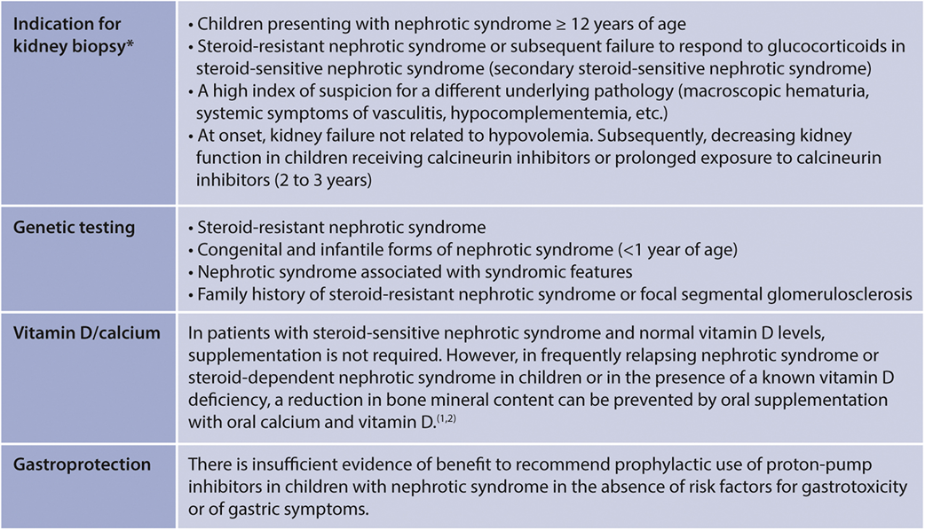
Steroid-Resistant Nephrotic Syndrome in Children – Special Situations
Practice Point 4.5.1: The figure (below) outlines the general principles in children with nephrotic syndrome.
Notes:
Please read this slide and present table

Slide 111
Chapter 5. Minimal Change Disease (MCD) in Adults

Slide 112
MCD in Adults
Diagnosis
Practice Point 5.1.1: MCD in adults can be diagnosed only with a kidney biopsy
Prognosis
Practice Point 5.2.1: Long-term kidney survival is excellent in patients with MCD who respond to glucocorticoids, but less certain for patients who do not respond
Notes:
In contrast to children, MCD in adults requires biopsy confirmation.
Long-term kidney survival is excellent in MCD patients who respond to glucocorticoids, but less certain for patients who do not respond.

Slide 113
MCD in Adults - Treatment
Recommendation 5.3.1: We recommend high-dose oral glucocorticoids for initial treatment of MCD (1C).
Practice Point 5.3.1: Algorithm for the initial treatment of MCD in adults
Practice Point 5.3.2: High-dose glucocorticoid treatment for MCD should be given for no longer than 16 weeks.
Notes:
High-dose oral glucocorticoids constitute initial treatment for MCD (Grade 1C) unless there are contraindications to glucocorticoids, in which case alternatives include cyclophosphamide, CNIs, MMF, and, possibly, rituximab.
This recommendation places a relatively higher value on low-quality evidence suggesting that high-dose glucocorticoids effectively reduce the significant morbidity associated with prolonged NS compared to no treatment. The recommendation places a relatively lower value on the possibility that MCD will spontaneously remit without treatment and on the risks of adverse events related to glucocorticoid treatment.

Slide 114
MCD in Adults - Treatment
Practice Point 5.3.3: Begin tapering of glucocorticoids 2 weeks after complete remission.
Practice Point 5.3.4: Although daily oral glucocorticoids are used most often to treat MCD, the route and frequency of administration can be individualized to patient needs.
Practice Point 5.3.5: For patients in whom glucocorticoids may be relatively contraindicated, consider initial therapy with cyclophosphamide, a CNI, or MMF.
Notes:
Please read this slide

Slide 115
MCD in Adults - Treatment
Notes:
The optimal glucocorticoid regimen is not well-defined; however, high-dose glucocorticoid treatment for MCD should be given for no longer than 16 weeks.
Tapering of glucocorticoids should start 2 weeks after remission.

Slide 116
MCD in Adults – Treatment of Relapse
Practice Point 5.3.1.1: Algorithm for treatment of frequently relapsing (FR)/steroid-dependent (SD) MCD in adults.
Practice Point 5.3.1.2: Treat infrequent relapses with glucocorticoids.
Recommendation 5.3.1.1: We recommend cyclophosphamide, rituximab, CNIs, or mycophenolic acid analogs (MPAA) for the treatment of frequently relapsing/steroid-dependent MCD, rather than prednisone alone or no treatment (1C).
Notes:
Infrequent relapses should be treated with glucocorticoids.
Cyclophosphamide, rituximab, CNIs, or mycophenolic acid analogs (MPAA) should be employed for the treatment of frequently relapsing/glucocorticoid-dependent MCD (Grade 1C).
This recommendation places a relatively higher value on avoiding the morbidity associated with prolonged glucocorticoid exposure in FR/SD MCD. It places a relatively lower value on the low-quality evidence supporting the efficacy of cyclophosphamide, rituximab, CNIs, and mycophenolic acid analogs (MPAA), and lower value on the higher cost of these alternative agents compared with prednisone. The choice of therapy for FR/SD MCD may be informed by patient preference, drug side effects, costs, and availability, as there is limited evidence to suggest 1 drug class over the other.
An algorithm for treatment of frequently relapsing/ glucocorticoid-dependent MCD in adults is shown in this slide

Slide 117
MCD in Adults – Treatment of Relapse
Notes:
Observational studies and small RCTs showed that all 4 categories (CNI, cyclophosphamide, rituximab, MPAA) of agents reduce relapse rate and induce remission in adult patients with FR/SD MCD.
Efficacy rates range from 70% to 90% in maintaining remission.

Slide 118
MCD in Adults – Treatment of Relapse
Notes:
Observational studies and small RCTs showed that all 4 categories (CNI, cyclophosphamide, rituximab, MPAA) of agents reduce relapse rate and induce remission in adult patients with FR/SD MCD.
Efficacy rates range from 70% to 90% in maintaining remission.

Slide 119
Chapter 6. Focal Segmental Glomerulosclerosis (FSGS) in Adults

Slide 120
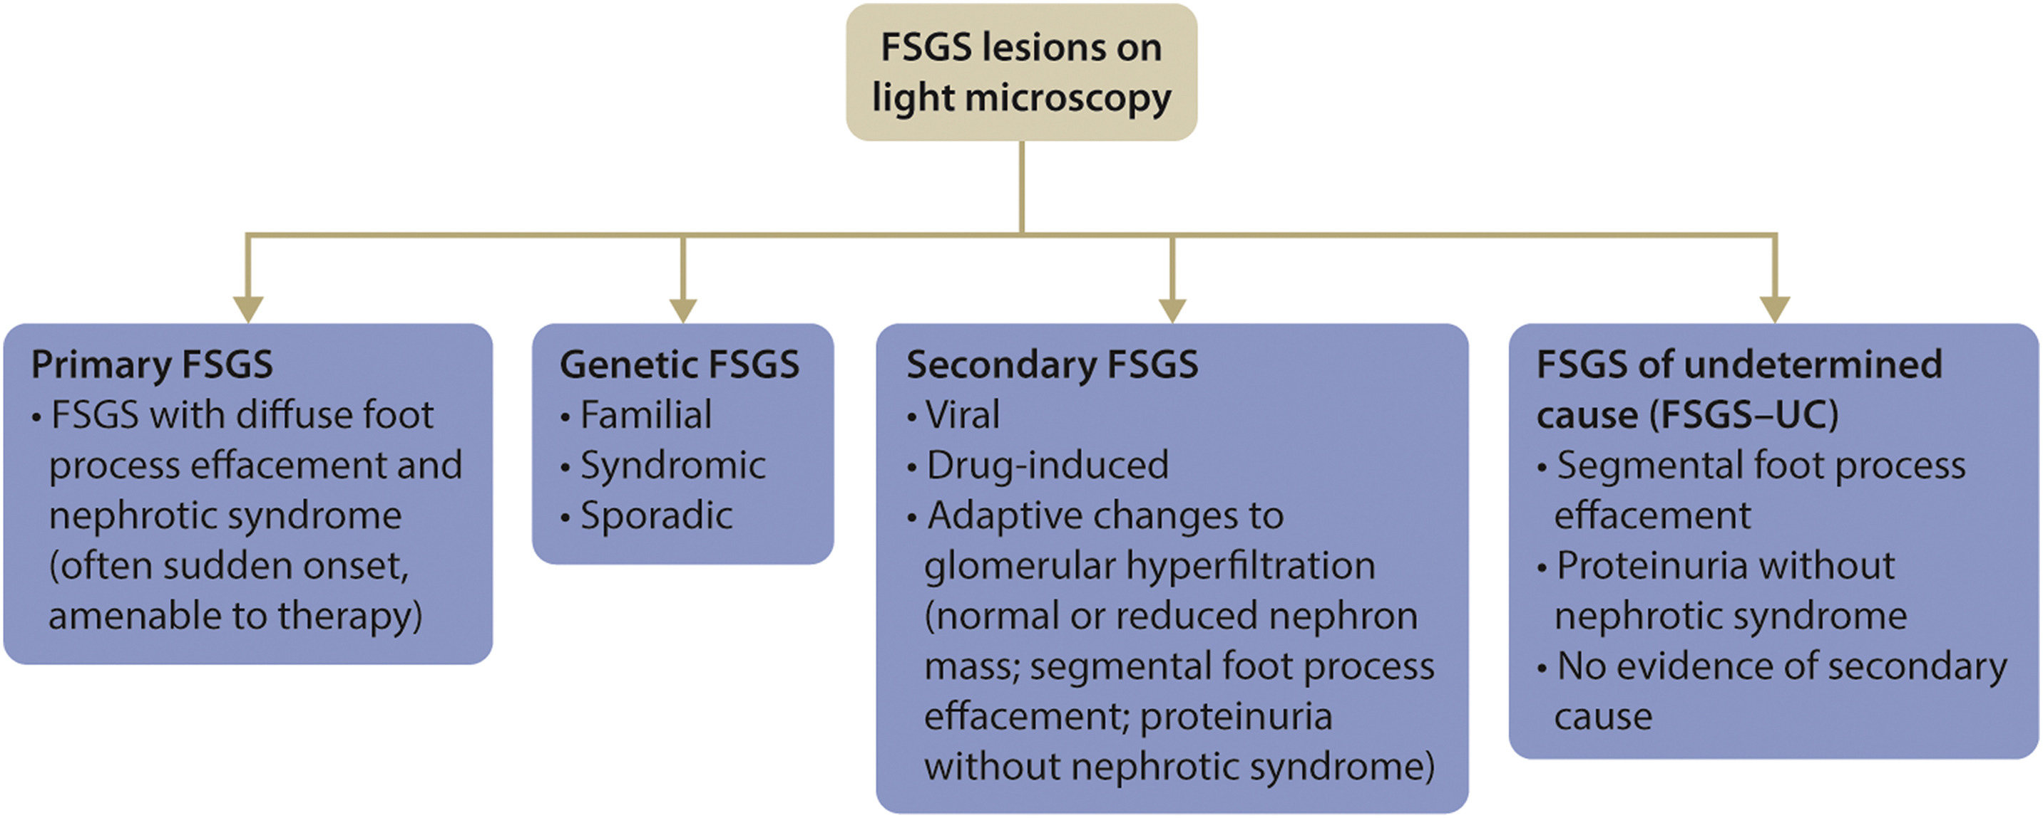
FSGS in Adults - Classification
Notes:
Advances in the management of glomerular diseases that demonstrate FSGS lesions on light microscopy have been confounded by the absence of a rigorous classification of the diseases that lead to an FSGS pattern of injury, coupled with a poor understanding of the molecular pathways involved in disease pathogenesis.
To clearly illustrate the heterogeneity of the processes that can result in FSGS histology, the Work Group proposed a revised classification of FSGS (refer to slide).
An important suggestion of the proposed classification system is to eliminate the term idiopathic from the FSGS lexicon, and to only use primary FSGS for the disease entity presumably caused by an as of yet unidentified podocyte-toxic factor that is often amenable to treatment.
The new system adds a category of FSGS of undetermined cause (FSGS-UC). These patients have an FSGS lesion on kidney biopsy, but do not have an identifiable underlying cause of FSGS or the clinicopathologic features of primary FSGS.
FSGS-UC patients bear careful scrutiny as changes in their clinical characteristics may prompt a second biopsy, supporting a need for treatment.

Slide 121
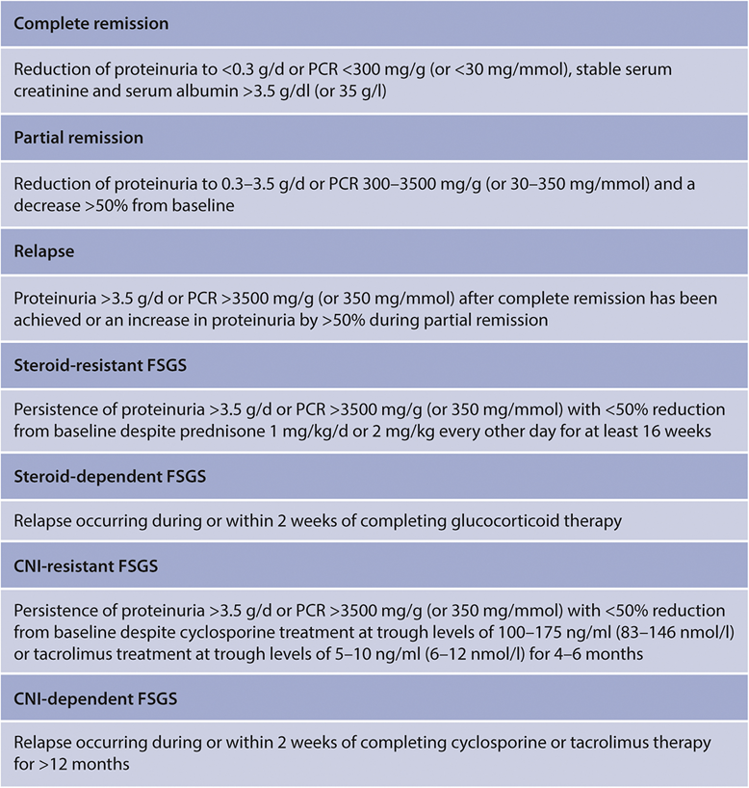
FSGS in Adults - Definitions
Notes:
There is no consensus with regard to the definition of remission, resistance, or relapse in adults with FSGS.
It is the judgment of the KDIGO GD Work Group that harmonizing these definitions for FSGS and MCD in adults will simplify epidemiologic comparisons and unify treatment approaches for adults with idiopathic NS.
Suggested definitions for remission, relapse, treatment resistance, and treatment dependence are listed

Slide 122
FSGS in Adults – Diagnosis: Differentiating between primary and secondary FSGS
Practice Point 6.1.1.1: Adults with FSGS who do not have nephrotic syndrome should be evaluated for a secondary cause.
Notes:
The development of the NS occurs in about 54%–100% of patients with primary FSGS.
The variable incidence of the NS had been attributed to the inclusion of unrecognized secondary FSGS in some studies.
Primary FSGS is typically characterized by an abrupt onset of marked proteinuria, and in 1 series, when conditions associated with secondary forms of FSGS were excluded, NS was found in 100% of the study population with primary FSGS.
The diagnosis of primary FSGS should, therefore, be revisited in patients who do not have the NS at the time of kidney biopsy, and a search for an underlying condition should be undertaken.

Slide 123
FSGS in Adults – Diagnosis: Differentiating between primary and secondary FSGS
Notes:
The causes of secondary FSGS are presented on this slide

Slide 124
FSGS in Adults – Diagnosis: Genetic testing
Practice Point 6.1.2.1: Genetic testing may be beneficial for selected patients with FSGS who should be referred to specialized centers with such expertise.
Notes:
Please read this slide

Slide 125
FSGS in Adults – Treatment: Management of FSGS-UC and secondary FSGS
Practice Point 6.2.1.1: Immunosuppression should not be used in adults with FSGS of undetermined cause (FSGS-UC), or in those with secondary FSGS.
Notes:
Adult patients with FSGS should receive the necessary supportive treatment as advised for all patients with persistent proteinuria (Chapter 1), including the use of RAS blockade, optimal BP control, and dietary salt restriction.
Patients who have secondary FSGS due to an underlying disease process should be managed as required for the primary medical condition.
There is no evidence or a priori rationale justifying the use of glucocorticoids or other immunosuppressive drugs in this population, and the potential for harm of such treatment is clear.

Slide 126
FSGS in Adults – Treatment: Initial Treatment of Primary FSGS
Recommendation 6.2.2.1: We recommend that high-dose oral glucocorticoids be used as the first-line immunosuppressive treatment for primary FSGS (1D).
Notes:
The 2 key recommendations for the treatment of primary FSGS remain the same as the 2012 recommendations.
High-dose glucocorticoids are recommended as first-line therapy (Grade 1D).
This recommendation places a relatively higher value on very low-quality evidence that the use of glucocorticoids may achieve remission of proteinuria in adult patients with primary FSGS, the increased risk of progressive CKD without remission of proteinuria, as well as the high morbidity and mortality associated with kidney failure, and a relatively lower value on the adverse effects of high-dose glucocorticoids.

Slide 127
FSGS in Adults – Special Situations: Steroid-resistant primary FSGS
Recommendation 6.3.1.1: For adults with steroid-resistant primary FSGS, we recommend that cyclosporine or tacrolimus be given for ≥6 months rather than continuing with glucocorticoid monotherapy or not treating (1C).
Notes:
For glucocorticoid-resistant or intolerant patients, a trial of a CNI is recommended (Grade 1C).
This recommendation places a high value on achieving proteinuria remission in reducing the risk of kidney failure and on the excessive risks associated with continued glucocorticoid use in patients unresponsive to prednisone therapy. This recommendation places a lower value on the cost and risks of nephrotoxicity with cyclosporine or tacrolimus treatment, as well as the need for monitoring drug levels in patients treated with these agents.

Slide 128
FSGS in Adults – Treatment: Initial Treatment of Primary FSGS
Practice Point 6.2.2.1: Suggested dosing schedule for glucocorticoids in the initial treatment of primary FSGS is outlined below.
Notes:
Suggested treatment protocols are outlined in this slide.

Slide 129
FSGS in Adults – Treatment: Initial Treatment of Primary FSGS
Practice Point 6.2.2.2: Initial high-dose glucocorticoids should be continued until complete remission is achieved, or as tolerated by patients up to a maximum of 16 weeks, whichever is earlier.
Practice Point 6.2.2.3: Adults with primary FSGS who respond to glucocorticoid treatment should receive glucocorticoids for ≥6 months.
Practice Point 6.2.2.4: In adults with relative contraindications or intolerance to glucocorticoids, alternative immunosuppression with CNIs should be considered as the
initial therapy in patients with primary FSGS.
Notes:
The use of oral predniso(lo)ne at a dose of 1 mg/kg/ d has the potential for severe toxicity, so application of this recommendation requires close supervision for side effects and a maximum duration of 16 weeks is suggested.
Additionally, patients who are expected to respond to glucocorticoids usually show at least some improvement in proteinuria within 4–8 weeks.
In the setting of no indication of response and/or severe glucocorticoid side effects, it is prudent to move patients to second-line therapy with a CNI.
The overall duration of glucocorticoids should be 6 months (high-dose period plus taper), and the overall duration of CNIs should be 12 months.

Slide 130
FSGS in Adults – Special Situations: Dosing schedule for cyclosporine and tacrolimus
Practice Point 6.3.2.1: Treatment of steroid-resistant primary FSGS: Suggested dosing schedule for cyclosporine and tacrolimus.
Notes:
If patients have not responded to glucocorticoids or a CNI, the therapeutic choices for primary FSGS are limited.
Several other immunosuppressive agents have been tried, but there are no high-quality data supporting their use.

Slide 131
FSGS in Adults – Special Situations: Patients resistant to or intolerant to CNIs
Practice Point 6.3.4.1: Adults who have steroid-resistant primary FSGS with resistance to or intolerance of CNIs should be referred to specialized centers for consideration of rebiopsy, alternative treatment, or enrollment in a clinical trial.
Notes:
This speaks to the importance of considering FSGS patients for clinical trials, and for trying to identify the circulating factor(s) mediating FSGS, as this may lead to more targeted therapies with less toxicity than long-term, high-dose glucocorticoids or CNIs.

Slide 132
FSGS in Adults – Special Situations: Management of relapse
Practice Point 6.3.5.1: Adults with previous steroid-sensitive primary FSGS who experience a relapse can be treated using the same approach as that for adults with relapsing MCD
Notes:
Please read this slide

Slide 133
Chapter 7. Infection-related Glomerulonephritis

Slide 134
Bacterial Infection-related GN – Diagnosis
Practice Point 7.1.1.1: Kidney biopsy can be useful in suspected bacterial infection-related glomerulonephritis (GN), particularly when culture evidence of infection is elusive or the diagnosis is in doubt, to assess prognosis, and/or for potential therapeutic reasons. In some cases, biopsy may be critical for arriving at the correct diagnosis, as comorbidities may contribute to confounding effects.
Notes:
Kidney biopsy can be useful in suspected bacterial infection-related GN, particularly when culture evidence of infection is elusive or the diagnosis is in doubt, to assess prognosis, and/or for potential therapeutic reasons. In some cases, biopsy may be critical at arriving at the correct diagnosis, as comorbidities contribute to difficulty in making the diagnosis.

Slide 135
Bacterial Infection-related GN – Prognosis and Treatment
Practice Point 7.1.2.1: Prognosis and suggested therapy of bacterial infection-related GN are summarized in the figure.
Notes:
Prognosis and therapy of classic bacterial infection related GN syndromes depends on the underlying infection.
In general, prognosis is good with early diagnosis and antibiotic treatment of the infection.
However, in IgA dominant infection-related GN, dialysis is frequently required in the acute phase and <20% of the patients return to their premorbid levels of kidney function.
The utility of immunosuppression, even in cases of crescentic GN, is uncertain and carries substantial potential risks, in particular in the elderly. In classical postinfectious GN, persistently low C3 in serum beyond week 12 may be an indication for kidney biopsy to particularly exclude complement C3 glomerulonephritis (C3GN).

Slide 136
Viral Infection-related GN – Hepatitis C (HCV)
The Work Group concurs fully with Recommendations 5.1–5.2.3 of the KDIGO 2018 Clinical Practice Guideline for the Prevention, Diagnosis, Evaluation, and Treatment of Hepatitis C in Chronic Kidney Disease.
Notes:
The Work Group concurs fully with Recommendations 5.1 through 5.2.3 of the KDIGO 2018 Clinical Practice Guideline for the Prevention, Diagnosis, Evaluation, and Treatment of Hepatitis C in Chronic Kidney Disease.

Slide 137
Viral Infection-related GN – Hepatitis B (HBV)
Diagnosis
Practice Point 7.2.2.1.1: Patients with proteinuric glomerular disease should undergo testing for HBV infection.
Prognosis
Practice Point 7.2.2.2.1: Adult patients with chronic HBV infection should be considered at risk for the development of kidney failure.
Notes:
Patients with proteinuric glomerular disease should undergo testing for HBV infection, and adult patients with chronic HBV infection should be considered at risk for the development of kidney failure.

Slide 138
Viral Infection-related GN – Hepatitis B (HBV)- Treatment
Recommendation 7.2.2.3.1: We recommend that patients with replicative HBV infection (as denoted by HBV DNA levels >2000 IU/ml) and GN receive treatment with nucleos(t)ide analogues as recommended for the general population by standard clinical practice guidelines for HBV infection (1C).
Practice Point 7.2.2.3.1: Pegylated interferon regimens should not be used to treat patients with replicative HBV infection and GN.
Practice Point 7.2.2.3.2: Immunosuppressive agents, such as cyclophosphamide or rituximab, may accelerate HBV replication and should be avoided in patients with untreated replicative HBV infection and GN.
Notes:
KDIGO recommends that patients with replicative HBV infection (as denoted by HBV DNA levels >2000 IU/ml) and GN receive treatment with nucleos(t)ide analogues, as recommended for the general population by standard clinical practice guidelines for HBV infection (Grade 1C).
Rec 7.2.2.3.1: Due to the poor prognosis of untreated HBV infection (hepatocellular cancer, cirrhosis of the liver, GN, and/or vasculitis) and the availability of effective (but not curative) antiviral agents, nearly all patients with this condition should be considered candidates for antiviral therapy, unless contraindication exists.
Immunosuppressive agents, such as cyclophosphamide or rituximab, may accelerate HBV replication and should be avoided in patients with untreated replicative HBV infection and GN.

Slide 139
Viral Infection-related GN – Hepatitis B (HBV) – Special Situations
Practice Point 7.2.2.4.1: Rituximab and cyclophosphamide should be avoided in patients with simultaneous HBV infection and anti-PLA2R antibody-mediated MN until a
sustained virologic remission has been obtained by nucleos(t)ide analogue therapy.
Practice Point 7.2.2.4.2: Plasma exchange may be tried in patients with accompanying cryoglobulinemic vasculitis.
Practice Point 7.2.2.4.3: Children with HBV infection and MN should be managed conservatively without immunosuppression due to a high likelihood of spontaneous
remission of the kidney disease.
Notes:
Rituximab and cyclophosphamide should be avoided in patients with simultaneous HBV infection and anti-PLA2R antibody-mediated MN until a sustained virologic remission has been obtained by nucleos(t)ide analogue therapy.
Plasma exchange may be tried in patients with accompanying cryoglobulinemic vasculitis.
Children with HBV infection and MN should be managed conservatively without immunosuppression due to a high likelihood of spontaneous remission of the kidney disease

Slide 140
Viral Infection-related GN – Human Immunodeficiency virus (HIV)
Notes:
HIV-related kidney disease is a global problem contributing significantly to CKD rates.

Slide 141
Viral Infection-related GN – Human Immunodeficiency virus (HIV) - Diagnosis
Practice Point 7.2.3.1.1: A kidney biopsy should be performed, when feasible, to evaluate the morphology of HIV-related kidney disease. A pathology-based description of HIV-related kidney disease should be used to help define and guide therapy.
Notes:
A kidney biopsy should be performed, when feasible, to evaluate the morphology of HIV-related kidney disease.
A pathology based description of HIV-related kidney disease should be used to help define and guide therapy.
The spectrum of kidney biopsy findings in HIV-infected patients in the modern era is shown in this slide.

Slide 142
Viral Infection-related GN – Human Immunodeficiency virus (HIV) - Prognosis
Practice Point 7.2.3.2.1: The factors contributing to the long-term outcome of HIV infection associated with GN are numerous and include persistence of viral replication, response to antiviral treatment, genetic predisposition to glomerular injury (e.g., APOL1 risk alleles), coinfection with other viruses, and development of immune complex disease or thrombotic microangiopathy. Thus, the estimation of prognosis in individual patients can be very difficult.
Notes:
The factors contributing to the long-term outcome of HIV infection associated with GN are numerous and include persistence of viral replication, response to antiviral treatment, genetic predisposition to glomerular injury (e.g., apolipoprotein L1 [APOL1] risk alleles), coinfection with other viruses, and development of immune complex (IC) disease or thrombotic microangiopathy.
Thus, the estimation of prognosis in individual patients can be very difficult.

Slide 143
Viral Infection-related GN – Human Immunodeficiency virus (HIV) - Diagnosis
Notes:
Lifetime risk of HIVAN or FSGS-UC in the setting of HIV by number of APOL1 risk alleles.

Slide 144
Viral Infection-related GN – Human Immunodeficiency virus (HIV) - Treatment
Recommendation 7.2.3.3.1: We recommend that antiretroviral therapy be initiated in all patients with HIV and CKD, especially biopsy-proven HIV-associated nephropathy (HIVAN), regardless of CD4 count, adjusted to the degree of kidney function (1C).
Practice Point 7.2.3.3.1: A decision for the use of glucocorticoids as an adjunct therapy for HIVAN must be made on a case-by-case basis, as the risks and benefits long-term are uncertain.
Notes:
KDIGO recommends that antiretroviral therapy (ART) should be initiated in all patients with HIV and CKD, especially biopsy-proven HIV-associated nephropathy (HIVAN), regardless of CD4 count, adjusted to the degree of kidney function (Grade 1C).
Rec 7.2.3.3.1: The presence of CKD is not a contraindication for antiretroviral therapy (ART) of HIV infection. Current consensus data, based on 2 large RCTs on the time to initiate ART, namely Strategic Timing of AntiRetroviral Treatment (START), and Early Antiretroviral Treatment and/or Early Isoniazid Prophylaxis Against Tuberculosis in HIV-infected Adults (TEMPRANO), demonstrate benefit of early initiation of ART at the time of diagnosis, regardless of CD4 count. This Work Group believes that the benefit outweighs the risk to support this recommendation, and patients with such infections also place a high value on early treatment, when possible.
A decision for the use of glucocorticoids as an adjunct therapy for HIVAN must be made on a case-by-case basis as the risks and benefits long-term are uncertain.
The presence of CKD is not a contraindication for ART of HIV infection.

Slide 145
Nephropathies due to Infections – Schistosomal Nephropathy - Diagnosis
Practice Point 7.3.1.1.1: Test for appropriate endemic coinfections (Salmonella, HBV, HCV, HIV), as targeted treatment may alter the aggressiveness of an underlying GN
or the sequela of schistosomiasis.
Practice Point 7.3.1.1.2: Obtain a kidney biopsy in patients suspected of having schistosomal GN in the presence of a viral coinfection (HCV, HBV, HIV).
Notes:
Test for appropriate endemic coinfections (Salmonella, HBV, HCV, HIV) as targeted treatment may alter the aggressiveness of an underlying GN or the sequela of schistosomiasis.
A kidney biopsy should be obtained in patients suspected of having schistosomal GN in the presence of a viral coinfection (HCV, HBV, HIV).

Slide 146
Nephropathies due to Infections – Schistosomal Nephropathy - Treatment
Practice Point 7.3.1.2.1: Treat patients with schistosomal infection and GN with an appropriate antiparasitic agent in sufficient dosage and duration to eradicate the organism.
There are no indications for use of immunosuppressive agents in schistosomal nephropathy.
Notes:
Patients with schistosomal infection and GN should be treated with an appropriate antiparasitic agent in sufficient dosage and duration to eradicate the organism.
There are no indications for use of immunosuppressive agents in schistosomal nephropathy.

Slide 147
Nephropathies due to Infections – Schistosomal Nephropathy – Special Situations
Practice Point 7.3.1.3.1: Monitor patients with hepatic fibrosis from schistosomiasis for the development of kidney disease.
Practice Point 7.3.1.3.2: Evaluate patients with a history of schistosomiasis and an elevated SCr and/or hematuria for bladder cancer and/or urinary obstruction.
Notes:
Monitor patients with hepatic fibrosis from schistosomiasis for the development of kidney disease and evaluate patients with a history of schistosomiasis and an elevated serum creatinine and/or hematuria for bladder cancer and/or urinary obstruction.

Slide 148
Nephropathies due to Infections – Filariasis and Glomerular Disease – Treatment
Practice Point 7.3.2.1.1: Treat patients with filarial infection and GN with an appropriate antiparasitic agent in sufficient dosage and duration to eradicate the organism.
Notes:
Patients with filarial infection and GN should be treated with an appropriate antiparasitic agent in sufficient dosage and duration to eradicate the organism.

Slide 149
Nephropathies due to Infections – Malarial Nephropathy
Notes:
Malaria-related kidney disease mostly manifests as AKI, but GN can also occur.

Slide 150
Nephropathies due to Infections – Malarial Nephropathy – Pathophysiology of Kidney Involvement in Malaria
Notes:
Pathophysiology of kidney involvement in malaria
Immune system activation between the malaria antigen and host red blood cells can lead to immune complex complement-mediated GN, acute interstitial nephritis, or acute GN

Slide 151
Nephropathies due to Infections – Malarial Nephropathy – Histopathologic Staging of Quartan Malarial Nephropathy
Notes:
Chronic infection with P. malariae (and to a lesser extent P. vivax, P. ovale) has been associated with irreversible and progressive GN.
In the past, this has been known as tropical nephritis or “quartan malarial nephropathy” (QMN).
Nephrotic syndrome, sometimes with impaired kidney function, is a common clinical manifestation.
QMN is principally encountered in young children.
Nowadays, the lesion is much less common, and most children in the tropics with NS have MCD, FSGS, HBV or HIV infection, sickle cell disease, or SLE, rather than QMN.

Slide 152
Nephropathies due to Infections – Malarial Nephropathy - Treatment
Practice Point 7.3.3.1.1: Treat patients with malarial infection and GN with an appropriate antiparasitic agent in sufficient dosage and duration to eradicate the organism from blood
and hepatosplenic sites. There are no indications for use of immunosuppressive agents in malarial nephropathy.
Notes:
Patients with malarial infection and GN should be treated with an appropriate antiparasitic agent in sufficient dosage and duration to eradicate the organism from blood and hepatosplenic sites.
There are no indications for use of immunosuppressive agents in malarial nephropathy.

Slide 153
Nephropathies due to Infections – Malarial Nephropathy – Special Situations: Pregnancy
Notes:
Halofantrine is both embryotoxic and cardiotoxic. Tetracycline/minocycline is associated with impairment of bone growth and teeth discoloration in the fetus and during infancy. Both are contraindicated during pregnancy and/or breastfeeding.
Primaquine and tafenoquine can cause hemolysis in individuals with G6PD deficiency and are contraindicated in G6PD-deficient individuals, pregnant women, infants <6 months of age, and for women breastfeeding infants <6 months old.

Slide 154
Chapter 8. Immunoglobulin- and Complement-Mediated Glomerular Diseases with a Membranoproliferative Glomerulonephritis (MPGN) Pattern of Injury

Slide 155
Immunoglobulin- and Complement-mediated GD – Diagnosis
Practice Point 8.1.1: Evaluate patients with immune
complex-mediated GN (ICGN) for underlying disease.
Practice Point 8.1.2: Evaluate patients with GN and
monoclonal immunoglobulin deposits for a hematologic
malignancy.
Notes:
A membranoproliferative pattern of injury on a kidney biopsy does not reflect a specific disease, but is a histologic finding that often occurs in the setting of aberrant complement activation and/or IC deposition.
This led the Work Group to suggest eliminating the term membranoproliferative glomerulonephritis (MPGN) from the new glomerular diseases guideline, in favor of a more pathophysiologic classification of these diseases.
The diseases that can result in an MPGN pattern are heterogeneous and require distinct therapies; they must be properly identified beyond their histologic characteristics.

Slide 156
Immunoglobulin- and Complement-mediated GD – Pathophysiology of Membranoproliferative Lesions
Notes:
The new classification relies on immunofluorescence examination; deposits are defined as primarily immunoglobulin (monoclonal), polyclonal immunoglobulin and complement, or predominantly complement.
If the biopsy is positive for immunoglobulins, with or without complement components, the evaluation should be focused on distinguishing between monoclonal deposition diseases, autoimmune IC diseases, and infection-associated diseases.
In adults, idiopathic immune complex glomerulonephritis (ICGN) is rare, and all other diagnostic possibilities should be exhausted before making this diagnosis.
If immunofluorescence microscopy shows a complement dominant pattern, C3 or C4 glomerulopathy (C3G, C4G) should be considered, and an appropriate evaluation of the complement system should be undertaken.
Negative immunofluorescence should raise the possibility of several diseases but especially various types of thrombotic microangiopathy (TMA).
Like most classification schemes, caveats apply.

Slide 157
Immunoglobulin- and Complement-mediated GD – Diagnosis
Practice Point 8.1.3: If no underlying etiology is found for ICGN after extensive workup, evaluate for both complement dysregulation and drivers of complement dysregulation.
Practice Point 8.1.4: Rule out infection-related GN or postinfectious GN prior to assigning the diagnosis of C3 glomerulopathy (C3G).
Practice Point 8.1.5: Evaluate for the presence of a monoclonal protein in patients who present for the first time with a C3G diagnosis at ≥50 years of age
Notes:
Fortuitously, the immunofluorescence findings on biopsy can be used to move the work-up of these patients in the correct direction.
First, consider infection such as HBV and HCV infection, chronic bacterial infection (e.g., endocarditis, shunt nephritis, abscesses), fungal, and particularly in the developing world, parasitic infections (e.g., schistosomiasis, echinococcosis, malaria). Streptococcal serology should be performed in patients with recent history of infection.
Second, consider autoimmune disorders such as SLE and, less often, Sjögren’s syndrome or rheumatoid arthritis.
Besides autoimmunity, an underlying immune abnormality may be a trigger for ICGN. ICGN may be associated with malignancy; therefore, age-appropriate cancer screening may be warranted.

Slide 158
Immunoglobulin- and Complement-mediated GD – Treatment of Immune Complex-Mediated GN
Practice Point 8.2.1.1: When the cause of ICGN is determined, the initial approach to treatment should focus on the underlying pathologic process.
Practice Point 8.2.1.2: Indolent ICGN, whether idiopathic or linked to a primary disease process, is best managed with supportive care and carefully considered use of
immunosuppression.
Practice Point 8.2.1.3: For patients with idiopathic ICGN and proteinuria <3.5 g/d, the absence of the nephrotic syndrome, and a normal eGFR, we suggest supportive therapy with RAS inhibition alone.
Practice Point 8.2.1.4: For patients with idiopathic ICGN, a nephrotic syndrome, and normal or near-normal SCr, try a limited treatment course of glucocorticoids.
Notes:
Treatment for monoclonal immunoglobulin-associated diseases focuses on controlling the clone of B cells or plasma cells responsible for production of the monoclonal immunoglobulin.
Autoimmune diseases are most often treated with immunosuppression, and infection associated glomerular diseases generally respond to controlling the infection.
The management of idiopathic ICGN and C3G/C4G is less clear, and because of the absence of any RCT data, the Work Group was able to offer only practice points in these areas and no specific recommendations.

Slide 159
Immunoglobulin- and Complement-mediated GD – Treatment of Immune Complex-Mediated GN
Practice Point 8.2.1.5: For patients with idiopathic ICGN, abnormal kidney function (but without crescentic involvements), active urine sediment, with or without nephrotic-range proteinuria, add glucocorticoids and immunosuppressive therapy to supportive care.
Practice Point 8.2.1.6: For patients presenting with a rapidly progressive crescentic idiopathic ICGN, treat with high-dose glucocorticoids and cyclophosphamide.
Practice Point 8.2.1.7: For most patients with idiopathic ICGN presenting with an eGFR <30 ml/min per 1.73 m², treat with supportive care alone.
Practice Point 8.2.1.8: Patients who fail to respond to the treatment approaches discussed in 8.2.1.4 and 8.2.1.5 should be considered for a clinical trial where available.
Notes:
In contrast to the 2012 guideline, the current approach to idiopathic ICGN is more nuanced, as opposed to immediately committing to an immunosuppressive drug.
This approach tailors therapy to severity of disease presentation and histology. Importantly, the approach suggests restraint in treating patients aggressively who have a chronic and significant impairment of kidney function.

Slide 160
Immunoglobulin- and Complement-mediated GD – Approach to idiopathic ICGN
Notes:
This slide depicts what is written in slides 156 and 157

Slide 161
Immunoglobulin- and Complement-mediated GD – Treatment of C3 Glomerulopathy
Practice Point 8.2.2.1: In the absence of a monoclonal gammopathy, C3G in patients with moderate-to-severe disease should be treated initially with MMF plus glucocorticoids, and if this fails, eculizumab should be considered.
Practice Point 8.2.2.2: Patients who fail to respond to the treatment approaches discussed in 8.2.2.1 should be considered for a clinical trial where available.
Notes:
For patients with C3G in whom a monoclonal gammopathy has been excluded, and who have moderate-to-severe disease (proteinuria >1 g/d and/or declining kidney function over several months), MMF is suggested as first-line therapy.
Observational data showed that MMF decreased progression to kidney failure compared to other immunosuppressives.
After MMF, the direction of treatment is not clear.
Because C3G is a complement-mediated disease, eculizumab has been used in a small number of patients with variable results.
While eculizumab can be tried in patients who fail to respond to MMF, such patients should be considered for clinical trials to begin to address this unmet need by gathering controlled study data.

Slide 162
Chapter 9. Antineutrophil Cytoplasmic Antibody (ANCA)-associated Vasculitis

Slide 163
ANCA-associated Vasculitis - Diagnosis
Practice Point 9.1.1: In the case of a clinical presentation compatible with small-vessel vasculitis in combination with positive myeloperoxidase (MPO)- or proteinase 3 (PR3)-
ANCA serology, waiting for a kidney biopsy to be performed or reported should not delay starting immunosuppressive therapy, especially in patients who are rapidly deteriorating.
Notes:
Because of the potential severity of AAV, if a patient’s clinical presentation is compatible with a small-vessel vasculitis and myeloperoxidase (MPO)- or proteinase 3 (PR3)-ANCA serology is positive, waiting for a kidney biopsy to be done or reported to verify diagnosis should not delay starting immunosuppressive therapy.
Besides confirming diagnosis, the kidney biopsy provides prognostic information so it should be done when feasible.
In all cases, however, infection must be excluded with as much certainty as possible before significant immunosuppression is given.

Slide 164
ANCA-associated Vasculitis - Diagnosis
Practice Point 9.1.2: Patients with ANCA-associated vasculitis (AAV) should be treated at centers with experience in AAV management
Notes:
This slides presents the definition of disease activity, remission, relapse, and treatment-resistant disease in AAV

Slide 165
ANCA-associated Vasculitis - Diagnosis
Notes:
Diagnostic strategy in rapidly progressive glomerulonephritis

Slide 166
ANCA-associated Vasculitis - Diagnosis
Notes:
Frequency of organ involvement in AAV

Slide 167
ANCA-associated Vasculitis – Prognosis: Kidney Prognosis and Treatment Response
Notes:
Kidney histology is predictive of long-term risk of kidney failure; prognostic histologic scores have been developed (e.g., by Berden et al. and Brix et al.)

Slide 168
ANCA-associated Vasculitis – Prognosis: Relapse
Practice Point 9.2.3.1: The persistence of ANCA positivity, an increase in ANCA levels, and a change in ANCA from negative to positive are only modestly predictive of future disease relapse and should not be used to guide treatment decisions.
Notes:
PR3- and MPO-AAV are characterized by the occurrence of relapses.
Patients who are PR3-ANCA-positive experience more relapses than those who are MPO-ANCA positive.
The achievement of ANCA-negativity after induction treatment is associated with a lower risk of relapse.
Both a rise or persistence of ANCA are only modestly predictive of future disease relapse.
Also, a change in ANCA status from negative to positive has been associated with a higher incidence of relapse, and more frequent clinical assessments should be considered.
However, regarding the relapsing phenotype of AAV, ANCA measurements should not guide treatment decisions in individual patients.

Slide 169
ANCA-associated Vasculitis – Treatment: Induction
Recommendation 9.3.1.1: We recommend that glucocorticoids in combination with cyclophosphamide or rituximab be used as initial treatment of new-onset AAV (1B).
Notes:
The initial therapy of new-onset AAV has been updated to include induction with cyclophosphamide or rituximab combined with glucocorticoids.
The best evidence is available for patients with new-onset AAV. In patients with severe (SCr >4 mg/dl [>354 mmol/l]) kidney disease, limited data for induction therapy with rituximab are available

Slide 170
ANCA-associated Vasculitis – Treatment: Induction
Practice Point 9.3.1.1: A recommended treatment algorithm for AAV with kidney involvement is given in the figure.
Notes:
Please read slide and present algorithm

Slide 171
ANCA-associated Vasculitis – Treatment: Induction
Practice Point 9.3.1.2: In patients presenting with markedly reduced or rapidly declining GFR (SCr >4 mg/dl [>354 mmol/l]), there are limited data to support rituximab and glucocorticoids. Cyclophosphamide and glucocorticoids are preferred for induction therapy. The combination of rituximab and cyclophosphamide can also be considered in this setting.
Practice Point 9.3.1.3: Considerations for choosing between rituximab and cyclophosphamide for induction therapy are given in the figure below.
Notes:
As a caveat, it was emphasized that there are only limited data for rituximab induction in the setting of severely impaired kidney function (serum creatinine >4 mg/dl [>354 mmol/l]).
Cyclophosphamide remains the preferred immunosuppressive for such patients, although the combination of cyclophosphamide plus rituximab can be considered.
To help in choosing whether to use cyclophosphamide or rituximab, the Work Group provided several suggestions as shown in this slide.
For relapsing disease, patients should be re-induced and the treatment of choice is rituximab, especially if patients have already reached a cumulative dose of cyclophosphamide over 36 g, as this may increase chances for developing a malignancy.

Slide 172
ANCA-associated Vasculitis – Treatment: Induction
Practice Point 9.3.1.4: Considerations for choosing the route of administration of cyclophosphamide are given in the figure.
Practice Point 9.3.1.5: Discontinue immunosuppressive therapy after 3 months in patients who remain on dialysis and who do not have any extrarenal manifestations of disease.
Notes:
Please read slide and present information in the table

Slide 173
ANCA-associated Vasculitis – Treatment: Induction
Practice Point 9.3.1.6: Recommendations for oral glucocorticoid tapering are given in the figure.
Notes:
PEXIVAS demonstrated that glucocorticoid dosing can safely be reduced from the high dose regimens traditionally used in AAV.

Slide 174
ANCA-associated Vasculitis – Treatment: Induction
Practice Point 9.3.1.7: Recommendations for immunosuppressive dosing are given in the figure.
Notes:
Please read slide and present information in the table

Slide 175
ANCA-associated Vasculitis – Treatment: Induction
Practice Point 9.3.1.8: Consider plasma exchange for patients with SCr >5.7 mg/dl (500 mmol/l) requiring dialysis or with rapidly increasing SCr, and in patients with diffuse
alveolar hemorrhage who have hypoxemia.
Practice Point 9.3.1.9: Add plasma exchange for patients with an overlap syndrome of ANCA vasculitis and anti-GBM.
Notes:
One of the more controversial aspects of the initial management of AAV is the role of plasma exchange in patients who present with severe kidney failure and/or require dialysis.
Older studies suggested a benefit, but the recently reported PEXIVAS trial did not show that plasma exchange delayed time to kidney failure or death in AAV patients who presented with eGFR < 50 ml/min/1.73 m² or alveolar hemorrhage. It is suggested that plasma exchange not be used routinely in AAV.
However, if AAV overlaps with anti-GBM antibody GN, plasma exchange should be used

Slide 176
ANCA-associated Vasculitis – Treatment: Maintenance Therapy
Recommendation 9.3.2.1: We recommend maintenance therapy with either rituximab or azathioprine and low-dose glucocorticoids after induction of remission (1C).
Practice Point 9.3.2.1: Following cyclophosphamide induction, either azathioprine plus low-dose glucocorticoids or rituximab without glucocorticoids should be used to
prevent relapse.
Practice Point 9.3.2.2: Following rituximab induction, maintenance immunosuppressive therapy should be given to most patients.
Practice Point 9.3.2.3: The optimal duration of azathioprine plus low-dose glucocorticoids is not known but should be between 18 months and 4 years after induction of remission.
Notes:
This recommendation places a higher value on prevention of relapses and a relatively lower value on adverse events related to immunosuppressive drugs.
After induction therapy, patients with AAV require maintenance immunosuppression because of their high likelihood of relapse, especially those with PR3-ANCA disease.

Slide 177
ANCA-associated Vasculitis – Treatment: Maintenance Therapy
Practice Point 9.3.2.4: The optimal duration of rituximab maintenance is not known, but studies to date have evaluated a duration of 18 months after remission. There is no role for the routine use of an oral glucocorticoid or oral immunosuppressive with rituximab
maintenance.
Practice Point 9.3.2.5: When considering withdrawal of maintenance therapy, the risk of relapse should be considered, and patients should be informed of the need for prompt attention if symptoms recur.
Notes:
Because the treatment of AAV uses therapies that come with considerable risk for adverse events, therapeutic futility should be considered.
The Work Group suggested that immunosuppression be discontinued in patients who have no extrarenal disease manifestations if after 3 months they remain dialysis-dependent.
Persistence of ANCA positivity after treatment, rising titers of ANCA, and conversion from ANCA negativity to ANCA positivity are only modestly predictive of future relapse; therefore, removing maintenance therapy remains a clinical decision, as opposed to a biomarker-driven decision for now.

Slide 178
ANCA-associated Vasculitis – Treatment: Maintenance Therapy
Practice Point 9.3.2.6: Consider methotrexate for maintenance therapy in patients, after induction with methotrexate or for those who are intolerant of azathioprine and
MMF, but not if GFR is <60 ml/min per 1.73 m².
Practice Point 9.3.2.7: Considerations for choosing rituximab or azathioprine for maintenance therapy are presented in the figure.
Notes:
The updated recommendations for AAV maintenance include rituximab or azathioprine plus low-dose glucocorticoids, although the Work Group preferred rituximab for maintenance.
Considerations for using rituximab or azathioprine are outlined in this slide.

Slide 179
ANCA-associated Vasculitis – Treatment: Maintenance Therapy
Practice Point 9.3.2.8: Recommendations for dosing and duration of maintenance therapy are given in the figure.
Notes:
The dosing and duration of maintenance immunosuppression in AAV is not clear.
Both rituximab and azathioprine have been used for a minimum of 18 months, and up to 4 years for azathioprine.
It is therefore suggested that the duration of maintenance therapy be at least 18 months.
Withdrawal can then be considered, after factoring in the risk of disease relapse.

Slide 180
ANCA-associated Vasculitis – Treatment: Relapsing Disease
Practice Point 9.3.3.1: Patients with relapsing disease (life or organ-threatening) should be reinduced (Recommendation 9.3.1.1.), preferably with rituximab.
Notes:
It must be noted that, the commonly monitored serologies in ANCA vasculitis are imperfect biomarkers of disease relapse.
Persistence of ANCA positivity after treatment, rising titers of ANCA, and conversion from ANCA negativity to ANCA positivity are only modestly predictive of future relapse; therefore, removing maintenance therapy remains a clinical decision, as opposed to a biomarker-driven decision for now.
Relapses respond to immunosuppression with a similar response rate as the initial presentation, and severe relapses should be treated by reintroducing induction therapy.
When deciding whether to use cyclophosphamide again, the cumulative dose of cyclophosphamide already given should be taken into account. Cumulative dosages above 36 g have been associated with the occurrence of malignancies.
In a post hoc analysis of the RAVE trial, higher remission rates were seen in relapsing patients treated with rituximab compared to cyclophosphamide, especially for patients with PR3-AAV.
In patients with non-severe relapses, immunosuppression should be increased while avoiding cyclophosphamide.
Apart from MMF, which has been tested in combination with glucocorticoids in RCTs for induction therapy in relapsing patients, there is no strong evidence to support other regimens.
However, if non-severe relapses are treated with MMF, there is an increased rate of future relapse, and glucocorticoid exposure will be increased accordingly.
Rituximab is therefore preferred for relapsing AAV.

Slide 181
ANCA-associated Vasculitis – Special Situations: Refractory Disease
Practice Point 9.4.1.1: Refractory disease can be treated by an increase in glucocorticoids (intravenous or oral), by the addition of rituximab if cyclophosphamide induction had
been used previously, or vice versa. Plasma exchange can be considered.
Practice Point 9.4.1.2: In the setting of diffuse alveolar bleeding with hypoxemia, plasma exchange should be considered in addition to glucocorticoids with either cyclophosphamide or rituximab.
Notes:
Please read this slide

Slide 182
ANCA-associated Vasculitis – Special Situations: Transplantation
Practice Point 9.4.2.1: Delay transplantation until patients are in complete clinical remission for ≥6 months. Persistence of ANCA should not delay transplantation.
Notes:
If patients progress to require long-term kidney replacement therapy, kidney transplantation should be delayed until patients are in clinical remission for ≥6 months.
Importantly, persistent ANCA positivity should not delay kidney transplantation

Slide 183
Chapter 10. Lupus Nephritis (LN)
Notes:
The management recommendations for LN may change in the coming months because several high-quality RCTs of novel therapies have recently been successfully completed.
These approaches will be incorporated into the guideline as the community understands how best to apply the new agents in the context of existing regimens.
However, as the 2021 guideline was being established, details of these new data were not yet available, such that the recommendations on choice of treatment may appear not too dissimilar to the 2012 guideline.
Nonetheless, some new management themes for LN have emerged, and management guidelines are presented in the current context.

Slide 184
Lupus Nephritis - Diagnosis
Practice Point 10.1.1: Approach to the diagnosis of kidney involvement in systemic lupus erythematosus (SLE).
Notes:
Please read this slide and present the algorithm

Slide 185
Lupus Nephritis - Diagnosis
Notes:
Activity and chronicity items included in LN kidney biopsy report.
Clinicians should pay attention to the detailed description of both active and chronic histopathologic features affecting different elements of the kidney parenchyma, especially regarding potentially reversible active lesions versus chronic damage not reversible by immunosuppressive medications.
These histopathological features are not only important for diagnosis, but for treatment as well.

Slide 186
Lupus Nephritis – Treatment: General Management
Recommendation 10.2.1.1: We recommend that patients with SLE, including those with lupus nephritis (LN), be treated with hydroxychloroquine or an equivalent antimalarial unless contraindicated (1C).
Notes:
It is recommended that antimalarials be given to patients with systemic lupus erythematosus (SLE) if there are no contraindications.
This recommendation places a relatively higher value on the various benefits associated with hydroxychloroquine use reported in observational studies (including lower rates of disease flares, progressive kidney damage, and vascular complications) and on the generally favorable safety profile of hydroxychloroquine treatment. It places a relatively lower value on the lack of large scale prospective RCT data.

Slide 187
Lupus Nephritis – Treatment: General Management
Practice Point 10.2.1.1: Adjunctive therapies to manage LN and attenuate complications of the disease or its treatments should be considered for all patients, as outlined in the figure.
Notes:
Given the systemic nature of SLE and the potential adverse effects of therapies used to treat LN, the Work Group noted that a holistic approach to the management of LN be considered.
Several relevant suggestions to improve the health and well-being of LN patients are described in this slide.

Slide 188
Lupus Nephritis – Treatment: Class I or Class II LN
Practice Point 10.2.2.1: Approach to immunosuppressive treatment for patients with Class I or Class II LN
Notes:
Please read the slide and present the algorithm

Slide 189
Lupus Nephritis – Treatment: Class III or Class IV LN: Initial therapy
Recommendation 10.2.3.1.1: We recommend that patients with active Class III or IV LN, with or without a membranous component, be treated initially with glucocorticoids plus either low-dose intravenous cyclophosphamide or MPAA (1B).
Notes:
This recommendation places a high value on the data demonstrating that glucocorticoids, in combination with MPAA or standard-dose cyclophosphamide, will improve kidney outcomes in active severe LN. It also places a high value on the data demonstrating comparable efficacy between MMF and cyclophosphamide in active severe LN. The Work Group recognizes that 2 new therapies have been approved for LN by the US FDA recently. The data leading to the approvals have recently been published. This evidence has not yet been systematically reviewed in the context of current therapies, and it has not been graded for quality. Nevertheless, these therapies are promising and are discussed in subsequent practice points. All potential approaches to initial treatment of proliferative LN are shown.
Considering the specific treatment of LN, there has been an increasing realization that for proliferative forms of LN (Class III/IV Class V) many patients may need less intense immunosuppression, especially with regard to glucocorticoid exposure, than previously thought. This is reflected in the new recommendation for the initial treatment of proliferative LN.
Although glucocorticoids plus either MMF or cyclophosphamide are still recommended, the dosing goals have been reduced compared to the prior recommendations.
Intravenous methylprednisolone is still recommended to initiate therapy, but the cumulative dose has been reduced, followed by a lower starting dose of oral prednisone that is tapered fairly rapidly. MMF and cyclophosphamide remain the 2 recommended first-line immunosuppressive drugs.
Initial MMF dosing has not changed, but low-dose intravenous cyclophosphamide (the Euro-Lupus regimen) has replaced high-dose cyclophosphamide (the National Institutes of Health regimen) and oral cyclophosphamide as the method of choice to give an alkylating agent.
The combination of a glucocorticoid, MMF, and a CNI, the so-called “multitarget” regimen, shows good efficacy compared to cyclophosphamide.
Because the multitarget regimen had not been studied in diverse lupus populations, it was not recommended as first-line treatment but suggested as an alternative for MMF and cyclophosphamide.
The novel CNI, voclosporin, was approved as an add-on to prednisone and MMF for the treatment of adults with active LN (Classes III, IV, V, and mixed) based on the results of a positive multicenter, multinational phase 3 trial. Of likely importance to patients, the voclosporin regimen is significantly glucocorticoid sparing, and will hopefully reduce the glucocorticoid adverse events often seen during LN treatment.
Biologics such as rituximab, which targets a B-cell surface marker, or belimumab, a monoclonal antibody to the B-cell growth and survival factor, B-cell activating factor (BAFF), are not included in the recommendation of first-line treatment. Biologics are, however, discussed in a practice point, noting that there are positive data from recent clinical trials demonstrating that biologics are effective in LN, and have favorable safety profiles.

Slide 190
Lupus Nephritis – Treatment: Class III or Class IV LN: Initial therapy
Practice Point 10.2.3.1.1: A regimen of reduced-dose glucocorticoids following a short course of methylprednisolone pulses may be considered during the initial treatment
of active LN when both the kidney and extrarenal disease manifestations show satisfactory improvement.
Notes:
Please read slide and present table

Slide 191
Lupus Nephritis – Treatment: Class III or Class IV LN: Initial therapy
Practice Point 10.2.3.1.2: Intravenous cyclophosphamide should be used as the initial therapy for active Class III and Class IV LN in patients who may have difficulty adhering to
an oral regimen.
Notes:
Please read slide and present table

Slide 192
Lupus Nephritis – Treatment: Class III or Class IV LN: Initial therapy
Practice Point 10.2.3.1.3: An MPAA-based regimen is the preferred initial therapy of proliferative LN for patients at high risk of infertility, patients who have a moderate to
high prior cyclophosphamide exposure, and patients of Asian, Hispanic, or African ancestry.
Practice Point 10.2.3.1.4: Initial therapy with a triple immunosuppressive regimen that includes a CNI (tacrolimus or cyclosporine) with reduced-dose MPAA and glucocorticoids is reserved for patients who cannot tolerate standard-dose MPAA or are unfit for or will not use cyclophosphamide-based regimens.
Notes:
Please read slide

Slide 193
Lupus Nephritis – Treatment: Class III or Class IV LN: Initial therapy
Practice Point 10.2.3.1.5: In patients with baseline eGFR of at least 45 ml/min per 1.73 m², voclosporin can be added to MPAA and glucocorticoids as initial therapy for 1 year.
Practice Point 10.2.3.1.6: There is an emerging role for Blymphocyte targeting biologics in the treatment of LN. Belimumab can be added to standard therapy in the treatment of active LN. Rituximab may be considered for patients with persistent disease activity or repeated flares.
Practice Point 10.2.3.1.7: Other therapies, such as azathioprine or leflunomide combined with glucocorticoids, may be considered in lieu of the recommended initial drugs for
proliferative LN in situations of patient intolerance, lack of availability, and/or excessive cost of standard drugs, but these alternatives may be associated with inferior efficacy,
including increased rate of disease flares and/or increased incidence of drug toxicities.
Notes:
Please read slide

Slide 194
Lupus Nephritis – Treatment: Class III or Class IV LN: Maintenance therapy
Recommendation 10.2.3.2.1: We recommend that after completion of initial therapy, patients should be placed on MPAA for maintenance (1B).
Notes:
This recommendation places a high value on the data demonstrating that long-term, reduced-dose MPAA decrease the risk of LN relapse compared to azathioprine or no treatment and that MPAA have effectiveness comparable to that of cyclophosphamide but with a lower risk of adverse events.
The recommendation places a lower value on the risk of adverse events associated with long-term MPAA treatment as compared to no treatment.

Slide 195
Lupus Nephritis – Treatment: Class III or Class IV LN: Maintenance therapy
Practice Point 10.2.3.2.1: Azathioprine is an alternative to MPAA after completion of initial therapy in patients who do not tolerate MPAA, who do not have access to MPAA, or
who are considering pregnancy.
Practice Point 10.2.3.2.2: Glucocorticoids should be tapered to the lowest possible dose during maintenance, except when glucocorticoids are required for extrarenal lupus
manifestations; discontinuation of glucocorticoids can be considered after patients have maintained a complete clinical renal response for ≥12 months.
Practice Point 10.2.3.2.3: The dose of MMF in the early maintenance phase is approximately 750–1000 mg twice daily, and for MPA, approximately 540–720 mg twice daily.
Notes:
Please read slide

Slide 196
Lupus Nephritis – Treatment: Class III or Class IV LN: Maintenance therapy
Practice Point 10.2.3.2.4: If MPAA and azathioprine cannot be used for maintenance, CNIs or mizoribine should be considered.
Practice Point 10.2.3.2.5: The total duration of initial immunosuppression plus combination maintenance immunosuppression for proliferative LN should not be <36 months.
Notes:
It is reasonable to consider a CNI for maintenance therapy in any patients who cannot take MPAA or azathioprine. CNIs can also be used safely during pregnancy.
The experience with mizoribine as maintenance therapy in LN is largely limited to Japanese patients, but the findings from the trial demonstrates that mizoribine was safe and effective.
Despite not knowing the optimal duration of maintenance immunosuppression for proliferative LN, most patients will require $≥$3 years of therapy. Clinical response findings do not correlate completely with ongoing kidney inflammation. A repeat kidney biopsy could be considered to inform the decision to continue or withdraw maintenance immunosuppression.

Slide 197
Lupus Nephritis – Treatment: Class V LN
Practice Point 10.2.4.1: A suggested approach to the management of patients with pure Class V LN is described in the figure.
Notes:
Of the histologic types of LN, the membranous form (Class V) has received the least attention in terms of specific clinical trials.
However, several of the newer trials evaluating novel treatments included patients with pure Class V LN.
Subgroup analyses will help in understanding if these new agents have a role in Class V management.
Until then, the suggested approach to pure Class V LN has not materially changed since the last glomerular disease guideline

Slide 198
Lupus Nephritis – Treatment: Class V LN: Assessing Treatment Response
Practice Point 10.2.4.1.1: Definitions of response to therapy in LN are provided in the figure.
Notes:
One of the issues facing the evaluation of novel LN therapies is defining a meaningful response to treatment.
These definitions are commonly used with “baseline” kidney function referring to the level before disease flare, which is not known in patients with no previous medical record.
Another caveat is the lack of consensus on the appropriate time when response should be assessed.
For logistic and economic reasons, large clinical trials often evaluate response at 6–12 months, but improvement of proteinuria and eGFR is continuous over time, and the rate of improvement varies considerably among patients. Also, there are marked differences in baseline kidney abnormalities at disease presentation.
Therefore, the time to reach prespecified proteinuria and eGFR cutoffs, either absolute or relative to baseline, varies considerably among patients.
Outside of a formal clinical trial setting, the Work Group suggests that if patients are improving, allowing 18–24 months to achieve a complete response is reasonable in patients who show continuous improvement.
A potential tool to predict kidney outcomes was derived from a post hoc analysis of the large ALMS trial.
This analysis suggested favorable kidney outcomes are predicted by normalization of complement levels and ≥25% reduction of proteinuria after 8 weeks of treatment.

Slide 199
Lupus Nephritis – Treatment: Class V LN: Management of Unsatisfactory Response to Treatment
Practice Point 10.2.4.2.1: An algorithmic approach to patients whose response to therapy is deemed unsatisfactory is provided in the figure.
Notes:
LN may be considered refractory if a patient does not respond to either of the currently standard induction therapies (CYC or MMF) used sequentially.
A suggested algorithm for refractory disease is illustrated in this slide.
Medication adherence should always be evaluated.
Repeat kidney biopsy to distinguish active LN from scarring and/or identify new lesions could be considered.
For persistently active LN, if MMF was used for induction, consider switching to CYC or vice versa.
After this, other regimens could be tried.

Slide 200
Lupus Nephritis – Treatment: Class V LN: Treatment of Relapse
Practice Point 10.2.4.3.1: After a complete or partial remission has been achieved, LN relapse should be treated with the same initial therapy used to achieve the original
response, or an alternative recommended first-line therapy.
Notes:
There are no data that focus on the treatment of LN flares alone. However, it is generally agreed that there is no major difference between management of an LN flare and that of de novo active LN, and initial therapies are the same as outlined above.
Although these considerations form the basis for Practice Point 10.2.4.3.1, there are several caveats in choosing an approach:
1. If patients had been treated with cyclophosphamide in the past, it is important to calculate lifetime exposure. Ovarian failure has been associated with age (and oocyte reserve) and cumulative dose, with sustained amenorrhea occurring in up to 50% of patients aged >32 years with a cumulative exposure of 8 g/m². The chance of future malignancy increases after a total exposure of 36 g, so if a patient is approaching this level, cyclophosphamide is better avoided.
2. If patients relapse during pregnancy, treatment choices are more limited. These are discussed in more detail in the guideline.
3. Patient preference and/or tolerance of the initial regimen should be considered. Also, patient adherence should be considered in the choice of treatment.
4. Disease activity should be verified, as proteinuria may be secondary to CKD. The last point is critical but complex.

Slide 201
Lupus Nephritis – Special Situations: LN and Thrombotic Microangiopathy
Practice Point 10.3.1.1: Patients with LN and thrombotic microangiopathy (TMA) should be managed according to the underlying etiology of TMA, as shown in the figure.
Notes:
The key to a good outcome for TMA in LN is rapid diagnosis and prompt treatment.
When appropriate expertise is available, it is preferable that patients with LN and TMA be comanaged with an experienced hematologist.
However, some of the serologic and genetic testing needed for a specific diagnosis, such as ADAMTS13 activity or the presence of anti-ADAMTS13 antibodies in the case of TTP, antiphospholipid antibodies, and complement studies may not be available, and even when they are available, they often take considerable time to complete.
If TTP is suspected, one may consider using the PLASMIC score, and if the score defines an intermediate-to-high risk of TTP, adults should be started on plasma exchange and glucocorticoids while waiting for the investigation results.
In children, TTP is less common, and plasma exchange has been associated with considerable morbidity, so it is acceptable to defer plasma exchange for 24–48 hours until the ADAMTS13 result is available to confirm that the procedure is indicated.

Slide 202
Lupus Nephritis – Special Situations: Pregnancy
Practice Point 10.3.2.1: Patients with active LN should be counseled to avoid pregnancy while the disease is active or when treatment with potentially teratogenic drugs is
ongoing, and for ≥6 months after LN becomes inactive.
Practice Point 10.3.2.2: To reduce the risk of pregnancy complications, hydroxychloroquine should be continued during pregnancy, and low-dose aspirin should be started
before 16 weeks of gestation.
Practice Point 10.3.2.3: Only glucocorticoids, hydroxychloroquine, azathioprine, and CNIs are considered safe immunosuppressive treatments during pregnancy.
Notes:
Please read slide

Slide 203
Lupus Nephritis – Special Situations: LN in Children
Practice Point 10.3.3.1: Treat pediatric patients with LN using immunosuppression regimens similar to those used in adults, but consider issues relevant to this population,
such as dose adjustment, growth, fertility, and psychosocial factors, when devising the therapy plan.
Notes:
Approximately 20% of SLE is diagnosed before the age of 18 years, and genetic components are more common in childhood onset SLE.
There is suggestive evidence that disease is often more severe in the pediatric population.
In adolescent patients with SLE and isolated proteinuria, orthostatic or postural proteinuria should be excluded, as this phenomenon has been observed frequently in this population.

Slide 204
Lupus Nephritis – Special Situations: LN in Kidney Failure
Practice Point 10.3.4.1: Patients with LN who develop kidney failure may be treated with hemodialysis, peritoneal dialysis, or kidney transplantation; and kidney transplantation is preferred to long-term dialysis
Notes:
There are no data to favor one form of dialysis over another in kidney failure due to LN.
Patients with lupus receiving hemodialysis display similar 3-year survival rates and mortality due to CV or infectious complications to those of patients receiving peritoneal dialysis.
Therefore, kidney replacement therapy should be individualized, taking into account patient characteristics and preferences.
Although lupus activity tends to decrease after kidney failure develops, patients can still flare, so periodic monitoring is required. LN can recur in kidney allografts, but the risk is low, and flares do not generally result in allograft loss.

Slide 205
Chapter 11. Anti-glomerular Basement Membrane (Anti-GBM) Antibody Glomerulonephritis

Slide 206
Anti-GBM Disease – Diagnosis
Practice Point 11.1.1: Diagnosis of anti-glomerular basement membrane (GBM) disease should be made without delay in all patients with suspected RPGN.
Notes:
Please read slide and present algorithm

Slide 207
Anti-GBM Disease – Treatment
Recommendation 11.2.1: We recommend initiating immunosuppression with cyclophosphamide and glucocorticoids plus plasmapheresis in all patients with anti-GBM GN except those who are treated with dialysis at presentation, have 100% crescents
or >50% global glomerulosclerosis in an adequate biopsy sample, and do not have pulmonary hemorrhage (1C).
Practice Point 11.2.1: Treatment for anti-GBM disease should start without delay if this diagnosis is suspected, even before the diagnosis is confirmed.
Practice Point 11.2.2: Plasma exchange should be performed until anti-GBM titers are no longer detectable.
Notes:
The recommended therapy for anti-GBM antibody GN had not changed from the 2012 Glomerulonephritis guideline. Patients should be treated with glucocorticoids, cyclophosphamide, and plasmapheresis (Grade 1C).
This recommendation places a relatively higher value on preventing mortality and further loss of kidney function and a relatively lower value on the potential adverse events that may occur with the intense immunosuppression regimen recommended. Given the uniformly poor prognosis of untreated disease, almost every patient and physician would be expected to choose this treatment regimen.
However, in the absence of pulmonary hemorrhage, if a patient requires dialysis at presentation and their kidney biopsy shows 100% crescents or more than 50% global glomerulosclerosis, the risk of this intense immunosuppressive protocol is difficult to justify given the very poor prognosis for sufficient recovery of kidney function to discontinue dialysis.
Because anti-GBM disease may progress rapidly, if there is a high degree of suspicion for the diagnosis, treatment should not be delayed by the logistics of performing or interpreting a kidney biopsy. The biopsy can be done after treatment has been initiated.
Importantly, for patients who do respond to therapy and recover, maintenance therapy with an immunosuppressive is not required as anti-GBM disease only rarely relapses.
However, if a patient is positive for both anti-GBM antibodies and ANCA (up to 30% of patients), they should be given maintenance immunosuppression, as would be done for patients with AAV.

Slide 208
Anti-GBM Disease – Treatment
Practice Point 11.2.3: Cyclophosphamide should be administered for 2–3 months and glucocorticoids for about 6 months.
Notes:
Formation of anti-GBM antibody ceases spontaneously after 6–9 months.
However, based on available clinical experience, oral cyclophosphamide daily for 3 months and gradually tapered glucocorticoids completely withdrawn within 6 months seem to be appropriate in most patients to prevent new antibody production.
In patients with persistent anti-GBM antibody after 3 months of cyclophosphamide, continuation of treatment with either azathioprine or mycophenolate (in combination with glucocorticoids) is suggested.
As the risk of infection in patients with kidney failure treated with cyclophosphamide is high, prophylaxis of Pneumocystis pneumonia with cotrimoxazole can be considered.
In patients with serious infection during treatment with plasma exchange, adding i.v. immunoglobulin therapy to antibiotics can be considered.
Intravenous immunoglobulin should be given immediately after plasma exchange to limit its removal, but the real impact of this approach is uncertain.

Slide 209
Anti-GBM Disease – Treatment
Practice Point 11.2.4: No maintenance therapy of anti-GBM disease is necessary.
Practice Point 11.2.5: Patients with GN who are anti-GBM and ANCA-positive should be treated with maintenance therapy as for patients with AAV.
Practice Point 11.2.6: In refractory anti-GBM disease, rituximab may be tried.
Practice Point 11.2.7: Kidney transplantation in patients with kidney failure due to anti-GBM disease should be postponed until anti-GBM antibodies remain undetectable
for ≥6 months.
Notes:
11.2.4
Relapses of anti-GBM disease are uncommon (0%–6% of cases).
Individual patients with relapses many years after the first presentation of the disease have been reported and repeated relapses may occur in patients who do not stop smoking or who are exposed to lung irritants.
Treatment of patients who do not have detectable anti-GBM antibodies beyond 6 months is not recommended.
Smoking should be strongly discouraged.
11.2.5
Double positivity of anti-GBM and ANCA is frequent.
About 5% of patients with AAV will also have anti-GBM antibodies, and up to one-third of patients with anti-GBM GN may be ANCA-positive.
Double-positive patients also may have severe kidney disease and often have lung hemorrhage at presentation, but they have a greater chance of kidney recovery from dialysis dependence than patients with only anti-GBM antibodies.
In contrast to patients with only anti-GBM antibodies, double-positive patients have a similar relapse rate as that of patients with AAV and require aggressive early treatment as for anti-GBM disease followed by maintenance immunosuppression as for AAV.
11.2.7
Survival of patients with anti-GBM disease after kidney transplantation is comparable to that in patients with other causes of kidney failure.
Recurrence of anti-GBM disease may be as high as 50% after transplantation in patients who have detectable anti-GBM antibodies at the time of transplantation, but it is very rare

Slide 210
Guideline Updates

Slide 211
Guideline Updates
Focused updating of specific chapters will be conducted based on new evidence
The process will entail:
Conduct systematic searches for the topics of interest from 2020 to current date
Screen search results to identify new studies eligible for inclusion based on the inclusion criteria for the 2021 Update (as listed above)
Perform meta-analyses, where appropriate
WG will evaluate the change implications to the guideline recommendations and practice points based (wording, grading, need for additional statements) based on this new evidence review
Guideline text will be revised accordingly and presented to the full Work Group for consensus

Slide 212
Guideline Updates
First update expected to kick-off in Q1 on 2022
Chapters updated in this first iteration will prioritize ANCA-Associated Vasculitis and Lupus Nephritis, then Nephrotic Syndrome and Membranous Nephropathy.
Updates will be published in Kidney International as discrete chapters

Slide 213
Questions?

Slide 214
Acknowledgments
KDIGO gratefully acknowledges our Knowledge Translation Lead, Edgar V. Lerma, MD, FACP, FASN, FAHA, FASH, FNLA, FNKF, FASDIN, FCRS, FPSN (Hon) for his time and expertise in creating the speaker's notes in this Speaker's Guide.
KDIGO also gratefully acknowledges Guideline Co-Chairs, Brad Rovin, MD (United States), and Jürgen Floege, MD (Germany), and the Guideline Work Group for their dedication, time, and insights in authoring the Glomerular Diseases Guideline.

