Slide 1

KDIGO 2020 Clinical Practice Guideline on Diabetes Management in CKD
Speaker’s Guide
KDIGO Guideline Co-Chairs:
Ian de Boer, MD, MS
Peter Rossing, MD, DMSc

Slide 2
Table of contents
Introduction
Guideline Development Process:
  Evidence Review
  Guideline Format
Guideline Statements and Rationale from:
  Chapter 1. Comprehensive Care in Patients with Diabetes and CKD
  Chapter 2. Glycemic Monitoring and Targets in Patients with Diabetes and CKD
  Chapter 3. Lifestyle Interventions in Patients with Diabetes and CKD
  Chapter 4. Antihyperglycemic Therapies in Patients with Diabetes and CKD
  Chapter 5. Approaches to Management of Patients with Diabetes and CKD
Question and Answer

Slide 3
KDIGO Programs
Guidelines
  KDIGO’s core mission. KDIGO is the only organization developing global guidelines in nephrology.
Controversies Conferences
  International Conferences that examine significant topics in nephrology and related disciplines that are not fully resolved. Results in a published paper, usually in Kidney International. Often a Controversies Conference will prompt development of a guideline or a guideline update.
Implementation Activities
  Dissemination and Implementation of KDIGO Guidelines
  Controversies Conference Reports and Observations
  Live Clinical Practice Conferences – usually with a nephrology society to bring global KDIGO’s work to local audiences, using case studies
  Implementation Summits bring local experts together to discuss local or regional barriers and opportunities
  Core Implementation Kits – educational materials including Speaker’s Guides, Reference Tools, and Case Studies to assist with implementation of all KDIGO publications

Slide 4
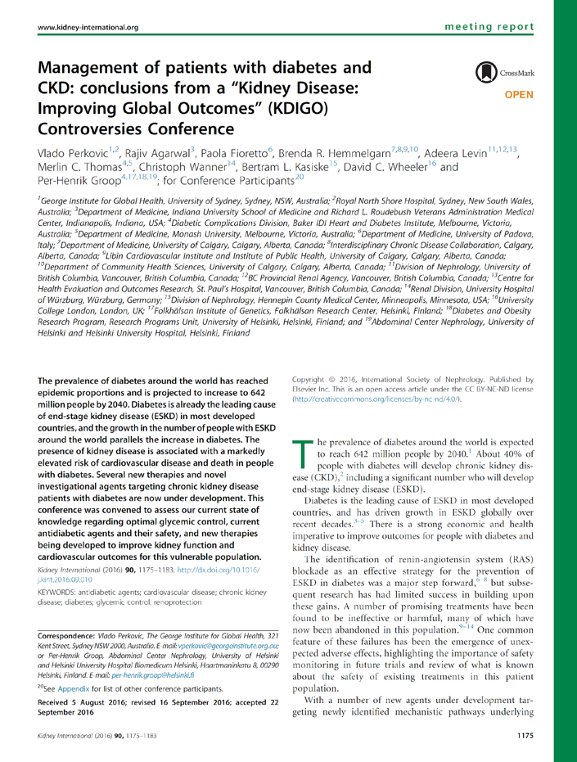
KDIGO Controversies Conference: Diabetes & CKD
February, 2015 (Vancouver, BC)
Topics:
  Lifestyle measures
  Glycemic control
  Cardiovascular & other outcomes
  Paths forward for new therapies
Report published in Kidney International (2016)
Led to initiation of new clinical practice guideline

Slide 5
Timeline: Guideline for Diabetes Management in CKD
Jun 15 - Aug 15
Evidence Review
Jan 14 - Jan 16
Meeting 1
Sep 15 - Sep 16
Meeting 2
Dec 19 - Jan 31
Guideline Public Review
Meeting 0
Apr 20
Scope of Work Public Review
Mar 27
Guideline Kickoff
Appointment of Work Group
Jun 15
Print Publication
Oct 15
Oct 1
2017
2018
2019
2020
Oct
Feb
Jun
Oct
Feb
Jun
Oct
Feb
Jun
Oct
2021

Slide 6
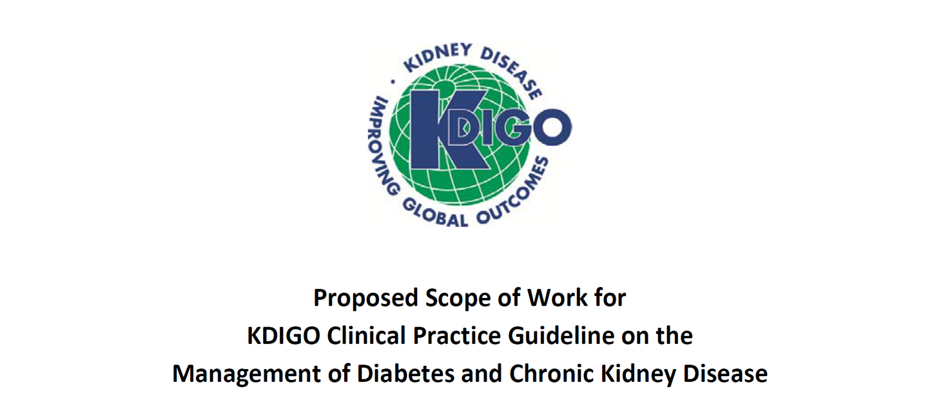
The Beginning

Slide 7
Scope of the Clinical Practice Guideline
Include:
Types 1 and 2 diabetes
All stages of CKD
  Kidney transplant recipients
  Dialysis
Interventions addressed with rigorous data (RCTs)
  Lifestyle
  Pharmacotherapy
  Systems
Exclude:
Interventions covered elsewhere
  Blood pressure
  Lipids
Prevention & screening
Topics with insufficient data
  Diagnosis
  Emerging & pipeline therapies

Slide 8
Guideline goals
Generate a useful resource for clinicians and patients
  Address relevant questions with actionable recommendations
  Take on controversial topics when sufficient evidence
  Communicate clearly: highlight figures and tables
Stay true to evidence
Target audience: broad, primarily clinicians treating diabetes & CKD
Be mindful of implications for policy and payment
Propose research questions

Slide 9
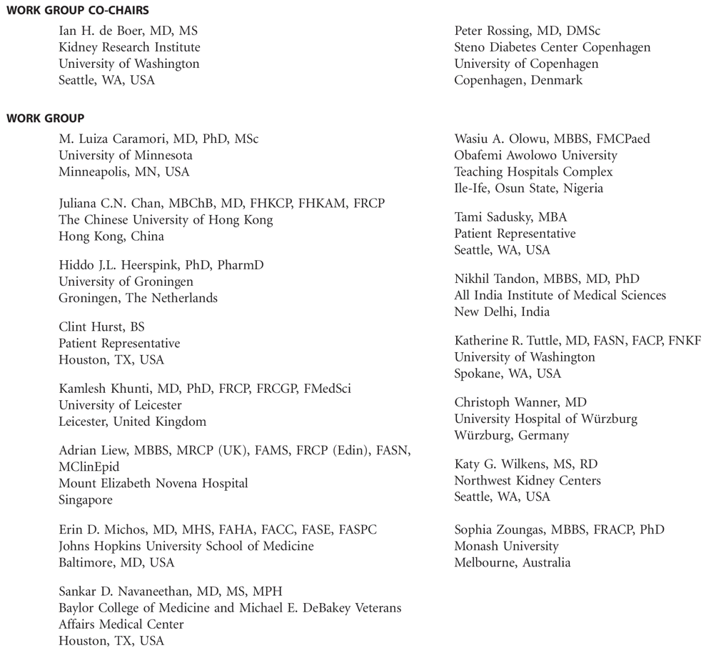
Work Group
Diverse expertise
Worldwide scope
Deep experience
Patients
Evidence Review Team

Slide 10


















Work Group

Slide 11






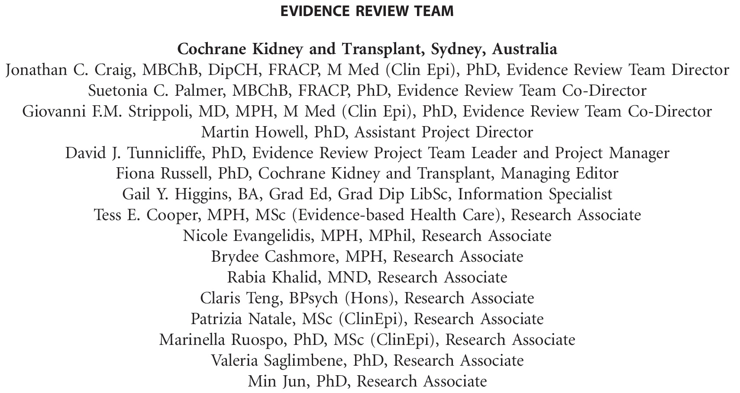



Slide 12
Challenges to the Guideline
What to do when evidence is lacking?
  Balance providing guidance with rigor
How to address clinically relevant groups of patients?
  Type 1 and Type 2 diabetes
  CKD stages
  Kidney failure/ESKD
  Transplant recipients

Slide 13

Evidence review
ERT - Cochrane Kidney Transplant
PICO questions developed
Clinical and important outcomes identified
Critical outcomes | Important outcomes
All-cause mortality | Albuminuria progression
Cardiovascular mortality | Acute kidney injury
3-point and 4-point MACE | Falls
Kidney failure (ESKD) | Harms (fatigue, amputations, fractures, etc.)
Cardiovascular outcomes - myocardial infarction, stroke, heart failure | Hyperkalemia
Doubling serum creatinine | Quality of life
Hypoglycemia requiring 3rd party assistance | Blood pressure
HbA1c | Body weight, body mass index (BMI)

Slide 14
Evidence Review
ERT - Cochrane Kidney Transplant
  Existing PICO questions and new PICO questions developed
  Clinical and important outcomes identified
Critical outcomes | Important outcomes
All-cause mortality | Albuminuria progression - (onset of albuminuria, micro to macroalbuminuria)
End-stage kidney disease
Cardiovascular outcomes - MACE, myocardial infarction, stroke, heart failure
Doubling serum creatinine
Hypoglycemia requiring 3rd party assistance
HbA1c

Slide 15
PICO questions
Focus on RCTs - mapped to existing Cochrane Systematic reviews
  New systematic reviews undertaken as required
  Some focused observational studies reviews
  General diabetes population - Existing systematic reviews
Population | Intervention | Comparator | Outcome
Comprehensive care
Patients with CKD and diabetes | Antihypertensive – RAS, aldosterone antagonists, direct renin inhibitors | Placebo / standard of care | Critical and important outcomes, hyperkalemia, AKI
Patients with CKD and diabetes | Other – potassium binders, antiplatelet therapy, bariatric surgery, weight loss therapy, smoking cessation | Placebo / standard of care | Critical and important outcomes, hyperkalemia, AKI, QoL, BP, BMI, weight fatigue

Slide 16
Population | Intervention | Comparator | Outcome
Glycemic monitoring and targets
Patients with CKD and diabetes General diabetes population | Continuous glucose monitoring Self-monitoring blood glucose | Measured blood glucose/ HbA1c | Diagnosis – sensitivity, specificity Correlation
Patients with CKD and diabetes General diabetes population | Alternative biomarkers (glycated albumin, fructosamine, carbamylates albumin) | Measured blood glucose/ HbA1c | Diagnosis – sensitivity, specificity Correlation
Patients with CKD and diabetes | Tight glycemic control (HbA1c targets - ≤7.0%, ≤6.5%, ≤6.0%) | Standard glycemic control | Critical and important outcomes
Lifestyle interventions
Patients with CKD and diabetes | Dietary interventions (protein, salt, potassium, dietary patterns – DASH diet) | Usual diet | Critical and important outcomes, QoL, BP, BMI, weight, fatigue
Patients with CKD and diabetes | Exercise interventions | Standard of care | Critical and important outcomes, QoL, BP, BMI, weight, fatigue

Slide 17
Population | Intervention |  | Comparator | Outcome
Antihyperglycemic therapies
Patients with CKD and diabetes |  | Older – metformin, sulfonylureas, thiazolidinediones, insulins Newer – SGLT2 inhibitors, GLP1 agonists, DPP-4 inhibitors | Standard of care vs other therapies | Critical and important outcomes, BMI, weight Harms - Hypoglycemia, lactic acidosis, amputations
Approaches to management
Patients with CKD and diabetes General diabetes population |  | Education and self-management programs | Standard of care | Critical and important outcomes, QoL, fatigue
Patients with CKD and diabetes General diabetes population |  | Models of care | Standard of care | Critical and important outcomes, Qol, fatigue

Slide 18
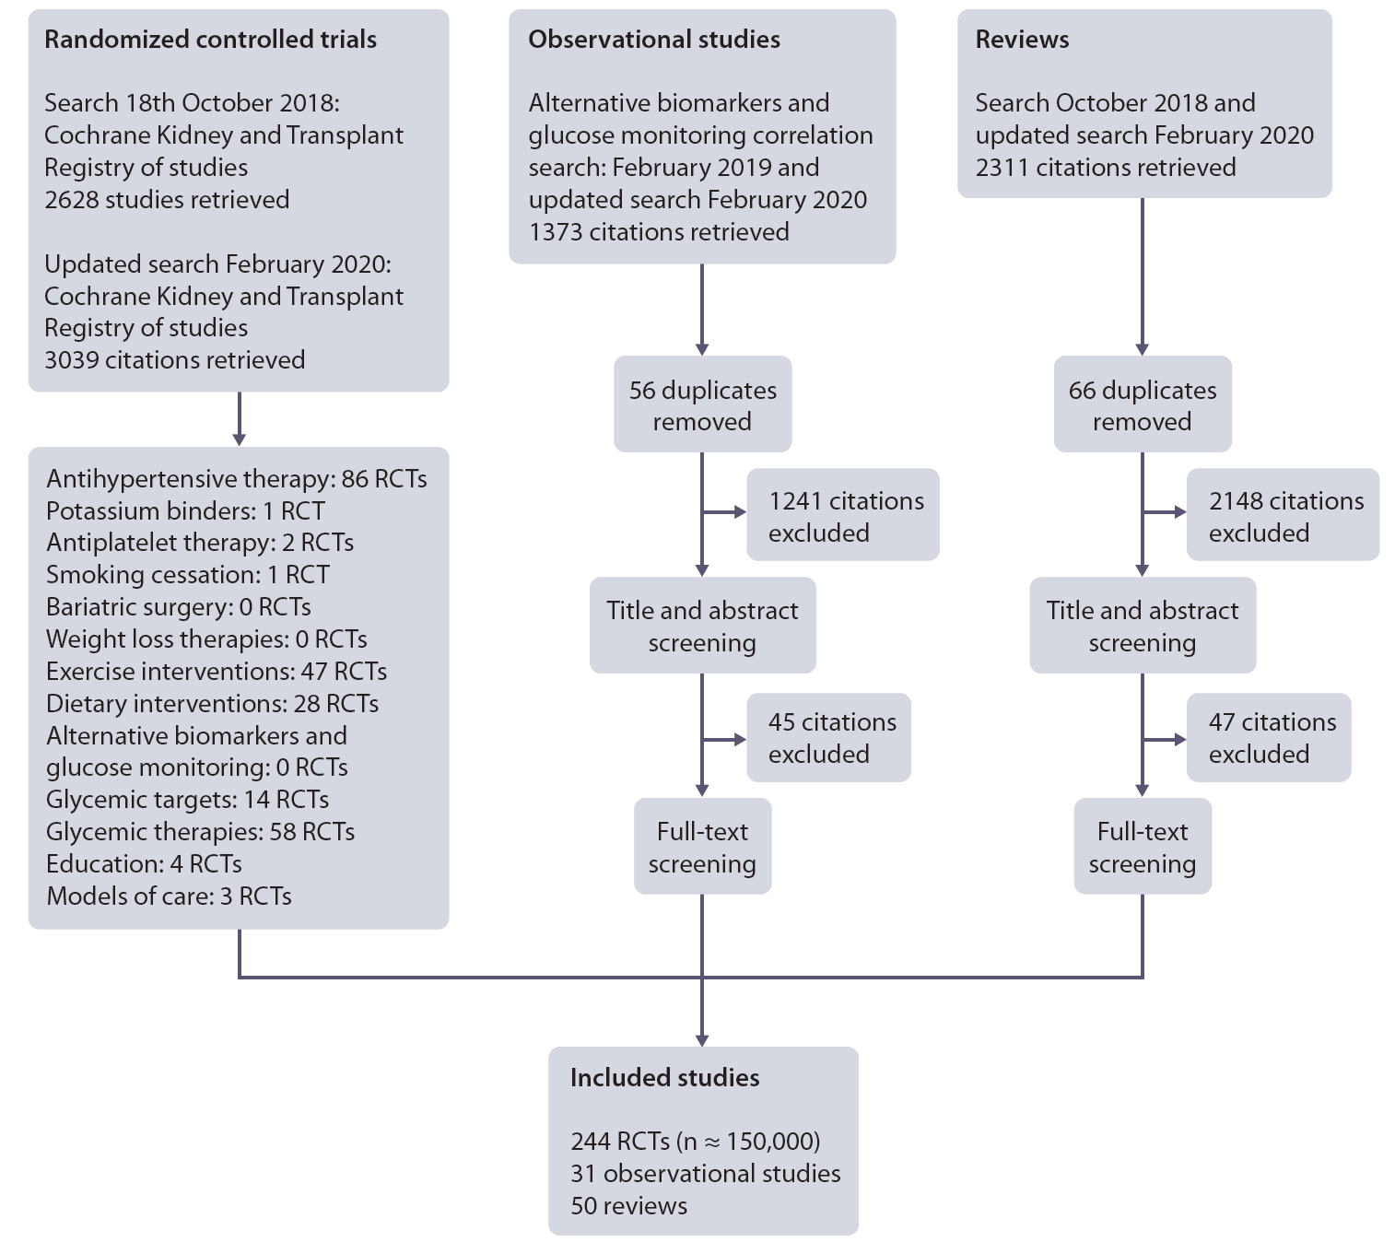
Literature search
October 2018; Updated in February 2020

Slide 19
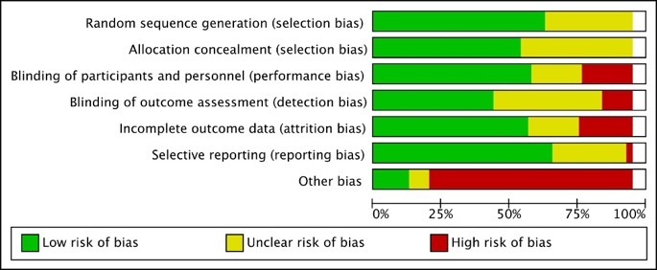
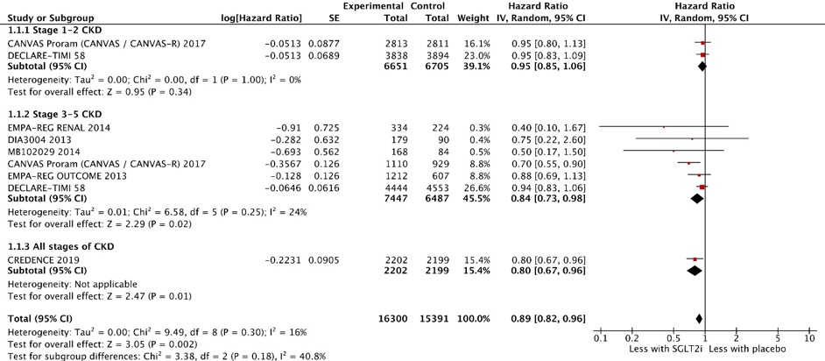
Evidence synthesis
Risk of bias graph example
Standard Cochrane methods – Two independent reviewers
  Data abstraction
  Critical appraisal – using validated tools
Data-analysis
  Random effects meta-analysis and generic inverse variance
    Relative risk for dichotomous outcomes
    Mean difference for continuous outcomes
  Heterogeneity assessed using the I² statistic
Forest plot example – SGLT2 inhibitors – 3-point MACE

Slide 20

Grading recommendations
  GRADE methodology
  The quality of the evidence – Level A, B, C, D
    Study limitations
    Inconsistency
    Indirectness
    Imprecision
    Publication bias
Strength of the recommendation – “We recommend” or “We suggest”
  Two face-to-face meetings – New Orleans Jan 2019, Barcelona Sept 2019
    Balance of benefits and harms
    Quality of the evidence
    Patient values and preferences – Two patients on the workgroup
    Resources and other considerations

Slide 21
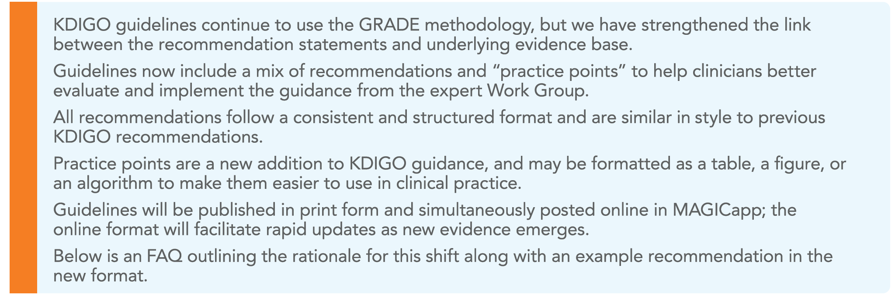
Guideline Format

Slide 22
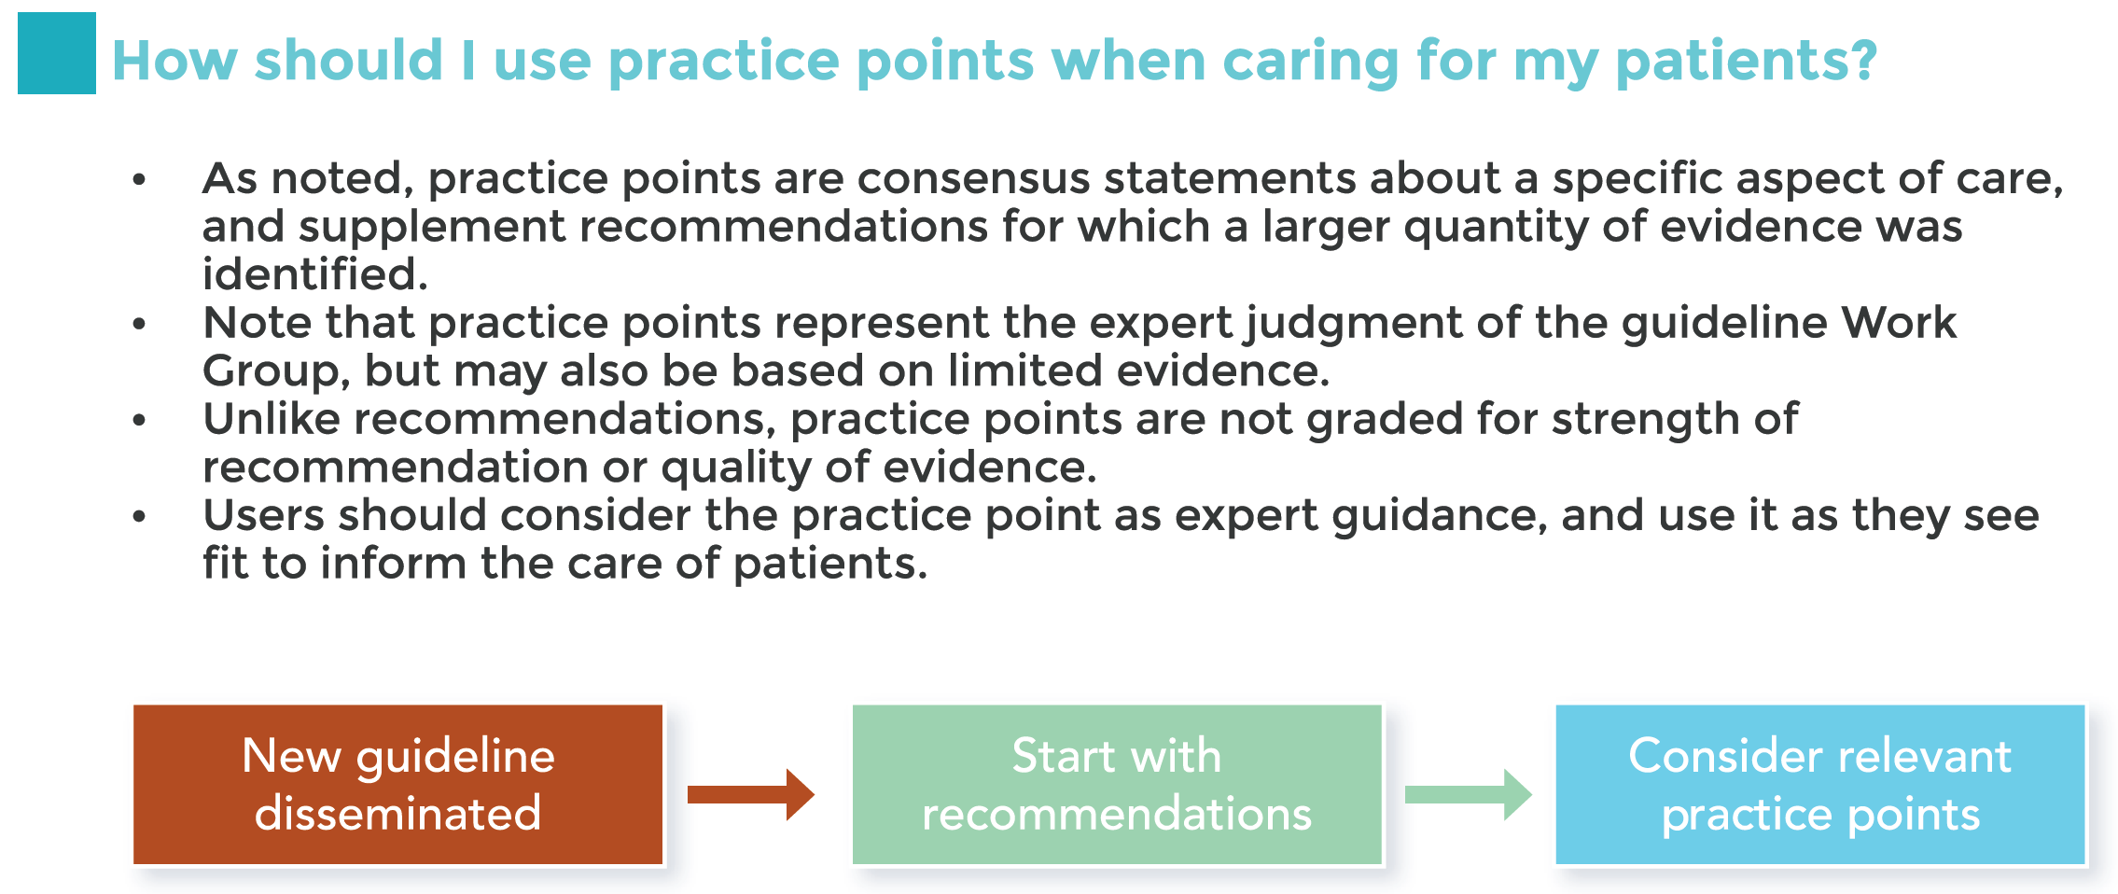
Guideline Format

Slide 23
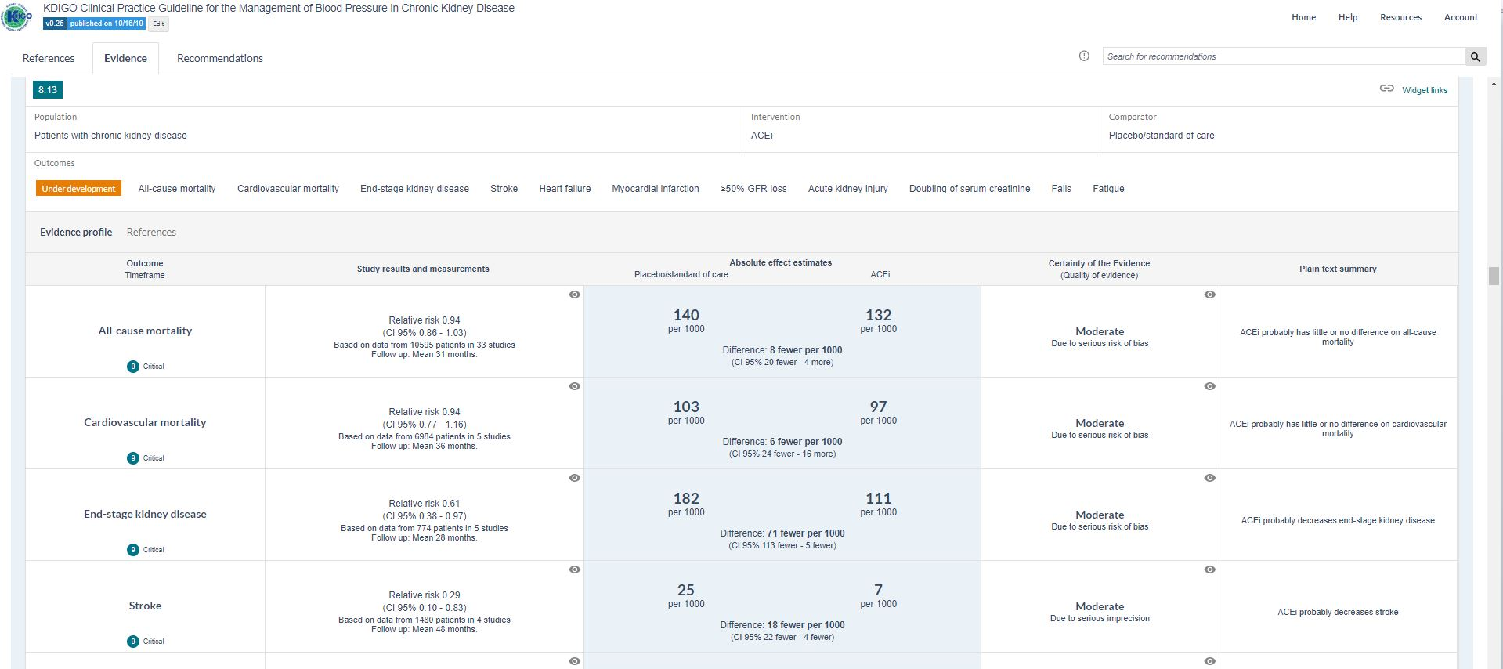
MAGICapp – Evidence to recommendation
Summary of findings tables presented in MAGICapp
Tables are linked directly to recommendations - transparency

Slide 24
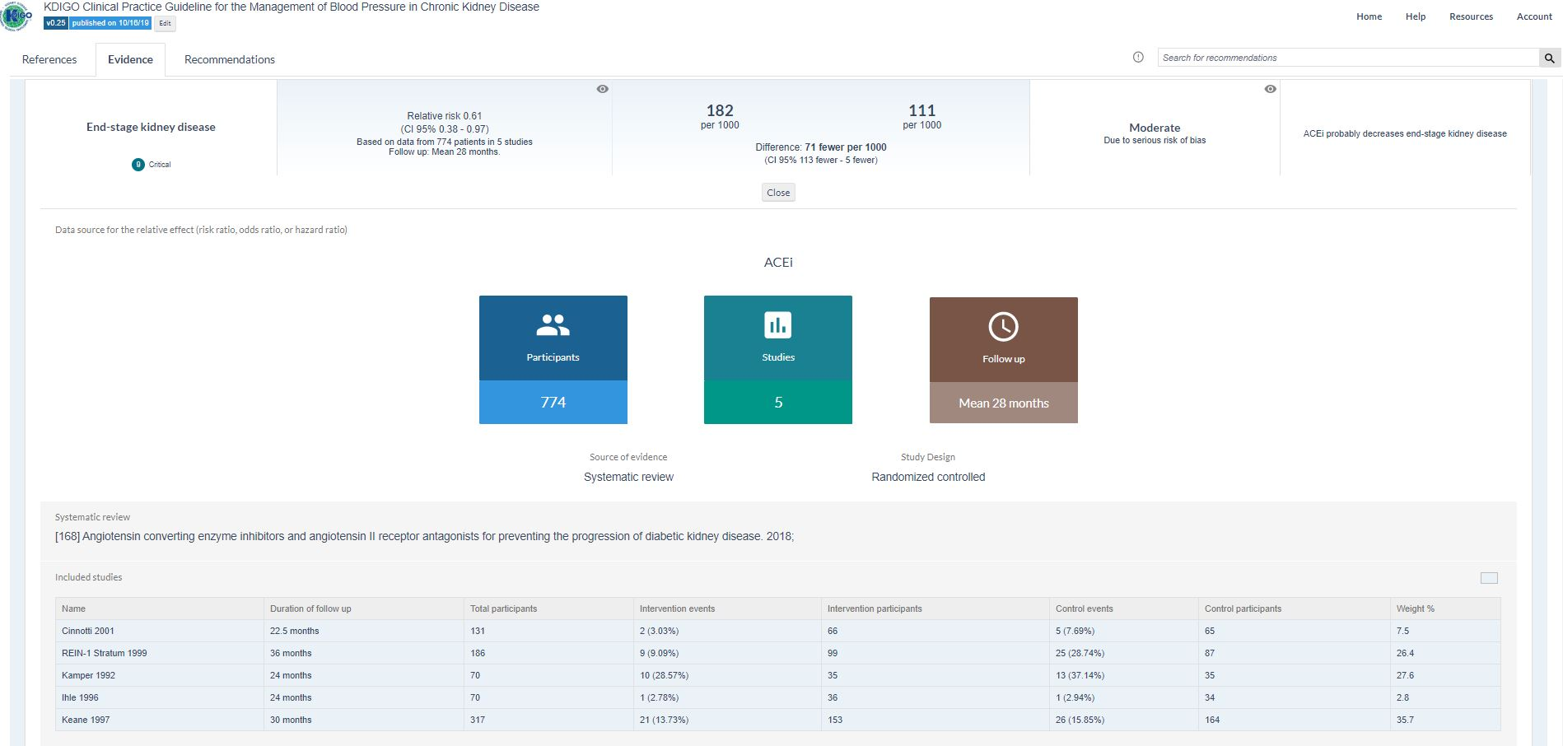
MAGICapp – Evidence to recommendation
Studies and references linked directly to tables
Easy updating – new studies added easily

Slide 25
Diabetes & CKD Guideline Contents
Chapter 1. Comprehensive care in patients with diabetes and CKD
  Comprehensive diabetes and CKD management
  RAS blockade
  Smoking cessation
Chapter 2. Glycemic monitoring and targets in patients with diabetes and CKD
  Glycemic monitoring
  Glycemic targets
Chapter 3. Lifestyle interventions in patients with diabetes and CKD
  Nutrition intake
  Physical activity
Chapter 4. Antihyperglycemic therapies in patients with diabetes and CKD
  Overall approach
  Metformin
  SGLT-2 inhibitors
  GLP-1 receptor agonists
Chapter 5. Approaches to management of patients with diabetes and CKD
  Self-management education programs
  Team-based integrated care

Slide 26
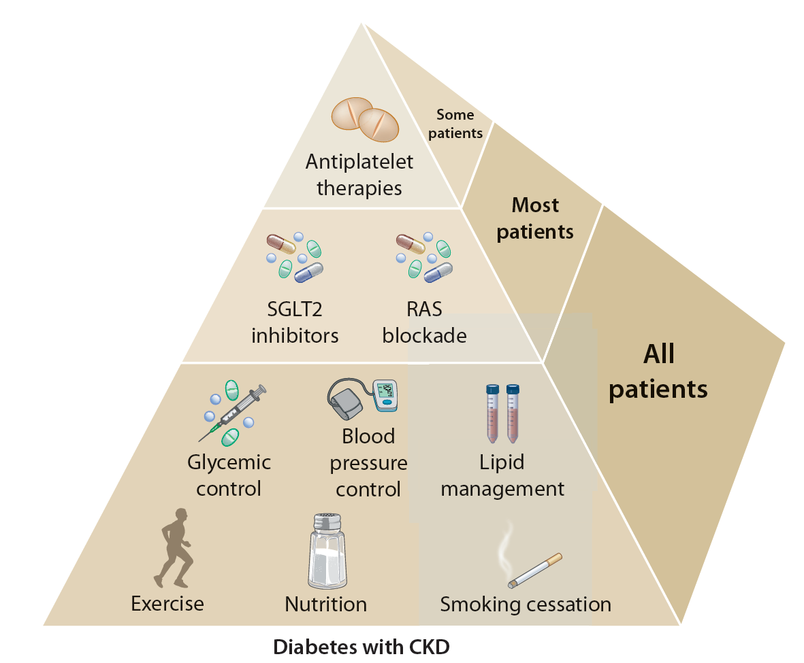
Comprehensive Care in Patients with Diabetes and CKD
Practice Point 1.1.1: Patients with diabetes and chronic kidney disease (CKD) should be treated with a comprehensive strategy to reduce risks of kidney disease progression and cardiovascular disease (Figure 2).
Notes:
*Glycemic control is based on insulin for T1D and metformin for T2D along with SGLT-2 inhibitors. SGLT-2 inhibitors recommended for patients with T2D and CKD. RASi recommended for patients with albuminuria and hypertension. Aspirin should generally be used lifelong for secondary prevention among those with established CVD and may be considered for primary prevention among high-risk individuals, with dual antiplatelet therapy used in patients after acute coronary syndrome or percutaneous coronary intervention.

Slide 27
Comprehensive Care in Patients with Diabetes and CKD
Recommendation 1.2.1: We recommend that treatment with an angiotensin-converting enzyme inhibitor (ACEi) or an angiotensin II receptor blocker (ARB) be initiated in patients with diabetes, hypertension, and albuminuria, and that these medications be titrated to the highest approved dose that is tolerated (1B).

Slide 28
Comprehensive Care in Patients with Diabetes and CKD
Practice Point 1.2.1: For patients with diabetes, albuminuria, and normal blood pressure, treatment with an ACEi or ARB may be considered.
Practice Point 1.2.2: Monitor for changes in blood pressure, serum creatinine, and serum potassium within 2-4 weeks of initiation or increase in the dose of an ACEi or ARB (Figure 4).
Practice Point 1.2.3: Continue ACEi or ARB therapy unless serum creatinine rises by more than 30% within 4 weeks following initiation of treatment or an increase in dose (Figure 4).
Practice Point 1.2.4: Advise contraception in women who are receiving ACEi or ARB therapy and discontinue these agents in women who are considering pregnancy or who become pregnant.

Slide 29
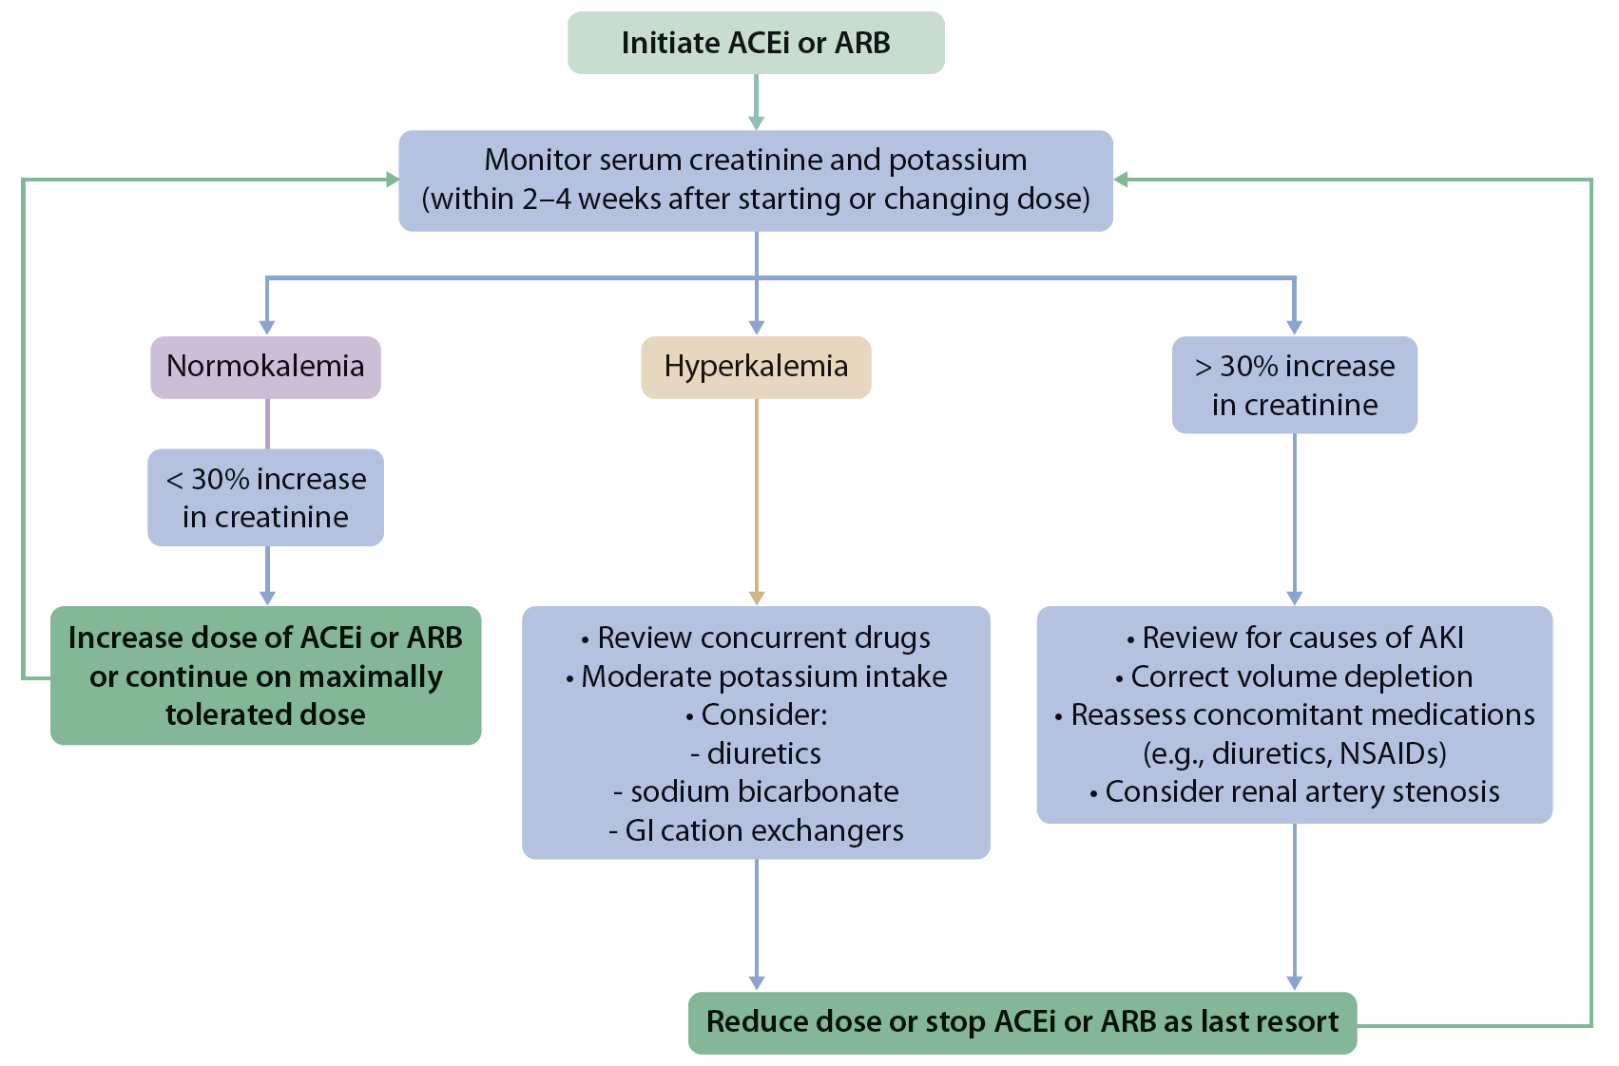
Figure 4. Monitoring of serum creatinine and potassium during ACEi or ARB treatment - dose adjustment and monitoring of side effects

Slide 30
Comprehensive Care in Patients with Diabetes and CKD
Practice Point 1.2.5: Hyperkalemia associated with the use of an ACEi or ARB can often be managed by measures to reduce serum potassium levels rather than decreasing the dose or stopping ACEi or ARB immediately (Figure 4).
Practice Point 1.2.6: Reduce the dose or discontinue ACEi or ARB in the setting of either symptomatic hypotension or uncontrolled hyperkalemia despite medical treatment outlined in Practice Point 1.2.5., or to reduce uremic symptoms while treating kidney failure (estimated glomerular filtration rate [eGFR] <15 ml/min per 1.73 m²).
Practice Point 1.2.7: Use only one agent at a time to block the RAS. The combination of an ACEi with an ARB, or the combination of an ACEi or ARB with a direct renin inhibitor, is potentially harmful.
Practice Point 1.2.8: Mineralocorticoid receptor antagonists are effective for management of refractory hypertension but may cause hyperkalemia or a reversible decline in glomerular filtration, particularly among patients with a low eGFR.

Slide 31
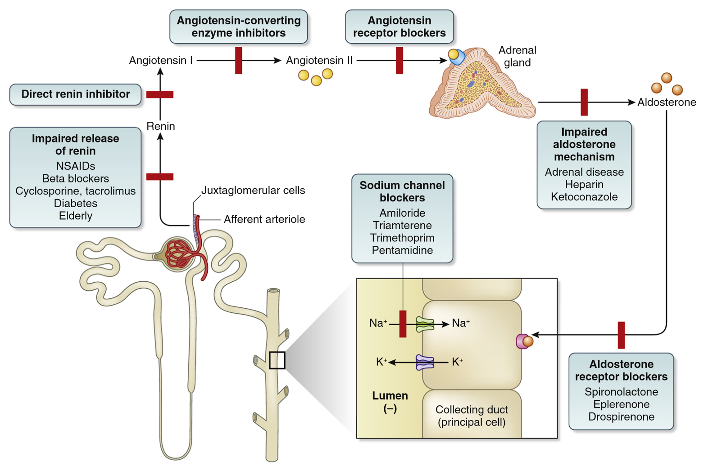
Drugs causing hyperkalemia
Notes:
https://www.kidney-international.org/article/S0085-2538(19)31012-9/abstract

Slide 32
Comprehensive Care in Patients with Diabetes and CKD
Recommendation 1.3.1: We recommend advising patients with diabetes and CKD who use tobacco to quit using tobacco products (1D).
Practice Point 1.3.1: Physicians should counsel patients with diabetes and CKD to reduce secondhand smoke exposure.

Slide 33
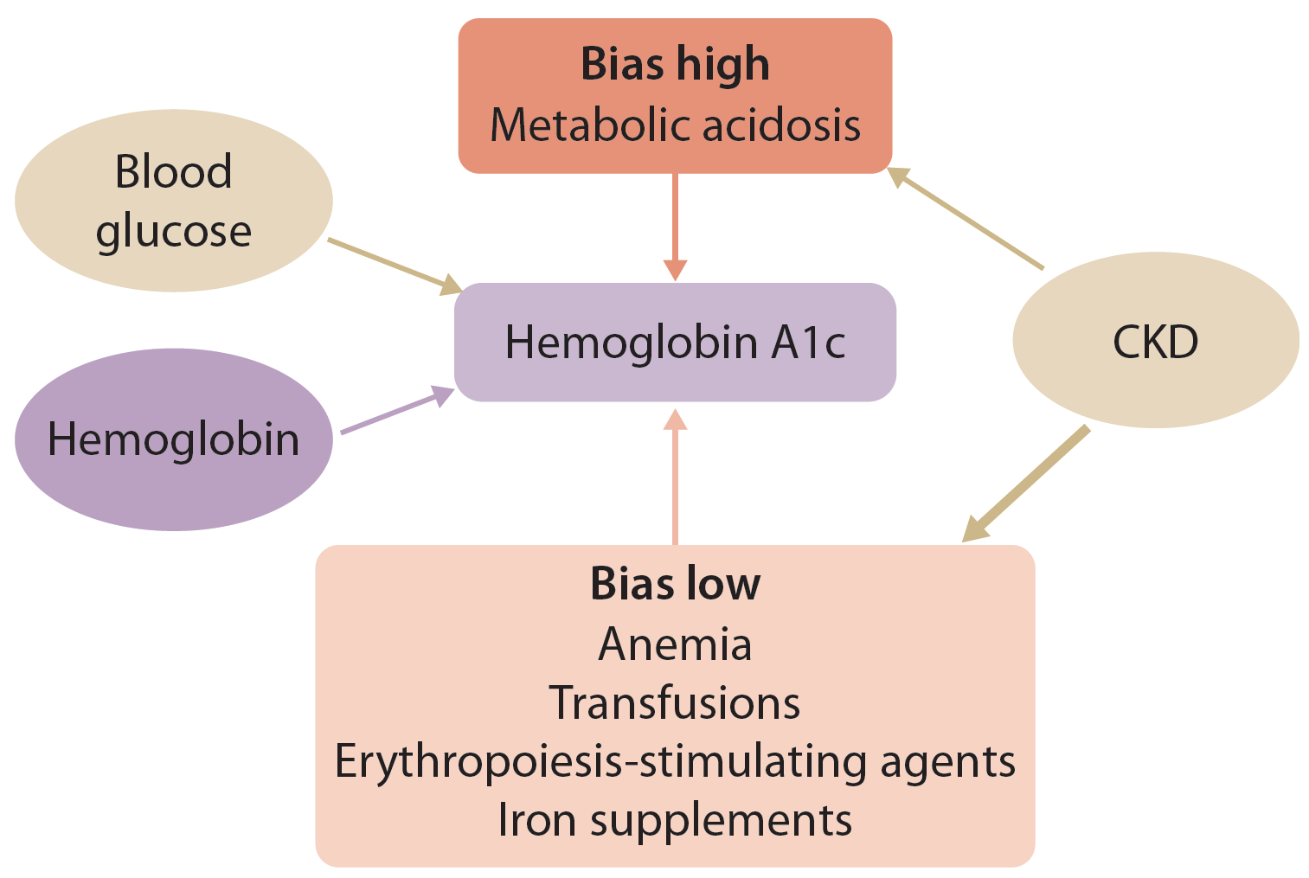
Glycemic Monitoring and Targets in Patients with Diabetes and CKD
Recommendation 2.1.1: We recommend hemoglobin A1c (HbA1c) to monitor glycemic control in patients with diabetes and CKD (1C).
Practice Point 2.1.1: Monitoring long-term glycemic control by HbA1c twice per year is reasonable for patients with diabetes. HbA1c may be measured as often as 4 times per year if the glycemic target is not met or after a change in antihyperglycemic therapy.
Practice Point 2.1.2: Accuracy and precision of HbA1c measurement declines with advanced CKD (G4-G5), particularly among patients treated by dialysis, in whom HbA1c measurements have low reliability.

Slide 34
Glycemic Monitoring and Targets in Patients with Diabetes and CKD
Practice Point 2.1.3: A glucose management indicator (GMI) derived from continuous glucose monitoring (CGM) data can be used to index glycemia for individuals in whom HbA1c is not concordant with directly measured blood glucose levels or clinical symptoms.
Practice Point 2.1.4: Daily glycemic monitoring with CGM or self-monitoring of blood glucose (SMBG) may help to prevent hypoglycemia and improve glycemic control when antihyperglycemic therapies associated with risk of hypoglycemia are used.
Practice Point 2.1.5: For patients with type 2 diabetes (T2D) and CKD who choose not to do daily glycemic monitoring by CGM or SMBG, antihyperglycemic agents that pose a lower risk of hypoglycemia are preferred and should be administered in doses that are appropriate for the level of eGFR.
Practice Point 2.1.6: CGM devices are rapidly evolving with multiple functionalities (e.g., real-time and intermittently scanned CGM). Newer CGM devices may offer advantages for certain patients, depending on their values, goals, and preferences.

Slide 35
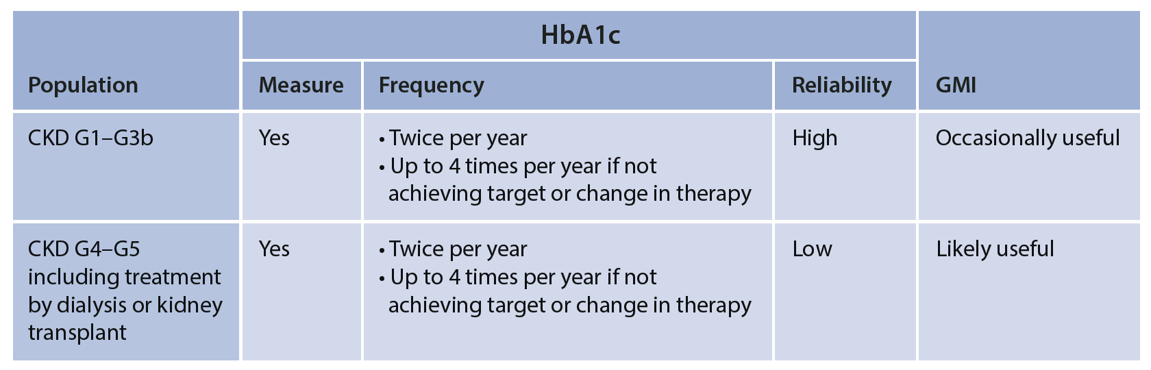
Figure 6. Frequency of HbA1c measurement and use of GMI in CKD

Slide 36
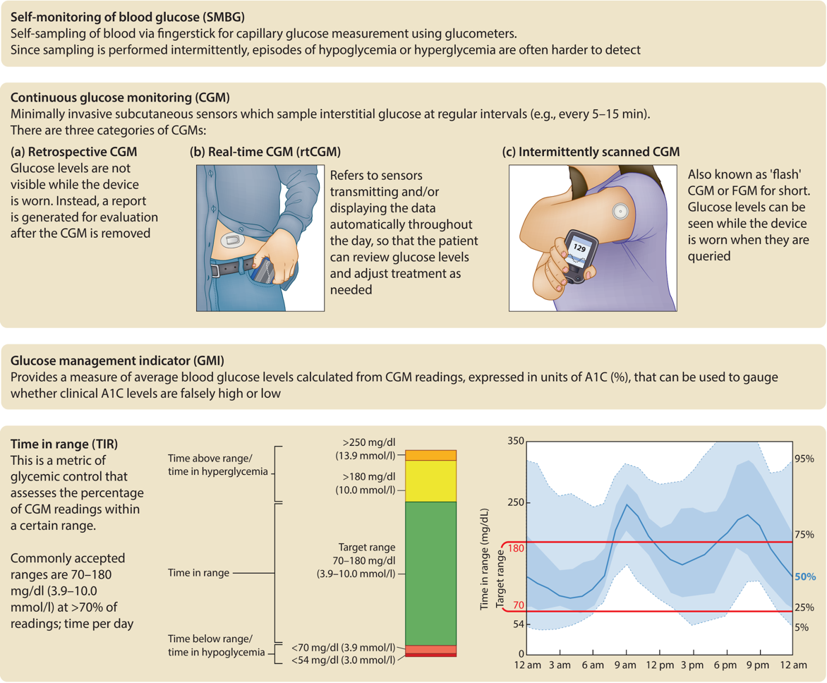
Figure 7. Glossary of glucose-monitoring terms*
*Adapted from Battelino T, et al.

Slide 37
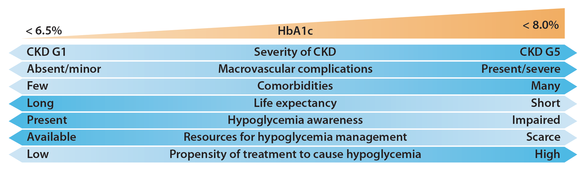
Glycemic Monitoring and Targets in Patients with Diabetes and CKD
Recommendation 2.2.1. We recommend an individualized HbA1c target ranging from <6.5% to <8.0% in patients with diabetes and CKD not treated with dialysis (Figure 9) (1C).

Slide 38
Glycemic Monitoring and Targets in Patients with Diabetes and CKD
Practice Point 2.2.1: Safe achievement of lower HbA1c targets (e.g., <6.5% or <7.0%) may be facilitated by CGM or SMBG and by selection of antihyperglycemic agents that are not associated with hypoglycemia.
Practice Point 2.2.2: CGM metrics, such as time in range and time in hypoglycemia, may be considered as alternatives to HbA1c for defining glycemic targets in some patients.

Slide 39
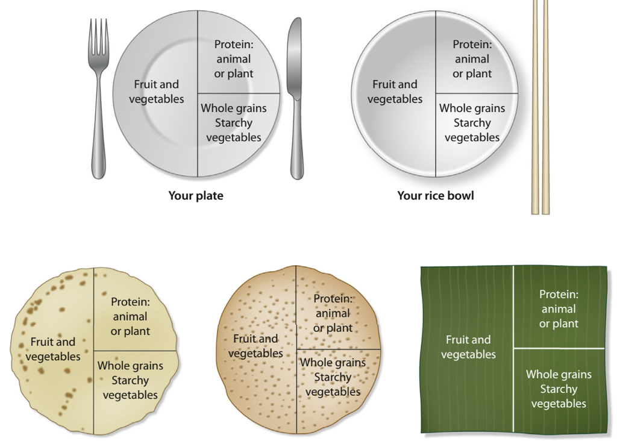
Lifestyle Interventions in Patients with Diabetes and CKD
Practice Point 3.1.1: Patients with diabetes and CKD should consume an individualized diet high in vegetables, fruits, whole grains, fiber, legumes, plant-based proteins, unsaturated fats, and nuts; and lower in processed meats, refined carbohydrates, and sweetened beverages.

Slide 40
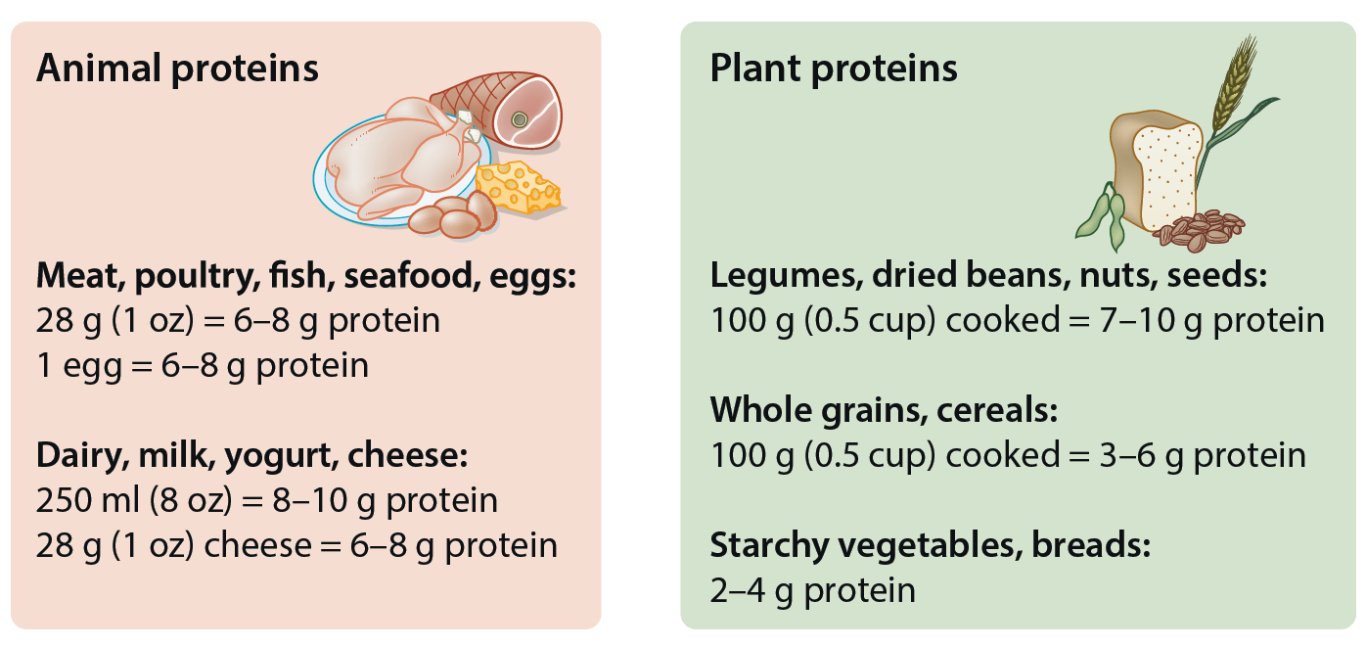
Lifestyle Interventions in Patients with Diabetes and CKD
Recommendation 3.1.1: We suggest maintaining a protein intake of 0.8 g of protein/kg (weight)/d for those with diabetes and CKD not treated with dialysis (2C).
Practice Point 3.1.2: Patients treated with hemodialysis, and particularly peritoneal dialysis should consume between 1.0 and 1.2 g protein/kg (weight)/d.

Slide 41
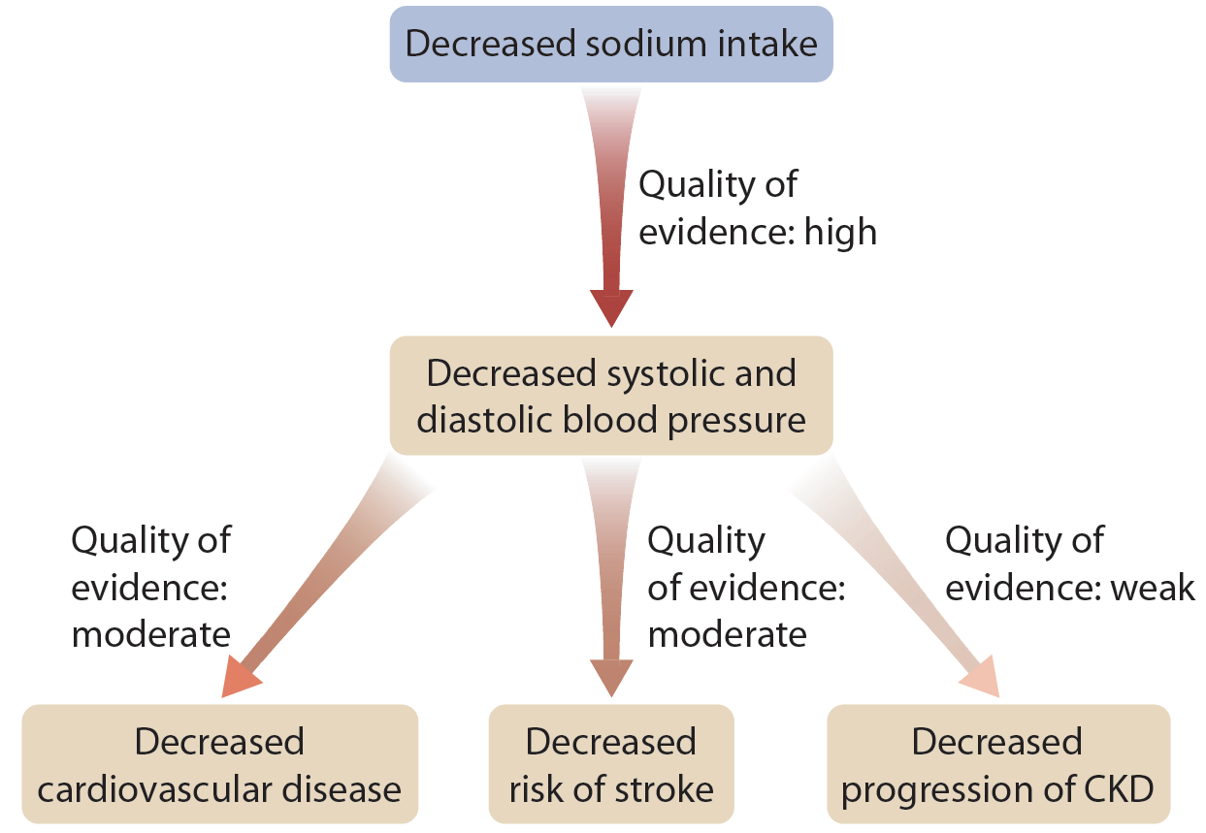
Lifestyle Interventions in Patients with Diabetes and CKD
Recommendation 3.1.2: We suggest that sodium intake be <2 g of sodium per day (or <90 mmol of sodium per day, or <5 g of sodium chloride per day) in patients with diabetes and CKD (2C).

Slide 42
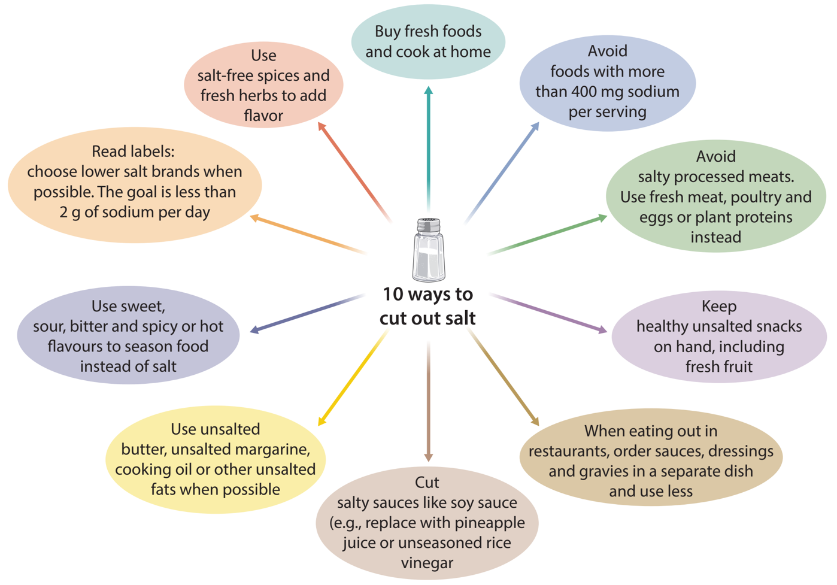
Figure 14. Ten ways to cut out salt

Slide 43
Lifestyle Interventions in Patients with Diabetes and CKD
Practice Point 3.1.3: Shared decision-making should be a cornerstone of patient-centered nutrition management in patients with diabetes and CKD.
Practice Point 3.1.4: Accredited nutrition providers, registered dietitians and diabetes educators, community health workers, peer counselors, or other health workers should be engaged in the multidisciplinary nutrition care of patients with diabetes and CKD.
Practice Point 3.1.5: Health care providers should consider cultural differences, food intolerances, variations in food resources, cooking skills, comorbidities, and cost when recommending dietary options to patients and their families.

Slide 44
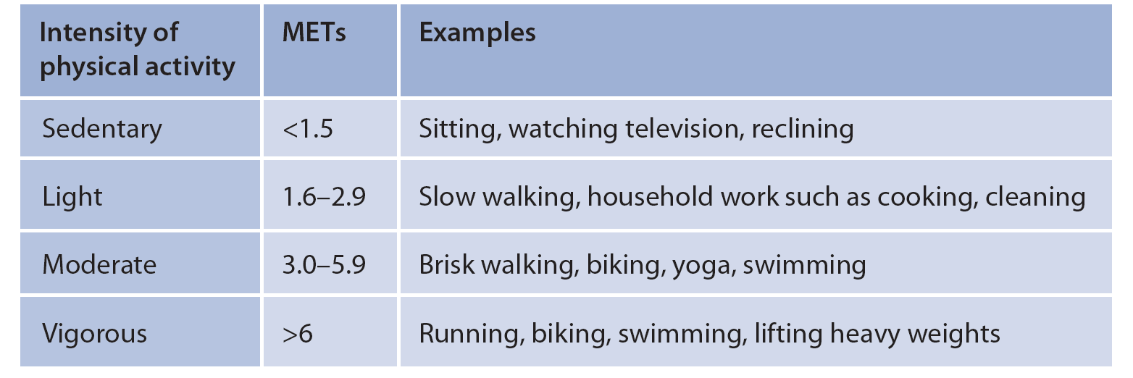
Lifestyle Interventions in Patients with Diabetes and CKD
Recommendation 3.2.1. We recommend that patients with diabetes and CKD be advised to undertake moderate-intensity physical activity for a cumulative duration of at least 150 minutes per week, or to a level compatible with their cardiovascular and physical tolerance (1D).

Slide 45
Lifestyle Interventions in Patients with Diabetes and CKD
Practice Point 3.2.1: Recommendations for physical activity should consider age, ethnic background, presence of other comorbidities, and access to resources.
Practice Point 3.2.2: Patients should be advised to avoid sedentary behavior.
Practice Point 3.2.3: For patients at higher risk of falls, health care providers should provide advice on the intensity of physical activity (low, moderate, or vigorous) and type of exercises (aerobic vs. resistance, or both).
Practice Point 3.2.4: Physicians should consider advising/encouraging patients with obesity, diabetes, and CKD to lose weight, particularly patients with eGFR ≥30 ml/min per 1.73 m².

Slide 46
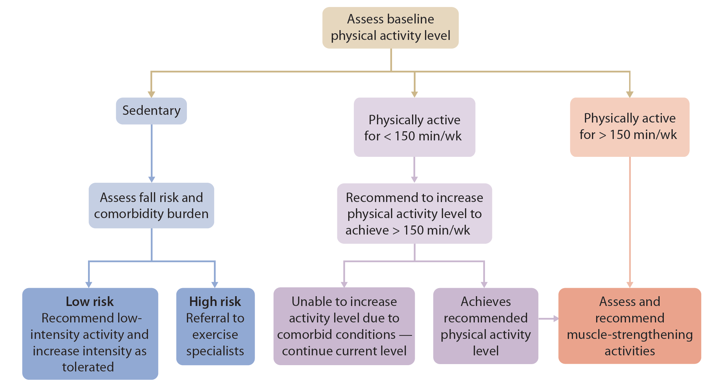
Figure 17. Suggested approach to address physical inactivity and sedentary behavior in CKD

Slide 47
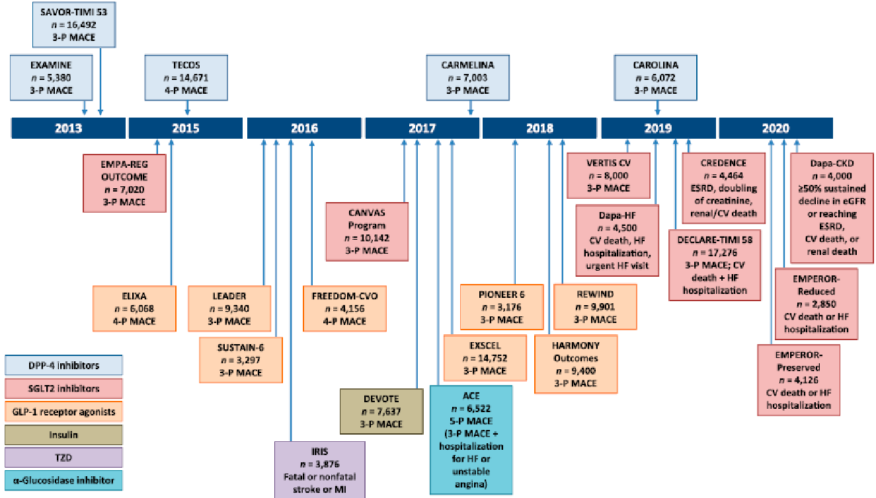
Clinical Trials of New Diabetes Drugs
Cefalu W et al, Diabetes Care 2018

Slide 48
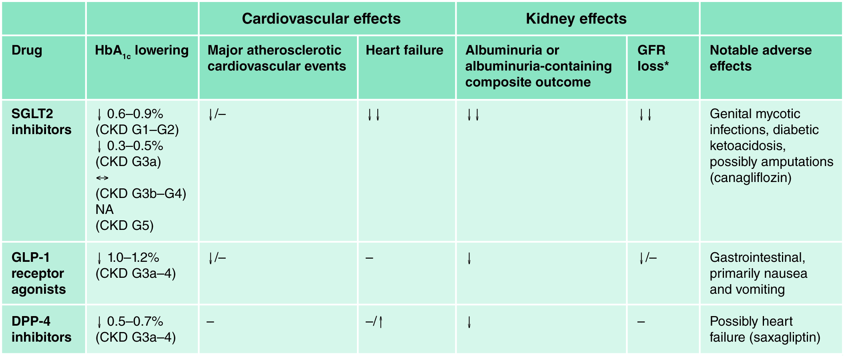
Summary of the benefits and harms of SGLT2 inhibitors, GLP-1 receptor agonists, and DPP-4 inhibitors, by class, as observed in large, placebo-controlled clinical outcomes trials
Notes:
Notes: ↓ = significant reduction in risk, with HR estimate > 0.7 and 95% confidence interval not overlapping 1; ↓↓ = significant reduction in risk, with HR estimate ≤ 0.7 and 95% confidence interval not overlapping 1; ↔ = no change; - = no significant effect; * = variable composite outcomes that include loss of eGFR, ESKD, and related outcomes.

Slide 49
Anti-hyperglycemic Therapies in Patients with Diabetes and CKD
Practice Point 4.1: Glycemic management for patients with T2D and CKD should include lifestyle therapy, first-line treatment with metformin and a sodium-glucose cotransporter-2 inhibitor (SGLT2i), and additional drug therapy as needed for glycemic control (Figure 18).
Practice Point 4.2: Most patients with T2D, CKD, and eGFR ≥30 ml/min per 1.73 m² would benefit from treatment with both metformin and an SGLT2i.
Practice Point 4.3: Patient preferences, comorbidities, eGFR, and cost should guide selection of additional drugs to manage glycemia, when needed, with glucagon-like peptide-1 receptor agonists (GLP-1 RA) generally preferred (Figure 20).

Slide 50
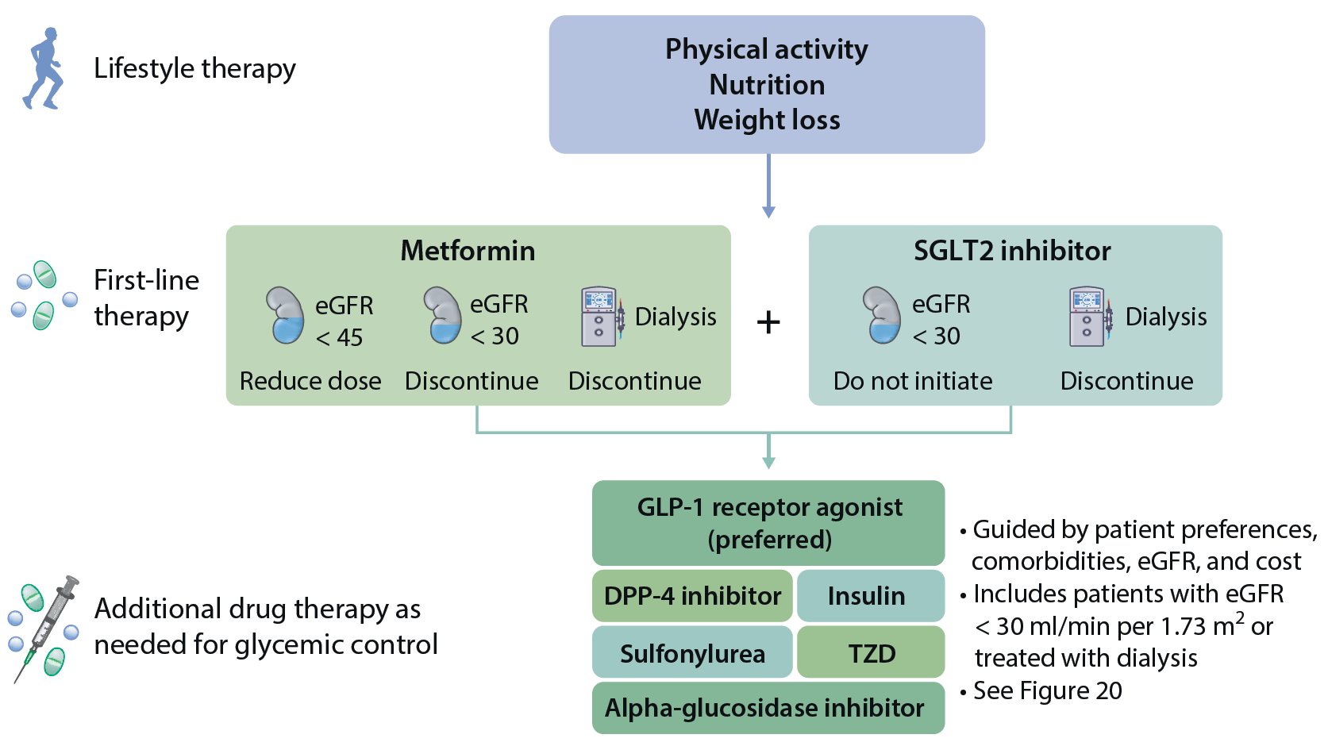
Figure 18. Treatment algorithm for selecting antihyperglycemic drugs for patients with T2D and CKD

Slide 51
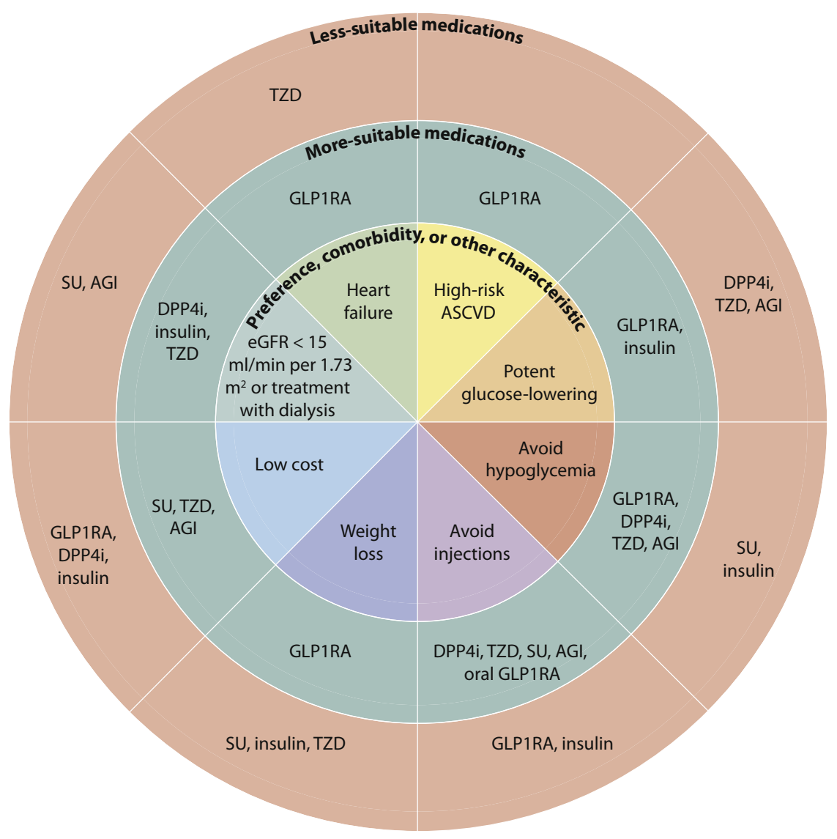
Figure 20. Patient factors influencing selection of glucose-lowering drugs other than SGLT2i and metformin in T2D and CKD

Slide 52
Anti-hyperglycemic Therapies in Patients with Diabetes and CKD
Recommendation 4.1.1: We recommend treating patients with T2D, CKD, and eGFR ≥30 ml/min per 1.73 m² with metformin (1B).
Practice Point 4.1.1: Treat kidney transplant recipients with T2D and eGFR ≥30 ml/min per 1.73 m² with metformin according to recommendations for patients with T2D and CKD.
Practice Point 4.1.2: Monitor eGFR in patients treated with metformin. Increase the frequency of monitoring when eGFR is <60 ml/min per 1.73 m² (Figure 22).

Slide 53
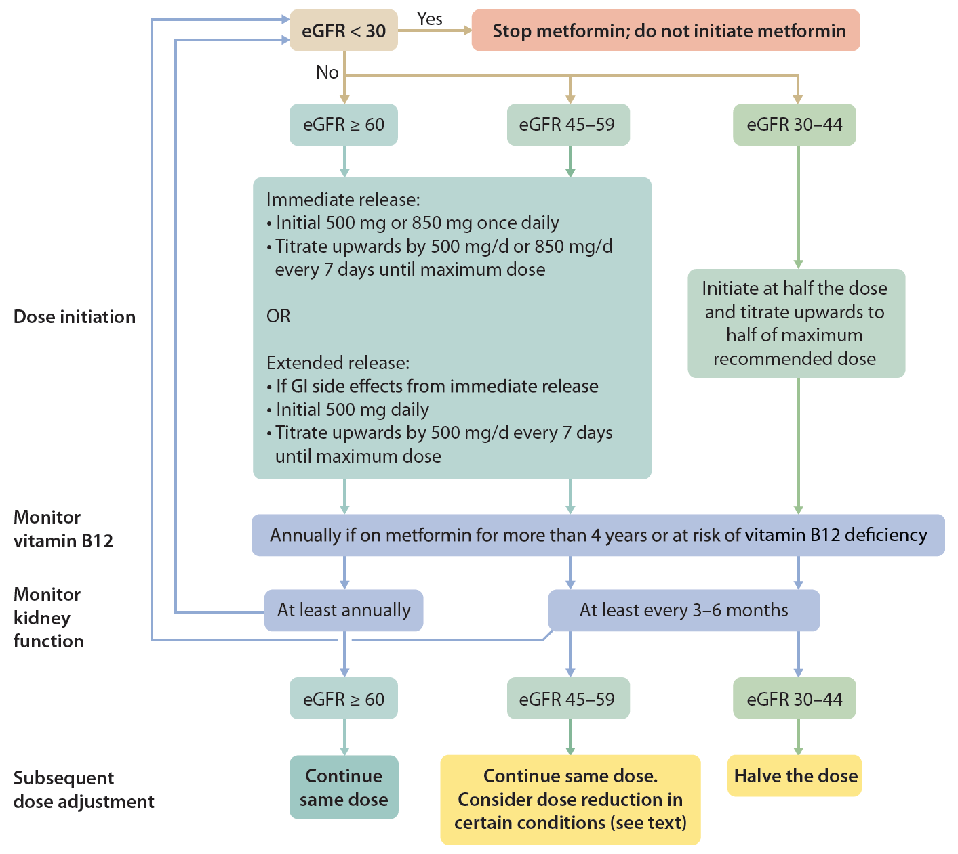
Figure 22. Suggested approach in dosing metformin based on the level of kidney function

Slide 54
Anti-hyperglycemic Therapies in Patients with Diabetes and CKD
Practice Point 4.1.3: Adjust the dose of metformin when eGFR is <45 ml/min per 1.73 m², and for some patients when eGFR is 45-59 ml/min per 1.73 m² (Figure 22).
Practice Point 4.1.4: Monitor patients for vitamin B12 deficiency when they are treated with metformin for more than 4 years.

Slide 55
Anti-hyperglycemic Therapies in Patients with Diabetes and CKD
Recommendation 4.2.1: We recommend treating patients with T2D, CKD, and eGFR ≥30 ml/min per 1.73 m² with an SGLT2i (1A).
Practice Point 4.2.1: An SGLT2i can be added to other antihyperglycemic medications for patients whose glycemic targets are not currently met or who are meeting glycemic targets but can safely attain a lower target (Figure 24).

Slide 56
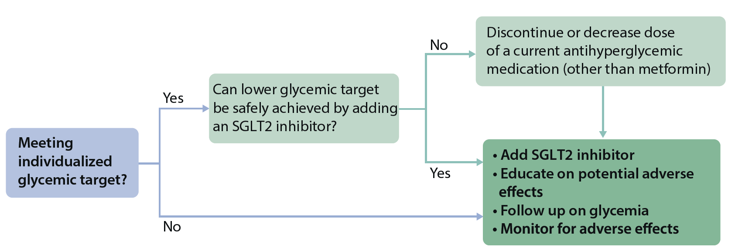
Figure 24. Algorithm for initiation of SGLT2i therapy for patients with T2D, CKD, and eGFR ≥30 ml/min per 1.73 m², who are already being treated with antihyperglycemic medications

Slide 57
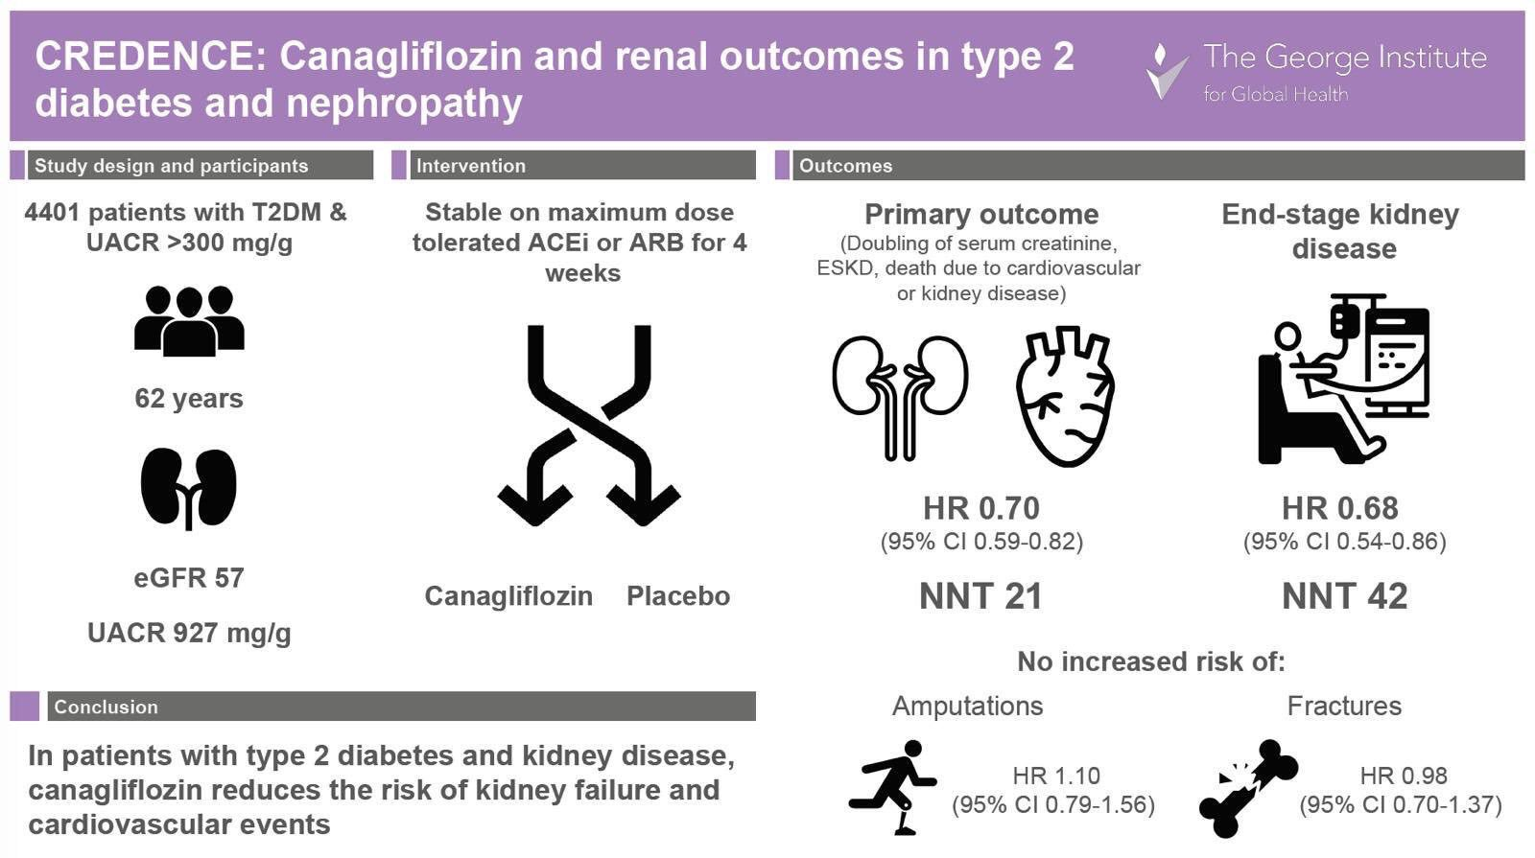

Slide 58
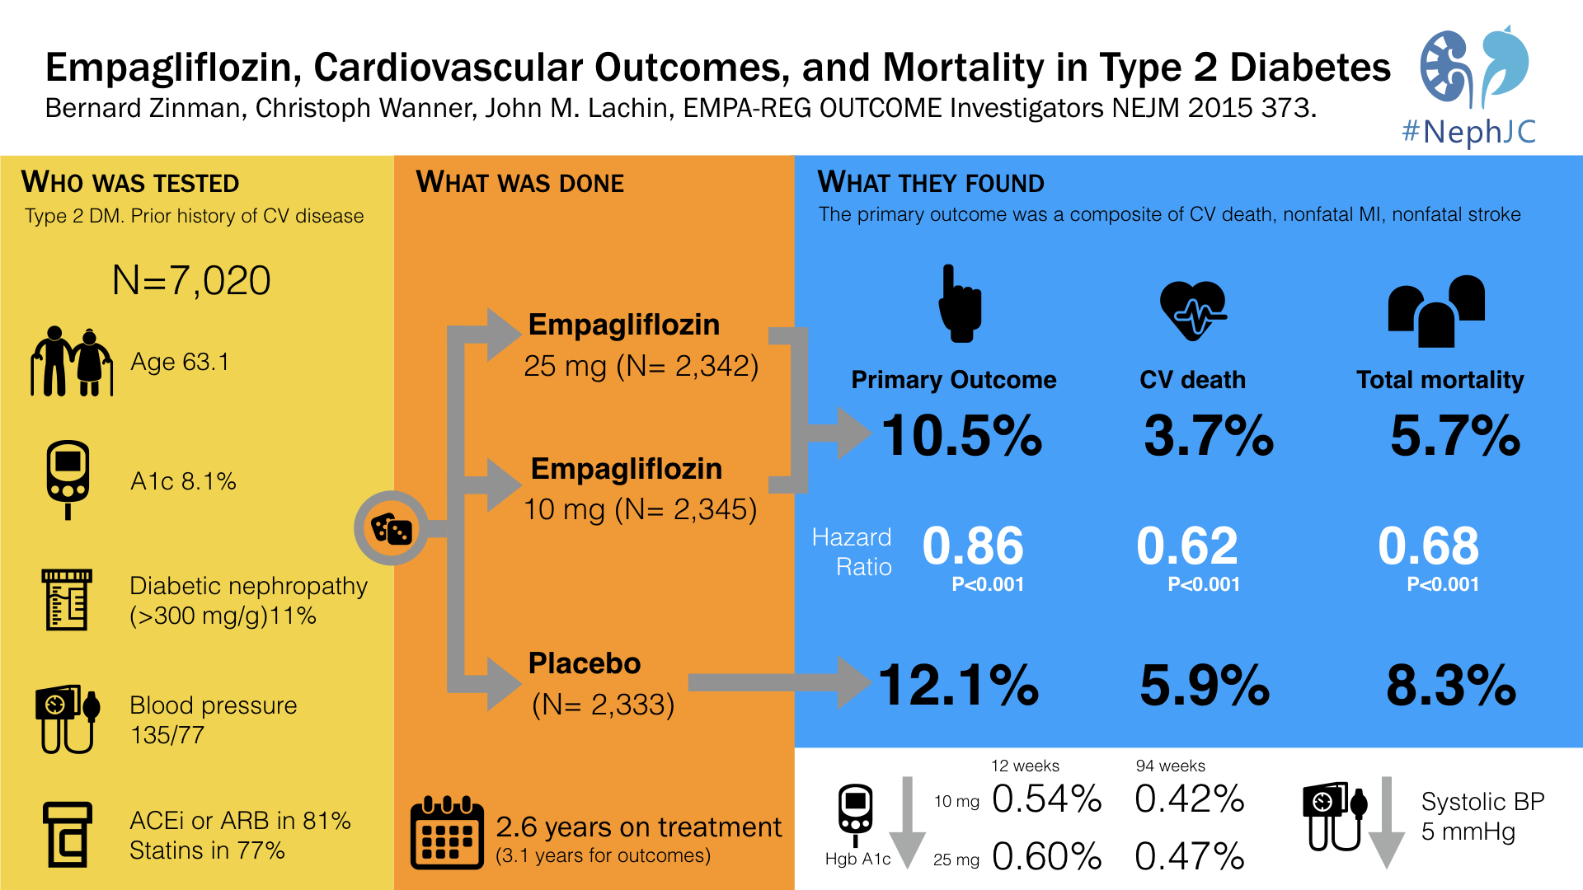

Slide 59
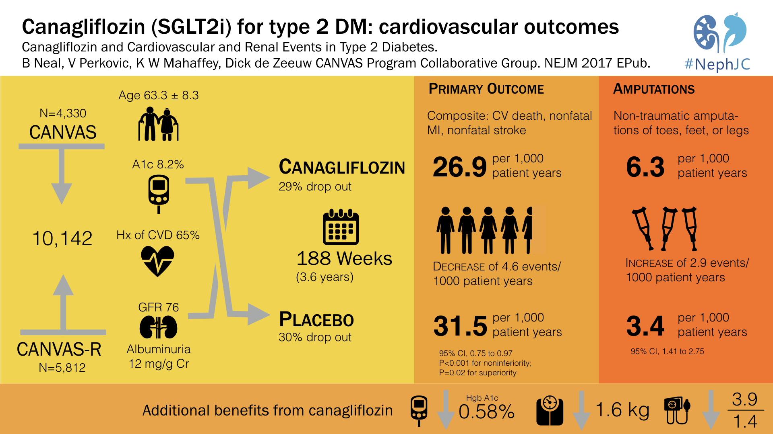

Slide 60
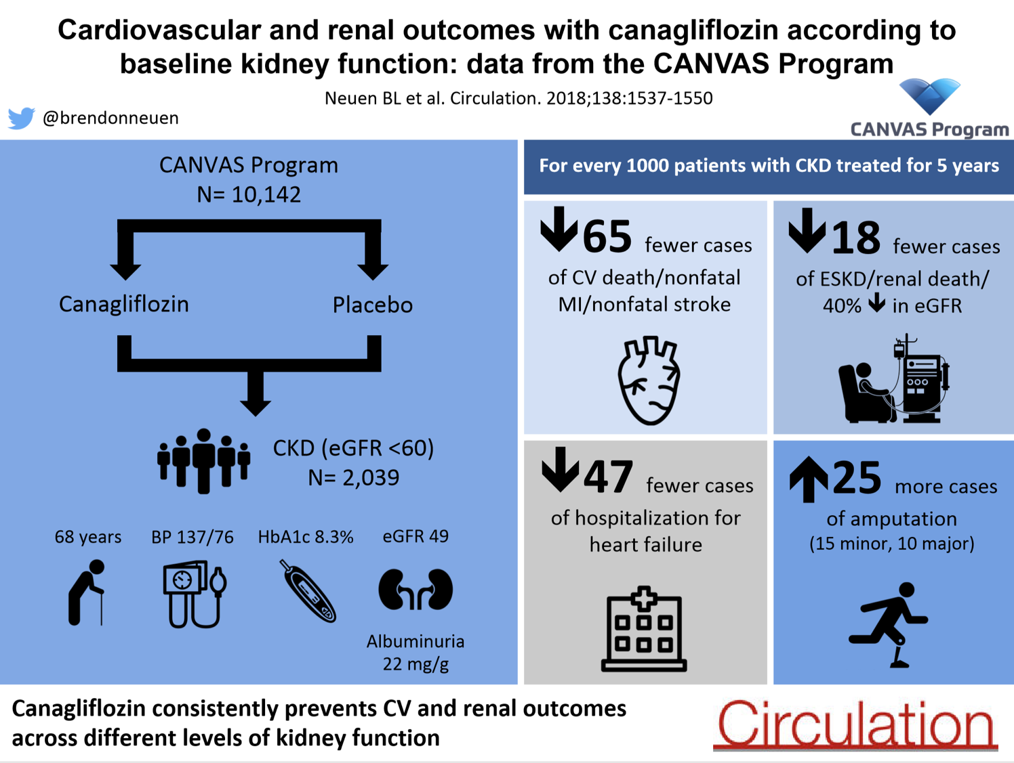

Slide 61
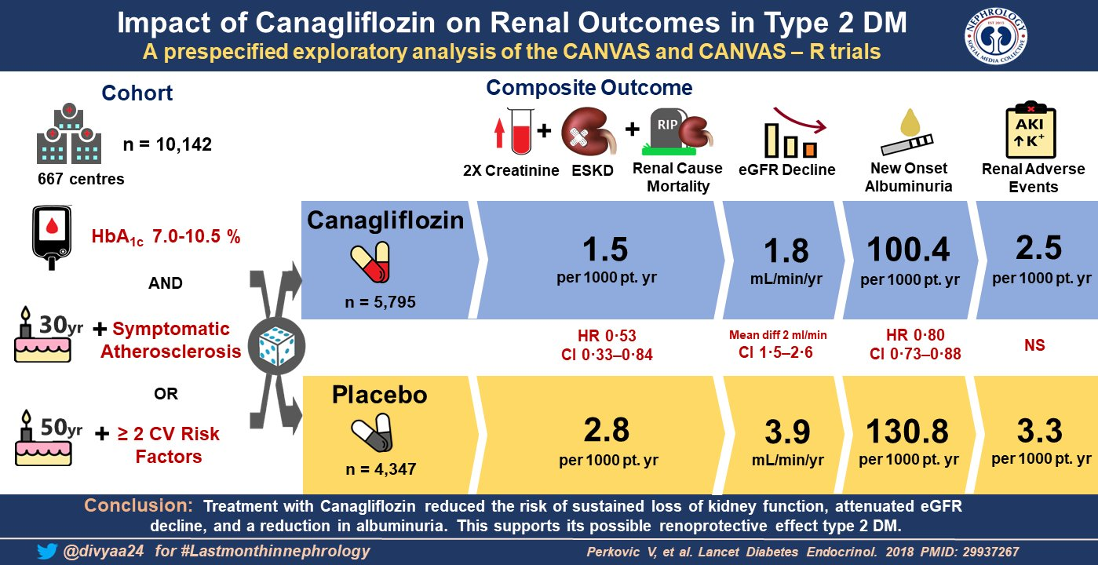

Slide 62
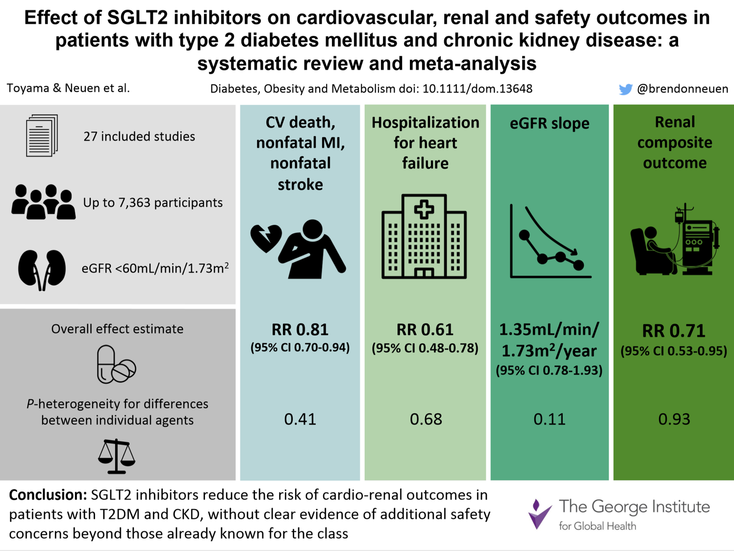

Slide 63
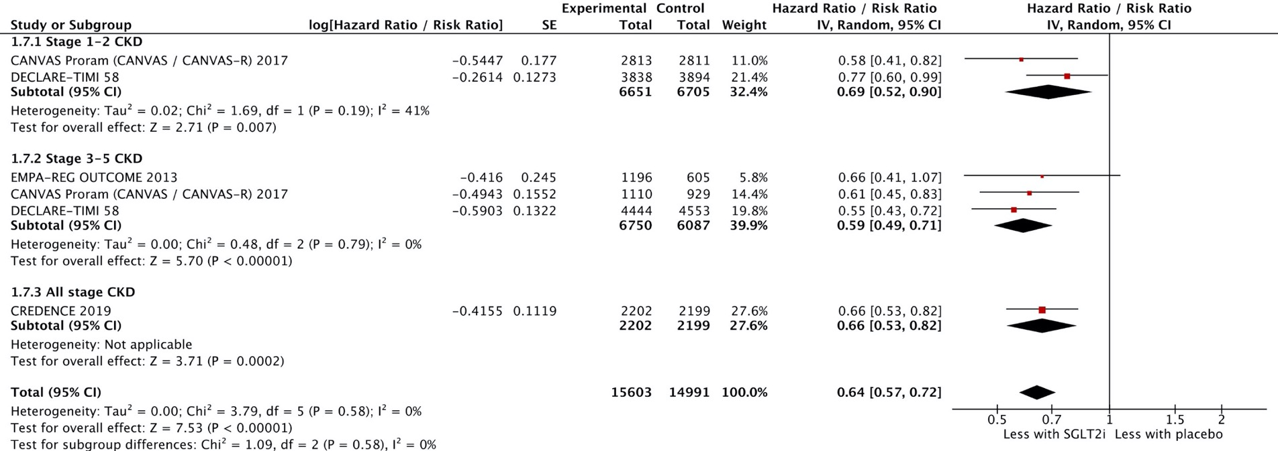
SGLT2 inhibitors and CKD progression

Slide 64
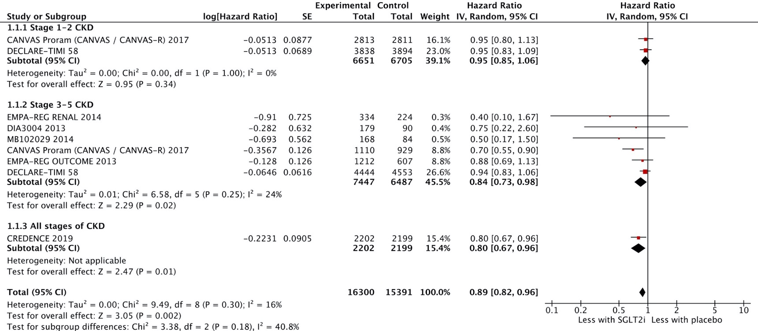
SGLT2 inhibitors and 3-point major cardiovascular events

Slide 65
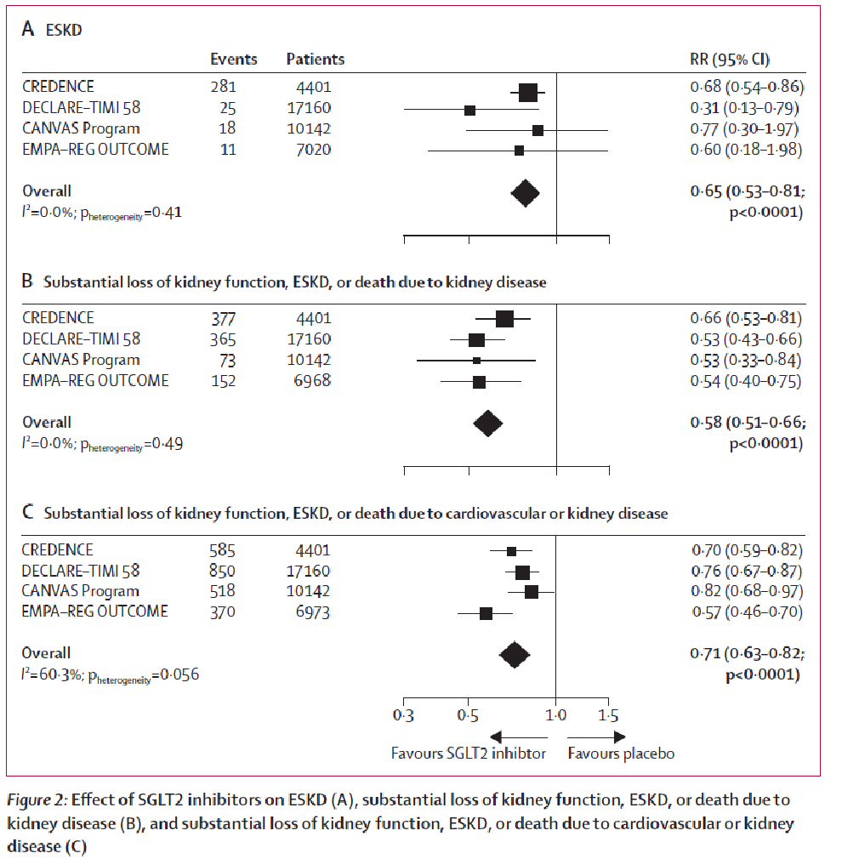
SGLT2 inhibitors and kidney outcomes
B Neuen et al The Lancet D&E Oct 2019

Slide 66
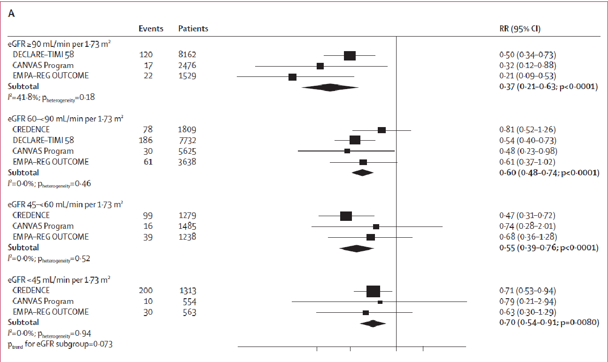

Effect of SGLT2i on substantial loss of kidney function, ESKD, or death due to kidney disease, stratified by baseline eGFR
B Neuen et al The Lancet D&E Oct 2019

Slide 67
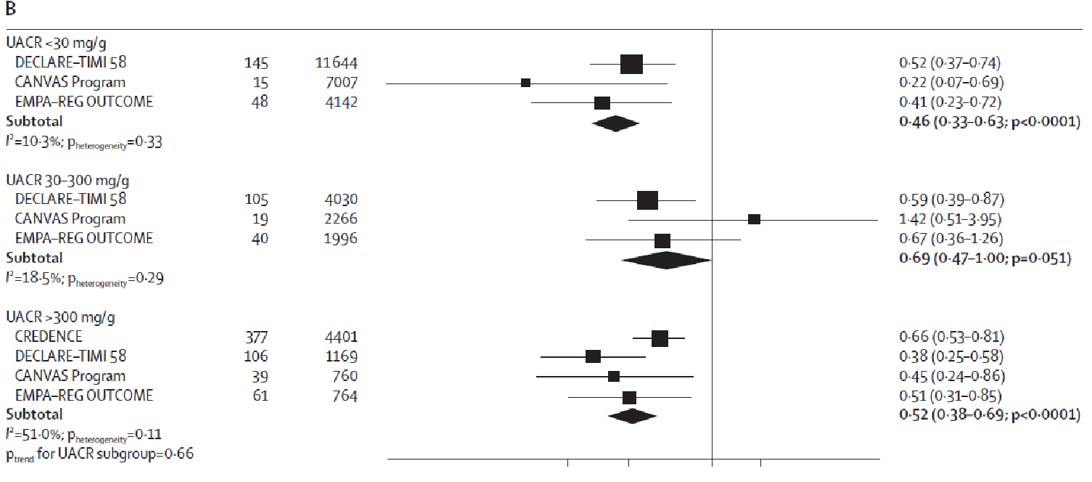
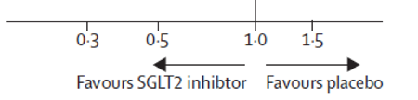
Effect of SGLT2i on substantial loss of kidney function, ESKD, or death due to kidney disease, stratified by baseline ACR
B Neuen et al The Lancet D&E Oct 2019

Slide 68
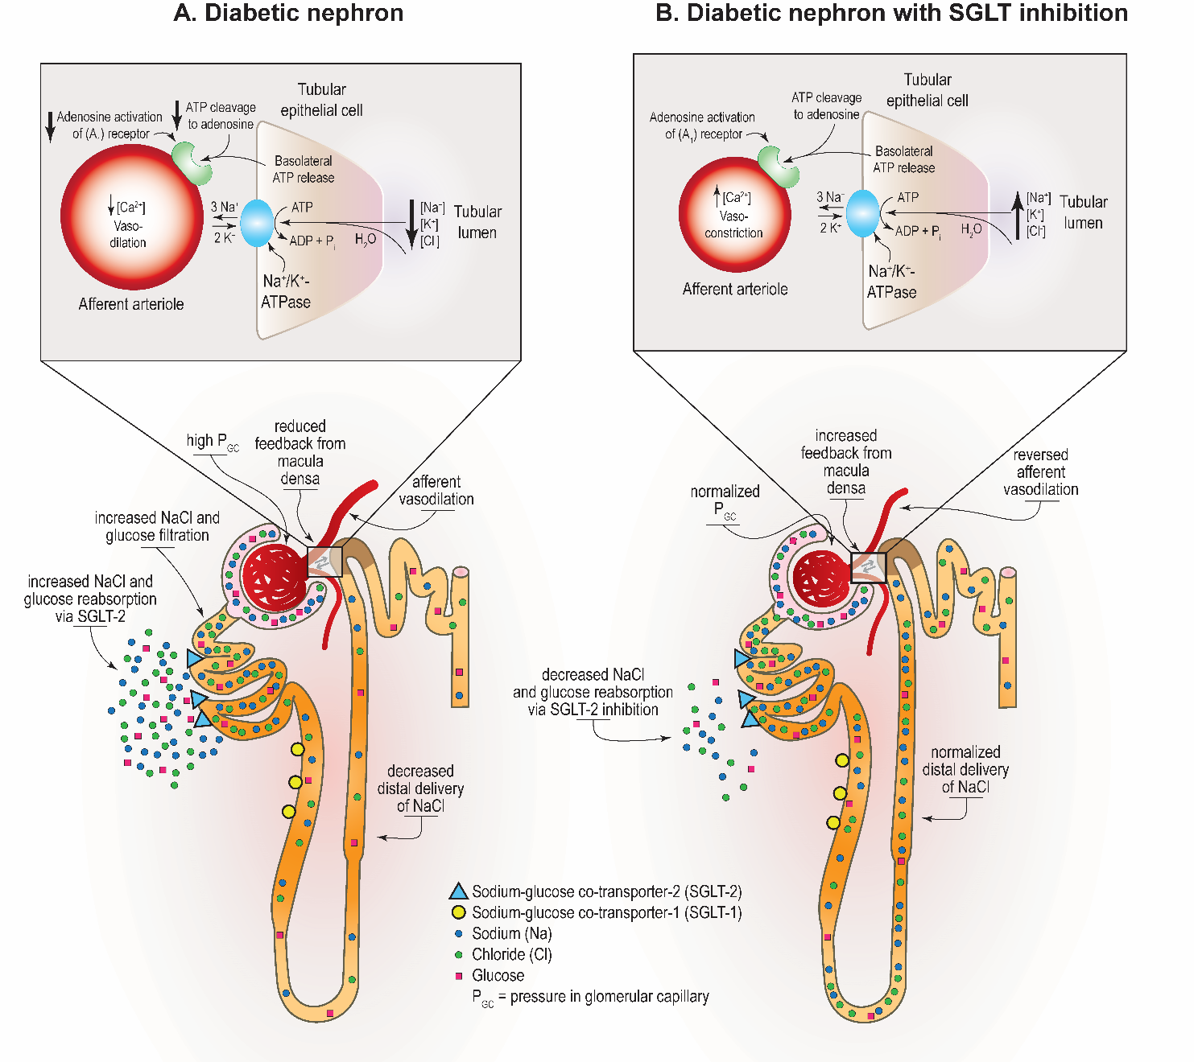
SGLT-2 Inhibition and Glomerular Hemodynamics in Diabetes
Alicic RZ, Johnson EJ, Tuttle KR.
Am J Kidney Dis 2018;72:267-277

Slide 69
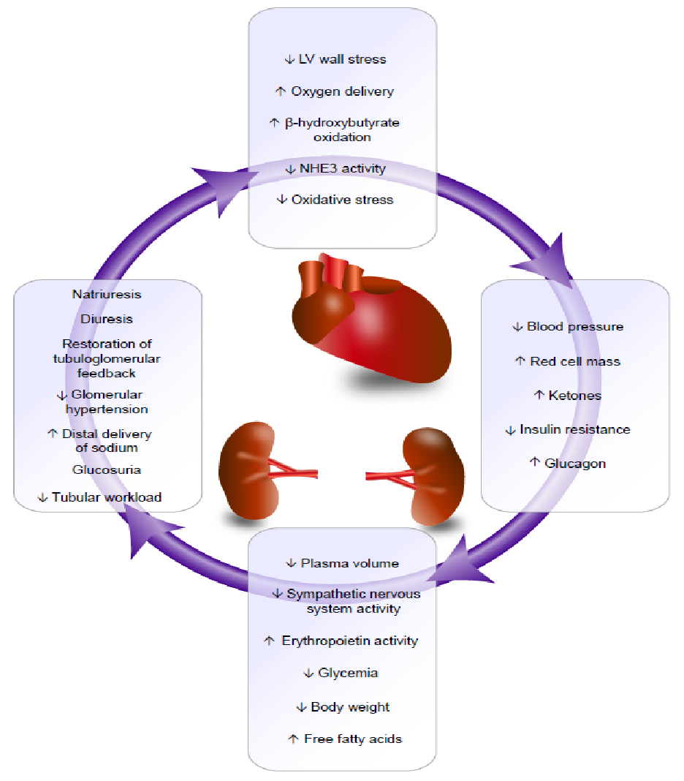
The Kidney-Heart Connection for Organ Protection
Scheen AJ; Circ Res 2018;122:1439-1459
Tuttle KR et al. Am J Kidney Dis 2020; in press

Slide 70
Anti-hyperglycemic Therapies in Patients with Diabetes and CKD
Practice Point 4.2.2: For patients in whom additional glucose-lowering may increase risk for hypoglycemia (e.g., those treated with insulin or sulfonylureas and currently meeting glycemic targets), it may be necessary to stop or reduce the dose of an antihyperglycemic drug other than metformin to facilitate addition of an SGLT2i.
Practice Point 4.2.3: The choice of an SGLT2i should prioritize agents with documented kidney or cardiovascular benefits and take eGFR into account.
Practice Point 4.2.4: It is reasonable to withhold SGLT2i during times of prolonged fasting, surgery, or critical medical illness (when patients may be at greater risk for ketosis).
Practice Point 4.2.5: If a patient is at risk for hypovolemia, consider decreasing thiazide or loop diuretic dosages before commencement of SGLT2i treatment, advise patients about symptoms of volume depletion and low blood pressure, and follow up on volume status after drug initiation.

Slide 71
Anti-hyperglycemic Therapies in Patients with Diabetes and CKD
Practice Point 4.2.6: A reversible decrease in the eGFR with commencement of SGLT2i treatment may occur and is generally not an indication to discontinue therapy.
Practice Point 4.2.7: Once an SGLT2i is initiated, it is reasonable to continue an SGLT2i even if eGFR falls below 30 ml/min per 1.73 m², unless it is not tolerated or kidney replacement therapy is initiated.
Practice Point 4.2.8: SGLT2i have not been adequately studied in kidney transplant recipients, who may benefit from SGLT2i treatment, but are immunosuppressed and potentially at increased risk for infections; therefore, the recommendation to use SGLT2i treatment does not apply to kidney transplant recipients. (see Recommendation 4.2.1)

Slide 72
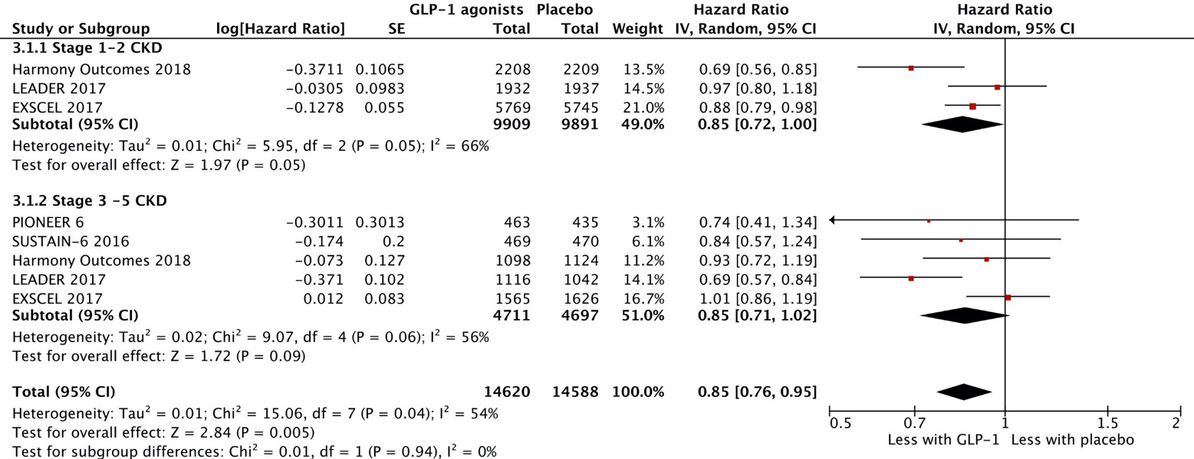
Anti-hyperglycemic Therapies in Patients with Diabetes and CKD
Recommendation 4.3.1: In patients with T2D and CKD who have not achieved individualized glycemic targets despite use of metformin and SGLT2i treatment, or who are unable to use those medications, we recommend a long-acting GLP-1 RA (1B).
3-point Major Cardiovascular Events

Slide 73
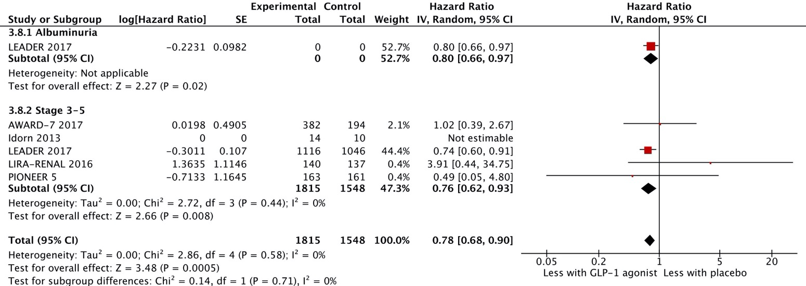
All-cause mortality with GLP-1 receptor agonists in patients with T2D

Slide 74
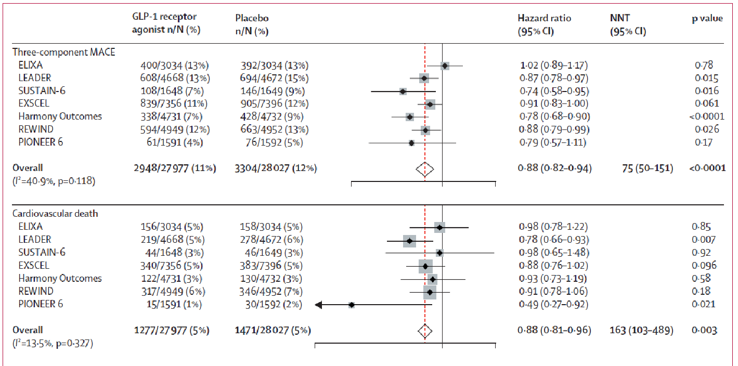
Anti-hyperglycemic Therapies in Patients with Diabetes and CKD
Recommendation 4.3.1: In patients with T2D and CKD who have not achieved individualized glycemic targets despite use of metformin and SGLT2i, or who are unable to use those medications, we recommend a long-acting GLP-1 RA (1B).
SL Kristensen et al Lancet Diabetes Endocrinol 2019; 7: 776–85

Slide 75
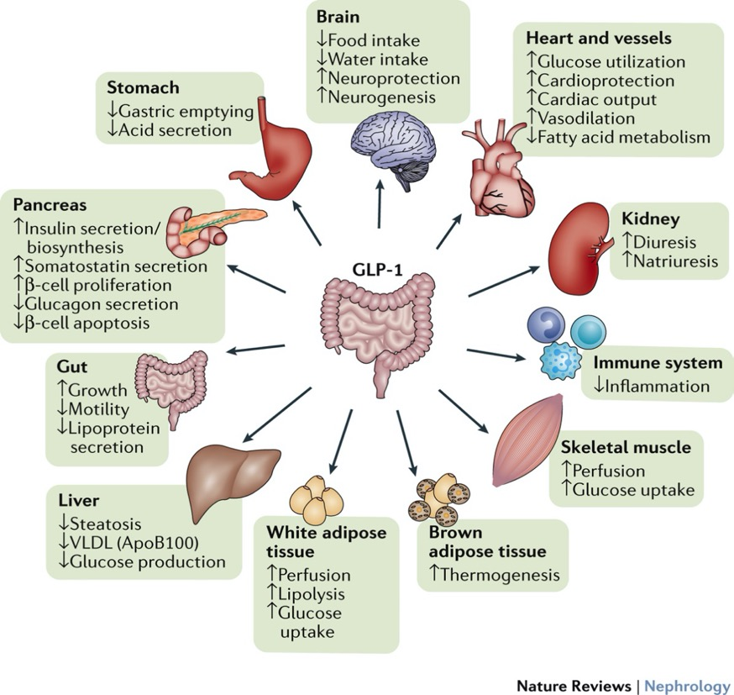
GLP-1 Receptor Agonists in Discovery and Pre-Clinical Science
GLP-1 receptors in the kidney.
  Endothelial cells
  Macrophages
  Proximal tubular cells
Mediators for effects of GLP-1 receptor agonists.
  Signaling – PKC beta inhibition
  Oxidative Stress – increased cAMP and PKA, NAD(P)H oxidase inhibition
  Inflammation – inhibition of ICAM-1 expression, macrophage infiltration
GLP-1 receptor agonists in experimental models.
  Reduce albuminuria
  Decrease mesangial expansion and GBM thickness
  Endothelial protection
  Restore podocytes
Tanaka T et al. Kidney Int 2014;86:701–711

Slide 76
Anti-hyperglycemic Therapies in Patients with Diabetes and CKD
Practice Point 4.3.1: The choice of GLP-1 RA should prioritize agents with documented cardiovascular benefits.
Practice Point 4.3.2: To minimize gastrointestinal side effects, start with a low dose of GLP-1 RA, and titrate up slowly (Figure 27).
Practice Point 4.3.3: GLP-1 RA should not be used in combination with dipeptidyl peptidase-4 (DPP-4) inhibitors.
Practice Point 4.3.4: The risk of hypoglycemia is generally low with GLP-1 RA when used alone, but risk is increased when GLP-1 RA are used concomitantly with other medications such as sulfonylureas or insulin. The doses of sulfonylurea and/or insulin may need to be reduced.

Slide 77
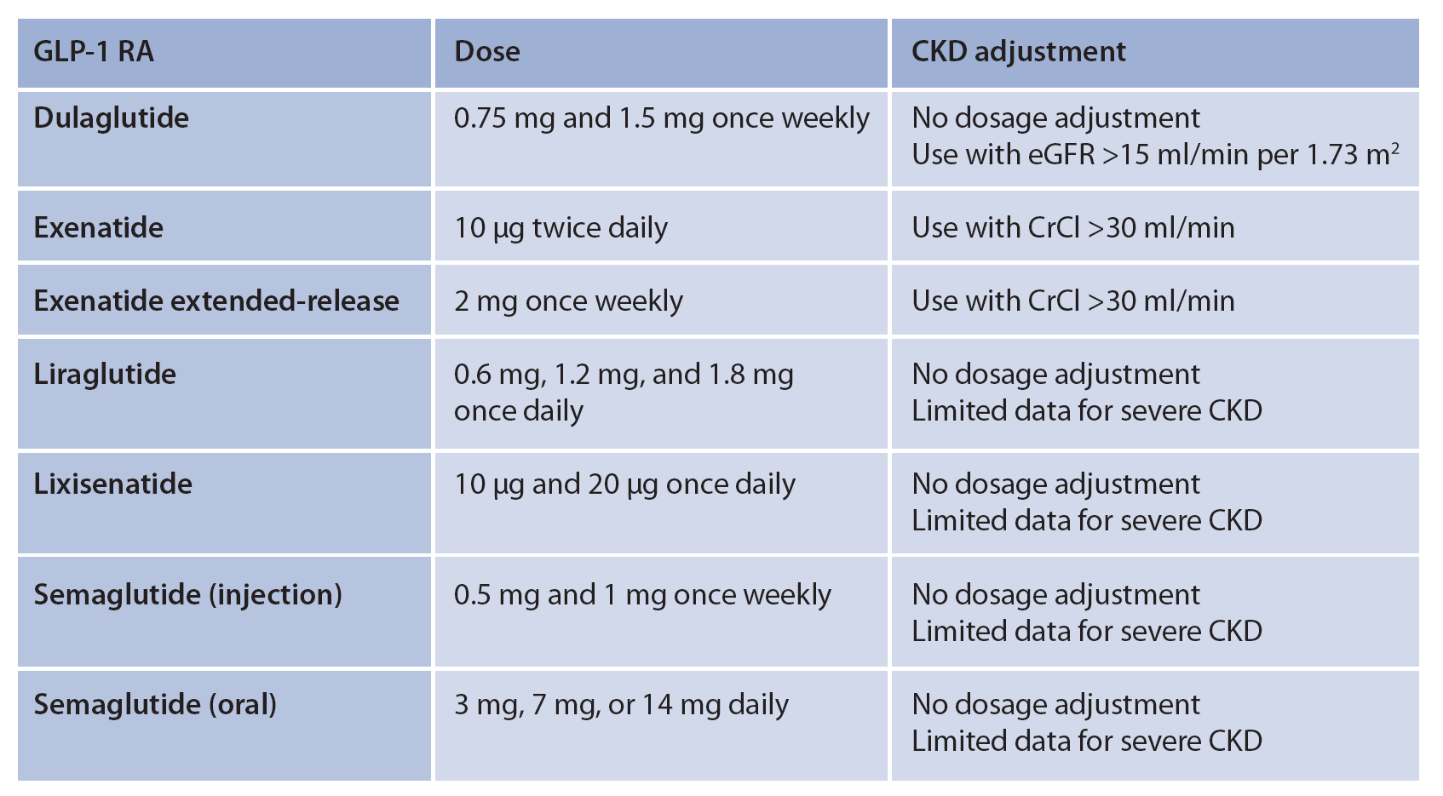
Figure 27. Dosing for available GLP-1 RA agents and dose modification for CKD

Slide 78
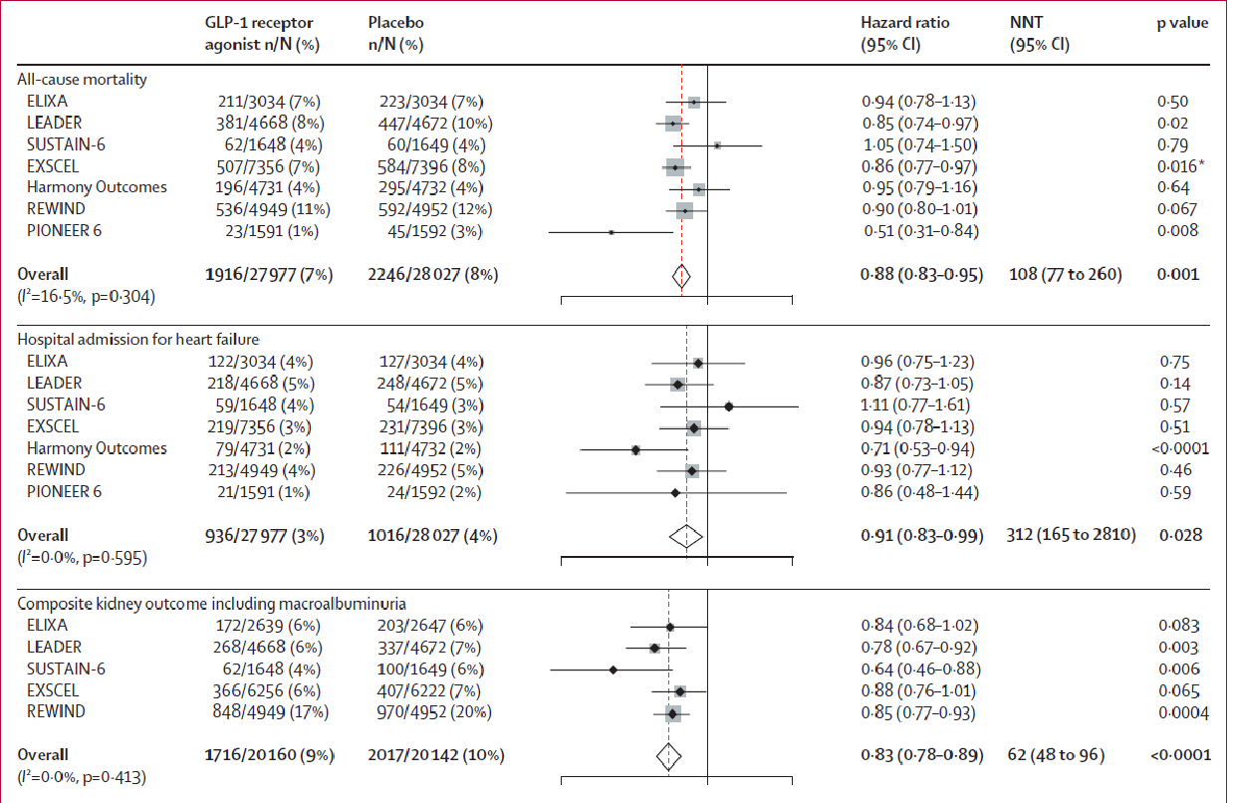
Cardiovascular mortality and kidney outcomes with GLP-1 receptor agonists in patients with T2D: A systematic review and meta-analysis of CVOTs
Mortality, hospitalization for heart failure and composite kidney outcomes
SL Kristensen et al Lancet Diabetes Endocrinol 2019; 7: 776–85
SL Kristensen et al Lancet Diabetes Endocrinol 2019; 7: 776–85

Slide 79




Ongoing and Upcoming Kidney Outcome Trials

Slide 80


Slide 81




Slide 82


Slide 83
Impact of outcome trials on treatment guidelines
Outcome trials have dramatically improved our knowledge on the non-HbA_{1c} effects of GLP-1 receptor agonists, DPP4 inhibitors and SGLT2 inhibitors
The CV benefit of GLP-1 receptor agonists and SGLT2 inhibitors has been well-proven and use of these drugs have been implemented in guidelines
The kidney benefit of new glucose lowering medications are being extensively investigated

Slide 84

Approaches to Management of Patients with Diabetes and CKD
Recommendation 5.1.1: We recommend that a structured self-management educational program be implemented for care of people with diabetes and CKD (Figure 28) (1C).
Practice Point 5.1.1: Health care systems should consider implementing a structured self-management program for patients with diabetes and CKD, taking into consideration local context, cultures, and availability of resources.

Slide 85

Approaches to Management of Patients with Diabetes and CKD
Recommendation 5.2.1: We suggest that policymakers and institutional decision-makers should implement team-based, integrated care focused on risk evaluation and patient empowerment to provide comprehensive care in patients with diabetes and CKD (2B).

Slide 86

Approaches to Management of Patients with Diabetes and CKD
Practice Point 5.2.1: Team-based integrated care, supported by decision-makers, should be delivered by physicians and nonphysician personnel (e.g., trained nurses and dieticians, pharmacists, health care assistants, community workers, peer supporters) preferably with knowledge of CKD (Figure 33).

Slide 87
Overall Summary
First KDIGO guideline on Diabetes and CKD now available
Provide recommendations and practice points on:
  Comprehensive care
  Glycemic monitoring and targets
  Lifestyle interventions
  Antihyperglycemic therapies
  Approaches to management of patients
Patient-centered decision-making and support; and consistent efforts at improving diet and exercise remain the foundation of all glycemic management
Control of risk factors including RAS blockade remains part of standard of care
Glycemia is monitored with HbA1c and blood glucose
Glycemic targets should be individualized with focus on increased risk for hypoglycemia with declining kidney function
Initial use of both metformin and SGLT2i is recommended
Health care organizations should support a coordinated effort.

Slide 88
Central Illustration

Slide 89
Question and Answer

