Slide 1

KDIGO 2022 Clinical Practice Guideline on Diabetes Management in CKD
Slide Set
KDIGO Guideline Co-Chairs:
Ian de Boer, MD, MS
Peter Rossing, MD, DMSc

Slide 2
Table of contents
Introduction
Guideline Development Process:
  Evidence Review
  Guideline Format
Guideline Statements and Rationale from:
  Chapter 1. Comprehensive care in patients with diabetes and CKD
  Chapter 2. Glycemic monitoring and targets in patients with diabetes and CKD
  Chapter 3. Lifestyle interventions in patients with diabetes and CKD
  Chapter 4. Glucose-lowering therapies in patients with T2D and CKD
  Chapter 5. Approaches to management of patients with diabetes and CKD
Question and Answer

Slide 3
KDIGO Programs
Guidelines
  KDIGO’s core mission. KDIGO is the only organization developing global guidelines in nephrology.
Controversies Conferences
  International Conferences that examine significant topics in nephrology and related disciplines that are not fully resolved. Results in a published paper, usually in Kidney International. Often a Controversies Conference will prompt development of a guideline or a guideline update.
Implementation Activities
  Dissemination and Implementation of KDIGO Guidelines
  Controversies Conference Reports and Observations
  Live Clinical Practice Conferences – usually with a nephrology society to bring global KDIGO’s work to local audiences, using case studies
  Implementation Summits bring local experts together to discuss local or regional barriers and opportunities
  Core Implementation Kits – educational materials including Speaker’s Guides, Reference Tools, and Case Studies to assist with implementation of all KDIGO publications

Slide 4
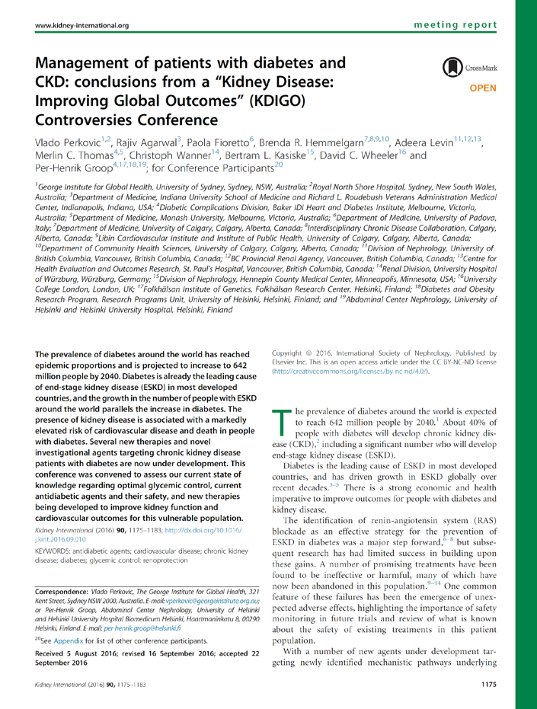
KDIGO Controversies Conference: Diabetes & CKD
February 2015 (Vancouver, BC)
Topics:
  Lifestyle measures
  Glycemic control
  Cardiovascular & other outcomes
  Paths forward for new therapies
Report published in Kidney International (2016)
Led to initiation of new clinical practice guideline

Slide 5
KDIGO 2020 Clinical Practice Guideline for Diabetes Management in CKD
October 2020
Topics:
  Ch 1. Comprehensive care
  Ch 2. Glycemic monitoring and targets
  Ch 3. Lifestyle interventions
  Ch 4. Antihyperglycemic therapies in T2D
  Ch 5. Approaches to management
Published as a Supplement
Executive Summary published in Kidney International

Slide 6
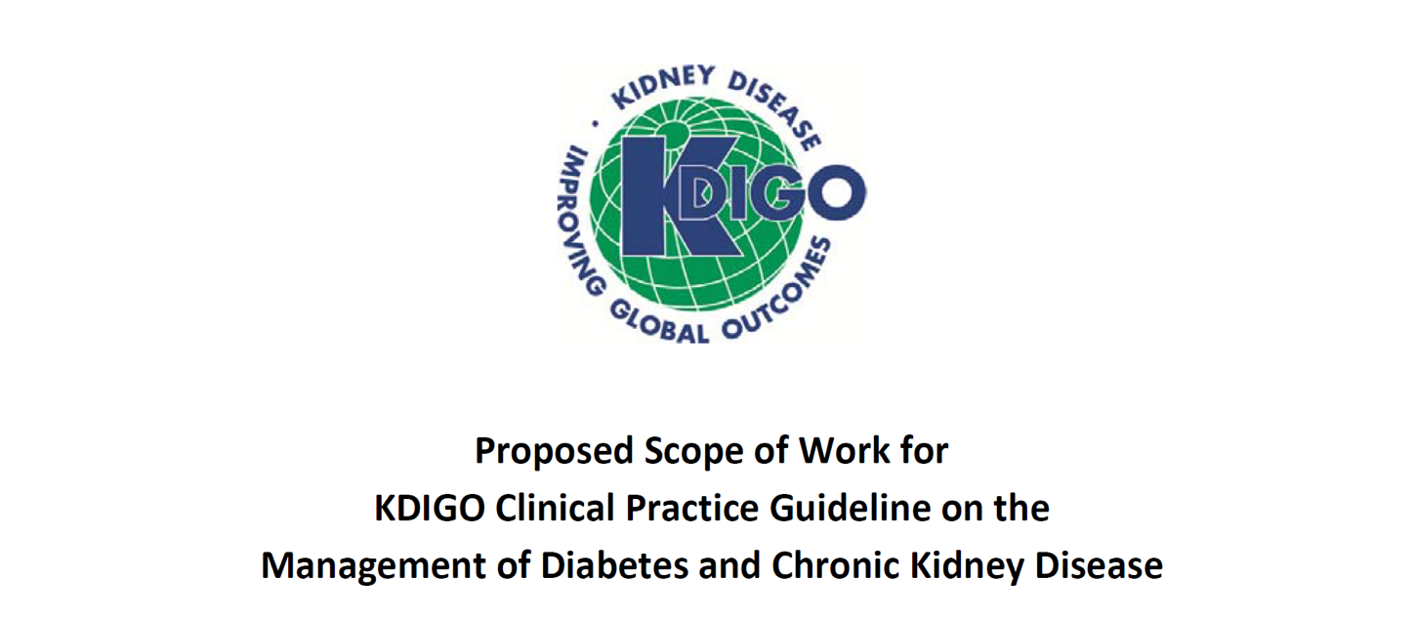
The Beginning

Slide 7
Scope of the Clinical Practice Guideline
Include:
Types 1 and 2 diabetes
All stages of CKD
  Kidney transplant recipients
  Dialysis
Interventions addressed with rigorous data (RCTs)
  Lifestyle
  Pharmacotherapy
  Systems
Exclude:
Interventions covered elsewhere
  Blood pressure
  Lipids
Prevention & screening
Topics with insufficient data
  Diagnosis
  Emerging & pipeline therapies

Slide 8
Guideline goals
Generate a useful resource for clinicians and patients
  Address relevant questions with actionable recommendations
  Take on controversial topics when sufficient evidence
  Communicate clearly: highlight figures and tables
Stay true to evidence
Target audience: broad, primarily clinicians treating diabetes & CKD
Be mindful of implications for policy and payment
Propose research questions

Slide 9
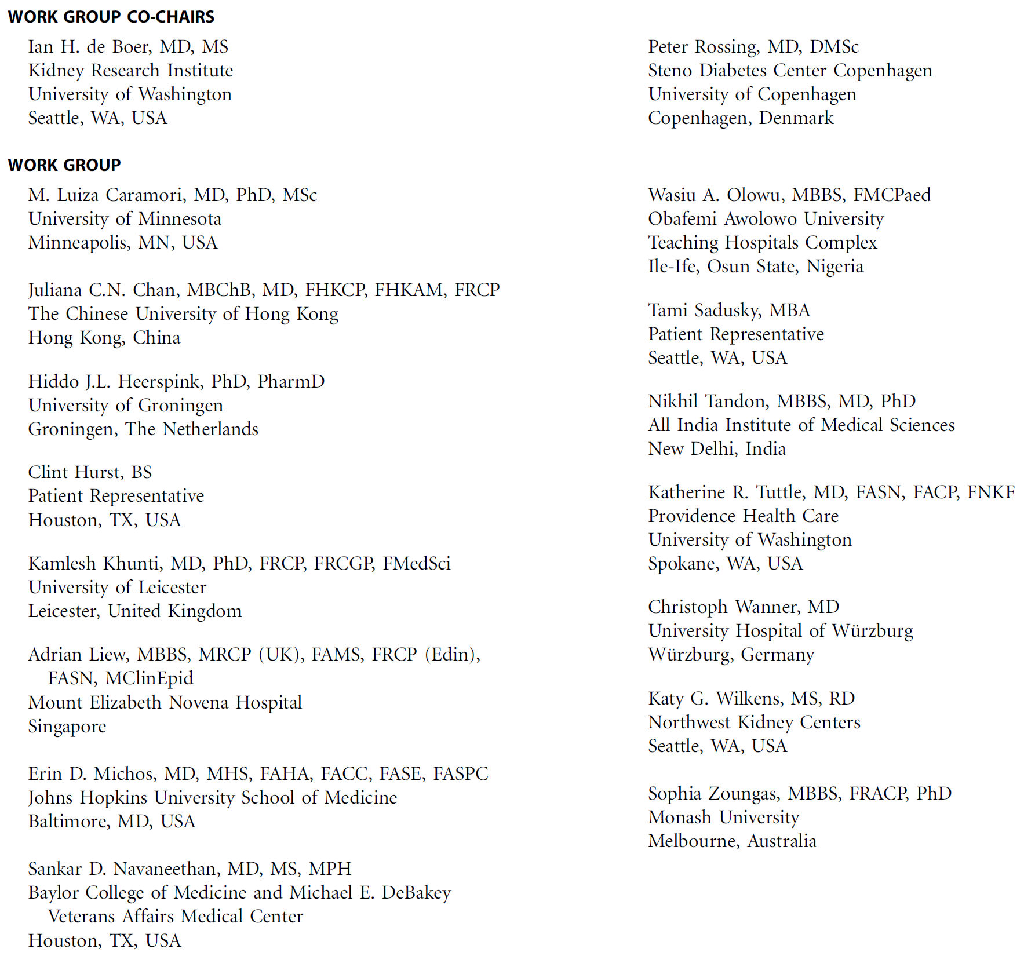
Work Group
Diverse expertise
Worldwide scope
Deep experience
Patients
Evidence Review Team

Slide 10







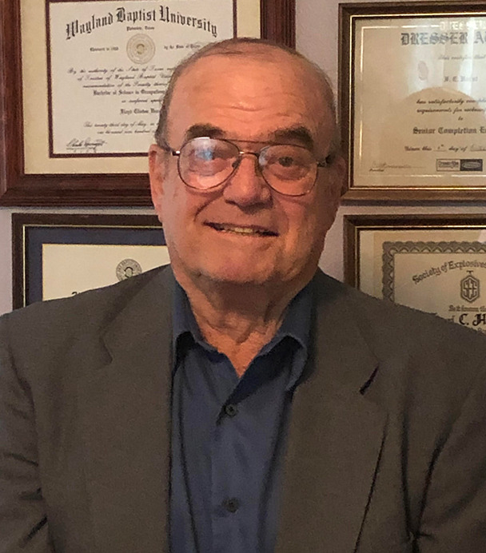









Work Group

Slide 11







Slide 12
Challenges to the Guideline
What to do when evidence is lacking?
  Balance providing guidance with rigor
How to address clinically relevant groups of patients?
  Type 1 and Type 2 diabetes
  CKD stages
  Kidney failure/ESKD
  Transplant recipients

Slide 13

Evidence Review
ERT - Cochrane Kidney Transplant
PICO questions developed
Clinical and important outcomes identified
Critical outcomes | Important outcomes
All-cause mortality | Albuminuria progression
Cardiovascular mortality | Acute kidney injury
3-point and 4-point MACE | Falls
Kidney failure (ESKD) | Harms (fatigue, amputations, fractures, etc.)
Cardiovascular outcomes - myocardial infarction, stroke, heart failure | Hyperkalemia
Doubling serum creatinine | Quality of life
Hypoglycemia requiring 3rd party assistance | Blood pressure
HbA1c | Body weight, body mass index (BMI)

Slide 14
Evidence Review
ERT - Cochrane Kidney Transplant
  Existing PICO questions and new PICO questions developed
  Clinical and important outcomes identified
Critical outcomes | Important outcomes
All-cause mortality | Albuminuria progression (onset of albuminuria, moderately increased to severely increased albuminuria)
Kidney failure/End-stage kidney disease
Cardiovascular outcomes - MACE, myocardial infarction, stroke, heart failure
Doubling serum creatinine
Hypoglycemia requiring 3rd party assistance
HbA1c

Slide 15
PICO questions
Focus on RCTs - mapped to existing Cochrane Systematic reviews
  New systematic reviews undertaken as required
  Some focused observational studies reviews
  General diabetes population - Existing systematic reviews
Population | Intervention | Comparator | Outcome
Comprehensive care
Adults with CKD (G1-G5, G5D) and diabetes (T1D and T2D) | Antihypertensive – RAS inhibitors (ACEi and ARB) | Placebo/standard of care | Critical and important outcomes, AKI, hyperkalemia
Adults with CKD (G1-G5, G5D) and diabetes (T1D and T2D) | Dual RAS inhibition | Mono RAS inhibition | Critical and important outcomes, AKI, hyperkalemia

Slide 16
PICO questions
Population | Intervention | Comparator | Outcome
Comprehensive care
Adults with CKD (G1-G5, G5D, G1T-G5T) and diabetes (T2D) | SGLT2i | Placebo/standard of care | Critical and important outcomes, Long-term harms: amputation, bone fractures, hypoglycemia, lactic acidosis
Adults with CKD (G1-G5, G5D) and diabetes (T1D and T2D) | Mineralocorticoid receptor antagonists or direct renin inhibitors | Standard of care or RAS inhibitors | Critical and important outcomes, AKI, hyperkalemia
Adults with CKD (G1-G5, G5D, G1T-G5T) and diabetes (T1D and T2D) | Potassium binders | Standard of care | Critical and important outcomes, AKI, hyperkalemia
Adults with CKD (G1-G5, G5D, G1T-G5T) and diabetes (T1D and T2D) | Antiplatelet therapy | Usual care | Critical and important outcomes, BP, fatigue, QoL

Slide 17
PICO questions
Population | Intervention | Comparator | Outcome
Comprehensive care
Adults with CKD (G1-G5, G5D, G1T-G5T) and diabetes (T1D and T2D) | Smoking-cessation interventions | Usual care | Critical and important outcomes, BP, BMI, body weight, fatigue, QoL
Adults with CKD (G1-G5, G5D, G1T-G5T) and diabetes (T1D and T2D) | Bariatric surgery | Usual care | Critical and important outcomes, BP, BMI, body weight, fatigue, QoL
Adults with CKD (G1-G5, G5D, G1T-G5T) and diabetes (T1D and T2D) | Weight loss therapies (olistat, phentermine, saxenda, liraglutide, lorcaserin, bupropion-naltrexone, topiramate, acarbose, miglitol, pramlintide, exenatide, zonisamide, fluoxetide, semaglutide, dulaglutide) | Placebo/Standard of care | Critical and important outcomes, BP, BMI, body weight, fatigue, QoL

Slide 18
PICO questions
Population | Intervention | Comparator | Outcome
Glycemic monitoring and targets
Adults with CKD (G1-G5, G5D) and diabetes (T1D and T2D) | Alternative biomarkers (glycated albumin, fructosamine, carbamylates albumin) | HbA1c or blood glucose monitoring | All-cause mortality, kidney failure, CKD progression (doubling of SCr, ≥40% decline in eGFR), mean blood glucose (HbA1c)
Adults with CKD (G1-G5, G5D) and diabetes (T1D and T2D) | Glucose monitoring (CGM, SMBG) | HbA1c | All-cause mortality, kidney failure, CKD progression (doubling of SCr, ≥40% decline in eGFR), mean blood glucose (HbA1c)
Adults with CKD (G1-G5, G5D) and diabetes (T1D and T2D) | Tight glycemic control (HbA1c targets - ≤7.0%, ≤6.5%, ≤6.0%) | Standard glycemic target | Critical and important outcomes

Slide 19
PICO questions
Population | Intervention | Comparator | Outcome
Lifestyle interventions
Adults with CKD (G1-G5, G5D) and diabetes (T1D and T2D) | Exercise/physical activity (aerobic training, resistance training) | Usual care | Critical and important outcomes, BP, BMI, body weight, fatigue, QoL
Adults with CKD (G1-G5, G5D) and diabetes (T1D and T2D) | Low-salt diets, low-potassium diets, low-phosphate diets, low-protein diets, dietary patterns (caloric-restriction diet, whole-food diets, Mediterranean diet, DASH diet, vegetarian diet) | Usual diet | Critical and important outcomes, BP, BMI, body weight, fatigue, QoL

Slide 20
PICO questions
Population | Intervention |  | Comparator | Outcome
Glucose-lowering therapies
Adults with CKD (G1-G5, G5D, G1T-G5T) and diabetes (T2D) | Older – metformin, sulfonylureas, thiazolidinediones, Newer – alpha-glucosidase inhibitors, GLP1 RA, DPP-4 inhibitors | Older – metformin, sulfonylureas, thiazolidinediones, Newer – alpha-glucosidase inhibitors, GLP1 RA, DPP-4 inhibitors | Placebo/Standard of care | Critical and important outcomes, For GLP-1 RA: BMI, body weight, Long-term harms: amputation, bone fractures, hypoglycemia, lactic acidosis
Approaches to management
Adults with CKD (G1-G5, G5D) and diabetes (T1D and T2D) |  | Education and self-management programs | Standard of care | Critical and important outcomes, fatigue, QoL
Adults with CKD (G1-G5, G5D) and diabetes (T1D and T2D) |  | Health service delivery programs/models of care | Standard of care | Critical and important outcomes, fatigue, Qol

Slide 21
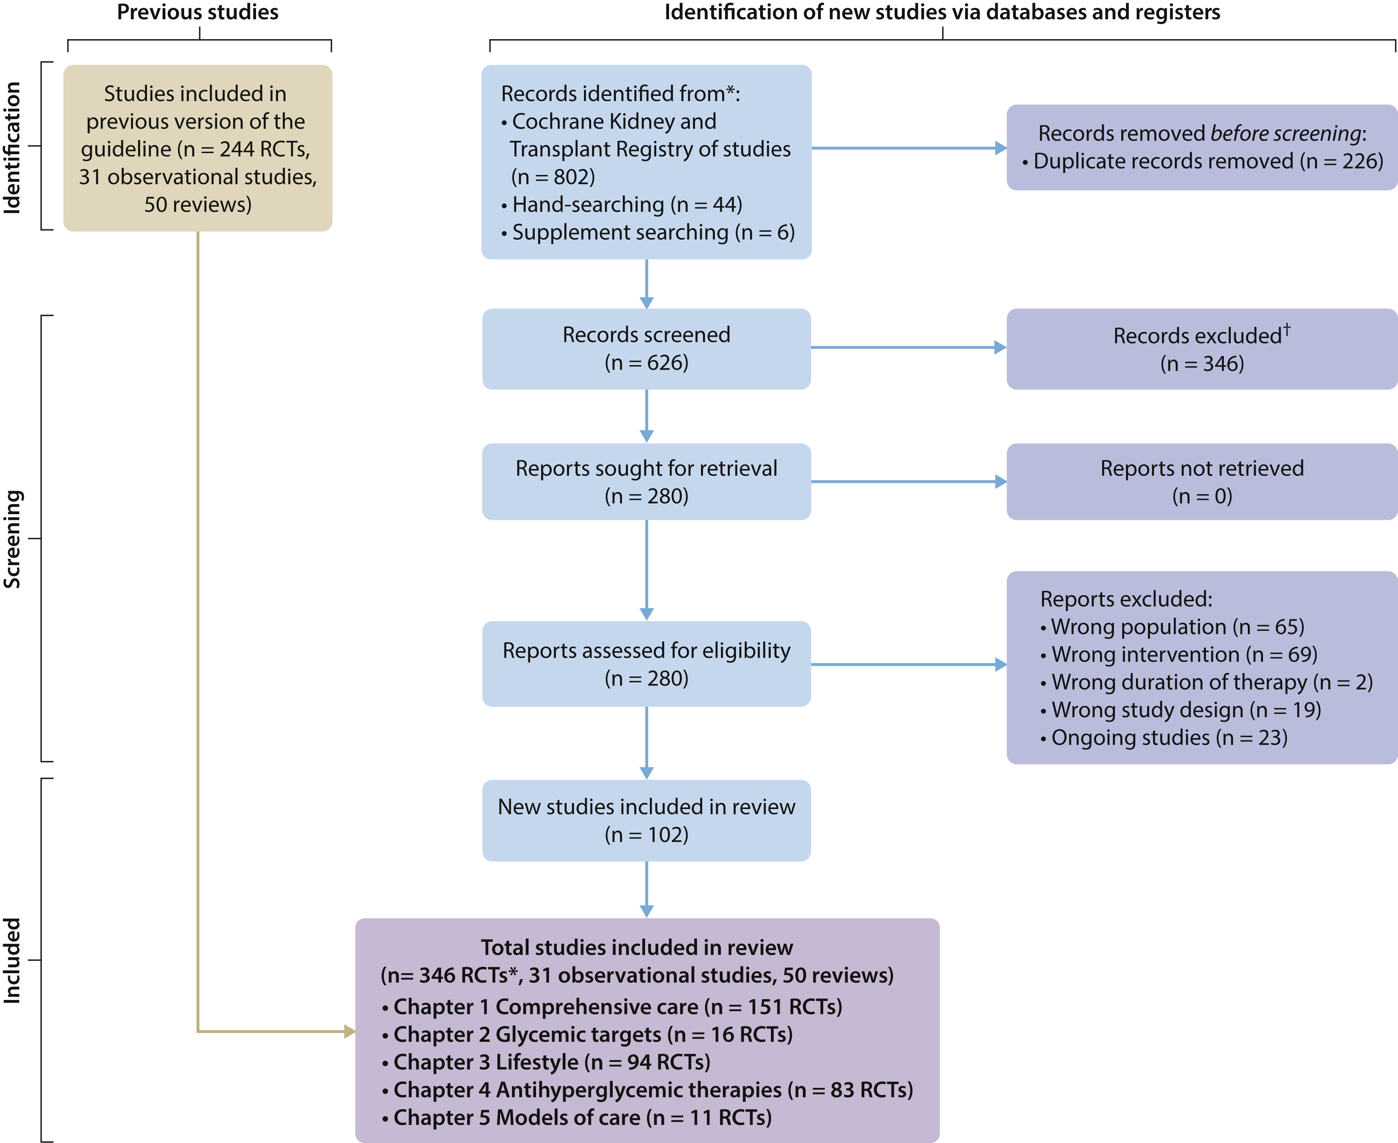
Literature search
December 2021; Updated in February 2022

Slide 22
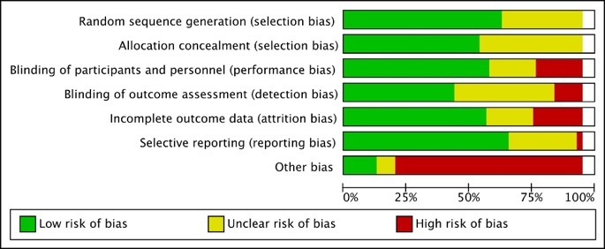
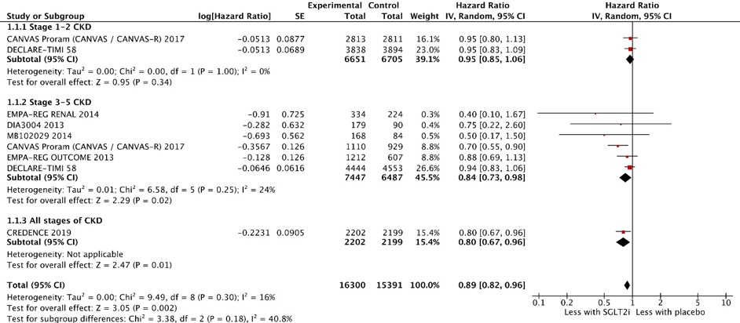
Evidence synthesis
Risk of bias graph example
Standard Cochrane methods – Two independent reviewers
  Data abstraction
  Critical appraisal – using validated tools
Data-analysis
  Random effects meta-analysis and generic inverse variance
    Relative risk for dichotomous outcomes
    Mean difference for continuous outcomes
  Heterogeneity assessed using the I² statistic
Forest plot example – SGLT2 inhibitors – 3-point MACE

Slide 23

Grading recommendations
  GRADE methodology
  The quality of the evidence – Level A, B, C, D
    Study limitations
    Inconsistency
    Indirectness
    Imprecision
    Publication bias
Strength of the recommendation – “We recommend” or “We suggest”
  Two face-to-face meetings – New Orleans Jan 2019, Barcelona Sept 2019
    Balance of benefits and harms
    Quality of the evidence
    Patient values and preferences – Two patients on the Work Group
    Resources and other considerations
  Update was conducted fully virtually through teleconferences

Slide 24
Guideline format
  KDIGO guidelines continue to use GRADE methodology, but we have strengthened the link between the recommendation statements and underlying evidence base.
  Guidelines are now a mox of recommendations and practice points to help clinicians better evaluate and implement the guidelines from the Work Group.
  All recommendations follow a consistent and structured format and are similar in style to previous KDIGO recommendations.
  Practice points are may be formatted as text, a table, a figure, or an algorithm to make them easier to use in clinical practice.

Slide 25
Situations when Practice Points Can/
Should Be Used
1.
Not Testable PICO Question
There is no reasonable alternative
Rarely needed
2.
Implementation Guidance
Commonly used as figures, tables, algorithms, and explanatory text
Variable as needed
3. Testable PICO Question
Not included in a systematic review due to resource limitations
Uncommon (ideally none)

Slide 26
How Should Practice Points Be Used When Caring for Patients?
  Practice points are consensus statements about a specific aspect of care and supplement graded recommendations for which a larger quantity of evidence was identified.
  While practice points represent the expert judgment of the guideline Work Group, they may also be based on limited evidence.
  Unlike recommendations, practice points are not graded for strength of recommendation or certainty of the evidence.
  Users should consider the practice point as expert guidance, and use it as they see fit to inform the care of patients.
New guideline disseminated
Start with recommendations
Consider relevant practice points

Slide 27
Diabetes & CKD Guideline Contents
Chapter 1. Comprehensive care in patients with diabetes and CKD
  Comprehensive diabetes and CKD management
  RAS blockade
  SGLT2i
  MRA
  Smoking cessation
Chapter 2. Glycemic monitoring and targets in patients with diabetes and CKD
  Glycemic monitoring
  Glycemic targets
Chapter 3. Lifestyle interventions in patients with diabetes and CKD
  Nutrition intake
  Physical activity
Chapter 4. Glucose-lowering therapies in patients with T2D and CKD
  Overall approach
  Metformin
  GLP-1 RA
Chapter 5. Approaches to management of patients with diabetes and CKD
  Self-management education programs
  Team-based integrated care

Slide 28
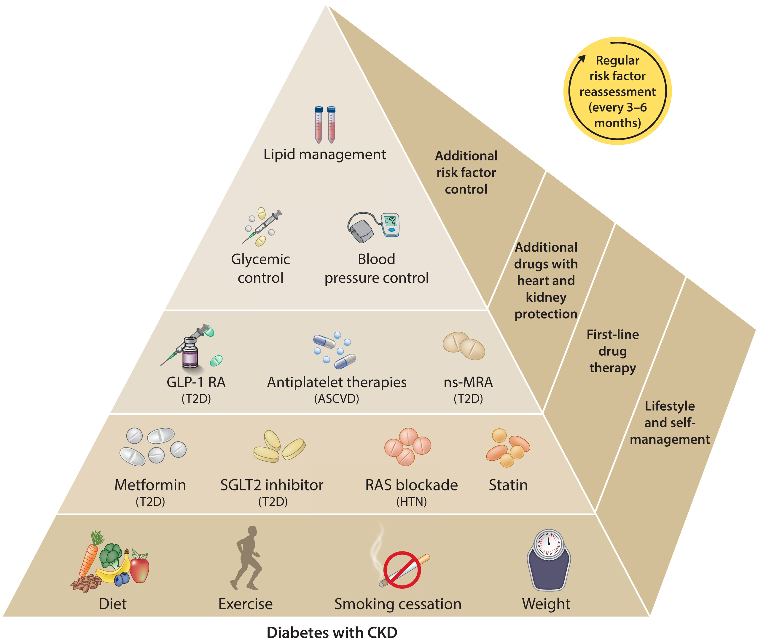
Comprehensive Care in Patients with Diabetes and CKD
Practice Point 1.1.1: Patients with diabetes and chronic kidney disease (CKD) should be treated with a comprehensive strategy to reduce risks of kidney disease progression and cardiovascular disease (Figure 1 and 2).
Notes:
Kidney–heart risk factor management. People with diabetes and chronic kidney disease (CKD) should be treated with a comprehensive approach to improve kidney and cardiovascular outcomes. This approach should include a foundation of lifestyle modification and self-management for all patients, upon which are layered first-line drug therapies according to clinical characteristics (in parentheses), additional drugs with proven kidney and heart protection as guided by assessments of residual risk, and additional interventions as needed to further control risk factors. Glycemic control is based on insulin for type 1 diabetes (T1D) and a combination of metformin and sodium–glucose cotransporter-2 inhibitors (SGLT2i) for type 2 diabetes (T2D). Metformin may be given when estimated glomerular filtration rate (eGFR) ≥30 ml/min per 1.73 m², and SGLT2i should be initiated when eGFR is ≥20 ml/min per 1.73 m² and continued as tolerated, until dialysis or transplantation is initiated. Renin–angiotensin system (RAS) inhibition is recommended for patients with albuminuria and hypertension (HTN). A statin is recommended for all patients with T1D or T2D and CKD. Glucagon-like peptide-1 receptor agonists (GLP-1 RA) are preferred glucose-lowering drugs for people T2D if SGLT2i and metformin are insufficient to meet glycemic targets or if they are unable to use SGLT2i or metformin. A nonsteroidal mineralocorticoid receptor antagonist (ns-MRA) can be added to first-line therapy for patients with T2D and high residual risks of kidney disease progression and cardiovascular events, as evidenced by persistent albuminuria (>30 mg/g [>3 mg/mmol]). Aspirin generally should be used lifelong for secondary prevention among those with established cardiovascular disease and may be considered for primary prevention among patients with high risk of atherosclerotic cardiovascular disease (ASCVD).

Slide 29
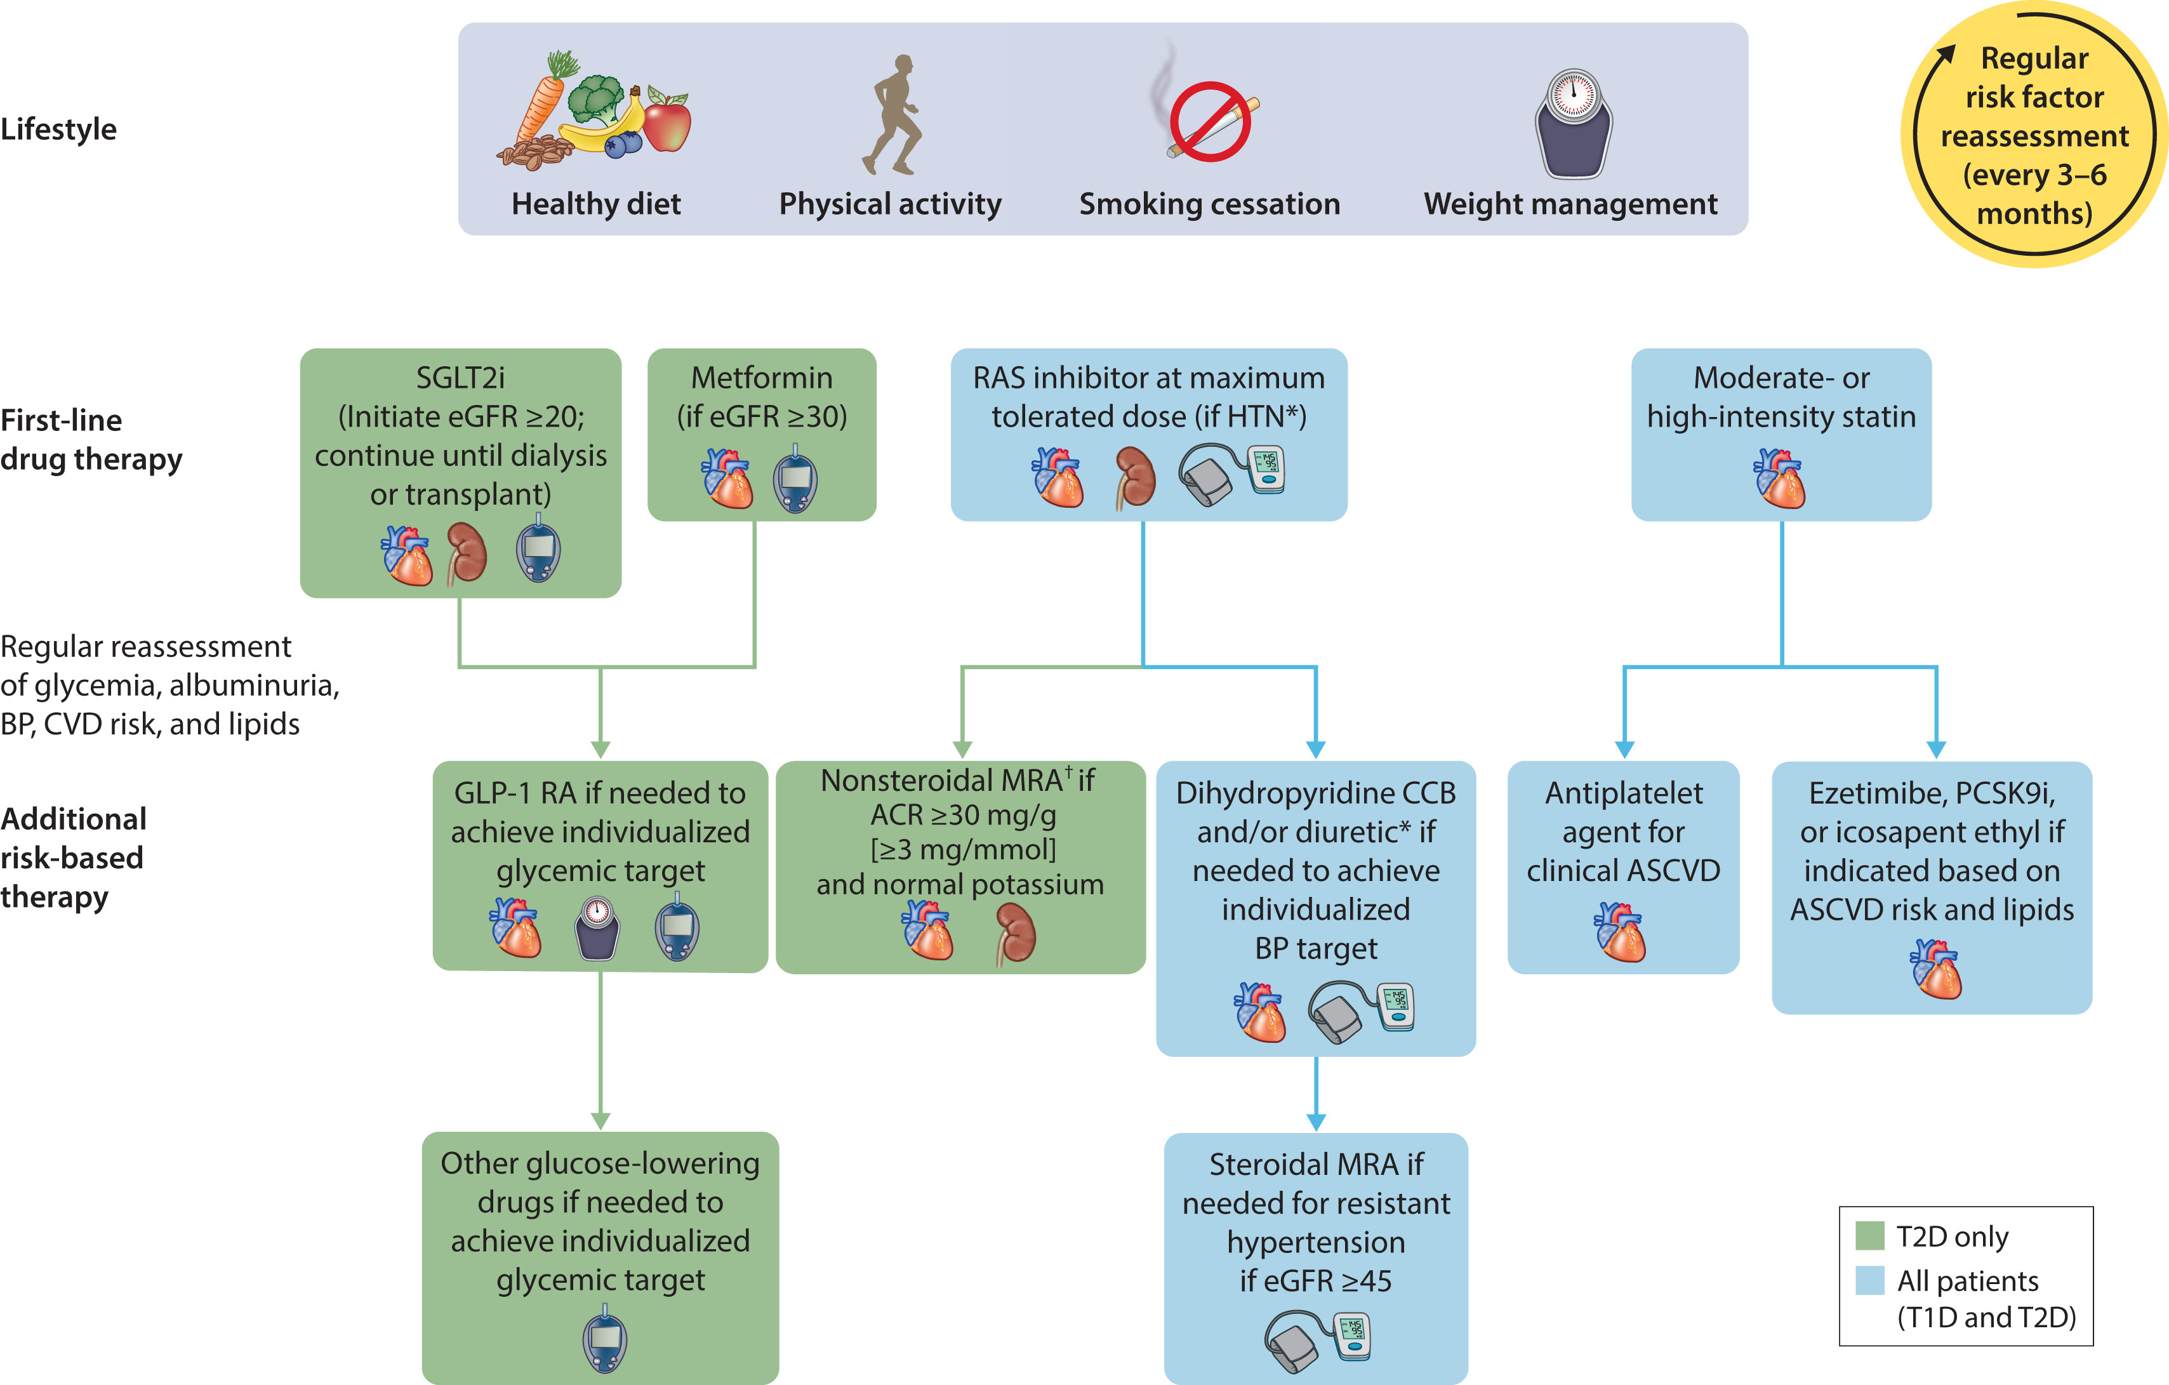
Figure 2. Holistic approach for improving outcomes in patients with diabetes and chronic kidney disease
Notes:
Holistic approach for improving outcomes in patients with diabetes and chronic kidney disease. *Angiotensin-converting ezyme inhibitor (ACEi) or angiotensin II receptor blocker (ARB) should be first-line therapy for hypertension (HTN) when albuminuria is present, otherwise dihydropyridine calcium channel blocker (CCB) or diuretic can also be considered; all 3 classes are often needed to attain blood pressure (BP) targets. †Finerenone is currently the only nonsteroidal mineralocorticoid receptor antagonist (MRA) with proven clinical kidney and cardiovascular benefits. Icons presented indicate the following benefits: blood pressure cuff = blood pressure–lowering; glucometer = glucose-lowering; heart = heart protection; kidney = kidney protection; scale, weight management; ACR, albumin-creatinine ratio; ASCVD, atherosclerotic cardiovascular disease; CVD, cardiovascular disease; eGFR, estimated glomerular filtration rate; GLP-1 RA, glucagon-like peptide-1 receptor agonist; PCSK9i, proprotein convertase subtilisin/kexin type 9 inhibitor; RAS, renin-angiotensin system; SGLT2i, sodium-glucose cotransporter-2 inhibitor; T1D, type 1 diabetes; T2D, type 2 diabetes.

Slide 30
Comprehensive Care in Patients with Diabetes and CKD
Recommendation 1.2.1: We recommend that treatment with an angiotensin-converting enzyme inhibitor (ACEi) or an angiotensin II receptor blocker (ARB) be initiated in patients with diabetes, hypertension, and albuminuria, and that these medications be titrated to the highest approved dose that is tolerated (1B).

Slide 31
Comprehensive Care in Patients with Diabetes and CKD
Practice Point 1.2.1: For patients with diabetes, albuminuria, and normal blood pressure, treatment with an ACEi or ARB may be considered.
Practice Point 1.2.2: Monitor for changes in blood pressure, serum creatinine, and serum potassium within 2-4 weeks of initiation or increase in the dose of an ACEi or ARB (Figure 4).
Practice Point 1.2.3: Continue ACEi or ARB therapy unless serum creatinine rises by more than 30% within 4 weeks following initiation of treatment or an increase in dose (Figure 4).
Practice Point 1.2.4: Advise contraception in women who are receiving ACEi or ARB therapy and discontinue these agents in women who are considering pregnancy or who become pregnant.

Slide 32
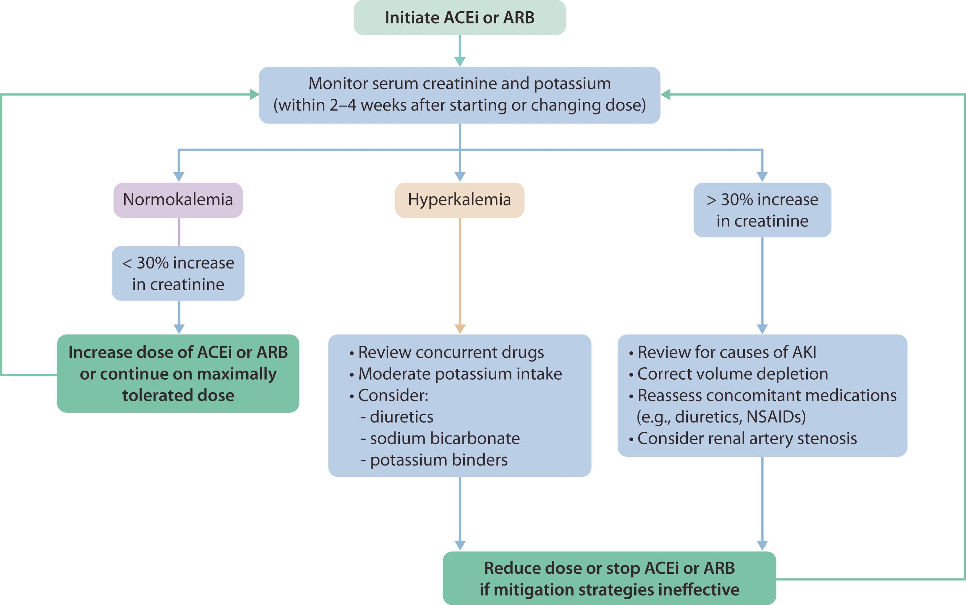
Figure 4. Monitoring of serum creatinine and potassium during ACEi or ARB treatment - dose adjustment and monitoring of side effects
Notes:
Monitoring of serum creatinine and potassium during angiotensin-converting enzyme inhibitor (ACEi) or angiotensin II receptor blocker (ARB) treatment—dose adjustment and monitoring of side effects. AKI, acute kidney injury; NSAID, nonsteroidal anti-inflammatory drug.

Slide 33
Comprehensive Care in Patients with Diabetes and CKD
Practice Point 1.2.5: Hyperkalemia associated with the use of an ACEi or ARB can often be managed by measures to reduce serum potassium levels rather than decreasing the dose or stopping ACEi or ARB immediately (Figure 4).
Practice Point 1.2.6: Reduce the dose or discontinue ACEi or ARB therapy in the setting of either symptomatic hypotension or uncontrolled hyperkalemia despite medical treatment outlined in Practice Point 1.2.5., or to reduce uremic symptoms while treating kidney failure (estimated glomerular filtration rate [eGFR] <15 ml/min per 1.73 m²).
Practice Point 1.2.7: Use only one agent at a time to block the RAS. The combination of an ACEi with an ARB, or the combination of an ACEi or ARB with a direct renin inhibitor, is potentially harmful.

Slide 34
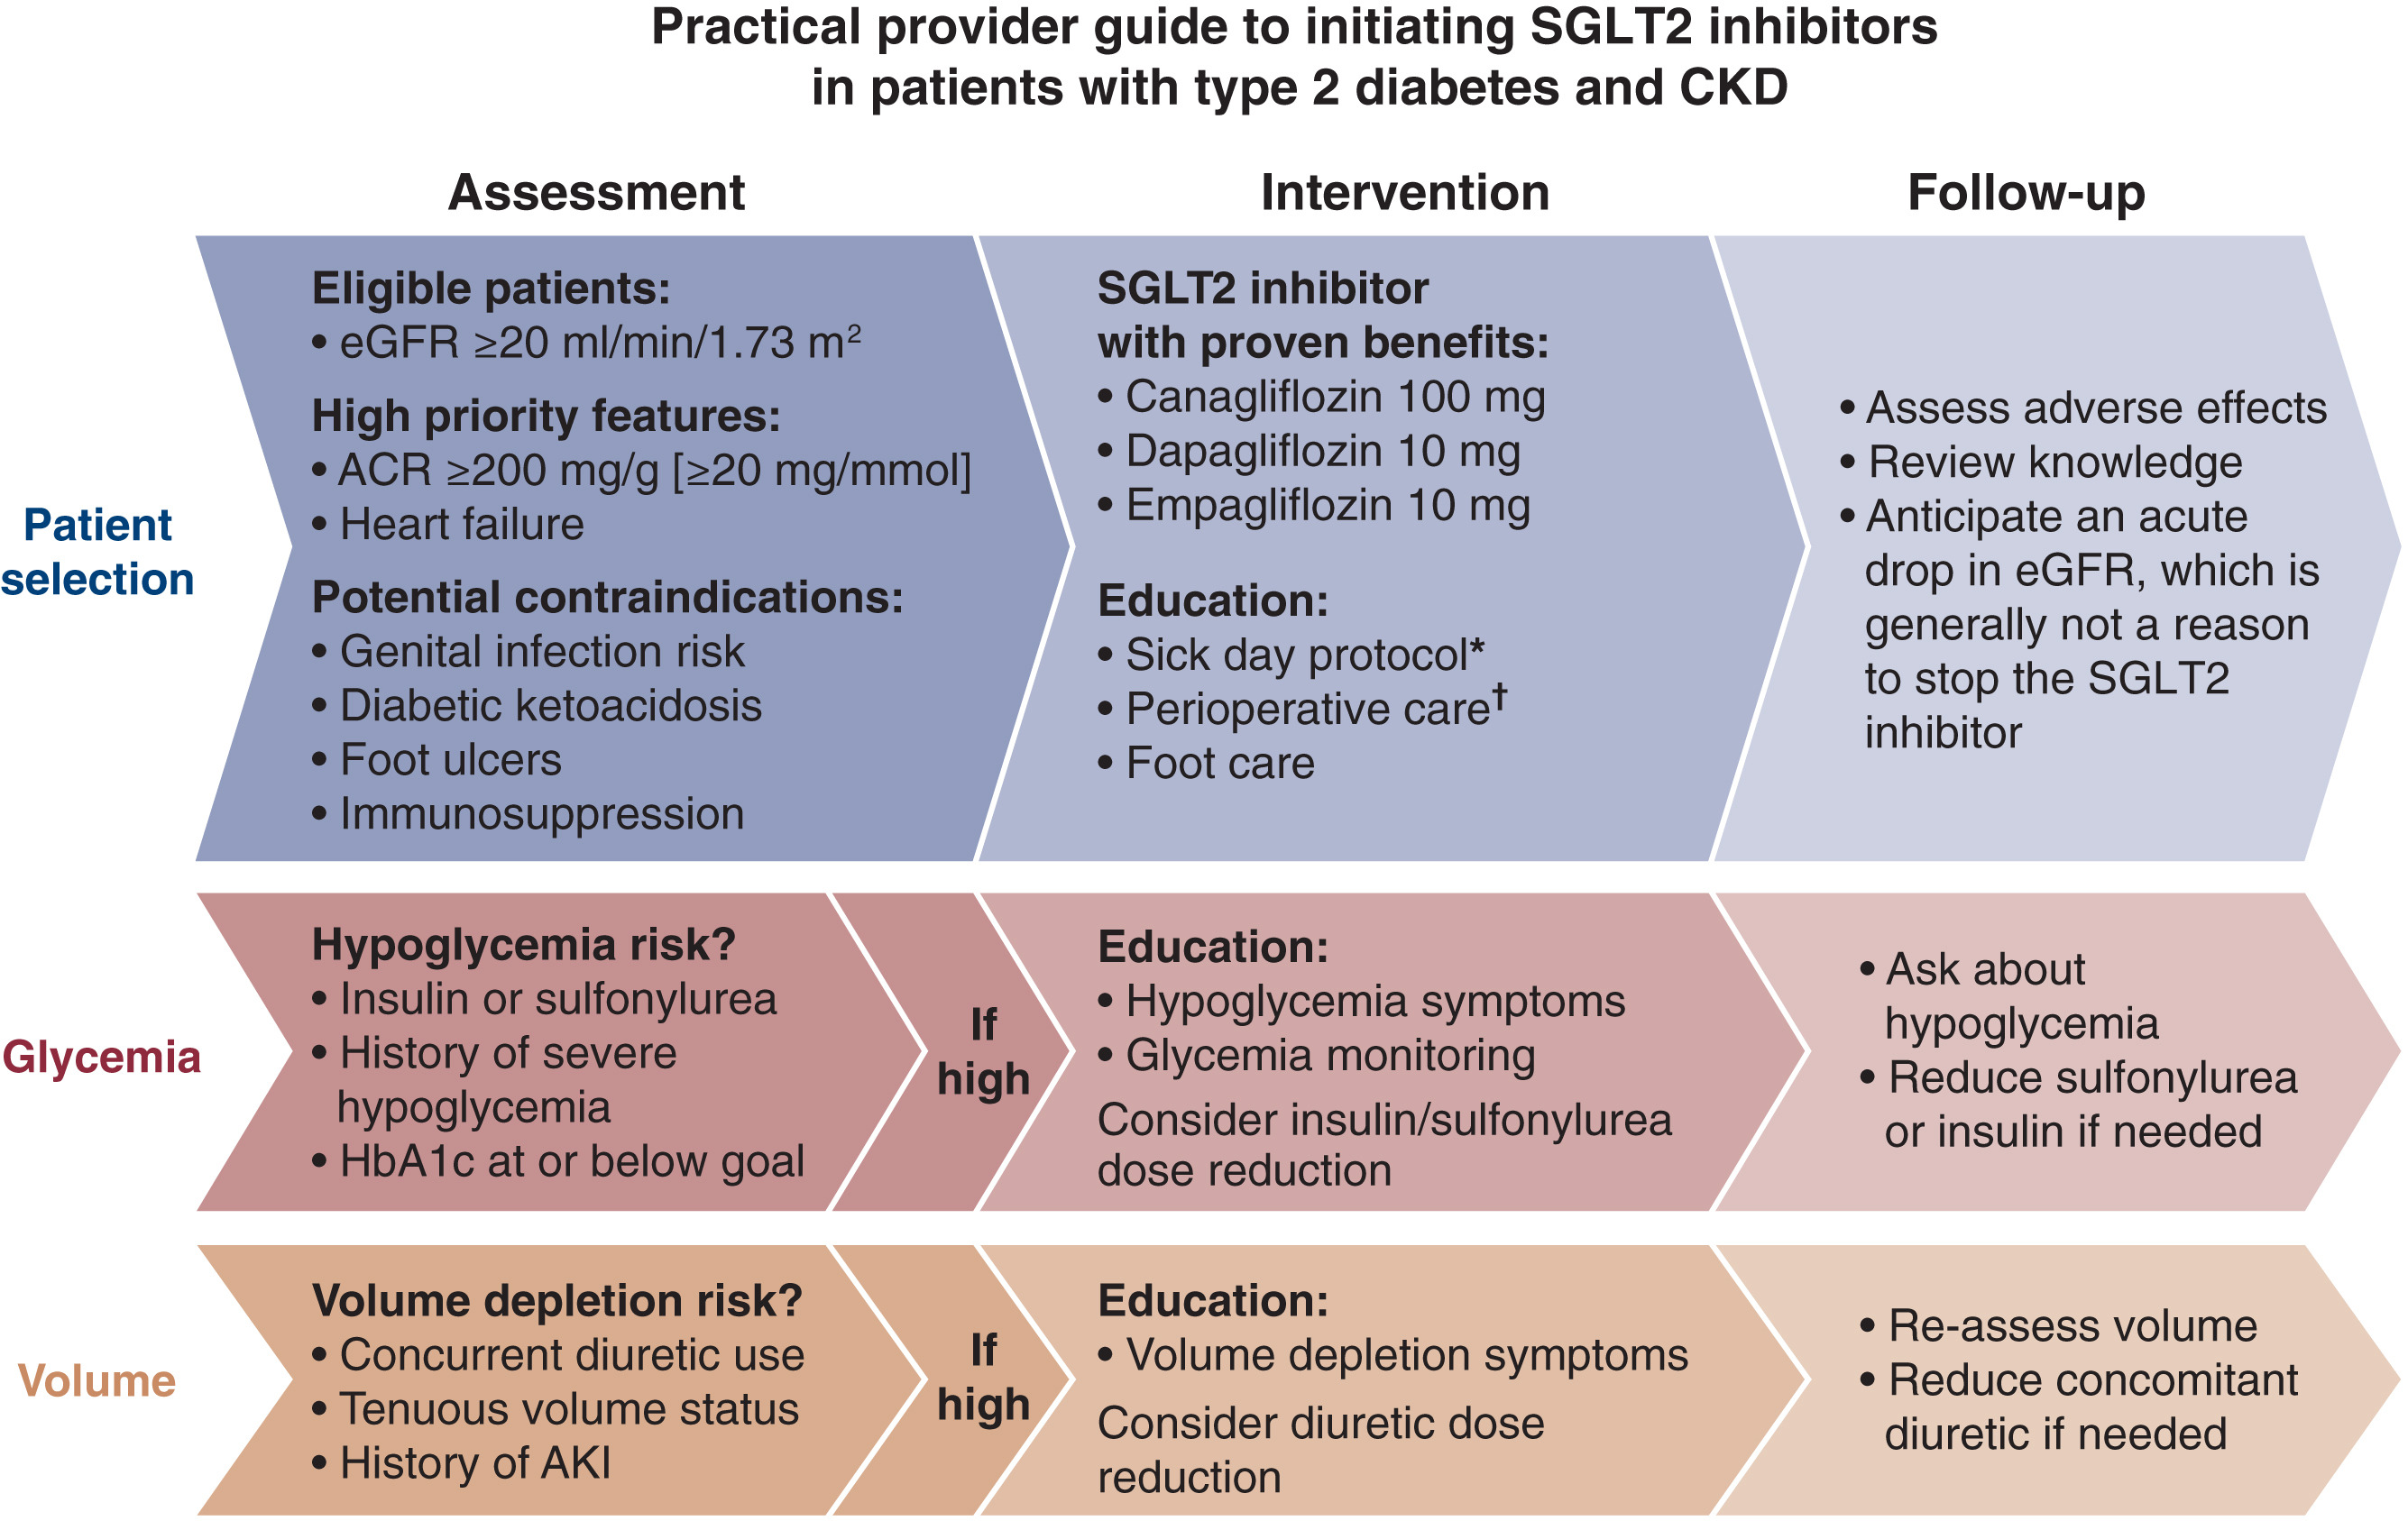
Comprehensive Care in Patients with Diabetes and CKD
Recommendation 1.3.1: We recommend treating patients with type 2 diabetes (T2D), CKD, and eGFR ≥20 ml/min per 1.73 m² with an SGLT2i (1A).
Notes:
Practical approach to initiating sodium-glucose cotransporter-2 inhibitors (SGLT2i) in patients with type 2 diabetes and chronic kidney disease (CKD). *Sick day protocol (for illness or excessive exercise or alcohol intake): temporarily withhold SGLT2i, keep drinking and eating (if possible), check blood glucose and blood ketone levels more often, and seek medical help early. †Periprocedural/perioperative care: inform patients about risk of diabetic ketoacidosis; withhold SGLT2i the day of day-stay procedures and limit fasting to minimum required; withhold SGLT2i at least 2 days in advance and the day of procedures/surgery requiring 1 or more days in hospital and/or bowel preparation (which may require increasing other glucose-lowering drugs during that time), measure both blood glucose and blood ketone levels on hospital admission (proceed with procedure/surgery if the patient is clinically well and ketones are <1.0 mmol/l), and restart SGLT2i after procedure/surgery only when eating and drinking normally. Adapted from Zoungas S, de Boer IH. SGLT2 inhibitors in diabetic kidney disease. Clin J Am Soc Nephrol. 2021;16:631–633.¹⁴⁸ Copyright © 2021 by the American Society of Nephrology. ACR, albumin-creatinine ratio; AKI, acute kidney injury; eGFR, estimated glomerular filtration rate; HbA1c, glycated hemoglobin.

Slide 35
Comprehensive Care in Patients with Diabetes and CKD
Practice Point 1.3.1: The recommendation for SGLT2i is for kidney and cardiovascular protection and SGLT2i have been shown to have safety and benefit in CKD patients, even for those without T2D. Thus, if patients are already being treated with other glucose-lowering agents, an SGLT2i can be added to the current treatment regimen (Figure 6).
Practice Point 1.3.2: The choice of an SGLT2i should prioritize agents with documented kidney or cardiovascular benefits and take eGFR into account.
Practice Point 1.3.3: It is reasonable to withhold SGLT2i during times of prolonged fasting, surgery, or critical medical illness (when patients may be at greater risk for ketosis).
Practice Point 1.3.4: If a patient is at risk for hypovolemia, consider decreasing thiazide or loop diuretic dosages before commencement of SGLT2i treatment, advise patients about symptoms of volume depletion and low blood pressure, and follow up on volume status after drug initiation.

Slide 36
Comprehensive Care in Patients with Diabetes and CKD
Practice Point 1.3.5: A reversible decrease in the eGFR with commencement of SGLT2i treatment may occur and is generally not an indication to discontinue therapy.
Practice Point 1.3.6: Once an SGLT2i is initiated, it is reasonable to continue an SGLT2i even if eGFR falls below 20 ml/min per 1.73 m², unless it is not tolerated or kidney replacement therapy is initiated.
Practice Point 1.3.7: SGLT2i have not been adequately studied in kidney transplant recipients, who may benefit from SGLT2i treatment, but are immunosuppressed and potentially at increased risk for infections; therefore, the recommendation to use SGLT2i treatment does not apply to kidney transplant recipients. (see Recommendation 1.3.1).

Slide 37
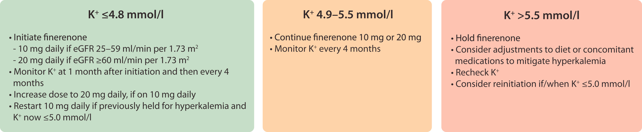
Comprehensive Care in Patients with Diabetes and CKD
Recommendation 1.4.1: We suggest a nonsteroidal mineralocorticoid receptor antagonist with proven kidney or cardiovascular benefit for patients with T2D, an eGFR ≥25 ml/min per 1.73 m², normal serum potassium concentration, and albuminuria (≥30 mg/g [≥ 3mg/mmol]) despite maximum tolerated dose of RAS inhibitor (RASi) (2A).
Notes:
Serum potassium monitoring during treatment with finerenone. Adapted from the protocols of Finerenone in Reducing Kidney Failure and Disease Progression in Diabetic Kidney Disease (FIDELIO-DKD) and Finerenone in Reducing Cardiovascular Mortality and Morbidity in Diabetic Kidney Disease (FIGARO-DKD). The United States Food and Drug Administration (FDA) has approved initiation of K+ <5.0 mmol/l. This figure is guided by trial design and the FDA label and may be different in other countries. Serum creatinine/estimated glomerular filtration rate (eGFR) should be monitored concurrently with serum potassium.

Slide 38
Comprehensive Care in Patients with Diabetes and CKD
Practice Point 1.4.1: Nonsteroidal MRA are most appropriate for patients with T2D who are at high risk of CKD progression and cardiovascular events, as demonstrated by persistent albuminuria despite other standard-of-care therapies.
Practice Point 1.4.2: A nonsteroidal MRA can be added to a RASi and an SGLT2i for treatment of T2D and CKD.
Practice Point 1.4.3: To mitigate risk of hyperkalemia, select patients with consistently normal serum potassium concentration and monitor serum potassium regularly after initiation of a nonsteroidal MRA.
Practice Point 1.4.4: The choice of a nonsteroidal MRA should prioritize agents with documented kidney or cardiovascular benefits.
Practice Point 1.4.5: A steroidal MRA should be used for treatment of heart failure, hyperaldosteronism, or refractory hypertension, but may cause hyperkalemia or a reversible decline in glomerular filtration, particularly among patients with a low GFR.

Slide 39
Comprehensive Care in Patients with Diabetes and CKD
Recommendation 1.5.1: We recommend advising patients with diabetes and CKD who use tobacco to quit using tobacco products (1D).
Practice Point 1.3.1: Physicians should counsel patients with diabetes and CKD to reduce secondhand smoke exposure.

Slide 40
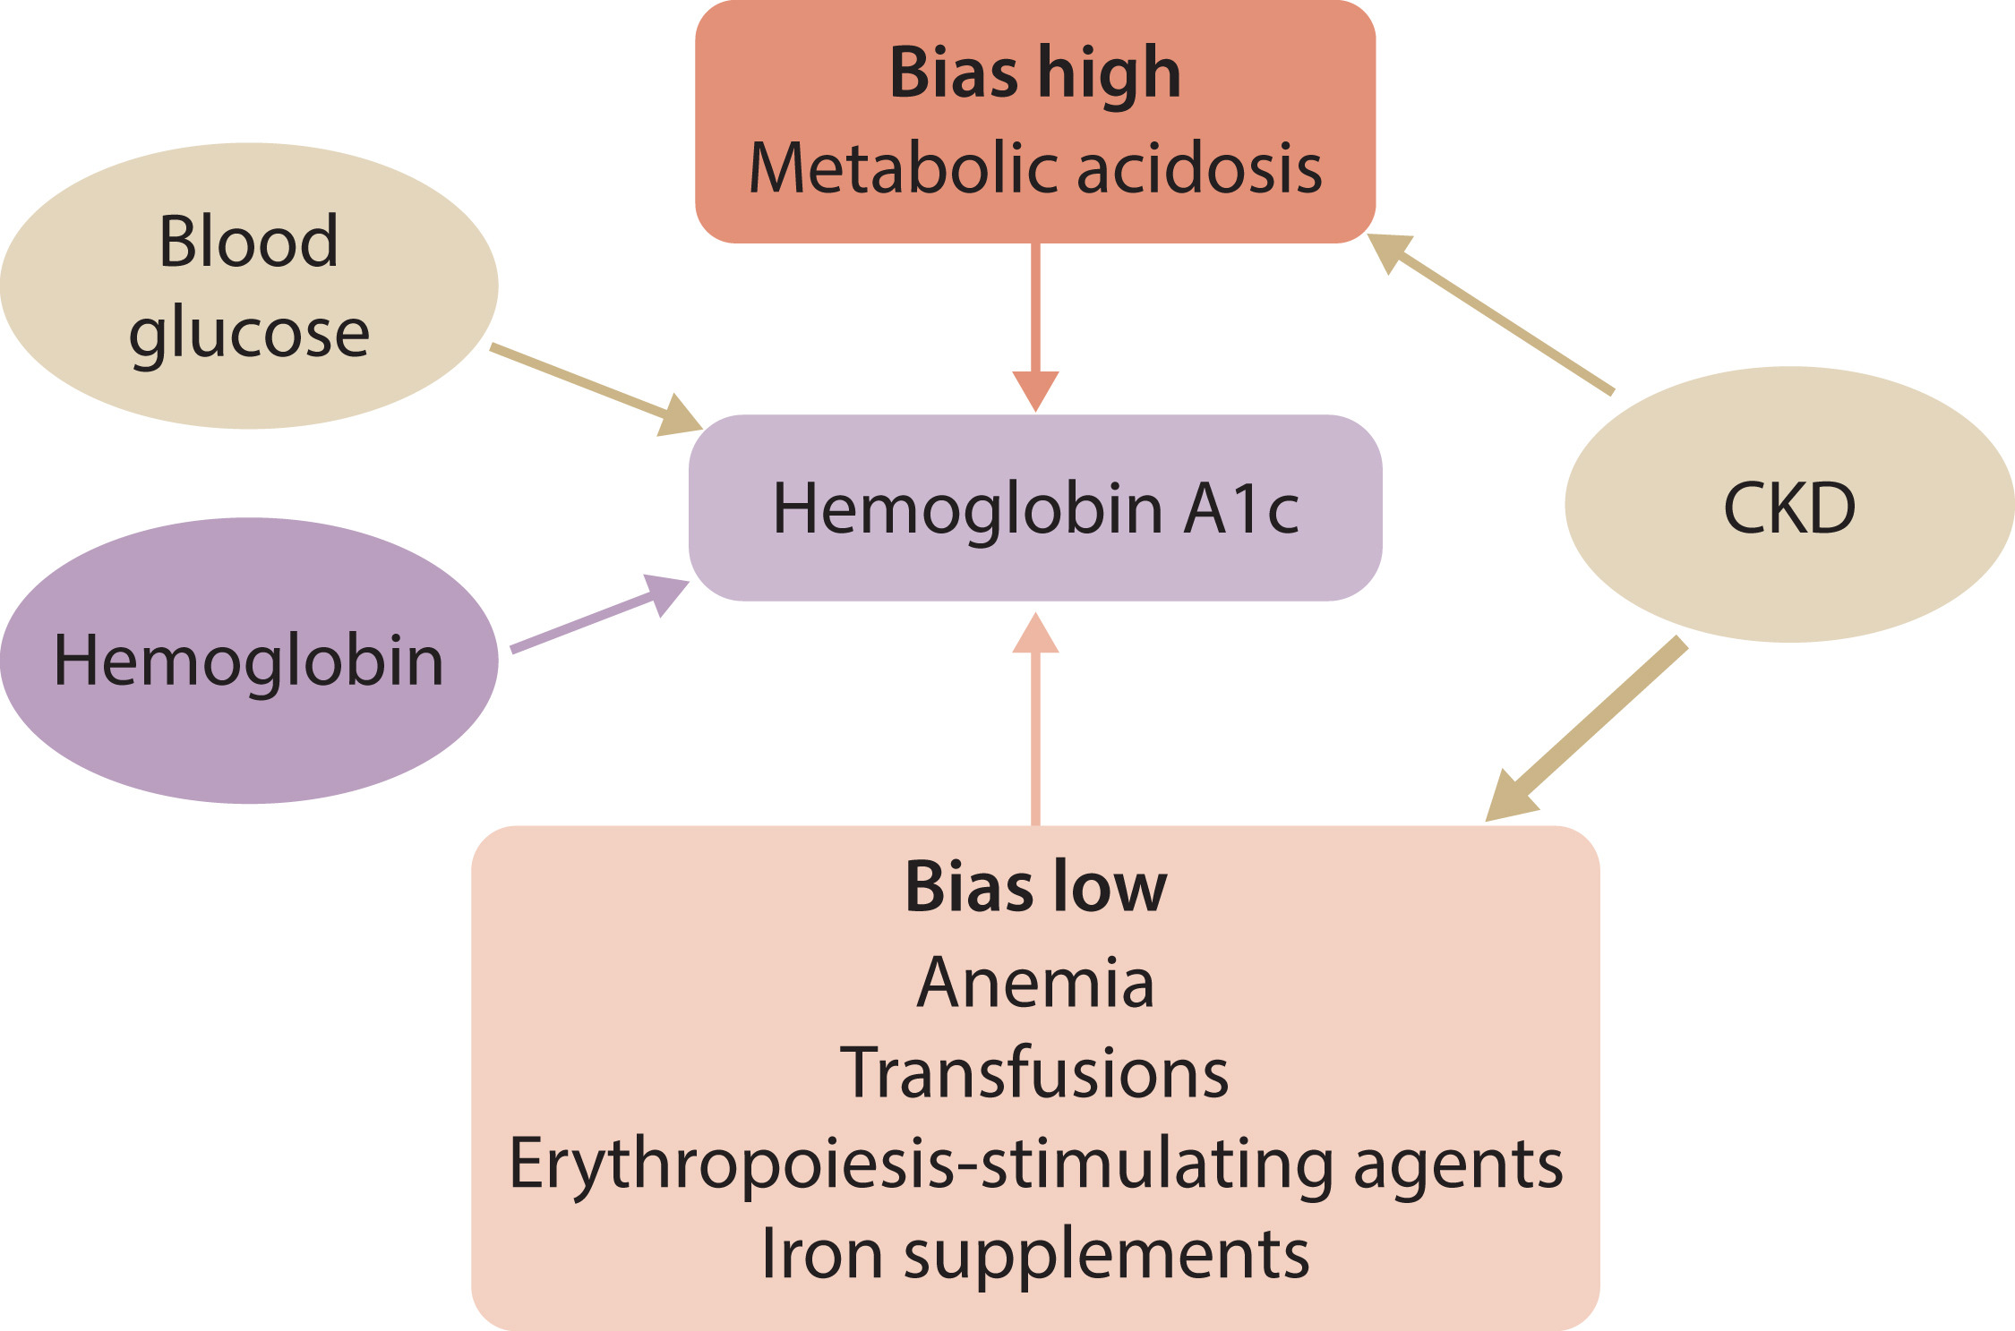
Glycemic Monitoring and Targets in Patients with Diabetes and CKD
Recommendation 2.1.1: We recommend hemoglobin A1c (HbA1c) to monitor glycemic control in patients with diabetes and CKD (1C).
Practice Point 2.1.1: Monitoring long-term glycemic control by HbA1c twice per year is reasonable for patients with diabetes. HbA1c may be measured as often as 4 times per year if the glycemic target is not met or after a change in glucose-lowering therapy.
Practice Point 2.1.2: Accuracy and precision of HbA1c measurement declines with advanced CKD (G4-G5), particularly among patients treated by dialysis, in whom HbA1c measurements have low reliability.
Notes:
Effects of chronic kidney disease (CKD)–related factors on glycated hemoglobin (HbA1c).

Slide 41
Glycemic Monitoring and Targets in Patients with Diabetes and CKD
Practice Point 2.1.3: A glucose management indicator (GMI) derived from continuous glucose monitoring (CGM) data can be used to index glycemia for individuals in whom HbA1c is not concordant with directly measured blood glucose levels or clinical symptoms.
Practice Point 2.1.4: Daily glycemic monitoring with CGM or self-monitoring of blood glucose (SMBG) may help to prevent hypoglycemia and improve glycemic control when glucose-lowering therapies associated with risk of hypoglycemia are used.
Practice Point 2.1.5: For patients with T2D and CKD who choose not to do daily glycemic monitoring by CGM or SMBG, glucose-lowering agents that pose a lower risk of hypoglycemia are preferred and should be administered in doses that are appropriate for the level of eGFR.
Practice Point 2.1.6: CGM devices are rapidly evolving with multiple functionalities (e.g., real-time and intermittently scanned CGM). Newer CGM devices may offer advantages for certain patients, depending on their values, goals, and preferences.

Slide 42
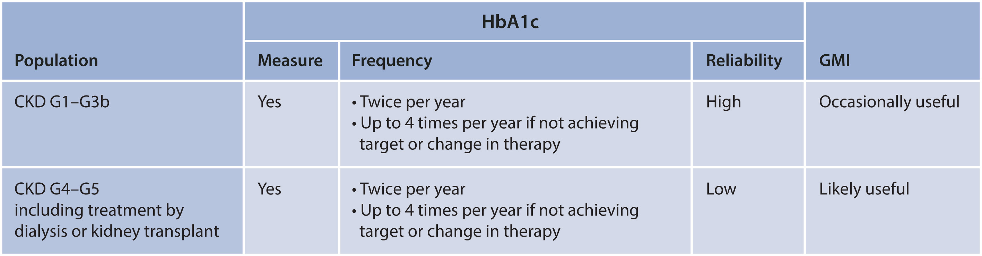
Figure 11. Frequency of HbA1c measurement and use of GMI in CKD
Notes:
Frequency of glycated hemoglobin (HbA1c) measurement and use of glucose management indicator (GMI) in chronic kidney disease (CKD). G1–G3b, estimated glomerular filtration rate (eGFR) ≥30 ml/min per 1.73 m²; G4–G5, eGFR <30 ml/min per 1.73 m².

Slide 43
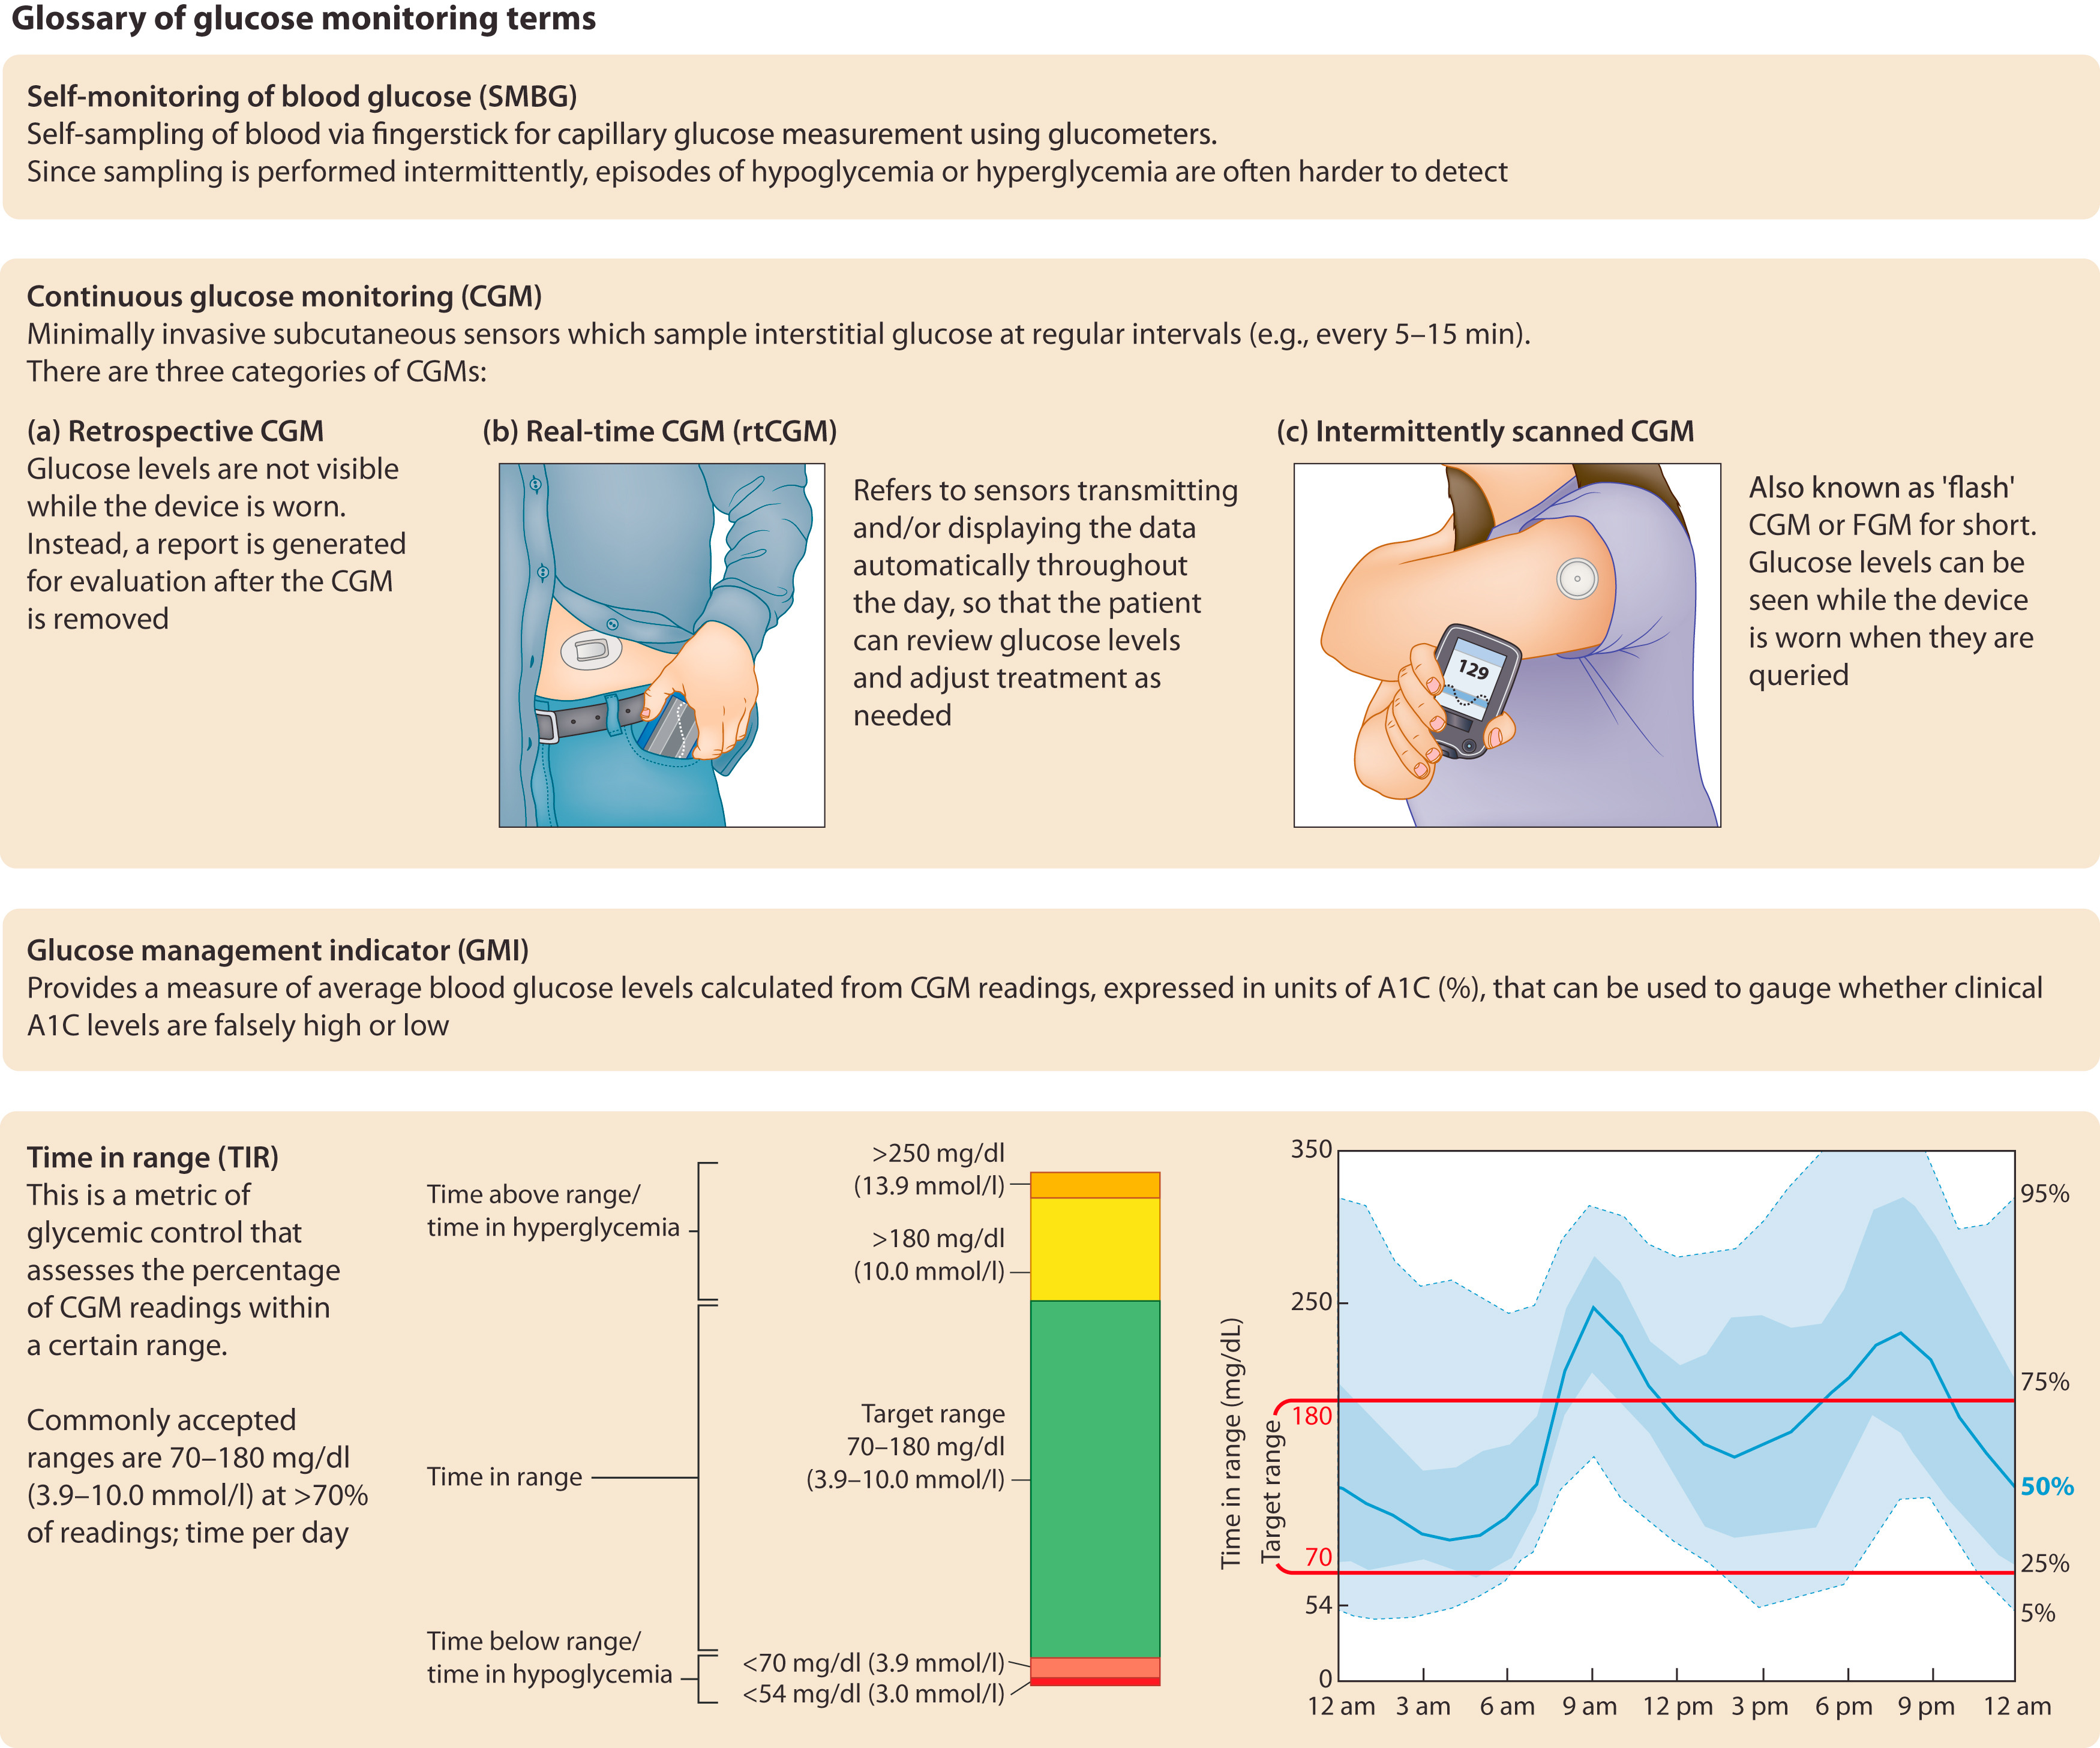
Figure 12. Glossary of glucose-monitoring terms*
*Adapted from Battelino T, et al.
Notes:
Glossary of glucose-monitoring terms. Adapted from American Diabetes Association, Clinical targets for continuous glucose monitoring data interpretation: recommendations from the international consensus on time in range, American Diabetes Association, 2019. Copyright and all rights reserved. Material from this publication has been used with the permission of American Diabetes Association.229

Slide 44
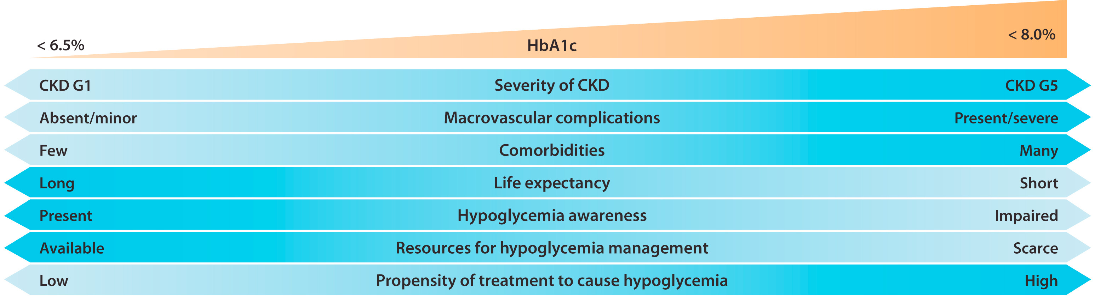
Glycemic Monitoring and Targets in Patients with Diabetes and CKD
Recommendation 2.2.1. We recommend an individualized HbA1c target ranging from <6.5% to <8.0% in patients with diabetes and CKD not treated with dialysis (Figure 14) (1C).
Notes:
Factors guiding decisions on individual glycated hemoglobin (HbA1c) targets. CKD, chronic kidney disease; G1, estimated glomerular filtration rate (eGFR) ≥90 ml/min per 1.73 m²; G5, eGFR <15 ml/min per 1.73 m².

Slide 45
Glycemic Monitoring and Targets in Patients with Diabetes and CKD
Practice Point 2.2.1: Safe achievement of lower HbA1c targets (e.g., <6.5% or <7.0%) may be facilitated by CGM or SMBG and by selection of glucose-lowering agents that are not associated with hypoglycemia.
Practice Point 2.2.2: CGM metrics, such as time in range and time in hypoglycemia, may be considered as alternatives to HbA1c for defining glycemic targets in some patients.

Slide 46
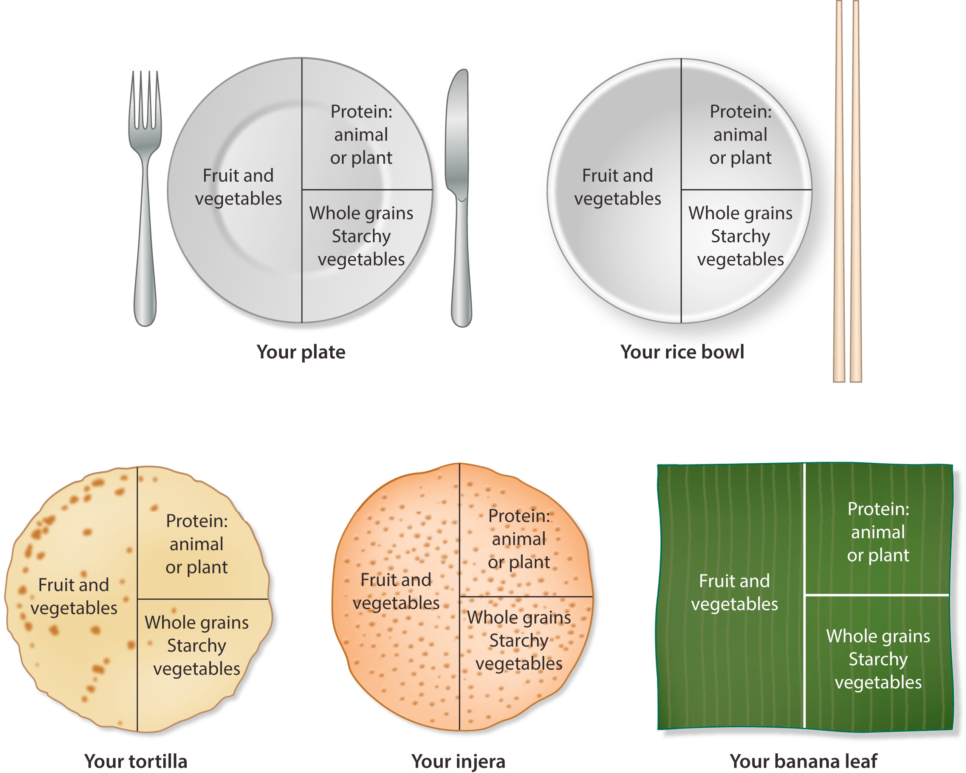
Lifestyle Interventions in Patients with Diabetes and CKD
Practice Point 3.1.1: Patients with diabetes and CKD should consume an individualized diet high in vegetables, fruits, whole grains, fiber, legumes, plant-based proteins, unsaturated fats, and nuts; and lower in processed meats, refined carbohydrates, and sweetened beverages.
Notes:
What does a healthy kidney diet look like?

Slide 47
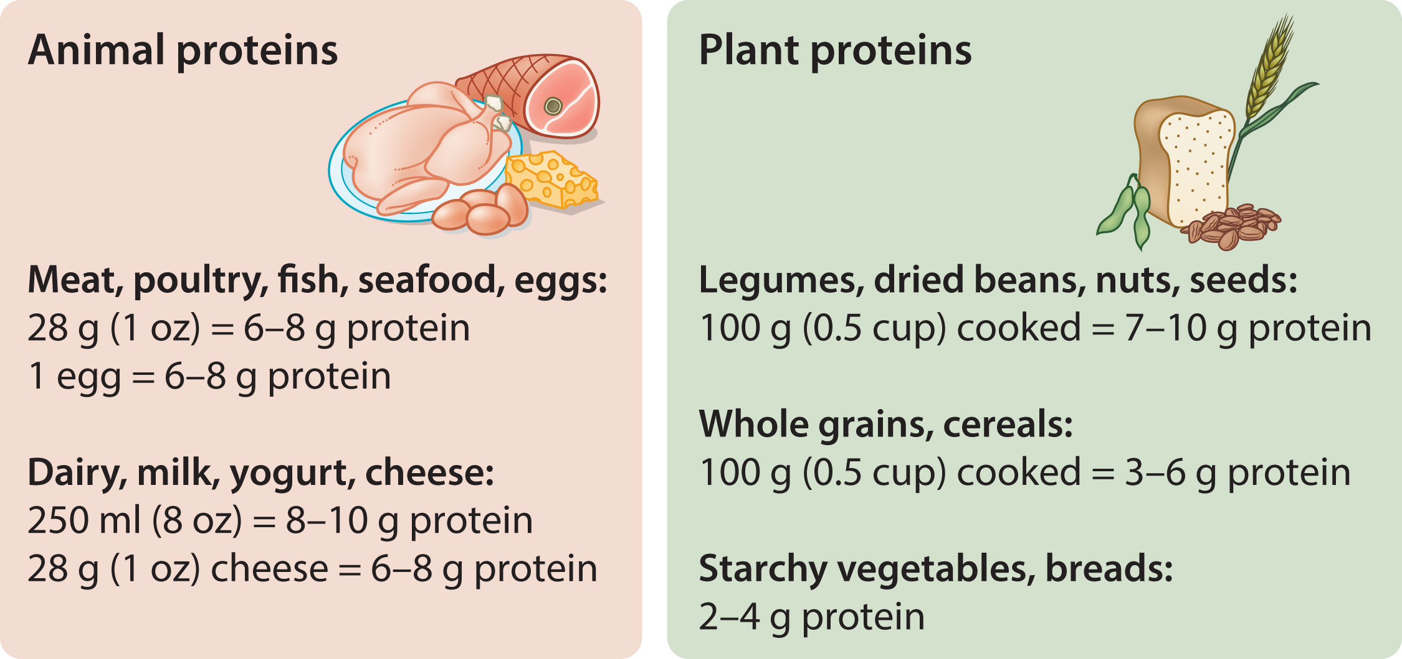
Lifestyle Interventions in Patients with Diabetes and CKD
Recommendation 3.1.1: We suggest maintaining a protein intake of 0.8 g of protein/kg (weight)/d for those with diabetes and CKD not treated with dialysis (2C).
Practice Point 3.1.2: Patients treated with hemodialysis, and particularly peritoneal dialysis should consume between 1.0 and 1.2 g protein/kg (weight)/d.
Notes:
Average protein content of foods in grams.

Slide 48
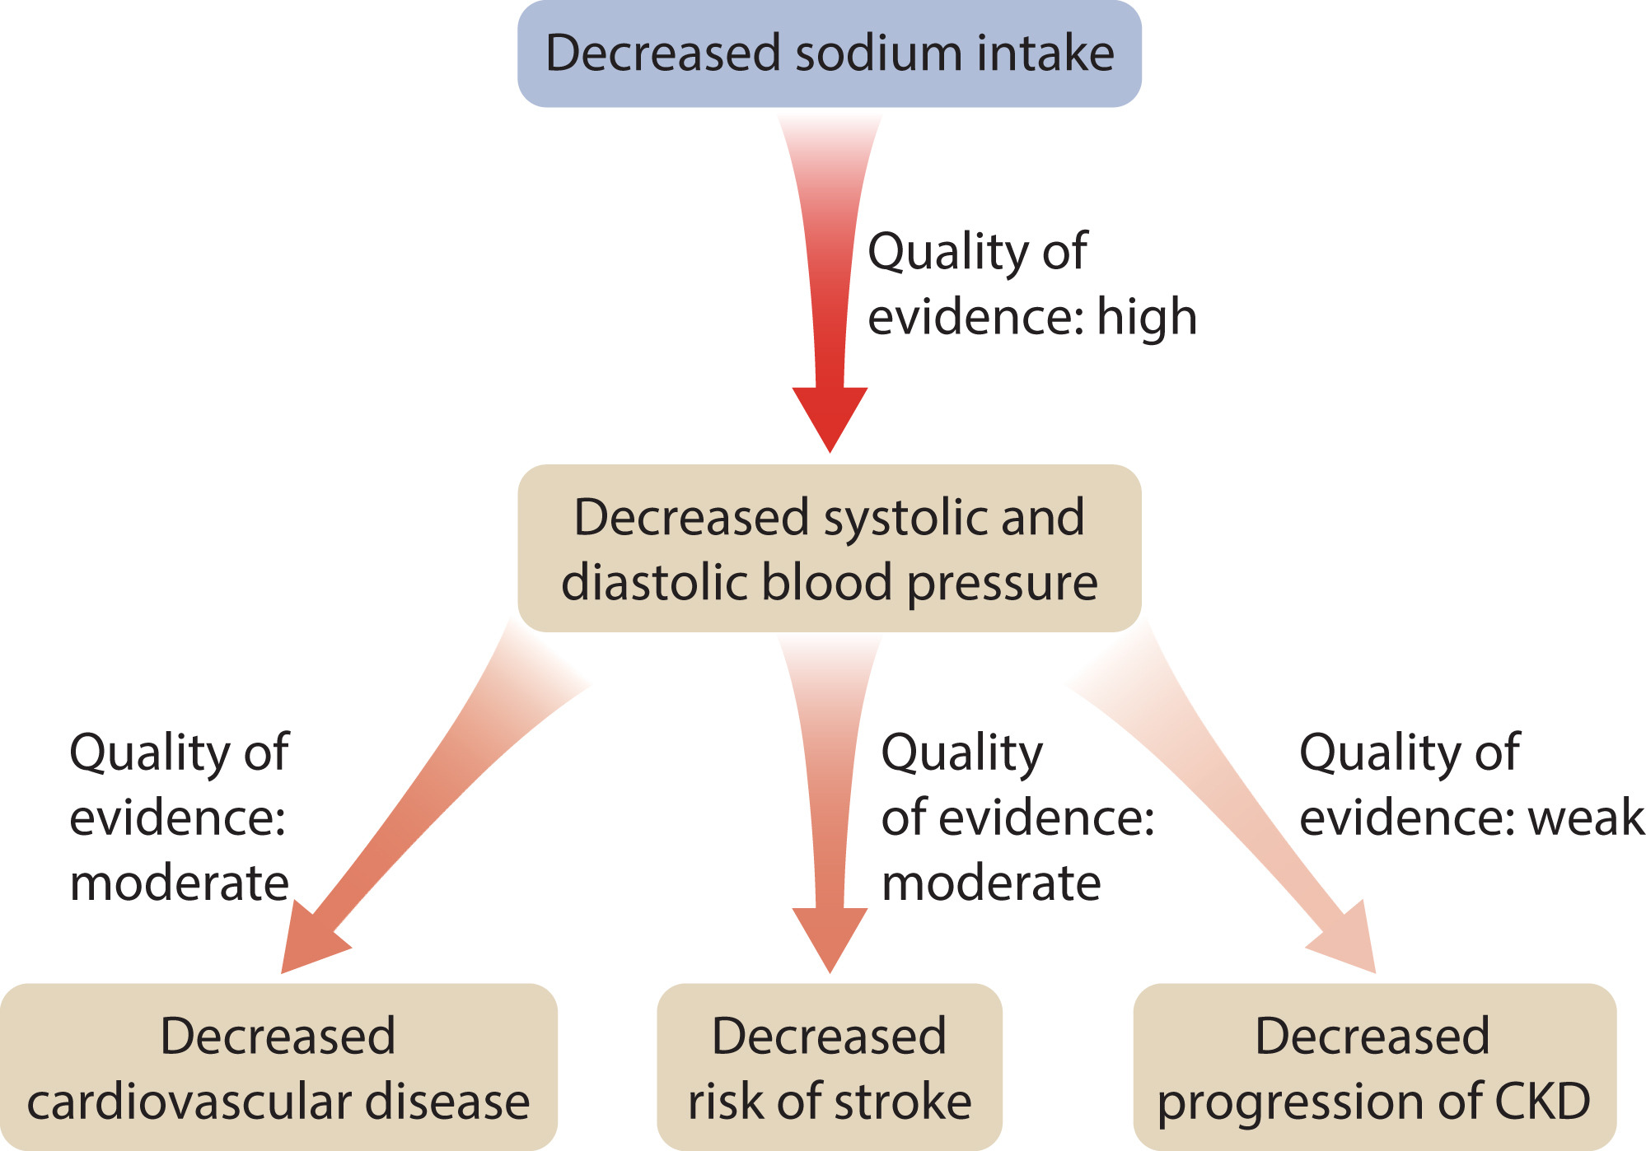
Lifestyle Interventions in Patients with Diabetes and CKD
Recommendation 3.1.2: We suggest that sodium intake be <2 g of sodium per day (or <90 mmol of sodium per day, or <5 g of sodium chloride per day) in patients with diabetes and CKD (2C).
Notes:
Effects of decreased sodium intake on various outcomes and accompanying quality of evidence.³⁰⁶ CKD, chronic kidney disease.

Slide 49
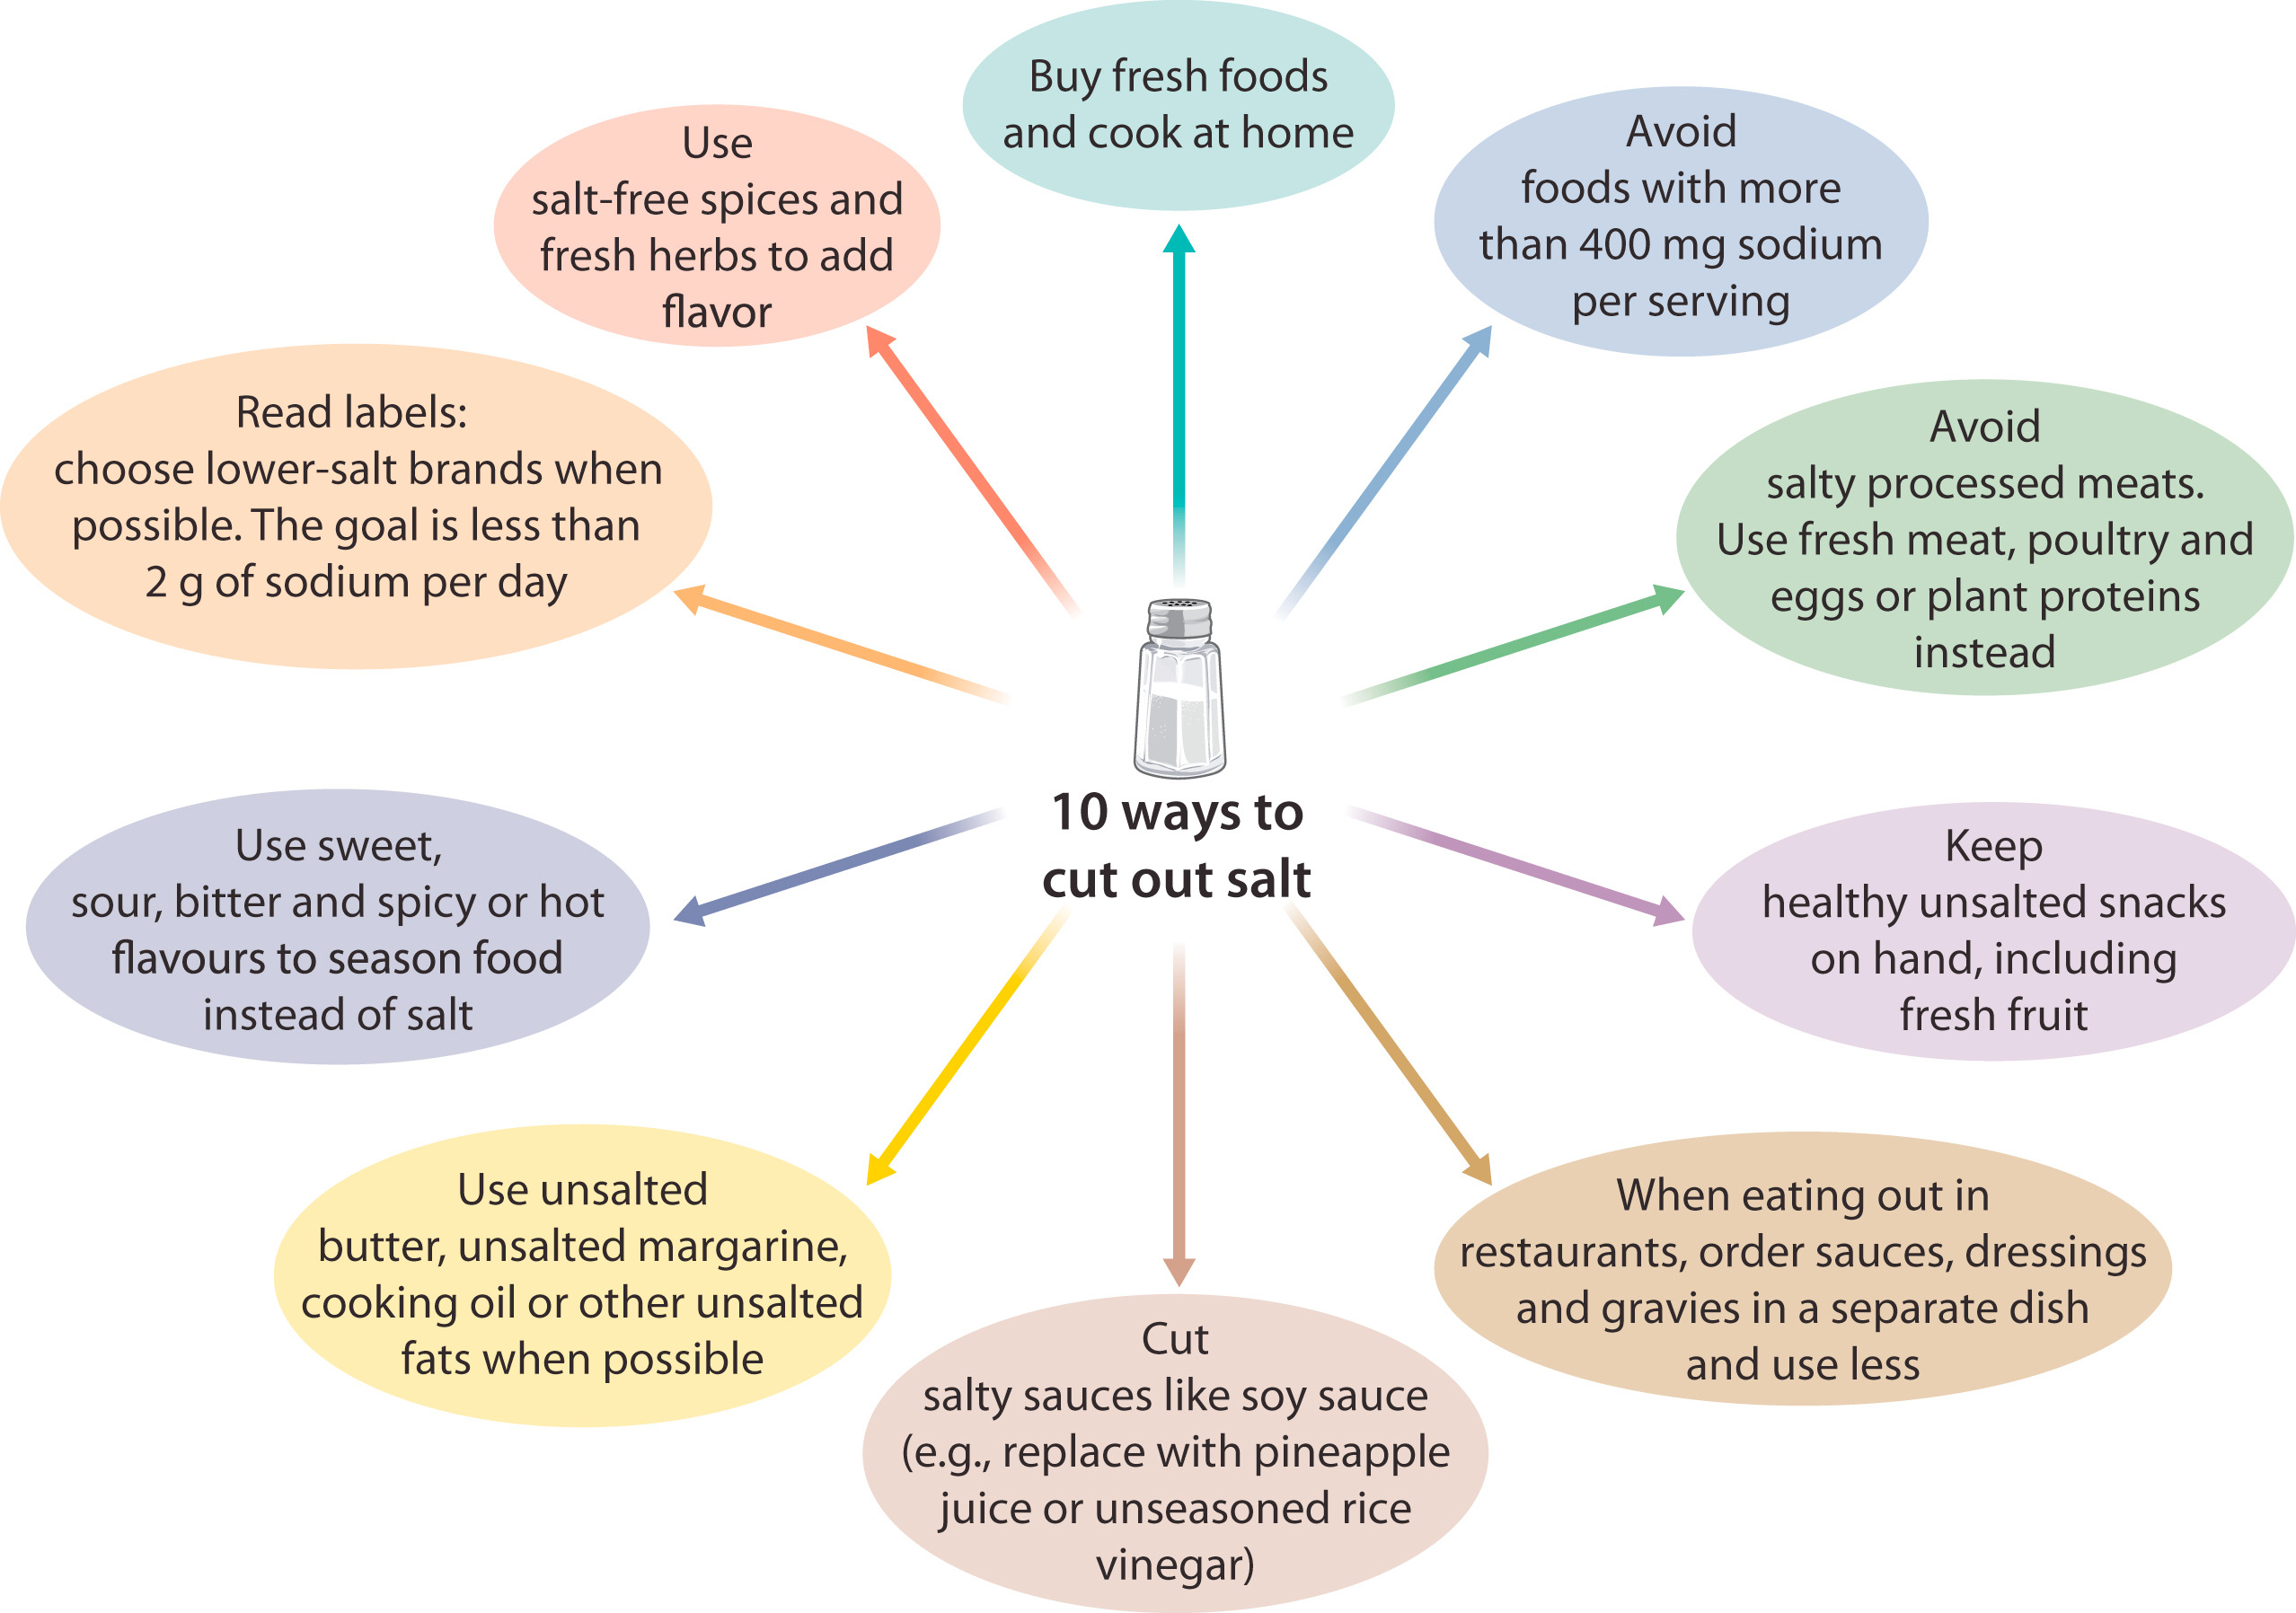
Figure 19. Ten ways to cut out salt
Notes:
Ten ways to cut out salt.

Slide 50
Lifestyle Interventions in Patients with Diabetes and CKD
Practice Point 3.1.3: Shared decision-making should be a cornerstone of patient-centered nutrition management in patients with diabetes and CKD.
Practice Point 3.1.4: Accredited nutrition providers, registered dietitians and diabetes educators, community health workers, peer counselors, or other health workers should be engaged in the multidisciplinary nutrition care of patients with diabetes and CKD.
Practice Point 3.1.5: Health care providers should consider cultural differences, food intolerances, variations in food resources, cooking skills, comorbidities, and cost when recommending dietary options to patients and their families.

Slide 51
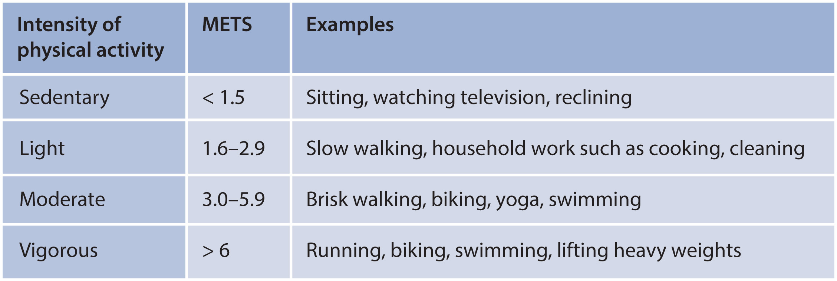
Lifestyle Interventions in Patients with Diabetes and CKD
Recommendation 3.2.1. We recommend that patients with diabetes and CKD be advised to undertake moderate-intensity physical activity for a cumulative duration of at least 150 minutes per week, or to a level compatible with their cardiovascular and physical tolerance (1D).
Notes:
Examples of various levels of physical activity and their associated metabolic equivalents (METs). A MET is a unit useful for describing the energy expenditure of a specific activity. A MET is the ratio of the rate of energy expended during an activity to the rate of energy expended at rest. Republished with permission of the American Society of Nephrology, Clinical Journal of the American Society of Nephrology, Light-intensity physical activities and mortality in the United States general population and CKD subpopulation. Beddhu S, Wei G, Marcus RL, et al., volume 10, issue 7, 2015, permission conveyed through the Copyright Clearance Center, Inc.³¹³ Copyright © American Society of Nephrology.

Slide 52
Lifestyle Interventions in Patients with Diabetes and CKD
Practice Point 3.2.1: Recommendations for physical activity should consider age, ethnic background, presence of other comorbidities, and access to resources.
Practice Point 3.2.2: Patients should be advised to avoid sedentary behavior.
Practice Point 3.2.3: For patients at higher risk of falls, health care providers should provide advice on the intensity of physical activity (low, moderate, or vigorous) and type of exercises (aerobic vs. resistance, or both).
Practice Point 3.2.4: Physicians should consider advising/encouraging patients with obesity, diabetes, and CKD to lose weight, particularly patients with eGFR ≥30 ml/min per 1.73 m².

Slide 53
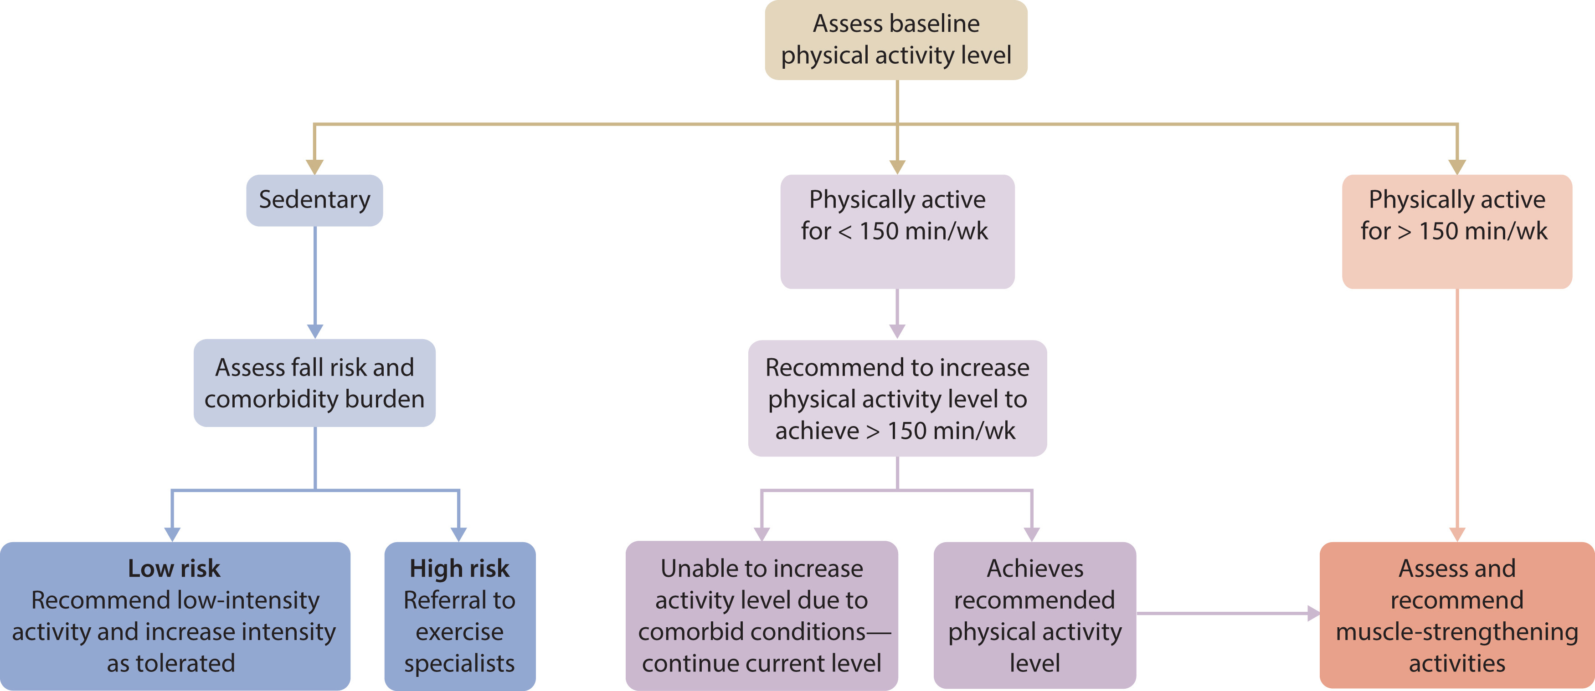
Figure 22. Suggested approach to address physical inactivity and sedentary behavior in CKD
Notes:
Suggested approach to address physical inactivity and sedentary behavior in chronic kidney disease (CKD).

Slide 54
Glucose-Lowering Therapies in Patients with Diabetes and CKD
Practice Point 4.1: Glycemic management for patients with T2D and CKD should include lifestyle therapy, first-line treatment with metformin and a sodium-glucose cotransporter-2 inhibitor (SGLT2i), and additional drug therapy as needed for glycemic control (Figure 23).
Practice Point 4.2: Most patients with T2D, CKD, and eGFR ≥30 ml/min per 1.73 m² would benefit from treatment with both metformin and an SGLT2i.
Practice Point 4.3: Patient preferences, comorbidities, eGFR, and cost should guide selection of additional drugs to manage glycemia, when needed, with glucagon-like peptide-1 receptor agonists (GLP-1 RA) generally preferred (Figure 25).

Slide 55
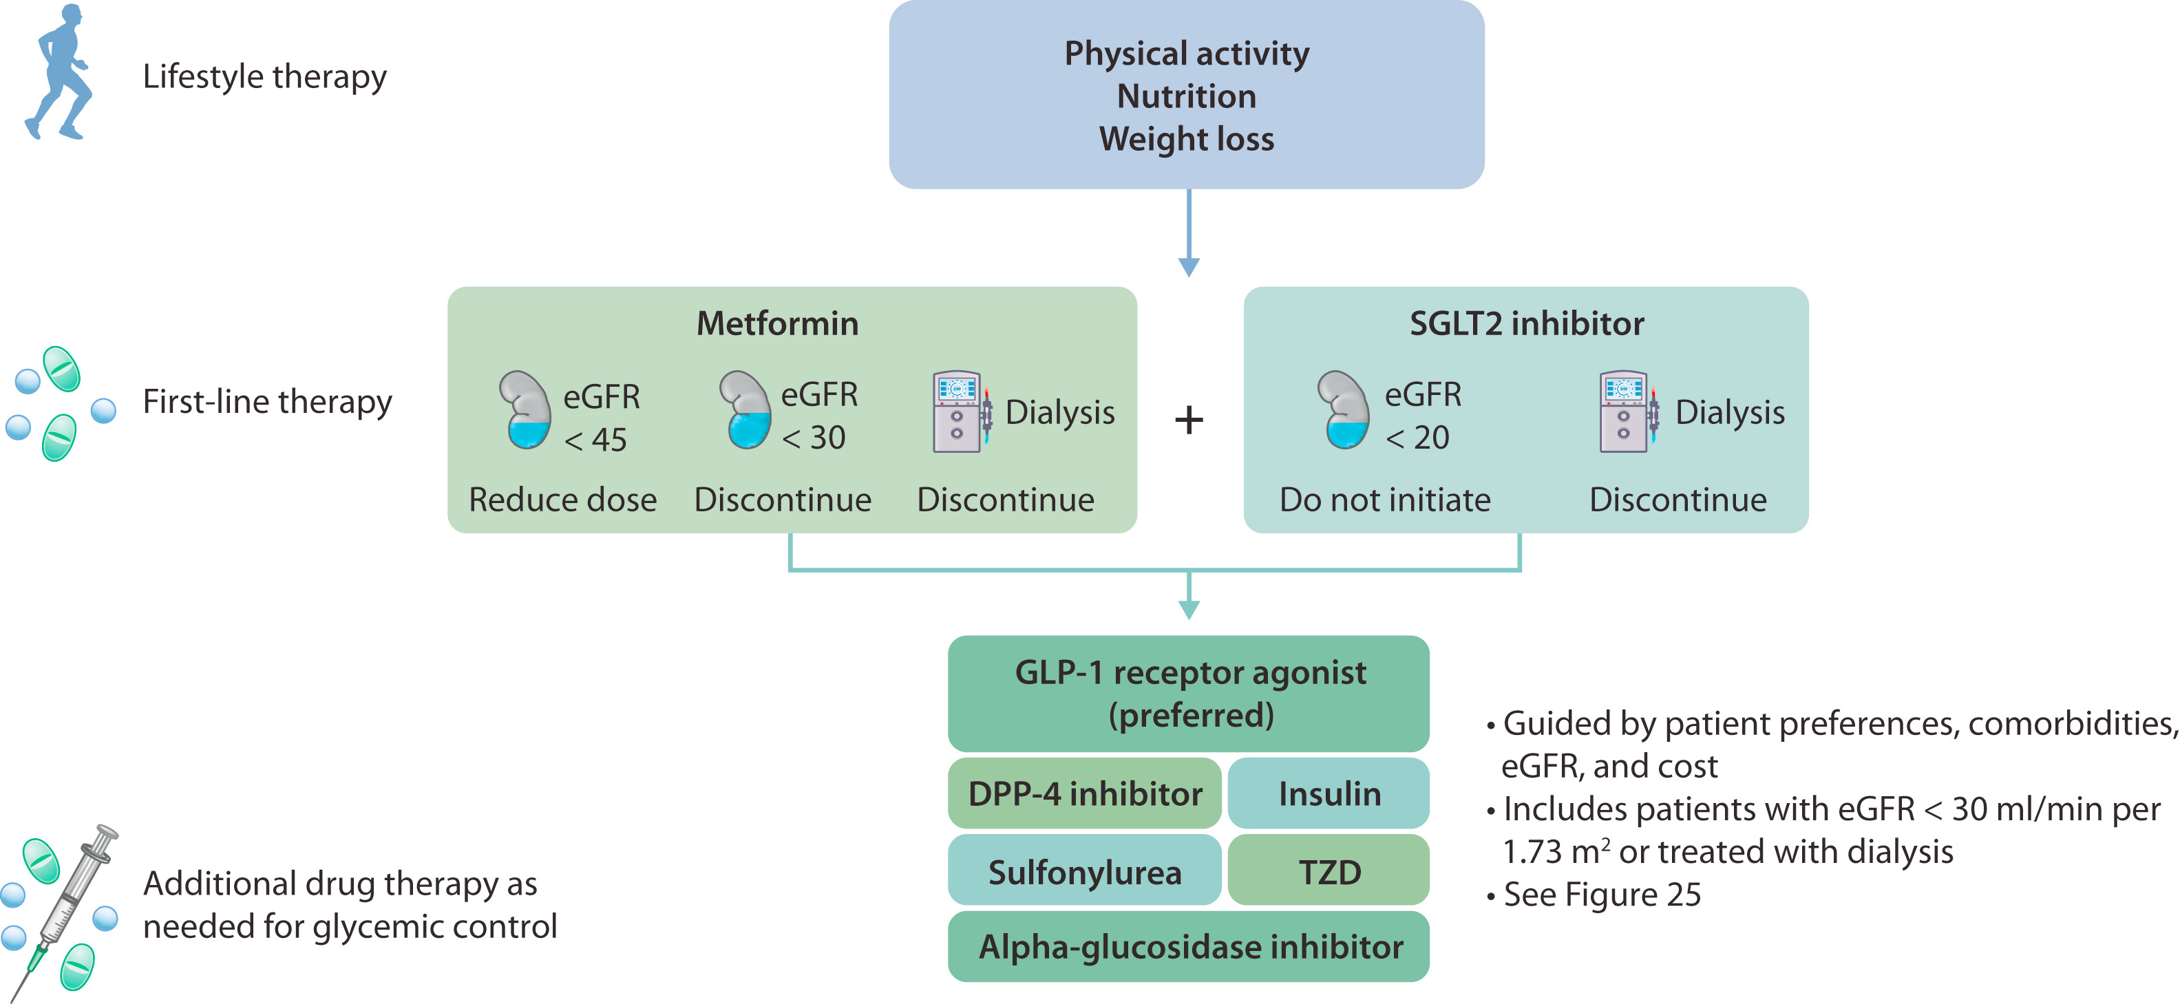
Figure 23. Treatment algorithm for selecting Glucose-Lowering drugs for patients with T2D and CKD
Notes:
Treatment algorithm for selecting glucose-lowering drugs for patients with type 2 diabetes (T2D) and chronic kidney disease (CKD). Kidney icon indicates estimated glomerular filtration rate (eGFR; ml/min per 1.73 m²); dialysis machine icon indicates dialysis. DPP-4, dipeptidyl peptidase-4; GLP-1, glucagon-like peptide-1; SGLT2, sodium–glucose cotransporter-2; TZD, thiazolidinedione.

Slide 56
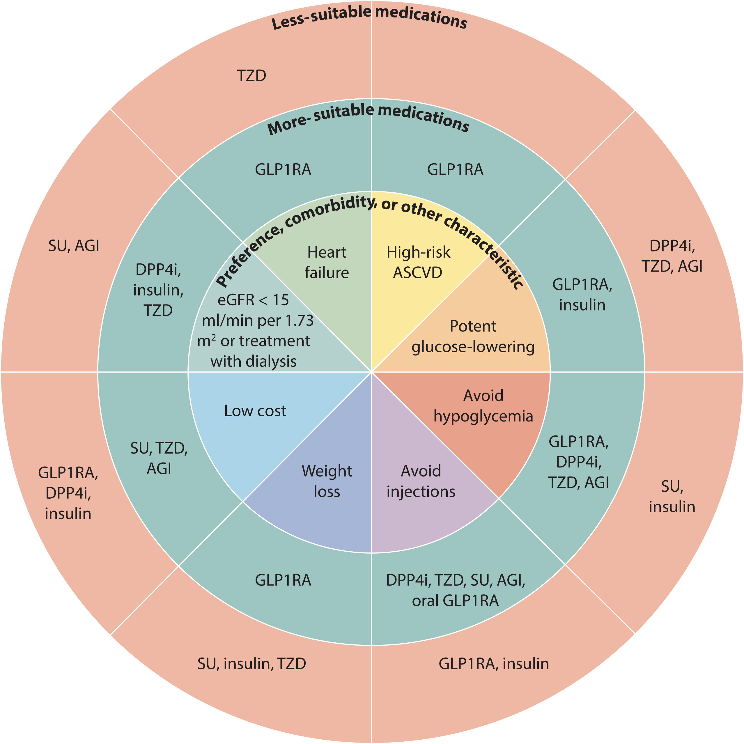
Figure 25. Patient factors influencing selection of glucose-lowering drugs other than SGLT2i and metformin in T2D and CKD
Notes:
Patient factors influencing the selection of glucose-lowering drugs other than sodium–glucose cotransporter-2 inhibitor (SGLT2i) and metformin in type 2 diabetes (T2D) and chronic kidney disease (CKD). AGI, alpha-glucosidase inhibitor; ASCVD, atherosclerotic cardiovascular disease; DPP4i, dipeptidyl peptidase-4 inhibitor; eGFR, estimated glomerular filtration rate; GLP1RA, glucagon-like peptide-1 receptor agonist; SU, sulfonylurea; TZD, thiazolidinedione.

Slide 57
Glucose-lowering Therapies in Patients with Diabetes and CKD
Recommendation 4.1.1: We recommend treating patients with T2D, CKD, and eGFR ≥30 ml/min per 1.73 m² with metformin (1B).
Practice Point 4.1.1: Treat kidney transplant recipients with T2D and eGFR ≥30 ml/min per 1.73 m² with metformin according to recommendations for patients with T2D and CKD.
Practice Point 4.1.2: Monitor eGFR in patients treated with metformin. Increase the frequency of monitoring when eGFR is <60 ml/min per 1.73 m² (Figure 27).

Slide 58
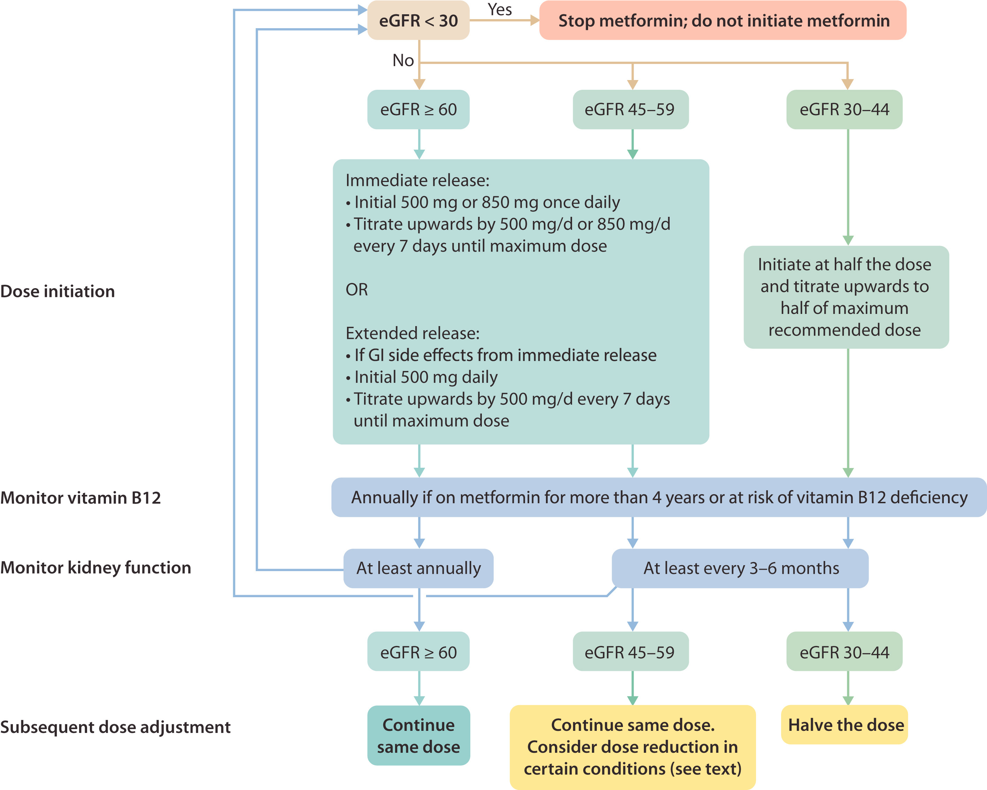
Figure 27. Suggested approach in dosing metformin based on the level of kidney function
Notes:
Suggested approach in dosing metformin based on the level of kidney function. eGFR, estimated glomerular filtration rate (in ml/min per 1.73 m²); GI, gastrointestinal.

Slide 59
Glucose-lowering Therapies in Patients with Diabetes and CKD
Practice Point 4.1.3: Adjust the dose of metformin when eGFR is <45 ml/min per 1.73 m², and for some patients when eGFR is 45-59 ml/min per 1.73 m² (Figure 27).
Practice Point 4.1.4: Monitor patients for vitamin B12 deficiency when they are treated with metformin for more than 4 years.

Slide 60
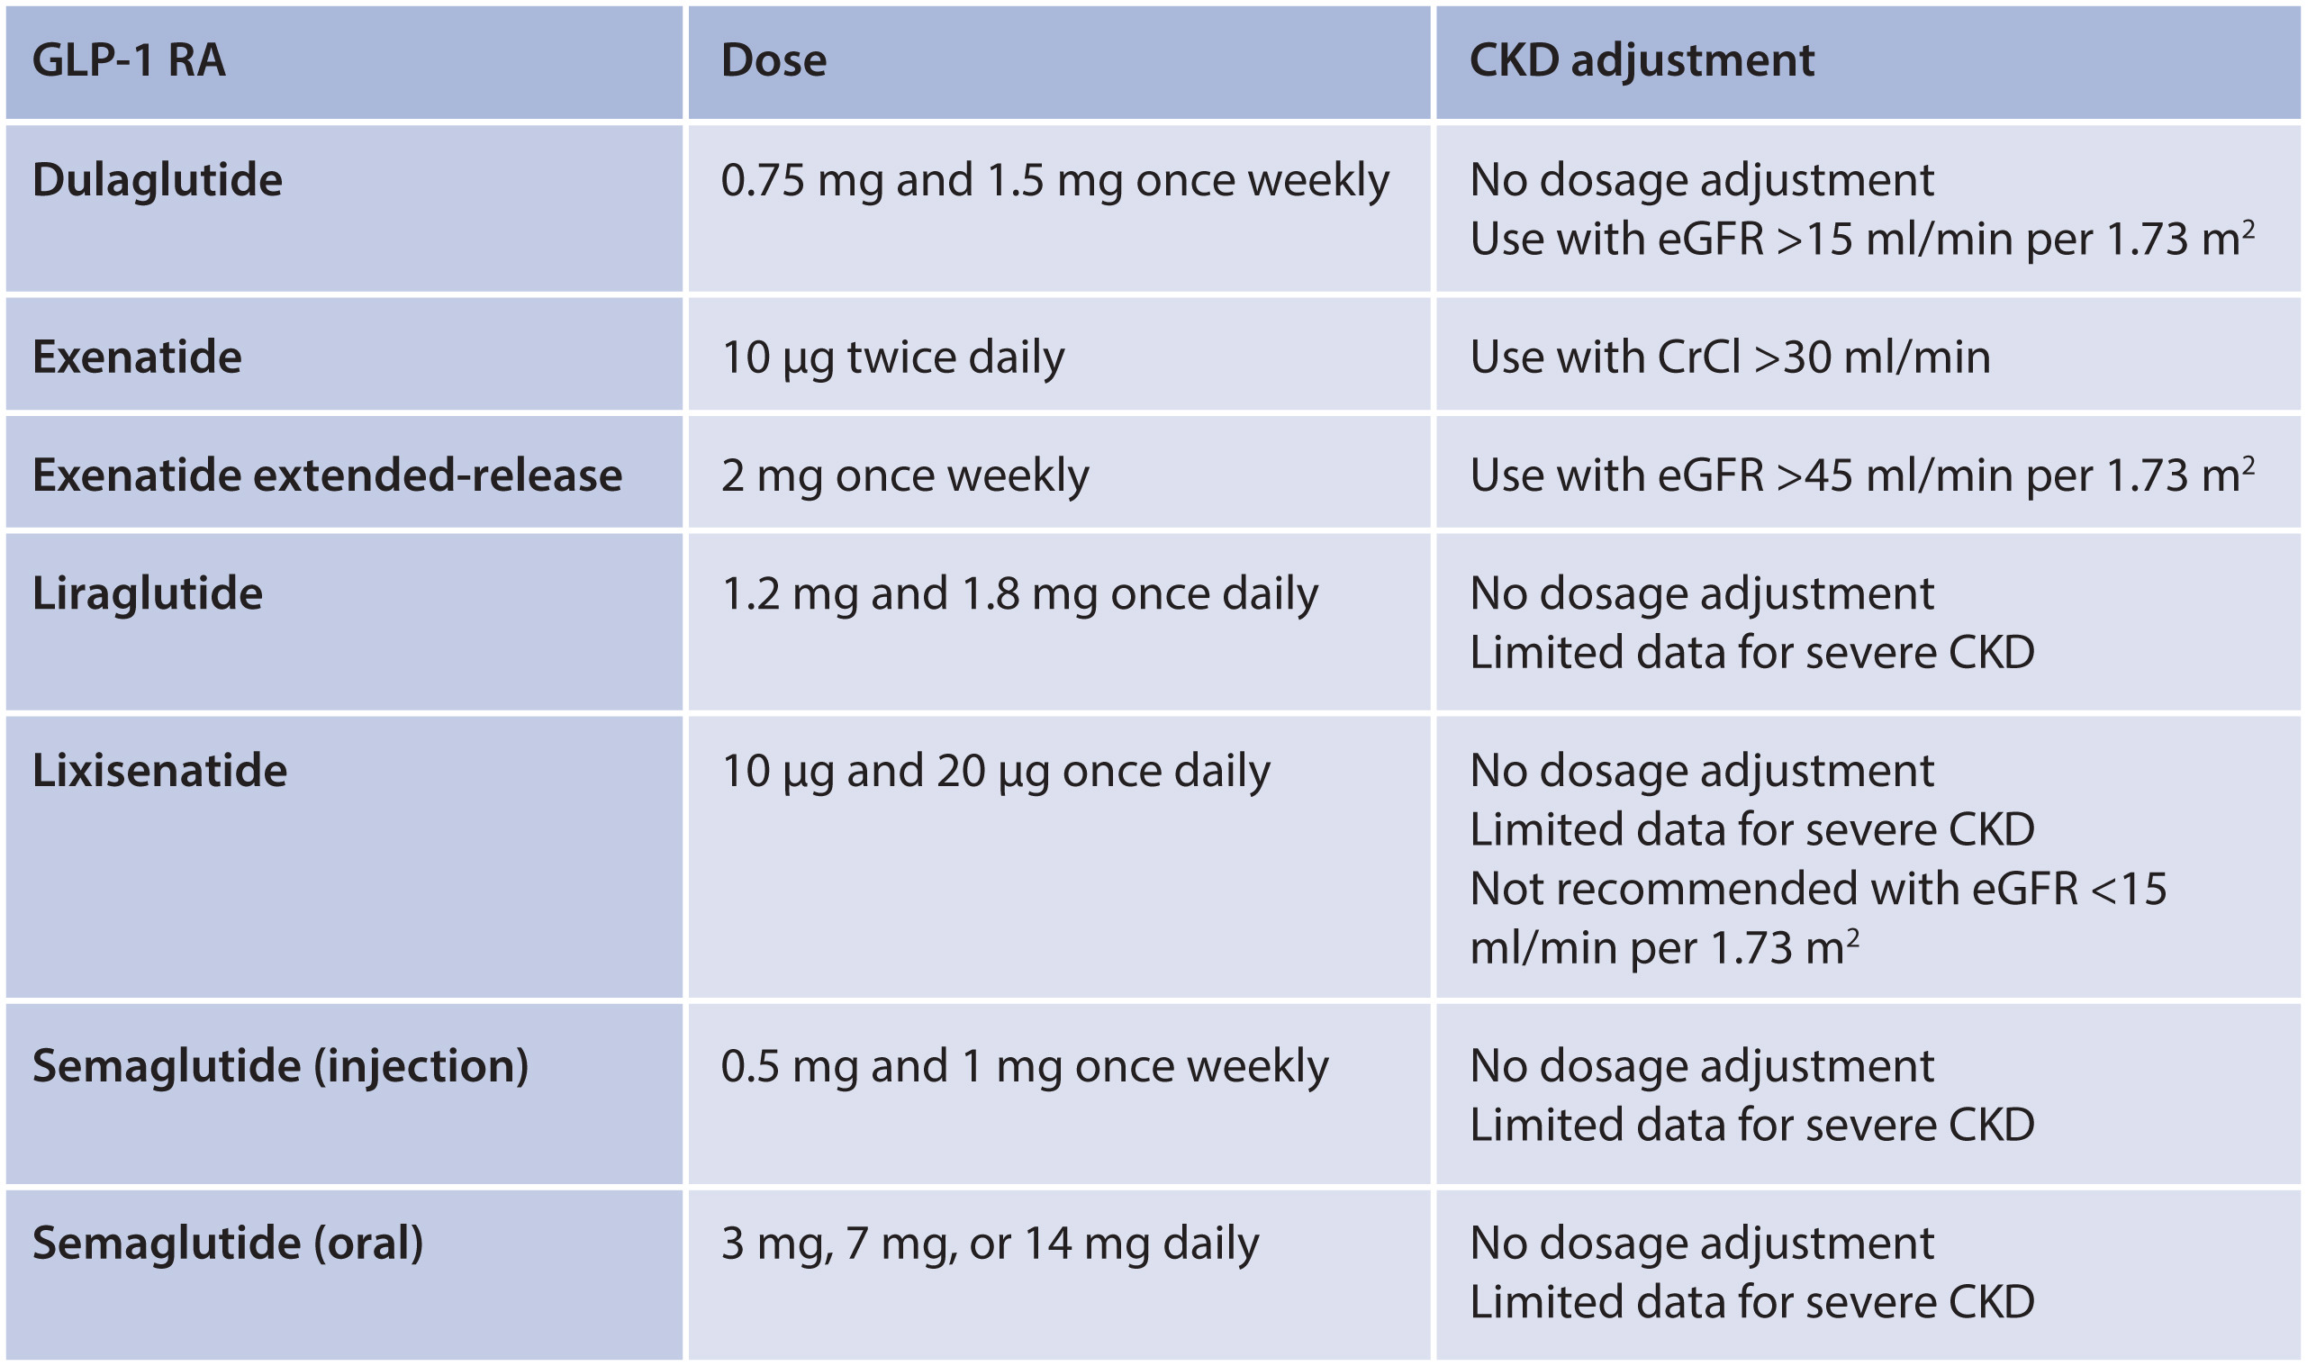
Glucose-lowering Therapies in Patients with Diabetes and CKD
Recommendation 4.2.1: In patients with T2D and CKD who have not achieved individualized glycemic targets despite use of metformin and SGLT2i treatment, or who are unable to use those medications, we recommend a long-acting GLP-1 RA (1B).
Notes:
Dosing for available glucagon-like peptide-1 receptor agonists (GLP-1 RA) and dose modification for chronic kidney disease (CKD). CrCl, creatinine clearance; eGFR, estimated glomerular filtration rate.

Slide 61
Glucose-lowering Therapies in Patients with Diabetes and CKD
Practice Point 4.2.1: The choice of GLP-1 RA should prioritize agents with documented cardiovascular benefits.
Practice Point 4.2.2: To minimize gastrointestinal side effects, start with a low dose of GLP-1 RA, and titrate up slowly (Figure 29).
Practice Point 4.2.3: GLP-1 RA should not be used in combination with dipeptidyl peptidase-4 (DPP-4) inhibitors.
Practice Point 4.2.4: The risk of hypoglycemia is generally low with GLP-1 RA when used alone, but risk is increased when GLP-1 RA are used concomitantly with other medications such as sulfonylureas or insulin. The doses of sulfonylurea and/or insulin may need to be reduced.
Practice Point 4.2.5: GLP-1 RA may be preferentially used in patients with obesity, T2D, and CKD to
promote intentional weight loss.

Slide 62
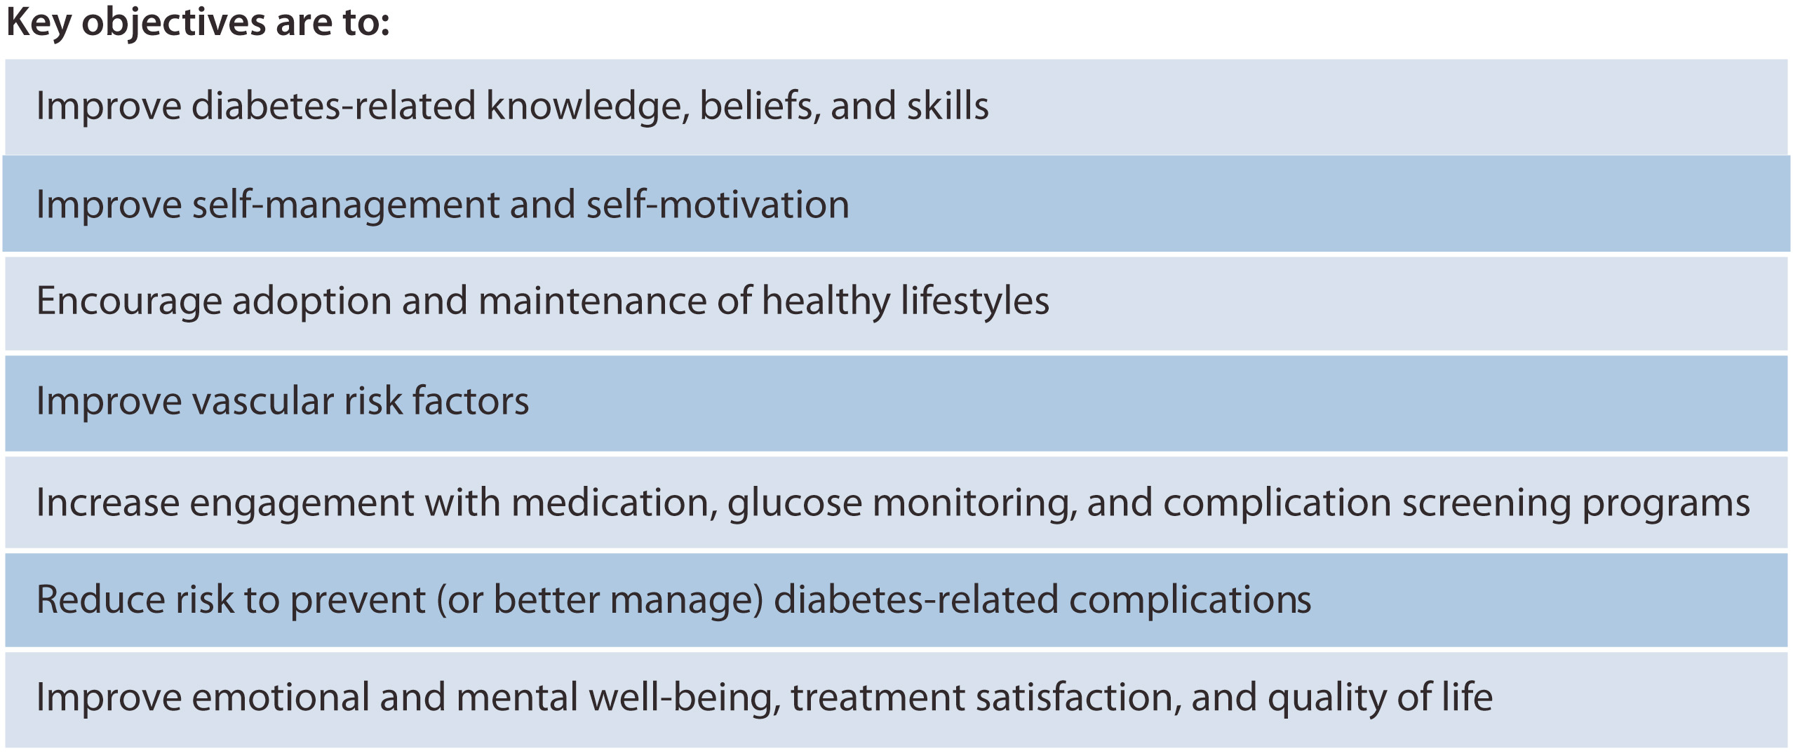
Approaches to Management of Patients with Diabetes and CKD
Recommendation 5.1.1: We recommend that a structured self-management educational program be implemented for care of people with diabetes and CKD (Figure 30) (1C).
Practice Point 5.1.1: Health care systems should consider implementing a structured self-management program for patients with diabetes and CKD, taking into consideration local context, cultures, and availability of resources.
Notes:
Key objectives of effective diabetes self-management education programs. Reprinted from The Lancet Diabetes & Endocrinology, volume 6, Chatterjee S, Davies MJ, Heller S, Speight J, Snoek FJ, Khunti K. Diabetes structured self-management education programmes: a narrative review and current innovations, pages 130–142, Copyright © 2018, with permission from Elsevier.⁴⁰³

Slide 63
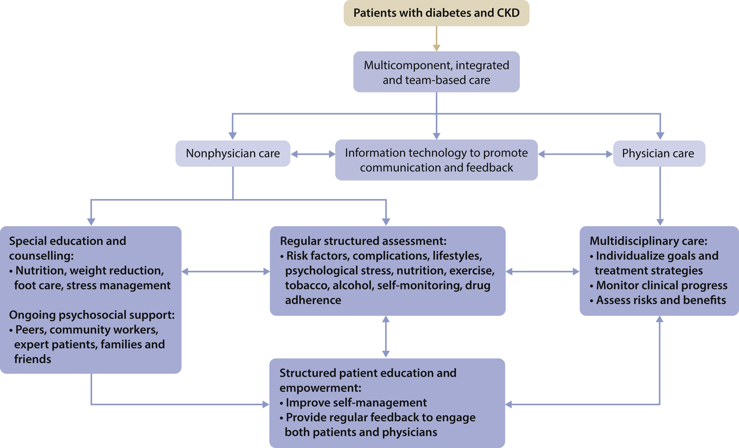
Approaches to Management of Patients with Diabetes and CKD
Recommendation 5.2.1: We suggest that policymakers and institutional decision-makers should implement team-based, integrated care focused on risk evaluation and patient empowerment to provide comprehensive care in patients with diabetes and CKD (2B).
Notes:
Integrated care approach to improve outcomes, self-management, and patient–provider communication in patients with diabetes and chronic kidney disease (CKD).^{429–432} A schematic diagram showing the use of physician and nonphysician personnel to provide regular assessments, assisted by information technology, to facilitate individualized management and patient self-management with ongoing support in order to detect, monitor, and treat risk factors and complications early to reduce hospitalizations, multiple morbidities, and premature death.

Slide 64
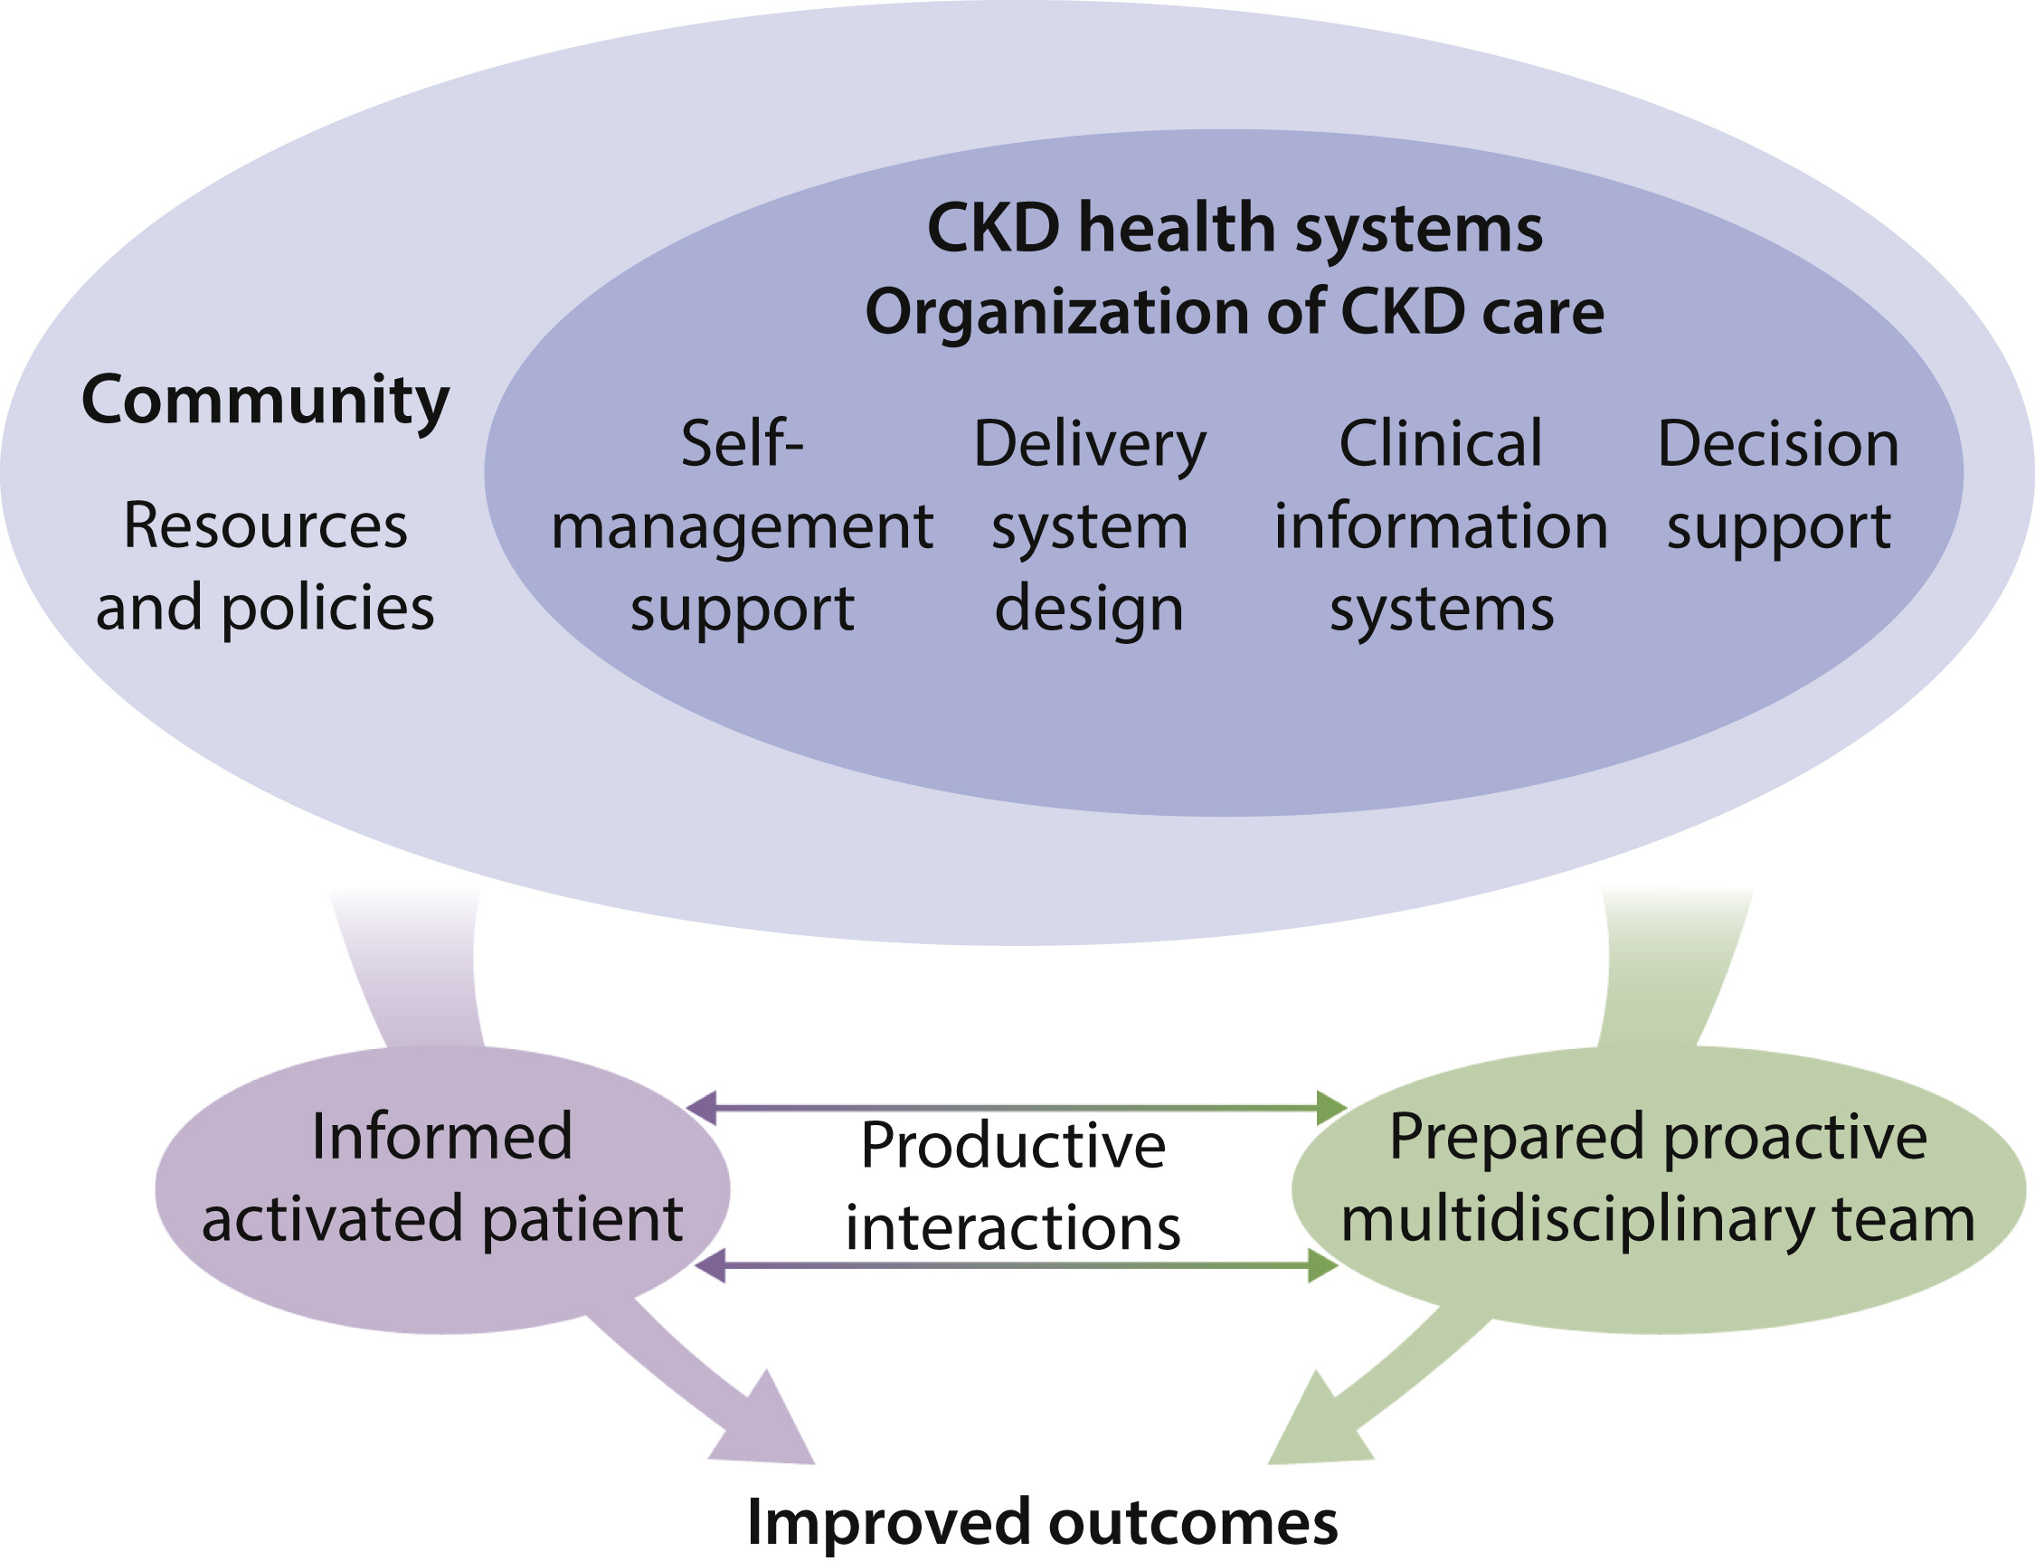
Figure 34. The chronic care model
Notes:
The chronic care model. The chronic care model emphasizes the additive benefits of different components at the system, policy, provider, and patient levels in improving clinical outcomes. CKD, chronic kidney disease. Reproduced from Improving the quality of health care for chronic conditions, Epping-Jordan JE, Pruitt SD, Bengoa R, et al., volume 13, 299–305, Copyright © 2004, with permission from BMJ Publishing Group Ltd.⁴³⁶

Slide 65
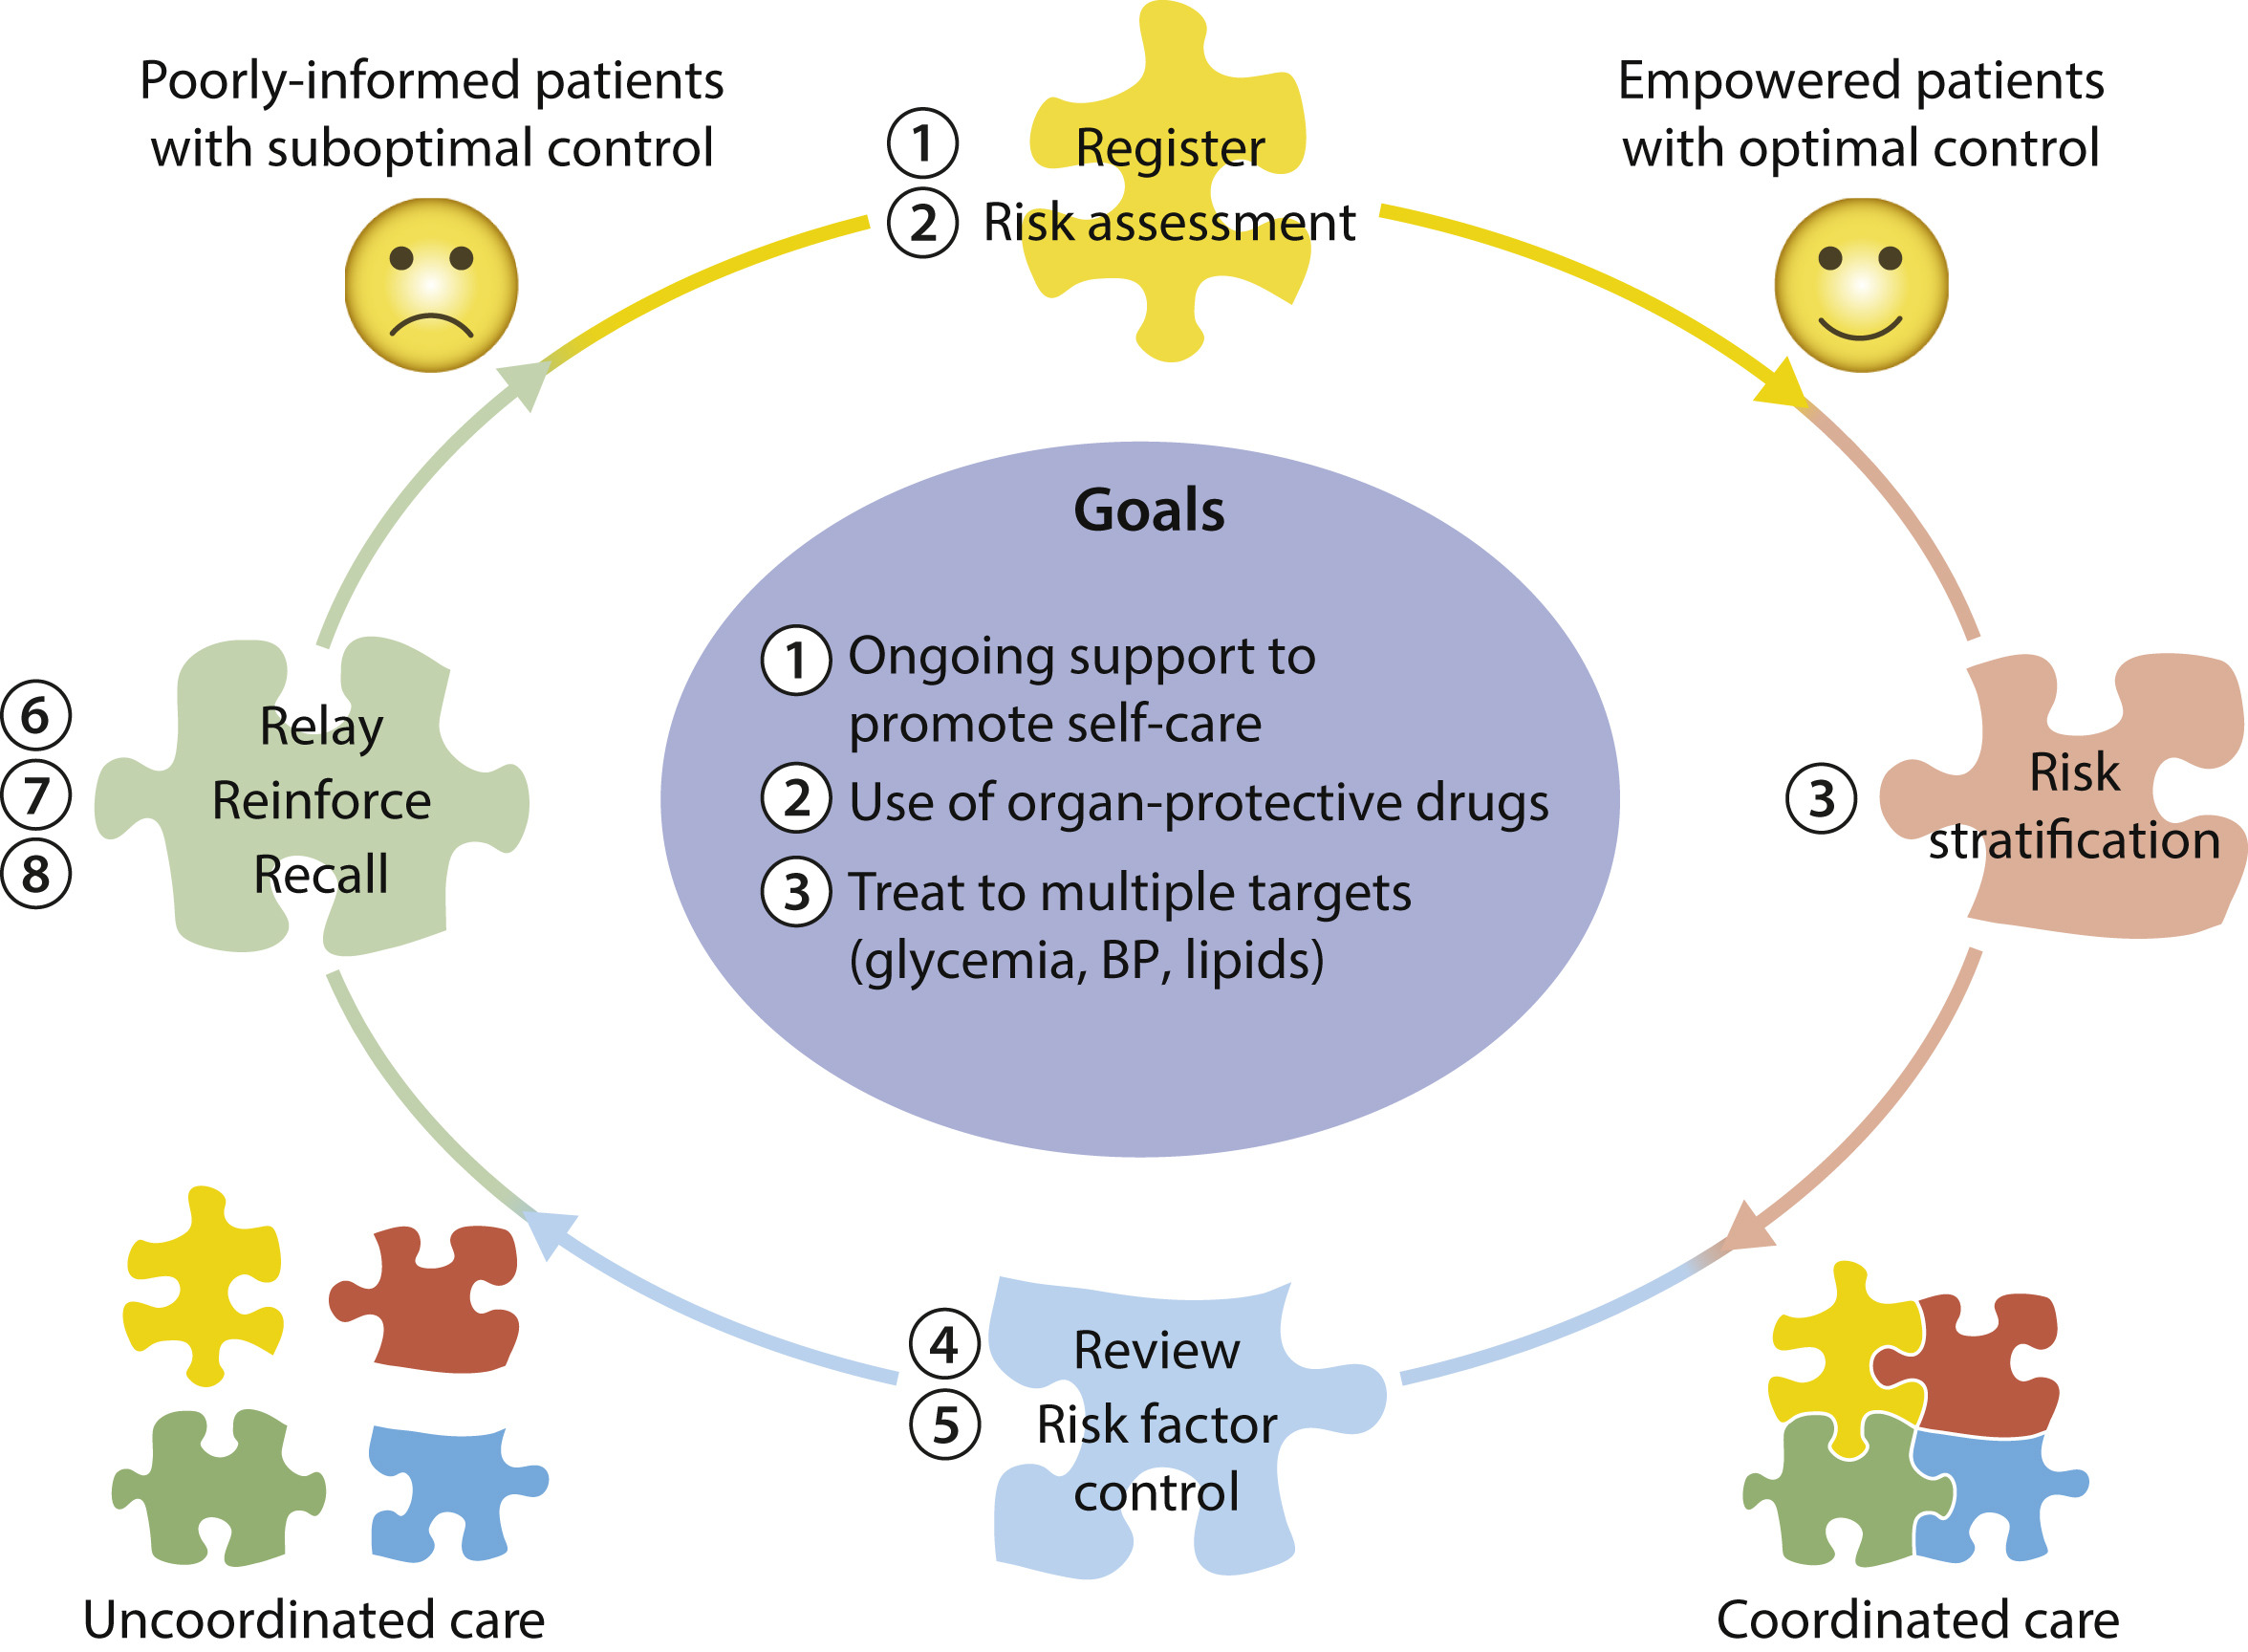
Approaches to Management of Patients with Diabetes and CKD
Practice Point 5.2.1: Team-based integrated care, supported by decision-makers, should be delivered by physicians and nonphysician personnel (e.g., trained nurses and dieticians, pharmacists, health care assistants, community workers, peer supporters) preferably with knowledge of CKD (Figure 35).
Notes:
Team-based integrated care delivered by physicians and nonphysician personnel supported by decision-makers. BP, blood pressure.

Slide 66
Overall Summary
KDIGO 2022 Guideline on Diabetes and CKD is now available
Provide recommendations and practice points on:
  Comprehensive care
  Glycemic monitoring and targets
  Lifestyle interventions
  Glucose-lowering therapies
  Approaches to management of patients
Patient-centered decision-making and support highlighting the need for a holistic approach; Consistent efforts at improving diet and exercise remain the foundation of all glycemic management
Control of risk factors including RAS blockade and statins remains part of standard of care
Glycemia is monitored with HbA1c and blood glucose; Glycemic targets should be individualized with focus on increased risk for hypoglycemia with declining kidney function.
Use of both metformin and SGLT2i is recommended as first-line therapy for T2D
Health care organizations should support a coordinated effort.

Slide 67
Central Illustration

Slide 68
Question and Answer

