Slide 1
MANAGEMENT AND TREATMENT OF GLOMERULAR DISEASES
Anti-Neutrophil Cytoplasmic Antibody-Associated Vasculitis
CONCLUSIONS FROM A
KDIGO CONTROVERSIES CONFERENCE

Slide 2
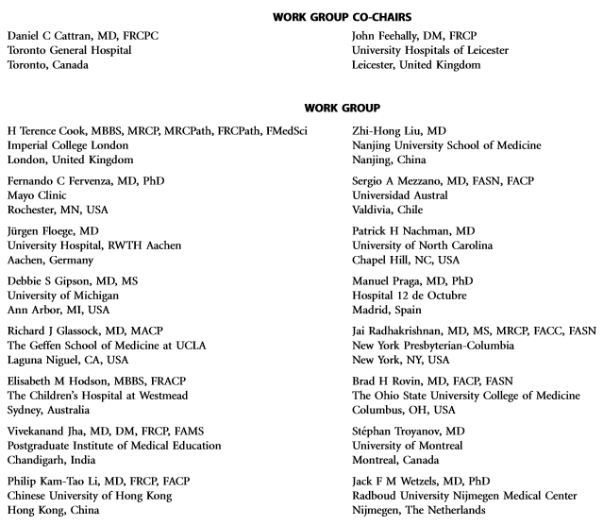
Notes:
Kidney Disease: Improving Global Outcomes (KDIGO) published its ﬁrst guideline on glomerular diseases in 2012. Available online at www.kdigo.org

Slide 3
#KDIGOGNConference
KDIGO Controversies Conference on Glomerular Diseases
Singapore, November 2017
Notes:
Given the enormous advances in understanding the pathogenesis of glomerular diseases, identiﬁcation of new diagnostic biomarkers, and emerging therapies, about 100 experts from various disciplines (nephrology, pathology, rheumatology, pediatrics) and organizations (academia, pharmaceutical industry) convened on November 17–19, 2017 for the KDIGO Controversies Conference on Glomerular Diseases. Through plenary sessions and small group discussions, the conference aimed to evaluate consensus and controversies in nomenclature, general work-up, and management of glomerular diseases, future needs in research, and, in particular, the critical assessment of existing guideline recommendations.

Slide 4
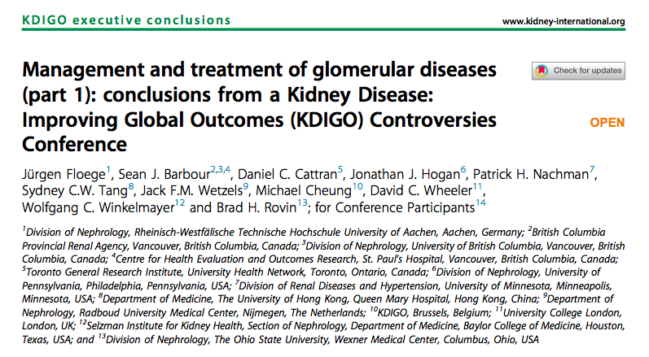
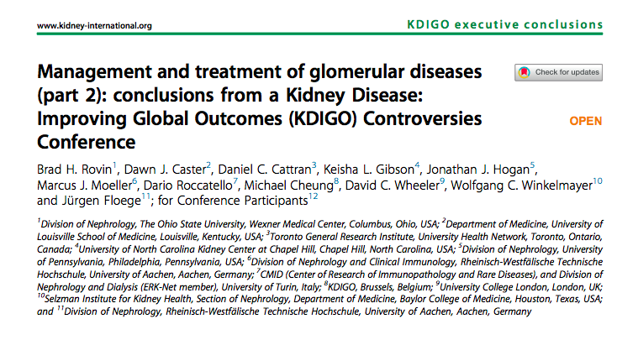
Notes:
The KDIGO Controversies Conference on Glomerular Diseases resulted in two publications in Kidney International in 2018.

Slide 5
Anti-neutrophil Cytoplasmic Antibody-Associated Vasculitis
Terminology
Pathogenesis
Biomarkers and Prediction of Prognosis
Treatment
Future studies
Clinical vignettes

Slide 6
TERMINOLOGY

Slide 7
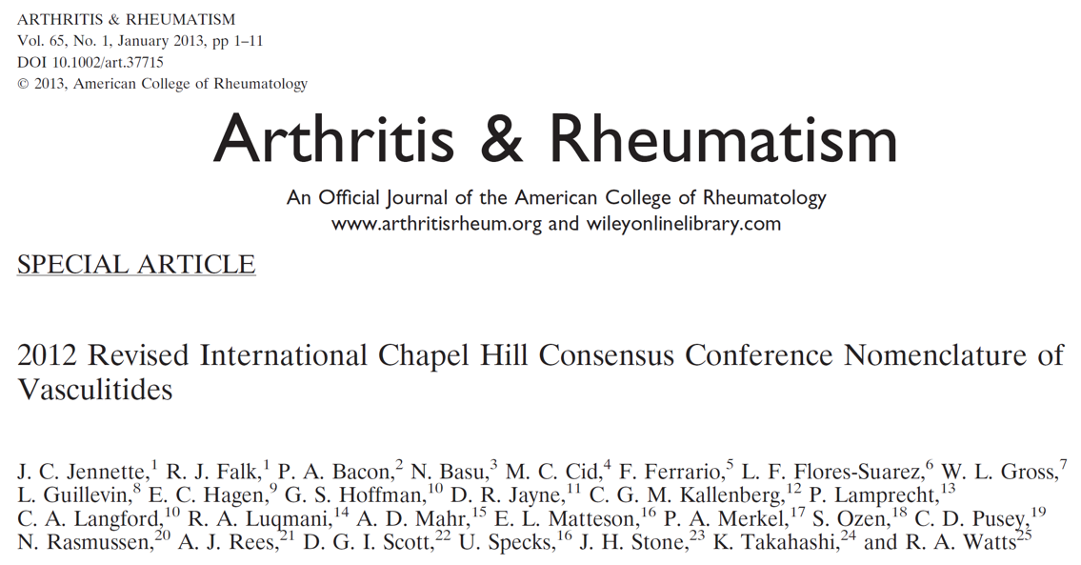

Slide 8
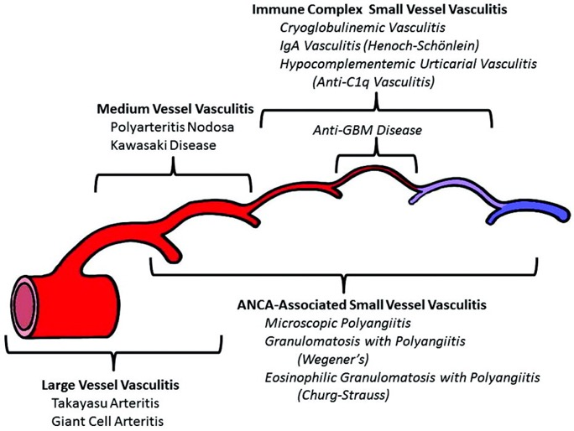
ANCA-associated vasculitis (AAV) represents a group of small vessel vasculitides that include granulomatosis with polyangiitis (GPA), microscopic polyangiitis, and eosinophilic granulomatosis with polyangiitis.
Renal-limited vasculitis can also occur. Kidney histology shows pauci-immune, focal necrotizing, and crescentic GN. Pauci-immune refers to the paucity but not absence of immune and complement deposits
Notes:
https://www.ncbi.nlm.nih.gov/pubmed/23045170

Slide 9
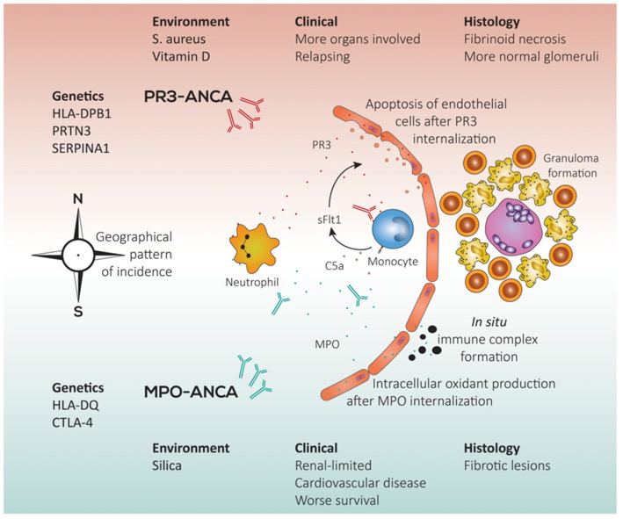
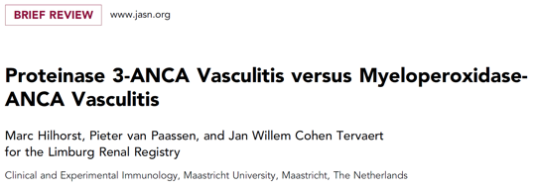
AAV is characterized by ANCA speciﬁc for myeloperoxidase (MPO-ANCA) or proteinase 3 (PR3-ANCA).

Slide 10
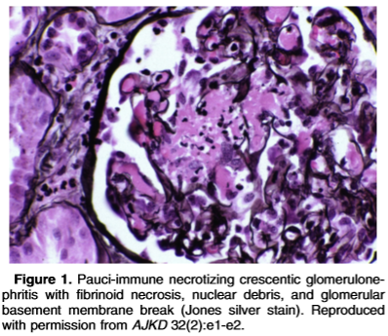
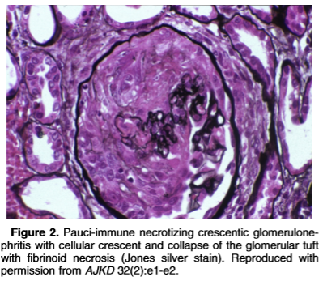
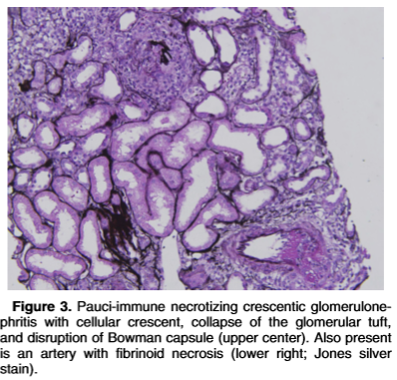
https://www.ajkd.org/pb/assets/raw/Health%20Advance/journals/yajkd/atlas32_2.htm
Rare patients with pauci-immune GN are negative for ANCA, but they are considered in the same spectrum of diseases. There is some evidence that a percentage of these cases may vary in ANCA detectability when tested by different assays.

Slide 11
Classifying patients as having GPA or microscopic polyangiitis might provide some prognostic information, but ANCA serology (MPO- or PR3-ANCA) is more relevant as it seems to predict outcomes and risk of relapse better.
Notes:
A genetic component exists in AAV and genetic distinctions between GPA and microscopic polyangiitis are associated with ANCA speciﬁcity.

Slide 12
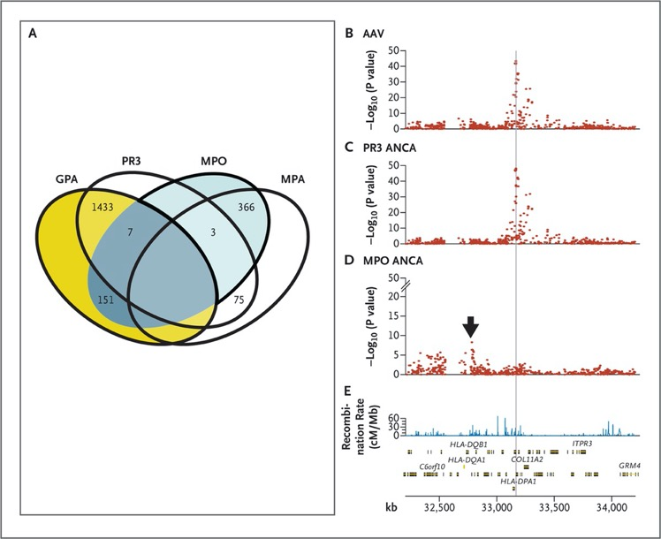
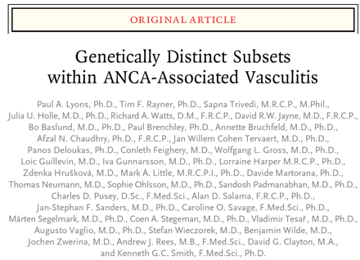
A genetic component exists in AAV and genetic distinctions between GPA and microscopic polyangiitis are associated with ANCA speciﬁcity.

Slide 13
PATHOGENESIS

Slide 14
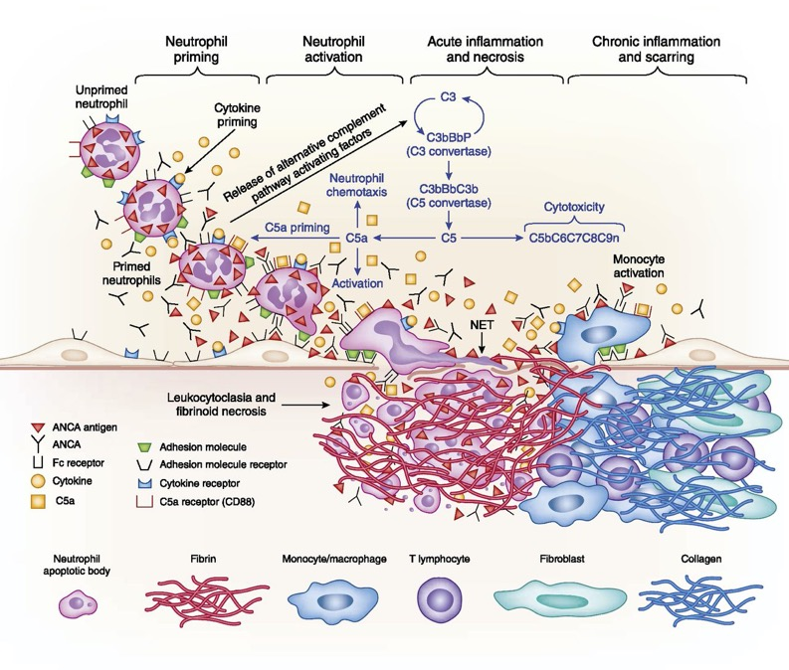
Notes:
The pathogenesis of AAV involves genetic, epigenetic, immunoregulatory, hormonal, and environmental phenomena. The relative contribution of each of these factors may vary in an individual patient. Polymorphisms associated with an increased risk of AAV particularly involve the human leukocyte antigen system (immune regulation) and target antigen (in anti-PR3 disease). A role for complement activation in the pathogenesis of ANCA-associated nephritis (AAN) has emerged from therapeutic studies with complement inhibitors.

Slide 15
BIOMARKERS AND PREDICTION OF PROGNOSIS

Slide 16
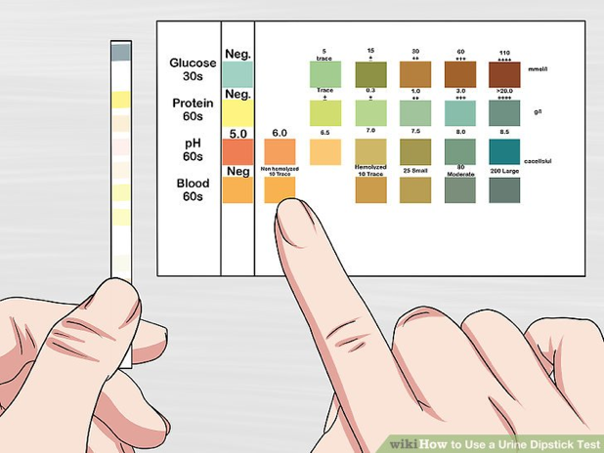
Proteinuria, hematuria, urinary sediment and estimated GFR
Proteinuria, hematuria, urinalysis, estimated GFR, and kidney biopsy are important clinical tools for the diagnosis and management of AAN.
At present, there is no biomarker that can be used to predict the development of AAN or disease ﬂares.

Slide 17
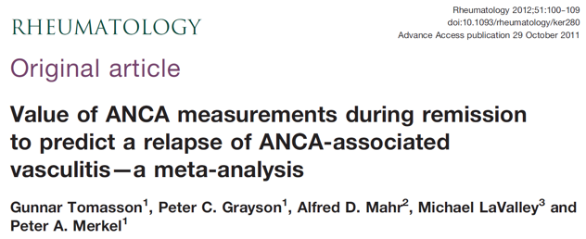
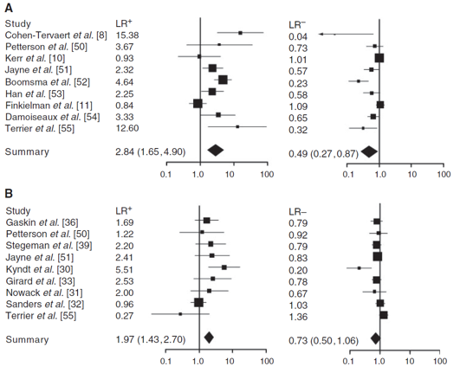
ANCA
Both an increase in ANCA titer and persistently positive ANCA are modestly but signiﬁcantly associated with disease relapse, although serial ANCA testing is not sufﬁciently robust to trigger changes in therapy.
Disease relapse is more frequent in PR3-ANCA than in those who are MPO-ANCA, and relapse may be predicted by PR3-ANCA levels.

Slide 18
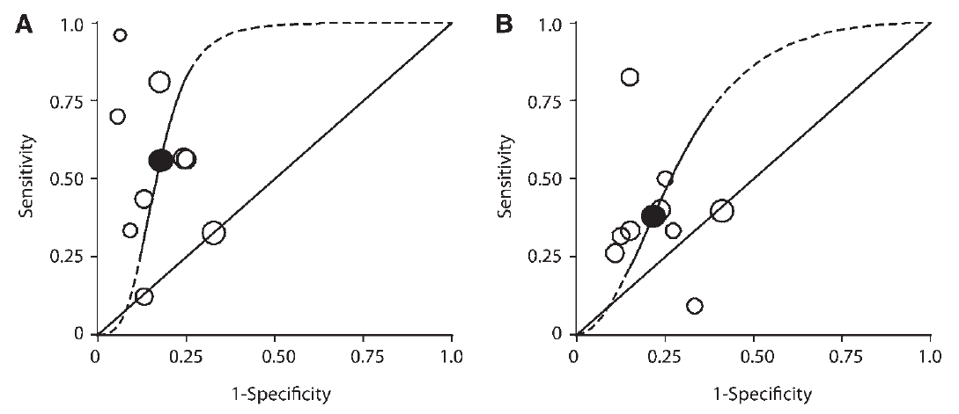
ANCA
Both an increase in ANCA titer and persistently positive ANCA are modestly but signiﬁcantly associated with disease relapse, although serial ANCA testing is not sufﬁciently robust to trigger changes in therapy.
Disease relapse is more frequent in PR3-ANCA than in those who are MPO-ANCA, and relapse may be predicted by PR3-ANCA levels.

Slide 19
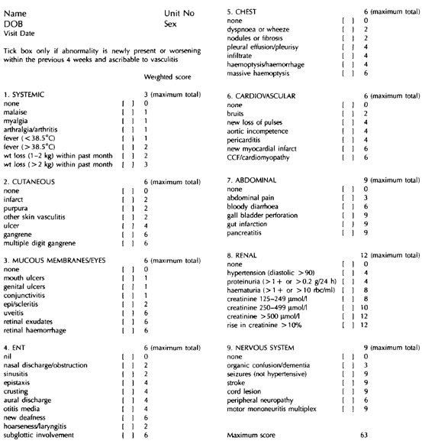
Novel urine/ serum biomarkers
Birmingham Vasculitis Activity Scores (BVAS)
The Birmingham Vasculitis Activity Score and the Vasculitis Damage Index utilize traditional clinical and laboratory biomarkers to evaluate vasculitis activity and are valuable research tools.

Slide 20
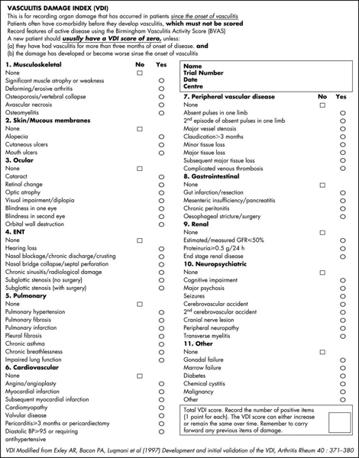
Novel urine/ serum biomarkers
The Birmingham Vasculitis Activity Score and the Vasculitis Damage Index utilize traditional clinical and laboratory biomarkers to evaluate vasculitis activity and are valuable research tools.
Notes:
Traditional laboratory measures do not differentiate between active disease and chronic damage very well.

Slide 21
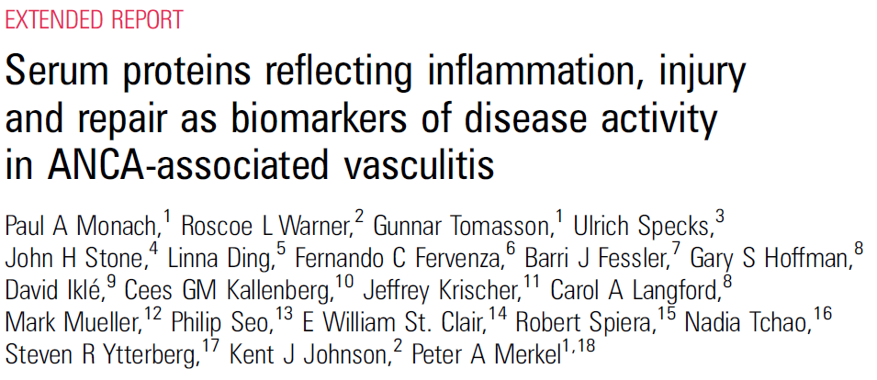
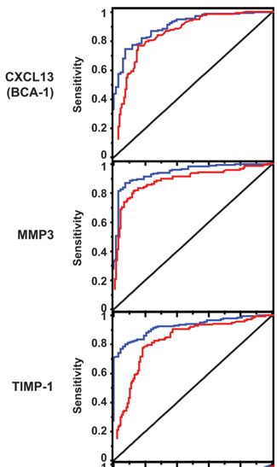
In a post-hoc analysis of the Rituximab for ANCA-Associated Vasculitis (RAVE) study, chemokine C-X-C motif chemokine ligand 13, matrix metalloproteinase-3, and tissue inhibitor of metalloproteinases-1 discriminated active from inactive AAV better than erythrocyte sedimentation rate and C-reactive protein

Slide 22
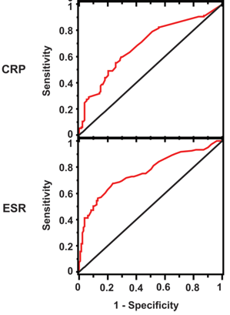
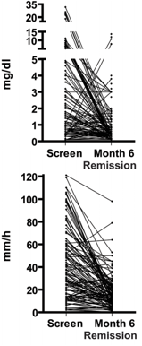
In a post-hoc analysis of the Rituximab for ANCA-Associated Vasculitis (RAVE) study, chemokine C-X-C motif chemokine ligand 13, matrix metalloproteinase-3, and tissue inhibitor of metalloproteinases-1 discriminated active from inactive AAV better than erythrocyte sedimentation rate and C-reactive protein

Slide 23
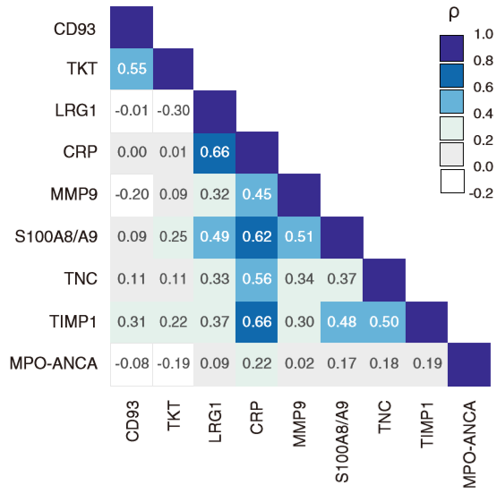
Tissue inhibitor of metalloproteinases-1 was the best marker of AAV activity as reported in the Remission Induction Therapy in Japanese Patients With AAV and Rapidly Progressive Glomerulonephritis (RemIT-JAV-RPGN) study

Slide 24
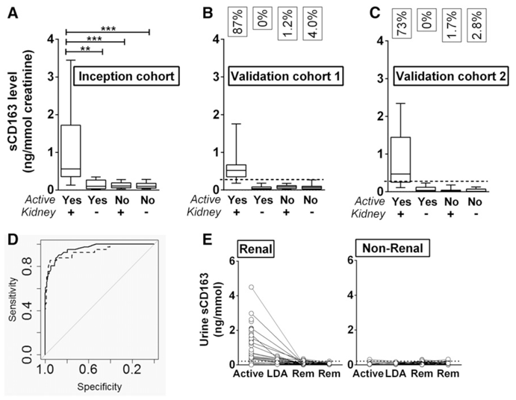
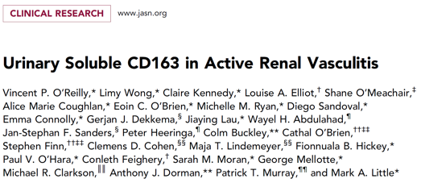
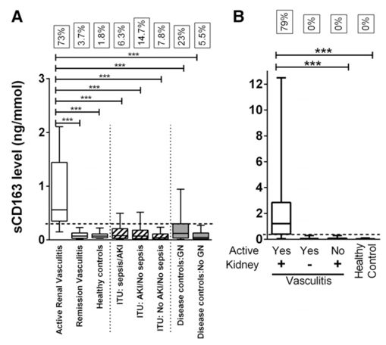
Urinary soluble CD163 levels are also promising for identifying active renal vasculitis
Notes:
These biomarkers need independent and, ideally, prospective validation.

Slide 25
TREATMENT

Slide 27
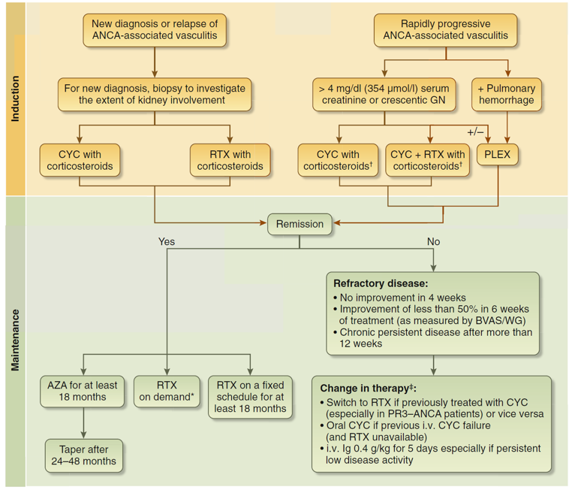

Slide 28
Treatment: Corticosteroids
Notes:
Corticosteroids are used almost universally for AAV and are often given as 500- to 1000-mg i.v. pulses daily for 1 to 3 days at the initiation of treatment, especially in patients with a clinical picture of rapidly progressive GN. However, corticosteroid monotherapy is not effective and corticosteroids are associated with signiﬁcant short- and long-term adverse effects. However, complement inhibition is on the horizon as an adjunct/steroid-sparing therapy in AAV/AAN.

Slide 29
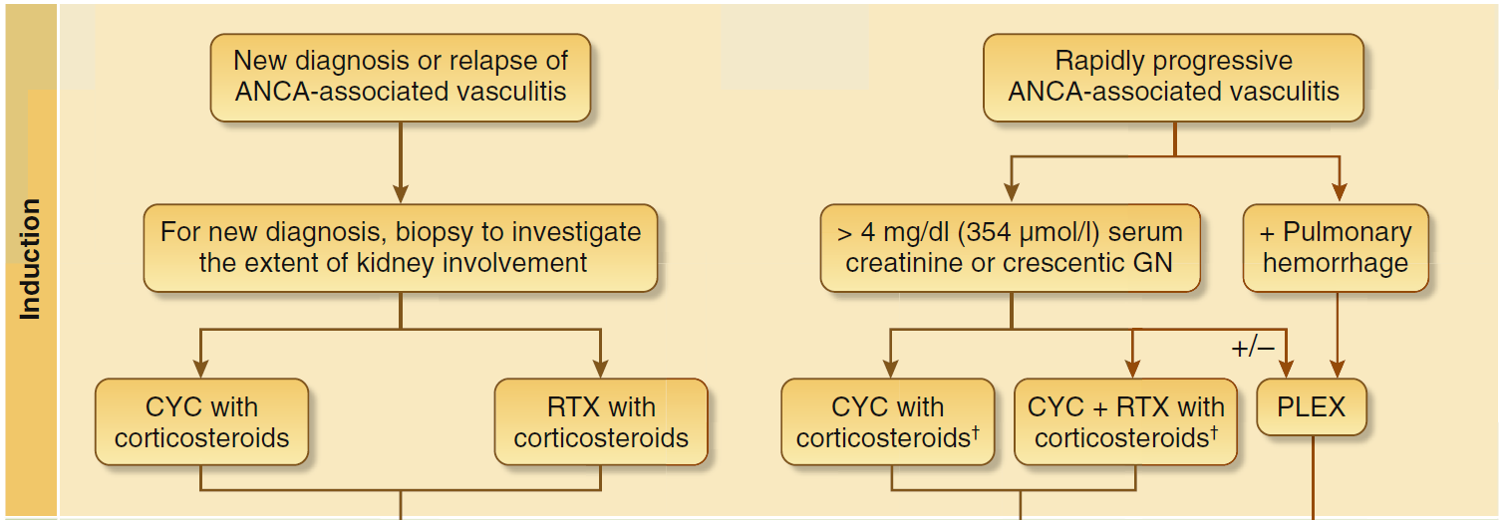
Treatment: Induction
Notes:
CYC has been the immunosuppressant of choice for decades. Despite its efﬁcacy in the management of AAV, its safety proﬁle has required the need for testing the value of alternative options.

Slide 30
Notes:
Recently, RTX has been proven to be as effective as CYC induction/AZA maintenance for AAN patients with serum creatinine <4 mg/dl (354 mmol/l). An alternative approach includes the use of CYC for the induction phase and considers RTX for maintenance. It is unknown whether treatment should be different for MPO-ANCA and PR3-ANCA.

Slide 31
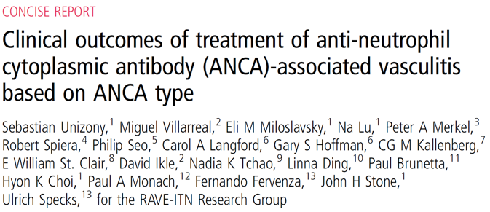
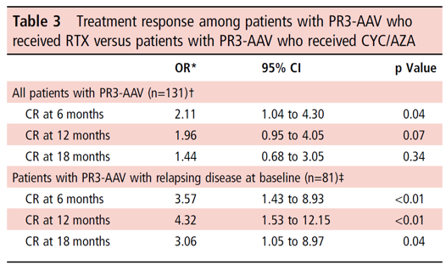
Notes:
However, a post-hoc analysis of RAVE suggested RTX was superior to CYC for PR3-ANCA and as effective as CYC for MPO-ANCA

Slide 32
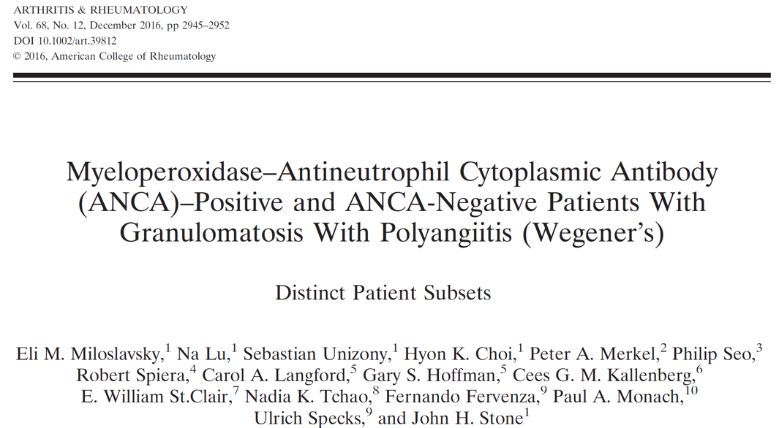
Notes:
In a pooled analysis of the Comparison of Methotrexate or Azathioprine as Maintenance Therapy for ANCA-Associated Vasculitides (WEGENT) and RAVE trials, clinical differences between MPO- and PR3-ANCA-positive patients with GPA were not obvious. The risk of relapse was associated more closely with disease type than ANCA subset.

Slide 33
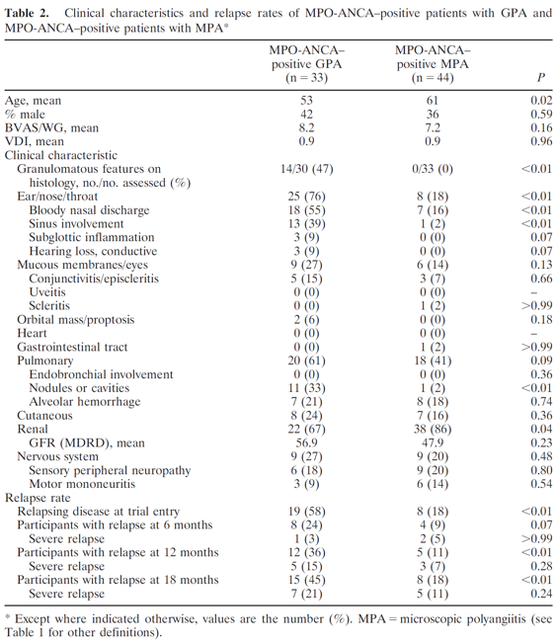
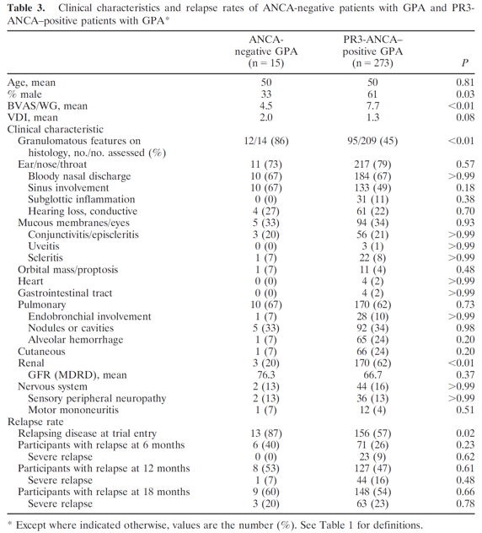
Notes:
In a pooled analysis of the Comparison of Methotrexate or Azathioprine as Maintenance Therapy for ANCA-Associated Vasculitides (WEGENT) and RAVE trials, clinical differences between MPO- and PR3-ANCA-positive patients with GPA were not obvious. The risk of relapse was associated more closely with disease type than ANCA subset.

Slide 34
Notes:
In patients with median GFR <20 ml/min per 1.73 m², a RTX-based regimen (An International, Randomized, Open Label Trial Comparing a Rituximab-based Regimen With a Standard Cyclophosphamide/Azathioprine-based Regimen in the Treatment of Active, Generalized ANCA-Associated Vasculitis [RITUXVAS] trial) consisting of a combination of corticosteroids, RTX 375 mg/m² per week for 4 weeks, and 2 i.v. CYC pulses followed by low-dose corticosteroids was found to be equal to the administration of standard corticosteroids with i.v. CYC for 3 to 6 months followed by AZA.

Slide 35
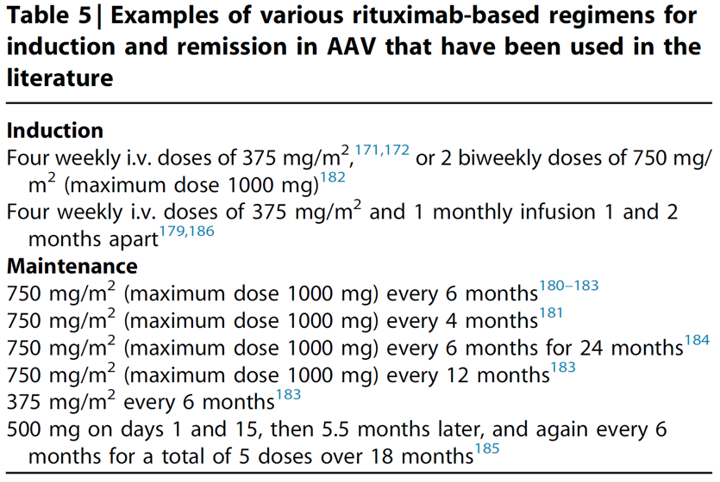

Slide 36
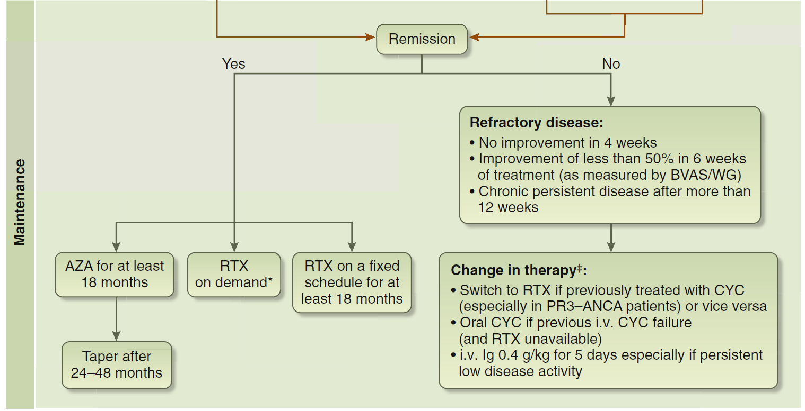
Treatment: Maintenance
Notes:
In AAN, maintenance therapy is initiated after remission is achieved, usually within 3 to 6 months after beginning induction and typically consists of AZA or RTX.
There is no consensus regarding the length of maintenance therapy in AAV. Duration may be different depending on the underlying ANCA serology as well as treatment, but this has not been adequately studied. For conventional therapy with CYC induction and AZA maintenance, the relapse rate was lower if maintenance was continued for 48 as opposed to 24 months.
Alternatively, patients with MPO-ANCA who achieve remission and ANCA negativity at end of induction might require a shorter course of maintenance. This is based on the observation that most patients with MPO–microscopic polyangiitis given a single course of 6 rituximab infusions without any maintenance therapy did not relapse for a mean of 66 months. However, it is unlikely that this observation applies to MPO-GPA. Retrospective and prospective studies have used RTX for remission maintenance in AAV, but there has been no consensus on dosing for maintenance or even induction therapy.

Slide 38
Notes:
It is also not clear whether rituximab should be given as a ﬁxed regimen or only when B cells reappear, but this is being tested by the Comparison Study of Two Rituximab Regimens in the Remission of ANCA-Associated Vasculitis (MAINRITSAN 2).

Slide 39
Treatment: Maintenance
Notes:
In a patient with worsening creatinine and/or proteinuria after initial therapy, medication adherence should be evaluated. Additionally, a repeat kidney biopsy to distinguish active AAV from scarring and/or identify new lesions could be considered. For continued active AAV lesions, initial treatment should change to the other standard-of-care regimen (i.e., switch from CYC to RTX or vice versa).

Slide 40
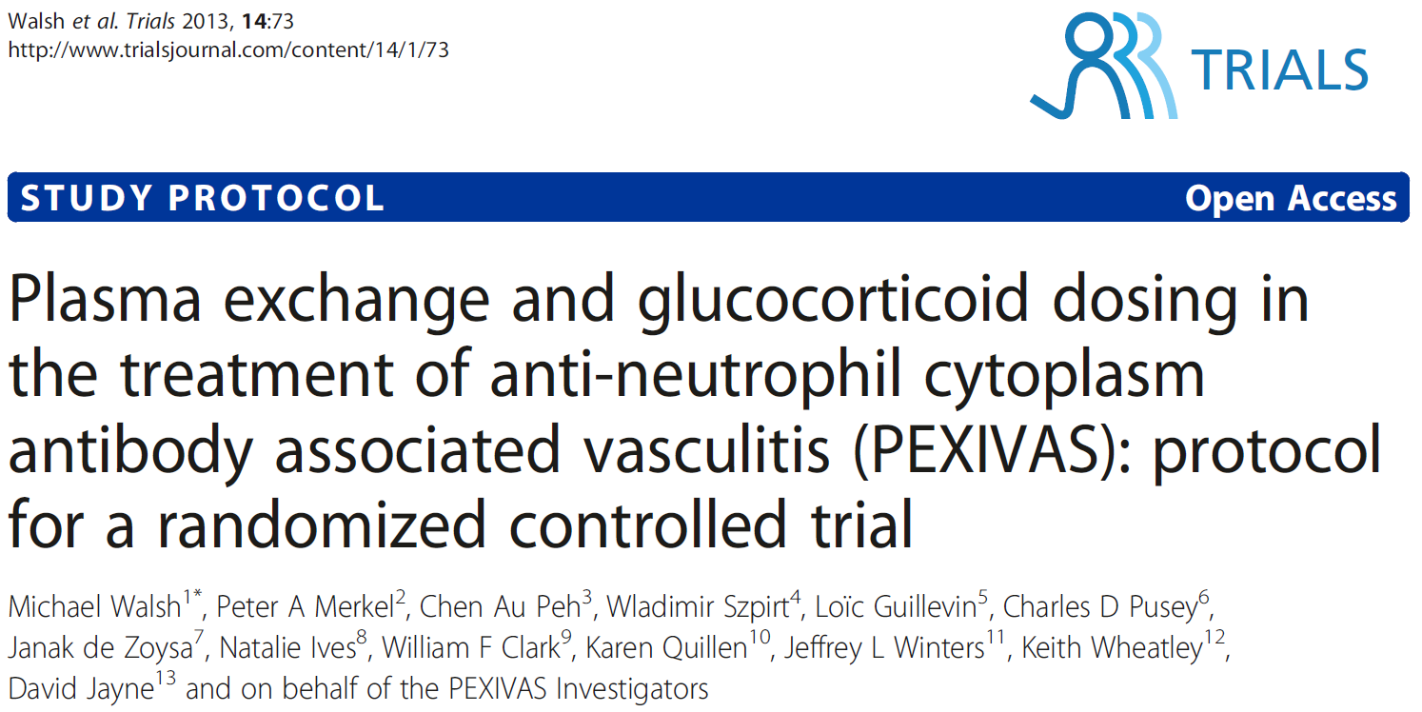
Plasma exchange did not reduce the risk of kidney failure or death
Compared to a standard dose, reduced glucocorticoids did not substantially
increase the risk of death or kidney failure & resulted in fewer serious infections
Notes:
Plasma exchange should be considered in AAN with severe kidney impairment (serum creatinine >5.6 mg/dl [495 mmol/l]) and/or diffuse crescents.
Plasma exchange may also have a role in AAV with pulmonary hemorrhage. The role of plasma exchange in patients with pulmonary hemorrhage and/or less severe kidney impairment is studied in the Plasma Exchange and Glucocorticoids for Treatment of Antineutrophil Cytoplasm Antibody–Associated Vasculitis (PEXIVAS) trial and published in February 2020 (see next slide).

Slide 41
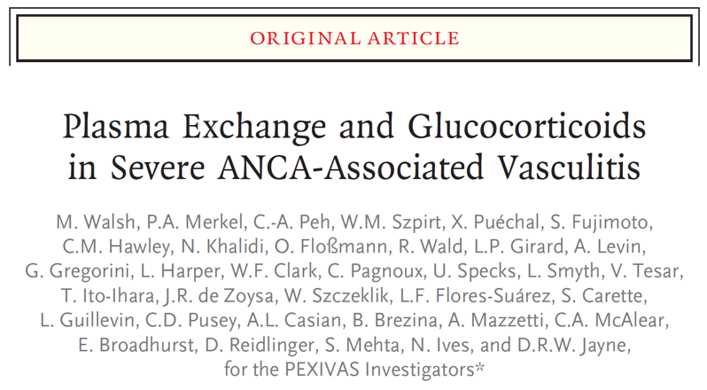

Slide 45
Childhood-onset disease
AAV in children should be studied
separately from AAV in adults.
There is a high frequency of kidney
disease (75%) among pediatric AAV
patients and a predominance of females
(65%, compared to 40–45% in adult
cohorts).
There have not been any RCTs in
children, but cohort studies support
efficacy of both cyclophosphamide and
rituximab.

Slide 46
Future studies
ANCA subtype
Identification of high risk patients (e.g., with comorbidities)
Future clinical trials in AAV should target subgroups of patients stratified according to:
Differentiation between active vs chronic disease by
non-invasive biomarkers
Should further investigate the CYC-sparing effect of biologic agents (e.g., anti-B-cell therapies) and the steroid-sparing effect of newer agents such as complement inhibitors
The clinical role and cost-effectiveness of RTX in severe kidney disease and optimal maintenance regimens remain undefined
ANCA, anti-neutrophil cytoplasmic antibody; AAV, anti-neutrophil cytoplasmic antibody-associated vasculitis; CYC, cyclophosphamide; RTX, rituximab
Notes:
Determining optimal time for assessing primary endpoint and the minimum duration of clinical trial/follow-up has to be further investigated (preferably 12–24 months)

Slide 47
Notes:
Ongoing trial of complement inhibitor, avacopan, as adjunct/steroid-sparing therapy for AAV

Slide 48
CLINICAL VIGNETTES

Slide 49
CASE 1
A 40-year-old previously healthy woman presents to her primary care physician with night sweats, weight loss, joint pain, and fatigue for 4–5 weeks. On examination, she is normotensive and afebrile. Her physical examination is normal. Laboratory testing shows 1+ protein and 30–40 RBC/HPF in the urine, serum creatinine 1.8 mg/dl, ESR 80 mm/hour, urine cultures negative. She is referred to a nephrologist who notes that only a PR3 ANCA is positive at 40 U/ml (negative <0.4 U/ml), with negative anti-glomerular basement antibody, negative lupus profile, negative workup for monoclonal gammopathy, and normal complements.
The kidney biopsy is likely to show which of the following immune staining patterns in this patient?
A. Negative immune staining
B. Linear glomerular basement staining
C. Granular staining for IgG, IgA, IgM, C3, and C1q along the capillary wall
D. Staining with IgG and only kappa light chain along the basement membrane

Slide 50
The answer is A.
This patient is presenting with features of ANCA-associated vasculitis. Serological tests show only ANCA-positivity. In such patients, the kidney biopsy is typically negative or only shows trace staining for antibodies on immunofluorescence (“pauci immune”).
The presence of linear glomerular basement (GBM) staining is suggestive of anti-GBM antibody disease. This entity is typically associated with positive anti-GBM antibodies.
Similarly, granular staining suggests immune complex disease. The presence of multiple antibodies and complement components being positive suggests lupus nephritis, which is unlikely given the negative lupus serologies and complements.
The finding of immunoglobulin with only kappa or lambda light chains suggest a monoclonal gammopathy–related kidney disease. In the presence of a negative peripheral monoclonal gammopathy workup, this is unlikely.

Slide 51
CASE 2
A 60-year-old woman with PR3-ANCA associated vasculitis is being seen for follow-up. She presented 4 months ago with rapidly progressive kidney failure (peak serum creatinine 4.5 mg/dl), vasculitic skin lesions and hemoptysis.
She was treated with pulse steroids, plasma exchange and intravenous cyclophosphamide. At the present time she has no symptoms. She is taking prednisone 5 mg daily and she received her 4th dose of intravenous cyclophosphamide 2 weeks ago.
Her physical examination is normal. Laboratory tests are notable for normal hemogram, serum creatinine 1.8 mg/dl, normal urinalysis, normal sedimentation rate and negative ANCA titers.

Slide 52
What is your next step in the management of this patient?
A. Stop all medications
B. Switch to azathioprine
C. Reduce cyclophosphamide to 3-monthly infusions
D. Switch to etanercept

Slide 53
The answer is B.
The patient being discussed presented with severe ANCA-associated disease involving the lungs and kidneys. She is currently in full remission on a minimal dose of steroids and monthly IV cyclophosphamide, which had been started as part of her induction regimen.
This is the time to de-escalate immunosuppression and switch to a maintenance protocol. The risk of relapse in ANCA-associated vasculitis is high in the absence of maintenance therapy. Current guidelines favor azathioprine over other maintenance therapies.

Slide 54
KDIGO THANKS THE FOLLOWING PARTNERS FOR THEIR SUPPORT OF THIS SPEAKER’S GUIDE

Slide 55
FOLLOW KDIGO
www.kdigo.org
/goKDIGO
@goKDIGO
@goKDIGO

