Slide 1
MANAGEMENT AND TREATMENT OF GLOMERULAR DISEASES General Principles
CONCLUSIONS FROM A
KDIGO CONTROVERSIES CONFERENCE

Slide 2
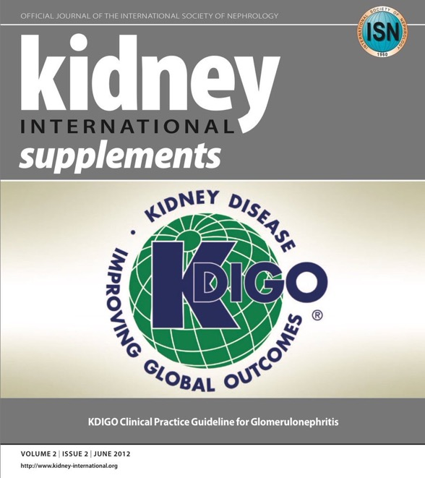
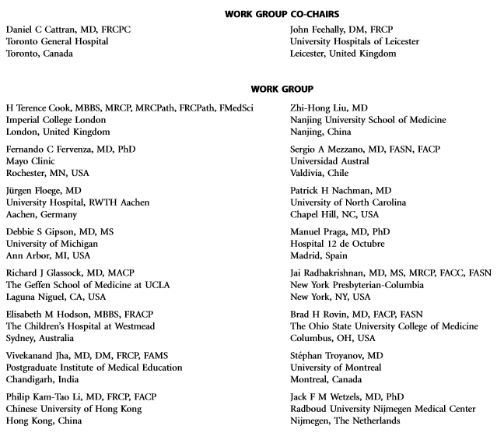
Notes:
Kidney Disease: Improving Global Outcomes (KDIGO) published its ﬁrst guideline on glomerular diseases in 2012. Available online at www.kdigo.org

Slide 3
#KDIGOGNConference
KDIGO Controversies Conference on Glomerular Diseases
Singapore, November 2017
Notes:
Given the enormous advances in understanding the pathogenesis of glomerular diseases, identiﬁcation of new diagnostic biomarkers, and emerging therapies, about 100 experts from various disciplines (nephrology, pathology, rheumatology, pediatrics) and organizations (academia, pharmaceutical industry) convened on November 17–19, 2017 for the KDIGO Controversies Conference on Glomerular Diseases. Through plenary sessions and small group discussions, the conference aimed to evaluate consensus and controversies in nomenclature, general work-up, and management of glomerular diseases, future needs in research, and, in particular, the critical assessment of existing guideline recommendations.

Slide 4
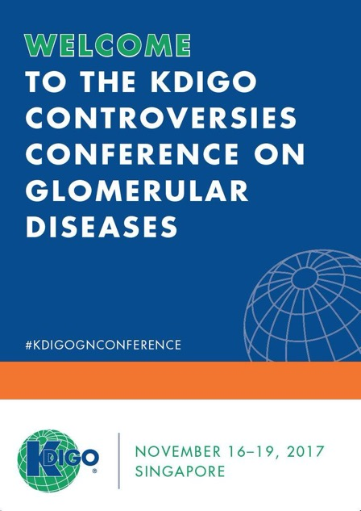
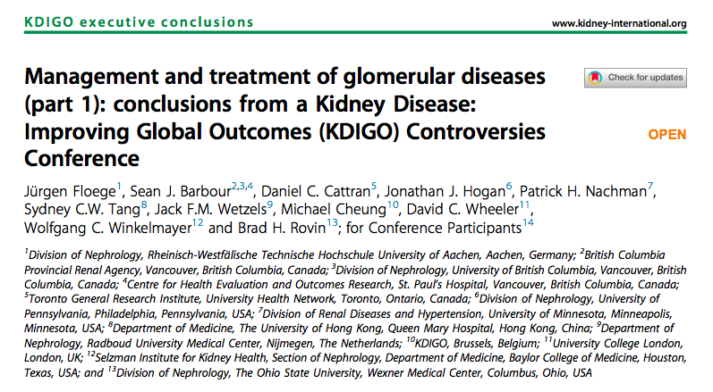
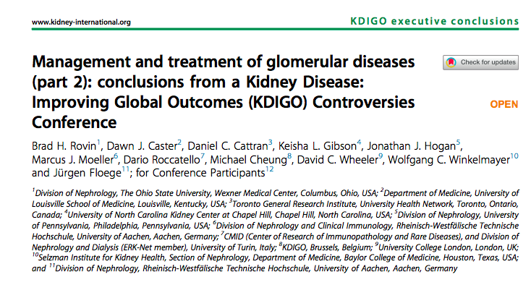
Notes:
The KDIGO Controversies Conference on Glomerular Diseases resulted in two publications in Kidney International in 2018.

Slide 5
General Principles in the Management and Treatment of Glomerular Diseases
Kidney Biopsy
Assessment of Kidney Function
Management of Complications
Hypercoaguability
Future Studies

Slide 6
Kidney Biopsy

Slide 7
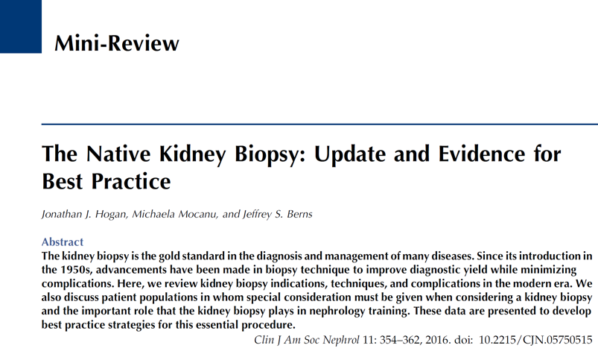
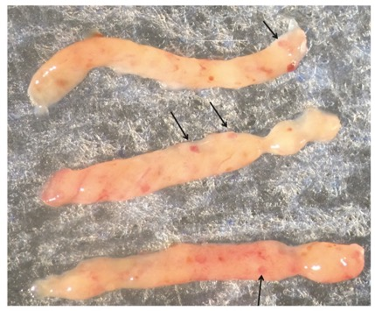
The kidney biopsy remains the cornerstone for the evaluation of glomerular disease
Notes:
In very few and speciﬁc circumstances such as childhood steroid-sensitive nephrotic syndrome, diagnosis and treatment are often done without a kidney biopsy. In adults this approach is uncommon but maybe considered in individual cases.

Slide 8
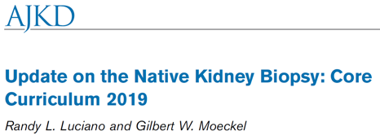
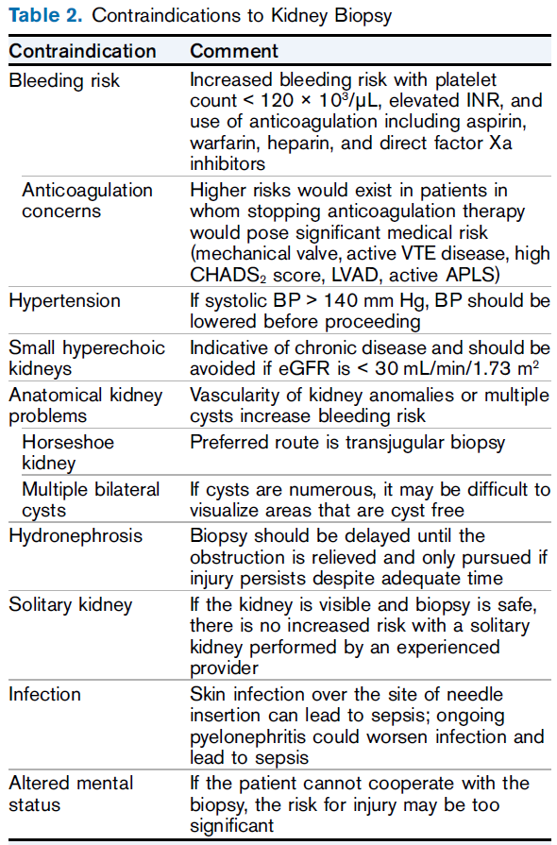
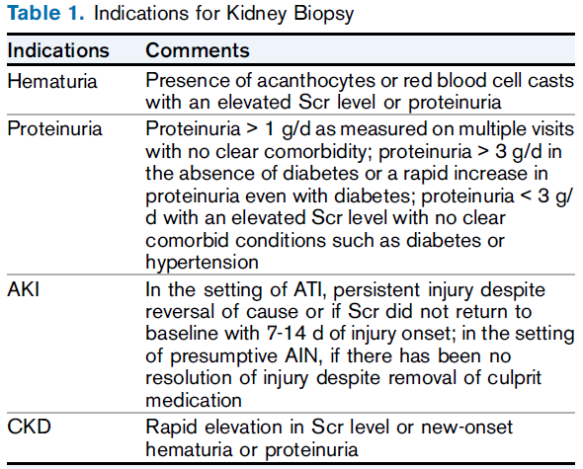
Notes:
Kidney tissue is also critical for assessing the degree of histologic activity and chronicity and to identify unexpected features such as interstitial nephritis, acute kidney injury, and crescents, all factors that might signiﬁcantly impact disease management.

Slide 9
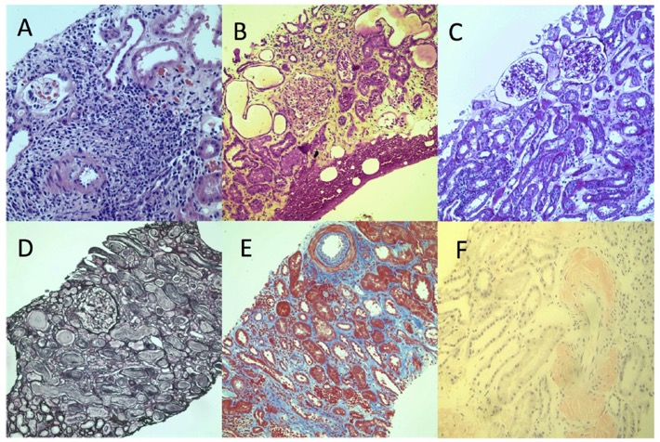
Hematoxylin-eosin stain
Nuclei will stain deep purple and
cytoplasm pink
(B) Hematoxylin phloxine saffron
stain
Areas of fibrous tissue will stain
yellow-orange
(C) Periodic acid–Schiff stain
Polysaccharides in basement
membranes will stain deep purple
(D) Jones stain
(E) Trichrome stain
This stains cytoplasm as red and
collagen as blue
(F) Congo red stain
Amyloid fibrils are stained red
in the vessel and interstitium
Light Microscopy
Luciano RL, Moeckel GW. Am J Kidney Dis. 2019; 73:404-415

Slide 10
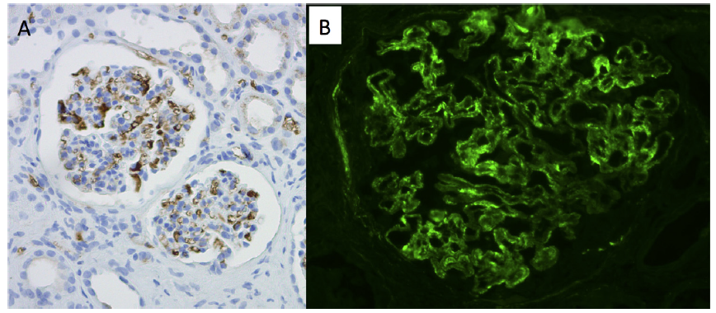
Immunohistochemistry (IHC) and Immunofluorescence microscopy
Luciano RL, Moeckel GW. Am J Kidney Dis. 2019; 73:404-415
Detection of immunoglobulin A using IHC: immune complexes appear as
brownish material in the mesangium.
(B) Detection of C3 using immunofluorescence

Slide 11
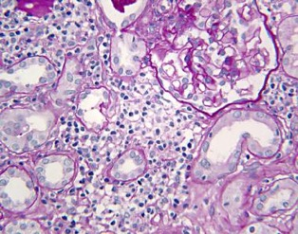
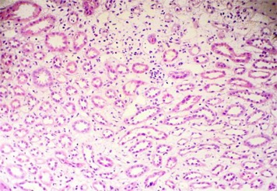
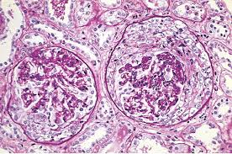
Kidney tissue is also critical for assessing the degree of histologic activity and chronicity to identify unexpected features, that may significantly impact disease management
Interstitial nephritis
Acute Kidney Injury
Crescents

Slide 12
The kidney biopsy should be interpreted in the context of ethnicity, age and hypertension, as these may modify the background kidney histology
Notes:
For instance, understanding the “normal” range of age-related focal segmental glomerulosclerosis in a population might allow a better estimate of the extent of glomerular disease in an individual biopsy. Application of other modiﬁers, such as ethnicity, needs to be considered.

Slide 13
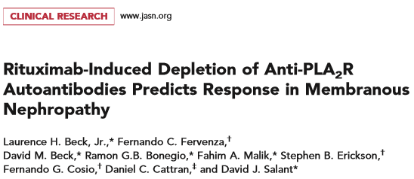
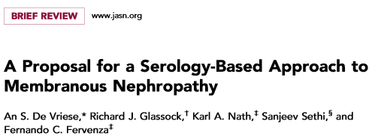
The value of kidney tissue is likely to expand significantly in the near term
A more system-related approach to the biopsy will enhance its value by providing more information important to diagnosis, prognosis, and treatment.
To develop targeted therapies, identification of these pathways is necessary and will require a focus on the mechanisms operative at the tissue level rather than relying solely on standard histologic findings.
Notes:
For example, all clinical trials have treatment failures suggesting variations between individuals in the molecular pathways driving disease progression despite similar histopathology
This also ties into the concept of immunologic vs clinical remission.

Slide 14
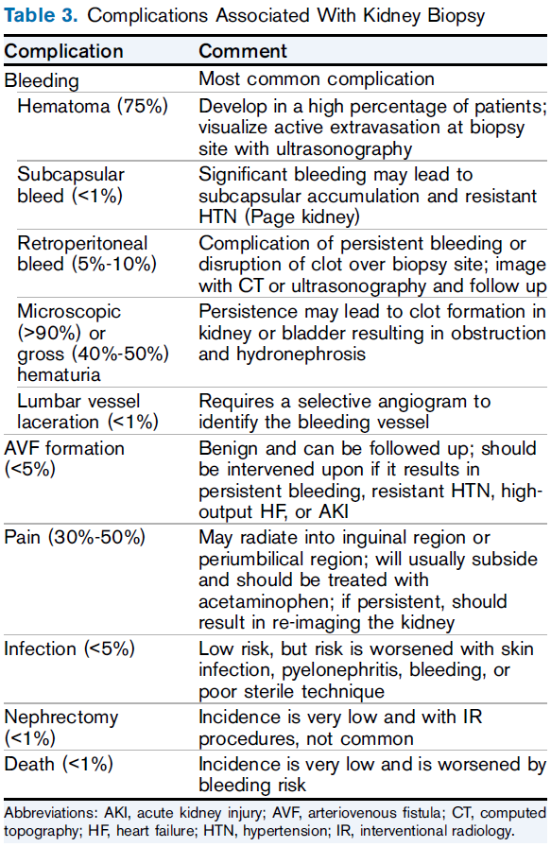
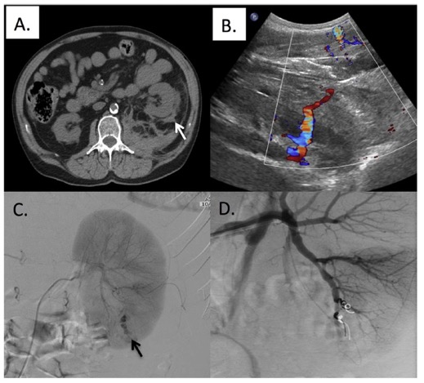

Slide 15
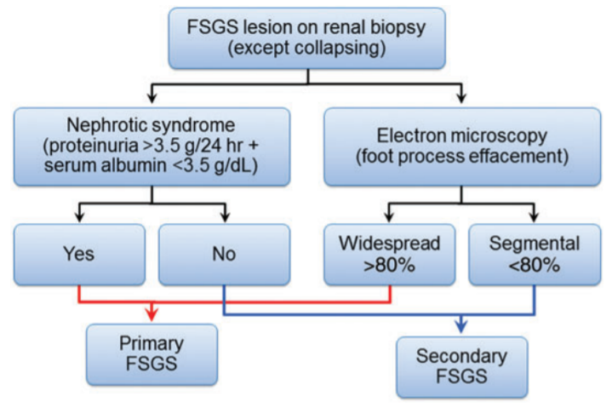
The need for electron microscopy for every biopsy remains controversial
Sethi S et al. Nephrol Dial Transplant. 2015; 30:375-384
It may be critical in some cases, for example, to differentiate between
immunologically mediated and adaptive FSGS variants.
Notes:
Application at a worldwide level may be difﬁcult, but it could possibly be leveraged by preservation of a small amount of tissue and, if judged critical to management, sent to an electron microscopy reference laboratory for evaluation.

Slide 16
Assessment of Kidney Function

Slide 17
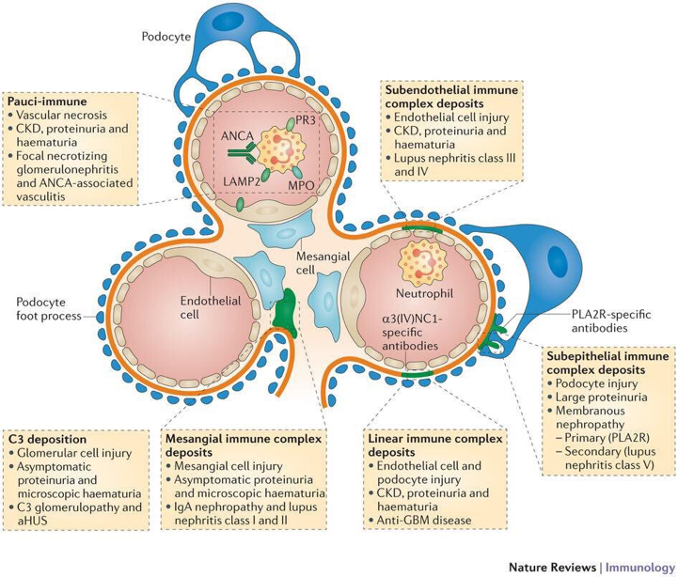
Proteinuria
Most glomerular diseases are
associated with proteinuria
Kurts C et al. Nat Rev Immunol. 2013; 13:738-53

Slide 18
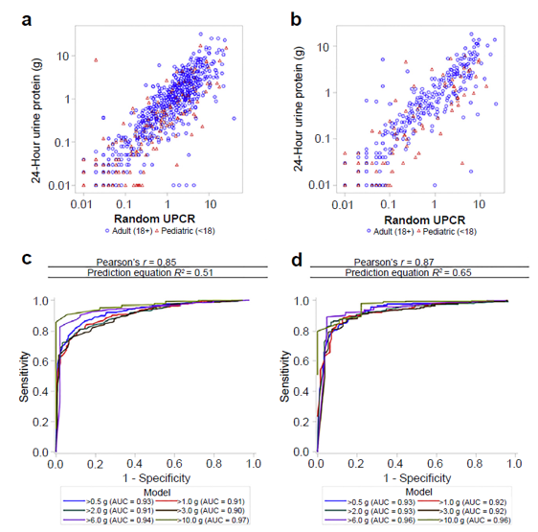
Although ratios of albumin-to-creatinine or
protein-to-creatinine (PCR) in random spot
urine samples are commonly used, recent
data highlight the poor agreement between
these ratios and 24-hour urine protein
measurements.

Slide 19
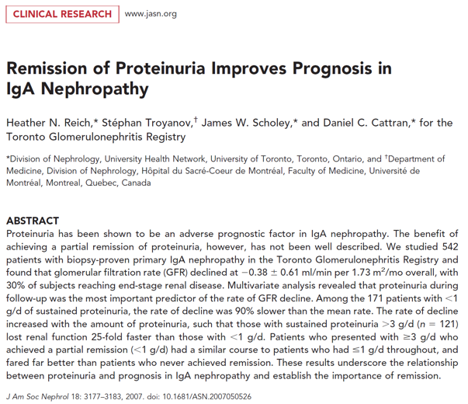
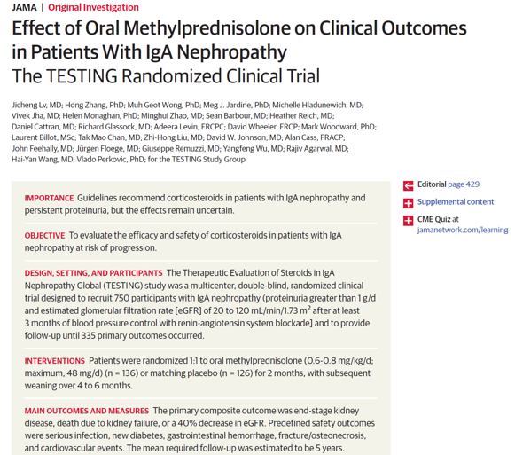
Although spot albumin-to-creatinine ratio and PCR are helpful in general clinical
management, they are not sufficiently accurate when therapeutic decisions about using high-risk medications are being made on small changes in proteinuria.
Notes:
In such cases, a 24-hour urine protein or PCR should be measured.

Slide 20
Importantly, the PCR from an intended 24-hour urine collection that is at least
50% complete has been shown to accurately reflect 24-hour proteinuria.

Slide 21
In young children, obtaining a 24-hour
urine collection is usually not possible
and PCR is the preferred means to
assess proteinuria.
Notes:
Monitoring serum albumin levels in nephrotic patients also represents a valuable tool to indirectly assess the extent of proteinuria.

Slide 22
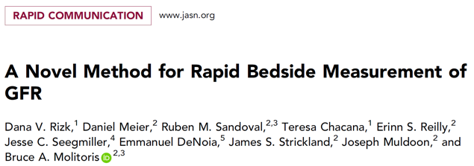
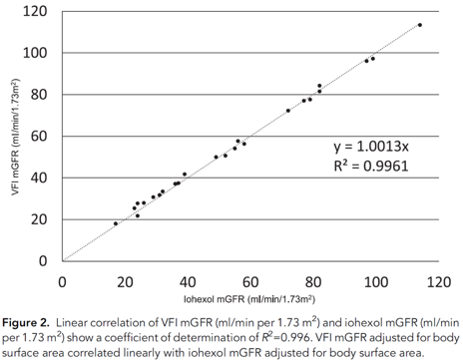
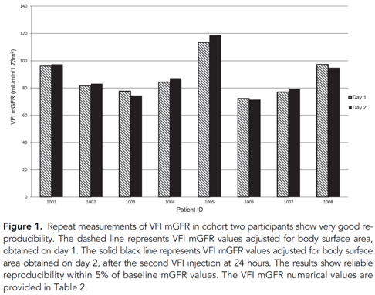
Assessment of GFR
Newer, accurate techniques to measure
GFR are evolving.
Notes:
The gold standard for estimating renal excretory function remains inulin or isotopic clearance techniques, but these are expensive and require operator expertise.

Slide 23
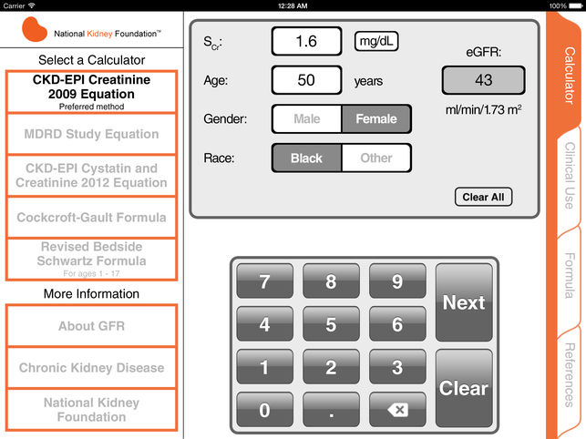
Presently, the Chronic Kidney Disease Epidemiology Collaboration’s (CKD-EPI)
equation for estimating GFR is often used.

Slide 24
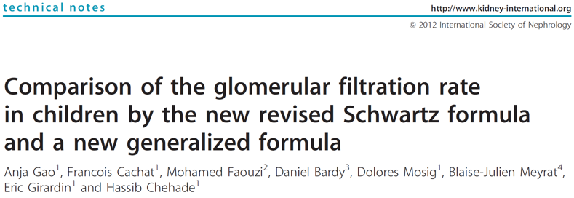
Formulas have also been developed for children.

Slide 25
A simple, reliable, and inexpensive biomarker of
kidney function is still wanting.
Notes:
However, estimated GFR (eGFR) equations have not been validated in speciﬁc glomerular diseases and patient populations. In addition, when estimating glomerular function in patients with high-grade proteinuria, the majority of studies still use 24-hour urine collections for creatinine clearance. Errors related to collection and laboratory measurements under these conditions can induce up to 50% of errors in GFR measurement.
The accuracy of these methods may be partially compensated by frequent longitudinal measurement and use of data-smoothing techniques.

Slide 26
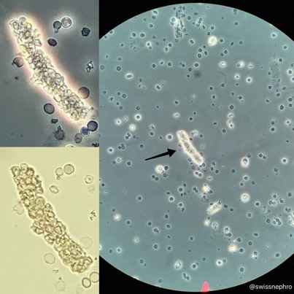
Hematuria
Macro- or microhematuria is associated
with almost all glomerular disorders and
identification of red cell casts may
provide clues to nephritic disease.
Kurts C et al. Nat Rev Immunol. 2013; 13:738-53

Slide 27
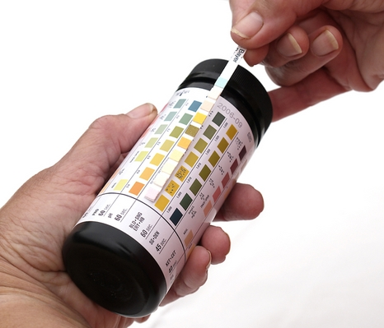
Qualitatively, the routine urine dipstick can
distinguish the presence or absence of
microhematuria, but the capacity to
quantitate hematuria has pitfalls:
timing between collection and examination
urine concentration
preparation of the urine pellet
pH of the urine, and
the expertise of the examiner

Slide 28
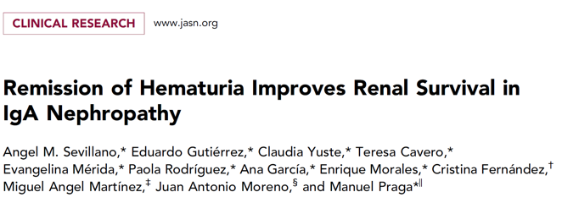
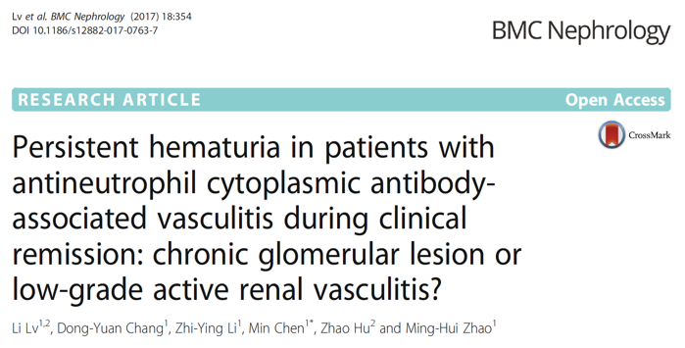
The disappearance of hematuria,
however, associated with complete
clinical remission can be important
in assessing the activity of diseases
such as IgAN and antineutrophil
cytoplasmic antibody vasculitis

Slide 29
Outcome measures
Regulatory agencies still grant approval for drugs in GN based on the classic findings:
Complete remission of proteinuria, as a positive outcome
End-stage kidney disease (ESKD) (or a 50% reduction in eGFR), and/or mortality as negative outcomes

Slide 30
Recent collaborations among the US Food and Drug Administration, the pharmaceutical industry, and members of nephrology organizations, under the umbrella of the Kidney Health Initiative, are developing alternative surrogate endpoints for drug approval.
Notes:
The first consensus meeting culminated in a decision to allow a 40% reduction in eGFR to serve as an endpoint, but earlier endpoints are needed in these rare diseases.

Slide 31
The concept of “futility” can be critical to patient management
This “point of no return” is usually
deﬁned by a low eGFR, often < 30 ml/min
per 1.73 m² and/or kidney biopsy that shows
a high degree of irreversible chronic
changes.
Currently, the rate of change in kidney
function is likely more important than a
single cross-sectional measurement of eGFR
in deﬁning futility.
Additionally, age and overall wellness
should be considered when determining
futility.
Notes:
The question of futility also extends to clinical trials. Futility criteria are often used to exclude patients from clinical trials with the thought that risk will outweigh gain for such patients. Therefore, many patients miss the opportunity to participate in trials, complicating attainment of sample size and generalizability of results. It may be helpful to have more patient engagement in determining clinical trial eligibility. If the treating physician thinks it is reasonable to consider a clinical trial and their patient is fully informed, such patients could be considered if futility criteria were less rigid. This concept is commonly followed in clinical practice. Although controversial, patient engagement may become more relevant as low-risk treatments become available.

Slide 32
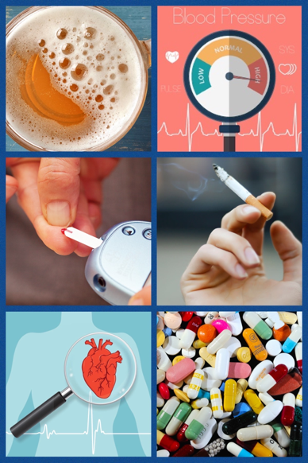
Determinants of Progression of Kidney Disease
RISK FACTORS FOR PROGRESSIVE LOSS OF GFR
Persistent proteinuria
Poorly-controlled hypertension
Poorly-controlled diabetes mellitus
Smoking
Widespread cardiovascular disease
Use of nephrotoxic drugs
Notes:
In addition to well-established progression factors such as persistent proteinuria, poorly controlled hypertension or diabetes, smoking, or widespread cardiovascular disease, new evidence supports prematurity as having an impact on nephron endowment and potentially limiting renal reserve and increasing risk of progression in glomerular diseases. This can be approximated by birth weight, a readily available, low-cost demographic. Its value within specific diseases is still speculative, but it could be considered as basic information that may affect treatment and outcomes of glomerular diseases.
Another recently defined health risk factor is sleep hygiene. From the National Health and Nutrition Examination Survey in the CKD population, low-sleep duration and other related disorders (e.g., restless legs syndrome, sleep apnea) were associated with all-cause mortality and cardiovascular mortality. Extrapolation into the glomerular disease population seems relevant as this is a modifiable factor and can be applied broadly to all patients.
Weight reduction in obese patients may benefit glomerular diseases. Small studies, focusing on diet and bypass surgery, have shown at least short-term benefits. Weight reduction and sleep improvement are intriguing possible additions to standard treatment approaches that are economical, widely applicable, and that foster patient engagement.
Sex is another issue that is often considered to be an important part of disease risk stratification in GN. Recent data, however, suggest that different rates of progression are more driven by the histologic category, blood pressure (BP), and severity of proteinuria than by sex.

Slide 33
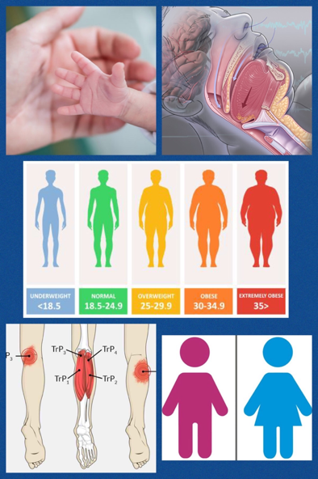
Determinants of Progression of Kidney Disease
EMERGING RISK FACTORS FOR PROGRESSIVE LOSS OF GFR
Prematurity (low birth weight) and other reasons for low nephron number
Low sleep duration and other related disorders (e.g., restless legs syndrome, sleep apnea)
Obesity
Gender ?
Notes:
In addition to well-established progression factors such as persistent proteinuria, poorly controlled hypertension or diabetes, smoking, or widespread cardiovascular disease, new evidence supports prematurity as having an impact on nephron endowment and potentially limiting renal reserve and increasing risk of progression in glomerular diseases. This can be approximated by birth weight, a readily available, low-cost demographic. Its value within specific diseases is still speculative, but it could be considered as basic information that may affect treatment and outcomes of glomerular diseases.
Another recently defined health risk factor is sleep hygiene. From the National Health and Nutrition Examination Survey in the CKD population, low-sleep duration and other related disorders (e.g., restless legs syndrome, sleep apnea) were associated with all-cause mortality and cardiovascular mortality. Extrapolation into the glomerular disease population seems relevant as this is a modifiable factor and can be applied broadly to all patients.
Weight reduction in obese patients may benefit glomerular diseases. Small studies, focusing on diet and bypass surgery, have shown at least short-term benefits. Weight reduction and sleep improvement are intriguing possible additions to standard treatment approaches that are economical, widely applicable, and that foster patient engagement.
Sex is another issue that is often considered to be an important part of disease risk stratification in GN. Recent data, however, suggest that different rates of progression are more driven by the histologic category, blood pressure (BP), and severity of proteinuria than by sex.

Slide 34
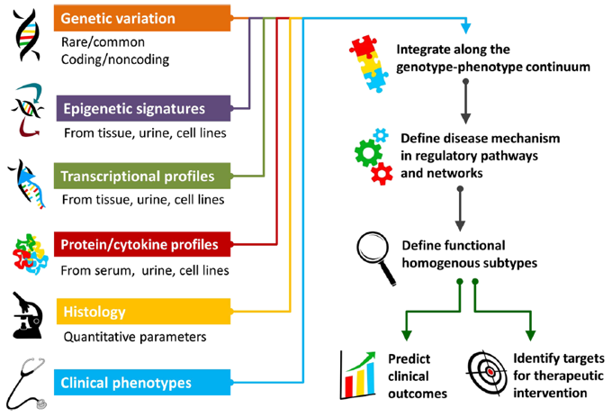
Genetic Testing
Genetic testing has rapidly evolved
and its role has expanded to include:
conﬁrming clinical diagnoses
establishing inheritance patterns
differentiating heterogeneous
disorders
determining appropriate treatment
guiding decisions about family
planning
determining the cause of
unexplained familial kidney disorders
Sampson MG et al. Pediatr Nephrol. 2015; 30:51-63
Notes:
Genetic testing is also expected to be used for identifying new risk factors for susceptibility and progression. Currently, cost and unclear clinical implications limit the use of genetic testing

Slide 35
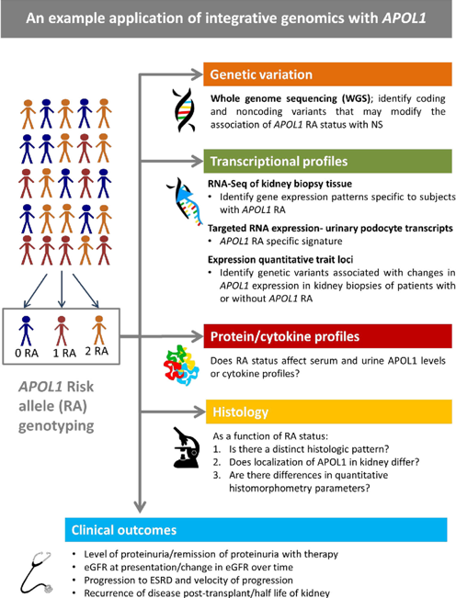
It is also expected to be used for identifying
new risk factors for susceptibility and
progression
Currently cost and unclear clinical implications limit the use of genetic testing
Sampson MG et al. Pediatr Nephrol. 2015; 30:51-63

Slide 36
Management of Complications

Slide 37
Hypertension control remains crucial to the management of GN
Although some controversy remains, data
support a BP target of 125/75 mm Hg in
the GN patient with proteinuria >1 g/d.

Slide 38
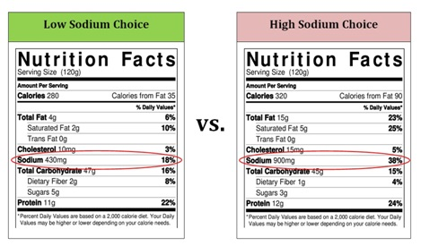
Critical to the management of resistant
hypertension is a careful review of the
patient’s dietary sodium intake.
Educating the patient on how to interpret
food labels and providing feedback by
assessing sodium intake with 24-hour urine
sodium estimates are effective strategies.
Notes:
Sodium restriction will not only lower BP, but may enhance the anti-proteinuric effects of renin–angiotensin system (RAS) blockers.
The Institute of Medicine currently recommends limiting dietary sodium to <1500 mg/d (65 mmol/d), which is a 50% to 75% reduction from the average North American intake. There are no clear data on optimal sodium restriction in children.

Slide 39
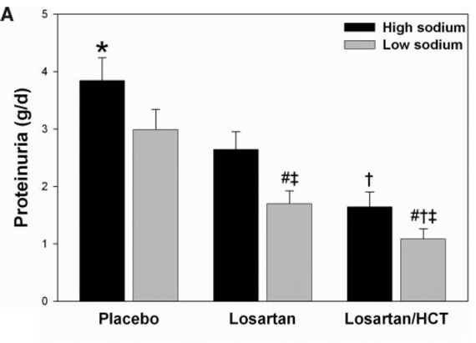
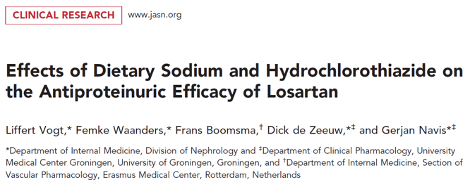
A low-sodium diet and HCT are equally efficacious in reducing proteinuria and BP
when added to a regimen containing losartan, and especially seem to benefit
individuals who are resistant to RAAS blockade.
Combining these interventions in sodium status is an effective method to maximize
the anti-proteinuric efficacy of RAAS blockade.

Slide 40
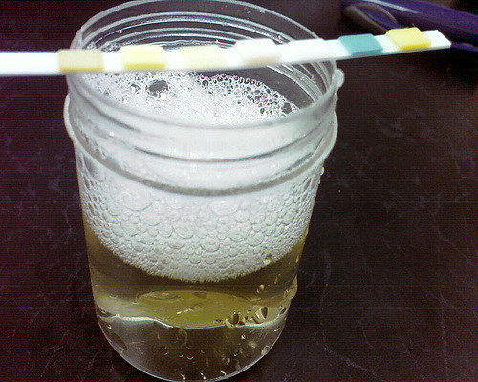
Proteinuria reduction
Proteinuria reduction remains a goal in
virtually all glomerular diseases.
The main approach is through
RAS blockade.

Slide 41
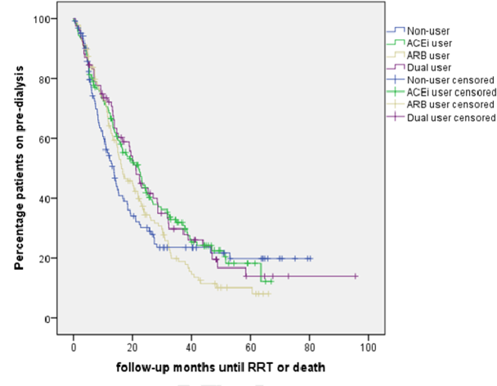
An area of controversy is whether
angiotensin-converting enzyme
inhibitors (ACEi) or angiotensin receptor blockers (ARB) should be used alone, as dual therapy and/or in combination with an aldosterone antagonist.
Previously, hyperkalemia and acute
kidney injury outweighed beneﬁts of
dual therapy, but recent studies
indicate that with careful monitoring,
combination therapy can be safe.
Voskamp WM, et al. J Am Soc Hypertens. 2017;11: 635-643

Slide 42
Voskamp WM, et al. J Am Soc Hypertens. 2017; 11: 635-643
Notes:
Nonetheless, the beneﬁt for dual RAS blockade in GN with high-grade proteinuria is not clear.

Slide 43
A practical approach to ameliorating
risks due to RAS blockers, particularly
acute kidney injury, is by providing “sick
day instructions” to withhold or decrease
the dose of these medications during
periods when volume depletion may
occur, as with vomiting or diarrhea.

Slide 44
Aldosterone blockade reduces cardiovascular mortality in patients with heart failure and also reduces albuminuria.
However, the absolute risk-beneﬁt ratio for aldosterone blockade in GN
remains unclear.

Slide 45
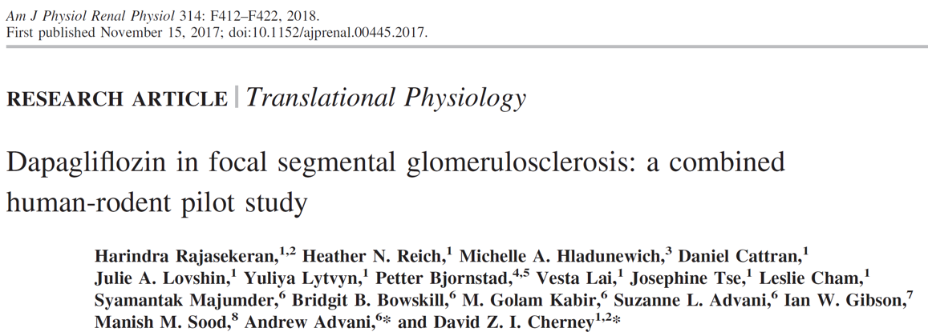
Short-term treatment with the SGLT2 inhibitor dapagliﬂozin did not modify renal
hemodynamic function or attenuate proteinuria in nondiabetic humans with
FSGS, possibly because of downregulation of renal SGLT2 expression in FSGS.

Slide 47
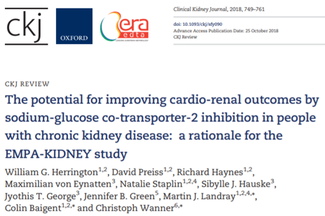
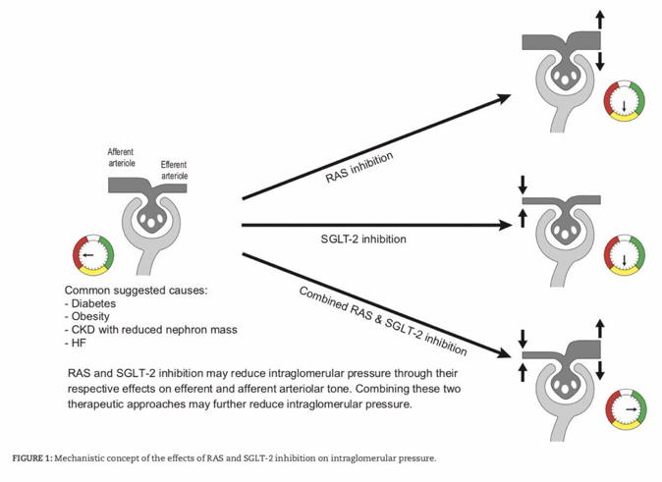
Several large studies are currently investigating SGLT2 inhibitors in non-diabetic CKD

Slide 48
Hyperlipidemia
The accelerated vascular disease seen in patients
with CKD includes those with GN, and recent data
suggest this may be worse in some glomerular
diseases than others.

Slide 49
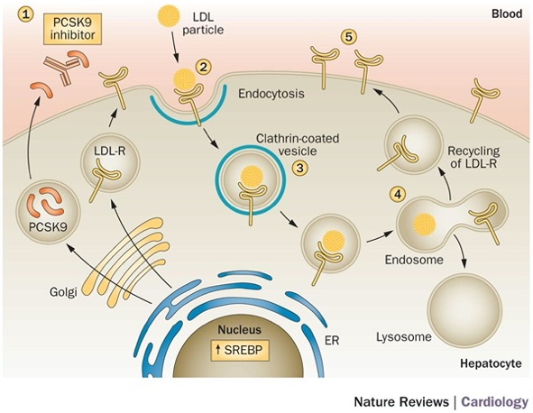
Although traditionally statins have
been used to treat hyperlipidemia
and are effective, target values may
not be achieved, especially in the new
era of very low target low density
lipoprotein levels.
Novel powerful agents such as
proprotein convertase subtilisin/kexin
type 9 inhibitors (e.g., evolocumab,
alirocumab) need to be studied in the
GN population.
Reiner Ž. Nat Rev Cardiol. 2015; 12:565-575

Slide 50
Evidence that lipid-lowering therapy in children
is beneﬁcial is of poor quality, but needs to be
explored given their expected longevity.
In contrast to cardiovascular benefits of statins,
renal benefits are not well established.

Slide 51
Hypercoagulability

Slide 53
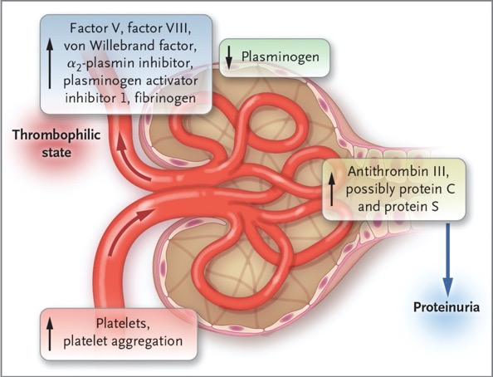
Mechanisms of the thrombophilic state in nephrotic syndrome
Urinary loss of proteins that prevent thrombosis
Increased synthesis of factors that promote thrombosis
Platelet hyperreactivity

Slide 54
Notes:
Concerning the risk-beneﬁt ratio of prophylactic anticoagulation in nephrotic patients, especially in those with glomerular diseases associated with thrombotic events, decision aids are available online particularly for patients with membranous nephropathy.
Whether non-vitamin-K antagonist oral anticoagulants can be safely used has only been demonstrated above an eGFR of 30 ml/min per 1.73 m². Effects of more severe CKD and proteinuria on non-vitamin-K antagonist oral anticoagulant metabolism and clearance require further study.

Slide 55
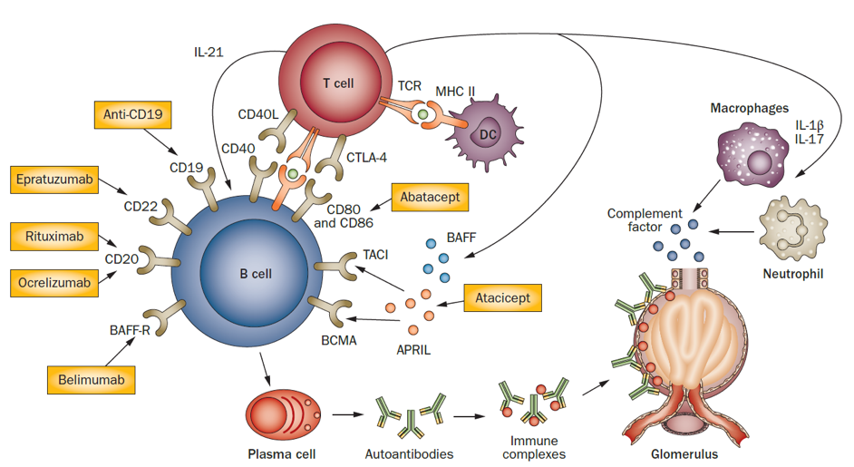
There is a risk of infection with most of the medications used to treat glomerular diseases
Gregersen JW, Jayne DR. Nat Rev Nephrol. 2012; 8:505-514
Notes:
There is a risk of infection with most of the medications used to treat the glomerular diseases, including common infections, in particular pneumonias, but also more speciﬁc infectious complications such as hepatitis B virus reactivation during immunosuppression or infections that cluster in particular regions, such as pneumocystis infections in Chinese patients. Thus, antimicrobial prophylaxis is needed as per regional practice.

Slide 56
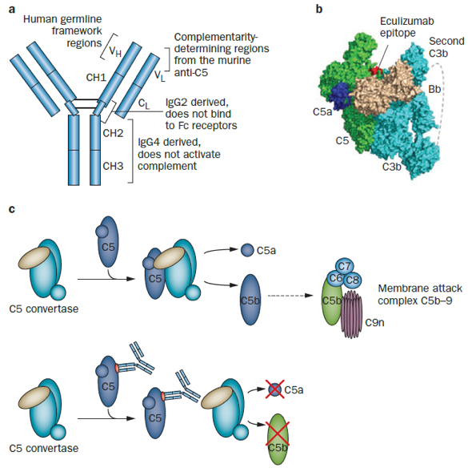
Speciﬁc infections are also more
common with certain drugs, such as
infection with encapsulated organisms
during treatment with the complement
inhibitor eculizumab.
All patients who will be given this
therapy should receive meningococcal
vaccination with the multicomponent
serogroup B vaccine, beginning at least
2 weeks before starting treatment.
This is likely to become more relevant in
GN patients as speciﬁc complement
inhibitors are evaluated for C3
nephropathy and IgAN.
Zuber J et al. Nat Rev Nephrol. 2012; 8:643-657
Notes:
From a global perspective there is also the additional need for careful evaluation of a patient’s potential for endemic infections such as tuberculosis, hepatitis B, and parasites based on geographic origins.

Slide 57
Future Studies

Slide 58
Important areas of future research,
aside from those mentioned
previously, include:
Better and more rapid point-of-care
methods (e.g., for GFR, proteinuria,
risk evaluations)
In-depth collaboration among
pathologists, pharmacists, nurses,
and clinicians
Accelerating new drug development
coupled with more sophisticated and
efﬁcient treatment trials
Notes:
Glomerular diseases are rare but represent a significant percentage of the ESKD population and are one of the few categories of kidney disease that are treatable. The majority have slowly progressive courses; so to reach the outlined goals, we need more specialized GN centers to acquire the necessary sample size cohorts for clinical trials. A GN center (hub) associated with several peripheral units (spokes) is one useful design for connecting with patient advocacy groups and sharing vital information across registries/biobanks.
In addition, glomerular disease experts, advocacy groups, and the pharmaceutical industry should be collaborating at all phases of development to improve investigative strategies, determine best trial designs, and assist in their execution.

Slide 59
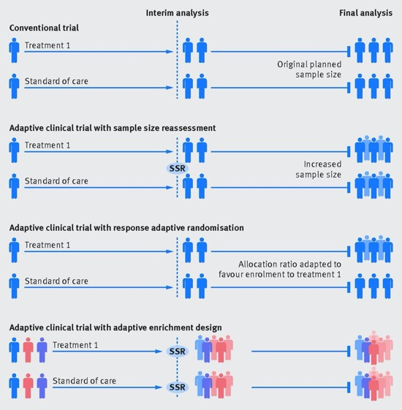
Cluster and adaptive design methods
can shorten trial time, reduce sample
size, and accelerate early development.

Slide 60
KDIGO THANKS THE FOLLOWING PARTNERS FOR THEIR SUPPORT OF THIS SPEAKER’S GUIDE

Slide 61
FOLLOW KDIGO
www.kdigo.org
/goKDIGO
@goKDIGO
@goKDIGO

