Slide 1
MANAGEMENT AND TREATMENT OF GLOMERULAR DISEASES
IgA Nephropathy
CONCLUSIONS FROM A
KDIGO CONTROVERSIES CONFERENCE

Slide 2
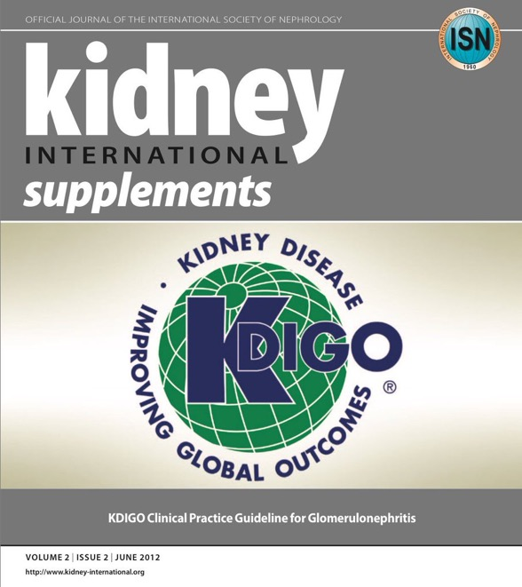
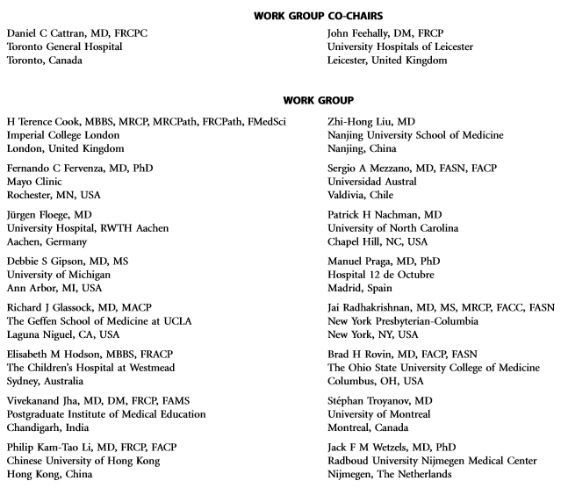
Notes:
Kidney Disease: Improving Global Outcomes (KDIGO) published its ﬁrst guideline on glomerular diseases in 2012. Available online at www.kdigo.org

Slide 3
#KDIGOGNConference
KDIGO Controversies Conference on Glomerular Diseases
Singapore, November 2017
Notes:
Given the enormous advances in understanding the pathogenesis of glomerular diseases, identiﬁcation of new diagnostic biomarkers, and emerging therapies, about 100 experts from various disciplines (nephrology, pathology, rheumatology, pediatrics) and organizations (academia, pharmaceutical industry) convened on November 17–19, 2017 for the KDIGO Controversies Conference on Glomerular Diseases. Through plenary sessions and small group discussions, the conference aimed to evaluate consensus and controversies in nomenclature, general work-up, and management of glomerular diseases, future needs in research, and, in particular, the critical assessment of existing guideline recommendations.

Slide 4
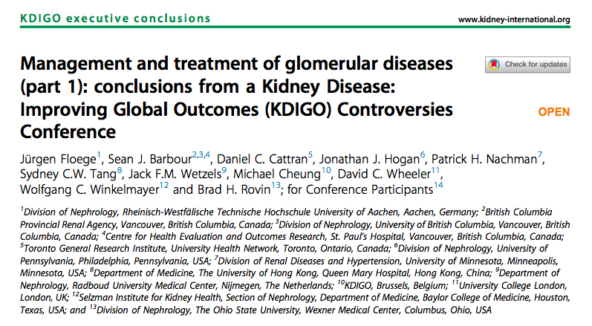
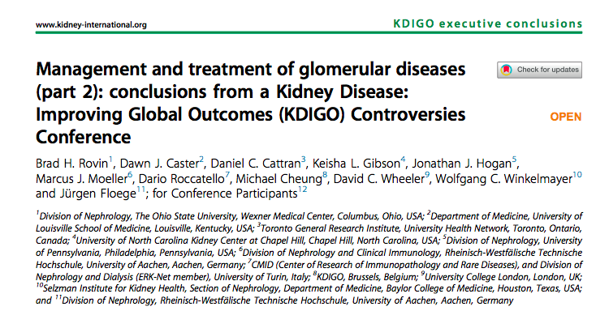
Notes:
The KDIGO Controversies Conference on Glomerular Diseases resulted in two publications in Kidney International in 2018.

Slide 5
IgA Nephropathy
Definition
Pathogenesis
Epidemiology
Clinical Manifestations
Associated Diseases
Differential Diagnosis
Pathology
Prognostic Markers
Treatment
Transplantation
Recent and Ongoing Studies
Clinical Vignettes

Slide 6
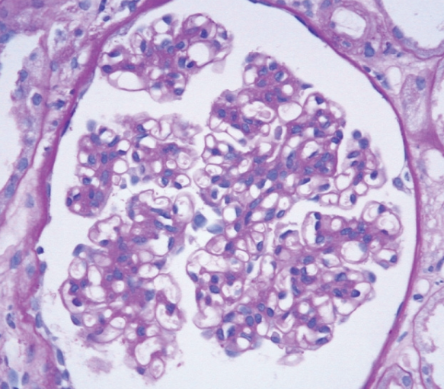
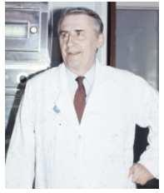
IgA Nephropathy: Definition
Mesangial proliferative
glomerulonephritis characterized by
diffuse mesangial deposition of IgA.
IgAN was first recognized in 1968
by Jean Berger when IF techniques
were introduced for the study of renal
biopsy specimens.
IgAN is unique among glomerular
diseases in being defined by the
presence of an immune reactant rather
than by any other morphologic feature
on renal biopsy, and the LM changes are
variable.

Slide 7
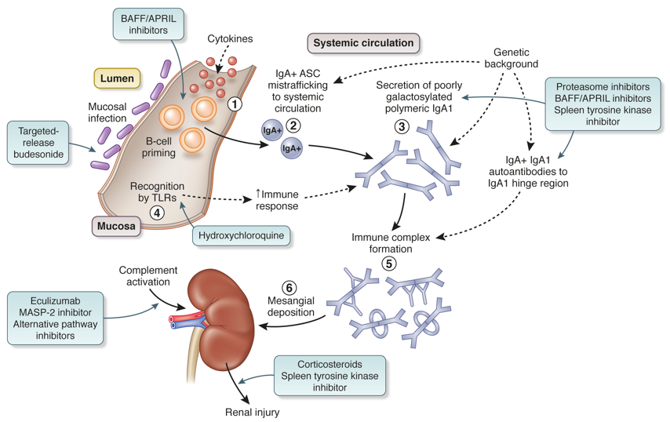
IgA Nephropathy: Pathogenesis
APRIL, a proliferation-inducing ligand; ASC, antibody-secreting cells; BAFF, B-cell-activating factor; IgA, immunoglobulin A; IgAN, immunoglobulin A nephropathy; MASP2, mannan-binding lectin-associated serine protease 2; TLR, Toll-like receptor
Adapted with permission from Boyd JK, et al. Kidney Int 2012;81(9):833–843
Notes:
Mucosal infection primes naïve B cells to class switch to become IgA ASCs through both T-cell–dependent (cytokine mediated) and T-cell-independent (TLR ligation) pathways
Some IgA ASCs mis-home to the systemic compartment during lymphocyte trafficking
Displaced IgA+ ASCs take up residence in systemic sites and secrete normal ‘mucosal-type’ (poorly galactosylated and polymeric) IgA1 into the systemic circulation
IgA1 secretion by displaced mucosal ASC is augmented by TLR ligation from mucosal-derived pathogen-associated molecular patterns, which have entered the systemic compartment
IgA1 immune complexes form in the systemic circulation. Poorly galactosylated polymeric IgA1 molecules are the substrate for immune complex formation. These combine with IgG and IgA auto-antibodies reactive to exposed neoepitopes in the poorly galactosylated IgA1 hinge region
IgA1 immune complexes deposit in the mesangium through a combination of mesangial trapping and increased affinity of poorly galactosylated IgA1 for extracellular matrix components. Immune complex deposition triggers a series of downstream pathways, including complement activation via the mannose-binding lectin and other pathways, leading to glomerular injury and tubule-interstitial scarring

Slide 8
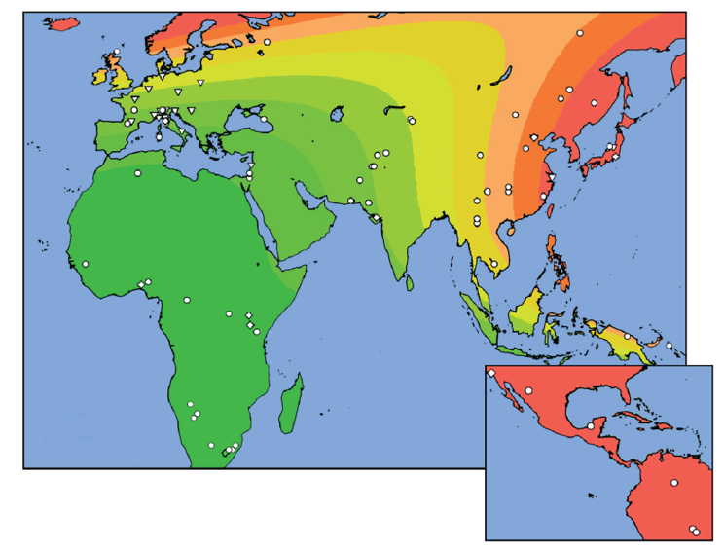
IgA Nephropathy: Epidemiology
Kiryluk K, et al. PLoS Genet. 2012;8:e1002765.
Genome-wide association studies indicate a
geographical gradient of risk from green (low risk) to red (high risk).
Notes:
IgAN is the most prevalent pattern of glomerular disease seen in most Western and Asian countries where renal biopsy is widely practiced.
See: Kiryluk K, et al. PLoS Genet. 2012; 8:e1002765.

Slide 9
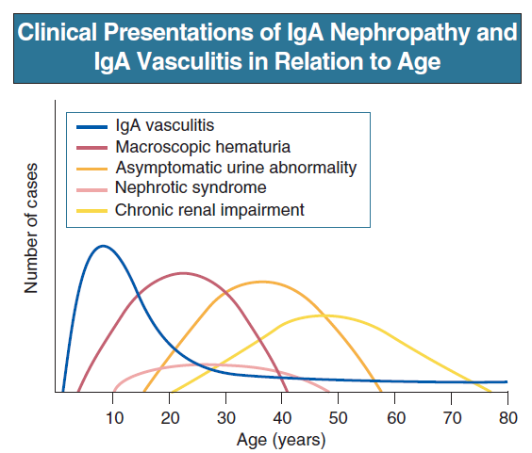
IgA Nephropathy: Clinical Manifestations
The wide range of clinical
presentations of IgAN varies in
frequency with age.
No clinical pattern is
pathognomonic of IgAN.
In populations of White descent,
IgAN is more common in males than
females by a ratio of 3 : 1, whereas
the ratio approaches 1 : 1 in most
Asian populations.
Feehally J, Floege J, Tonelli M, Johnson RJ. Comprehensive Clinical Nephrology, 6th Edn (2019)

Slide 10
IgA Nephropathy: Clinical Manifestations
Macroscopic hematuria (40-50%)
Asymptomatic hematuria and
proteinuria (30-40%)
- Proteinuria usually < 2 gms/day
Proteinuria and nephrotic
syndrome (5%)
Acute Kidney Injury (AKI) (<5%)
Chronic Kidney Disease (CKD)
Feehally J, Floege J, Tonelli M, Johnson RJ. Comprehensive Clinical Nephrology, 6th Edn (2019)
Notes:
AKI develops by three distinct mechanisms:
There may be acute severe immune and inflammatory injury with necrotizing GN and crescent formation (crescentic IgAN); this may be the first presentation of IgAN, or it may be superimposed on established, less aggressive disease. Rapid deterioration in IgAN in pregnancy may be caused by crescentic transformation
Alternatively, AKI can occur with mild glomerular injury when heavy glomerular hematuria leads to tubule occlusion by red blood cells (RBCs)
Third, especially in elderly patients, chronic IgAN will predispose to AKI from a variety of incidental renal insults
Source: Feehally J, Floege J, Tonelli M, Johnson RJ. Comprehensive Clinical Nephrology, 6th Edn (2019)

Slide 11
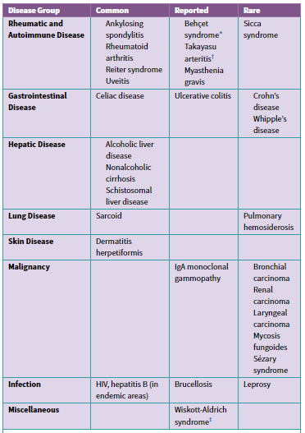
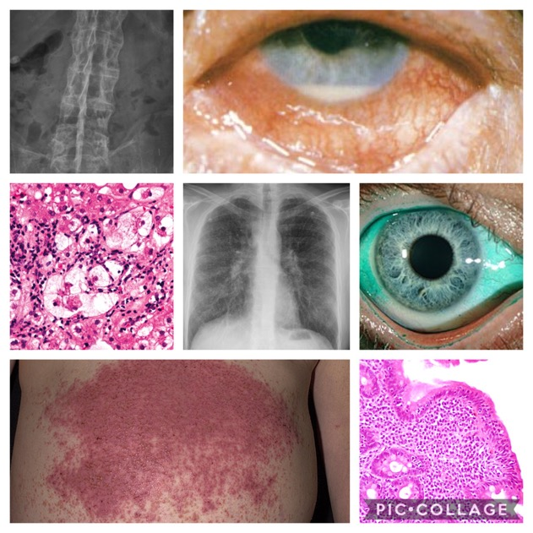
IgA Nephropathy: Associated diseases
Notes:
Source: Feehally J, Floege J, Tonelli M, Johnson RJ. Comprehensive Clinical Nephrology, 6th Edn (2019)

Slide 12
IgA Nephropathy: Differential Diagnosis
Feehally J, Floege J, Tonelli M, Johnson RJ. Comprehensive Clinical Nephrology, 6th Edn (2019)

Slide 13
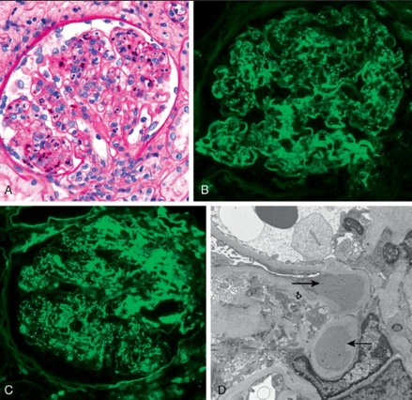
An important differential diagnosis
is IgA-dominant acute post-infectious
glomerulonephritis (APIGN), in which
IgA is the dominant immunoglobulin
in glomerular deposits
It usually occurs in association with
staphylococcal infections.
Risk factors particularly include
diabetes.
Compared with IgAN, patients with
IgA-dominant APIGN are more likely
to be older and have AKI,
documented staphylococcal infection,
hypocomplementemia, diffuse
glomerular endocapillary
hypercellularity with prominent
neutrophil infiltration on LM, stronger
immunofluorescence staining for
C3 than IgA, and the presence of
subepithelial humps on EM.
Feehally J, Floege J, Tonelli M, Johnson RJ. Comprehensive Clinical Nephrology, 6th Edn (2019)

Slide 14
10.1.3: Pathological features may be
used to assess prognosis. (Not Graded)
Notes:
KDIGO Guideline recommendation statement 10.1.3

Slide 15
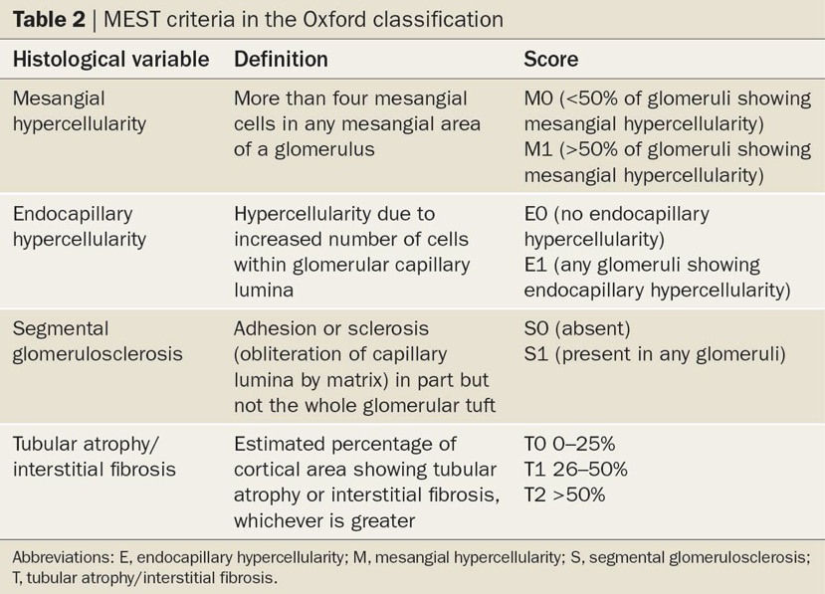
Roberts IS. Nat Rev Nephrol. 2014; 10:445-454
Notes:
The MEST scoring system for IgAN offered the ﬁrst opportunity to use histology to predict renal outcome independent of proteinuria, BP, and eGFR.

Slide 16
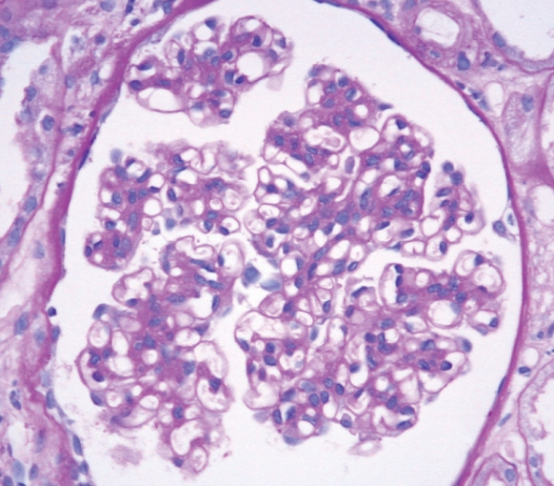
IgA Nephropathy: Pathology
Diffuse mesangial hypercellularity (M1)
Feehally J, Floege J, Tonelli M, Johnson RJ.
Comprehensive Clinical Nephrology, 6th Edn (2019)

Slide 17
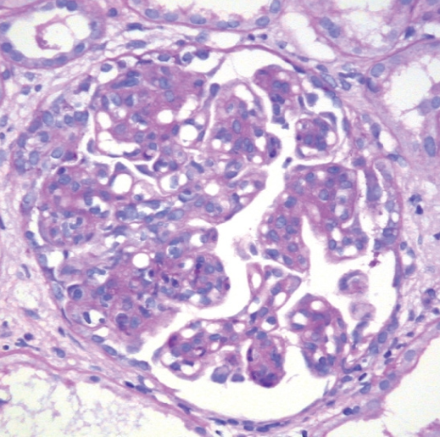
IgA Nephropathy: Pathology
Endocapillary hypercellularity (E1)
Feehally J, Floege J, Tonelli M, Johnson RJ.
Comprehensive Clinical Nephrology, 6th Edn (2019)

Slide 18
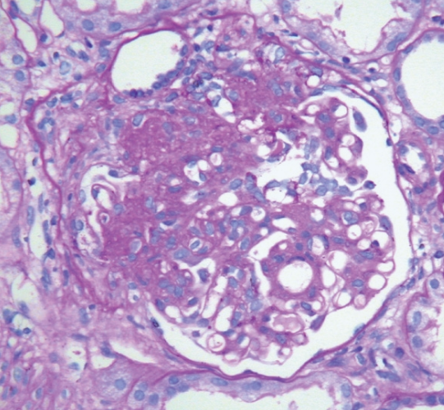
IgA Nephropathy: Pathology
Segmental sclerosis (S1)
Feehally J, Floege J, Tonelli M, Johnson RJ.
Comprehensive Clinical Nephrology, 6th Edn (2019)

Slide 19
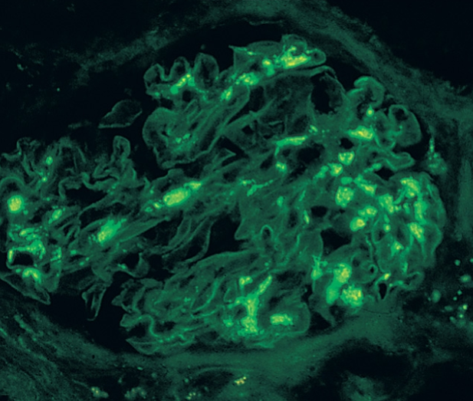
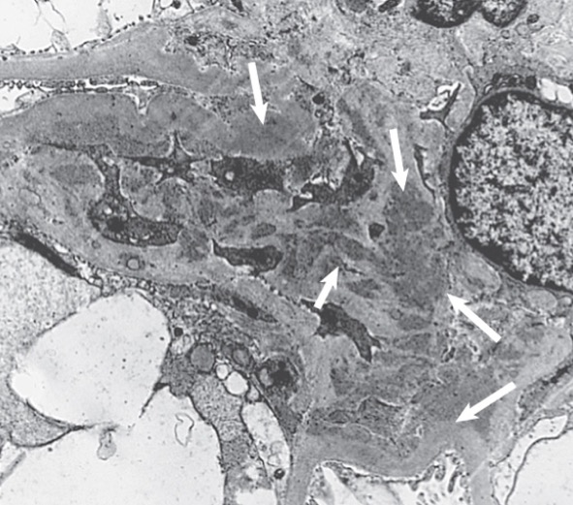
IgA Nephropathy: Pathology
Diffuse mesangial IgAN seen on indirect IF with
fluorescein isothiocyanate–anti-IgA (magnification ×3300).
Mesangial electron-dense deposits (arrows)
(electron micrograph; ×316,000).
Feehally J, Floege J, Tonelli M, Johnson RJ. Comprehensive Clinical Nephrology, 6th Edn (2019)

Slide 20
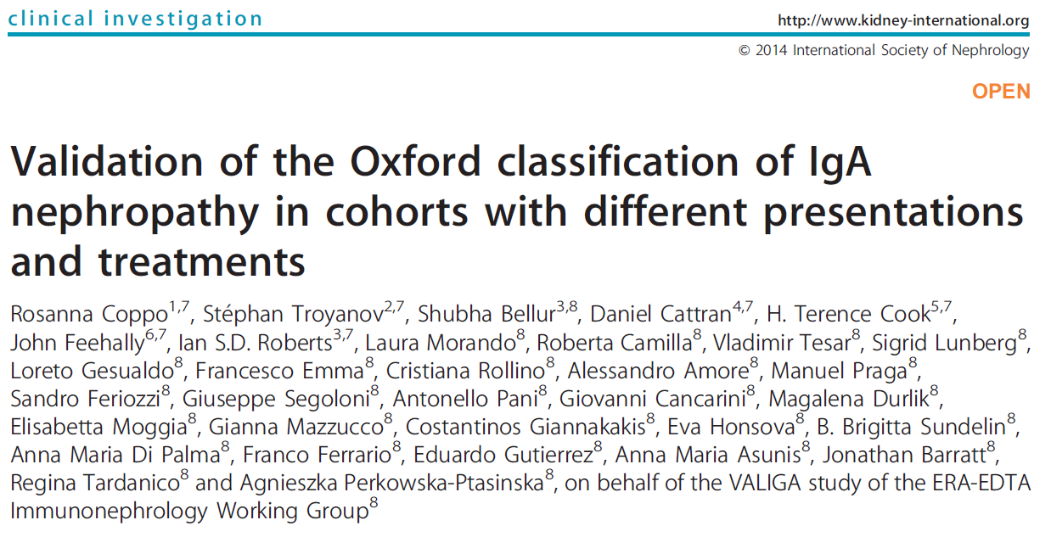
Notes:
The European Validation Study of the Oxford Classiﬁcation of IgAN (VALIGA) study conﬁrmed the association of M1, S1, and T1/2 with kidney outcome, and the association of M1 and E1 with subsequent increase in proteinuria.

Slide 21
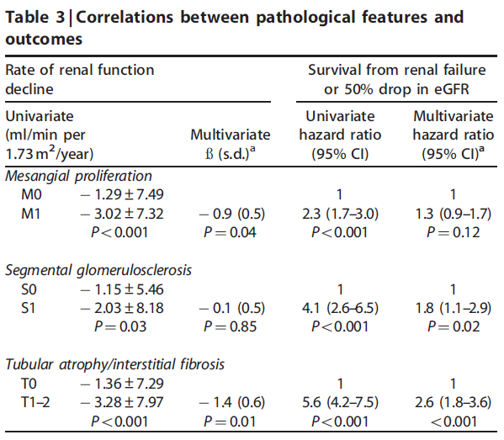

Slide 22
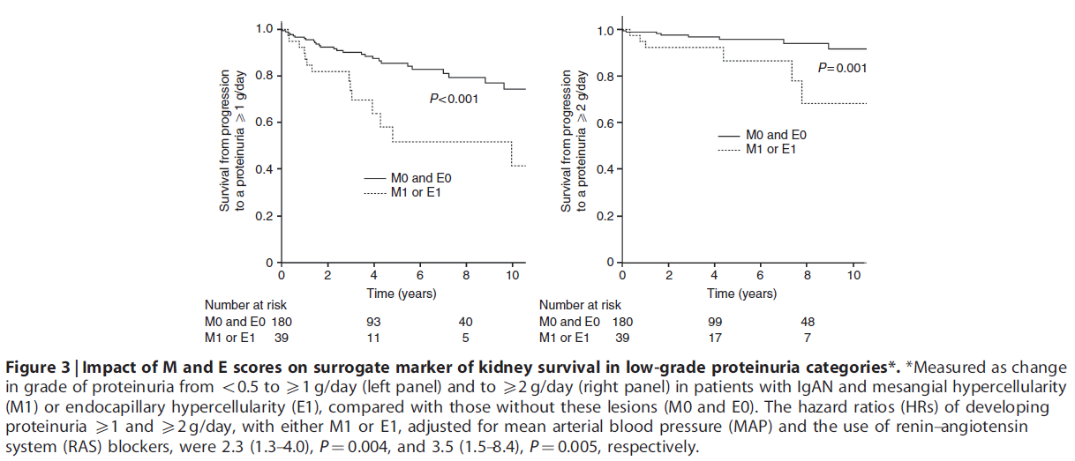

Slide 23
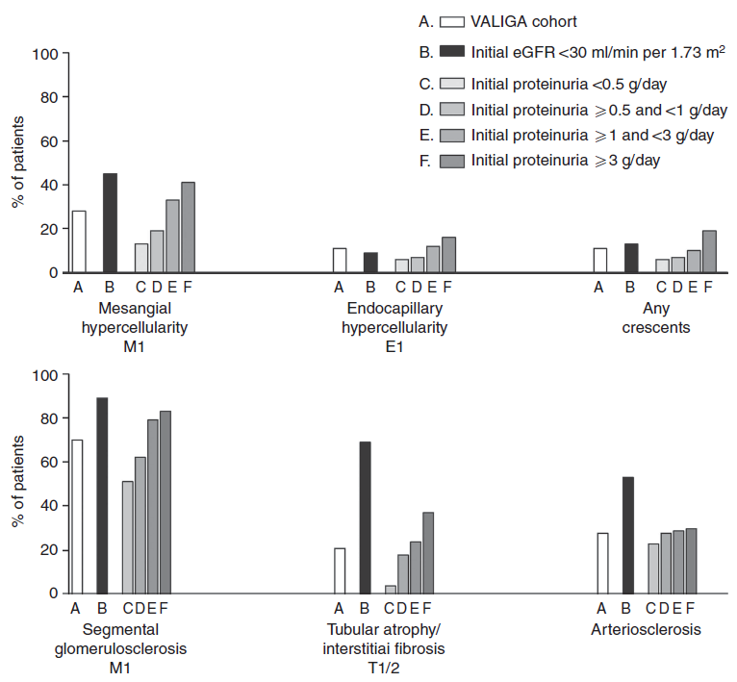
In children, MEST scoring yielded
a higher prevalence of proliferative
lesions versus sclerotic lesions.

Slide 24
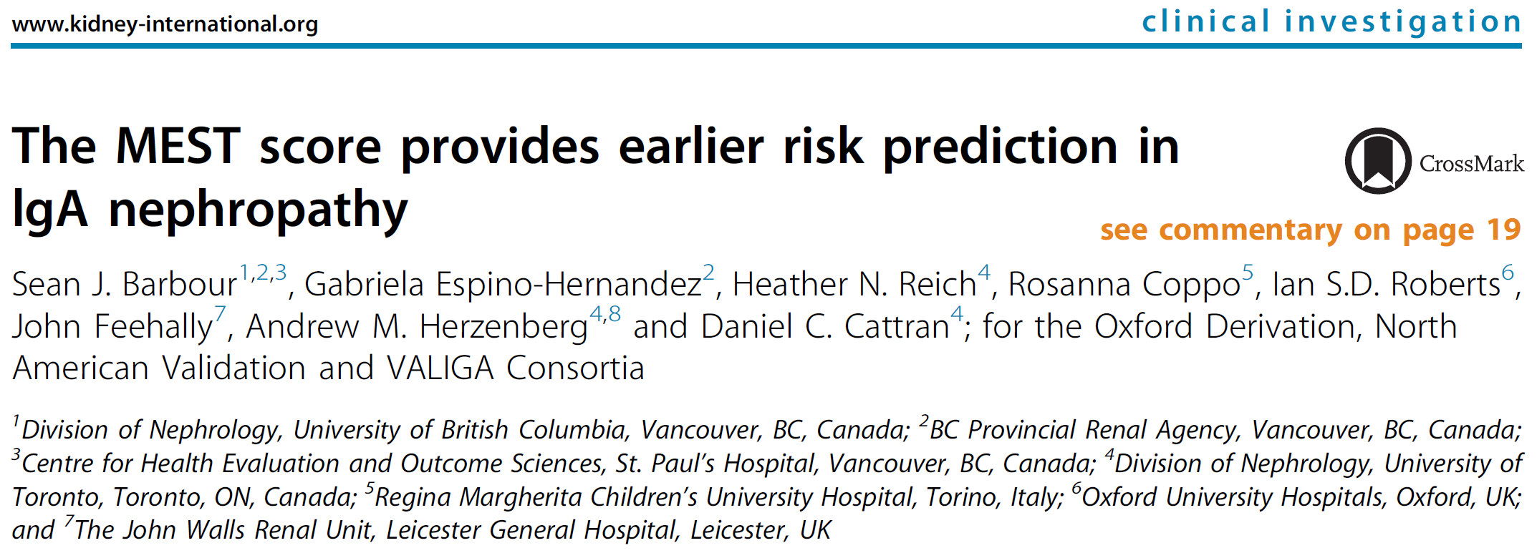
When the MEST score in adults was combined with eGFR, proteinuria, and BP
at biopsy, it was possible to predict kidney outcome with the same accuracy as
clinical data over 2 years of follow-up, and thereby the MEST score allowed risk
stratiﬁcation at an earlier time point

Slide 25
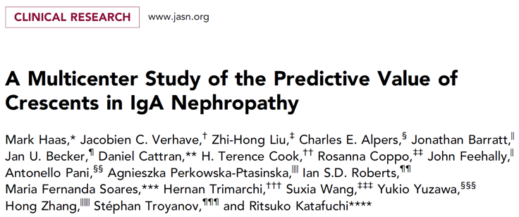
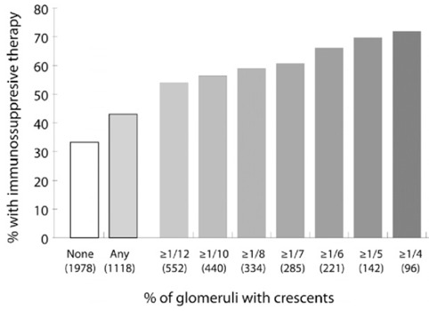

Slide 26
This large analysis of IgAN patients demonstrated that cellular or ﬁbrocellular
crescents were independently associated with a higher risk of kidney disease
progression, especially in those not immunosuppressed.

Slide 27
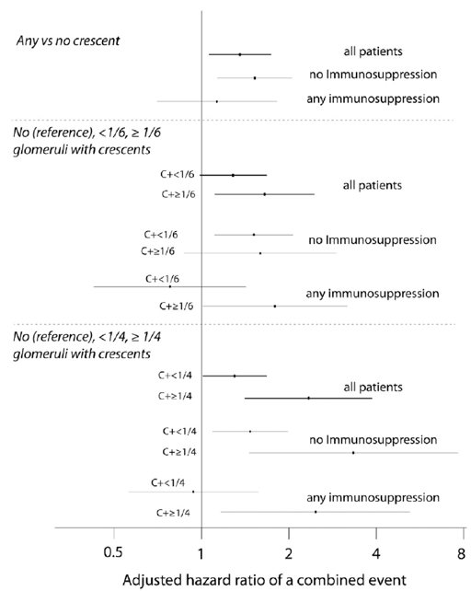
In addition, crescents in >25% of glomeruli
were associated with an increased risk of
poor kidney outcome even in patients treated
with immunosuppression, although this was
based on small subgroups and the results
were not consistent across all outcomes
evaluated.
Notes:
Based on this study, MEST now includes a C score of 1 or 2 (crescents <25% or >25%, respectively).
Importantly, MEST-C score was developed to predict kidney outcome and not to guide treatment or to predict treatment response.

Slide 28
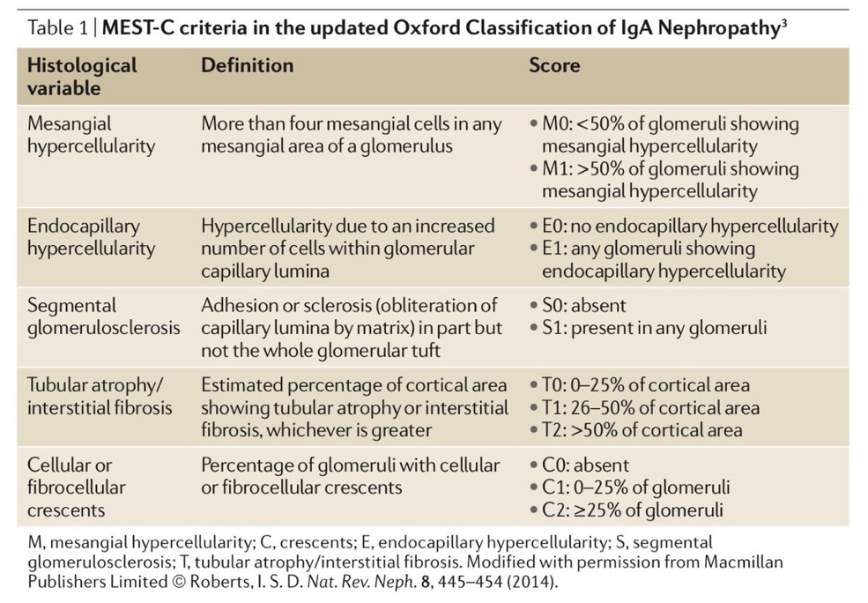
Notes:
Based on this study, MEST now includes a C score of 1 or 2 (crescents <25% or >25%, respectively).
Importantly, MEST-C score was developed to predict renal outcome and not to guide treatment or to predict treatment response.
Source: Markowitz G. Nat Rev Nephrol. 2017; 13: 385-386.

Slide 29
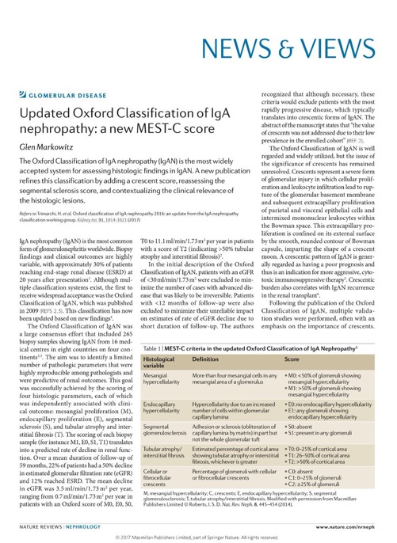
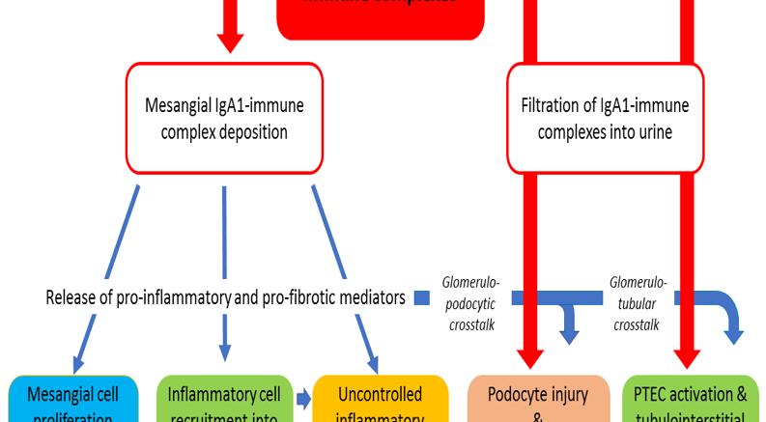
Courtesy of Dr. Jonathan Barratt
Importantly, MEST-C score was developed to
predict kidney outcome and not to guide treatment
or to predict treatment response.
Notes:
Although observational data suggest that E1 and crescents may predict outcomes differently in treated versus untreated patients, and the beneﬁts of steroids may differ in patients with M1 or S1, there is currently insufﬁcient evidence to suggest that immunosuppression decisions should be based on histology parameters.
A major limitation is the absence of a validated risk prediction model that allows integration of histology with clinical predictors to establish an accurate individual prognosis.

Slide 30
10.1.2: Assess the risk of progression
in all cases by evaluation of proteinuria,
blood pressure, and eGFR at the time
of diagnosis and during follow-up.
(Not Graded)

Slide 31
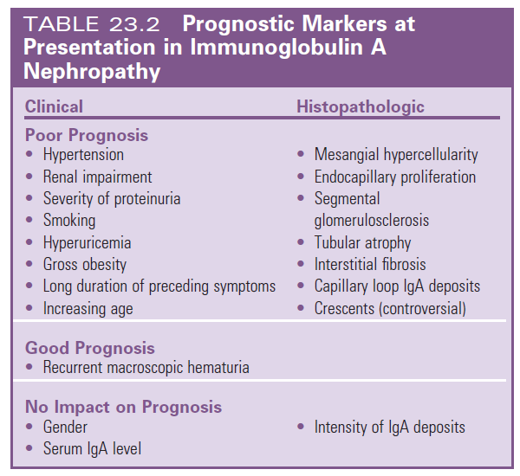
IgA Nephropathy: Prognostic markers at presentation
Feehally J, Floege J, Tonelli M, Johnson RJ. Comprehensive Clinical Nephrology, 6th Edn (2019)

Slide 32
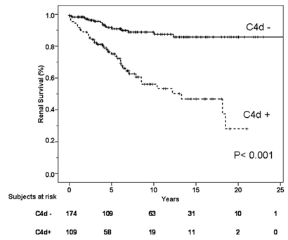
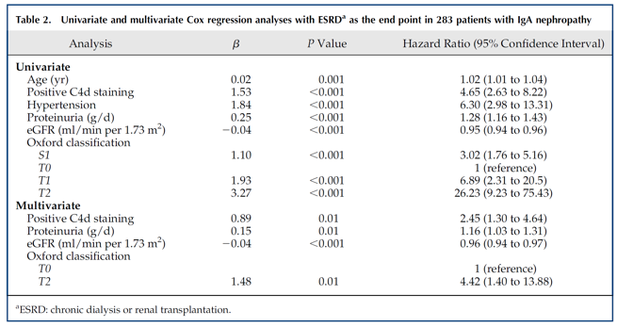
New biomarkers are needed to further improve prediction of renal prognosis in IgAN
Notes:
Glomerular C4d deposition may represent a marker of an adverse prognosis, but this ﬁnding needs more external validation before it can be routinely recommended.
Source: Espinosa M, et al. Clin J Am Soc Nephrol. 2014; 9: 897-904

Slide 33
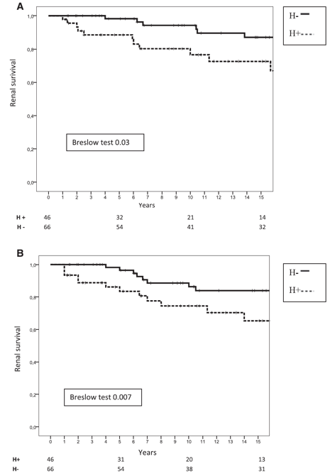
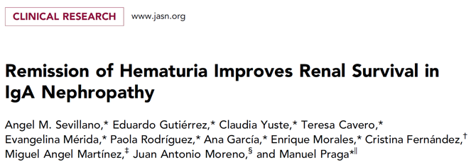
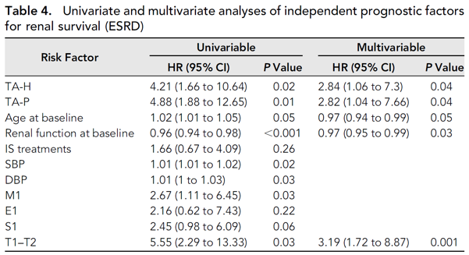
Notes:
This small study demonstrated an association between time-averaged microhematuria >5 red blood cells per high-power ﬁeld and the risk of ESKD especially when combined with time-averaged proteinuria.
However, time-averaged values require the entire duration of follow-up, which is not clinically relevant, and it is not clear whether the association is independent of MEST-C and other established clinical predictors.

Slide 34
There have been over 1000 derivation
studies for biomarkers in IgAN.
To date, none have externally validated
the assay reproducibility and association
with kidney outcome using commercially
available platforms, and none have
translated the results into clinical practice
by demonstrating that the biomarker
improves prediction beyond other readily
available risk factors.
Currently, no biomarker is ready for
clinical application.

Slide 35
Notes:
In this study, the 2 full prediction models were shown to be accurate and validated methods for predicting disease progression and patient risk stratification in IgAN in multi-ethnic cohorts, with additional applications to clinical trial design and biomarker research.

Slide 37
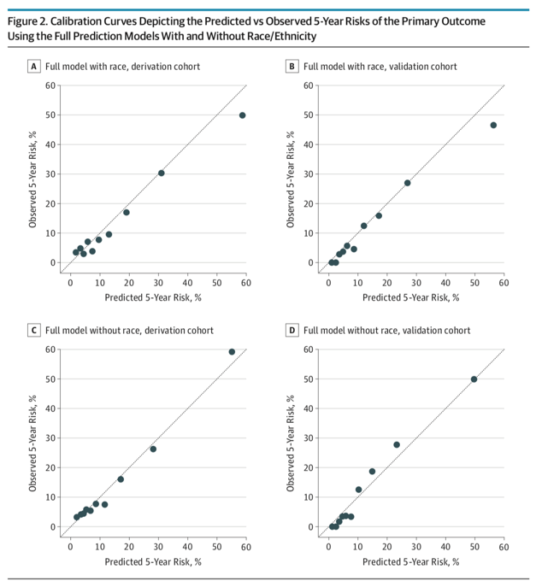
Predicted 5-year risks are from the
prediction model, and observed
5-year risks are from Kaplan-Meier
estimates within deciles of predicted
risk.
Notes:
Results from the derivation cohort are on the left, and from the validation cohort on the right. Predicted 5-year risks are from the prediction model, and observed 5-year risks are from Kaplan-Meier estimates within deciles of predicted risk. The dotted line represents perfect calibration in which predicted and observed risks are identical.

Slide 38
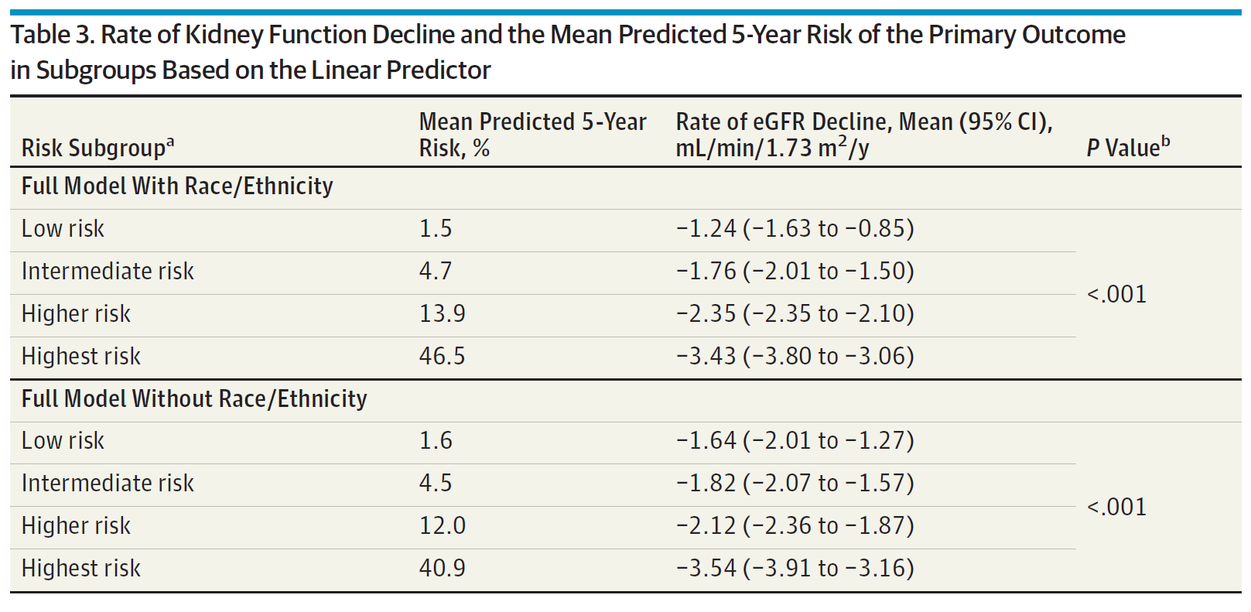
Notes:
a Subgroups were based on the 16th (lowest risk), 16th to 50th (intermediate risk), 50th to 84th (higher risk) and higher than 84th (highest risk) percentiles of the linear predictor from the full models with or without race/ethnicity.
b P values are for the differences in the rates of eGFR decline across risk subgroups.

Slide 39
TREATMENT

Slide 40
10.2: Antiproteinuric and antihypertensive therapy
10.2.1: We recommend long-term ACE-I
or ARB treatment when proteinuria is > 1 g/d, with up-titration of the drug depending on blood pressure. (1B)
10.2.2: We suggest ACE-I or ARB
treatment if proteinuria is between 0.5-1 g/d (in children, between 0.5-1 g/d per 1.73 m²). (2D)
10.2.3: We suggest the ACE-I or ARB be
titrated upwards as far as tolerated to
achieve proteinuria < 1 g/d. (2C)
10.2.4: In IgAN, use blood pressure
treatment goals of < 130/80 mmHg in
patients with proteinuria < 1 g/d, and
< 125/75 mmHg when initial proteinuria
is >1 g/d. (Not Graded)

Slide 41
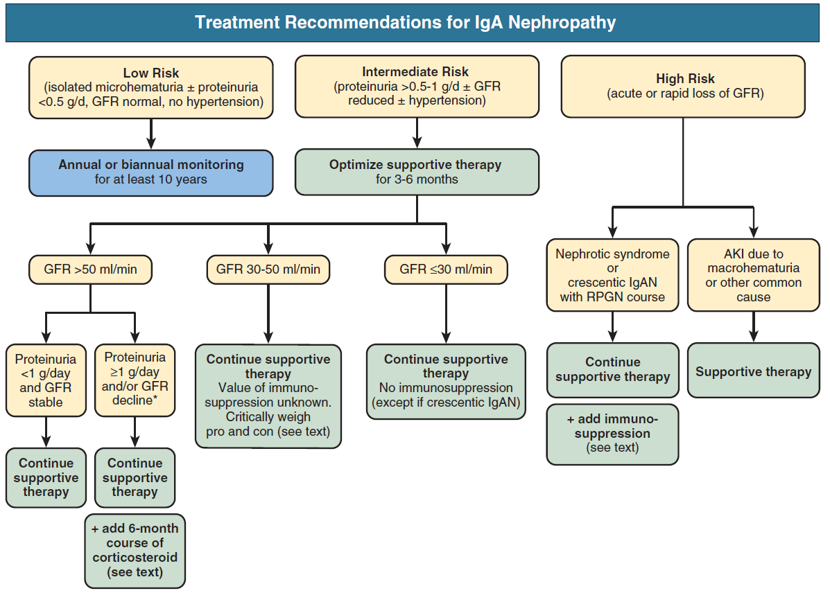
Feehally J, Floege J, Tonelli M, Johnson RJ. Comprehensive Clinical Nephrology, 6th Edn (2019)

Slide 42
10.4: Immunosuppressive agents
(cyclophosphamide, azathioprine, MMF,
cyclosporine)
10.4.1: We suggest not treating with
corticosteroids combined with
cyclophosphamide or azathioprine in
IgAN patients (unless there is crescentic
IgAN with rapidly deteriorating kidney
function; see Recommendation 10.6.3).
(2D)

Slide 43
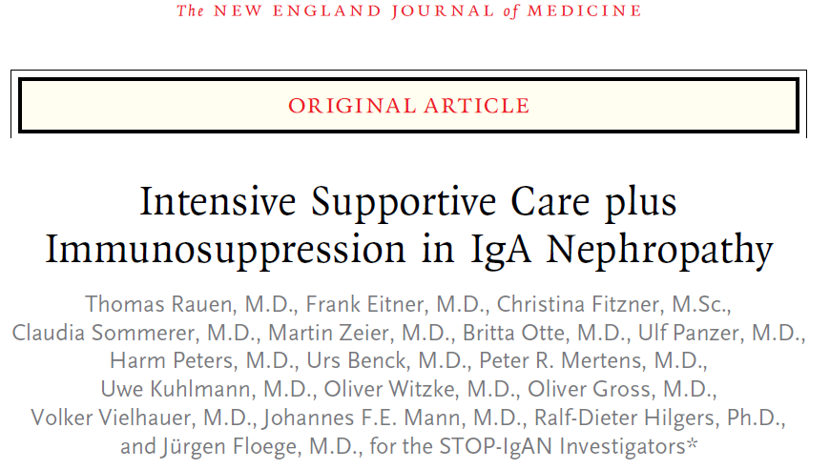
Notes:
The Supportive Versus Immunosuppressive Therapy for the Treatment of Progressive IgA Nephropathy (STOP-IgAN) trial randomized patients to supportive treatment, or to steroids alone, or steroids in conjunction with sequential cyclophosphamide and azathioprine based on eGFR.
Immunosuppression transiently reduced proteinuria over 3 years but had no impact on eGFR and only resulted in signiﬁcant, particularly, infectious adverse events.
Proteinuria reduction occurred mostly in the steroid and not immunosuppressive combination therapy group.
Optimized supportive treatment was associated with a very slow loss of kidney function in the control group, so that the study was underpowered to detect eGFR-based outcomes.

Slide 44
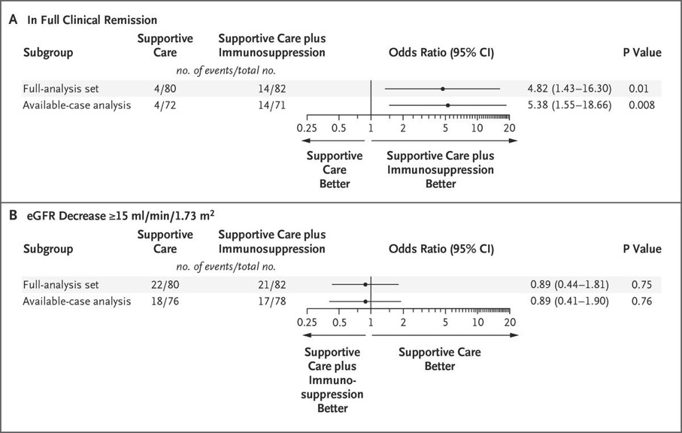
Primary Endpoints

Slide 45
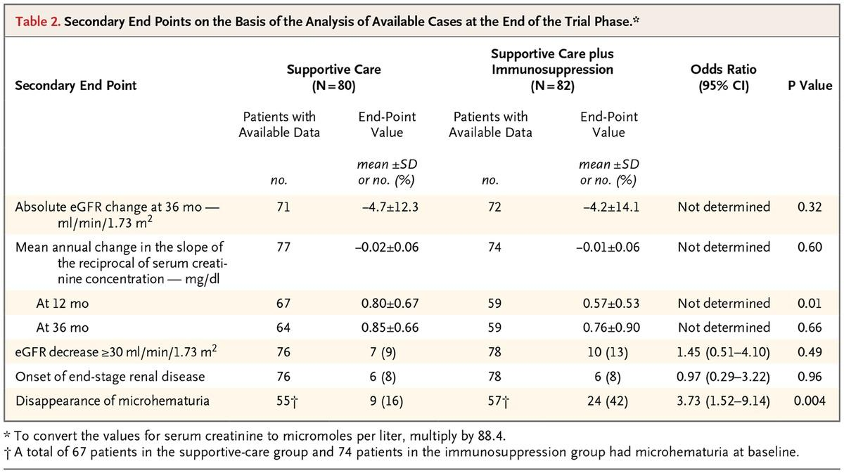

Slide 46
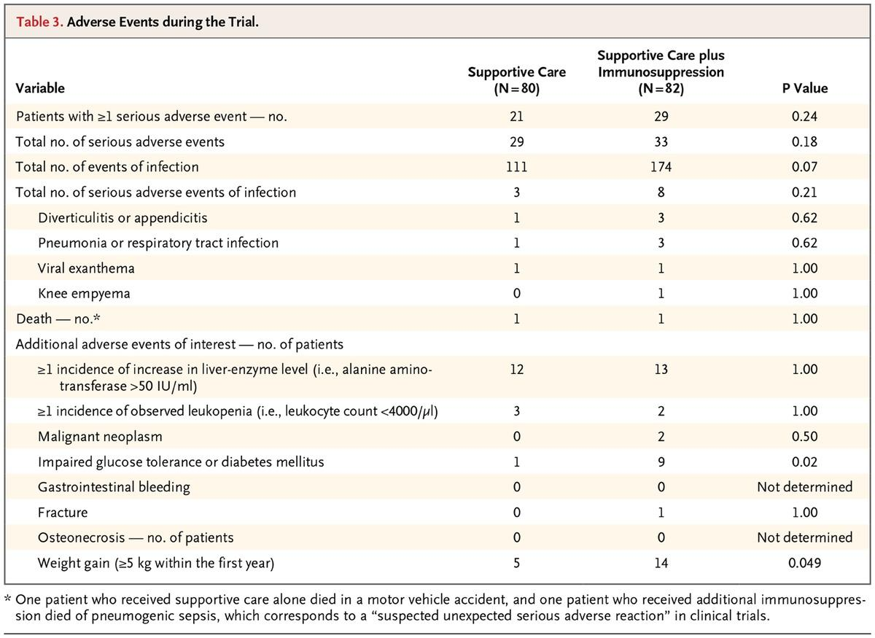

Slide 47
Notes:
The Supportive Versus Immunosuppressive Therapy for the Treatment of Progressive IgA Nephropathy (STOP-IgAN) trial randomized patients to supportive treatment, or to steroids alone, or steroids in conjunction with sequential cyclophosphamide and azathioprine based on eGFR.
Immunosuppression transiently reduced proteinuria over 3 years but had no impact on eGFR and only resulted in signiﬁcant, particularly, infectious adverse events.
Proteinuria reduction occurred mostly in the steroid and not immunosuppressive combination therapy group.
Optimized supportive treatment was associated with a very slow loss of kidney function in the control group, so that the study was underpowered to detect eGFR-based outcomes.

Slide 48
10.3: Corticosteroids
10.3.1: We suggest that patients with
persistent proteinuria ≥ 1 g/d, despite
3–6 months of optimized supportive
care (including ACE-I or ARBs and blood
pressure control), and GFR > 50 ml/min
per 1.73 m², receive a 6-month course
of corticosteroid therapy. (2C)

Slide 49
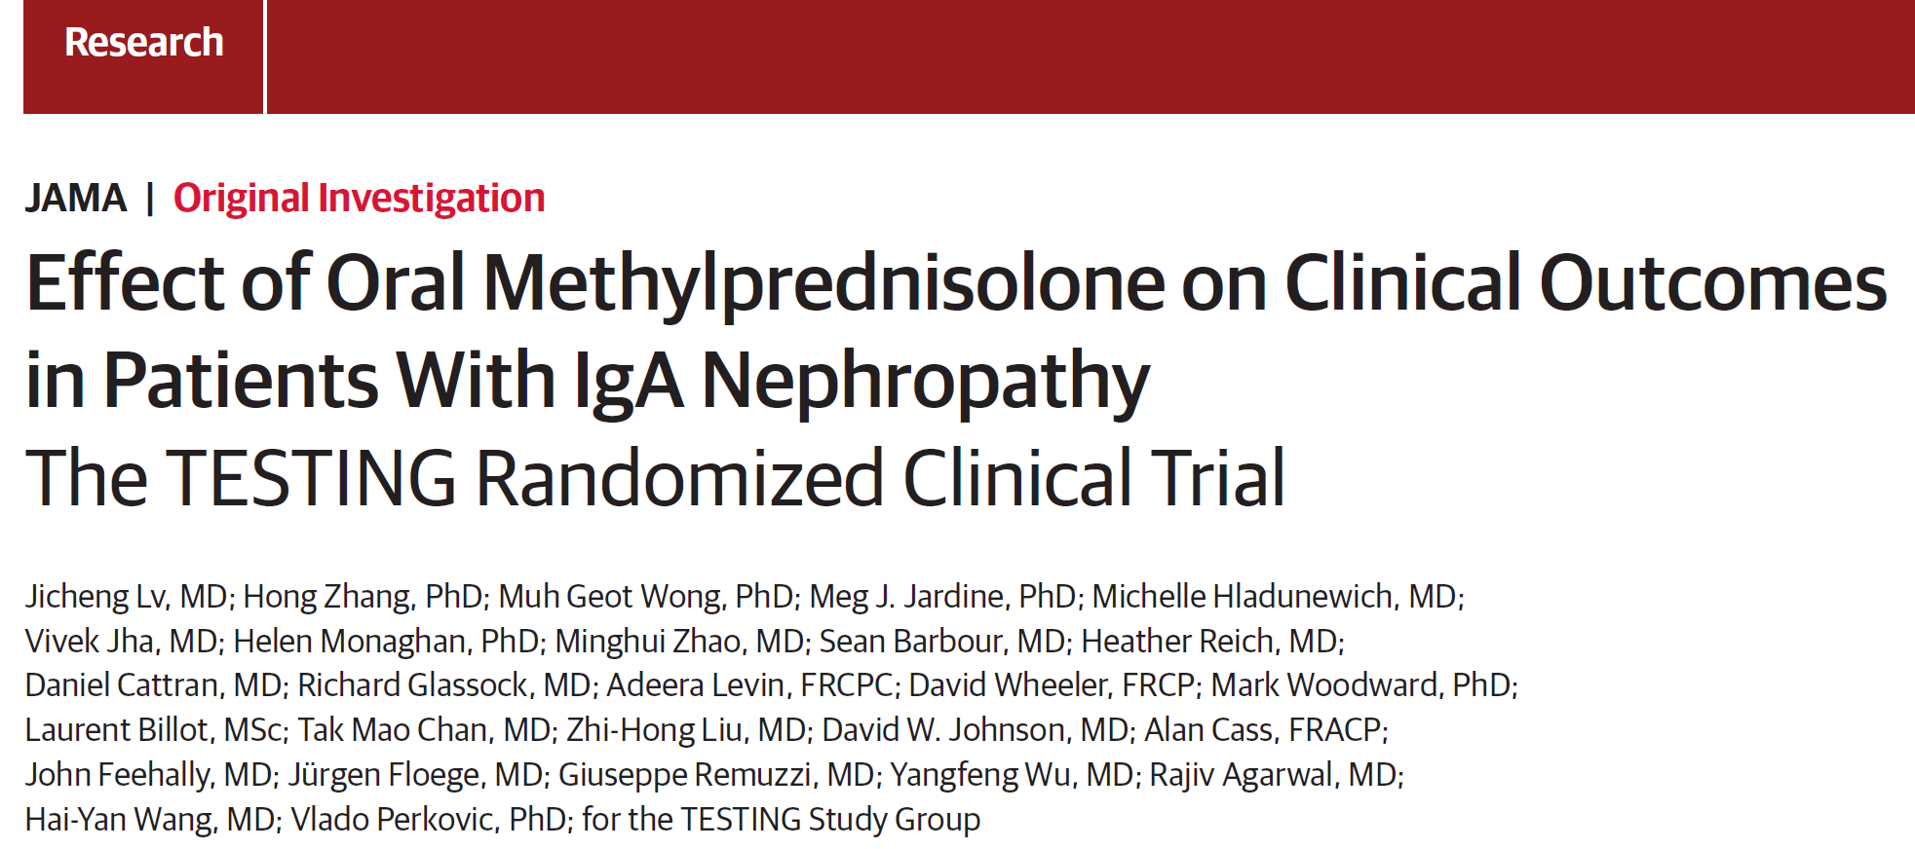
Notes:
The Therapeutic Evaluation of Steroids in IgA Nephropathy Global Study (TESTING Low Dose Study) (TESTING) trial randomized patients to 6 months of steroids or placebo and was terminated early after an interim analysis revealed a high risk of infectious serious adverse events including lethal Pneumocystis jirovecii pneumonia.
There was a signiﬁcant reduction in the risk of a 40% decline in eGFR or ESKD in the steroid group. The kidney function loss in the control group was 4 times faster in the TESTING trial than in the STOP-IgAN trial, suggesting a higher-risk population and/or differences in supportive therapy.
In TESTING, the beneﬁcial impact of steroids was similar in patients with eGFR > or <50 ml/min per /1.73 m². This ﬁnding is consistent with analyses of other clinical trials that also showed a beneﬁt of immunosuppression at lower eGFR but with an increased risk of adverse events.

Slide 50
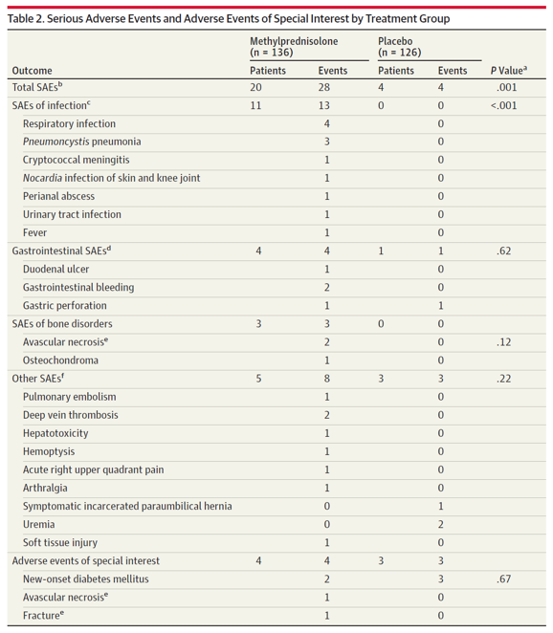
28 serious adverse events (SAEs)
were reported in 20 participants
(14.7%) in the methylprednisolone
group compared with 4 SAEs in 4
(3.2%) in the placebo group
(relative risk, 4.63 [95% CI,
1.63 to 13.2]; p = 0.001),
equating to a risk difference
of 11.5% (95% CI, 4.8% to 18.2%).
Notes:
Twenty-eight SAEs were reported in 20 participants (14.7%) in the methylprednisolone group compared with 4 SAEs in 4 (3.2%) in the placebo group (relative risk, 4.63 [95% CI, 1.63 to 13.2]; P = .001 by Fisher exact test), equating to a risk difference of 11.5% (95% CI, 4.8% to 18.2%). Most adverse events occurred in the first 3 months of treatment. This was mainly driven by an excess of serious infections (2 fatal) among 11 patients (8.1%) in the methylprednisolone group, compared with no serious infections in the placebo group (risk difference, 8.1% [95% CI, 3.5% to 13.9%]; P < .001). One patient in the placebo group died of stroke after commencing dialysis. Effects on SAE rates were broadly consistent according to predefined baseline subgroups, but small event numbers limited subgroup power.

Slide 51
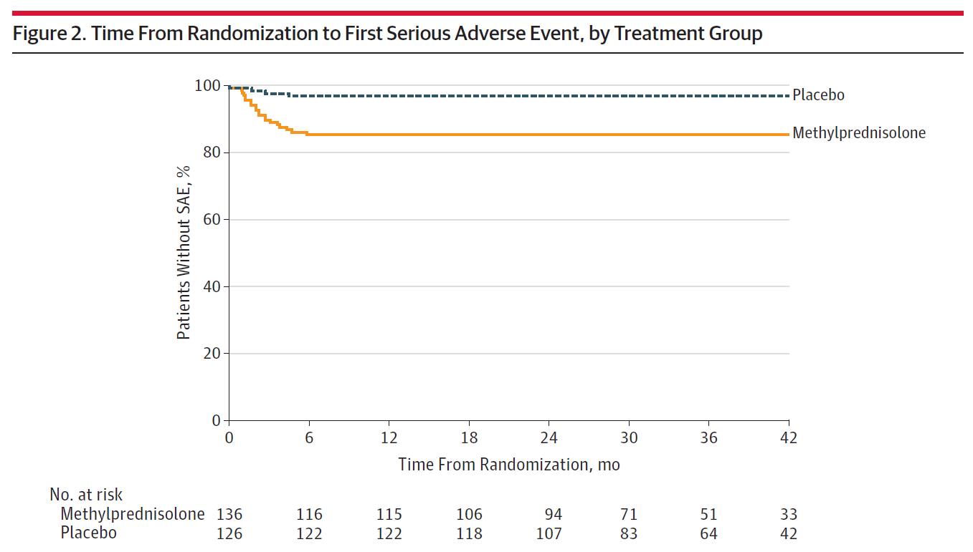
Most adverse events
occurred in the first
3 months of treatment
Notes:
Most adverse events occurred in the first 3 months of treatment. This was mainly driven by an excess of serious infections (2 fatal) among 11 patients (8.1%) in the methylprednisolone group, compared with no serious infections in the placebo group (risk difference, 8.1% [95% CI, 3.5% to 13.9%]; P < .001).

Slide 52
Notes:
The Therapeutic Evaluation of Steroids in IgA Nephropathy Global Study (TESTING Low Dose Study) (TESTING) trial randomized patients to 6 months of steroids or placebo and was terminated early after an interim analysis revealed a high risk of infectious serious adverse events including lethal Pneumocystis jirovecii pneumonia.
There was a signiﬁcant reduction in the risk of a 40% decline in eGFR or ESKD in the steroid group. The kidney function loss in the control group was 4 times faster in the TESTING trial than in the STOP-IgAN trial, suggesting a higher-risk population and/or differences in supportive therapy.
In TESTING, the beneﬁcial impact of steroids was similar in patients with eGFR > or <50 ml/min per /1.73 m². This ﬁnding is consistent with analyses of other clinical trials that also showed a beneﬁt of immunosuppression at lower eGFR but with an increased risk of adverse events.

Slide 54
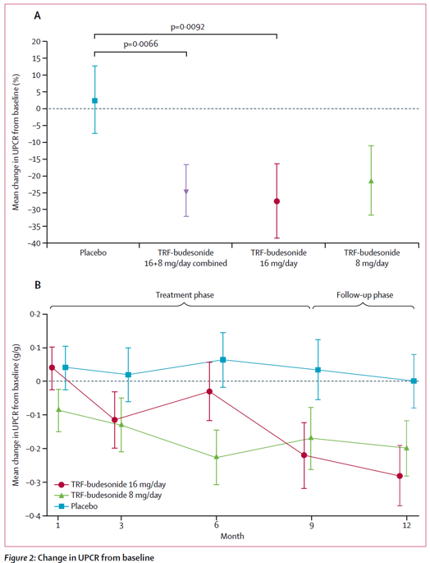
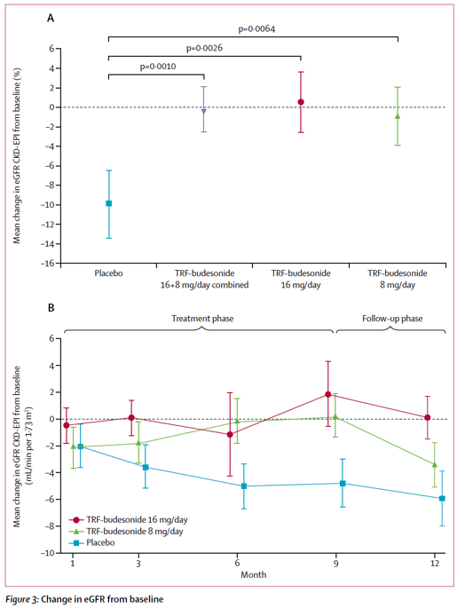

Slide 55
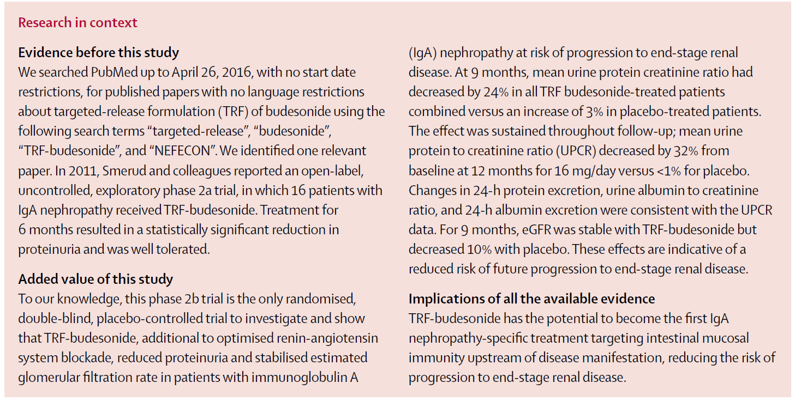

Slide 56
10.4.3: We suggest not using MMF in
IgAN. (2C)

Slide 57
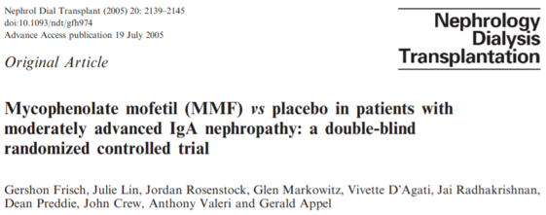
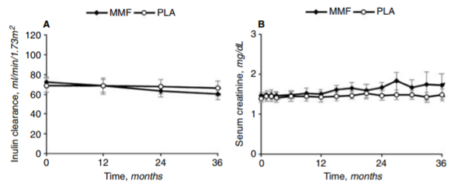
2004
2005
These studies suggested mycophenolate mofetil (MMF) was not effective for
treatment of IgAN.

Slide 58
2015

Slide 59
This trial, consisting of mostly Caucasians, was stopped early for futility because there was no MMF effect on the proteinuria-based primary outcome

Slide 60
2017
Notes:
A Chinese trial randomized patients to 6 months of full dose steroids or lower dose steroids with MMF.
After 1 year, complete proteinuria remission was similar between the 2 groups, but with fewer steroid-related adverse events in those treated with MMF. This study reintroduces the possibility that MMF may be effective for IgAN; however, there was very infrequent use of RAS-blockade; it was not a multiethnic study population and the follow-up duration was too short to evaluate an effect on kidney function.
Further studies will be required before MMF can be considered for treatment in IgAN. Both RAS-blockers and MMF may affect pregnancy adversely and patients will need to understand this and exercise appropriate use of contraception when being treated.

Slide 61
10.5.3: Tonsillectomy
10.5.3.1: We suggest that tonsillectomy
not be performed for IgAN. (2C)

Slide 62
Tonsillectomy remains a controversial therapy for IgAN
Notes:
This Japanese trial compared tonsillectomy with steroids versus steroids alone and found marginally higher proteinuria reduction in the tonsillectomy group but no impact on eGFR over 12 months.

Slide 63
A: Tonsillectomy/ steroid pulse
B: Steroid pulse therapy alone
LIMITATION: Only one-half of the patients received RAS blockade, and there
was no long-term follow-up to evaluate changes in eGFR.

Slide 64
Notes:
In this European cohort, tonsillectomy patients were propensity-score matched to control patients with no beneﬁt in change of GFR or proteinuria.

Slide 65
Tonsillectomy may only be considered
in IgAN patients with recurrent tonsillitis.

Slide 66
Although observational data
suggest that IgAN incidence
and outcome may differ
between Caucasians and
Asians, there is currently
insufﬁcient evidence to
suggest that treatment
approaches should differ
by ethnicity.

Slide 67
Possibly, systematic differences in study populations, other than ethnicity,
may explain different treatment responses.
Notes:
Possibly, systematic differences in study populations, other than ethnicity, may explain different treatment responses.
Multiethnic trials, such as the ongoing TESTING Low Dose trial (ClinicalTrials.gov NCT01560052), are evaluating this issue further.

Slide 68
IgA Nephropathy: Transplantation
Mesangial IgA deposits recur in the
donor transplant kidney in up to 60% of
patients with IgAN. They may occur within
days or weeks, but the risk increases with
the duration of the transplant. The deposits
seem benign in the short term and are not
often associated initially with LM changes.
Notes:
Transplant registry data show that transplant outcome is not affected for the first 10 years if IgAN is the patient’s primary renal disease; thereafter, however, recurrent disease may lead to accelerated graft loss.

Slide 69
In pooled series, recurrent IgAN is 30%
in living related transplants versus 23% in
cadaveric grafts, but this does affect graft
survival only beyond 10 years after
transplantation.
Living related donation should not be
discouraged.
However, any urinary abnormality in a potential related donor requires thorough evaluation, including, if necessary, a kidney biopsy.
Recurrence of crescentic IgAN with rapid
graft failure occurs infrequently and is
generally resistant to treatment.
Floege J, Gröne HJ. NDT. 2013; 28:1070-1073

Slide 70
IgA Nephropathy: Recent Studies
eGFR
Trials of rituximab and tacrolimus have yielded negative results.

Slide 71
IgA Nephropathy: Recent Studies
Proteinuria
Trials of rituximab and tacrolimus have yielded negative results.

Slide 72
IgA Nephropathy: Recent Studies
Trials of rituximab and tacrolimus have yielded negative results.

Slide 73
IgA Nephropathy: Recent Studies
Patients with primary FSGS achieved significantly greater reductions in proteinuria with sparsentan compared with
irbesartan over 8 weeks, without an increase in adverse events

Slide 74
IgA Nephropathy: Recent Studies
A pilot study of the proteasome inhibitor bortezomib has just been completed.

Slide 75
IgA Nephropathy: Recent Studies
A pilot study of the proteasome inhibitor bortezomib has just been completed.

Slide 76
IgA Nephropathy: Ongoing Studies
Selvaskandan H et al. Clin Exp Nephrol. 2019; 23:577-588
Current trials address the spleen tyrosine kinase inhibitor fostamatinib, and the
B-cell activating factor and a proliferation inducing ligand blocker atacicept

Slide 77
IgA Nephropathy: Ongoing Studies
Notes:
ªOn Day 1, patients are randomized 1:1 to sparsentan or irbesartan, stratified by eGFR value (30-60 mL/min/1.73 m² and ≥60 mL/min/1.73 m²) and total urine protein (≤1.75 g/day and >1.75 g/day).
^{b}Patients resume standard-of-care treatment including RAASi (excluding irbesartan). Where possible, the same treatment regimen the patient was on at study entry (ie, the same ACEI and/or ARB at the same dose[s]) should be used, unless in the Investigator’s opinion, an alternative treatment approach is warranted.

Slide 78
Modulation of
(Auto-) Antibody
Production
Corticosteroids
MMF in Asians?
Cyclophosphamide
Azathioprine
STOP-IgAN. Sprsentan? Hydroxychloroquine?
Complement
inhibitors
Tyrosine kinase
Inhibitors
Bardoxolone?
Notes:
Future multi-ethnic trials of other pharmacologic agents should incorporate therapeutic drug level monitoring to help determine whether ethnic differences in outcome may be related to pharmacokinetics versus differential disease response.

Slide 79
Modified from Floege J, Eitner F. J Am Soc Nephrol 2011; 22:1785–1794

Slide 80
Moran SM, Cattran A. Neph Dial Transpl 2019; 34: 1099-1101

Slide 81
KEY POINTS
The MEST scoring system for IgAN offered the ﬁrst opportunity to use histology to predict kidney outcome independent of proteinuria, BP, and eGFR. A major limitation is the absence of a validated risk prediction model that allows integration of histology with clinical predictors to establish an accurate individual prognosis.
Signiﬁcant controversy surrounds the use of steroids in IgAN. Future guideline recommendations will need to include an assessment of the relative risks and beneﬁts of steroids in individual patients over a broader range of eGFR, with careful consideration of infections and prophylaxis.
Tonsillectomy remains a controversial therapy for IgAN. With the current literature, tonsillectomy may only be considered in IgAN patients with recurrent tonsillitis.

Slide 82
CLINICAL VIGNETTES

Slide 83
CASE 1
A healthy 25-year-old white man developed gross hematuria one day after upper respiratory tract infection. He denies abdominal pain, rashes, or use of illicit drugs. Blood pressure is 160/95, pulse 80.
Physical examination is remarkable only for pharyngeal injection without any discharge and nasal congestion. Urinalysis confirmed gross hematuria and also revealed occasional red blood cell cast, many dysmorphic red blood cells, and 2+ proteinuria. Serum creatinine is 2.5 mg/dL.
What is the most appropriate next step in evaluating and treating this patient?
Quantify the proteinuria
Kidney biopsy
High dose corticosteroid
Serum IgA levels
Serum anti-Streptolysin O levels

Slide 84
The answer is B.
Given the presence of gross hematuria and acute kidney failure in the setting of “synpharyngitic hematuria” (hematuria occurring at the same time as upper respiratory tract infection), the most likely diagnosis is IgA nephropathy, with potential for crescentic presentation.
However, lupus nephritis (less likely given gender and no other systemic symptoms to suggest lupus), and other diseases that cause rapidly progressive glomerulonephritis, such as antiglomerular basement disease and renal limited vasculitis (less likely given age) are in the differential diagnosis.
Although poststreptococcal glomerulonephritis is also in the differential diagnosis, it is less likely because of the short time elapsed from upper respiratory tract symptoms to gross hematuria (hence “synpharyngitic”).
A kidney biopsy is indicated to determine the diagnosis and guide treatment.

Slide 85
Empiric corticosteroid treatment should not be pursued since some of the diseases in the differential diagnosis require cytotoxic treatment as well (e.g., cyclophosphamide, mycophenolate), and such treatment may not be indicated if patient has acute kidney failure from hematuria-induced acute tubular necrosis in the setting of IgA nephropathy.
Quantifying the proteinuria is indicated but has little prognostic use unless the disease becomes chronic.
Antistreptolysin O (ASO) antibody level is only useful if the diagnosis of antistreptococcal glomerulonephritis is being entertained, and is more effective in ruling out the disease if it is negative. If ASO antibodies are present, may be indicative of prior infection and not current infection.
At this time, serum IgA levels are neither sensitive nor specific enough for diagnosis. Serum IgA1 levels, specifically looking for galactose-deficient IgA1, may be useful for the future, but would require further study and validation.

Slide 86
CASE 2
A 28-year-old man is found to have IgA nephropathy when a kidney biopsy was performed for unexplained proteinuria, hematuria, and impaired kidney function (serum creatinine 3.5 mg/dL).
Extensive tubulointerstitial fibrosis and tubular atrophy were present and about 20% of the glomeruli revealed segmental fibrocellular crescents. Urine protein to creatinine ratio on first morning voided urine was 2 g protein/g creatinine. Blood pressure was 155/94 mm Hg.
Based on these findings, in addition to starting an angiotensin-converting enzyme inhibitor, which ONE of the following would be the BEST initial approach to treatment
Start oral cyclophosphamide plus steroids.
Start oral mycophenolate plus steroids.
Start oral cyclosporine plus steroids.
Start intravenous methylprednisolone plus oral steroids.
No additional immunosuppressive therapy is indicated.

Slide 87
This patient has IgA nephropathy with advanced chronic kidney disease. At a serum creatinine 3.5 mg/dL, he has likely reached the “point-of-no return” where no specific therapy, other than control of blood pressure, will reverse the condition.
Thus none of the options involving immunosuppressive therapy are correct.
He should be vigorously treated with angiotensin II inhibition in an attempt to reduce his blood pressure to around 120/80 mm Hg and his protein excretion rate to less than 1.0 g/day, if possible.

Slide 88
KDIGO THANKS THE FOLLOWING PARTNERS FOR THEIR SUPPORT OF THIS SPEAKER’S GUIDE

Slide 89
FOLLOW KDIGO
www.kdigo.org
/goKDIGO
@goKDIGO
@goKDIGO

