Slide 1
MANAGEMENT AND TREATMENT OF GLOMERULAR DISEASES
Lupus Nephritis
CONCLUSIONS FROM A
KDIGO CONTROVERSIES CONFERENCE

Slide 2
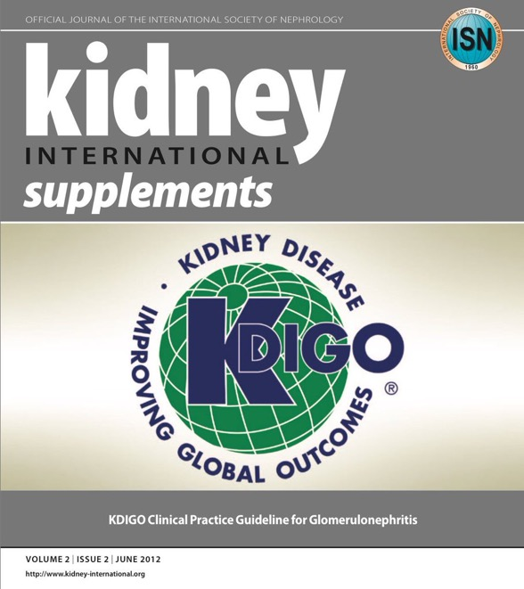
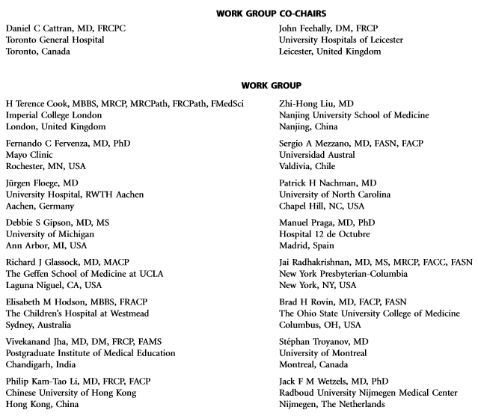
Notes:
Kidney Disease: Improving Global Outcomes (KDIGO) published its ﬁrst guideline on glomerular diseases in 2012. Available online at www.kdigo.org

Slide 3
#KDIGOGNConference
KDIGO Controversies Conference on Glomerular Diseases
Singapore, November 2017
Notes:
Given the enormous advances in understanding the pathogenesis of glomerular diseases, identiﬁcation of new diagnostic biomarkers, and emerging therapies, about 100 experts from various disciplines (nephrology, pathology, rheumatology, pediatrics) and organizations (academia, pharmaceutical industry) convened on November 17–19, 2017 for the KDIGO Controversies Conference on Glomerular Diseases. Through plenary sessions and small group discussions, the conference aimed to evaluate consensus and controversies in nomenclature, general work-up, and management of glomerular diseases, future needs in research, and, in particular, the critical assessment of existing guideline recommendations.

Slide 4
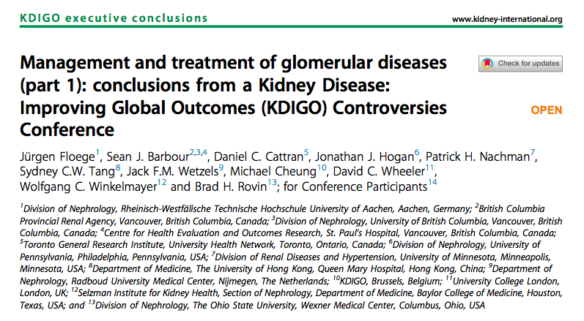
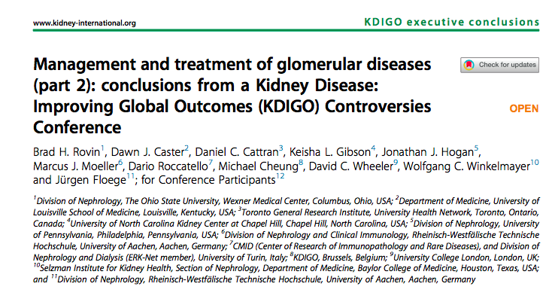
Notes:
The KDIGO Controversies Conference on Glomerular Diseases resulted in two publications in Kidney International in 2018.

Slide 5
Lupus Nephritis
Terminology
Pathogenesis
Biomarkers and Prediction of Prognosis
Treatment
Special Circumstances
Future Studies

Slide 6
TERMINOLOGY

Slide 7
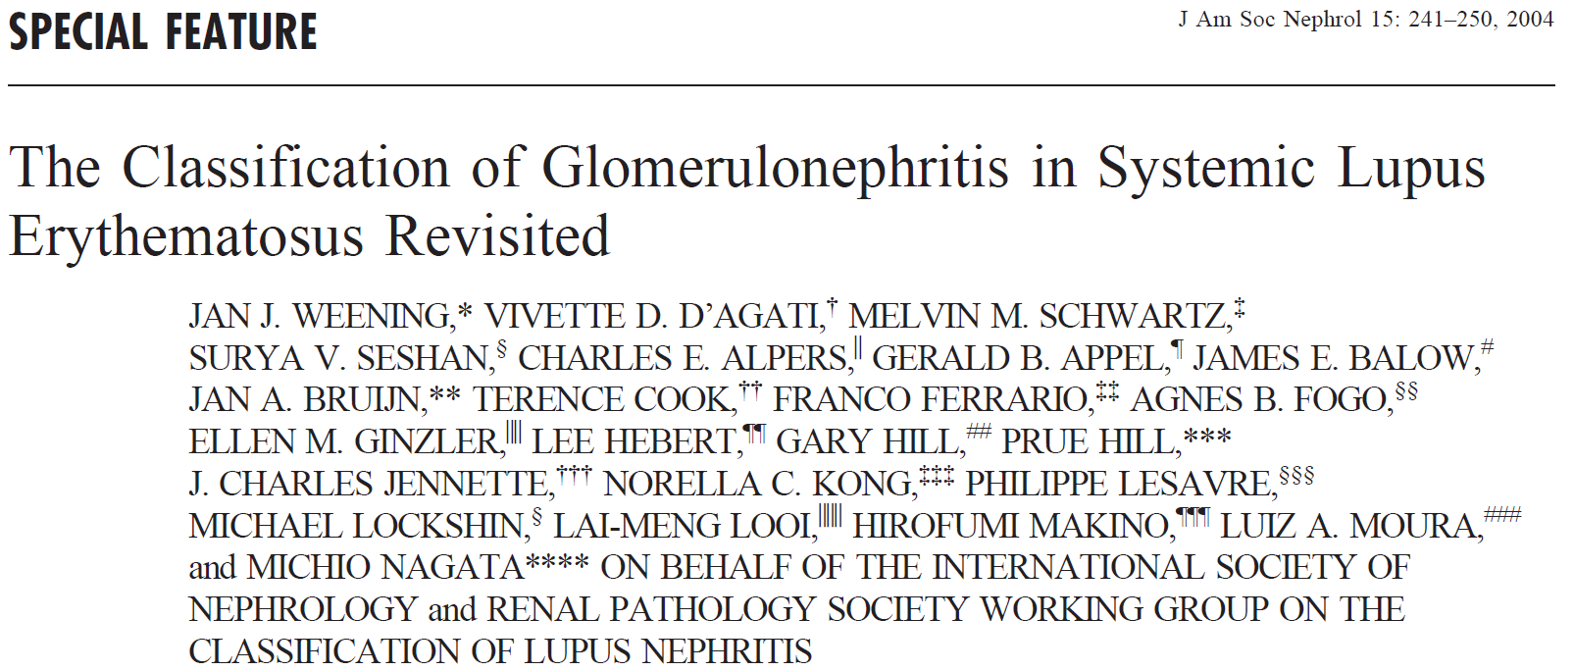
Notes:
LN is histologically classiﬁed by the International Society of Nephrology/Renal Pathology Society system, but this classiﬁcation does not consider tubulointerstitial injury, vascular lesions, or podocytopathies.

Slide 8
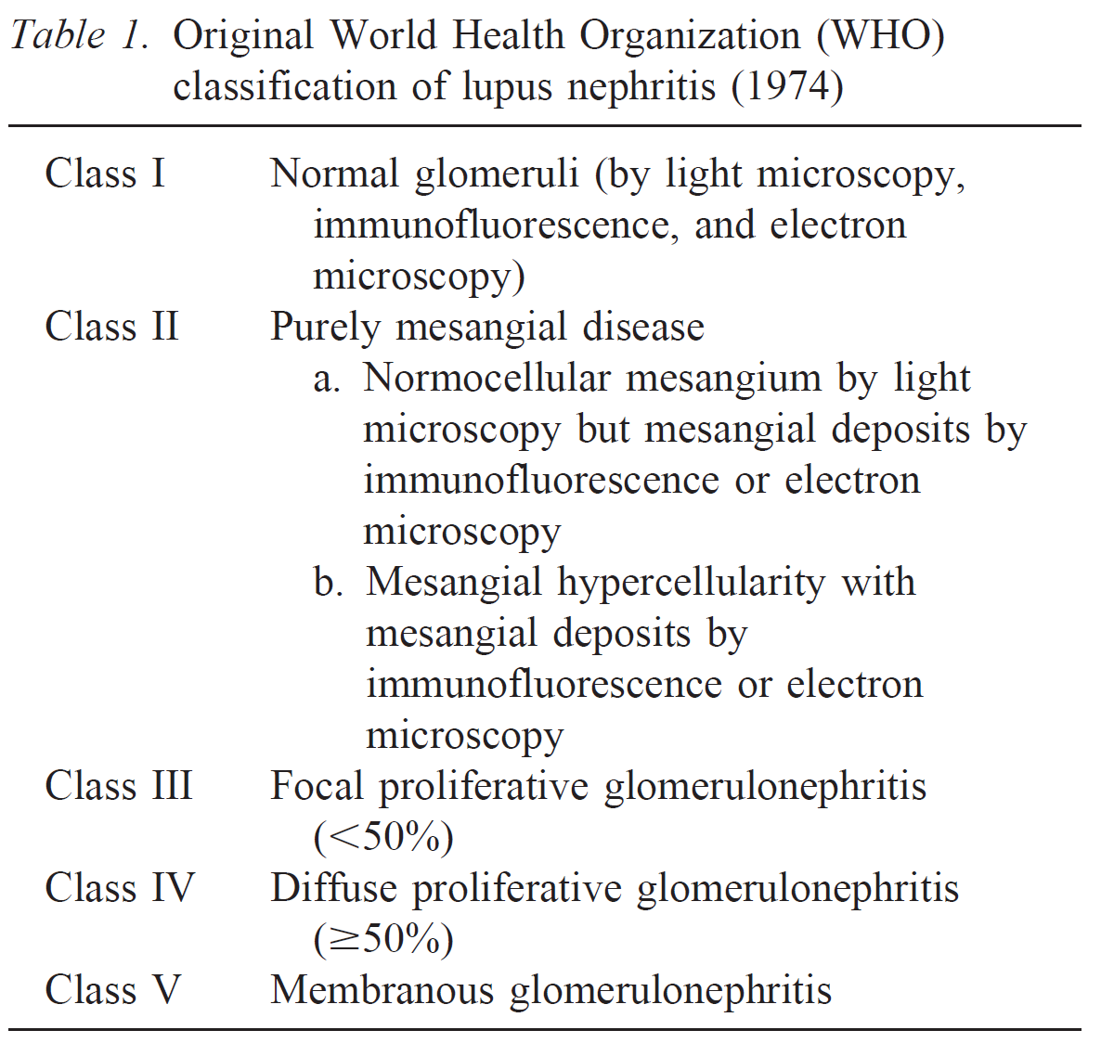

Slide 9
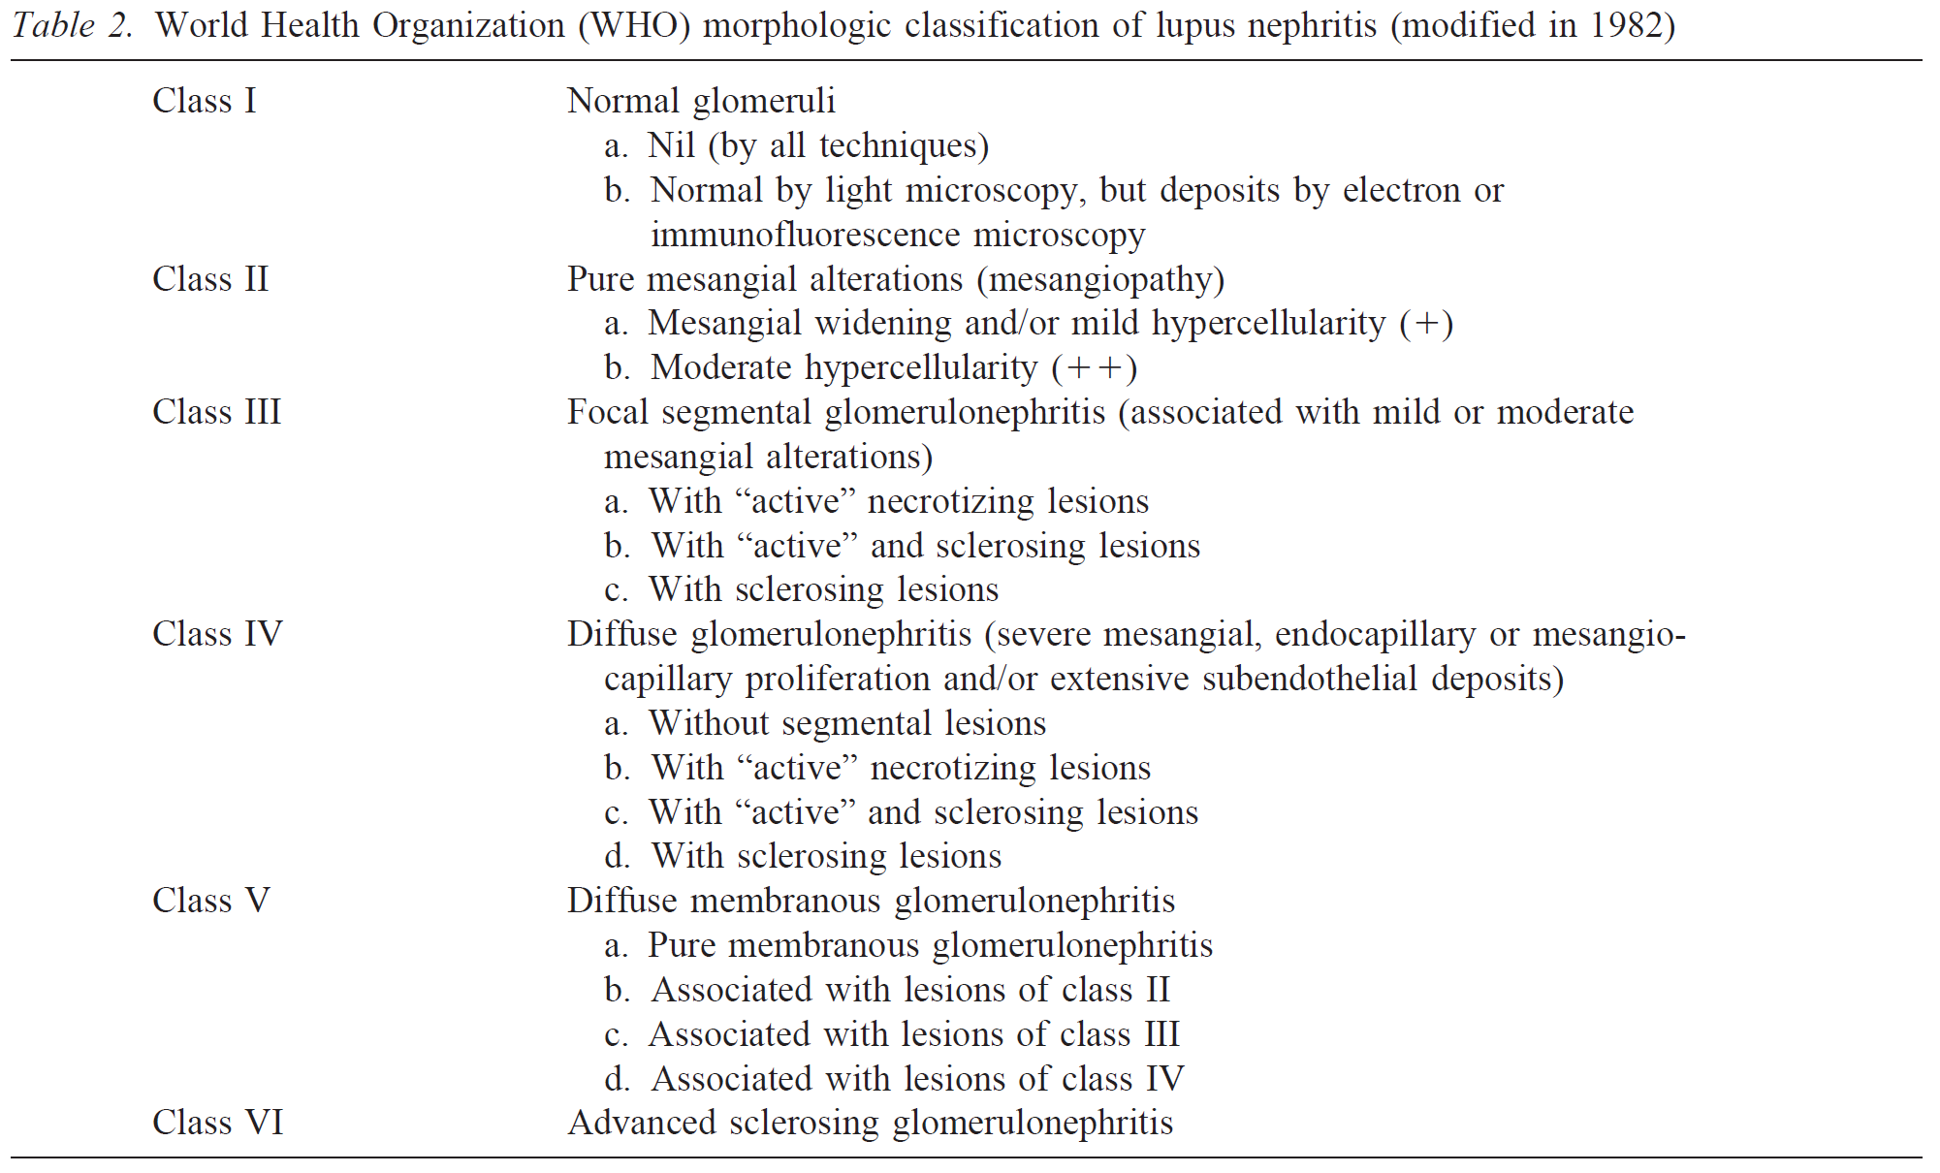

Slide 10
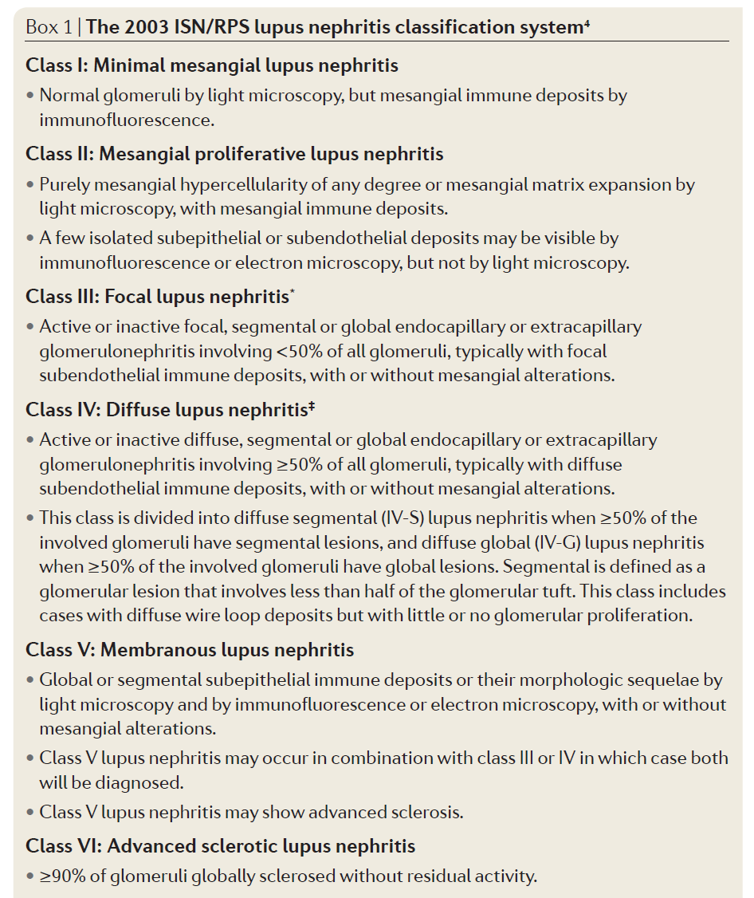
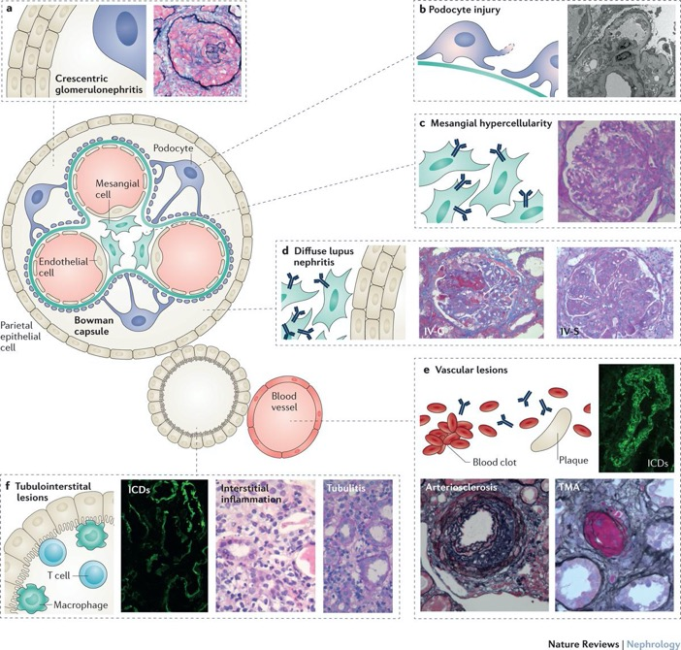
Nat Rev Nephrol. 2017; 13:483-495
Notes:
LN is histologically classiﬁed by the International Society of Nephrology/Renal Pathology Society system, but this classiﬁcation does not consider tubulointerstitial injury, vascular lesions, or podocytopathies. Patients with tubulointerstitial injury, thrombotic microangiopathy (TMA), and renal vasculitis have worse outcomes. Additionally, the International Society of Nephrology/Renal Pathology Society classiﬁcation lacks sufﬁcient quantiﬁcation of disease activity and chronicity, and descriptive categories lack clear prognostic value.

Slide 11
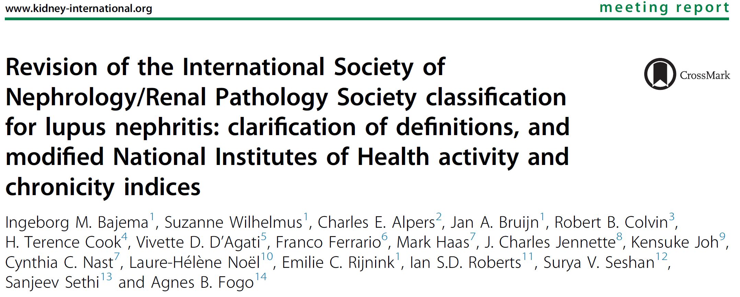
Notes:
An evidence-based approach is needed to better deﬁne clinically relevant categories within the class III/IV spectrum, including the signiﬁcance of segmental necrotizing lesions, along with the development of lupus nephritis activity and chronicity indices that accurately identify patients who would beneﬁt from immunosuppression. An international working group of leading nephropathologists recently proposed updates to the International Society of Nephrology/Renal Pathology Society classiﬁcation system to address limitations within the current system.

Slide 12
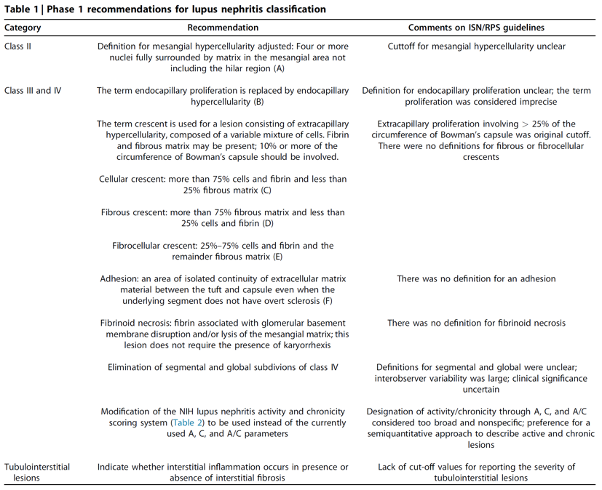

Slide 13
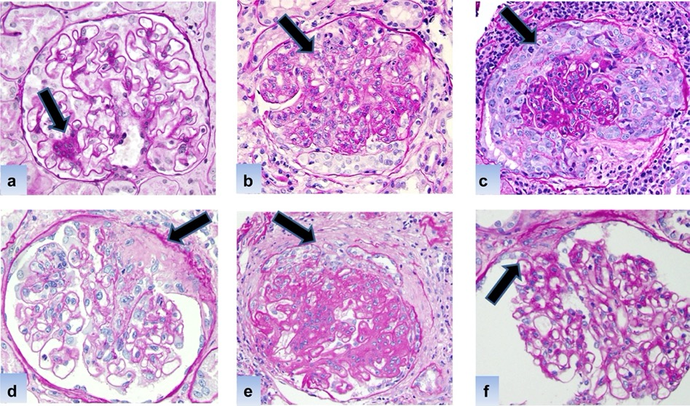

Slide 14
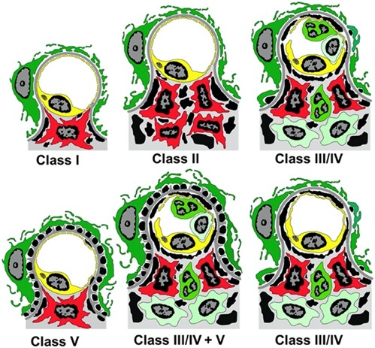

Slide 15
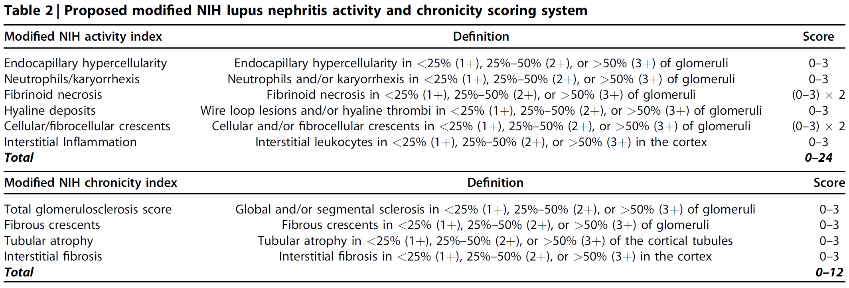

Slide 16
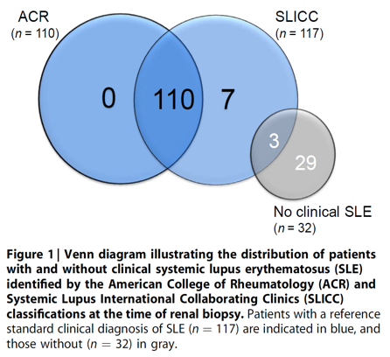
According to the Systemic Lupus International Collaborating Clinic diagnostic criteria for systemic lupus erythematosus (SLE), immune complex GN consistent with LN in the setting of a positive antinuclear antibody or anti–double stranded DNA is sufﬁcient for diagnosing SLE.
Systemic Lupus International Collaborating Clinic criteria demonstrated increased sensitivity when compared with American College of Rheumatology classiﬁcation with similar speciﬁcity in the validation cohort.
Notes:
However, when applied to a cohort of patients with immune complex GN, the Systemic Lupus International Collaborating Clinic criteria demonstrated decreased speciﬁcity compared with those of the American College of Rheumatology, with some patients incorrectly identiﬁed as having SLE.

Slide 17
When applied to a cohort of patients with immune complex GN, the Systemic Lupus International Collaborating Clinic criteria demonstrated decreased speciﬁcity compared with those of the American College of Rheumatology, with some patients incorrectly identiﬁed as having SLE.

Slide 18
PATHOGENESIS

Slide 19
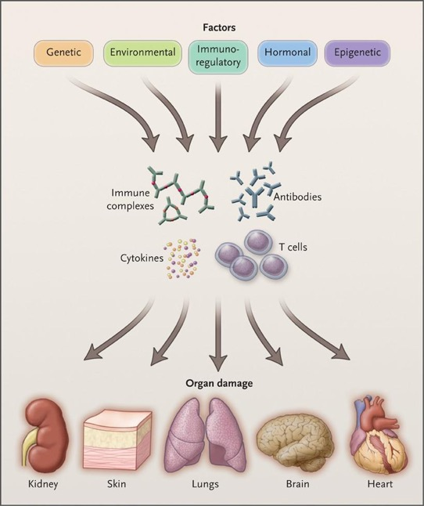
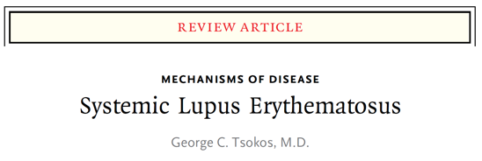
The pathogenesis of LN involves genetic, epigenetic, immunoregulatory, hormonal, and environmental phenomena.

Slide 20
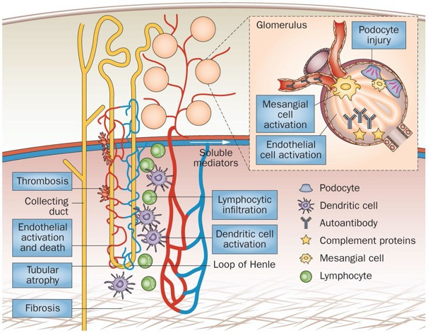
In situ formation of immune complexes with complement activation and induction of inflammatory mediators results in chemotaxis and activation of inflammatory cells within the kidney and further release of pro-inflammatory signals and mediators, leading to injury and damage of cellular and structural elements within the renal parenchyma

Slide 21
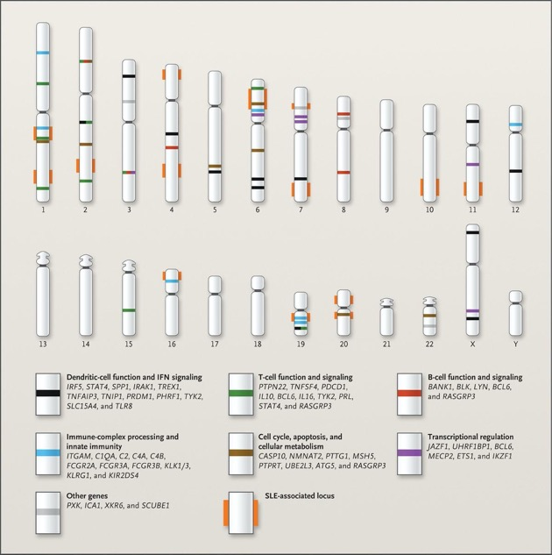
Multiple gene polymorphisms have been associated with an increased risk of SLE and/or LN.

Slide 22
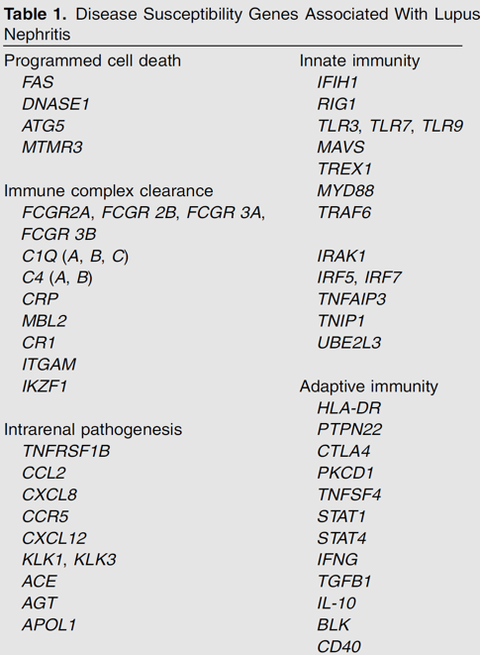
Multiple gene polymorphisms have been associated with an increased risk of SLE and/or LN.
Notes:
Many of them involve immune cells and immunoregulatory pathways.

Slide 23
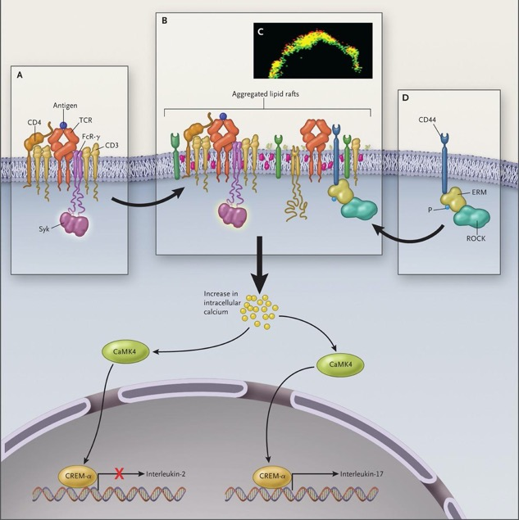
Identiﬁcation of these polymorphisms has given insight into pathways involved in the pathogenesis of LN.

Slide 24
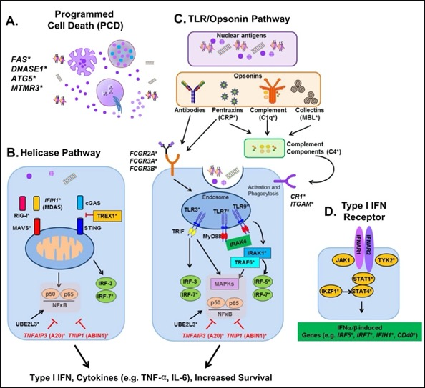
Identiﬁcation of these polymorphisms has given insight into pathways involved in the pathogenesis of LN.
Innate immunity processes contribute to lupus nephritis
Notes:
Many of them involve immune cells and immunoregulatory pathways.

Slide 25
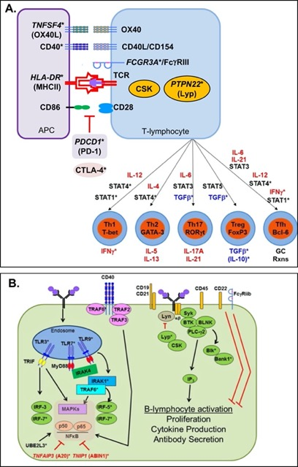
Identiﬁcation of these polymorphisms has given insight into pathways involved in the pathogenesis of LN.
Adaptive immunity processes contribute to lupus nephritis
Notes:
Many of them involve immune cells and immunoregulatory pathways.

Slide 26
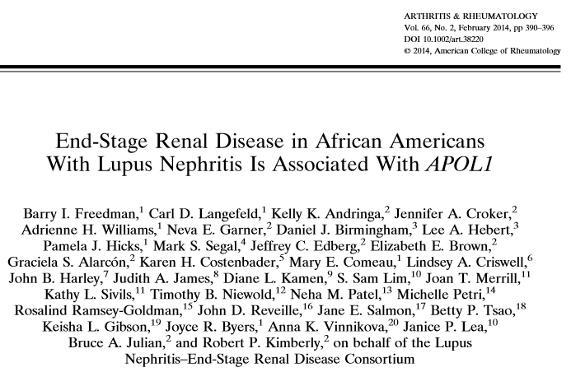
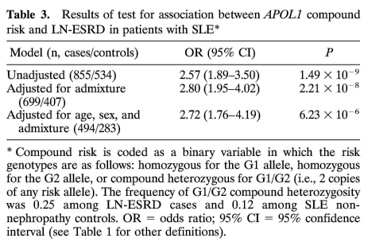

Slide 27
LN patients of African ancestry with apolipoprotein L1 (APOL1) risk alleles are at increased risk for worse kidney outcomes; however, APOL1 testing is not routinely available and the risks and beneﬁts of APOL1 testing need to be clariﬁed.

Slide 28
BIOMARKERS AND PREDICTION OF PROGNOSIS

Slide 29
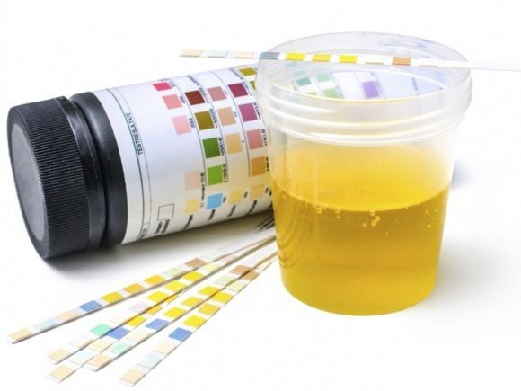
Proteinuria, hematuria, urinary sediment and estimated GFR
No single biomarker predicts the development of LN in patients with SLE or of LN ﬂares in patients with quiescent disease.
Proteinuria, hematuria, urinary sediment analysis, and serum creatinine (with estimated GFR) remain important to diagnose LN and monitor response to therapy.
Notes:
There are limitations to these clinical markers. Repeat kidney biopsy studies have shown that patients with resolution of proteinuria and normalization of serum creatinine can still have histologic activity on biopsy and vice versa.

Slide 30
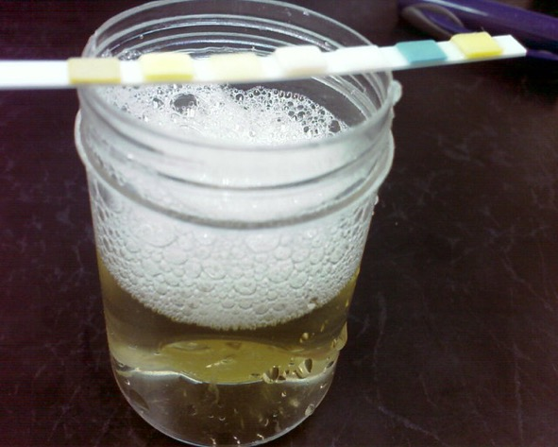
Proteinuria, hematuria, urinary sediment and estimated GFR
Proteinuria at 1 year was the best predictor of long-term kidney outcome.
Random spot urine protein-to creatinine ratios are not sufﬁciently accurate to direct therapeutic changes.
Such changes should be based on 24-hour urine collections for proteinuria or the urine protein-to creatinine ratios from a 24-hour urine.
Notes:
There are limitations to these clinical markers. Repeat kidney biopsy studies have shown that patients with resolution of proteinuria and normalization of serum creatinine can still have histologic activity on biopsy and vice versa.

Slide 31
Proteinuria, hematuria, urinary sediment and estimated GFR
The diagnosis of LN should be conﬁrmed by biopsy

Slide 32
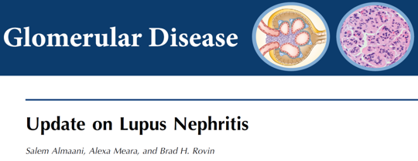
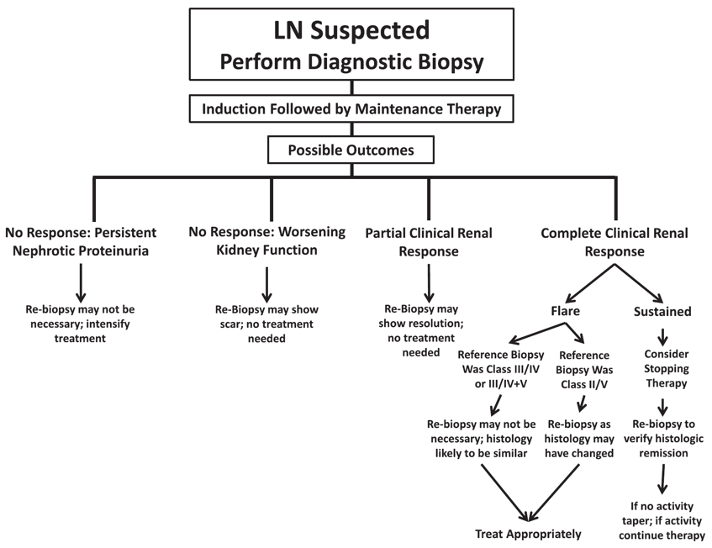

Slide 34
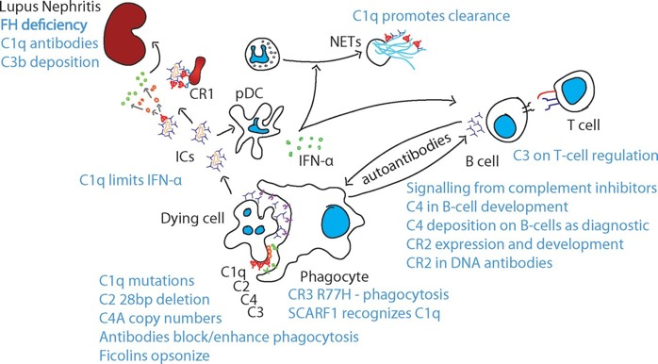
The combination of
Elevated anti–double-stranded DNA,
Low serum complement, and
anti-C1q autoantibody levels (if available)
is strongly associated with renal involvement in SLE and should be monitored in patients at risk for LN or LN ﬂare.
Notes:
Levels may change several months prior to LN ﬂare, and how these changes relate to ﬂare prediction needs to be validated in prospective studies.

Slide 35
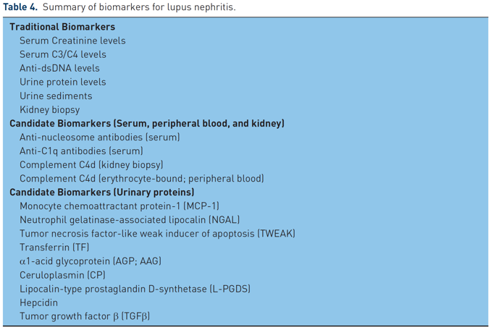
Several putative novel serum and urine biomarkers have been studied in LN.
Notes:
These candidate markers must be studied in a prospective fashion, ideally in clinical trials. It is likely that biomarker panels will be required to accurately stratify risk, predict ﬂare, determine treatment, monitor response to treatment, and predict prognosis. Molecular interrogation of the kidney biopsy may help in these processes.

Slide 36
TREATMENT

Slide 37
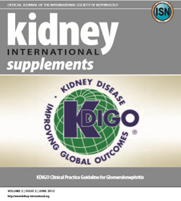
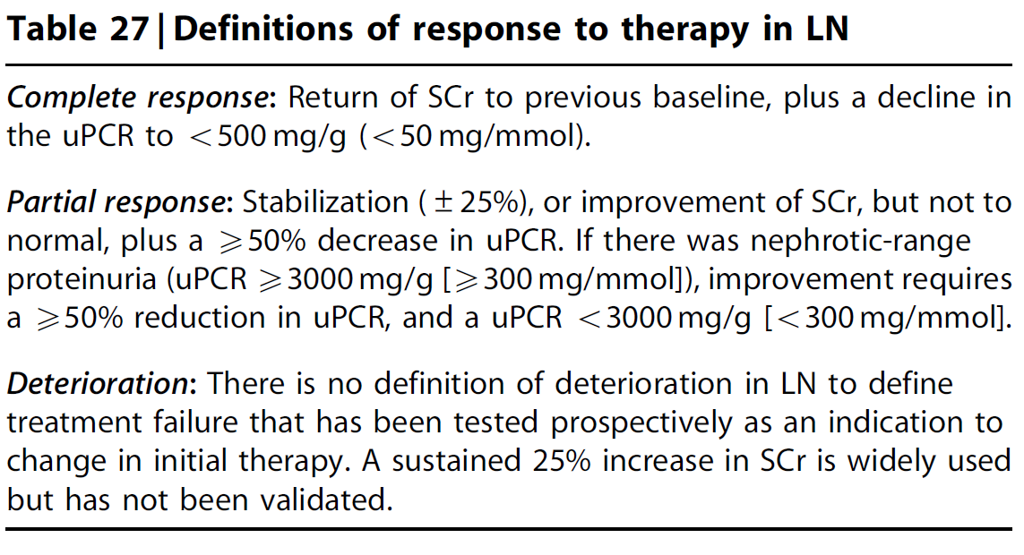

Slide 38
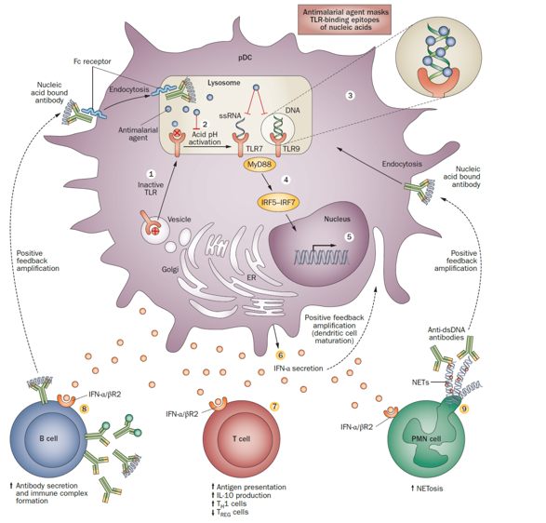
Treatment: Antimalarials
Antimalarial treatment is recommended for all patients with LN.
Notes:
Observational and cohort studies have demonstrated that antimalarials reduce the odds of developing LN in patients with SLE and are associated with a higher likelihood of a complete renal response to treatment and a reduced likelihood of developing kidney failure.

Slide 39
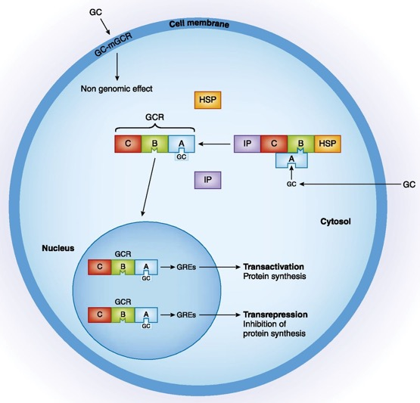
Treatment: Corticosteroids
Corticosteroids, although almost universal in LN regimens, are associated with signiﬁcant short- and long-term adverse effects. Patients with LN are more likely to develop corticosteroid-associated organ damage than are SLE patients without nephritis.
Notes:
Moderate doses are not safer and are associated with as many adverse effects as high doses. Therefore, although not possible for all patients, an attempt to minimize corticosteroids (e.g., prednisone equivalent ≤ 5 mg/d) during LN maintenance therapy, should be made.

Slide 40
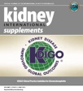
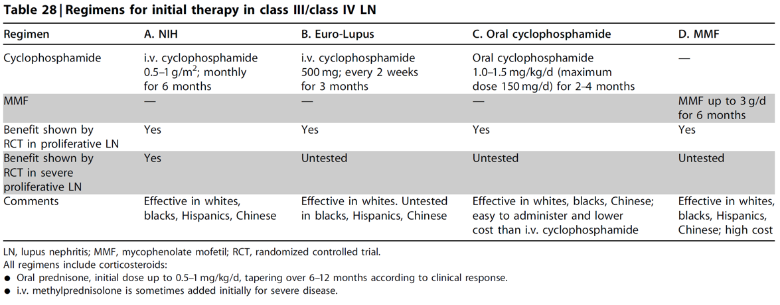
Treatment: Immunosuppressive therapy
While CYC- or MMF-based regimens for remission induction remain the gold standard therapy for most patients, CNI-based regimens have been studied in Asia, and they often combine MMF and corticosteroids with a CNI.

Slide 41
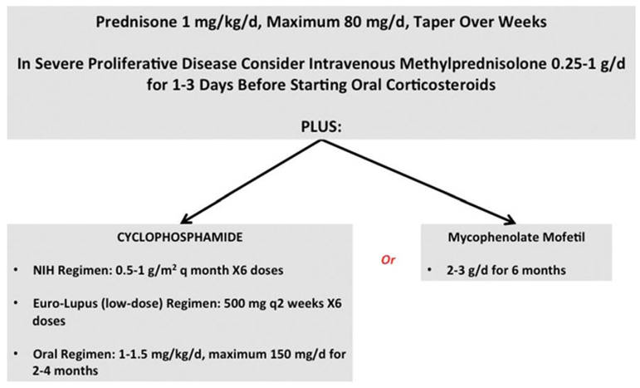
Treatment: Immunosuppressive therapy
While CYC- or MMF-based regimens for remission induction remain the gold standard therapy for most patients, CNI-based regimens have been studied in Asia, and they often combine MMF and corticosteroids with a CNI.

Slide 42
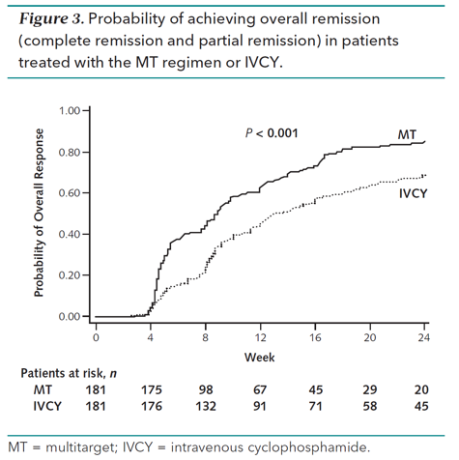
A large Chinese multicenter RCT compared low-dose MMF, tacrolimus, and corticosteroids with monthly i.v. CYC and corticosteroids for induction therapy of LN. The CNI-based regimen was superior at achieving 24-week complete and partial renal remissions.

Slide 43
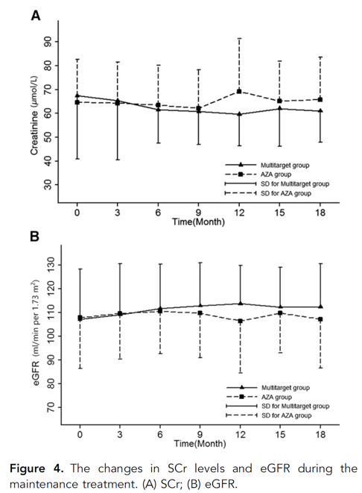
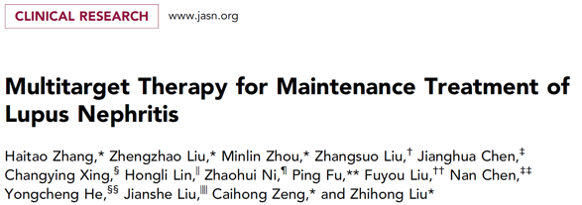
A large Chinese multicenter RCT compared low-dose MMF, tacrolimus, and corticosteroids with monthly i.v. CYC and corticosteroids for induction therapy of LN. The CNI-based regimen was superior at achieving 24-week complete and partial renal remissions.
However, the cumulative response rates were similar in the 2 treatment arms with extended follow-up.
Notes:
Ongoing studies are addressing the role and toxicity of CNI-based regimens in ethnically diverse populations. Protocol biopsies in clinical trials using CNIs will help clarify immunologic responses as CNIs can reduce proteinuria by non-immunologic mechanisms.

Slide 44
Treatment: Maintenance treatment
Maintenance treatment after induction typically consists of MMF or azathioprine (AZA) with or without low-dose corticosteroids.
It is not clear how long to continue maintenance.
In recent clinical trials, the duration of maintenance has been 3 to 5 years, and many patients remained on maintenance therapy for 10 years.
A minimum of 3 years is suggested.

Slide 45
Prolonged maintenance for “high-risk” groups may be considered

Slide 46
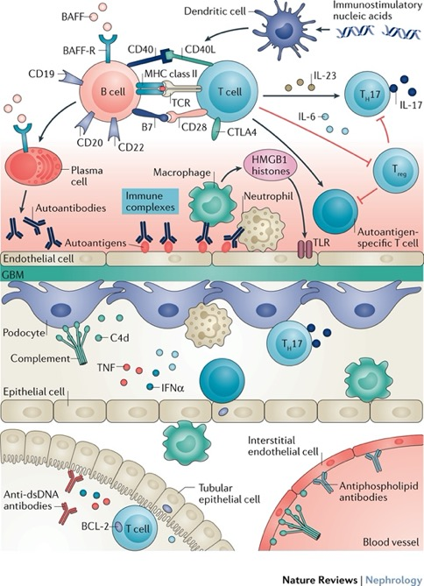
Preliminary studies suggest that intensive B-cell depletion with a RTX plus CYC-based regimen may avoid the need for maintenance therapy.
Nat Rev Nephrol. 2017; 13: 483-495
Notes:
This must be veriﬁed in large studies.

Slide 47
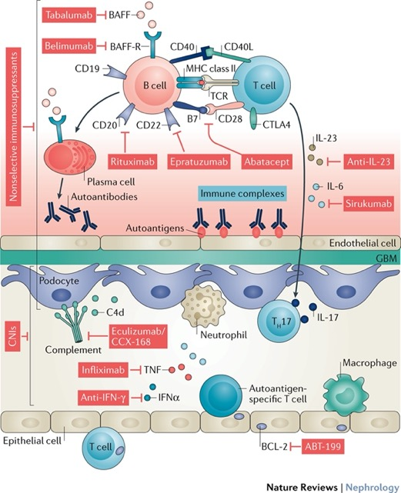
Preliminary studies suggest that intensive B-cell depletion with a RTX plus CYC-based regimen may avoid the need for maintenance therapy.
Nat Rev Nephrol. 2017; 13: 483-495
Nat Rev Nephrol. 2017; 13: 483-495
Notes:
This must be veriﬁed in large studies.

Slide 48
A repeat kidney biopsy may be helpful to exclude persistent but clinically silent histologic activity.
Notes:
Slowly withdrawing immunosuppression could be considered in patients with complete clinical remission. Patients should be closely monitored for relapse after decreasing or discontinuing maintenance therapy.

Slide 49
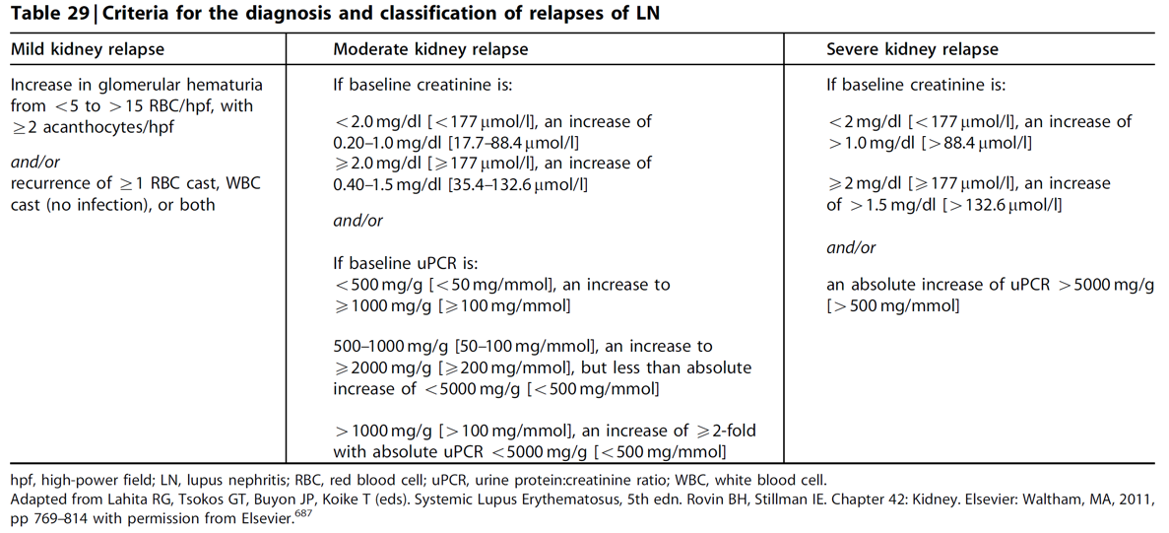

Slide 50
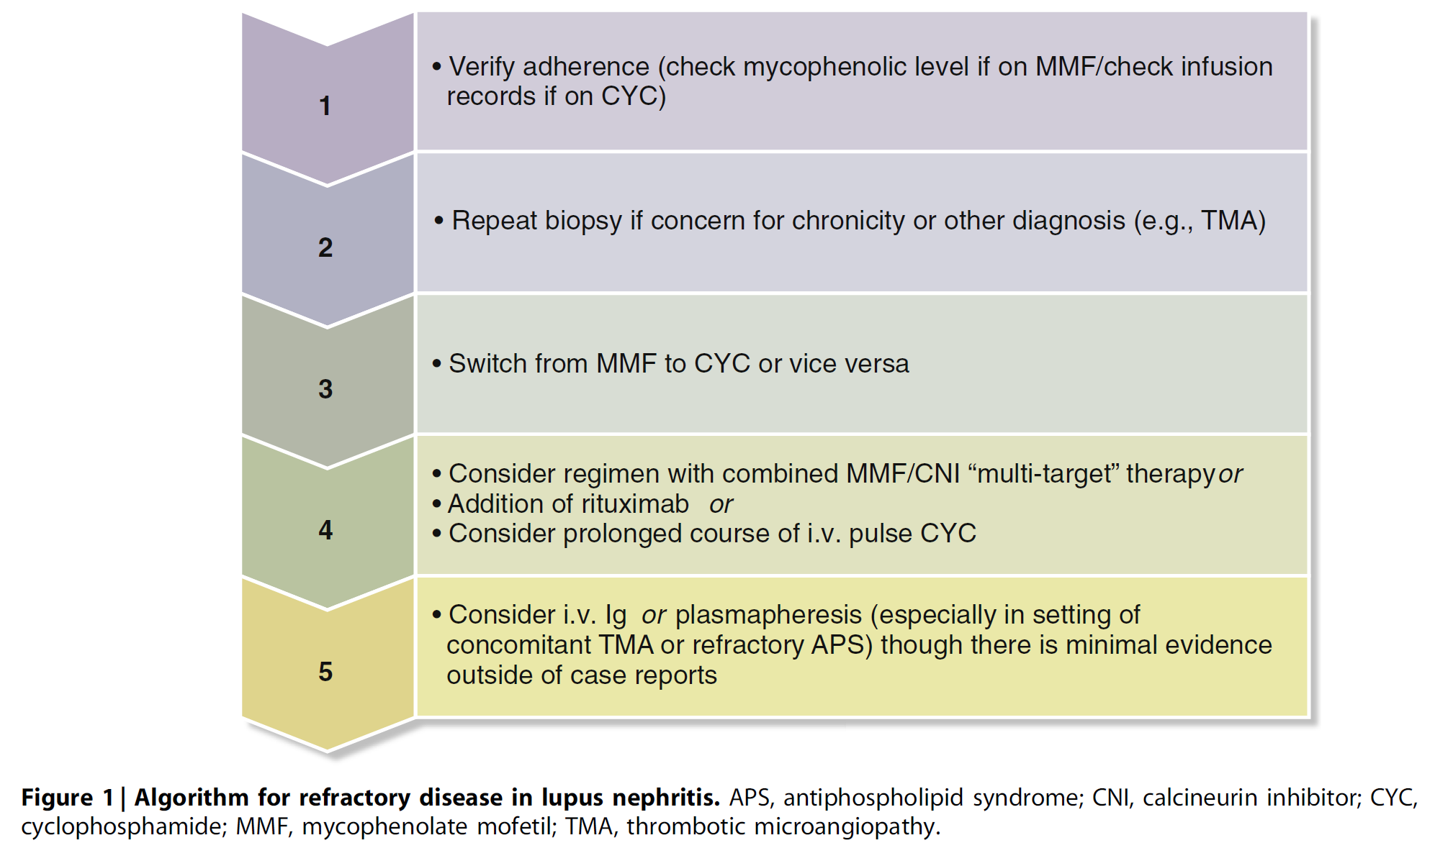
Notes:
LN may be considered refractory if a patient does not respond to either of the currently standard induction therapies (CYC or MMF) used sequentially.
Medication adherence should always be evaluated. Repeat kidney biopsy to distinguish active LN from scarring and/or identify new lesions could be considered. For persistently active LN, if MMF was used for induction, consider switching to CYC or vice versa. After this, RTX or CNI-based regimens could be tried.

Slide 51
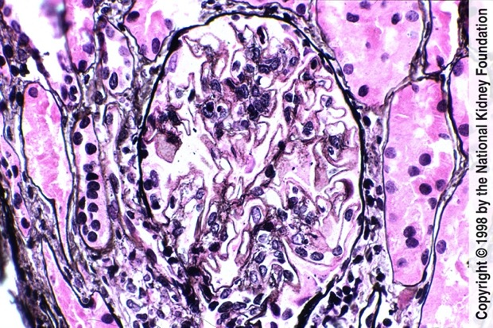
Special circumstances: Class V LN
There is consensus that class V LN with persistent nephrotic proteinuria should receive immunosuppression, but some would also treat patients with lower levels of proteinuria.
The level of proteinuria at which immunosuppressive therapy may provide beneﬁt therefore needs to be established.
http://www.ajkd.org/pb/assets/raw/Health%20Advance/journals/yajkd/atlas32_1b.htm

Slide 52
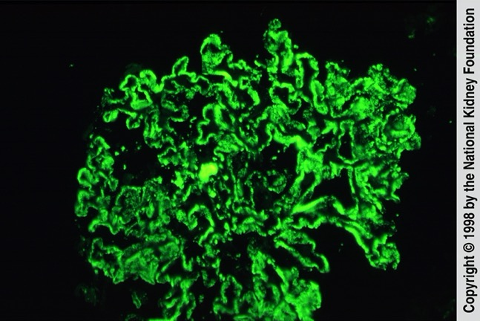
Special circumstances: Class V LN
Class V LN is often treated initially with MMF, but if not effective, CYC may be used.
Some investigators also suggest using CNIs for class V LN.
RTX may be considered in the treatment options for class V LN
http://www.ajkd.org/pb/assets/raw/Health%20Advance/journals/yajkd/atlas32_1b.htm

Slide 53
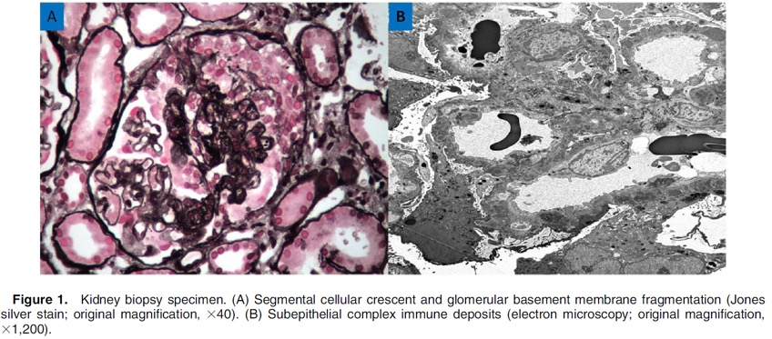
Special circumstances: TMA
TMA with LN on kidney biopsy may be due to:
Antiphospholipid antibodies/syndrome ([APS], anticardiolipin antibodies, anti-b2 glycoprotein I, and lupus anticoagulant),
Thrombotic thrombocytopenic purpura, or
Atypical hemolytic uremic syndrome

Slide 54
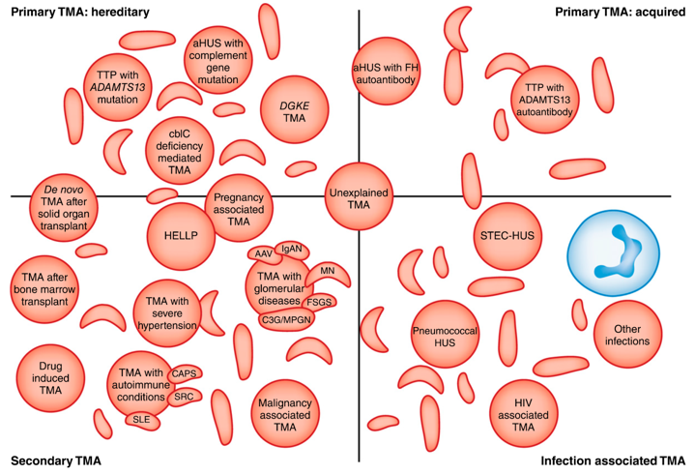
Special circumstances: TMA
Treatment should be guided by the underlying etiology of TMA.
Plasma exchange is indicated for thrombocytopenic purpura, but it may also be beneﬁcial in cases of refractory APS.
Anti-complement therapies may be considered in catastrophic APS, thrombocytopenic purpura, complement-mediated TMA, and recurrent TMA in an allograft.
Anticoagulation remains the standard of care when APS is present.
Notes:
https://cjasn.asnjournals.org/content/13/2/300

Slide 55
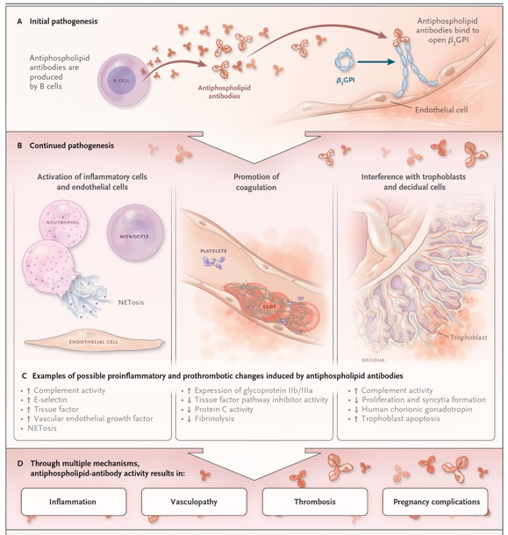
Special circumstances: TMA
Treatment should be guided by the underlying etiology of TMA.
Plasma exchange is indicated for thrombocytopenic purpura, but it may also be beneﬁcial in cases of refractory APS.
Anti-complement therapies may be considered in catastrophic APS, thrombocytopenic purpura, complement-mediated TMA, and recurrent TMA in an allograft.
Anticoagulation remains the standard of care when APS is present.

Slide 56
Special circumstances: TMA
Treatment should be guided by the underlying etiology of TMA.
Plasma exchange is indicated for thrombocytopenic purpura, but it may also be beneﬁcial in cases of refractory APS.
Anti-complement therapies may be considered in catastrophic APS, thrombocytopenic purpura, complement-mediated TMA, and recurrent TMA in an allograft.
Anticoagulation remains the standard of care when APS is present.
Notes:
The impact of anticoagulation on renal lesions is unclear, and many patients experience a decline in kidney function despite therapeutic anticoagulation.
Mammalian target of rapamycin inhibition increased kidney transplant survival in patients with a history of APS nephropathy, but further studies are needed in native kidneys.

Slide 57
Special circumstances: Pregnancy
Patients who are on MMF maintenance and wish to become pregnant should be switched to AZA, as MMF is teratogenic.
CNIs may be considered for treatment of LN in pregnancy if AZA cannot be tolerated, as adjunct therapy with AZA in severe cases or as primary therapy for class V LN with nephrotic syndrome.
Notes:
Similarly, renin-angiotensin system blockers should be stopped before conception.

Slide 58
Special circumstances: Post-transplant
Patients with LN have equivalent or better outcomes following kidney transplantation compared with other primary glomerular diseases.
Clinically signiﬁcant LN post-transplant recurs in <20% of patients.

Slide 59
Special circumstances: Post-transplant
Patients should remain on hydroxychloroquine post-transplant and be on MMF/ CNI-based immunosuppressive regimen.
Patients with mild ﬂares can be treated with oral corticosteroids alone.
Patients with moderate ﬂares should be treated with i.v. corticosteroids and increased MMF.
Patients with crescentic disease/ severe ﬂare should be treated with i.v. corticosteroids and CYC.
MMF should be held while patient is on CYC therapy.

Slide 60
Special circumstances: Pediatric-onset disease
Pediatric-onset LN, occurring before age 16, needs further study but children are excluded from adult trials.
Children often have few co-morbidities, but they exhibit more severe disease with a higher genetic contribution.
There is consensus for response, relapse, and treatment for children with proliferative LN.
Children with class V LN tend to need additional immunosuppression even with sub-nephrotic proteinuria.

Slide 61
Notes:
The Single Hub and Access Point for Paediatric Rheumatology in Europe initiative has recently published recommendations for the treatment of children with LN.

Slide 62
Ongoing trials
Parikh SV et al. Am J Kidney Dis 2020; https://doi.org/10.1053/j.ajkd.2019.10.017

Slide 63
Future studies
Class III/IV LN should be studied separately from class V LN in view of their different disease courses.
Data are needed to assess beneﬁts of treating class V LN patients with sub-nephrotic proteinuria.
Validated histological activity indices are also needed.
Clinical trials should require a recent (≤ 3 months) kidney biopsy, and trial duration should be at least 12 months for induction therapies and longer to assess relapse rates.
Patient-reported outcomes should be integrated into future studies and biomarkers of prognosis and response are needed.

Slide 64
CLINICAL VIGNETTE

Slide 65
CASE
A 23-year-old woman with a 3-year history of SLE and biopsy-proven Class IV Diffuse Proliferative LN (high-activity index, low-chronicity index) received induction therapy with pulse cyclophosphamide monthly for 6 months, and then switched to mycophenolate mofetil 1 g twice daily and low dose prednisone as maintenance therapy.
Extrarenal disease remitted and lupus serologies and kidney function had normalized by the 1 year follow-up visit. Despite excellent compliance with the treatment regimen, between months 12 and 16, proteinuria steadily rose from a nadir, partial-remission value of 0.6 g/day to 5.6 g/day and creatinine increased from a nadir value of 1.3 mg/dl to 2.4 mg/dl.
Urinalysis showed minimal hematuria along with granular, broad and waxy casts. Anti-DNA and complement that had normalized during induction therapy remained unchanged.

Slide 66
Which of the following would represent the best approach to the escalating proteinuria and deteriorating kidney function?
A. Consider that the latest clinical scenario represents a flare of Class IV LN and reinstitute the previously successful induction regimen
B. Consider that the new clinical scenario might represent a change in class of LN and proceed to a repeat kidney biopsy to gather evidence that will determine the need for possible change in therapies
C. Consider that the patient has failed the best available therapies and prepare the patient for the inevitable need for kidney failure therapies
D. Switch to a completely different therapeutic approach to the flare using a combination of calcineurin inhibitor and rituximab

Slide 67
The answer is B.
There is rather broad experience showing that proteinuric flares can arise during maintenance therapy. In cases such as this, the renal pathology may reflect attenuated expression (related to the ongoing immunosuppression) of flares arising from the same original class of proliferative disease.
Quite often, proteinuric flares in such cases may represent transition to class V lupus membranous nephropathy, or a combination of mixed membranous and proliferative LN.
Kidney biopsy is usually needed to distinguish these pathways, to assess the degree of cumulative damage, and to redirect therapies.

Slide 68
KDIGO THANKS THE FOLLOWING PARTNERS FOR THEIR SUPPORT OF THIS SPEAKER’S GUIDE

Slide 69
FOLLOW KDIGO
www.kdigo.org
/goKDIGO
@goKDIGO
@goKDIGO

