Slide 1
MANAGEMENT AND TREATMENT OF GLOMERULAR DISEASES
Nephrotic Syndrome in Children, and Minimal Change Disease and Focal Segmental Glomerulosclerosis in Adults
CONCLUSIONS FROM A
KDIGO CONTROVERSIES CONFERENCE

Slide 2
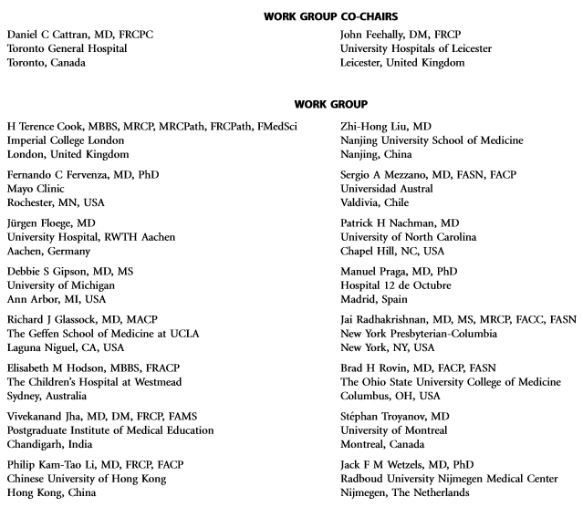
Notes:
Kidney Disease: Improving Global Outcomes (KDIGO) published its ﬁrst guideline on glomerular diseases in 2012. Available online at www.kdigo.org

Slide 3
#KDIGOGNConference
KDIGO Controversies Conference on Glomerular Diseases
Singapore, November 2017
Notes:
Given the enormous advances in understanding the pathogenesis of glomerular diseases, identiﬁcation of new diagnostic biomarkers, and emerging therapies, about 100 experts from various disciplines (nephrology, pathology, rheumatology, pediatrics) and organizations (academia, pharmaceutical industry) convened on November 17–19, 2017 for the KDIGO Controversies Conference on Glomerular Diseases. Through plenary sessions and small group discussions, the conference aimed to evaluate consensus and controversies in nomenclature, general work-up, and management of glomerular diseases, future needs in research, and, in particular, the critical assessment of existing guideline recommendations.

Slide 4
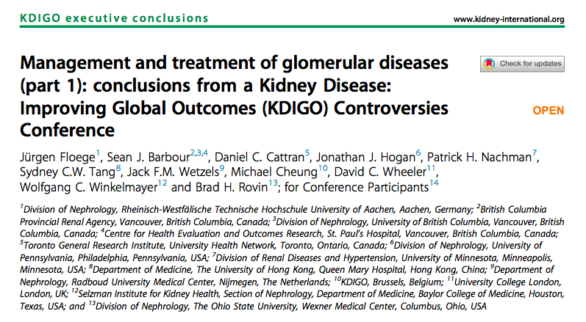
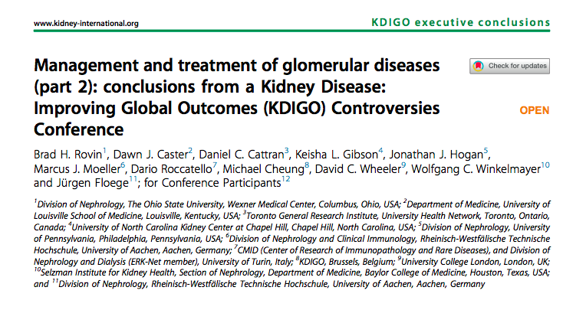
Notes:
The KDIGO Controversies Conference on Glomerular Diseases resulted in two publications in Kidney International in 2018.

Slide 5
Minimal Change Disease and Focal Segmental Glomerulosclerosis
Terminology
Pathogenesis
Biomarkers and Prediction of Prognosis
Genetic Testing
Treatment
Future studies
Clinical Vignettes

Slide 6
Terminology
The terms “minimal change disease” (MCD) and “focal segmental glomerulosclerosis” (FSGS) remain relevant.
Although there may be pathophysiologic overlap between MCD and FSGS, the presence of focal and segmental sclerosis by light microscopy has diagnostic and prognostic importance.

Slide 7
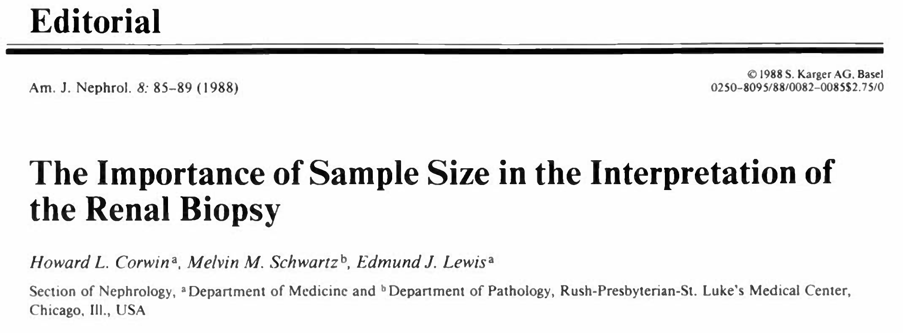
To discriminate between MCD and FSGS by kidney biopsy, at least 20 glomeruli are
needed, and biopsies performed soon after diagnosis may only show MCD, but the
patients may later develop FSGS.

Slide 8
“MCD refers to nephrotic syndrome in which glomeruli
appear normal or with very subtle morphologic changes under light microscopy, with podocyte foot process fusion or effacement found on electron microscopy. MCD represents the most common type of nephrotic syndrome in children (~80%), whereas in adults it accounts for 10% to 20% of cases.”
Feehally J, Floege J, Tonelli M, Johnson RJ. Comprehensive Clinical Nephrology, 6th Edn (2019)

Slide 9
In children, kidney biopsy is not usually performed in patients that
respond to prednisone treatment.
Response to prednisone treatment and timing of relapses allows classiﬁcation of childhood nephrotic syndrome

Slide 10
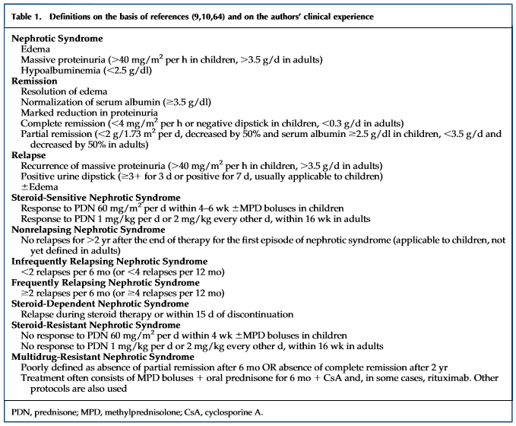
There was consensus that
the designations
“steroid sensitive” and
“steroid-resistant” nephrotic
syndrome are clinically
useful disease descriptions
in children and that most
steroid-sensitive idiopathic
nephrotic syndromes in
children are MCD.
Response to therapy is
often of more prognostic
value than biopsy histology

Slide 11
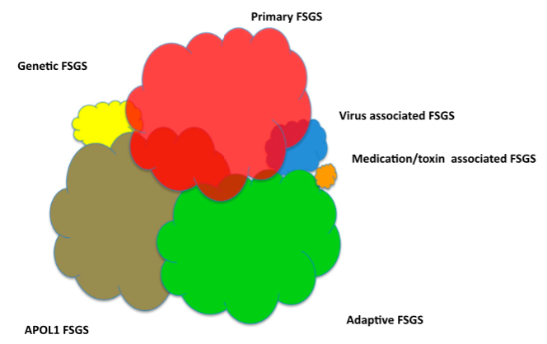
The terms “primary/idiopathic FSGS”
should be reserved for FSGS caused by as yet unknown permeability factors.
Patients with genetic, adaptive (in the setting of reduced nephron mass), drug-induced, and viral-induced FSGS should not be designated as primary.

Slide 12
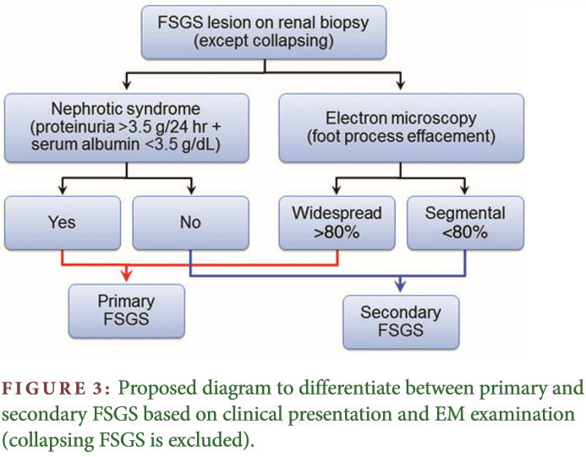

Slide 13
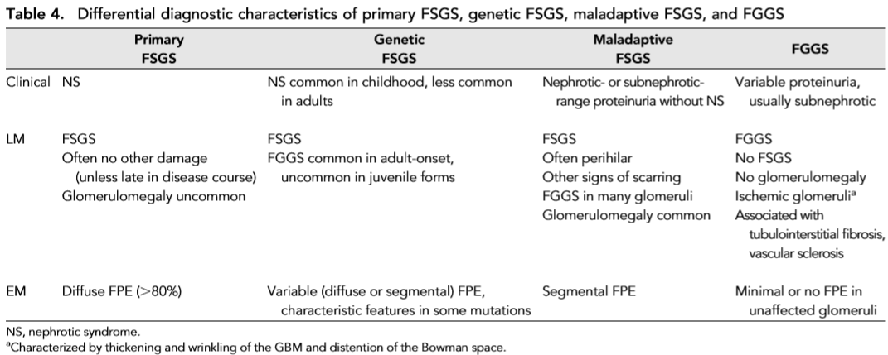
Notes:
Primary FSGS is often characterized by acute-onset heavy proteinuria and diffuse podocyte foot process effacement histologically. Other FSGS subtypes typically show more modest proteinuria and segmental foot process effacement.
Further efforts are warranted to better deﬁne these FSGS subgroups in the context of their presumed pathogenesis.

Slide 14
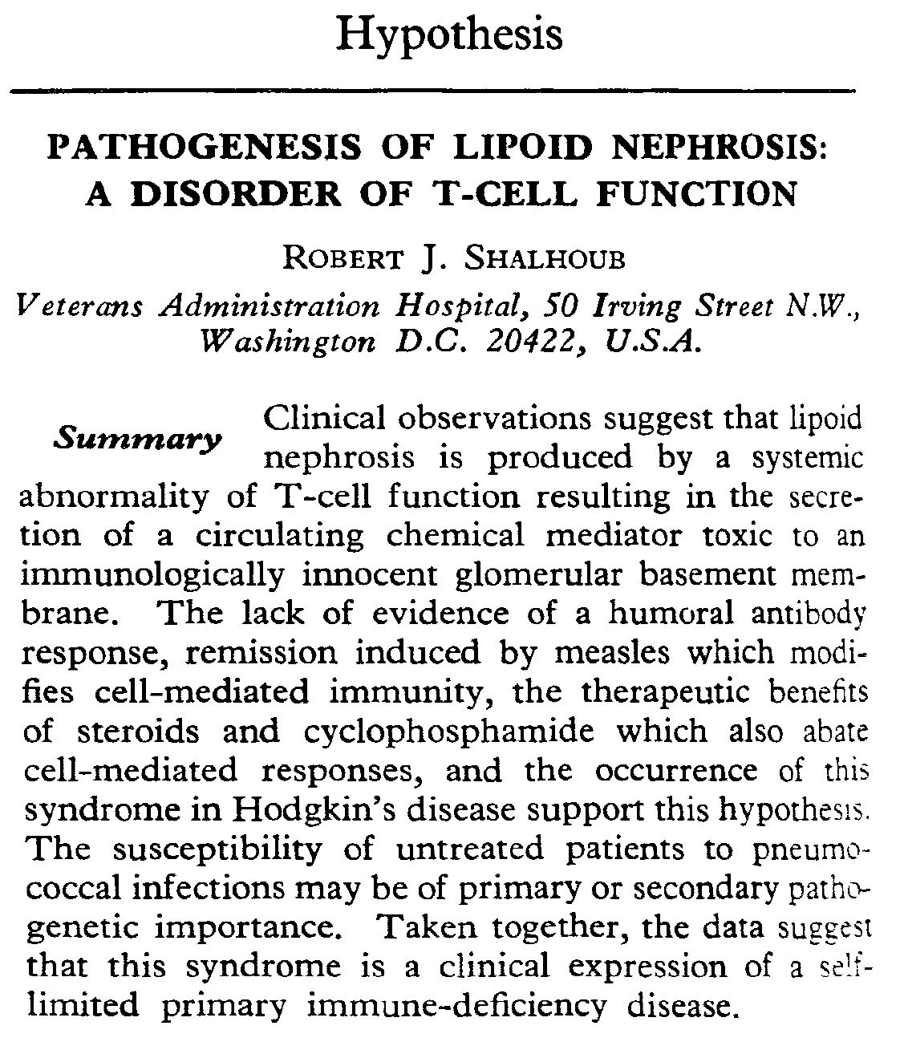
Pathogenesis
A role for dysfunctional T cells in MCD was proposed over 40 years ago

Slide 15
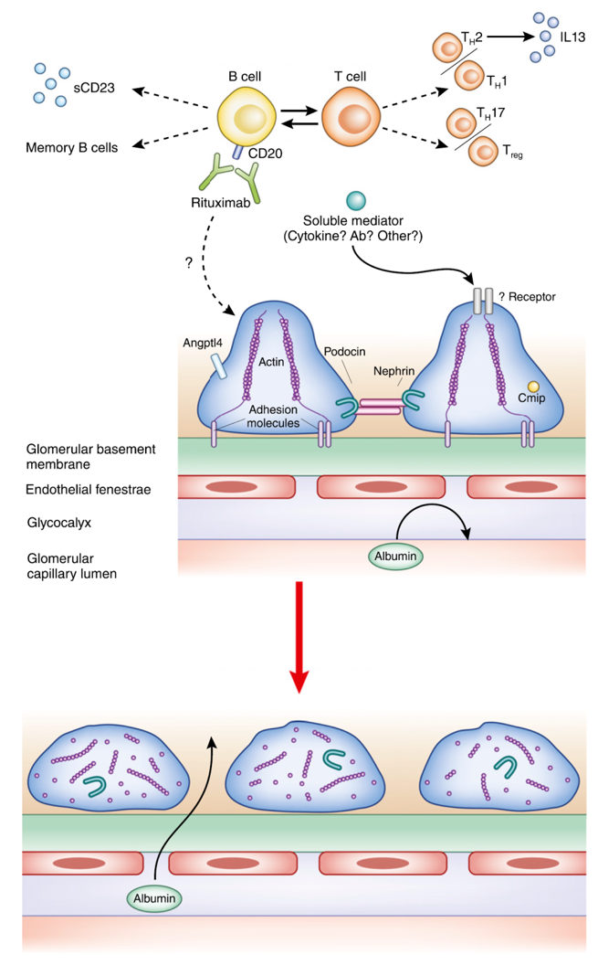
More recently, a role for B cells has become evident, supported by efﬁcacy of immunoadsorption and B cell depletion in inducing remission
Notes:
Thus far none of the reported circulating permeability factor candidates have been independently validated in primary FSGS.

Slide 16
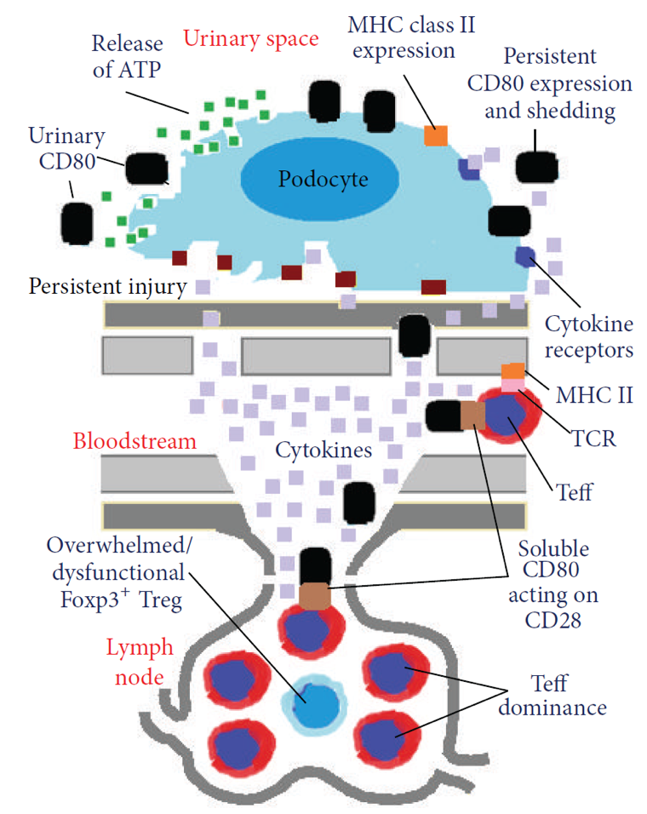
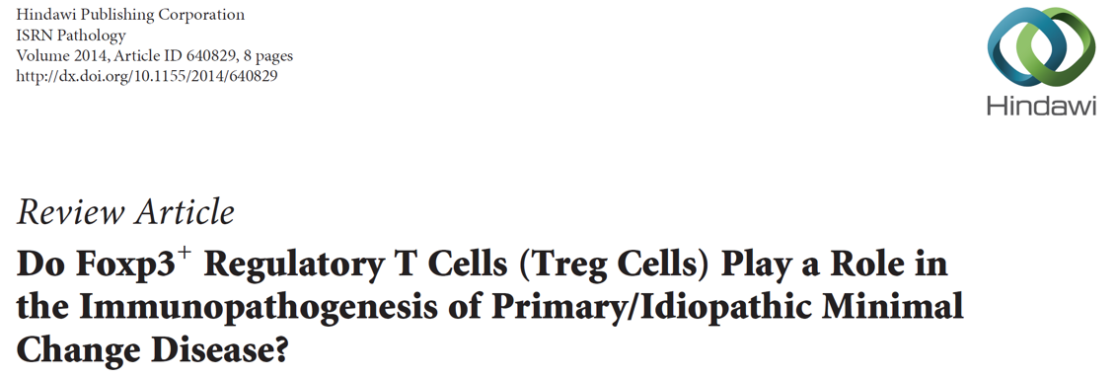
It has been suggested that MCD/FSGS may be mediated by podocyte CD80 (B7-1) expression induced after an innocuous event such as an infection.
However, CD80 overexpression on podocytes could not be conﬁrmed
Hue SS., et al. ISRN Pathology 2014, Article ID 640829
Notes:
Dysfunctional Treg cells promoting a pathogenic “injury loop” in minimal change disease. If intrinsic or Treg cell-dependent regulatory mechanisms fail, persistent injury to podocytes leads to expression and shedding of CD80 molecules. Soluble CD80 molecules could diffuse back into the bloodstream and bind to CD28 on Teff cells, distantly or locally, sustaining continuous activation and synthesis of cytokines in a podocyte “injury loop.”

Slide 17
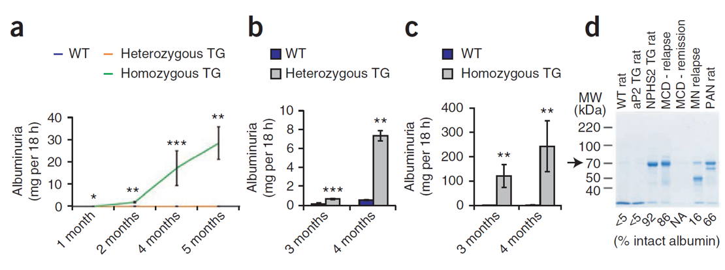
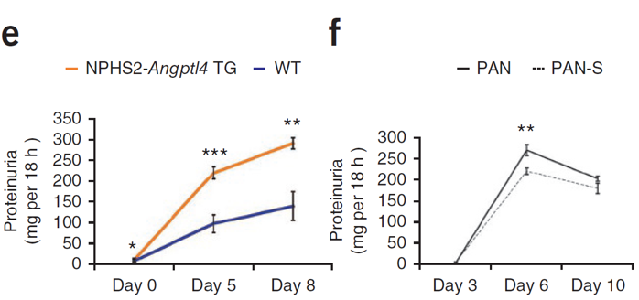
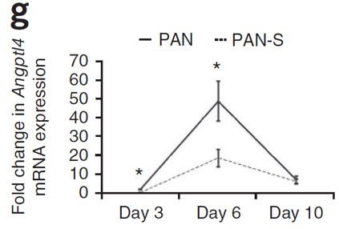
Angiopoietin-like-4, a secreted glycoprotein, is highly upregulated in the serum and in podocytes in experimental models of MCD and in the human disease.
This biomarker has relevant potential in patients with steroid-sensitive nephrotic syndrome.
Nat Med. 2011; 17: 117-122
Relationship of Angptl4 overexpression with proteinuria

Slide 18
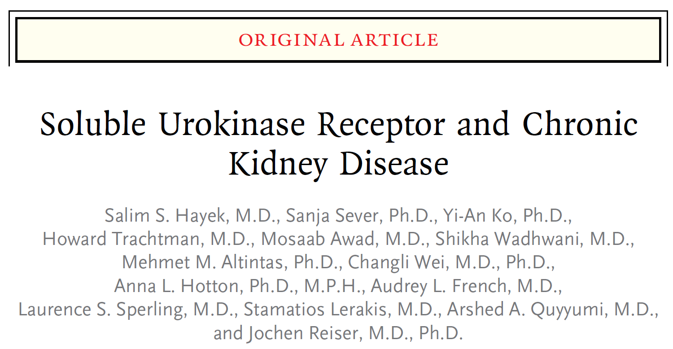
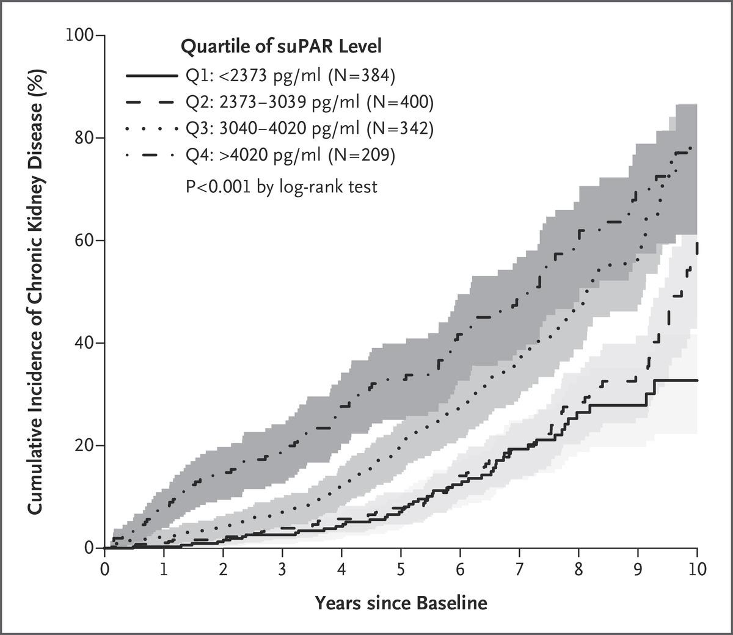
Soluble urokinase-type plasminogen activator receptor may be a novel prognostic biomarker for chronic kidney disease, but does not appear to have a role as a diagnostic biomarker or to represent the permeability factor in FSGS

Slide 19
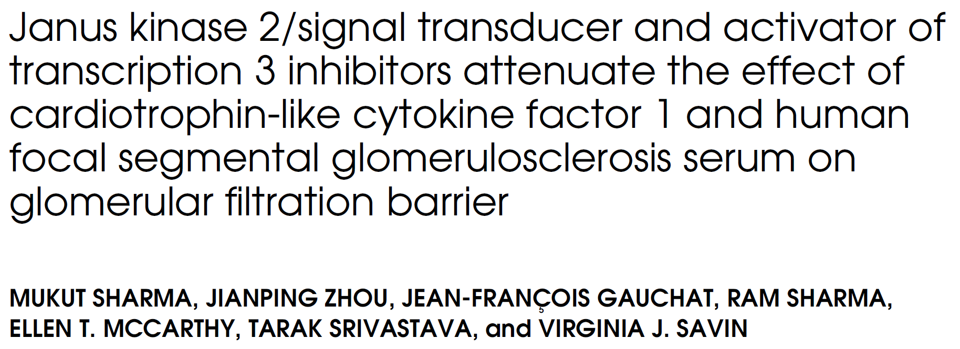
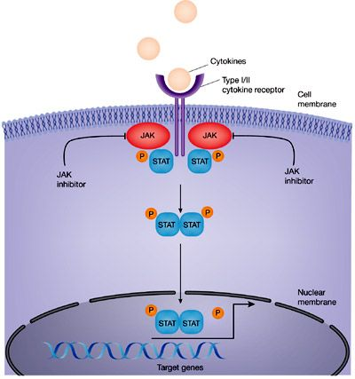
Cardiotrophin-like cytokine-1, a member of the interleukin 6 cytokine family, may be a candidate FSGS permeability factor.
Cardiotrophin-like cytokine-1 has been identiﬁed in the plasma of patients with FSGS and has been found to decrease nephrin expression in podocyte culture.
In patients with recurrent FSGS, its concentration may be up to 100 times that of normal subjects.
Notes:
Source (right panel): http://www.nephronpower.com/2016/01/in-news-cardiotrophin-like-cytokine.html

Slide 20
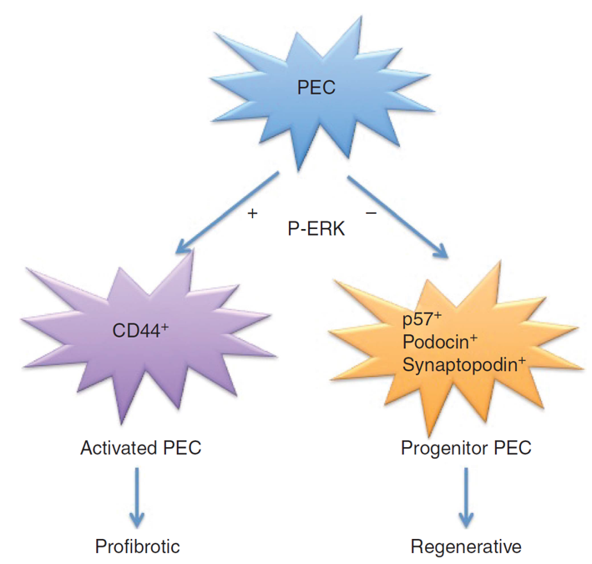
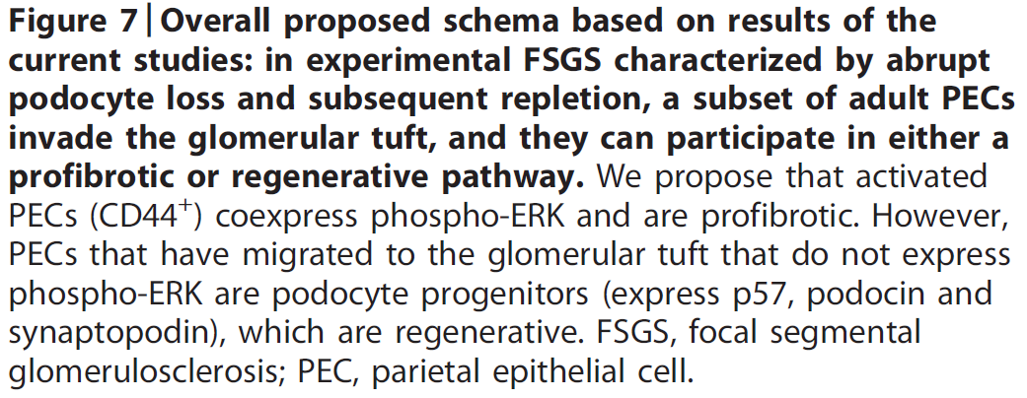
A role for glomerular parietal epithelial cells in the pathogenesis of virtually all histological types of FSGS lesions has also been proposed.

Slide 21
BIOMARKERS AND PREDICTION OF PROGNOSIS

Slide 22
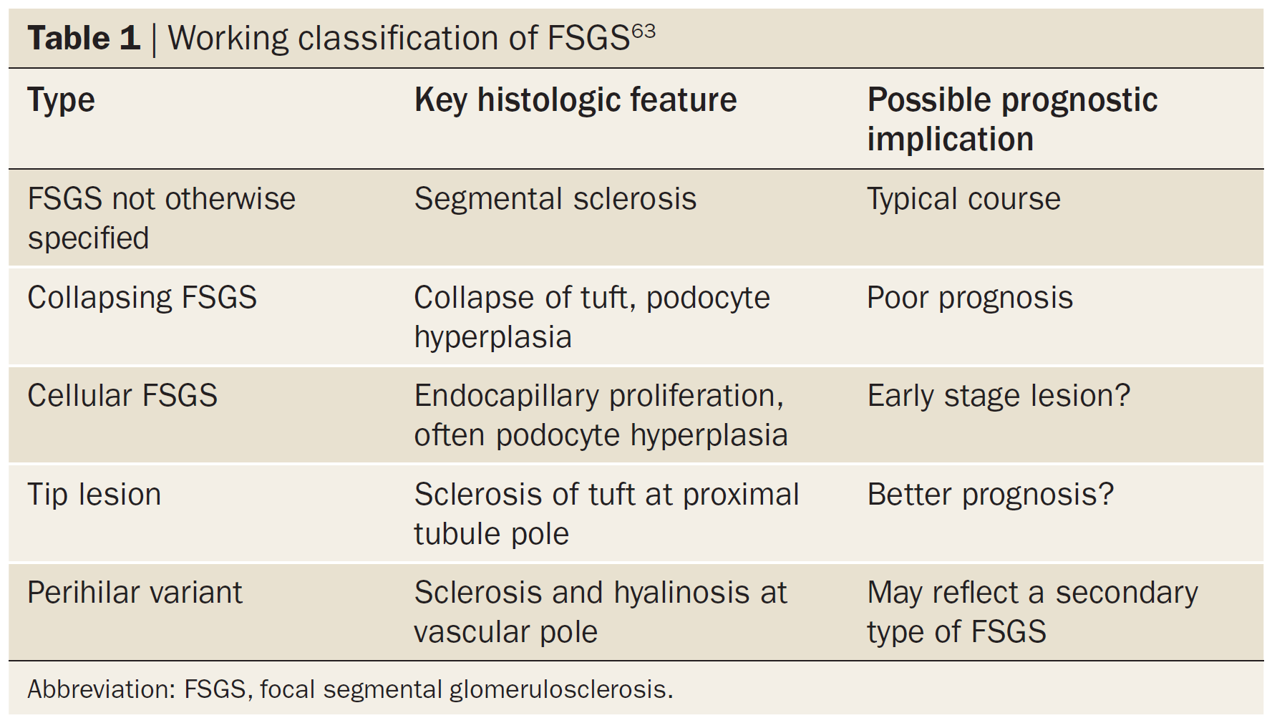
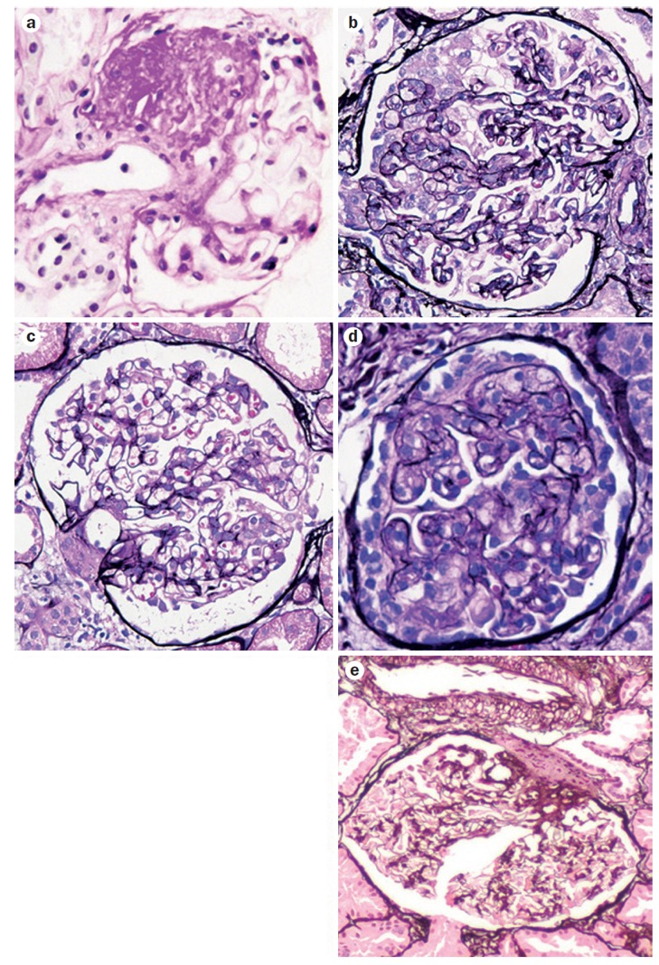
The histological subtype of FSGS as deﬁned by the Columbia classiﬁcation may support decision-making and help with anticipating response to treatment and prognosis, but it is not speciﬁc for underlying disease mechanisms.

Slide 23
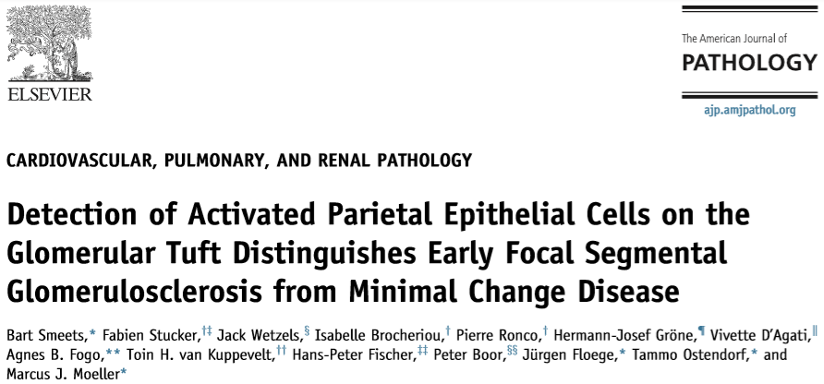
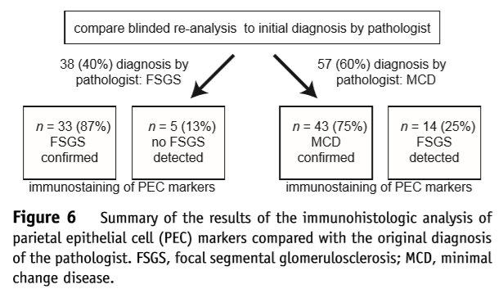
Immunostaining of kidney biopsy specimens for parietal epithelial cell activation markers may improve sensitivity for detecting sclerotic lesions when distinguishing primary FSGS from MCD
Notes:
Proteomic analysis of kidney biopsy specimens may provide additional insights.

Slide 25
Genetic testing for pediatric nephrotic syndrome and adult FSGS is controversial, but it should be considered for:
Patients with congenital and infantile forms of nephrotic syndrome (children <1 year of age) or less than 2 years of age with steroid-resistant nephrotic syndrome,
Nephrotic syndrome associated with other syndromic features, or
Familial forms of steroid-resistant nephrotic syndrome/FSGS

Slide 26
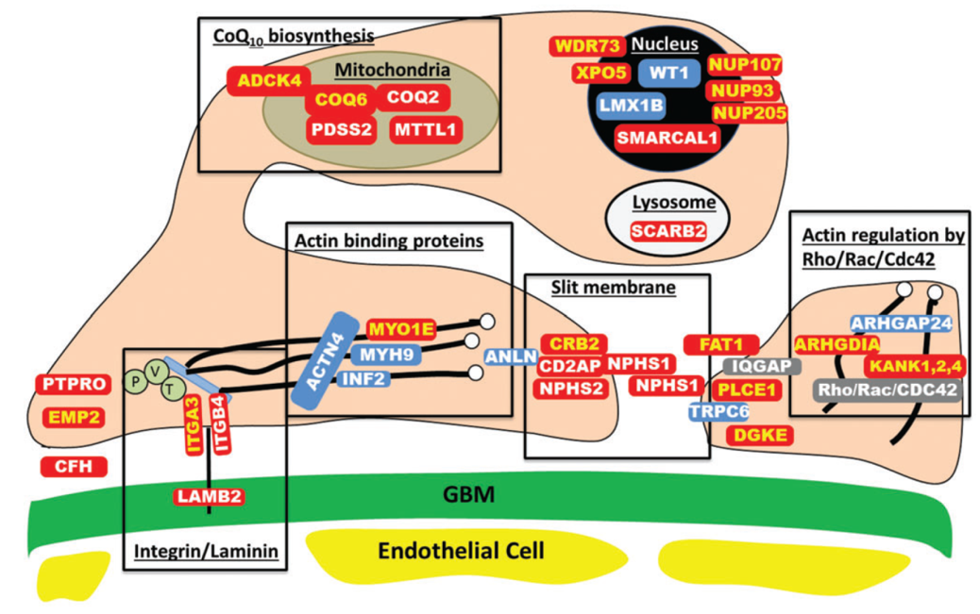
Adding to the controversy of when to perform genetic testing, single gene mutations have been found in up to 30% of patients under age 25.
Notes:
Testing should target relevant genes based on patient characteristics and contemporary knowledge. Genetic testing may be considered for inclusion and stratiﬁcation in clinical trials. Biospecimens should routinely be collected, and patients consented for later genetic analysis. Ethical issues should be addressed before recommending genetic analyses.

Slide 27
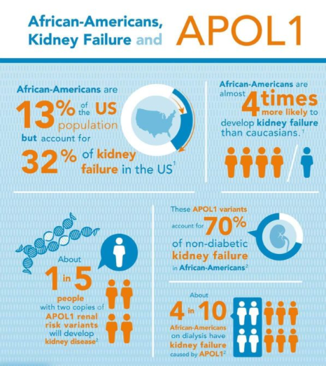
The role of high-risk apolipoprotein L1 genotypes in the development of glomerulosclerosis is still under investigation and the conference attendees agreed that data are still insufﬁcient to support using this information to guide clinical decisions.
https://www.wakeforestinnovations.com/stories/charting-new-waters/
Notes:
Testing should target relevant genes based on patient characteristics and contemporary knowledge. Genetic testing may be considered for inclusion and stratiﬁcation in clinical trials. Biospecimens should routinely be collected, and patients consented for later genetic analysis. Ethical issues should be addressed before recommending genetic analyses.

Slide 28
TREATMENT

Slide 29
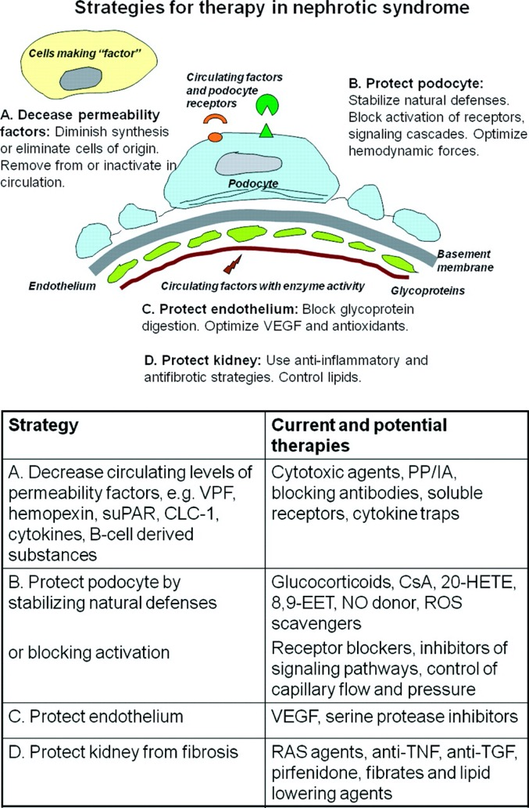
While immunomodulatory therapies are the ﬁrst-line treatment in primary/idiopathic FSGS caused by a permeability factor, other FSGS subtypes respond better to blood pressure control and correction of abnormal glomerular hemodynamics, such as glomerular hypertension (e.g., in adaptive FSGS), or other speciﬁc interventions.
Notes:
The use of immunomodulatory therapy after causative FSGS mutations are identiﬁed is controversial. Rare reports of varying degrees of remission in these patients may or may not reﬂect the non-immune modulating effects of these therapies.

Slide 30
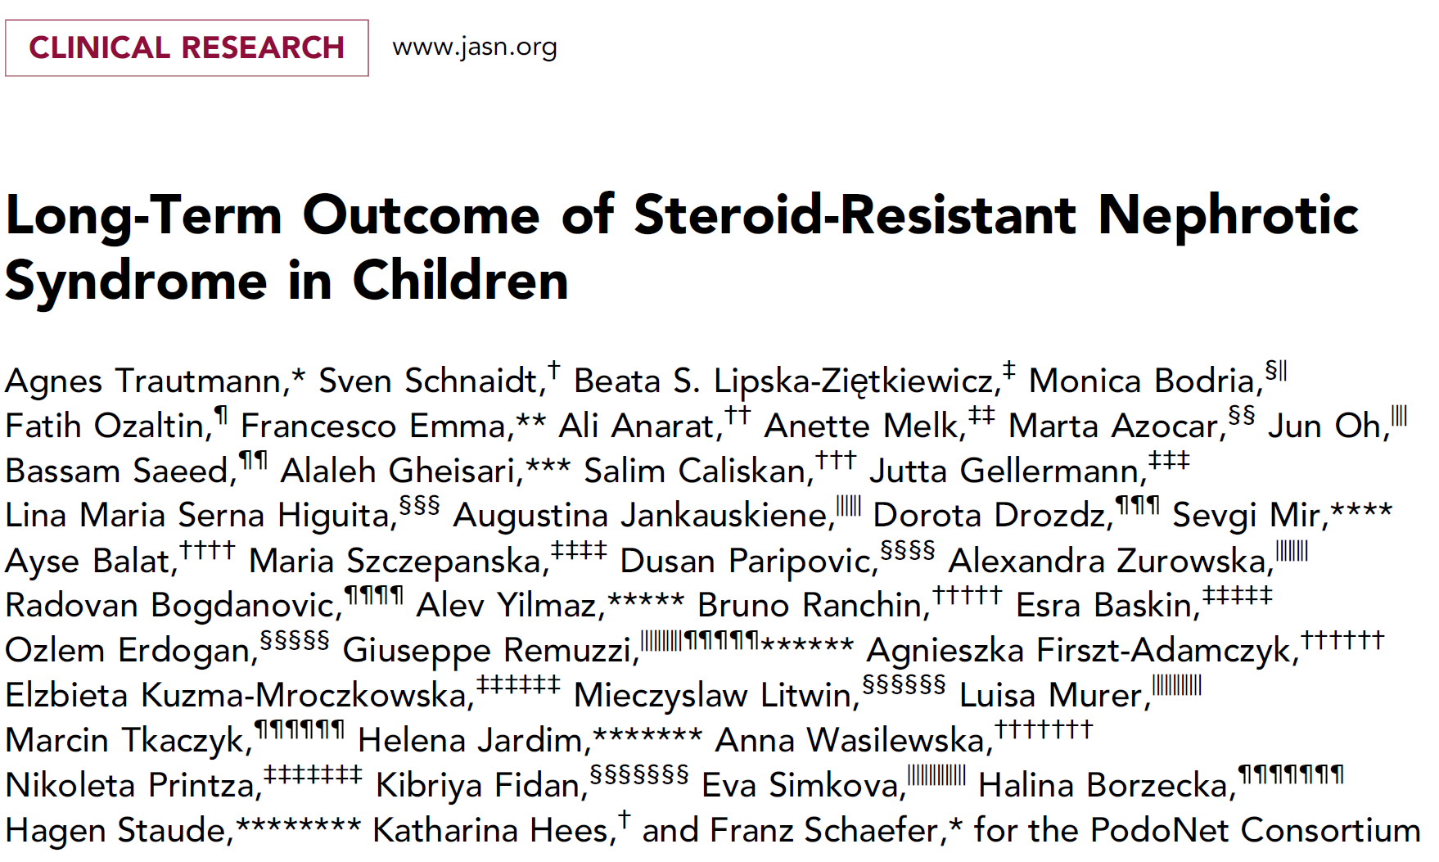
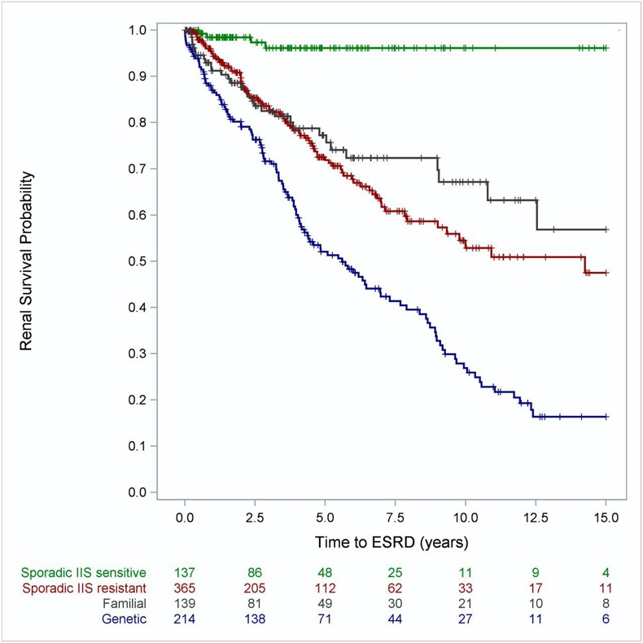
Rare reports of varying degrees of remission in these patients may or may not reﬂect the non-immune modulating effects of these therapies.
Notes:
The use of immunomodulatory therapy after causative FSGS mutations are identiﬁed is controversial.

Slide 31
Following identiﬁcation of causative mutations, treatment should include known directed therapies for speciﬁc mutations (e.g., coenzyme Q-10, vitamin B12 where applicable), anti-proteinuric therapy, and prompt discontinuation of immunosuppressive therapy in those with no early signal of response.
Notes:
Testing should target relevant genes based on patient characteristics and contemporary knowledge. Genetic testing may be considered for inclusion and stratiﬁcation in clinical trials. Biospecimens should routinely be collected, and patients consented for later genetic analysis. Ethical issues should be addressed before recommending genetic analyses.

Slide 32
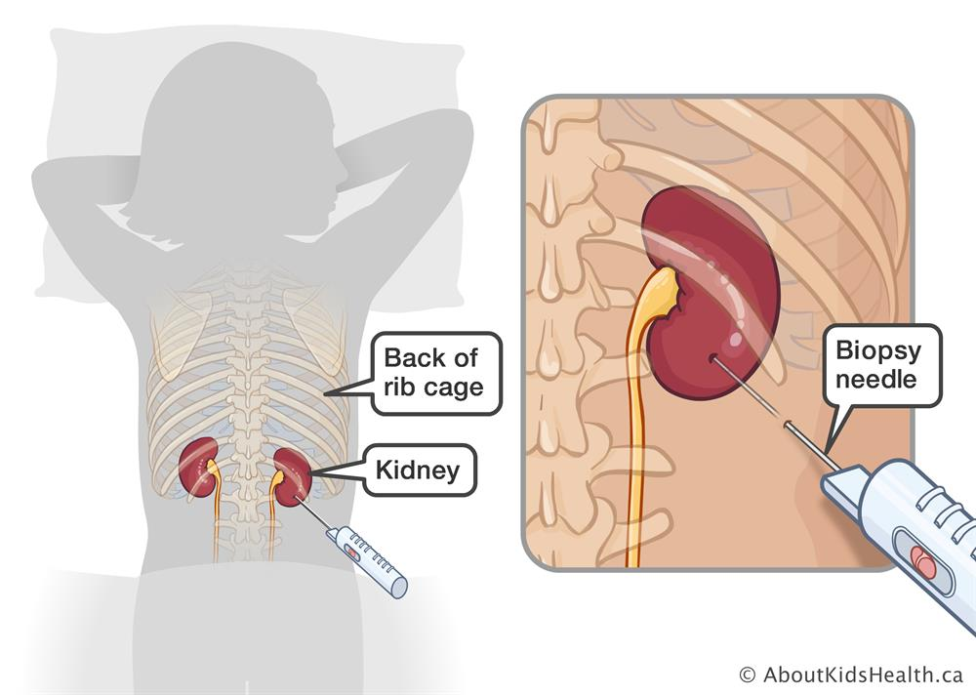
Because ~ 80% of children with incident nephrotic syndrome have MCD on biopsy, and of the remaining patients, some will respond to corticosteroid therapy, the conference attendees agreed that there are no data to challenge the practice of treating all pediatric nephrotic patients with corticosteroids ﬁrst, except those younger than 9 to 10 months of age.
Due to the increased incidence of steroid-resistant nephrotic syndrome and FSGS with age, consideration to biopsy children older than 12 years prior to treatment is recommended.
https://www.aboutkidshealth.ca/Article?contentid=35&language=English

Slide 33
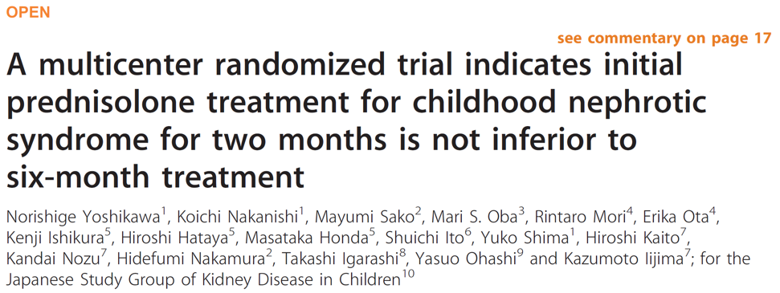
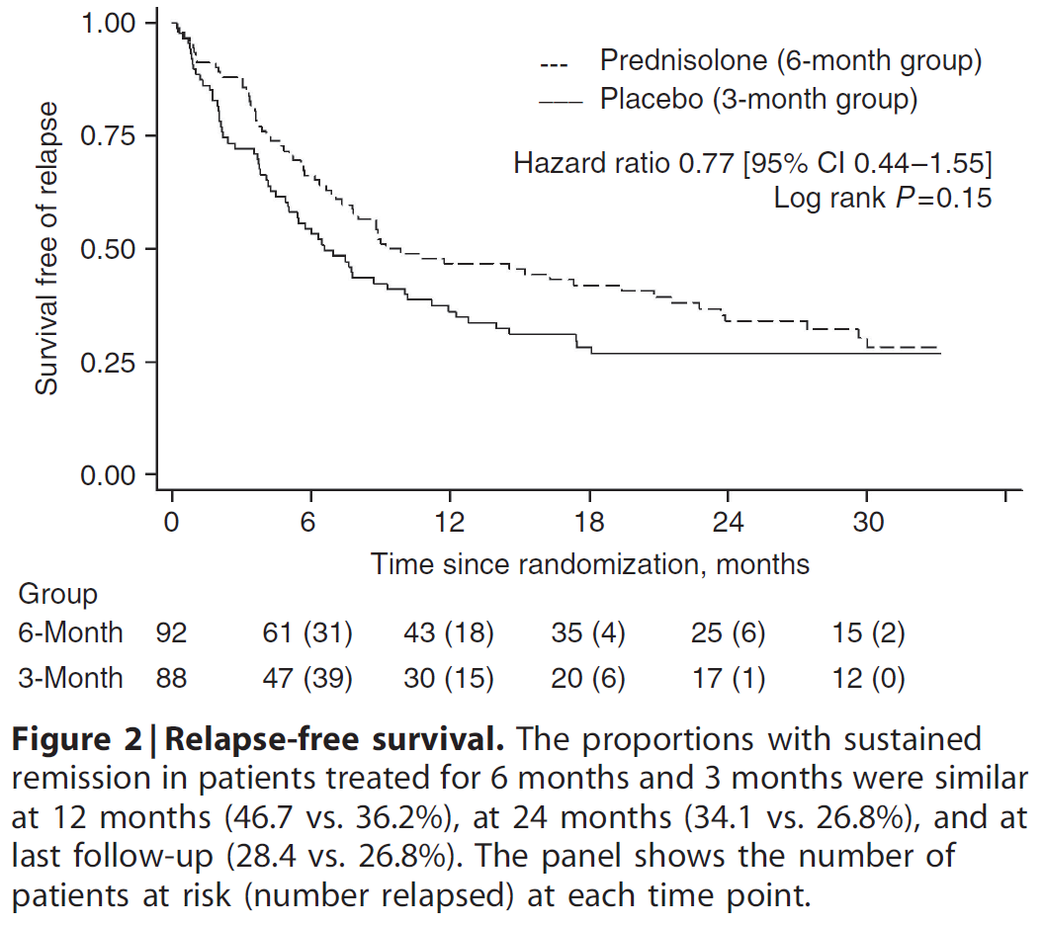
In children with steroid-sensitive nephrotic syndrome, recent data from randomized controlled trials do not support steroid exposure beyond 8 to 12 weeks.

Slide 34
Controversies remain about the minimum duration of corticosteroid therapy required to deﬁne steroid resistance.
Notes:
The 2012 KDIGO guideline recommended at least 8 weeks of corticosteroids in children before deﬁning steroid resistance. While consensus was not reached, the need for a globally accepted deﬁnition of “steroid resistance” to improve comparability of future clinical trials was recognized.

Slide 36
The efﬁcacy of low-dose daily corticosteroids over alternate day dosing for maintaining remission in relapsing nephrotic syndrome is promising.

Slide 37
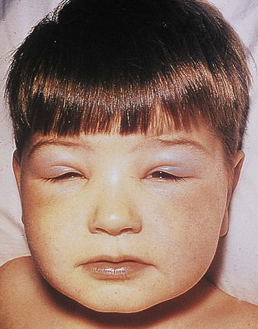
Therapy with alternative immunosuppressive agents should be considered in children with frequently relapsing nephrotic syndrome.
While data support the use of cyclophosphamide (CYC), levamisole, mycophenolate mofetil (MMF), calcineurin inhibitors (CNIs), and rituximab (RTX), the precise order of therapy is not well determined.

Slide 38
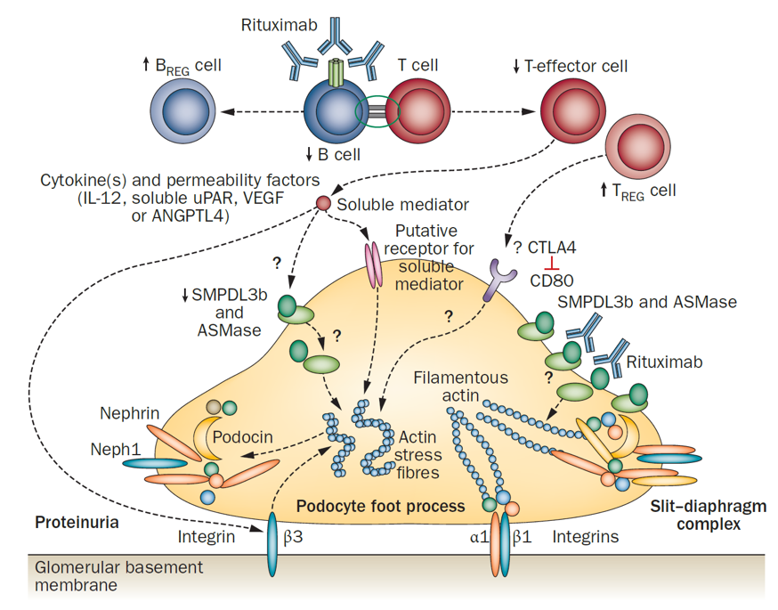
A direct action of RTX on podocytes was not conﬁrmed, supporting B-cell depletion as RTX’s primary mechanism of action.
Notes:
Data are emerging to support an early role of RTX in the management of children with steroid-dependent nephrotic syndrome.

Slide 39
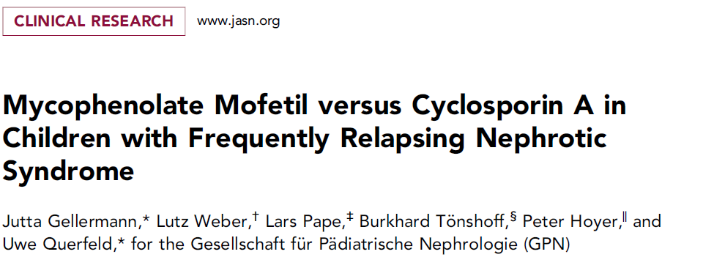
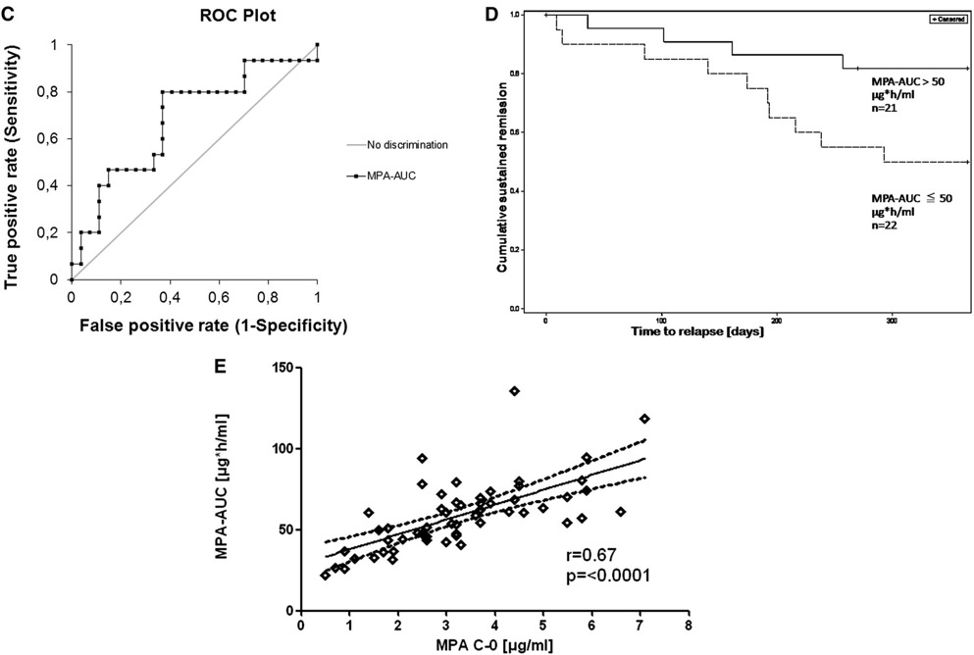
Post-hoc analyses suggest that targeting higher area under the serum/plasma concentration time curves for MMF could result in similar numbers of children maintaining remission with MMF as with CNIs, but this needs to be conﬁrmed in randomized controlled trials.

Slide 40
Nephrotic patients have a high risk of infection regardless of immunosuppression.
The 2012 KDIGO guideline provides some recommendations regarding vaccinations in children but does not highlight the importance of hepatitis B screening and vaccination, especially in those receiving B-cell depleting therapies.
Vaccination against meningococci should also be included as based on expert opinion.

Slide 41
In adults, recommending a minimum duration of 16 weeks of high-dose corticosteroids as ﬁrst-line therapy for FSGS or MCD was felt to be controversial, given its potential for toxicity.
However, data to support alternative ﬁrst-line agents or combination therapies with lower doses of corticosteroids are insufﬁcient.
The conference attendees agreed that CNIs or CYC should remain as second-line agents in adults with frequently relapsing or steroid-dependent MCD.

Slide 42
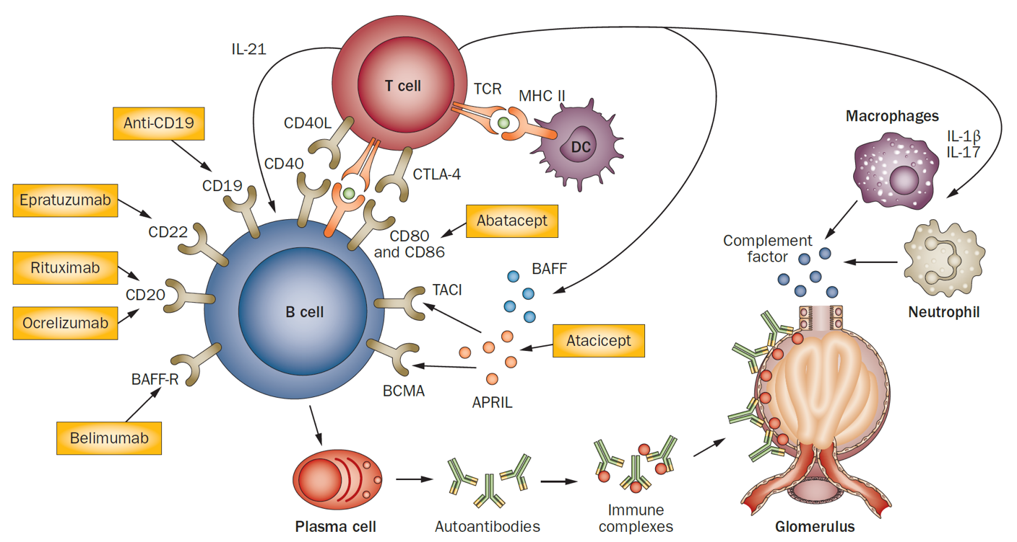
RTX is an emerging second-line therapy in MCD in adults, although evidence is observational only.
The recommendation for CNIs and MMF as second- and third-line treatments, respectively, for FSGS should be maintained.

Slide 43
FUTURE STUDIES

Slide 44
Randomized controlled trials are underway to investigate the value of RTX in adult MCD and the CD80 inhibitor abatacept, regardless of CD80 expression on podocytes, in MCD and FSGS.
Notes:
Additional ongoing RTX studies for MCD/FSGS:
EudraCT: 2018-004611-50
RIFIREINS: NCT03970577
NCT03298698
RITERM study: Rituximab and the assessment of InfecTions, Eosinophil counts, long-term Remission and Malignancy risk in idiopathic nephrotic syndrome

Slide 46
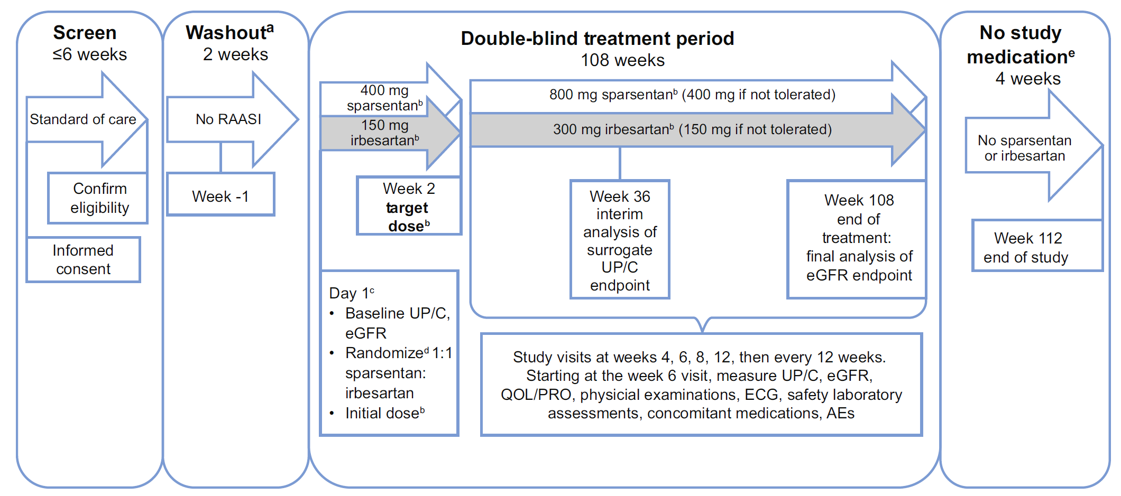
Notes:
ªFor patients who are undergoing washout from renin-angiotensin-aldosterone system inhibitor (RAASI).
^{b}Patients whose body weight is ≤50 kg at screening will receive half the otherwise specified doses of sparsentan or irbesartan (active control). Weight will be measured at each visit and the dose increased at the investigator’s discretion if the patient’s weight reaches >50 kg.
^{c}Day 1 events shown will occur in the order in which they are listed.
^{d}Randomization will be stratified by estimated glomerular filtration rate (eGFR) value (30-60 ml/min per 1.73 m² and ≥60 ml/min per 1.73 m² for all patients) and
urinary protein-to-creatinine ratio (UP/C) (≤3.5 g/g and >3.5 g/g [patients ≥18 yr of age] or ≤2 g/g and >2 g/g [patients <18 yr of age]) at screening.
^{e}Following the 108-week blinded treatment period, treatment with study medication will be discontinued.
Primary endpoint: slope of eGFR from week 6-108
Surrogate endpoint: % patients achieving urinary protein-to-creatinine (UP/C) ratio of ≤1.5 g/g and >40% reduction from baseline in UP/C at wk 36

Slide 47
CLINICAL VIGNETTES

Slide 48
CASE 1
A 38-year-old woman comes into your office with complaints of progressive ankle and leg swelling over the past 2–3 weeks. She has gained 15 lb, notices that her eyelids are swollen in the morning, and the waist of her pants is very tight. Her stools have been loose, and she has mild intermittent abdominal pain. Her knee and ankle joints feel tight. She denies any red or brown urine, preceding illness, sore throat, rashes, fever, shortness of breath, or other constitutional symptoms. She has a current history of allergic rhinitis and formerly had asthma as a child. Otherwise she has been healthy and works as an elementary school teacher. There is a family history of hypertension but no family history of heart disease, diabetes, kidney disease, liver disease, or arthritis.
On physical examination, she is alert and comfortable with mild periorbital edema, clear lungs, mild abdominal fullness with no fluid wave, and 2+ foot, ankle, and pretibial edema up to her mid calf region. There are no rashes or joint inflammation. Her blood pressure was 118/65 mm Hg, and she was afebrile. Initial laboratory evaluation shows a urinalysis with a pH of 5, specific gravity of 1.030, dipstick with 4+ protein, 2+ blood, 5–10 white blood counts (RBCs), and 2 WBCs per high-power field on microscopic examination. Her H/H is 13.7/42, platelets are 380,000, and her WBC is 7.8 with a normal differential. Her chemistry panel showed a creatinine of 0.8, BUN 27, albumin 2.2, serum cholesterol 320, ANA negative, and C3 complement was normal. Urine total protein/creatinine ratio was 4.7.

Slide 49
What is the next appropriate step?
A. After checking a tuberculosis (TB) test, begin empiric therapy with daily prednisone 2 mg/kg daily
B. Schedule a kidney biopsy
Check serologies for hepatitis B and C
Start therapy with a diuretic

Slide 50
The answer is B.
This woman fulfills the diagnostic criteria for nephrotic syndrome with nephrotic range proteinuria (urine total protein/creatinine ratio >3.5), hypoalbuminemia, hypercholesterolemia, and edema. As an adult, MCD is in the differential, but a kidney biopsy is required to diagnose her renal lesion in order to guide therapy.
Membranous nephropathy and FSGS are also in the differential. The presence of microscopic hematuria (which is seen in a minority of patients with MCD) broadens your differential to include other forms of glomerulonephritis such as IgA nephropathy. Hepatitis B and C testing might be indicated if the biopsy findings show a lesion that might be associated with those chronic infections.
It is always a good idea to test for TB prior to starting immunosuppressive therapy, but steroids should not be used empirically in an adult nephrotic patient without a diagnostic kidney biopsy. Diuretics should be used with caution, especially if the patient is not uncomfortable, as it can worsen the intravascular volume depletion seen in some patients.

Slide 51
CASE 2
The kidney biopsy of 30-year-old African American man presenting with nephrotic syndrome, serum creatinine of 1.9 mg/dl, and negative testing for HIV and hepatitis B and C revealed focal and segmental glomerulosclerosis (FSGS). He has no family history of nephrotic syndrome, FSGS, or kidney failure. He asks if he should have genetic testing to guide his therapy.
What factors should be considered to guide the recommendation for genetic testing?
A. Family history
B. Evaluation for kidney transplant preparation
C. Age of FSGS onset
D. Patient interest in research
E. All of the above

Slide 52
The answer is E.
In adults with FSGS and no family history of disease, genetic testing may be considered as part of the FSGS recurrence post-transplant risk assessment. Specifically, causative genetic polymorphisms confer a lower risk for FSGS recurrence.
Genetic testing has been incorporated in many research studies that support discovery of disease mechanisms, novel therapeutic targets, and phenotype/genotype associations.

Slide 53
KDIGO THANKS THE FOLLOWING PARTNERS FOR THEIR SUPPORT OF THIS SPEAKER’S GUIDE

Slide 54
FOLLOW KDIGO
www.kdigo.org
/goKDIGO
@goKDIGO
@goKDIGO

