Slide 1
MANAGEMENT AND TREATMENT OF GLOMERULAR DISEASES
Membranous Nephropathy
CONCLUSIONS FROM A
KDIGO CONTROVERSIES CONFERENCE

Slide 2
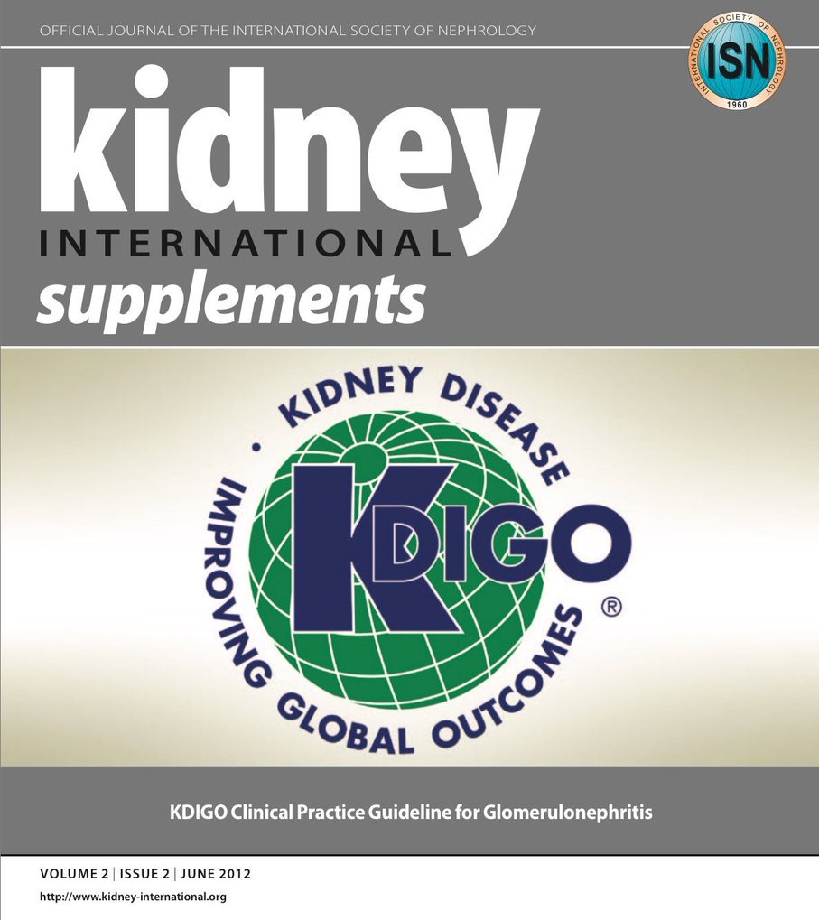
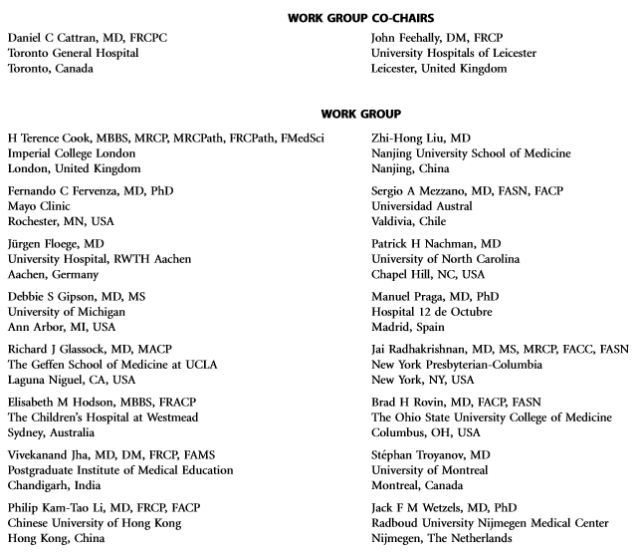
Notes:
Kidney Disease: Improving Global Outcomes (KDIGO) published its ﬁrst guideline on glomerular diseases in 2012. Available online at www.kdigo.org

Slide 3
#KDIGOGNConference
KDIGO Controversies Conference on Glomerular Diseases
Singapore, November 2017
Notes:
Given the enormous advances in understanding the pathogenesis of glomerular diseases, identiﬁcation of new diagnostic biomarkers, and emerging therapies, about 100 experts from various disciplines (nephrology, pathology, rheumatology, pediatrics) and organizations (academia, pharmaceutical industry) convened on November 17–19, 2017 for the KDIGO Controversies Conference on Glomerular Diseases. Through plenary sessions and small group discussions, the conference aimed to evaluate consensus and controversies in nomenclature, general work-up, and management of glomerular diseases, future needs in research, and, in particular, the critical assessment of existing guideline recommendations.

Slide 4
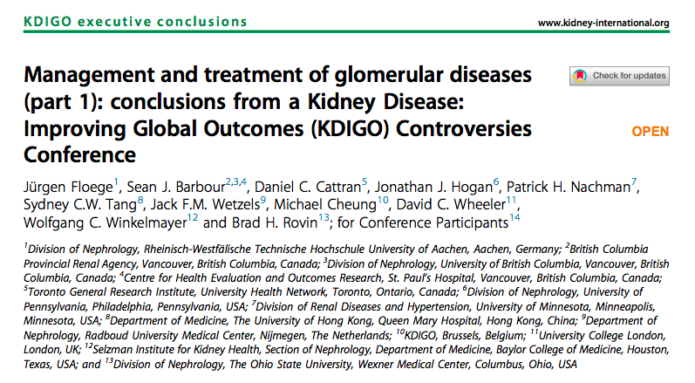
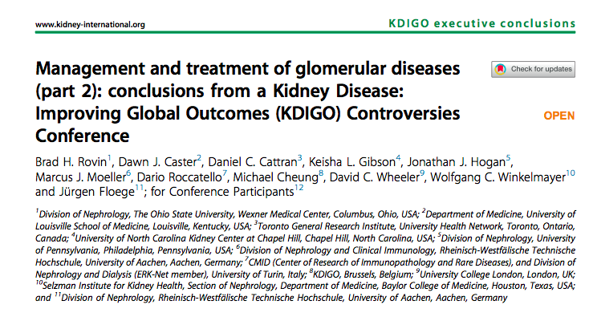
Notes:
The KDIGO Controversies Conference on Glomerular Diseases resulted in two publications in Kidney International in 2018.

Slide 5
Membranous Nephropathy
Definition
Etiology and Pathogenesis
Biomarkers: Diagnosis and Prediction of Prognosis
Pathology
Risk Stratification
Treatment
Disease Monitoring
Future Studies
Clinical Vignettes
Conclusions

Slide 6
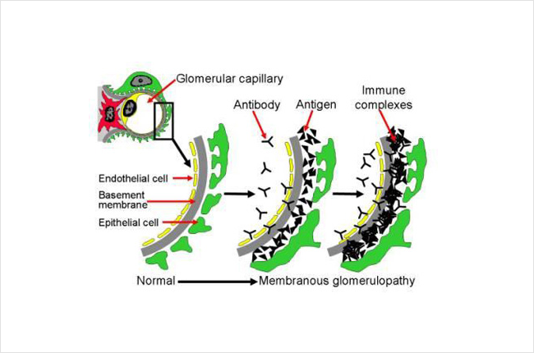
Membranous Nephropathy: Definition
Membranous nephropathy is
characterized by subepithelial
glomerular immune complexes.
The discovery of podocyte
antigens to which circulating
antibodies are directed has been
a major breakthrough.
Source: https://unckidneycenter.org/kidneyhealthlibrary/glomerular-disease/membranous-nephropathy/

Slide 7
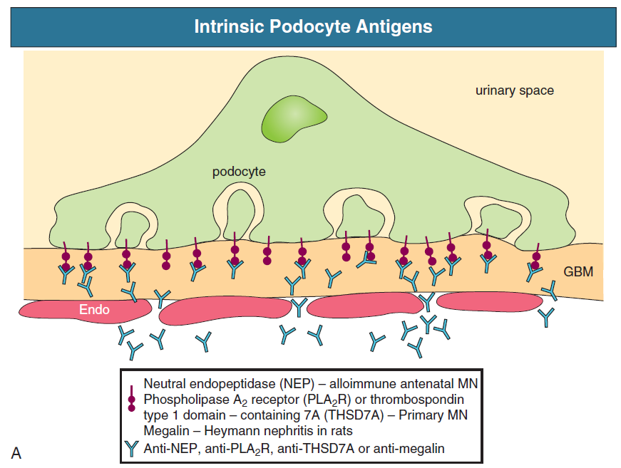
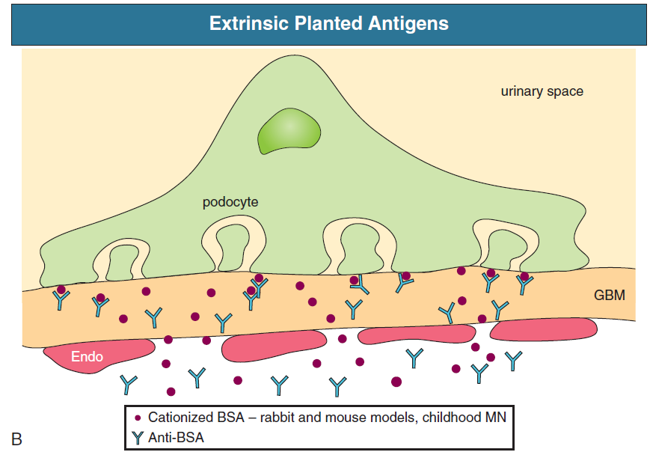
Membranous Nephropathy: Etiology and Pathogenesis
Notes:
Source: Feehally J, Floege J, Tonelli M, Johnson RJ. Comprehensive Clinical Nephrology, 6th Edn (2019)

Slide 8
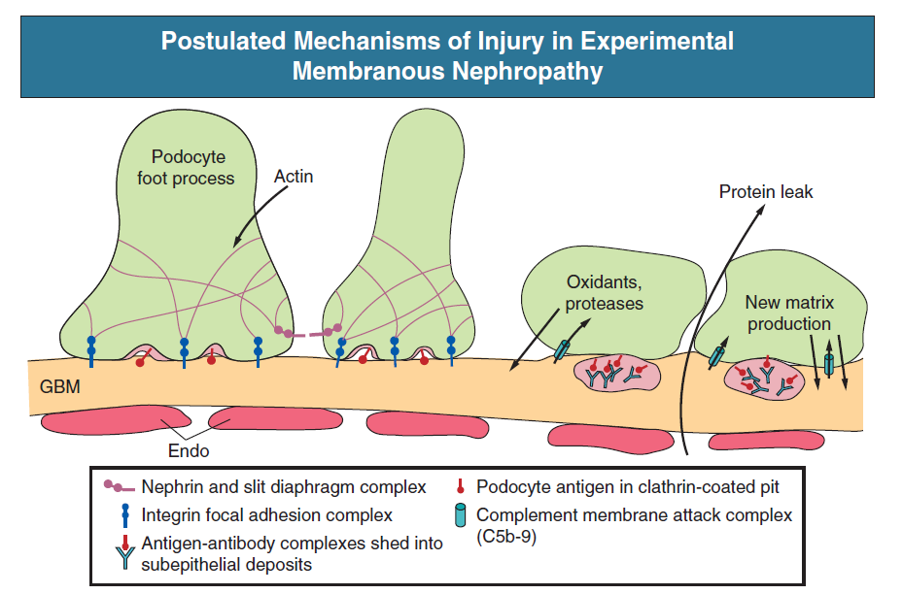
Membranous Nephropathy: Etiology and Pathogenesis
Notes:
Source: Feehally J, Floege J, Tonelli M, Johnson RJ. Comprehensive Clinical Nephrology, 6th Edn (2019)

Slide 9
7.1: Evaluation of MN
7.1.1: Perform appropriate
investigations to exclude
secondary causes in all cases of
biopsy-proven MN. (Not Graded)

Slide 10
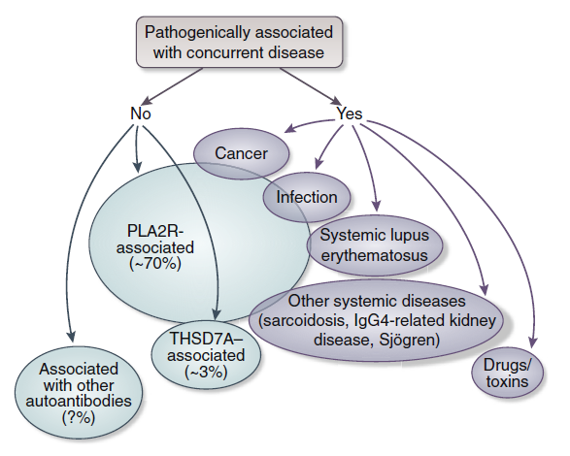
Membranous Nephropathy: Etiology and Pathogenesis
The discovery of antibodies against intrinsic podocyte antigens (PLA2R and thrombospondin-like domain 7A [THSD7A]) established that membranous nephropathy is an autoimmune disease.
Floege J et al. Kidney Int. 2019; 95:268-280

Slide 11
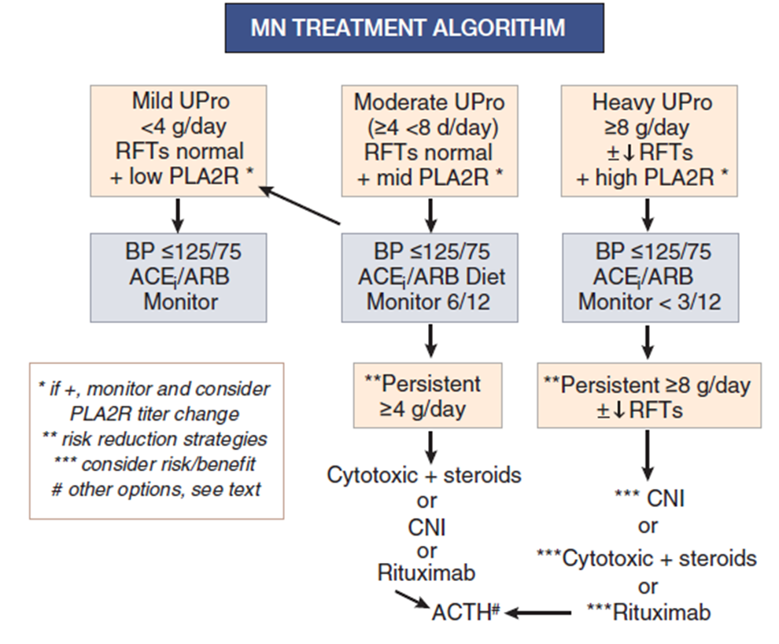
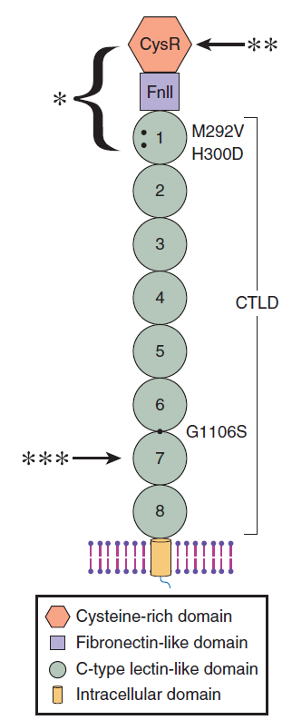
Feehally J, Floege J, Tonelli M, Johnson RJ. Comprehensive Clinical Nephrology, 6th Edn (2019)
Cattran DC, Brenchley PE. Kidney Int. 2017 Mar;91(3):566-574
Emerging data point to the diagnostic, prognostic, and disease-monitoring value of measuring antiPLA2R antibodies levels
Notes:
This introduced a categorization of membranous nephropathy based on the detectable auto-antibodies versus nephropathy not associated with either antibody. Membranous nephropathy associated with other disease processes (infections, systemic lupus erythematosus, sarcoidosis, malignancies) constitutes a separate category
Source (left): Feehally J, Floege J, Tonelli M, Johnson RJ. Comprehensive Clinical Nephrology, 6th Edn (2019)

Slide 12
Membranous Nephropathy: Etiology and Pathogenesis
Antibodies against PLA2R and THSD7A are present in 50% to 80% and 2% to 4% of patients with membranous nephropathy, respectively.
The 2 serotypes coexist only occasionally.
Floege J et al. Kidney Int. 2019; 95:268-280

Slide 13
Membranous Nephropathy: Etiology and Pathogenesis
PLA2R antibodies are uncommon in patients with membranous nephropathy associated with malignancies.
Conversely, cancer may be more common among patients with THSD7A antibodies, but the data are still insufﬁcient to direct malignancy screening approaches in membranous nephropathy.
Floege J et al. Kidney Int. 2019; 95:268-280

Slide 14
Membranous Nephropathy: Etiology and Pathogenesis
Membranous nephropathy associated with other disease processes (infections, systemic lupus erythematosus, sarcoidosis, malignancies) constitutes a separate category
Floege J et al. Kidney Int. 2019; 95:268-280

Slide 15
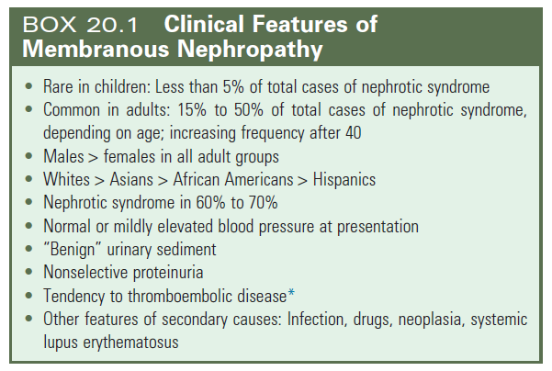
Biomarkers: diagnosis and prediction of prognosis
Notes:
Source: Feehally J, Floege J, Tonelli M, Johnson RJ. Comprehensive Clinical Nephrology, 6th Edn (2019)

Slide 16
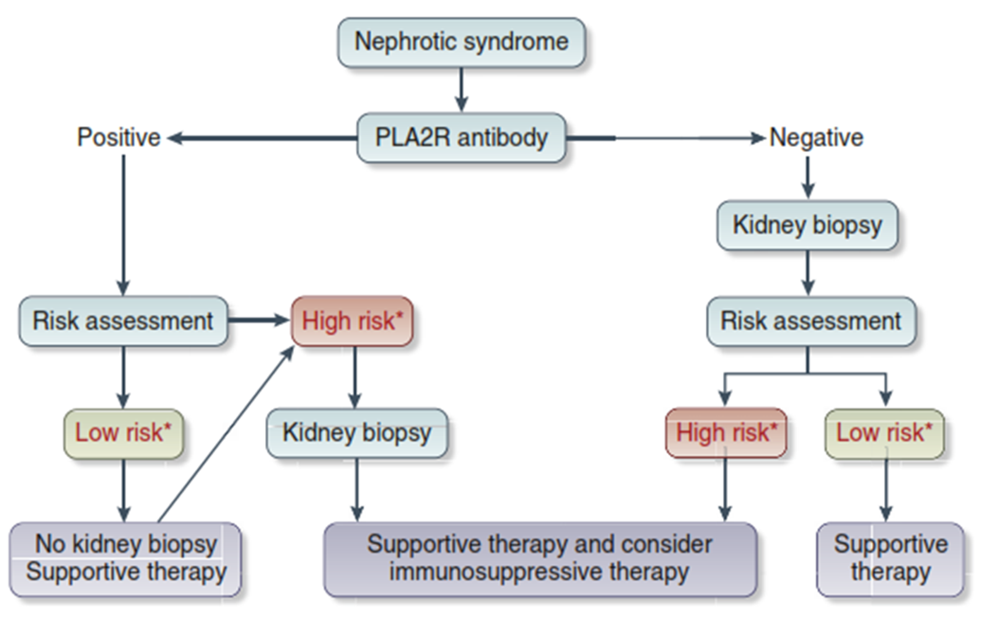
Biomarkers: diagnosis and prediction of prognosis
Because PLA2R antibodies predict membranous nephropathy with high speciﬁcity, a kidney biopsy may not be needed in anti PLA2R–positive patients with a low risk of disease progression and/or a high risk of biopsy-related morbidity
Floege J et al. Kidney Int. 2019; 95:268-280

Slide 17
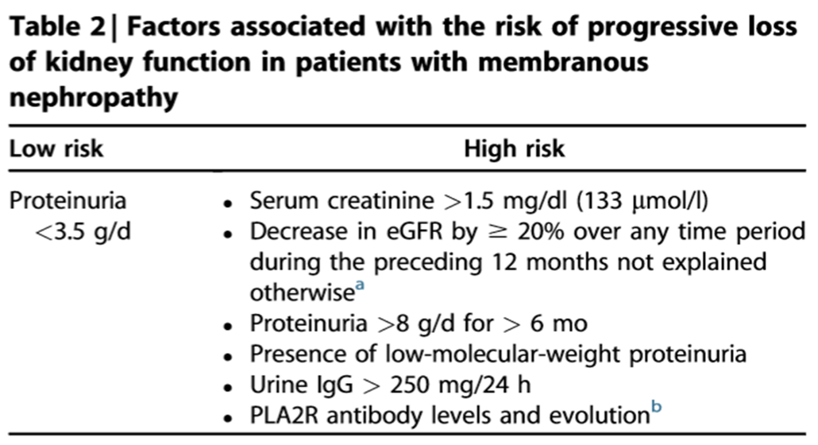
Biomarkers: diagnosis and prediction of prognosis
Because PLA2R antibodies predict membranous nephropathy with high speciﬁcity, a kidney biopsy may not be needed in anti PLA2R–positive patients with a low risk of disease progression and/or a high risk of biopsy-related morbidity
Floege J et al. Kidney Int. 2019; 95:268-280

Slide 18
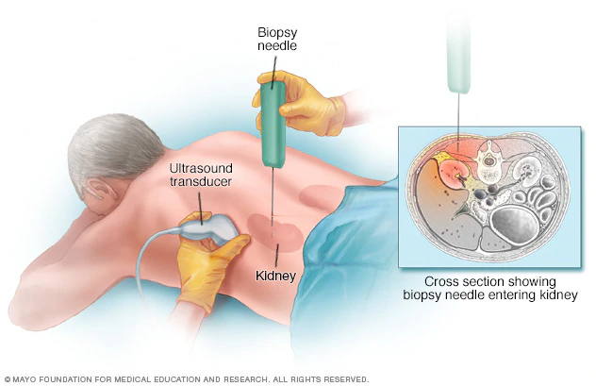
Biomarkers: diagnosis and prediction of prognosis
When immunosuppressive therapy is contemplated, performing a kidney biopsy is still recommended to exclude another concomitant process and to estimate the extent of chronic ﬁbrosis.
Patient Care & Health Information Tests & Procedures: Kidney biopsy
https://www.mayoclinic.org/tests-procedures/kidney-biopsy/about/pac-20394494
Notes:
The speciﬁcity of THSD7A antibodies in diagnosing membranous nephropathy is not well established.
The presence of PLA2R antibodies does not allow exclusion of a concurrent infection or cancer.

Slide 19
Biomarkers: diagnosis and prediction of prognosis
A kidney biopsy is indicated in cases of nephrotic syndrome and acute kidney injury because it may identify cases of membranous nephropathy with crescentic GN (anti–glomerular basement membrane or antineutrophil cytoplasmic antibody–associated) even in cases that are positive for anti-PLA2R.
Floege J et al. Kidney Int. 2019; 95:268-280
Notes:
When immunosuppressive therapy is contemplated, performing a kidney biopsy is still recom- mended to exclude another concomitant process and to estimate the extent of chronic fibrosis.

Slide 20
Biomarkers: diagnosis and prediction of prognosis
In anti-PLA2R–negative patients, a kidney biopsy is needed to diagnose membranous nephropathy.
In such patients, it is important to look at whether PLA2R staining is present in the glomeruli, because this will allow identiﬁcation of patients with PLA2R-associated membranous nephropathy.
In selected cases of membranous nephropathy, it may be important to look at IgG subclasses in the kidney biopsy, with IgG1 dominant staining being suggestive of secondary causes.
Floege J et al. Kidney Int. 2019; 95:268-280

Slide 21
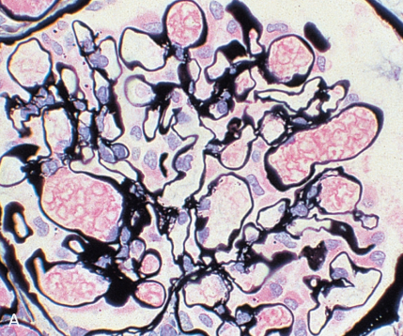
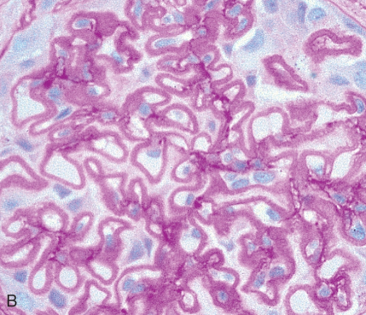
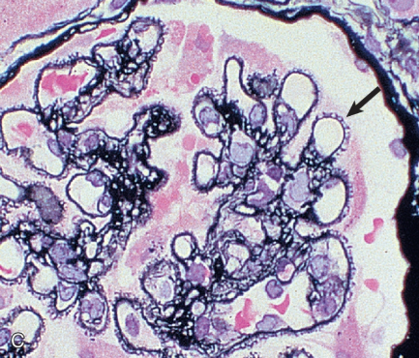
Membranous Nephropathy: Pathology
Notes:
Source: Feehally J, Floege J, Tonelli M, Johnson RJ. Comprehensive Clinical Nephrology, 6th Edn (2019)

Slide 22
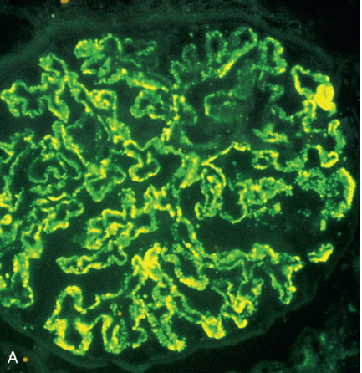
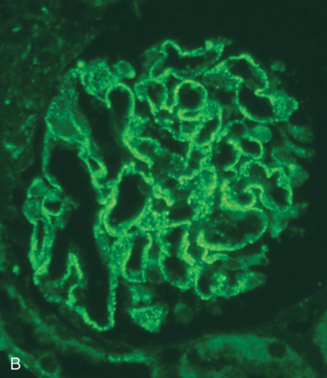
Membranous Nephropathy: Pathology
Notes:
Source: Feehally J, Floege J, Tonelli M, Johnson RJ. Comprehensive Clinical Nephrology, 6th Edn (2019)

Slide 23
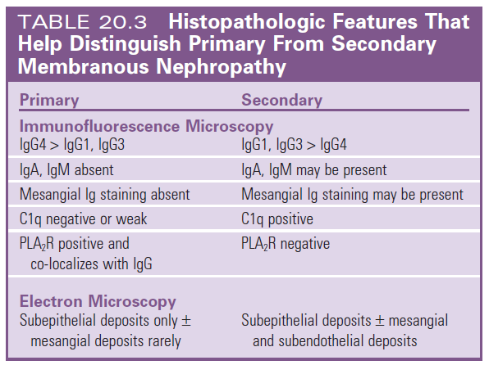
Membranous Nephropathy: Pathology
Notes:
Source: Feehally J, Floege J, Tonelli M, Johnson RJ. Comprehensive Clinical Nephrology, 6th Edn (2019)

Slide 24
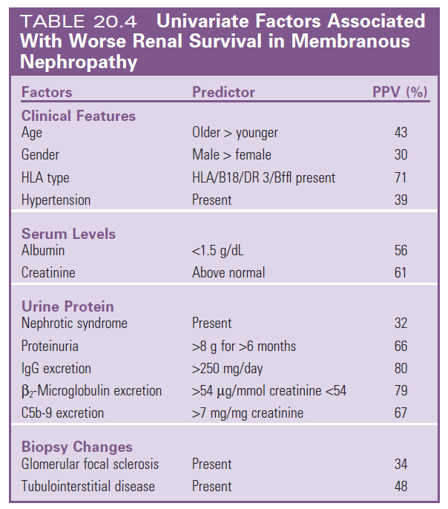
Membranous Nephropathy: Pathology
Notes:
Source: Feehally J, Floege J, Tonelli M, Johnson RJ. Comprehensive Clinical Nephrology, 6th Edn (2019)

Slide 25
Risk Stratification
Patients with membranous nephropathy and subnephrotic proteinuria have excellent long-term kidney survival and do not need immunosuppression.
Floege J et al. Kidney Int. 2019; 95:268-280

Slide 26
Among patients with nephrotic range proteinuria, disease severity varies and prognosis ranges from spontaneous remission to severe nephrotic syndrome and progression to kidney failure.
In such patients, the risks of immunosuppression should not exceed the short-term risks of nephrotic syndrome.
The current risk stratiﬁcation of patients who need treatment (>6 months of proteinuria >4 g/d) lacks speciﬁcity, as a substantial proportion of such patients may still develop spontaneous remission.
Risk Stratification
Floege J et al. Kidney Int. 2019; 95:268-280
Notes:
Models that use other cutoff points or that include the serial measurement of urinary low-molecular weight proteins, serum albumin, and eGFR may allow better assessment of the risk of disease complications and/or progression.

Slide 27
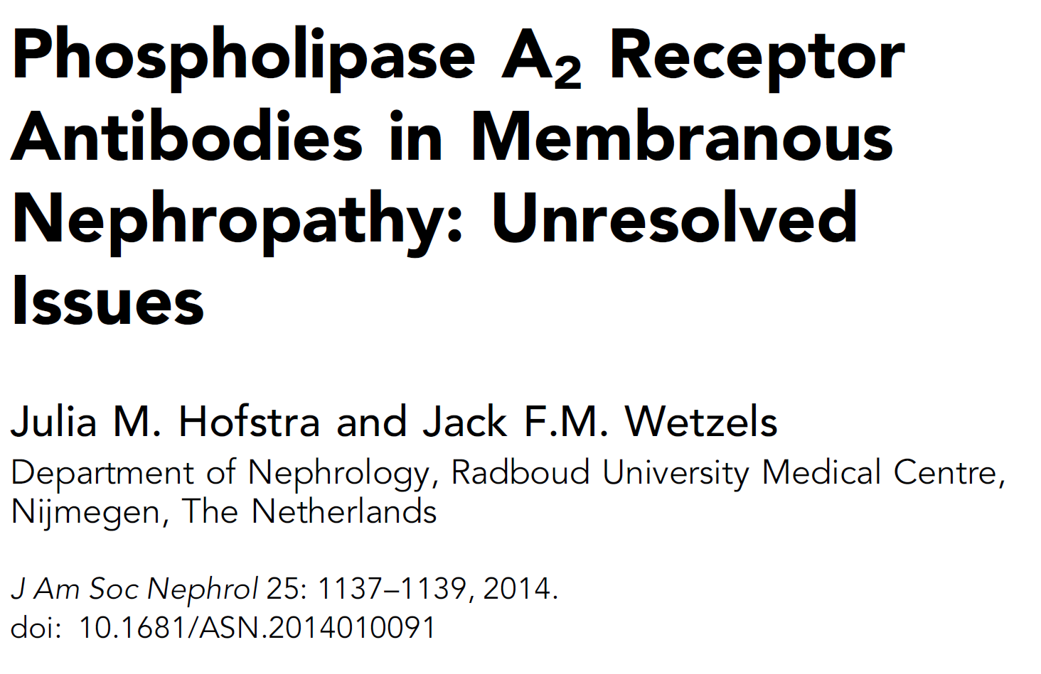
Emerging data point to the prognostic value of quantitatively measuring PLA2R antibody levels and possibly qualitatively deﬁning the spread of their target epitopes.

Slide 28
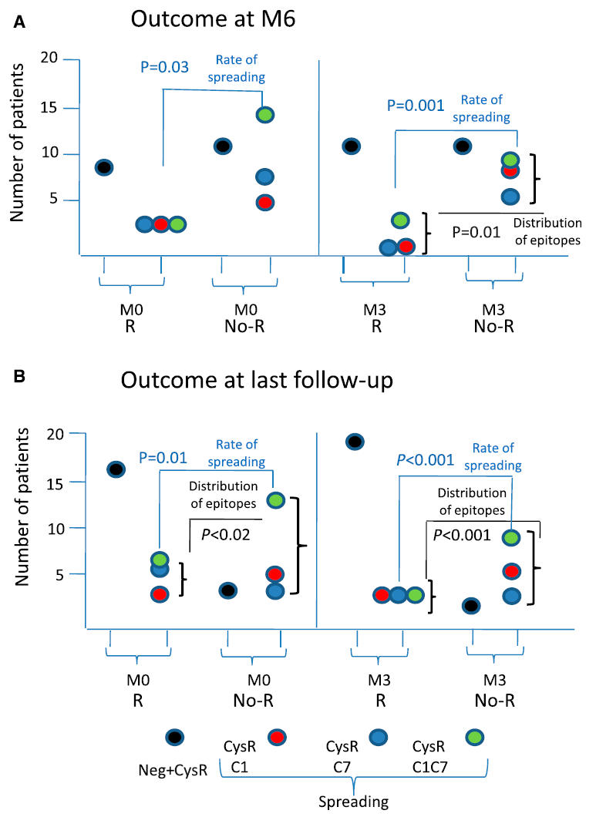
Emerging data point to the prognostic value of quantitatively measuring PLA2R antibody levels and possibly qualitatively deﬁning the spread of their target epitopes.
In PLA2R-positive patients, low antibody levels appear to predict a greater likelihood of spontaneous remission than high levels. Conversely, patients with antibodies targeting 2 or 3 target epitope domains may be less likely to develop a spontaneous remission.

Slide 29
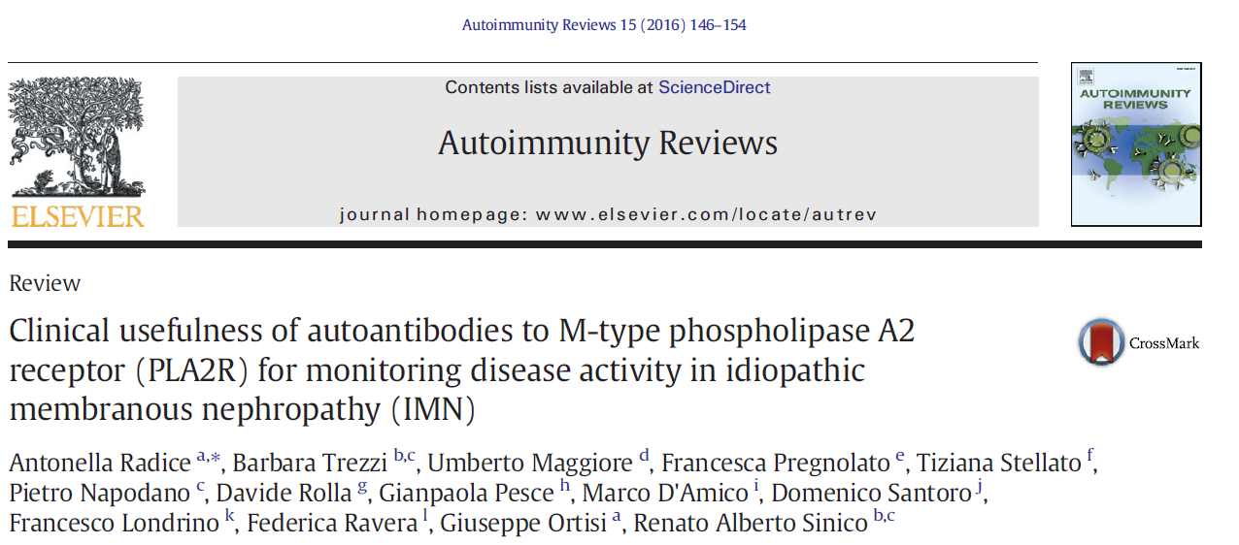
A recent study showed that changes in PLA2R antibody levels during follow-up were correlated with changes in proteinuria.
Because this study included treated patients, data are lacking on the value of monitoring the trend of PLA2R antibody levels prior to immunosuppressive therapy to guide the decision to initiate such treatment or the choice of therapeutic agents.

Slide 30
TREATMENT

Slide 31
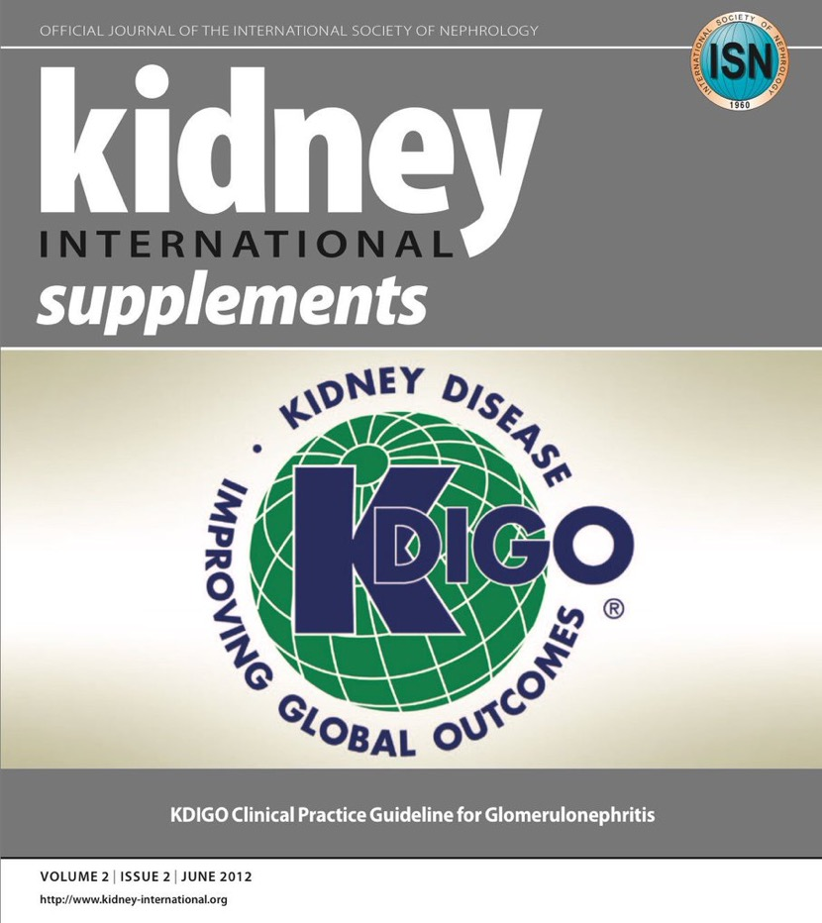
Membranous Nephropathy: Treatment
7.2: Selection of adult patients with IMN to be considered for treatment with immunosuppressive agents
7.2.1: We recommend that initial therapy be started only in patients with nephrotic syndrome AND when at least one of the following conditions is met:
Urinary protein excretion persistently exceeds 4 g/d AND remains at over 50% of the baseline value, AND does not show progressive decline, during antihypertensive and antiproteinuric therapy during an observation period of at least 6 months; (1B)
The presence of severe, disabling, or life-threatening symptoms related to the nephrotic syndrome; (1C)
SCr has risen by 30% or more within 6 to 12 months from the time of diagnosis but the eGFR is not less than 25–30 ml/min/1.73 m² AND this change is not explained by superimposed complications. (2C)

Slide 32
Membranous Nephropathy: Treatment
Besides preservation of kidney function and proteinuria remission, future goals of treatment should include:
improvement of patient-related outcomes and quality-of-life measures (for which validated instruments should be developed) and
prevention of cardiovascular and thromboembolic events, infections, and patient mortality
There is consensus that immunosuppression should be started in the presence of decreasing GFR or, in particular, severe life-threatening nephrotic syndrome.

Slide 33
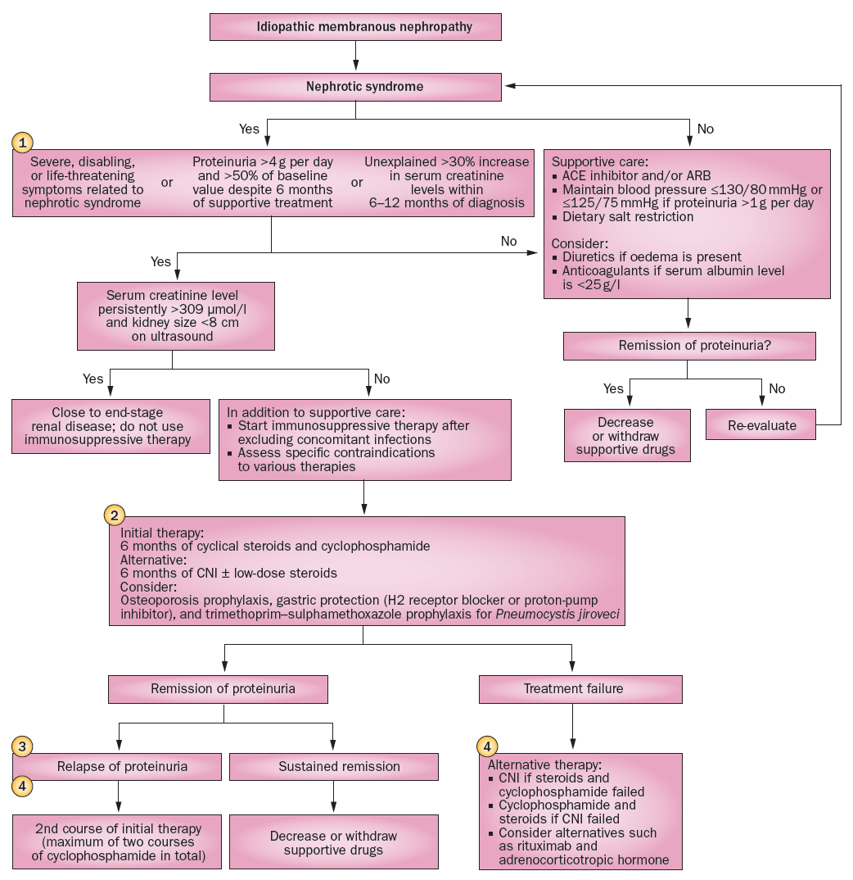
In patients with minimal symptoms and preserved kidney function, delaying immunotherapy while maximizing treatment of proteinuria, hypertension, and hyperlipidemia for up to 3 years may be acceptable.
Hofstra JM et al. Nat Rev Nephrol. 2013; 9:443-458
Notes:
The availability of less toxic treatments may lead to earlier initiation of immunotherapy to allow more rapid disappearance of symptoms of nephrotic syndrome.
Apart from small kidney size, there is no other threshold for which treatment is deemed futile. Therapy can stabilize even patients with eGFR <30 ml/min/1.73 m².

Slide 34
7.3: Initial therapy of IMN
7.3.1: We recommend that initial therapy consist of a 6-month course of alternating monthly cycles of oral and i.v. corticosteroids, and oral alkylating agents. (1B)
7.3.2: We suggest using cyclophosphamide rather than chlorambucil for initial therapy. (2B)
7.3.6: We suggest that continuous daily (noncyclical) use of oral alkylating agents may also be effective, but can be associated with greater risk of toxicity, particularly when administered for 46 months.
(2C)

Slide 35
Treatment with immunosuppressive agents
All patients should undergo screening for infections and an age-appropriate screening for malignancies prior to commencing immunosuppressive therapy.

Slide 36
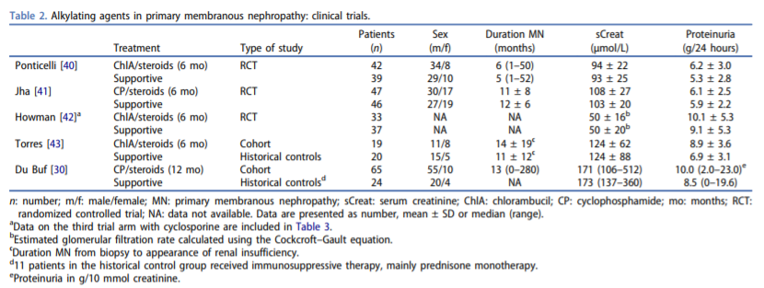
Alkylating agents remain the only agents proven effective in preventing kidney
failure or death
Notes:
Given their toxicity, alkylating agents should only be prescribed by experienced physicians and restricted to patients at high risk of progression.

Slide 37
Current and previous smokers may be at particularly increased risk for subsequent bladder or lung cancer associated with exposure to cytotoxic agents.

Slide 38
Special consideration should likewise be given to patients of childbearing age because of the risk of infertility associated with these agents.

Slide 39
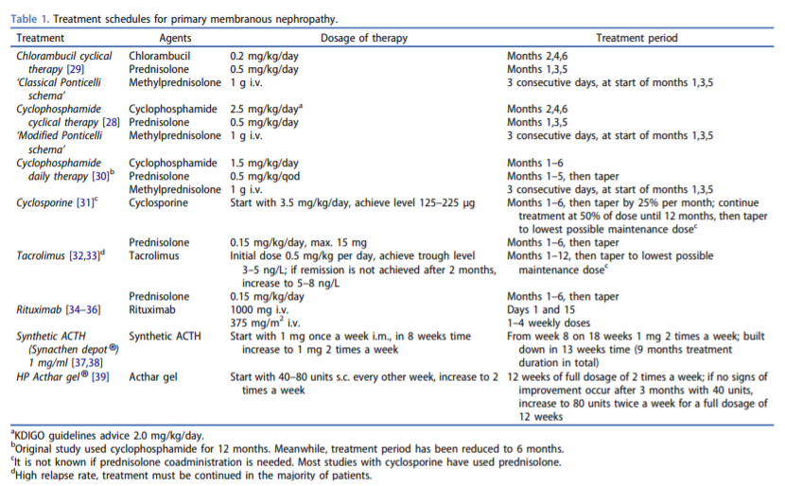
Notes:
Source: van de Logt AE et al. Expert Rev Clin Pharmacol. 2016; 9:1463-1478.

Slide 40
Historically, treatment with an alkylating agent had been cyclical and accompanied
by pulses of IV methylprednisolone.
Other regimens are used in clinical practice, including daily cyclophosphamide
and omission of pulses of methylprednisolone.
Notes:
Source: van de Logt AE et al. Expert Rev Clin Pharmacol. 2016; 9:1463-1478.

Slide 42
7.4: Alternative regimens for the initial therapy of IMN: CNI therapy
7.4.1: We recommend that cyclosporine or tacrolimus be used for a period of at least 6 months in patients who meet the criteria for initial therapy, but who choose not to receive the cyclical corticosteroid/alkylating-agent regimen or who have contraindications to this regimen. (1C)
7.4.2: We suggest that CNIs be discontinued in patients who do not achieve complete or partial remission after 6 months of treatment. (2C)

Slide 43
7.4.3: We suggest that the dosage of CNI be reduced at intervals of 4–8 weeks to a level of about 50% of the starting dosage, provided that remission is maintained and no treatment-limiting CNI-related nephrotoxicity occurs, and
continued for at least 12 months. (2C)
7.4.4: We suggest that CNI blood levels be monitored regularly during the initial treatment period, and whenever there is an unexplained rise in SCr (> 20%) during therapy. (Not Graded)

Slide 44
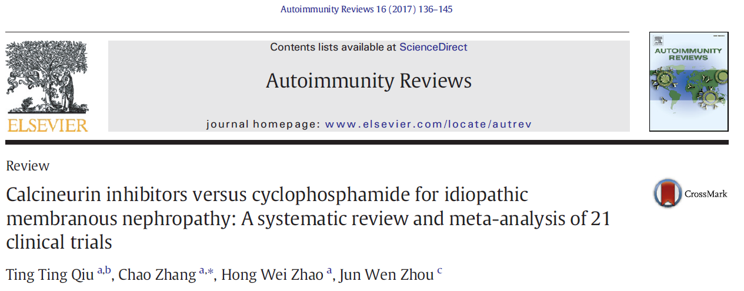
Therapy with calcineurin inhibitors induced remissions with similar
frequency as cyclophosphamide but was associated with a higher
relapse rate
Notes:
Other immunosuppressive agents only used proteinuria reduction as the endpoint.

Slide 45
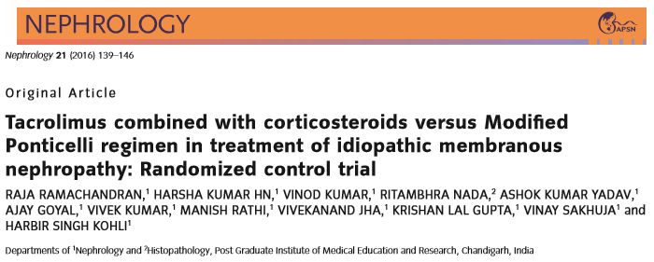
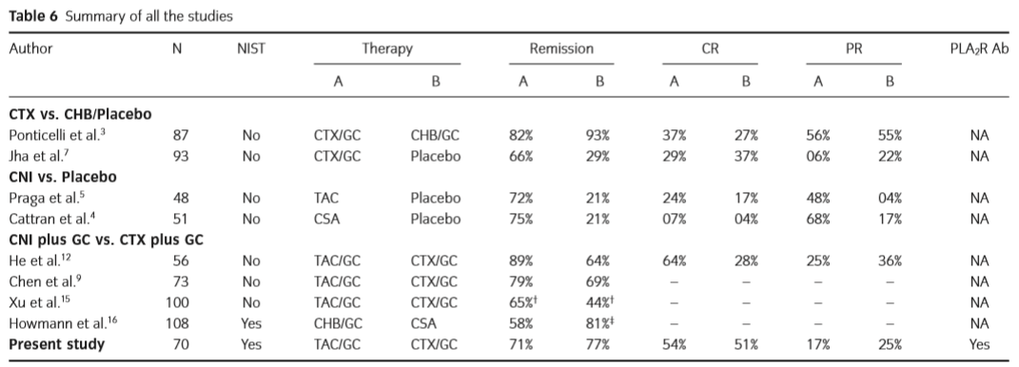
Therapy with calcineurin inhibitors
induced remissions with similar
frequency as cyclophosphamide
but was associated with a higher
relapse rate
Notes:
Other immunosuppressive agents only used proteinuria reduction as the endpoint.

Slide 48
Continued daily use of a calcineurin inhibitors may maintain remission;
however, the consequences of long-term therapy are unknown

Slide 49
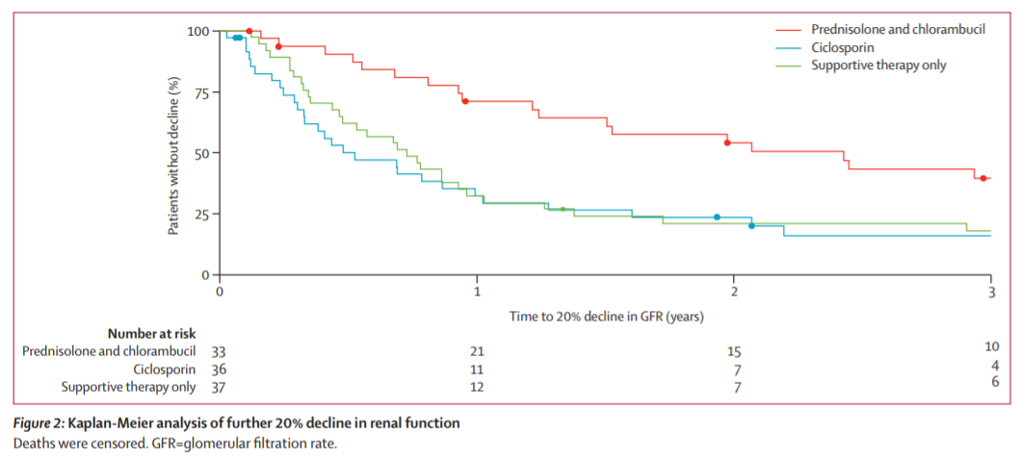
In 1 RCT, chlorambucil, but not cyclosporine, reduced eGFR loss in
membranous nephropathy with renal insufﬁciency
Notes:
Continued daily use of a calcineurin inhibitors may maintain remission; however, the consequences of long-term therapy are unknown

Slide 50
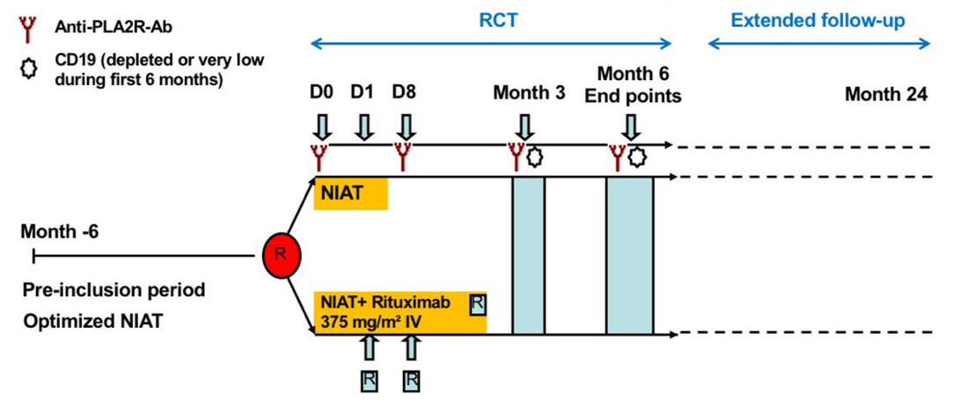
In the Evaluate Rituximab Treatment for Idiopathic Membranous Nephropathy
(GEMRITUX) study, rituximab was more effective than placebo in inducing
remissions after 17 months.
The nonresponse rate to rituximab was approximately 35%.

Slide 52
In the Evaluate Rituximab Treatment for Idiopathic Membranous Nephropathy
(GEMRITUX) study, rituximab was more effective than placebo in inducing
remissions after 17 months.
The non-response rate to rituximab was approximately 35%.

Slide 53
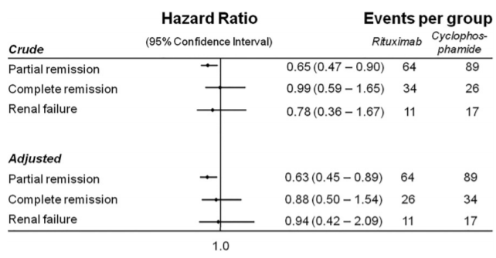
A recent retrospective propensity-matched cohort study suggested lower partial
remission rates with rituximab versus cyclophosphamide

Slide 54
Floege J, et al. Kidney Int. 2019; 95:268-280
Measurement of PLA2R antibodies might aid in predicting treatment response
Notes:
The choice of first-line therapy still awaits direct head-to-head trials. It is likely that the choice of therapy may be determined by improved risk-stratification models.

Slide 55
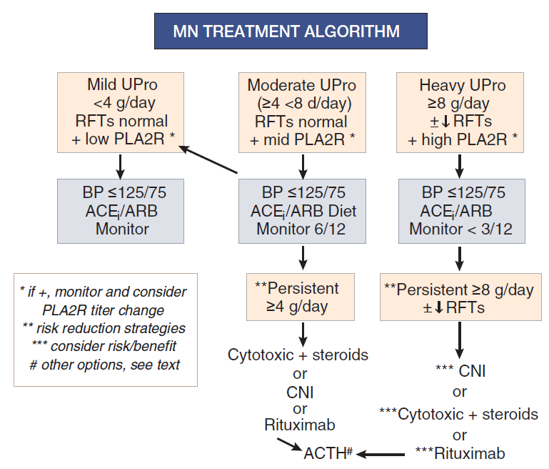
Disease Monitoring
PLA2R antibody levels may be valuable for monitoring treatment and follow-up.
Cattran DC, Brenchley PE. Kidney Int. 2017; 91: 566-574

Slide 56
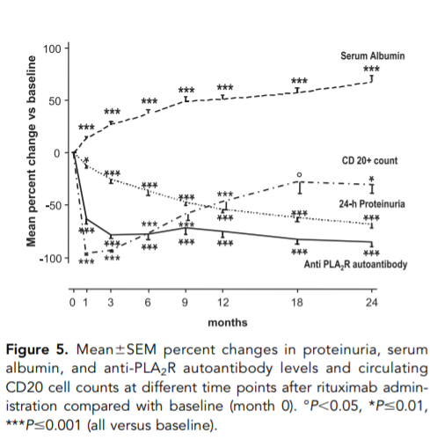
Complete remissions are almost always associated with the disappearance of PLA2R antibodies.
Although declining antibody levels may precede clinical remission, it is currently unclear to what extent a decrease predicts a subsequent remission.
Therefore, serial monitoring of PLA2R antibodies during treatment requires further study.

Slide 57
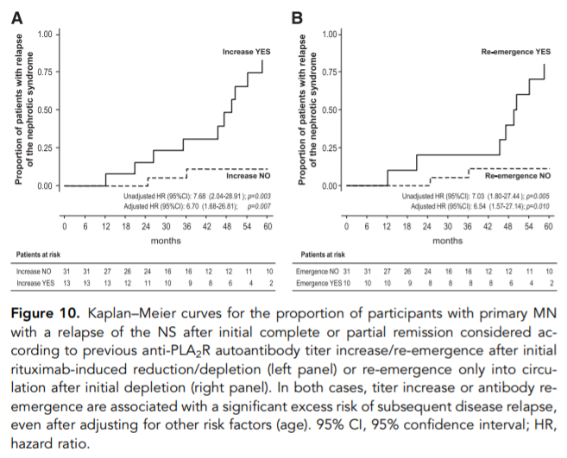
During remission of proteinuria, there is no evidence to support preemptive therapy based on rising antibody levels alone.
Still, measuring PLA2R antibodies in patients with a recurrence or worsening of proteinuria should help distinguish between relapse and other causes of proteinuria

Slide 58
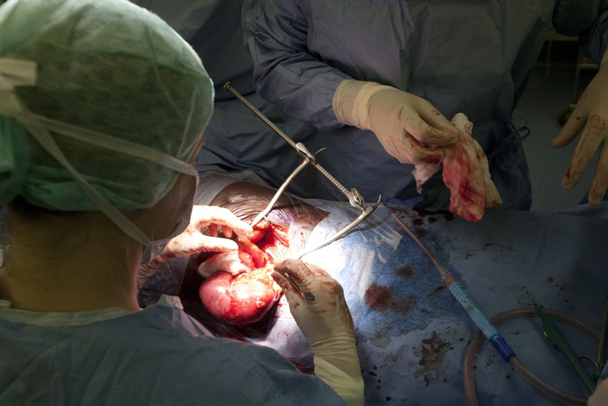
Persistent anti-PLA2R antibodies prior to kidney transplantation are associated with an increased risk of recurrence of membranous nephropathy in the allograft.
There are insufficient data to assess whether a kidney transplant should be delayed until the antibodies become negative and for how long.

Slide 59
Conditions under which a repeat biopsy or screening workup for infections, malignancy, or other causes of nephrotic syndrome should be done are not well defined.
Floege J et al. Kidney Int. 2019; 95:268-280

Slide 60
FUTURE STUDIES

Slide 61
Notes:
Courtesy of Dr. Pierre Ronco

Slide 65
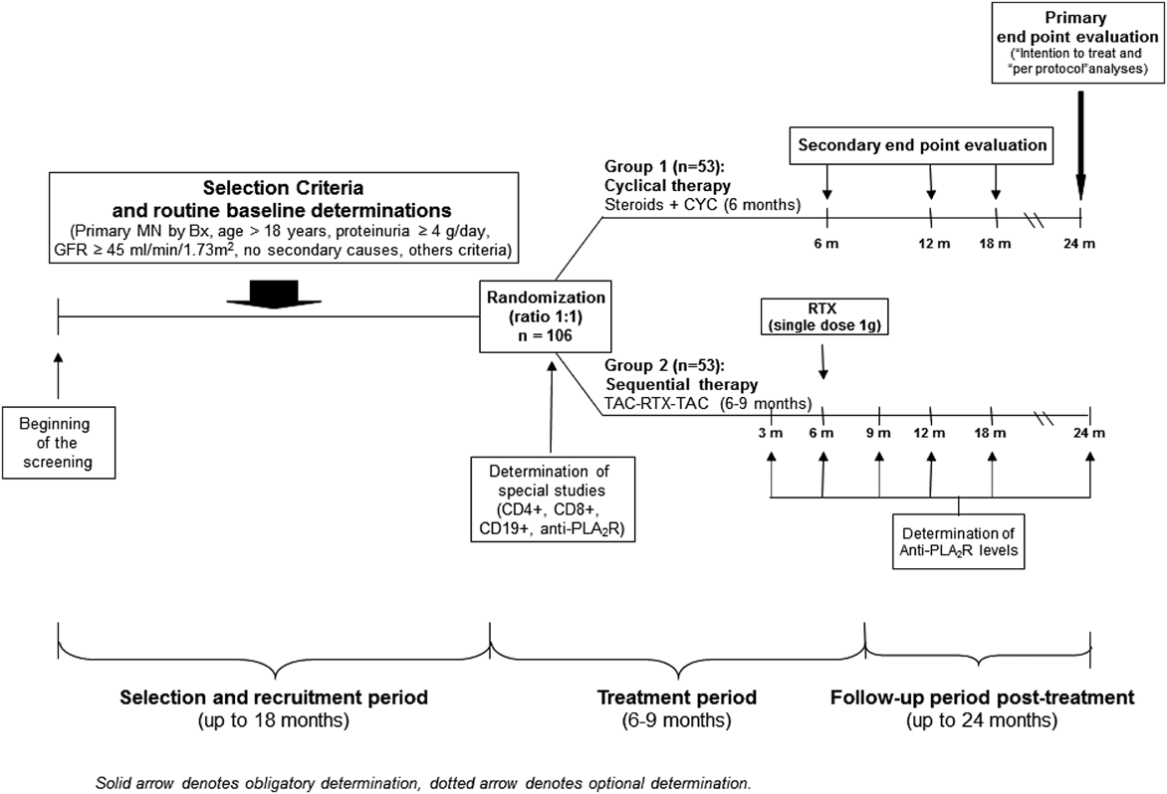
Schematic overview of STARMEN study
Rojas-Rivera J, et al. Clin Kidney J. 2015; 8:503-510
The STARMEN study (which compares tacrolimus (TAC) and rituximab (RTX) vs cyclical cyclophosphamide (CYC) and corticosteroids [the Ponticelli regimen]) report is expected soon

Slide 66
With respect to trial design, complete remission (proteinuria <0.3 g/day combined with stable glomerular filtration rate) may be used as a surrogate endpoint.
Partial remission (50% reduction of proteinuria to a level <3.5 g/d) should be evaluated as a surrogate endpoint
The role of serum albumin in defining partial remission needs further formal evaluation, and the serum albumin assays require harmonization
Additional research is required to develop more accurate risk-stratification models which incorporate other biomarkers of disease in addition to proteinuria—including qualitative and quantitative measures of autoantibodies

Slide 67
KEY POINTS
The discovery of antibodies against intrinsic podocyte antigens (PLA2R and thrombospondin-like domain 7A [THSD7A]) established that membranous nephropathy is an autoimmune disease.
Emerging data point to the diagnostic, prognostic, and disease-monitoring value of measuring antiPLA2R antibodies levels.
Because PLA2R antibodies predict membranous nephropathy with high speciﬁcity, a kidney biopsy may not be needed in antiPLA2R–positive patients with a low risk of disease progression and/or a high risk of biopsy-related morbidity.
The presence of PLA2R antibodies does not allow exclusion of a concurrent infection or cancer.
There is consensus that immunosuppression should be started in the presence of decreasing GFR or, in particular, severe life-threatening nephrotic syndrome. In patients with minimal symptoms and preserved kidney function, delaying immunotherapy while maximizing treatment of proteinuria, hypertension, and hyperlipidemia for up to 3 years may be acceptable.

Slide 68
CLINICAL VIGNETTES

Slide 69
CASE 1
A 65-year-old man, with a past history of hypertension controlled on amlodipine, presented to the ER with bilateral lower limb swelling for the past 10 days. He has a 30-year history of smoking 1 pack per day but quit 5 years ago. On review, he mentions increased frothiness in his urine.
His physical examination reveals a blood pressure of 140/90 mm Hg, and a heart rate of 80 beats/ min. He has bilateral lower limb swelling extending to the thighs. He weighs 80 kg compared to a baseline of 75 kg 3 months ago. Cardiovascular examination shows normal heart sounds. His chest is clear to auscultation. The rest of his examination is unremarkable.
On laboratory investigations, his serum creatinine is 1.7 mg/dl, 24-hour urine protein is 10 g/day. Serum albumin is 11 g/l, hemoglobin 123 g/l.
His kidney biopsy shows features of membranous nephropathy, with GBM thickening on light microscopy and by IF, IgG and C3 deposition in a granular fashion was seen and confirmed by subepithelial electron dense deposits on EM. His glomerular tissue staining for PLA2R is positive.

Slide 70
Which of the following steps in management should NOT be introduced at this time?
Add ramipril 5 mg once daily.
Start cyclosporine 125 mg twice daily.
Begin anticoagulation for venous thromboembolism prophylaxis.
D. Obtain CT chest to rule out lung cancer

Slide 71
The answer is B.
The patient has newly diagnosed MN. Although he is anti-PLA2R positive, the long history of smoking makes it imperative that lung cancer is ruled out by performing a chest CT.
He is hypertensive and thus should be started on angiotensin II blockade, which may also reduce proteinuria. The fact that he is severely nephrotic with a serum albumin of 11 g/l raises consideration for anticoagulation prophylaxis, unless contraindicated.
We do not have information on serum anti-PLA2R levels and they are crucial in ascertaining probability for spontaneous remission and to guide introduction of immunosuppression (De Vriese, et al. J Am Soc Nephrol. 2017;28(2):421–430).
As such, initial therapy in this case should be maximizing conservative therapy with low-sodium and low-protein diet, angiotensin II blockade, and blood pressure control

Slide 72
CASE 2
A 56-year-old man was diagnosed with primary membranous nephropathy a year ago with an initial 24-hour urine protein of 7 g/day, serum albumin of 30 g/l and normal serum creatinine.
After 6 months of conservative therapy, his 24-hour urine protein remains unchanged at 7 g/day.
Immunosuppressive treatment options were reviewed with the patient and he chose to be treated with a calcineurin inhibitor, cyclosporine.
After 6 months of treatment with appropriate trough levels, his 24-hour urine protein was 3 g/day, his albumin was up to 34 g/l, and his creatinine was unchanged.
His latest 12-hour cyclosporine trough level was 143 μg/l. He has had no complaints related to his treatment.

Slide 73
Which of the following would be the next step in the management of this patient?
Cyclosporine should be discontinued as he has achieved a good response.
Cyclosporine should be discontinued and treatment with rituximab should be trialed as there is still residual disease.
A repeat kidney biopsy should be considered to assess disease activity.
Cyclosporine should be continued since stopping this treatment at this stage is associated with a high risk of relapse.

Slide 74
The answer is D.
Current recommendations are to continue calcineurin inhibitors for at least 12 months in patients that are responding to the therapy.
Early discontinuation, especially in a patient who is in partial remission since early discontinuation of therapy, is likely to result in a relapse (Cattran, et al. Kidney Int. 2007;72(12):1429–1447).
Several studies have shown that nadir of proteinuria, in patients who are responding to therapy, may not be achieved until after 18–24 months (Ruggenenti, et al. J Am Soc Nephrol. 2012;23(8):1416–1425; Ponticelli, et al. J Am Soc Nephrol. 1998;9(3):444–450).
There is no role for repeating a kidney biopsy at this stage.
Monitoring serum antiPLA2R levels may also help in tailoring immunosuppressive therapy in patients with a positive antibody (De Vriese, et al. J Am Soc Nephrol. 2017;28(2):421–430)

Slide 75
Conclusions
Major progress has been made in our understanding of disease pathogenesis in membranous nephropathy
Old problems still exist, such as the optimal process for assessing kidney function, kidney disease activity, and proteinuria
Several phase 3 trials are currently underway in patients with membranous nephropathy
Recent attempts to redefine surrogate outcomes, such as full remission in membranous nephropathy, will further bolster the field
IgAN, immunoglobulin A nephropathy

Slide 76
KDIGO THANKS THE FOLLOWING PARTNERS FOR THEIR SUPPORT OF THIS SPEAKER’S GUIDE

Slide 77
FOLLOW KDIGO
www.kdigo.org
/goKDIGO
@goKDIGO
@goKDIGO

