Slide 1
MANAGEMENT AND TREATMENT OF GLOMERULAR DISEASES
Membranoproliferative
Glomerulonephritis
CONCLUSIONS FROM A
KDIGO CONTROVERSIES CONFERENCE

Slide 2
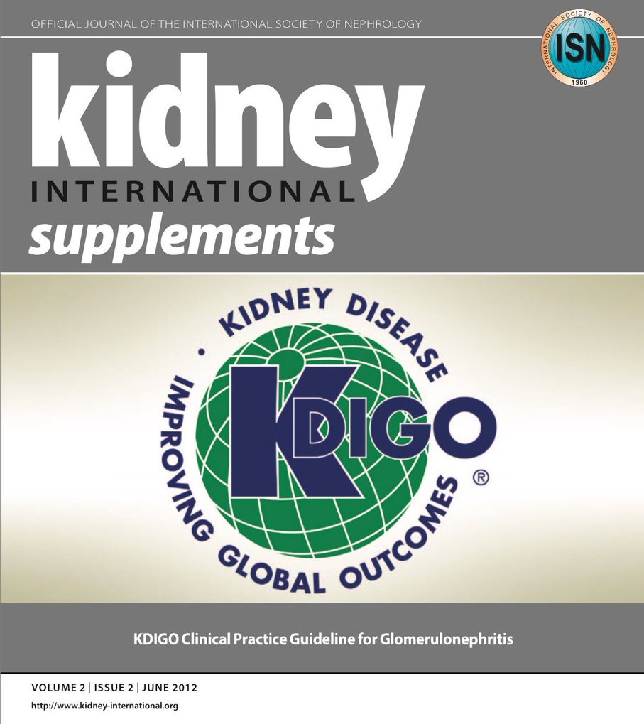
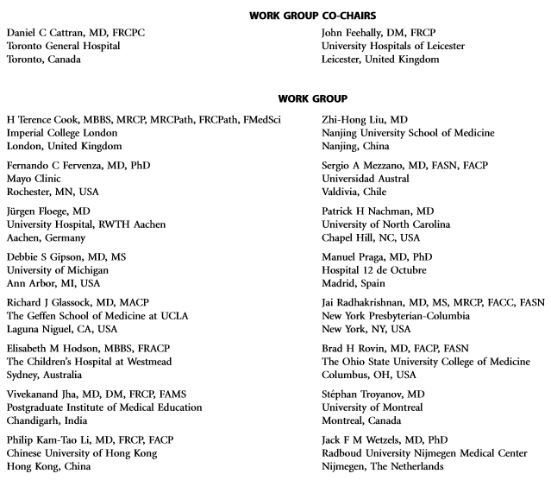
Notes:
Kidney Disease: Improving Global Outcomes (KDIGO) published its ﬁrst guideline on glomerular diseases in 2012. Available online at www.kdigo.org

Slide 3
#KDIGOGNConference
KDIGO Controversies Conference on Glomerular Diseases
Singapore, November 2017
Notes:
Given the enormous advances in understanding the pathogenesis of glomerular diseases, identiﬁcation of new diagnostic biomarkers, and emerging therapies, about 100 experts from various disciplines (nephrology, pathology, rheumatology, pediatrics) and organizations (academia, pharmaceutical industry) convened on November 17–19, 2017 for the KDIGO Controversies Conference on Glomerular Diseases. Through plenary sessions and small group discussions, the conference aimed to evaluate consensus and controversies in nomenclature, general work-up, and management of glomerular diseases, future needs in research, and, in particular, the critical assessment of existing guideline recommendations.

Slide 4
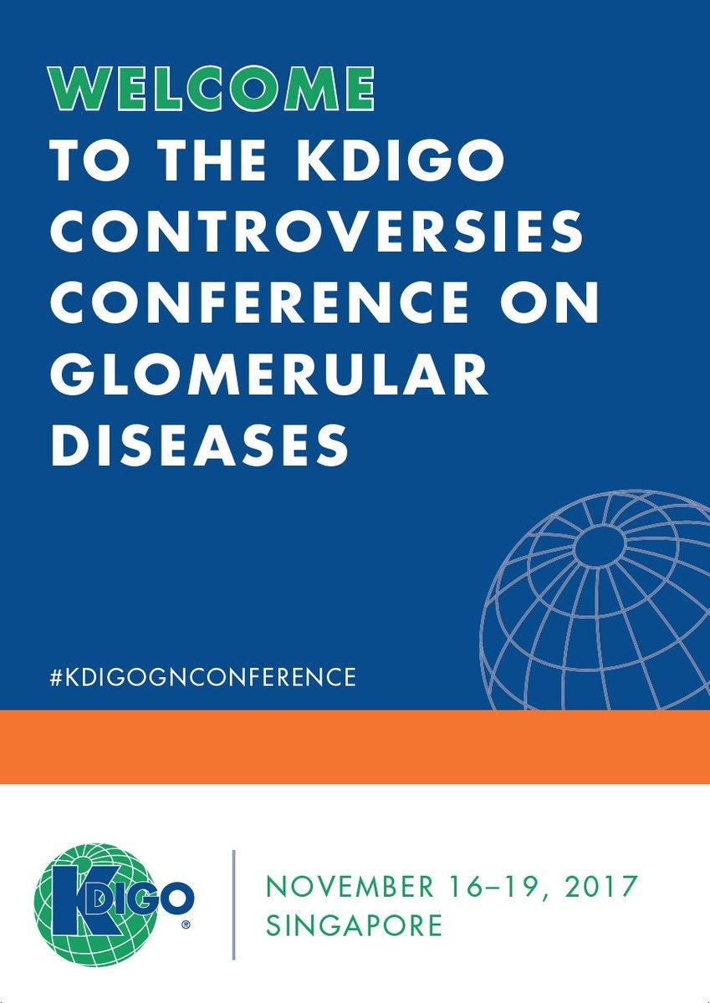
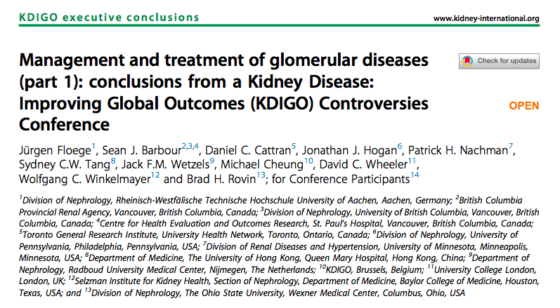
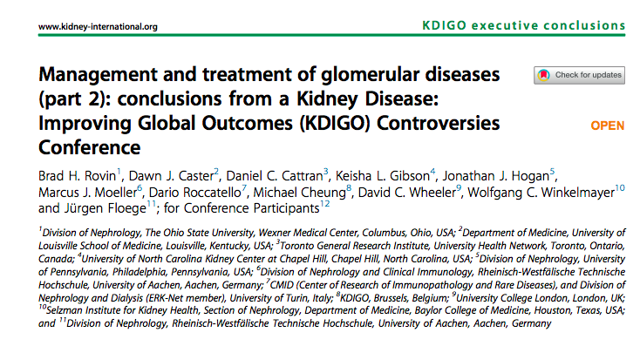
Notes:
The KDIGO Controversies Conference on Glomerular Diseases resulted in two publications in Kidney International in 2018.

Slide 5
Membranoproliferative Glomerulonephritis
Terminology
Pathogenesis
Biomarkers and Prediction of Prognosis
Treatment
Future Studies
Clinical Vignette

Slide 6
TERMINOLOGY

Slide 7
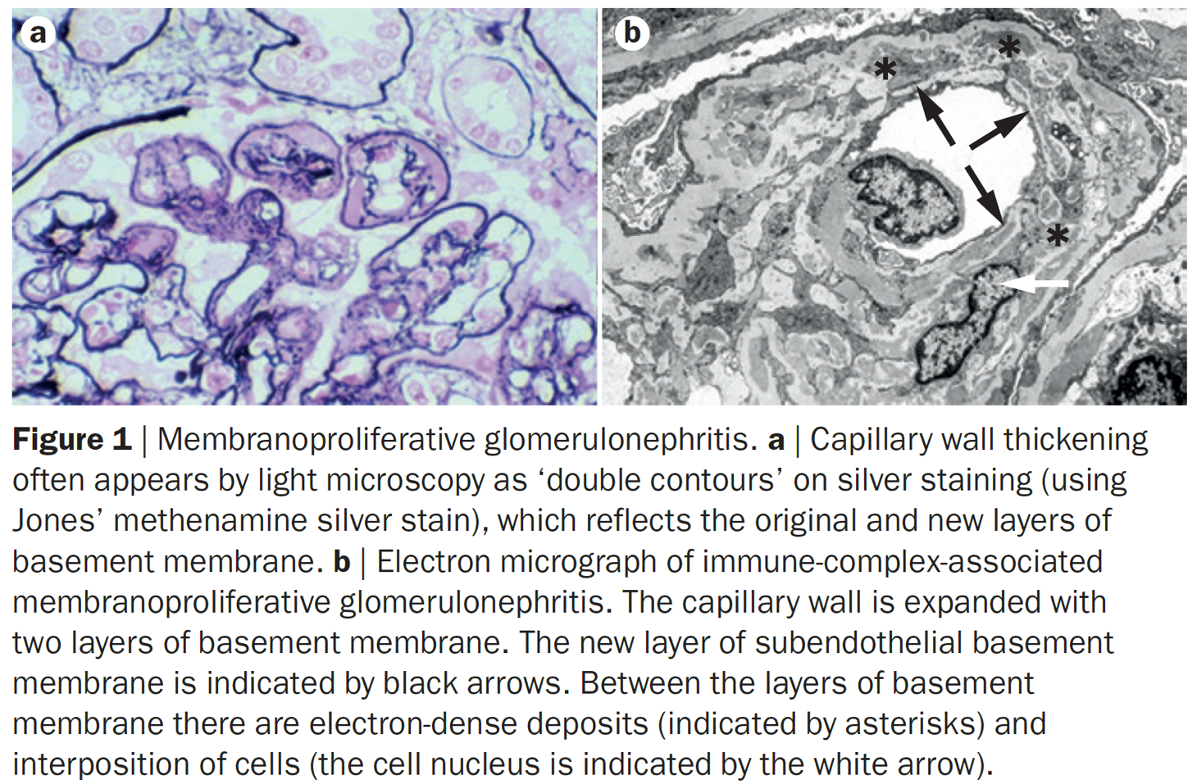
Notes:
The histology of these speciﬁc etiologies is not always membranoproliferative GN.

Slide 8
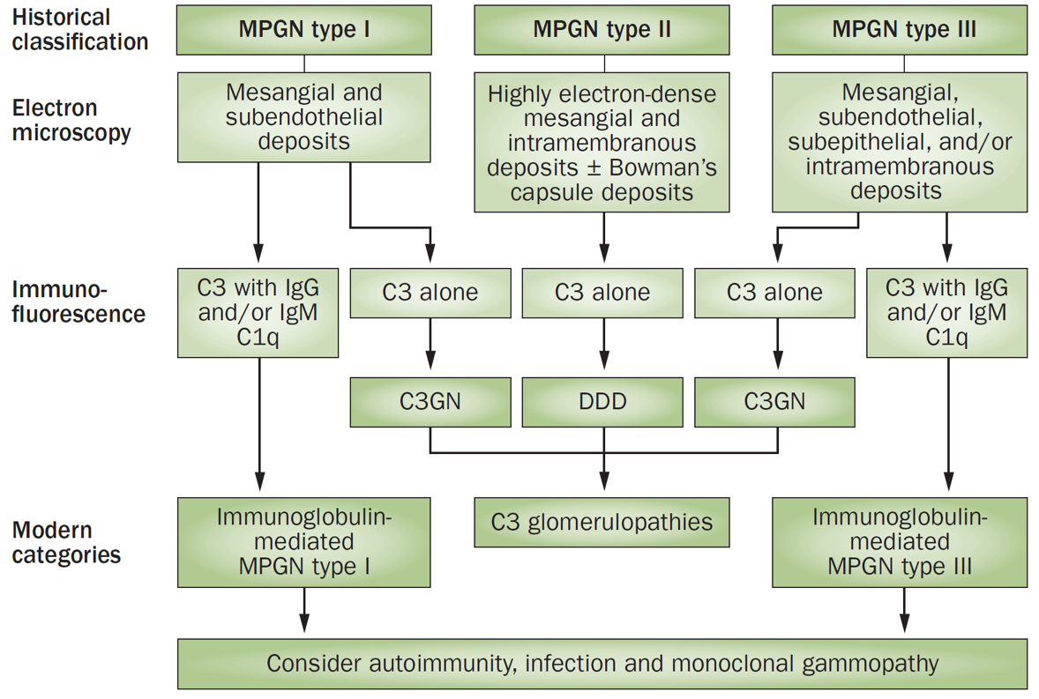
While the term “membranoproliferative” glomerulonephritis (GN) retains value as a histologic descriptor of glomerular injury, our increasing understanding of C3 glomerulopathy (C3G) and the monoclonal gammopathies of renal signiﬁcance (MGRS) (paraprotein-associated kidney diseases) illustrate the need for nomenclature based on pathogenesis and injury pattern.
Notes:
The histology of these speciﬁc etiologies is not always membranoproliferative GN.

Slide 9
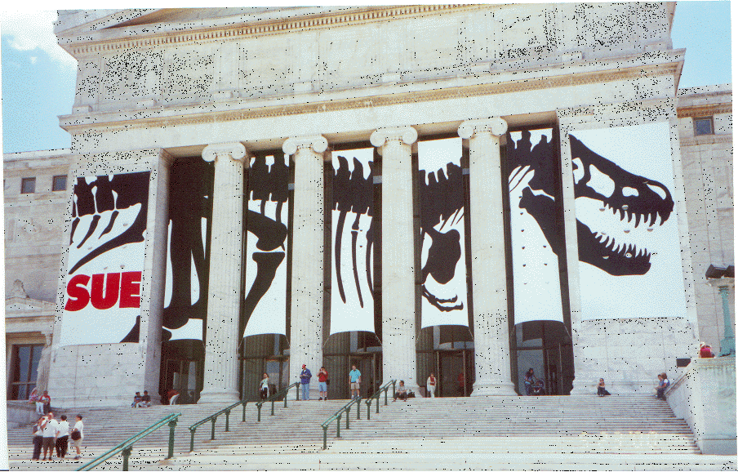
Over time, and with greater understanding of these diseases, using such a scheme may lead to the elimination of membranoproliferative GN as a distinct category of GN in clinical practice guidelines

Slide 10
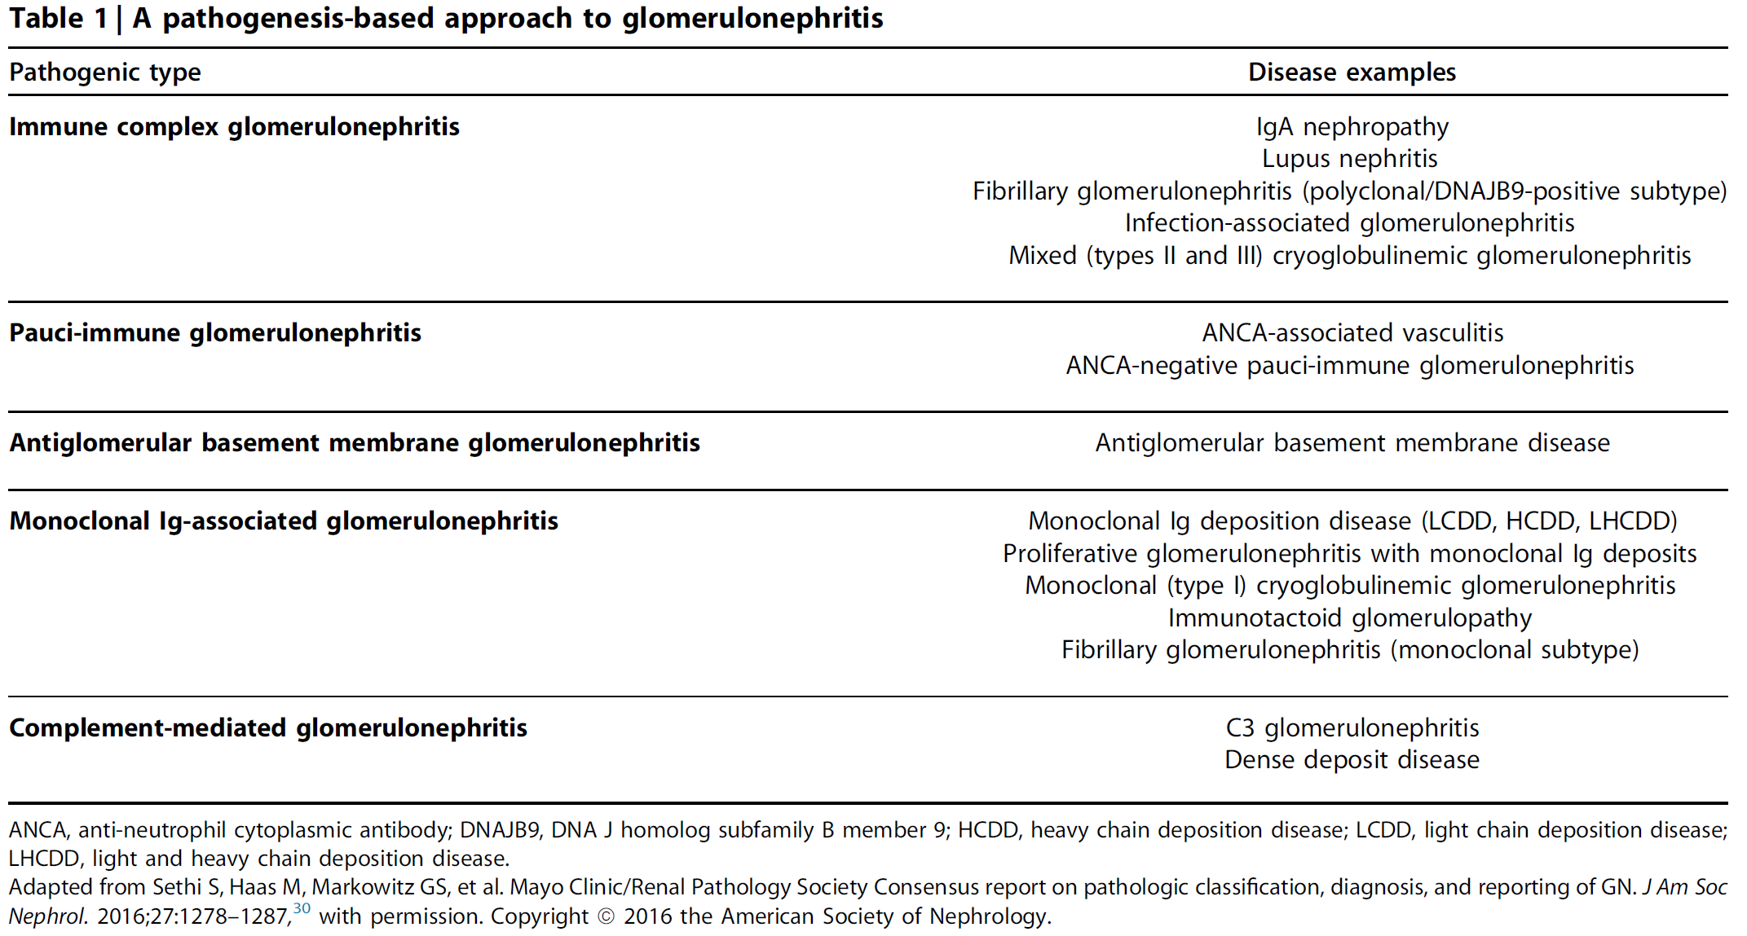
Notes:
Therefore, updated clinical practice guidelines should emphasize a diagnostic approach to GN that considers both pathobiology and renal histology.

Slide 11
C3 Glomerulopathies
Pathogenesis
Biomarkers and prediction of prognosis
Treatment

Slide 12
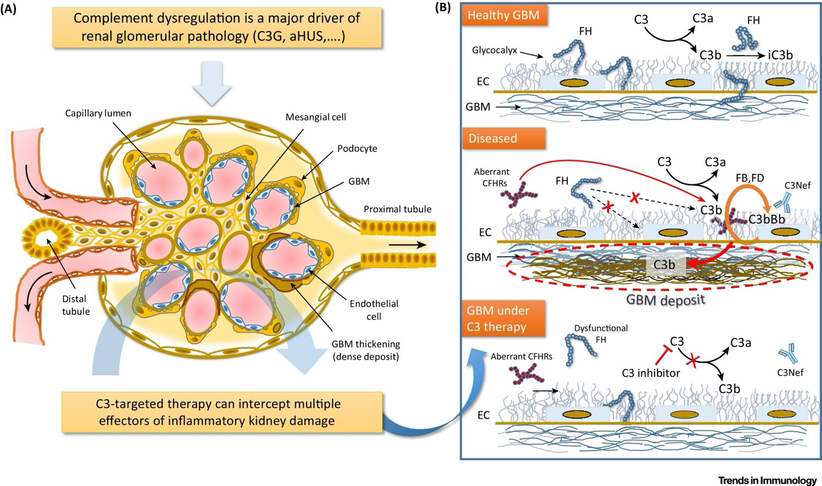
C3 Glomerulopathies: Pathogenesis
Mastellos DC., et al. Trends Immunol. 2017; 38:383-394

Slide 13
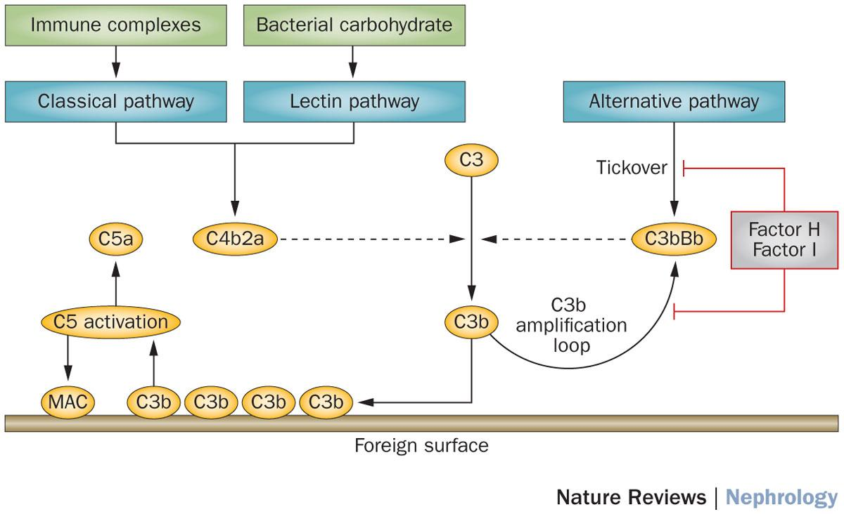
C3 Glomerulopathies: Pathogenesis
C3G is caused by abnormal complement activation, deposition and/or degradation.
Notes:
Drivers of disease are reviewed in the recent KDIGO Controversies Conference report (Kidney Int. 2017; 91: 539-551).
While it was generally agreed that human and animal data support the role of complement in well-described scenarios, as a matter of practicality it continues to be difﬁcult to substantiate the causal role of either single nucleotide changes or C3 nephritic factors in the majority of cases. Furthermore, the interpretation of published data is confounded by heterogeneity in the kidney biopsy criteria used for diagnosis. Addressing these controversies is especially important given that targeted anti-complement agents are available.

Slide 14
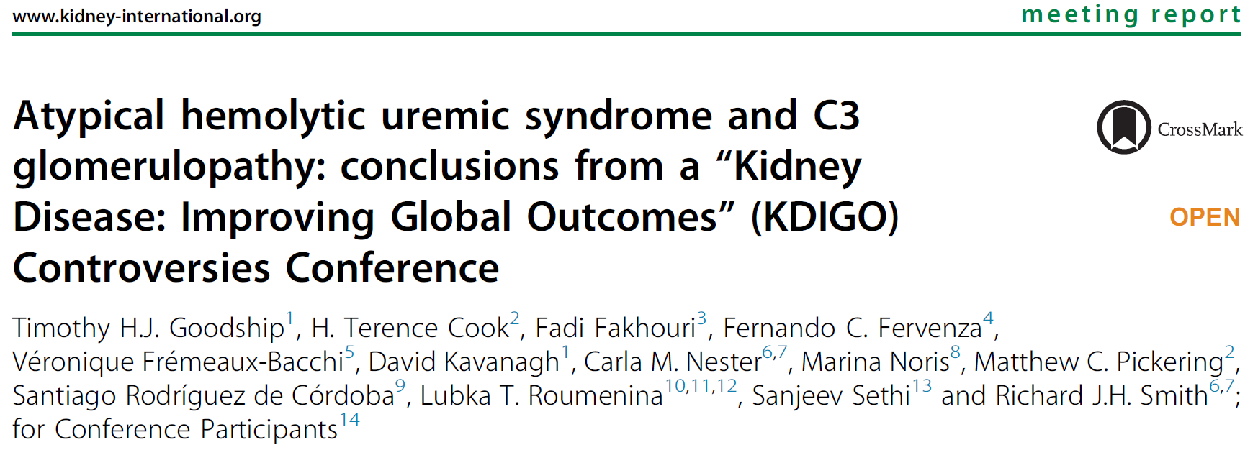
Notes:
The role of biomarkers in the diagnosis and management of C3G has been summarized recently.

Slide 15
Biomarkers and Prediction of Prognosis
The utility of biomarkers such as soluble C5b-9 levels for predicting treatment response remains unclear.
Controversy remains regarding the clinical utility of an extended biomarker assessment at diagnosis, and the use of serial complement testing requires further study.
Testing for paraproteins in C3G has also received increased attention.

Slide 16
C3G: TREATMENT

Slide 17
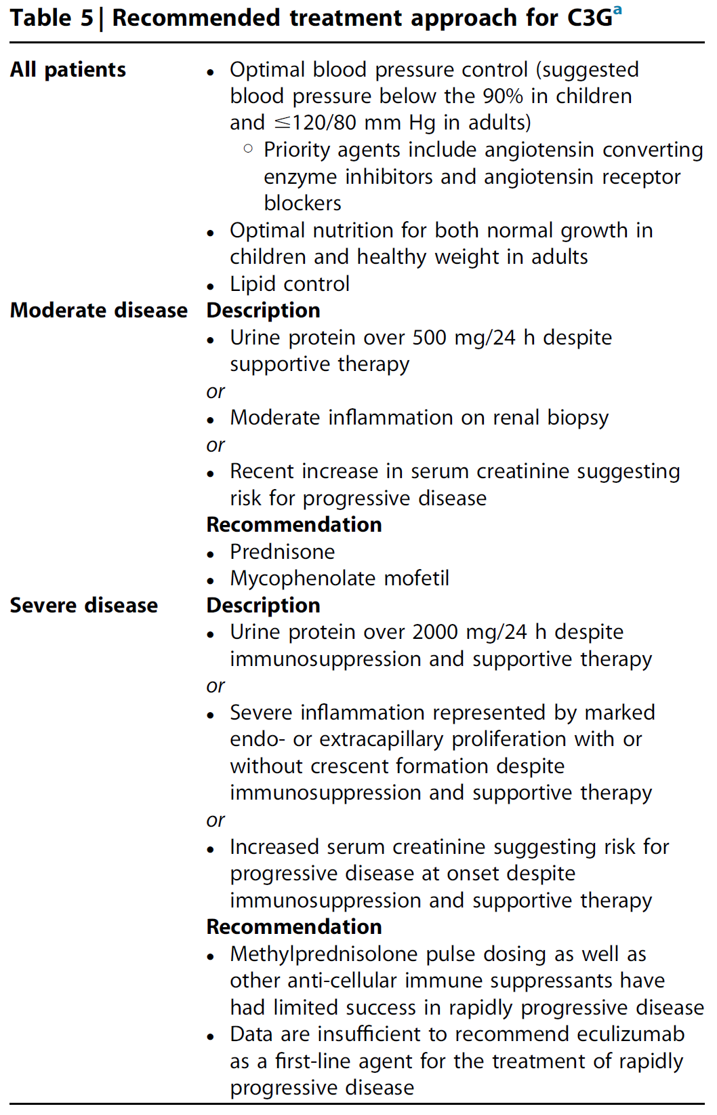
A contemporary approach to the treatment of C3G has been outlined, derived mostly from case reports and retrospective case series.
Current treatments have been empirically extrapolated from other glomerular diseases.
The optimal duration of therapy remains unclear.
Notes:
An important knowledge gap in the treatment of C3G is the absence of a robust understanding of its natural history.

Slide 18
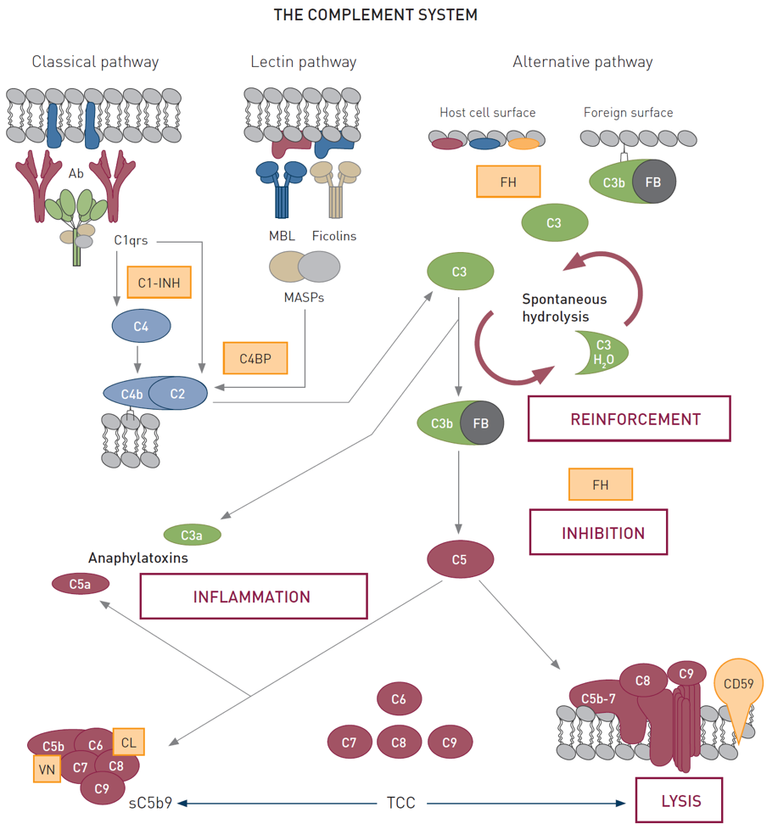
Current treatment guidelines focus on inhibiting deﬁnable pathways (inﬂammation or terminal complement activity) with available targeted therapeutics (antiproliferative agents or terminal complement blockers).

Slide 19
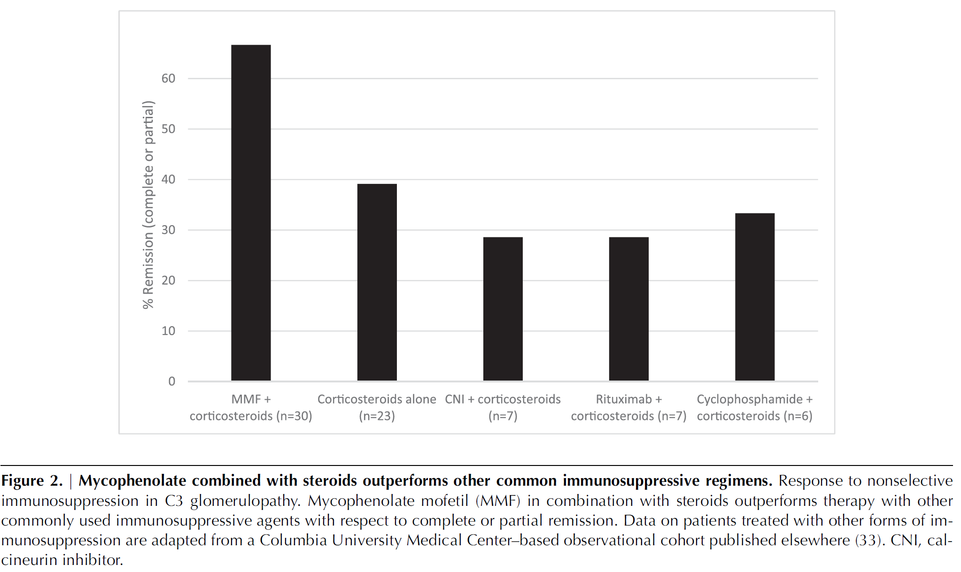

Slide 20
Treatment of active disease with MMF and corticosteroids has shown promise in 2 retrospective case series, but was not found to be effective in a third case series in patients with more severe baseline kidney disease.

Slide 21
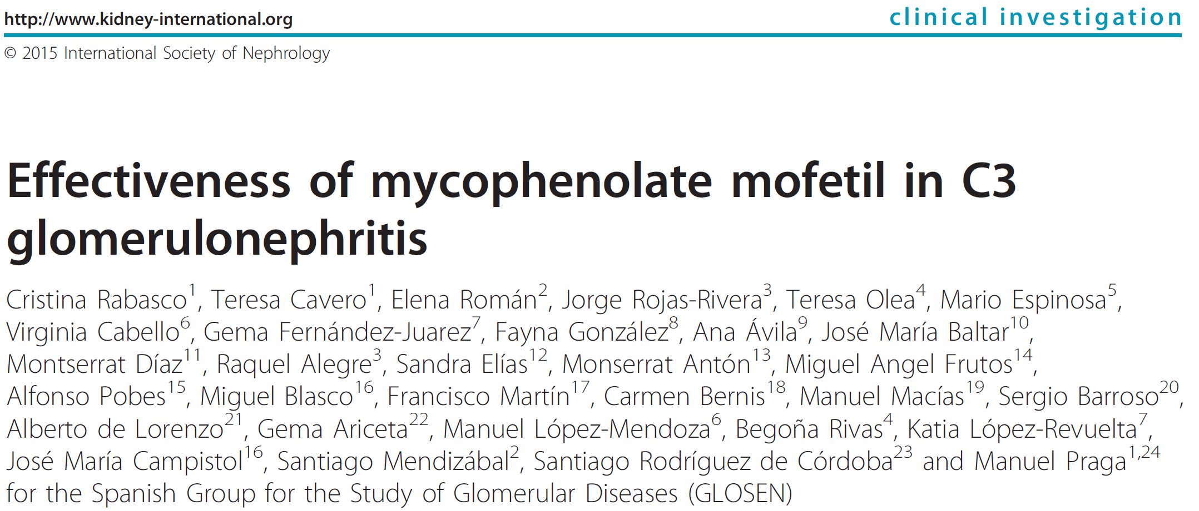
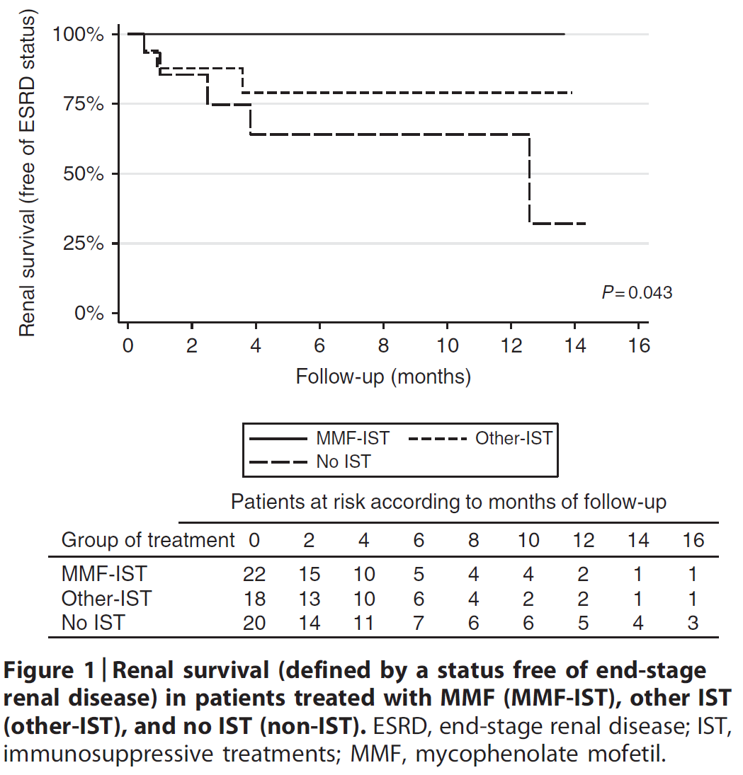
Treatment of active disease with MMF and corticosteroids has shown promise in 2 retrospective case series, but was not found to be effective in a third case series in patients with more severe baseline kidney disease.

Slide 22
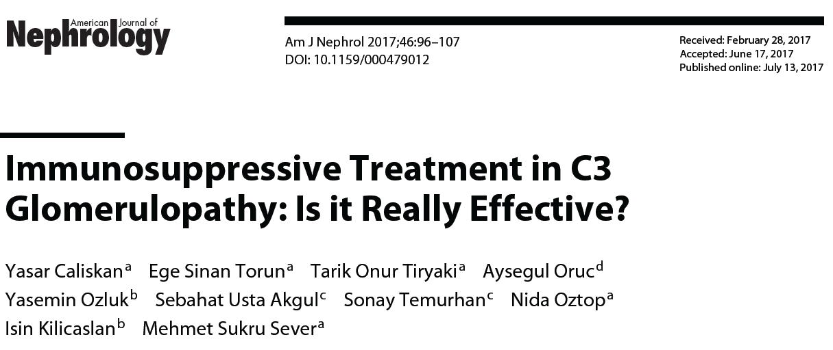
Treatment of active disease with MMF and corticosteroids has shown promise in 2 retrospective case series, but was not found to be effective in a third case series in patients with more severe baseline kidney disease.

Slide 23
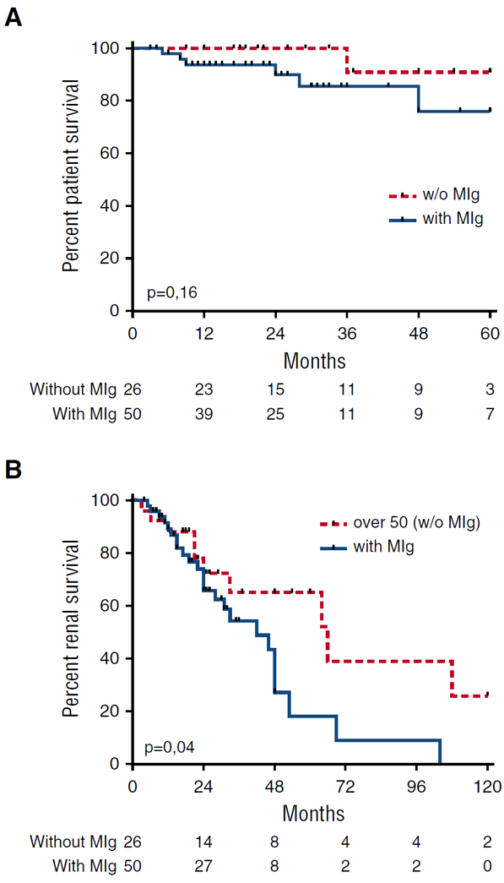
For patients with C3G and monoclonal gammopathy, a recent retrospective case series found superior hematologic and renal response rates, as well as renal survival, for patients treated with clone-directed chemotherapy compared with conservative or immunosuppressive treatment.
Kaplan-Meier patient survival analysis comparing C3G patients with or without
MIg older than 50 years. (B) Kaplan-Meier renal survival analysis comparing
patients with MIg-C3G and patients with C3G without MIg older than 50 years

Slide 24
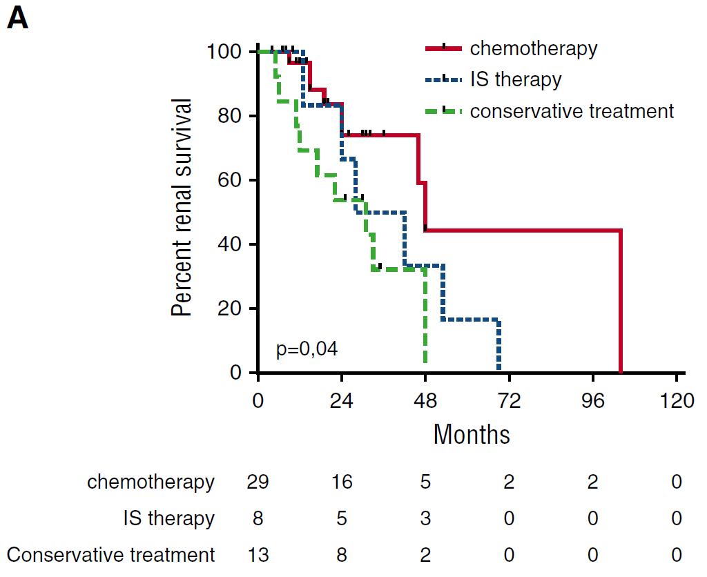
For patients with C3G and monoclonal gammopathy, a recent retrospective case series found superior hematologic and renal response rates, as well as renal survival, for patients treated with clone-directed chemotherapy compared with conservative or immunosuppressive treatment.
Kaplan-Meier renal survival analysis comparing MIg-C3G patients who received chemotherapy, immunosuppressive therapy, or conservative therapy

Slide 25
Monoclonal Gammopathies of Renal Significance (MGRS)
Pathogenesis
Biomarkers and prediction of prognosis
Treatment

Slide 26
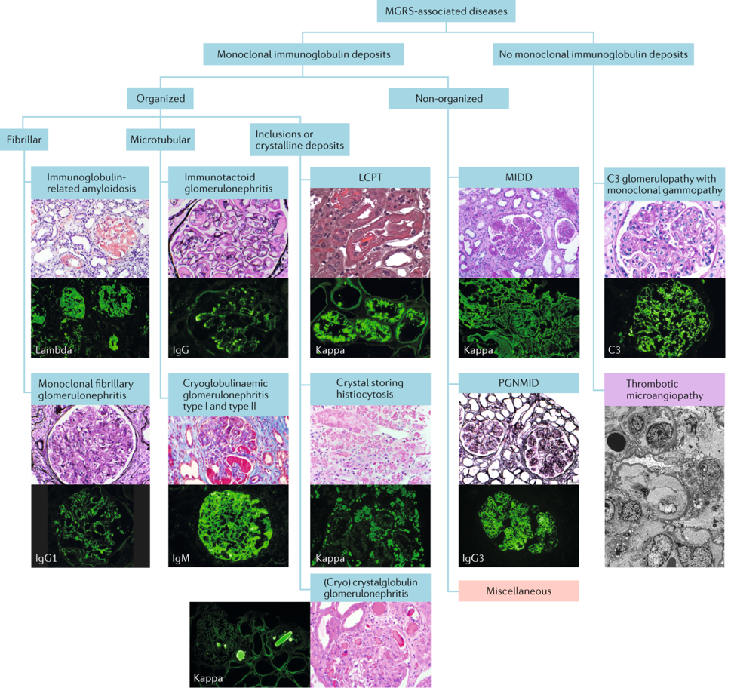
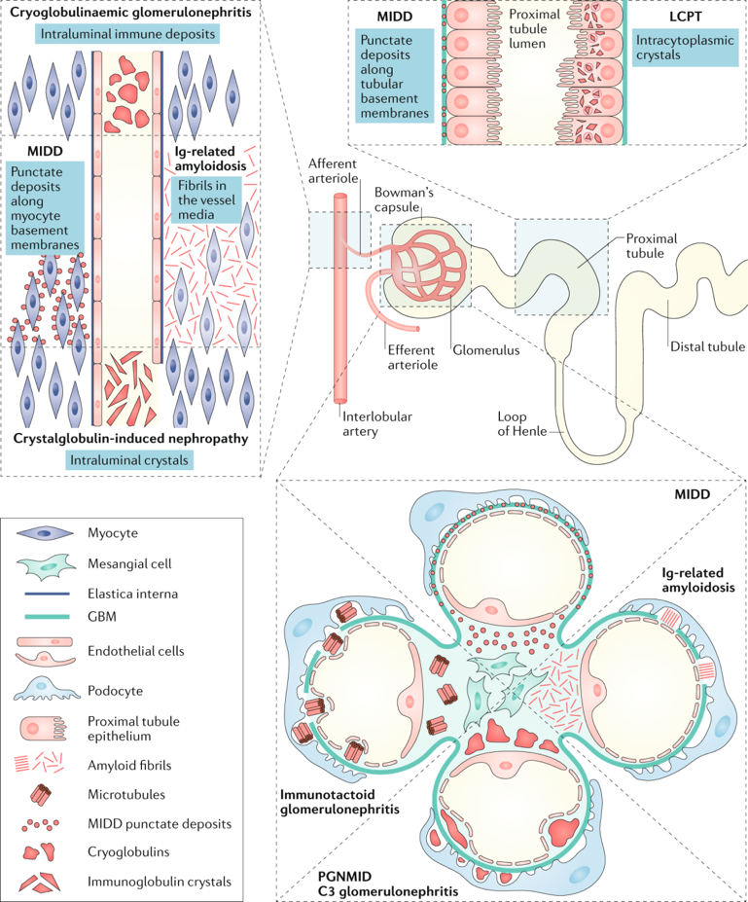
Monoclonal Gammopathies of Renal Significance (MGRS)
Nat Rev Nephrol. 2019; 15:45-59

Slide 27
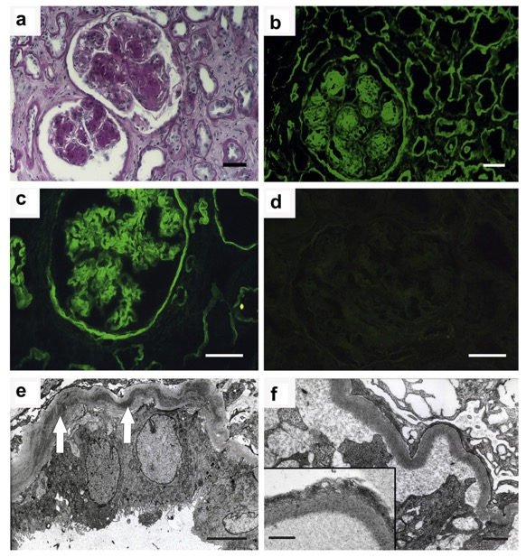
MGRS - Pathogenesis
Preclinical and clinical studies have elucidated the pathogenesis of some paraprotein-associated kidney diseases. For example, heavy chain deposition disease is caused by a truncated Ig heavy chain that lacks the ﬁrst constant domain (CH1 deletion).
Speciﬁc physiochemical properties of the truncated heavy chain may explain its tropism for the kidney.

Slide 28
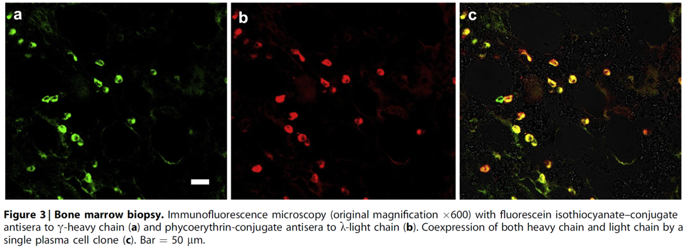
MGRS - Pathogenesis
Most patients with heavy chain deposition disease have an underlying plasma cell clone that does not meet criteria for multiple myeloma (i.e., a MGRS), and evidence of the truncated heavy chain can be found in the serum and bone marrow.

Slide 29
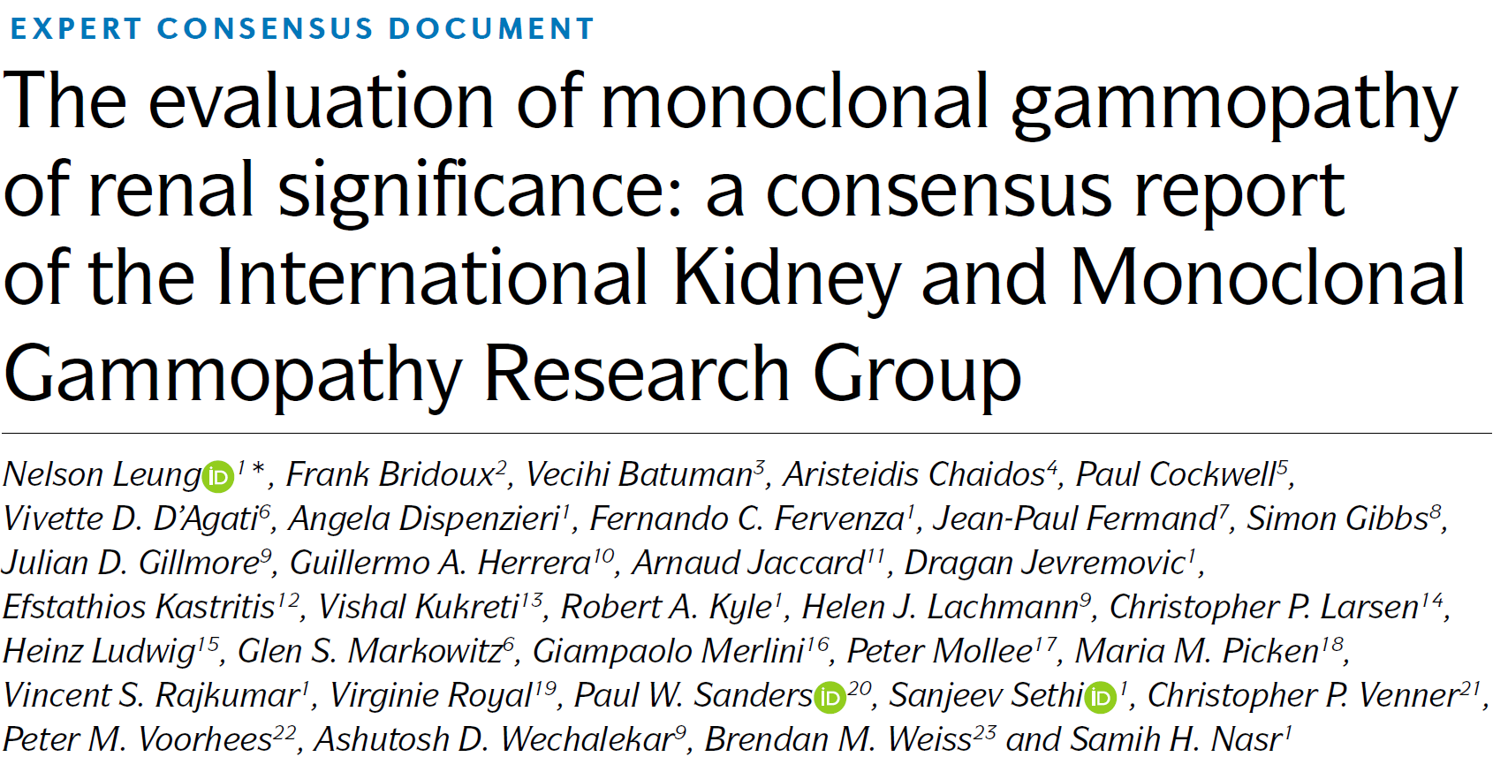
MGRS - Pathogenesis
Nat Rev Nephrol. 2019; 15:45-59

Slide 30
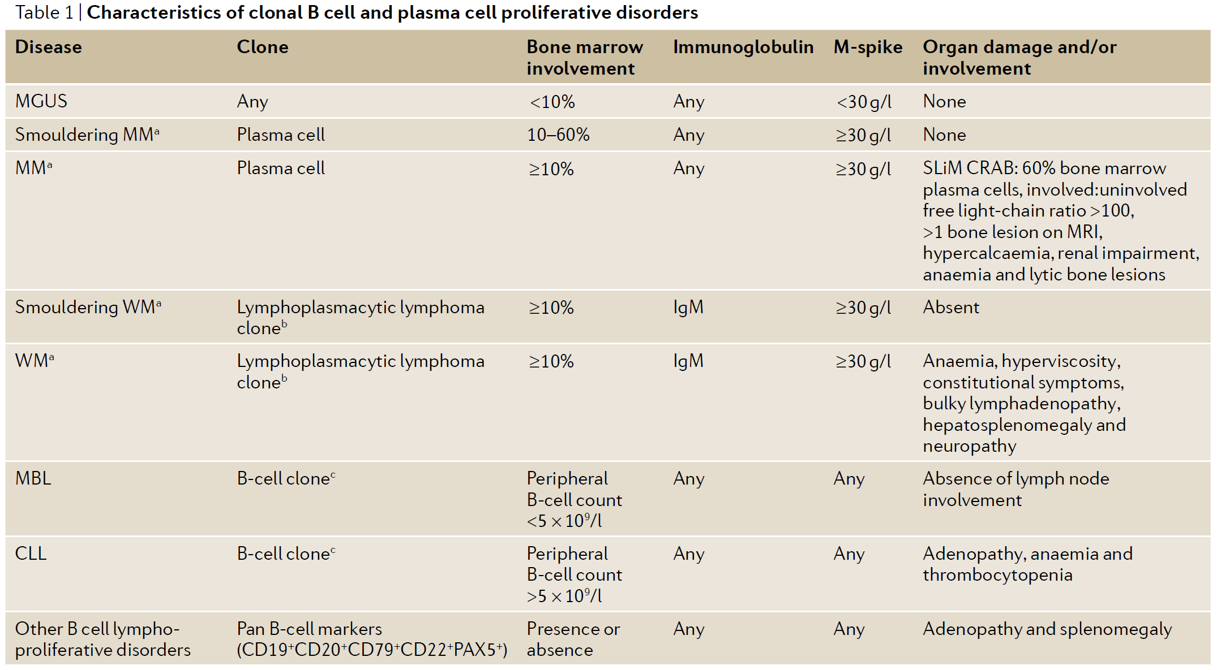
MGRS - Pathogenesis
Nat Rev Nephrol. 2019; 15:45-59
Notes:
In MGRS, pathogenic Igs are from plasma cell or B-cell clones. Targeting these clones may improve outcomes, but the clones are often undetectable.

Slide 31
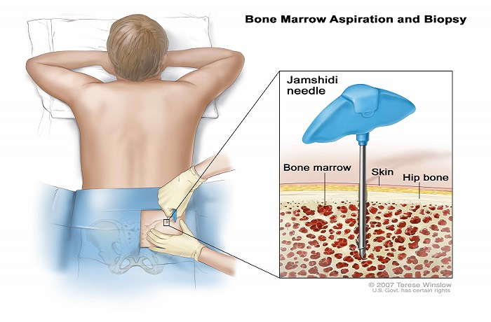
MGRS - Pathogenesis
The International Kidney and Monoclonal Gammopathy Research Group recommends that all patients with paraprotein-associated kidney disease undergo hematology evaluation, including a bone marrow biopsy, but the utility of the bone marrow is not clear in patients without a detectable circulating paraprotein.
https://www.cancer.gov/publications/dictionaries/cancer-terms/def/bone-marrow-aspiration-and-biopsy

Slide 32
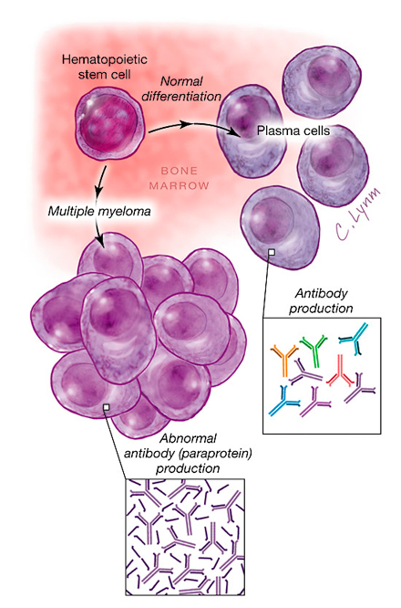
MGRS – Biomarkers and Predictions of Prognosis
In multiple myeloma and light chain amyloidosis, achieving hematologic response (improvement in levels of circulating paraprotein) is associated with improved overall and renal survival.
Moreover, stabilization or improvement in kidney function and proteinuria may be linked with long-term renal survival.
There are emerging data regarding the importance of hematologic response in MGRS, but it is not clear how to monitor patients without a detectable circulating paraprotein beyond glomerular ﬁltration rate (GFR) and proteinuria.
https://edhub.ama-assn.org/jn-learning/audio-player/16682215

Slide 33
MGRS - Treatment
The International Kidney and Monoclonal Gammopathy Research Group published
an approach to managing MGRS based on expert opinion.
Risk stratiﬁcation was based on kidney dysfunction and proteinuria, and treatment
strategies utilized a clone-directed approach similar to that employed for multiple
myeloma and lymphomas (i.e., chemotherapeutic regimens, autologous stem cell
transplant)
Notes:
The International Kidney and Monoclonal Gammopathy Research Group published an approach to managing MGRS based on expert opinion. Risk stratiﬁcation was based on kidney dysfunction and proteinuria, and treatment strategies utilized a clone-directed approach similar to that employed for multiple myeloma and lymphomas (i.e., chemotherapeutic regimens, autologous stem cell transplant)

Slide 34
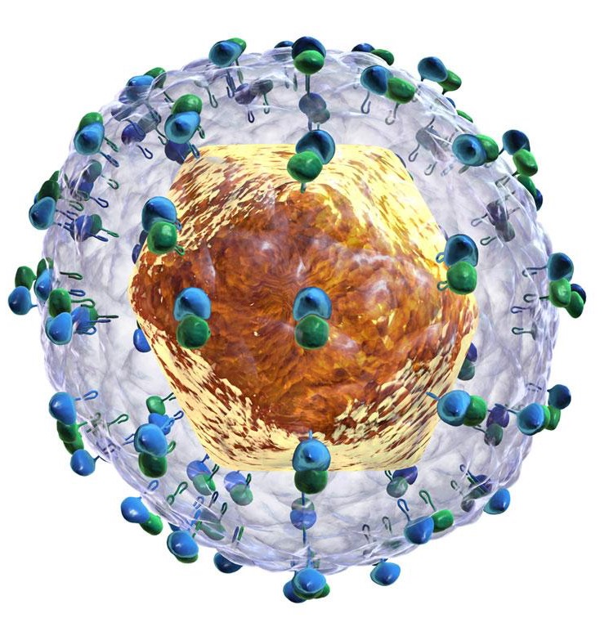
Hepatitis C-associated glomerulonephritis
The KDIGO Clinical Practice Guideline on the Prevention, Diagnosis, Evaluation and Treatment of Hepatitis C in CKD summarizes an approach to the treatment of these patients.
This approach will require validation.
The development or persistence of cryoglobulinemic vasculitis (with or without kidney involvement) after achieving sustained virologic response has been described.
Whether this presentation reﬂects continued B-cell production of pathogenic immune complexes requires further study.
Notes:
See: Kidney Int. 2018; 94: 663-673

Slide 35
Hepatitis C-associated glomerulonephritis
The KDIGO Clinical Practice Guideline on the Prevention, Diagnosis, Evaluation and
Treatment of Hepatitis C in CKD summarizes an approach to the treatment of these
patients. This approach will require validation.

Slide 36
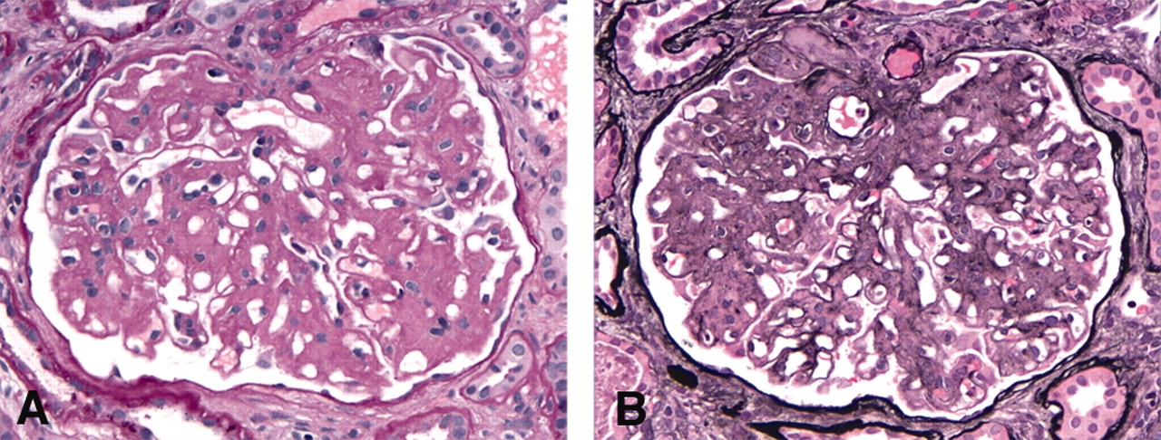
Fibrillary GN

Slide 37
Notes:
Immunohistochemical staining on kidney biopsy for the DNA J homolog subfamily B member 9 protein was identiﬁed as a sensitive and speciﬁc marker in ﬁbrillary GN. The role of DNA J homolog subfamily B member 9 in disease pathogenesis is unknown. The data on treating ﬁbrillary GN consist of small studies using a variety of therapies, none of which have been conclusive.

Slide 38
FUTURE STUDIES

Slide 39
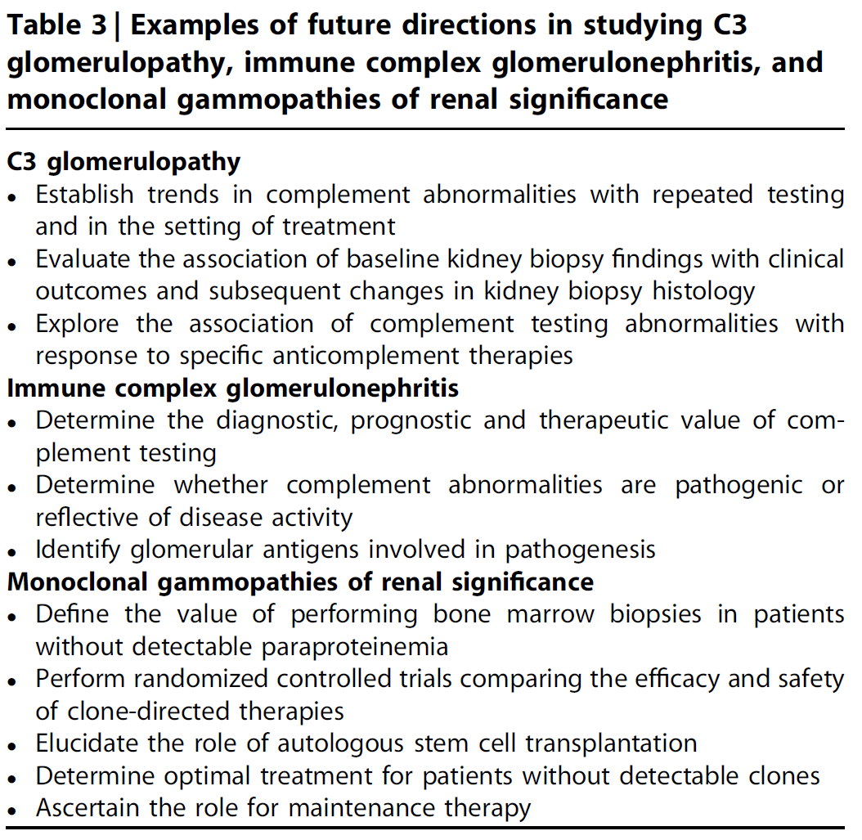
Future studies
Notes:
Investigations considered critical to the development of management protocols for C3G, immune complex GN, and monoclonal gammopathies of renal signiﬁcance

Slide 40
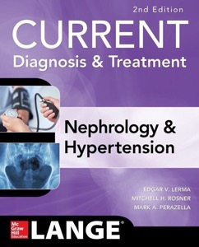
CLINICAL VIGNETTE

Slide 41
CASE
A 62-year-old man is noted to have fatigue and impaired kidney function. eGFR 46 ml/min/1.73 m². He has not traveled recently. He has nephrotic range proteinuria. He has no fever and his BP is 148/86. He has no jaundice and is breathing comfortably. The cardiac examination is normal. The ANA and ANCA titers are negative. A kidney biopsy reveals type 1 MPGN.
The most likely cause is:
A. Sarcoidosis
B. Monoclonal gammopathy
C. Malaria
D. Hepatitis B
E. Endocarditis

Slide 42
The answer is B.
This older man has no pulmonary or hepatic complaints, making sarcoidosis and hepatitis unlikely. The absence of travel makes malaria an unlikely diagnosis. He has no fever or murmur which would exclude endocarditis. The presence of MPGN with nephrotic range proteinuria is most consistent with the presence of a monoclonal gammopathy.

Slide 43
KDIGO THANKS THE FOLLOWING PARTNERS FOR THEIR SUPPORT OF THIS SPEAKER’S GUIDE

Slide 44
FOLLOW KDIGO
www.kdigo.org
/goKDIGO
@goKDIGO
@goKDIGO

