Slide 1
Iron Management in Chronic Kidney Disease Speaker’s Guide
Based on the 2014 KDIGO Controversies Conference

Slide 2
Supported by an Unrestricted Educational Grant from

Slide 3
DISCLAIMER
No part of this slide deck may be reproduced, amended, or transmitted in any form without explicit permission in writing from KDIGO. Details on how to seek permission for reproduction or translation, and further information about KDIGO’s permissions policies can be obtained by contacting KDIGO Communications at:
kdigocommunications@kdigo.org

Slide 4
Part 1: Iron Deficiency vs. Overload

Slide 5
Causes of Absolute Iron Deficiency
Blood losses associated with:^{1–3}
Laboratory tests and hospitalization
HD (from dialyzer and access)
 | Healthy Patient | Non-dialysis CKD Patient | Hemodialysis Patient
Daily Blood Loss | 0.83 ml/d | 3.2 ml/d | 5.0 ml/d
Annual Blood Loss | 0.3 L/yr | 1.2 L/yr | 2–5 L/yr
Annual Iron Loss | 0.1 g/yr | 0.4 g/yr | 1–2 g/yr to 4–5 g/yr
Sargent JA et al. Blood Purif 2004;22:112-113.
Rosenblatt SG et al. Am J Kidney Dis 1982;1:232-236.
Wizemann V et al. Kidney Int Suppl 1983;16:S218-S220.

Slide 6
Causes of Absolute Iron Deficiency
GI losses due to anticoagulant or antiplatelet drugs.
Reduced iron absorption due to medications (e.g., proton pump inhibitors and phosphate binders).
Reduced iron absorption due to increased hepcidin levels.
Reduced iron intake due to poor appetite, diet, and malnutrition.
Notes:
Iron deficiency can be considered under 2 main categories:
absolute: when there is a deficiency of total body iron stores; and
functional: when there are ample or increased total body iron stores, but with sequestration of iron in the reticuloendothelial system (RES), with inadequate iron supply for erythropoiesis.

Slide 7
Causes of Functional Iron Deficiency
Inflammation results in:
Sequestration of iron within reticuloendothelial system (RES).
Reduced total iron binding capacity.
Lowered absolute amount iron available for erythropoiesis.
ESAs can create increased demand for iron and worsen iron availability in chronically inflamed patients.
Notes:
Since transferrin is a negative acute phase protein, serum transferrin tends to be reduced in CKD patients. (Besarab et al, Am J Kidney Dis 1999;34:21-28)

Slide 8
Measuring Iron Deficiency
Both ferritin and TSAT have shortcomings when used to assess iron status.
Ferritin 200 µg/l is frequently used as a cutoff value in dialysis patients.
Although evidence is limited, TSAT <20% generally indicates absolute iron defiency.¹ However, TSAT >20% does not exclude this condition.
In CKD patients, ferritin and TSAT should be used together.^{1,2}
Percentage of hypochromic red cells and reticulocyte Hb content can indicate inadequate iron supply, but the method is not practical for wide adoption.
KDIGO Clinical Practice Guideline for Anemia in Chronic Kidney Disease. Kidney Int Suppl. 2012;2:279–335.
NICE Guideline No. 8, 2015.
Notes:
In aggregate, iron losses in HD patients are approximately 1–2 g/yr, but may be highly variable. In some patients, they may be as high as 4–5 g/yr.
The diagnosis of absolute iron deficiency is usually based on low serum ferritin concentrations (<20–30 μg/l) that reflect low body iron stores. In CKD patients, because of the presence of inflammation, threshold values indicating iron deficiency are higher. Serum ferritin of 100 or 200 µg/l is frequently cited as a cutoff value in nondialysis CKD and dialysis patients, respectively.
Percentage of hypochromic red cells and reticulocyte Hb measurements suffer from problems of analyzer availability and need to be performed soon after blood sampling.

Slide 9
Iron Dosing
Precise dosing to correct iron deficiency is uncertain, since the true amount of iron loss is unknown.
In general, IV iron doses >3 g/yr are likely to be associated with an increased risk of exceeding the ongoing iron loss and inducing positive iron balance.
The consequences of applying IV iron in excess of ongoing losses remain unknown.
Higher IV iron requirements should prompt investigation of increased losses (especially GI).

Slide 10
Iron Deposition in the Liver
Intravenous iron is deposited and stored in Kupffer cells of the reticuloendothelial system (RES) which is the iron storage system of the liver
Iron can also be deposited in hepatocytes of the liver parenchyma
Liver: structure of human liver. Art. Encyclopædia Britannica Online. Web. 07 Dec. 2015. http://www.britannica.com/science/liver/images-videos/Microscopic-structure-of-the-liver-Liver-cells-or-hepatocytes-have/60419>

Slide 11
Iron Compartmentalization in the Body
It has been hypothesized that parenchymal iron excess and labile iron can be harmful while iron sequestered within cells of the reticuloendothelial system may be of less concern
Size of the circles denotes the relative proportion of iron in various compartments
Source: Hoffmann Hematology Basic Principles and Practice, 2012

Slide 12
Defining Iron Overload
No feasible method exists to determine total body iron content.
Iron overload is a condition of increased body iron content.
Possibly associated with risk of organ dysfunction
Pathologic iron overload is a condition of increased total body iron content with signs of organ dysfunction.
Described for hematological diseases (e.g., hemochromatosis)

Slide 13
Assessing Iron Overload
Elevated serum ferritin does not always correlate with elevated liver iron content.
High ferritin + high TSAT can be of particular concern based on observations in hereditary hemochromatosis and transfusion-induced iron overload.
Notes:
Definitions of deficiency/overload are imperfect, because no feasible method exists to determine total body iron content.
High serum ferritin is not synonymous with iron overload, because ferritin level does not indicate whether iron is stored in parenchymal cells or reticuloendothelial (RES) cells.
Studies in HD patients suggest that liver iron content is increased, compared to reference values, in the majority of patients.

Slide 14
Ferritin: Assessing Iron Overload
Hyperferritinemia is not synonymous with iron overload.
Serum ferritin does not differentiate iron stored in parenchymal cells or RES.
Serum ferritin does not always correlate with liver iron content
Experience from patients with hemochromatosis suggest that combination of high TSAT and ferritin may be better indices as markers of parenchymal iron excess.

Slide 15
MRI: Assessing Iron Overload
MRI has been shown to be reliable for detecting tissue iron content in the non-CKD population.
However, there is limited experience in HD patients.
The relevance of increased liver iron content in the absence of elevated liver enzymes is unclear.
There is insufficient evidence to use MRI to guide IV iron therapy.

Slide 16
Iron Overload: Hematological Disorders
Organ toxicity associated with iron overload depends upon the magnitude and speed of iron accumulation.
The main target organs are liver, myocardium, endocrine glands, and joints.

Slide 17
Organ Toxicity Induced by Iron Overload
The magnitude, distribution, and duration of iron overload in CKD may be insufficient to produce similar toxicity as observed for hematological disorders.
Given that IV iron use has increased markedly in HD over the last few years, the exposure may not have been long enough to detect toxicity.
End-organ damage has not been established unequivocally; therefore, the toxicity of repeated high-dose IV iron cannot be excluded.

Slide 18
Case Study: “Barry”
• 58-y.o.male on HD for 3 yrs
• End-stage kidney failure due to hypertensive nephropathy
• Known chronic liver disease due to hepatitis C
• On EPO alfa 4000 units x3 per week + IV iron 200 mg monthly
Lab results
Hb 9.4 g/dL
Ferritin 1145 µg/L
TSAT 18%
CRP 2 mg/L

Slide 19
Case Study: “Barry”
What would you do next?
Continue present dose of EPO and IV iron
Increase his dose of EPO and continue IV iron
Increase his monthly prescription of IV iron and continue same dose of EPO
Increase both his dose of EPO and his monthly dose of IV iron
Continue EPO and reduce monthly iron dose
Notes:
A. Hb is running below accepted target levels, impacting on his quality-of-life and increasing his risk of blood transfusions (he may be eligible for a kidney or liver/kidney transplant one day), and so we should aim higher.
B. He has functional iron deficiency with a transferrin saturation below 20%, and although he may respond to a higher dose of EPO, it is advisable to use the lowest dose possible to avoid cardiovascular harm.
C. Increasing his monthly prescription of iron alone is less likely to bring his target hemoglobin into range. Also, with his chronic liver disease, one would wish to minimize the amount of IV iron he is prescribed.
D. CORRECT. This decision is supported by the results of the DRIVE study. He has functional iron deficiency, and his rather high ferritin level may be a consequence of his chronic liver disease rather than due to excess iron stores.
E. He has functional iron deficiency, and if his monthly iron dose is reduced, then he will almost certainly require a higher dose of EPO. As indicated above, it is advisable to use the lowest EPO dose possible to avoid cardiovascular harm.

Slide 20
Part 2: Oxidative Stress

Slide 21
Oxidative Stress in CKD
Oxidative stress early in CKD and is thought to herald poor prognosis.
It results from an overproduction of reactive oxygen/nitrogen species or impairment in the cellular antioxidant enzymatic activities, leading to oxidation of macromolecules.
Markers (NO₂, HOCl, and OH) are present in uremic plasma and are thought to be the fingerprints of increased oxidative stress.
However, diagnostic tools and the relevance of these markers to guide therapy in CKD are not established.
Notes:
Oxidative stress results from an overproduction of reactive oxygen/nitrogen species or impairment in cellular antioxidant enzymatic activities. It leads to oxidation of macromolecules such as proteins, carbohydrates, lipids, and DNA.
Issues with available biomarkers include:
absence of established reference ranges
variable analytical techniques
lack of understanding regarding the relationship between markers and impaired kidney function and associated comorbidities.
Effects of oxidative stress on tissues include oxidative damage to peripheral blood lymphocyte DNA, protein oxidation, and lipid peroxidation.
Oxidative stress also affects cellular processes, e.g., apoptosis, endothelial dysfunction, and monocyte adhesion.

Slide 22
IV Iron, Oxidative Stress, and CV Risk
IV iron promotes oxidative damage of peripheral lymphocyte DNA¹ and endothelial dysfunction.^{2,3}
However, the question of how IV iron accelerates atherosclerosis remains unresolved.
Accumulation of iron in plaques has not been proven to promote CV disease.
Limitations of observational studies do not allow any firm conclusions to be made on IV iron dose and CV risk.
Kuo KL et al. J Am Soc Nephrol. 2008;19:1817-1826.
Kamanna VS et al. Am J Nephrol. 2012;35:114-119.
Rooyakkers TM et al. Eur J Clin Invest. 2002;32 (Suppl 1): 9-16.
Notes:
One study in mice demonstrated that atherosclerotic plaque size was not increased in mice with elevated macrophage iron. (Kautz L, et al. Cell Rep. 2013;5:1436–1442.) In contrast, another showed that IV iron aggravated early atherosclerosis. (Kuo KL, et al. J Am Soc Nephrol. 2014;25:2596–2606).
Clinical studies have also demonstrated significant correlations among cumulative iron dose, intimal media thickness, and CV events. However, these findings are difficult to interpret because of their observational nature and confounding factors.

Slide 23
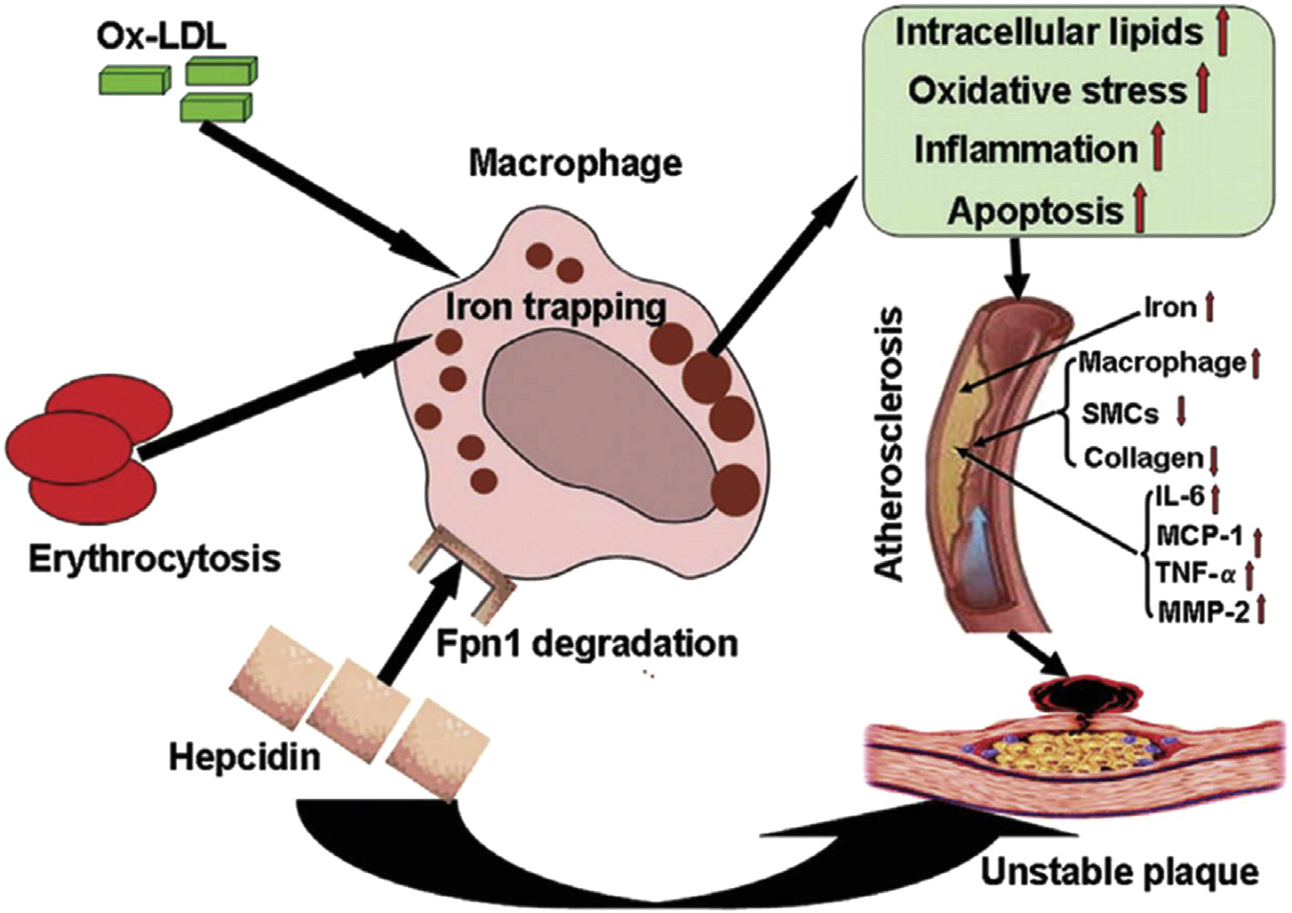
Hepcidin and CV Risk
Some studies suggest that hepcidin upregulation may increase CV risk in the general population. However, there is limited evidence in CKD patients.
Potential mechanism of hepcidin-mediated plaque instability
Source: Li JJ, et al. Arterioscler Thromb Vasc Biol. 2012;32:1158–1166.
Notes:
Hepcidin is the key iron regulatory protein synthesized in the liver that is sensitive to iron deficiency. It is also:
Upregulated by increased circulating and stored iron levels, inflammation, and infections.
Downregulated by hepcidin inhibitors, including testosterone, estrogen, and erythroferrone.
Hepcidin and macrophage iron correlate with monocyte chemoattractant protein-1 release and vascular damage in patients with metabolic disease.
In a clinical study of 766 women without kidney disease, serum hepcidin was associated with the presence of atherosclerotic plaques. (Galesloot TE, et al. Arterioscler Thromb Vasc Biol. 2014;34:446–456.)
Proposed mechanisms underlying the hepcidin-induced plaque instability. In the setting of erythrophagocytosis, hepcidin suppresses iron release from macrophages via downregulation of iron-exporting protein Fpn1 and increases iron storage. Iron trapping results in accumulated intracellular lipids and enhanced oxidative stress, inflammatory responses, and macrophage apoptosis. Thus, hepcidin is essential for Ox-LDL–mediated phenotypic switching of iron-loaded macrophages leading to atherosclerotic plaque destabilization. Fpn1, ferroportin 1; IL-6, interleukin-6; MCP-1, monocyte chemoattractant protein-1; MMP-2, matrix metalloproteinase-2; Ox-LDL, oxidized low-density lipoprotein; SMCs, smooth muscle cells; TNF-α, tumor necrosis factor-α. Caption text and figure reproduced with permission from Li et al., Artterioscler Thromb Vasc Biol 2012;32:1158-166.

Slide 24
Ferritin as a Risk Factor
Like hepcidin, ferritin is just as likely to reflect an inflammatory response as an iron-replete state.
In the general population, elevated serum ferritin is associated with increased risk for MI and carotid plaques.
In CKD patients, the association between ferritin levels and outcomes is not clear.
Prospective controlled studies are needed to assess whether elevated ferritin merely represents a risk marker or is an actual risk factor.
Notes:
Ferritin is significantly upregulated in the acute-phase response, particularly in the presence of low serum iron, transferrin, and TSAT.
One study reported that low serum iron is a predictor of poor outcome, even after adjustment for ferritin and the inflammatory marker C-reactive protein. (Kalantar-Zadeh K, et al. Am J Kidney Dis. 2004;43:671–684.)
In contrast, another observational study of 58,058 HD patients showed an association between high ferritin (>800 ng/ml) and mortality. However, the correlation was markedly attenuated after correction for markers of malnutrition and inflammation. (Kalantar-Zadeh K, et al. J Am Soc Nephrol. 2005;16:3070–3080)

Slide 25
Antioxidants and Iron Supplementation
Some studies have shown benefits of limited antioxidant treatments on lipid peroxidation.
However, a recent RCT in HD patients did not show beneficial effects of antioxidative therapy.¹
No definitive conclusion can be drawn as to whether iron-related oxidative stress responds to antioxidant therapy.
Himmelfarb J, et al. J Am Soc Nephrol. 2014;25:623–633.
Notes:
A study in 13 HD patients showed that the combination of IV iron and vitamin C was associated with an increased production of reactive oxygen species. (Conner TA, et al. Biometals. 2012;25:961–969.)
Another recent RCT examined 353 HD patients and showed that 6 months of antioxidative therapy (tocopherols and alpha-lipoic acid) failed to influence biomarkers of inflammation and oxidative stress. (Himmelfarb J, et al. J Am Soc Nephrol. 2014;25:623–633.)

Slide 26
Case Study: “John”
68-y.o. male on HD for 6 yrs
On EPO and IV iron to maintain ferritin levels above KDIGO minimum
Wants to stop IV iron because of his concerns about “oxidative stress”

Slide 27
Case Study: “John”
What would you do next?
Agree to John’s request and stop IV iron without further discussion
Tell John you will run some tests to assess oxidative stress level
Continue with IV iron after explaining the reasons for confusion in the medical literature
Do options B and C
Notes:
Stopping IV iron completely is not advisable as he may well eventually develop absolute iron deficiency, which results in inefficient erythropoiesis and require increased epoetin dosing.
Unfortunately there are no readily available, local laboratory tests that can be used to assess oxidative stress levels. There are biomarkers, but the normal ranges for patients with acceptable and poor renal function are variable, and techniques to measure them are even more varied. It is accepted that uremia is generally a state of enhanced oxidative stress, and the contribution of IV iron to that state is unclear.
CORRECT. Since he has raised concerns, it is very reasonable to maintain his ferritin levels slightly lower. As stated above, stopping IV iron will almost certainly result in his requiring higher doses of epoetin, which in itself may have harmful effects for him. This should be explained to him. Concerning the confusion in the literature there are issues with the IV iron studies in terms of observational data in humans which do not prove association. There are also conflicting experimental data among the different iron preparations, even among innovator and generic molecules.
See B above

Slide 28
Part 3: Risk of Infections

Slide 29
IV Iron: Infection Risk in HD Patients
Critical review¹ of studies (largely observational) evaluating infection risk association with a) ferritin, and b) iron usage:
Ferritin: 9 showed association (1.5- to to 3.1-fold higher incidence of infection or infection-related mortality), 4 did not.
Iron usage: 12 showed association (14%–45% higher risk of infection-related mortality), 10 did not.
Bolus dosing was reported to show higher risk than maintenance dosing for patients with a catheter and history of infection.²
In contrast, maintenance dosing or low dosing was not associated with increased risk.
Ishida JH, Johansen KL. Semin Dial. 2014;27:26–36.
Brookhart MA, et al. J Am Soc Nephrol. 2013;24:1151–1158.
Notes:
Only 2 studies have examined the risk of infection with different IV iron formulations:
In 63 HD patients, the adjusted RR for bacteremic episodes with iron sucrose vs. ferric gluconate were 2.92 (95% CI 1.01–8.50) and 2.84 (95% CI 1.32–6.09), respectively. (Sirken G, et al. Clin Nephrol. 2006;66:348–356)
In 559 patients, mean IV iron sucrose dose was significantly higher in patients with catheter-related sepsis than in patients without; similar findings were reported in patients who received IV iron dextran. (Diskin CJ, et al. Nephron Clin Pract. 2007;107:c128–c132)
Few studies have examined infection risk by type of iron formulation.

Slide 30
IV Iron in HD: Infection-Related Outcomes
Association of IV iron dose and cause-specific mortality in HD.¹
IV iron dose is the total 4-month dose, expressed as average mg/month.
Bailie G, et al. Kidney Int. 2015;87:162–168.
Notes:
More recent data in hemodialysis:
One recent multicenter study from Japan reported a significantly higher risk of infection with higher serum ferritin compared to lower ferritin, and with high and even low doses of IV iron compared with no IV iron (Kuragano T. Kidney Int 86:845-854). In contrast, three other studies, shown in the next three slides, found no increase in either infection-related mortality or hospitalization.
The data presented in this slide are based on the outcomes of 32,435 patients receiving IV iron in 12 countries (Bailie GR et al. Kidney Int. 2015;87:162–168). When compared to patients receiving 100–199 mg/mo, those receiving an average of 300–399 mg/mo or ≥400 mg/mo had a higher risk of all-cause mortality, but no significant increase in mortality due to infection. However, since this is an observational study, causality cannot be established and the possibility of residual confounding still remains. The study also did not address the impact of cumulative doses of IV iron over many years.

Slide 31
IV Iron in HD: Infection-Related Outcomes
Relationship between IV iron dose and infection-related hospitalization.¹
Duration of Iron Exposure | Doses (mg) | N (Hosp.) | Infectious Hosp: HR (95% CI)
1 month | None | 2187 | 0.92 (0.76, 1.11)
 | >0 to 150 | 1200 | 1 (ref)
 | >150 to 350 | 1648 | 0.94 (0.77, 1.15)
 | >350 | 1825 | 0.91 (0.77, 1.09)
3 months | None | 1047 | 1.03 (0.81, 1.33)
 | >0 to 450 | 1381 | 1 (ref)
 | >450 to 1050 | 2151 | 1.01 (0.81, 1.25)
 | >1050 | 1513 | 1.08 (0.86, 1.36)
6 months | None | 399 | 1.15 (0.79, 1.68)
 | >0 to 900 | 1383 | 1 (ref)
 | >900 to 2100 | 2589 | 0.94 (0.75, 1.19)
 | >2100 | 845 | 1.26 (0.94, 1.69)
Tangri N, et al. Nephrol Dial Transplant. 2015;30:667–675.
Notes:
In this study (DEcIDE-ESRD) of 9544 HD patients, higher cumulative dose of IV iron was not associated with all-cause, cardiovascular or infection-related hospitalizations. The authors observed no association between intravenous iron dose and the risk of infectious events in the 1-month, 3-month and 6-month cohorts (Tangri N et al. Nephrol Dial Transplant 30: 667-675, 2015).
The model is adjusted for all the covariates in all-cause and CVD hospitalizations models except recent infection.

Slide 32
IV Iron in HD: Infection-Related Outcomes
Association between IV iron and CV or sepsis-related mortality.¹
Zitt E, et al. PLoS ONE. 2014;9:e114144.
Notes:
This is another prospective, observational study of 235 incident dialysis patients who received IV iron supplementation. The authors found iron supplementation to be associated with a significantly reduced all-cause mortality [HR (95% CI: 0.22 (0.08–0.58); p=.002] and a marginally lower cardiovascular and sepsis-related mortality [HR (95% CI: 0.31 (0.09-1.04); p=0.06]
Association between iron supplementation and all-cause mortality and cardiovascular or sepsis-related mortality using time-dependent Cox proportional hazards models.

Slide 33
Studies in PD and Nondialysis Patients
One study showed more peritonitis episodes in PD patients after IV iron infusion.¹
A recent single-center RCT (REVOKE) also showed IV iron was associated with higher rate of adverse events; however, the findings are controversial.²
The FIND-CKD global multicenter study (non-dialysis CKD patients) found that the incidence of infections and CV events was identical for high-ferritin, low-ferritin, and oral iron groups.³
Prakash S, et al. Perit Dial Int. 2001;21:290–295.
Agarwal R, et al. Kidney Int. 2015;88:905–914.
Macdougall IC, et al. Nephrol Dial Transplant. 2014;29:2075–2084.
Notes:
In a study of 379 peritoneal dialysis patients, there were more peritonitis episodes during the 6 months after IV iron infusion, especially with iron dextran, compared to the peritonitis episodes during the 6 months before iron infusions (15 episodes vs. 8 episodes, respectively, in 6 months), but the difference was not statistically significant. (Prakash)
A recent RCT (REVOKE trial) by Agarwal et al. comparing oral versus IV iron in non-dialysis CKD patients showed a higher rate of serious adverse events in the IV iron treatment group, with increased CV events and infections requiring hospital admission. However, this study examined a single center, with a single investigator adjudicating all serious adverse events and only 99 subjects completing the trial.
The findings of Agarwal et al. are discrepant with those reported in the much larger FIND-CKD study, a global multicenter study conducted in 626 non-dialysis CKD patients across 193 sites in 20 countries and with considerably greater patient-years of follow-up. Even though patients were treated with much higher doses of IV ferric carboxymaltose (FCM) in FIND-CKD, no safety signals were evident, and indeed the incidences of infections (adverse events: 33.1% vs. 34.0% vs. 30.4%; serious adverse events: 3.9% vs. 3.3% vs. 3.8%) and cardiac events (6.5% vs. 4.7% vs. 4.5%) were identical across all 3 groups (high-ferritin FCM, low-ferritin FCM, and oral iron, respectively).

Slide 34
REVOKE Study
 | REVOKE¹
 | Oral ferrous sulfate | IV iron sucrose
Patients | 69 | 67
Study Period | 104 weeks
SAE (%) | 40 (58) | 37 (55)
SAE infections (%) | 11 (16) | 19 (28)
Agarwal R, et al. Kidney Int. 2015;88:905–914.
Notes:
NOTE: The REVOKE study was terminated early due to high incidence of adverse events.
The numbers above refer to the number of subjects. There were 27 hospitalized infectious events among 11 participants assigned to the oral iron treatment group and 37 events among 19 participants of the IV iron treatment group (adjusted incidence rate ratio 2.12 (95% confidence interval 1.24–3.64, P=0.006).

Slide 35
FIND-CKD Study
 | FIND-CKD¹
 | Oral ferrous sulfate | IV ferric carboxymaltose
Patients | 312 | 304
Study Period | 56 weeks
SAE (%) | 59 (19) | 75 (25)
SAE infections (%) | 12 (3.8) | 11 (3.6)
Macdougall IC, et al. Nephrol Dial Transplant. 2014;29:2075–2084.
Notes:
Study design differences in REVOKE and FIND-CKD (e.g., baseline characteristics, length of follow-up, patient population) patients rendered their differing findings difficult to reconcile.

Slide 36
Existing Evidence: Inconclusive
Studies in HD, PD, and non-dialysis CKD patients provide conflicting evidence for the association between IV iron and infection risk.
Most data are derived from observational studies in HD (subject to confounding) and the few RCTs conducted to date were of short duration or underpowered to assess the risk of infection
Current KDIGO recommendations are still prudent which calls for:
balancing potential benefits vs. risks of IV iron
avoiding IV iron use in patients with active systemic infections
Notes:
Recent systematic reviews and meta-analyses performed to date were likewise inconclusive. One meta-analysis which evaluated the safety and efficacy of IV iron therapy for functional iron deficiency reported no association of IV iron with risk of infection, but only limited conclusions could be drawn as it only included 2 studies comprising 359 analyzable patients (Susantitaphong P et al. Am J Nephrol 2014; 39:130-141). In contrast, another systematic review and meta-analysis of RCTs evaluating the safety and efficacy of IV iron therapy, which included HD and non-dialysis CKD patients, reported that IV iron was associated with a significantly higher risk of infection compared with either oral iron or no iron supplementation. (Litton E et al. BMJ 2013: 347: f4822) However, these findings were tempered by the fact that infection was not a predefined endpoint in many of the pooled studies and thus the introduction of unmeasured bias cannot be excluded.

Slide 37
Case Study: “Tammy”
67-y.o. female on HD
Admitted with ruptured diverticular abscess and cutaneous fistula
On weekly protocol: iron sucrose 100 mg/wk (KDOQI Guidelines) and epoetin alfa 6000 units/wk, target Hb 10.0–11.5 g/dL
Lab results
Hb 9.2 g/dL
Ferritin 335 µg/L
TSAT 10%

Slide 38
Case Study: “Tammy”
What would you do next?
Increase the EPO dose
Continue to administer IV iron due to low TSAT
Withhold IV iron and increase EPO dose
Withhold IV iron and maintain EPO dose
Continue with the same dose of EPO and frequency of IV iron
Notes:
The patient will be resistant to epoetin alfa, as there is concurrent infection and hepcidin concentrations in the blood would be elevated. This may be required, but more should be done.
There may be a theoretical risk that concurrent IV iron may be detrimental with the concurrent infection. Generally IV iron should be withheld when there is ongoing active infection.
The patient will likely be resistant to the epoetin alfa, and is unlikely to respond to a higher dose, which may potentially be harmful. In view of the potential futility and possible harm, there is not much to be gained from increasing the epoetin dose.
CORRECT. We should withhold IV iron until patient recovers from the infection. The patient will be resistant to epoetin alfa as there is concurrent infection, and increasing EPO dose is unlikely to be of benefit.
The patient will remain anemic. Iron should be withheld until the infection has resolved because of concerns of exacerbating the infection. It is likely that the patient will remain anemic until the infection has resolved.

Slide 39
Part 4: Hypersensitivity to Iron

Slide 40
Hypersensitivity Reactions to IV Iron
Concerns regarding IV iron safety largely originate from older formulations containing dextran.
Higher-molecular weight (HMW) iron dextran should not be used, since alternative formulations are available.
Alternatives include LMW iron dextran, iron sucrose, ferric sodium gluconate, ferric carboxymaltose, iron isomaltoside 1000, ferumoxytol.
These formulations may be viable alternatives to oral iron and may be cost-effective in certain settings, despite higher cost.
Notes:
Oral iron:
Common side-effects of oral iron, in up to 60% of patients, include constipation and nausea.
Anaphylaxis as a result of oral iron supplementation has been reported, but it is extremely rare.

Slide 41
Classification of Hypersensitivity Reactions
KDIGO suggests classifying the severity of reactions and then determining subsequent approaches to therapy.
Anaphylactic reactions Characterized by 2 or more organ systems involved (skin, gut, respiratory, CV) Objective evidence of bronchoconstriction, stridor, hypotension, severe generalized urticaria, nausea, abdominal pain
Minor infusion reaction Often described as pressure in the chest or lumbar region, associated with flushing, with or without minor urticaria, but no hypotension or other organ involvement
Flare in pre-existing immune and/or inflammatory conditions, particularly rheumatoid arthritis Manifesting as arthralgia

Slide 42
Severe Hypersensitivity Reactions
Excluding HMW iron dextran, anaphylactic reactions to IV iron are extremely rare, with an incidence of <1:200,000.
No anaphylactic reactions have been demonstrated with intradialytic iron or newer oral iron formulations, but risks cannot be ruled out.
No established and validated tests exist to predict or confirm iron hypersensitivity.
Notes:
The US FDA recently posted a regulatory update regarding severe hypersensitivity reactions with ferumoxytol, along with advice to slow down the rate of administration (http://www.fda.gov/downloads/Drugs/DrugSafety/UCM440336.pdf).

Slide 43
Possible Risk Factors for Hypersensitivity
No established and validated tests exist to predict or confirm iron hypersensitivity.
The following patient characteristics may indicate a higher risk for hypersensitivity reactions.
Prior reaction to any IV iron formulation Moderate to severe asthma Multiple pre-existing drug hypersensitivities or allergies Pre-existing immune-mediated disease (e.g., autoimmune disorders) Mast cell–associated disorders High TSAT or low plasma transferrin levels, which may increase the likelihood of circulating labile iron during infusion
Local skin reactions to extravasated iron can occur. Infusion-specific risk factors such as use of higher doses and rapid rate of infusion should also be considered when evaluating for any potential reactions. Whether generic formulations have a greater propensity for increased labile iron reactions is as yet unclear.

Slide 44
Minor Reactions
Minor reactions to IV iron include flushing, mild chest discomfort, dizziness, light-headedness, nausea, or itching.
These reactions resolve when the infusion is stopped or slowed and should generally not preclude ongoing IV iron therapy.

Slide 45
Management of Hypersensitivity
First dose should be administered in a clinical facility.
IV doses of iron gluconate or iron sucrose should not exceed 125 mg or 200 mg per dialysis, respectively.
No recommendation to observe patient for 30 min, as delayed reaction is unlikely.
Prior desensitization is not recommended.
Follow local jurisdictional requirements regarding IV iron administration.

Slide 46
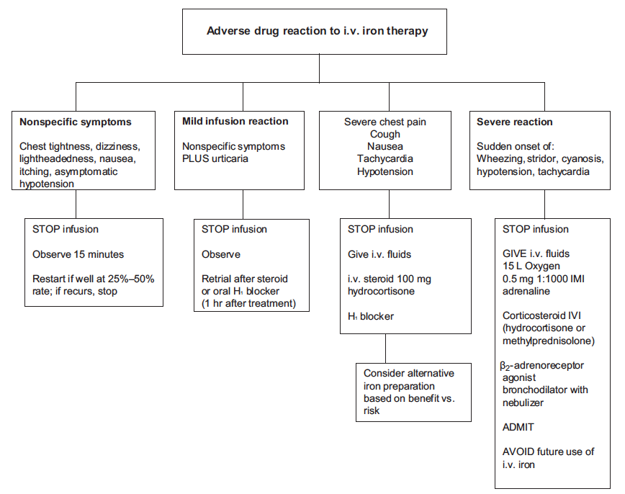
Suggested Management of Reactions to IV Iron
Notes:
Suggested management of reactions to IV iron. Optimal clinical treatment of severe anaphylaxis includes adrenaline as an essential anti-anaphylactic drug given by intramuscular injection of 0.5 mg in 1:1000 solution. This should be repeated after 5–10 minutes if needed. Additional supportive oxygen should be given at a high rate (>15 liters/min) by face mask. Volume loading should be given using 1 liter of crystalloid solution in addition to an antihistamine (H1 blocker) and corticosteroids to prevent a protracted or biphasic course of anaphylaxis. For nonspecific reactions, stopping the infusion for at least 15 minutes and monitoring the response (i.e., pulse, blood pressure, respiratory rate, and oxygen saturation) may be sufficient. If the patient improves, then the iron infusion can be resumed at 25%–50% of the initial infusion rate with monitoring. For mild reactions, if treatment is restarted, IV H1 blockers and corticosteroids should be considered and monitoring after therapy should be continued for 1 hour. If the infusion is discontinued and the reaction subsides, then rechallenge with the same or a different iron preparation may be undertaken in an environment where monitoring is available. A much lower dose of the iron preparation or slower infusion rate should be considered to gain reassurance that this reaction is likely to be dose-related and possibly due to labile iron release. IMI, intramuscular injection; IVI, intravenous infusion.

Slide 47
Case Study: “Judy”
38-y.o. female with CKD (IgA glomerulonephritis) and asthma
Lab results:
eGFR 22 ml/min/1.73 m²
Hb 9.5 g/dL
Ferritin 101 µg/L
TSAT 14%
Given IV ferumoxytol 510 mg over 20 min
Judy reports breathing problems, light-headedness, swelling, new erythematous rash. Nurses report slowly falling BP.

Slide 48
Case Study: “Judy”
What do you think is happening, and what should you do next?
She may be getting the flu
She is having an anaphylactic reaction
She is having an anaphylactoid reaction
She is having a minor reaction to IV iron
Notes:
In the context of receiving an IV iron product (all of the ones currently marketed), the physician should consider any new signs or symptoms as related to the IV iron and cease the infusion immediately.
It is unlikely to be an anaphylactic reaction at this stage, as it is not associated with severe bronchospasm or hypotension or urticarial rash. There was no abdominal pain. Anaphylaxis is associated with an immediate IgE- or IgG-related release of potent mediators, arising from from basophils (e.g., by complement) and mast cells in the tissues that cause a systemic reaction.
Anaphylactoid responses are identical but not mediated through IgE. The signs and symptoms are similar. IV iron may have an unknown allergenic determinant causing a “toxic” reaction.
CORRECT. This is a minor reaction and can also be accompanied by chest tightness, itching, or nausea. Generally, it is safest to stop the infusion temporarily till things settle, administer IV hydrocortisone and/or an oral H1 antagonist, then restart at a slower rate, an hour later.

Slide 49
Research Recommendations: Summary
Development of a methodology to objectively determine body iron stores and tissue distribution in CKD patients.
Do thresholds for increased risk of organ damage in patients with HFE hereditary hemochromatosis apply to CKD patients?
Further clarification of the predictive value of hepcidin.
Further studies to assess the safety and efficacy of IV iron using hard clinical endpoints.
Observational studies of risks/benefits of IV iron in predialysis, PD, and transplant patients.
Development of a standardized questionnaire to report any adverse reaction associated with IV iron.
Notes:
The development of a methodology to objectively determine body iron stores and tissue distribution in CKD and ESRD patients would be highly valuable. The role of MRI in detecting clinically relevant changes in tissue iron content (i.e., iron uptake in the Kupffer cells of the RES vs. in hepatocytes of the liver parenchyma) should be further ascertained. Can iron accumulation potentially aggravate other comorbidities in CKD patients (e.g., viral hepatitis, non-alcoholic steatohepatitis)?
Studies should evaluate whether thresholds for increased risk of organ damage in patients with HFE hereditary hemochromatosis (i.e., TSAT >45%, ferritin >1000 μg/l) are applicable to patients with CKD and whether less strikingly abnormal values are also markers for harm.
The role of hepcidin as a predictor for anemia or CVD progression in CKD non-dialysis patients should be further clarified.
Further RCTs should be conducted to assess the relative safety and efficacy of IV iron in the management of CKD-related anemia using hard clinical end points, as well as infection risk and other patient-related outcomes. Improved RCT designs based on the following should be considered: (i) random allocation of patients to high-dose vs. low-dose IV iron, high vs. low serum ferritin target, bolus vs. maintenance dosing, and different IV iron formulations vs. placebo; (ii) use of cluster RCTs (i.e., randomized to facility practice); (iii) use of rescue therapy for patients who develop iron deficiency to maintain the Hb level above 9 g/dl (10–12 g/dl); (iv) use of a fixed dose of ESA; (v) inclusion of outcomes such as ESA dose, blood transfusions, infection, mortality, CV events (e.g., stroke and myocardial infarction), quality of life, and other patient-related outcomes.
Observational studies should be conducted in predialysis CKD patients, kidney transplant recipients, and peritoneal dialysis patients to determine infection and CV risks, and possible benefits with IV iron in these populations.
A standardized questionnaire should be used to report any adverse reaction from an IV iron preparation using an adapted version of Ring and Messmer’s classification of adverse drug reactions (Ring J, Messmer K. Lancet. 1977;1:466–469). Future research should address the value of measuring tryptase or complement factors in acute hypersensitivity reactions.

Slide 50
Conclusions
Available data do not allow any firm statement to be made on the potential dangers of high-dose iron use and high ferritin levels.
RCTs are needed to assess the safety and efficacy of IV iron therapy using hard clinical endpoints.
The ongoing, event-driven trial, PIVOTAL, recruiting > 2000 HD patients across 50 sites in UK, randomized to a high and low IV iron regimen (planned follow-up of 2-4 years) will help to fill this gap of evidence.
There is consensus that further studies are needed to determine the clinical relevance of iron therapy beyond stimulation of erythropoiesis in CKD such as in patients with congestive heart failure, pulmonary arterial hypertension, restless leg syndrome and premenopausal women with low ferritin.
Meanwhile, nephrologists would do well to recognize the benefits and limitations of IV iron therapy.

Slide 51
Supported by an Unrestricted Educational Grant from

