Slide 1
KDIGO 2021 Clinical Practice Guideline for the Management of Glomerular Diseases Pathology Slide Set

Slide 2
Chapter 2. Immunoglobulin A Nephropathy (IgAN)/Immunoglobulin A Vasculitis (IgAV)

Slide 11
Chapter 3. Membranous Nephropathy

Slide 16
Chapter 4. Nephrotic Syndrome in Children

Slide 22
Chapter 5. Minimal Change Disease (MCD) in Adults

Slide 27
Chapter 6. Focal Segmental Glomerulosclerosis (FSGS) in Adults

Slide 33
Chapter 7. Infection-related Glomerulonephritis

Slide 39
Chapter 8. Immunoglobulin- and Complement-Mediated Glomerular Diseases with a Membranoproliferative Glomerulonephritis (MPGN) Pattern of Injury

Slide 45
Chapter 9. Antineutrophil Cytoplasmic Antibody (ANCA)-associated Vasculitis

Slide 51
Chapter 10. Lupus Nephritis (LN)

Slide 54
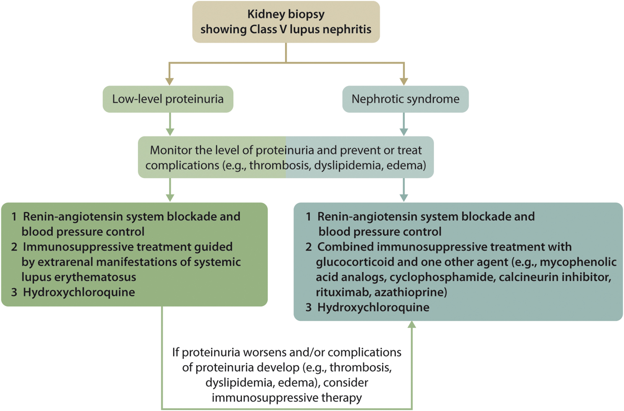

Slide 57
Chapter 11. Anti-glomerular Basement Membrane (Anti-GBM) Antibody Glomerulonephritis

Slide 62
KDIGO would like to sincerely thank Dr. Bourne and the Team from Arkana Laboratories for this valuable collaboration.
THANK YOU

