Slide 1

KDIGO Clinical Practice Guideline for the Management of Nephrotic Syndrome in Children
KDIGO Guideline Co-Chairs:
Jürgen Floege, MD
Brad H. Rovin, MD, FACP, FASN

Slide 2
Presenter Note
This slide deck is a comprehensive document covering all diseases presented in the KDIGO 2025 Clinical Practice Guideline for the Management of Nephrotic Syndrome in Children
Customization of this deck for your use is encouraged.
However, the guideline statements are presented verbatim from the final publication and any edits to these statements is strongly discouraged.

Slide 3
Table of contents
Introduction
Guideline development process
Guideline statements and rationale from the KDIGO 2024 Clinical Practice Guideline for the Management of Lupus Nephritis
Acknowledgements

Slide 4
Introduction

Slide 5
KDIGO Programs
Guidelines
  KDIGO’s core mission. KDIGO is the only organization developing global guidelines in nephrology.
Controversies Conferences
  International conferences that examine significant topics in nephrology and related disciplines that are not fully resolved. Results in a published paper, usually in Kidney International. Often, a Controversies Conference will prompt development of a guideline or a guideline update.
Implementation Activities
  Dissemination and implementation of KDIGO guidelines
  Controversies Conference reports and observations
  Live Clinical Practice conferences – usually with a nephrology society to bring global KDIGO’s work to local audiences, using case studies
  Implementation Summits bring local experts together to discuss local or regional barriers and opportunities
  Core Implementation Kits – educational materials including Speaker’s Guides, Key Takeaways, Reference Tools, and Case Studies to assist with implementation of all KDIGO publications

Slide 6
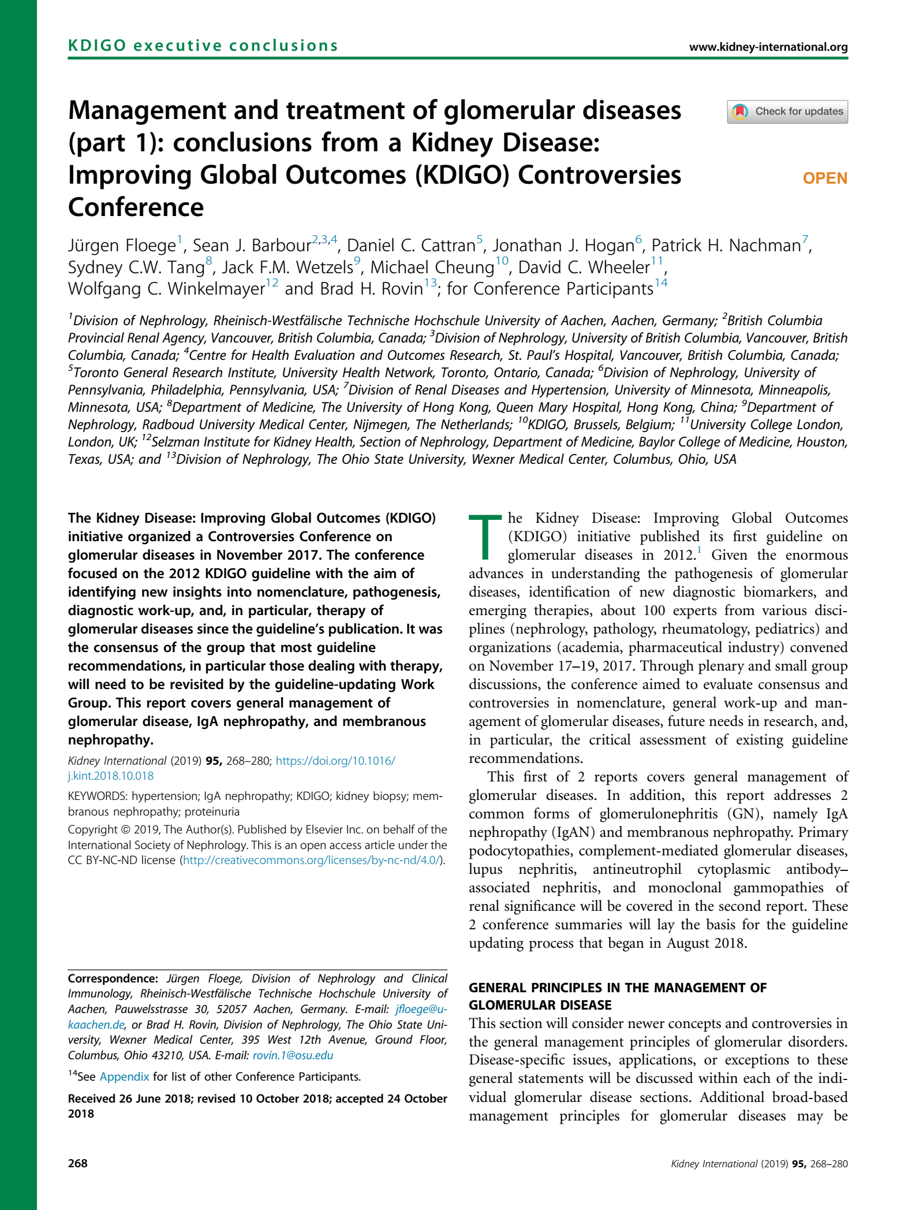
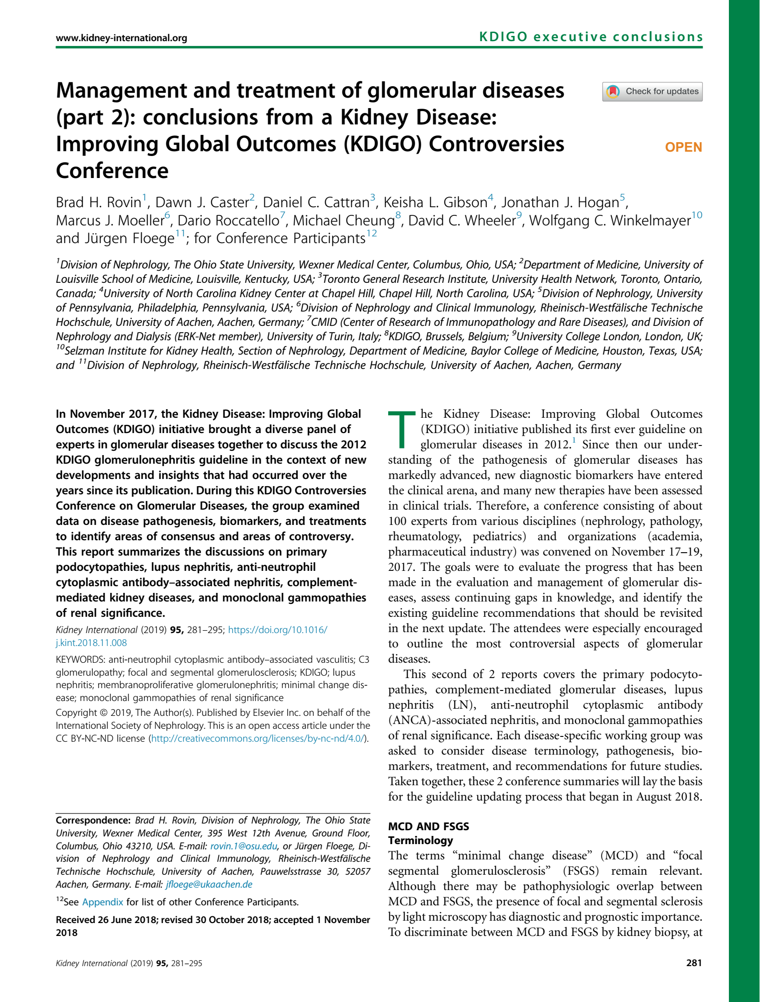
KDIGO Controversies Conference on Glomerular Diseases
November 2017 (Singapore)
Topics:
  General principles, Nephrotic syndrome, Membranoproliferative GN (MPGN), C3 glomerulonephritis (C3GN)
  IgA Nephropathy
  Membranous GN
  Minimal change disease (MCD) and Focal Segmental Glomerulosclerosis (FSGS)
  Lupus nephritis (LN) and ANCA vasculitis
Report published in Kidney International (2019)
Led to initiation of the update of the KDIGO guideline

Slide 7
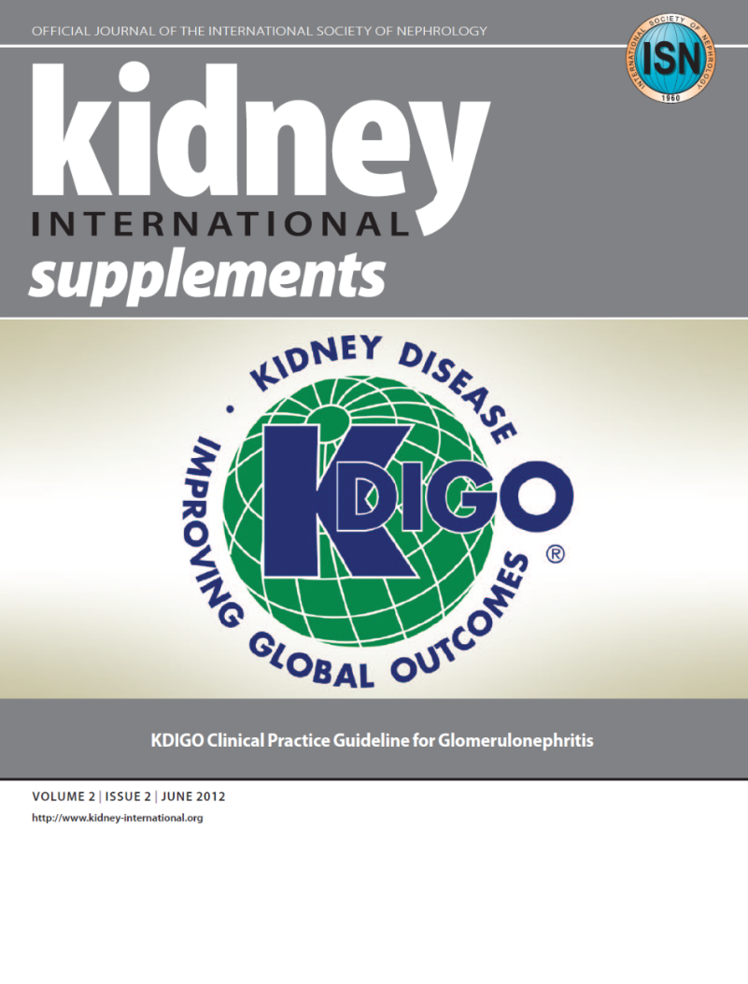
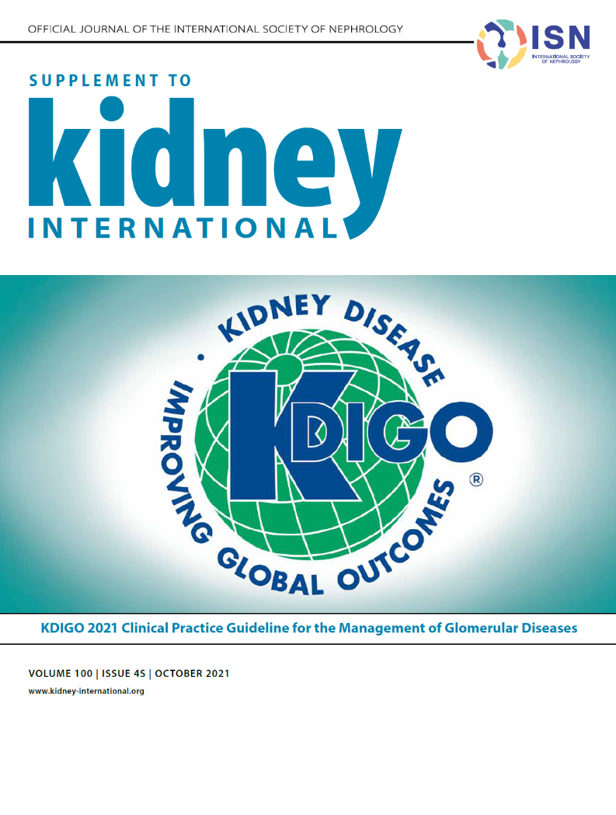
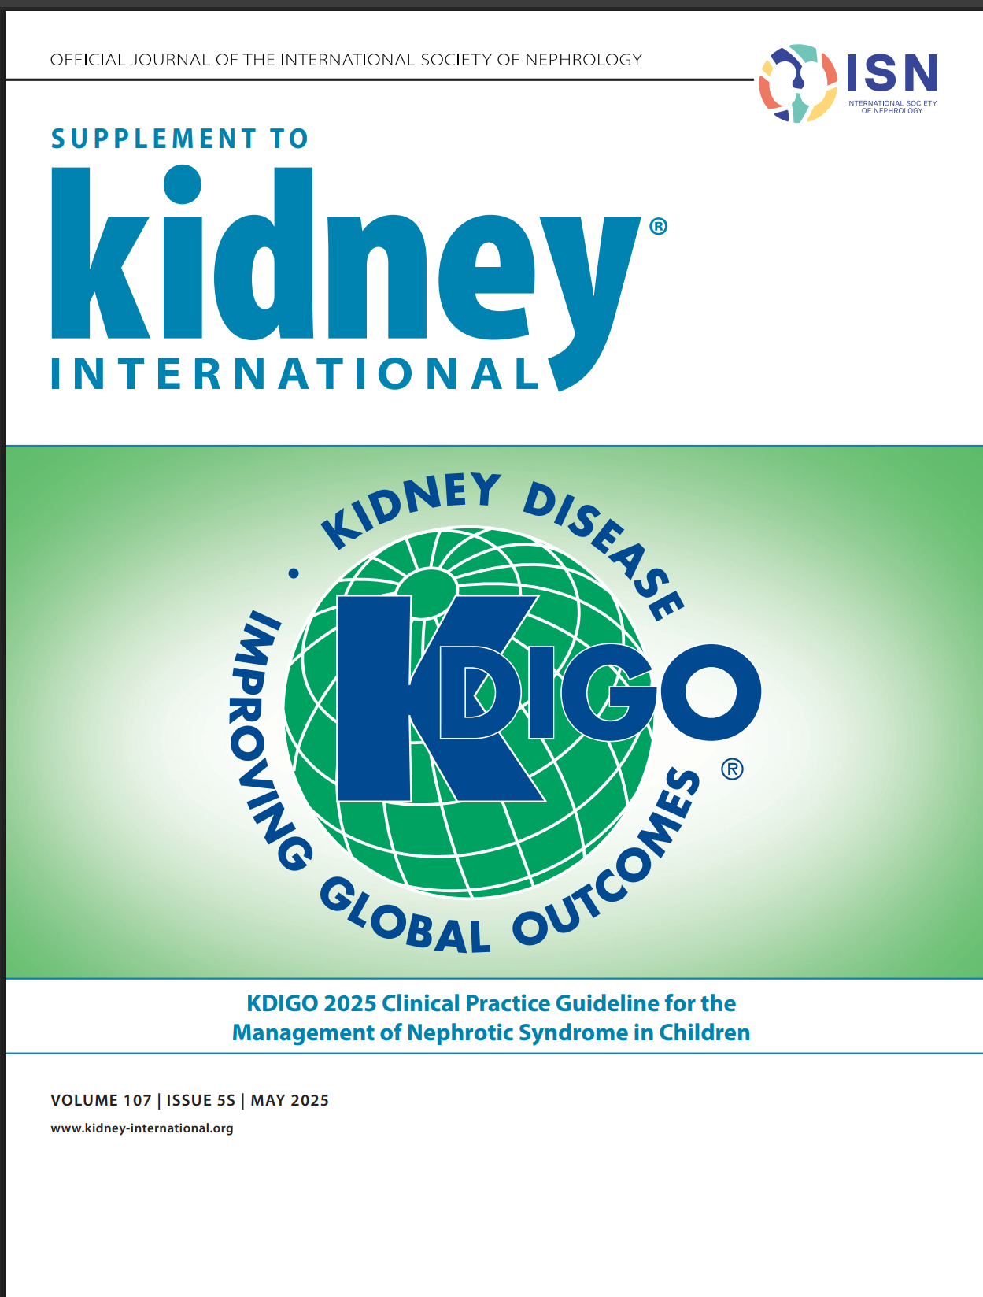
KDIGO 2012 Guideline: The Beginning
KDIGO 2021 Guideline: The Update
KDIGO 2025 Guideline: The NS Update

Slide 8
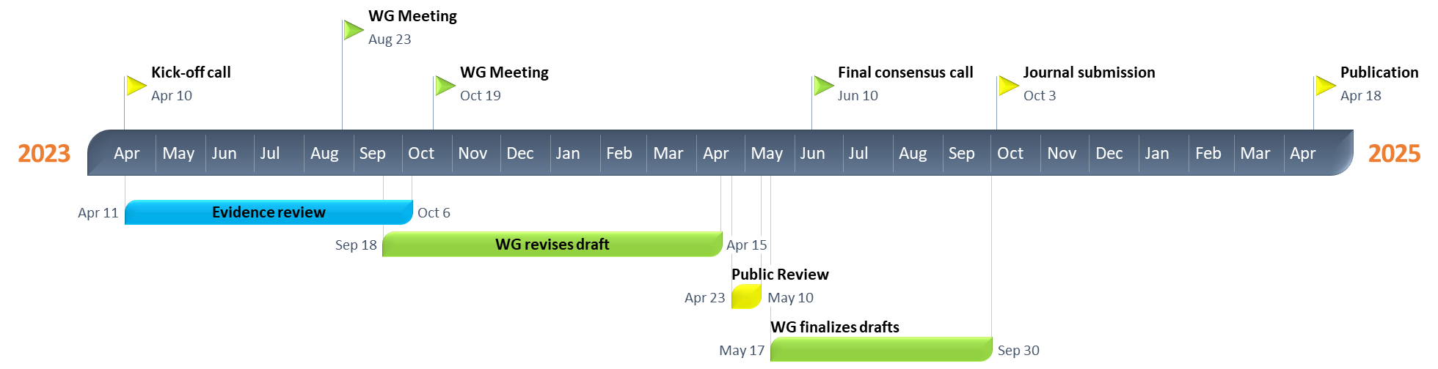
Timeline of Guideline for Management of NS in Children

Slide 9
Guideline Goals
Generate a useful resource for clinicians and patients
  Address relevant questions with actionable recommendations
  Take on controversial topics when sufficient evidence
  Communicate clearly
Target audience: Primarily clinicians treating patients with glomerular diseases
Stay true to evidence, where available
Propose research questions
Be mindful of implications for policy and payment

Slide 10
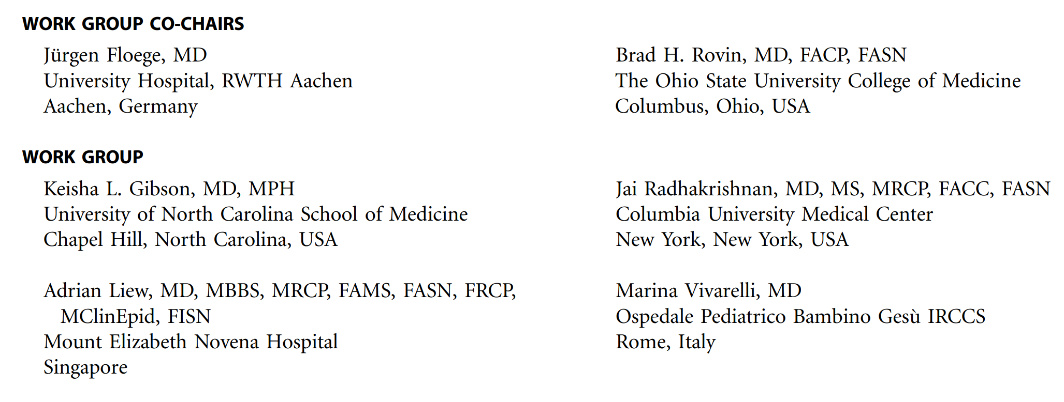






KDIGO NS in Children Guideline Work Group
Notes:
The KDIGO Guideline Work Group is:
Prior GL WG Members
Deep experience
Evidence Review Team

Slide 11
What Is New Since the 2021 KDIGO Guideline
New clinical characteristics and definitions for nephrotic syndrome which align with the recent International Pediatric Nephrology Association (IPNA) guidelines.
Additional definition for “confirmation period”.
Refined treatment algorithm for nephrotic syndrome in children specifying in which cases a biopsy and/or genetic testing should be considered and providing a detailed decision tree on immunosuppressive therapy in children with a complete response to glucocorticoids (steroid sensitive), who subsequently become infrequent or frequent relapsers or even steroid dependent.
Separate sections for (i) prevention and (ii) treatment and prevention of subsequent relapses.
Incorporation of data from the Prednisolone in Nephrotic Syndrome 2 (PREDNOS2) study demonstrating no differences in the incidence of upper respiratory tract infection–associated relapses of nephrotic syndrome between a fixed dose of prednisolone and placebo.

Slide 12
Guideline Development Process

Slide 13
Evidence Review
ERT – 2021: Cochrane Kidney Transplant; 2025 Update: Brown University
  Existing Population, Intervention, Comparator, Outcome, Study design (PICOS) questions and new PICOS questions developed
  Clinical and important outcomes identified
    The critical and important outcomes were voted on by the Work Group using an adapted Delphi process (1–9 Likert scale). Critical outcomes were rated 7–9, and important outcomes were rated 4–6 on the 9-point scale.
Critical outcomes | Important outcomes
All-cause mortality Kidney failure ≥50% loss of GFR Infection Glucocorticoid-related adverse events Malignancy | Complete remission or relapse Annual GFR loss (minimum 3 years follow-up)
GFR, glomerular filtration rate

Slide 14
PICOS Questions
Focus on RCTs - mapped to existing Cochrane Systematic reviews
  New systematic reviews undertaken as required
Key question | Population | Intervention | Comparator | Outcome | Study design
Chapter 4: NS in children
In children with SSNS, what glucocorticoid therapy regimens improve efficacy outcomes and reduce adverse effects? | Children (3-18 years of age) with SSNS | Glucocorticoid therapy | Placebo, no treatment, or standard of care | Critical and important outcomes | RCTs
In children with SSNS, what non-glucocorticoid immunosuppressive regimens improve efficacy outcomes and reduce adverse effects? | Children (3-18 years of age) with SSNS | Non-glucocorticoid immunosuppressive therapy

Slide 15
Key question | Population | Intervention | Comparator | Outcome | Study design
Chapter 4: NS in children
In children (3–18 years of age) with SRNS, what immunosuppressive therapy, improves efficacy outcomes and reduces adverse effects? | Children (3-18 years of age) with SRNS | Immunosuppressive therapy | No treatment, placebo, or other immunosuppressive therapies (including glucocorticoids) | Critical and important outcomes | RCTs

Slide 16
Literature Search
October 2018 Supplemented with additional studies until September 2019; Updated in June 2020, April 2023, and august 2024

Slide 17
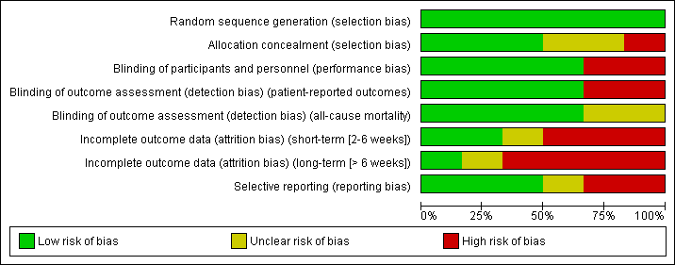
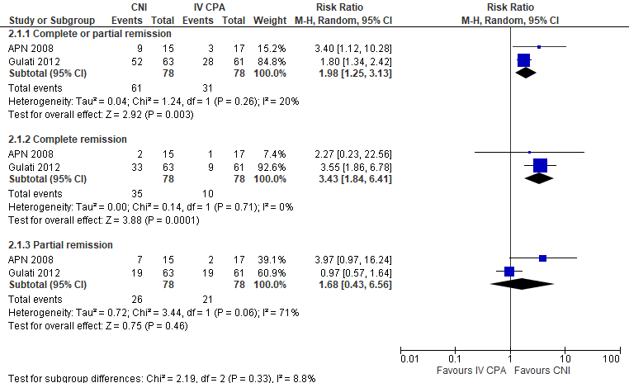
Evidence Synthesis
Risk of bias graph example
Standard Cochrane methods – Two independent reviewers
  Data abstraction
  Critical appraisal – using validated tools
Data-analysis
  Random effects meta-analysis and generic inverse variance
    Relative risk for dichotomous outcomes
    Mean difference for continuous outcomes
  Heterogeneity assessed using the I² statistic
Forest plot example

Slide 18

Grading Recommendations
  GRADE methodology
  The certainty of the evidence – Level A, B, C, D
    Study limitations
    Inconsistency
    Indirectness
    Imprecision
    Publication bias
  Strength of the recommendation – Level 1, “We recommend” or Level 2, “We suggest”
    Key Information
      Balance of benefits and harms
      Certainty of the evidence
      Patient values and preferences
      Resources and costs
      Considerations for implementation
    Rationale

Slide 19
Guideline Format
KDIGO guidelines continue to use the Grading of Recommendations Assessment, Development, Evaluation (GRADE) methodology, but we have strengthened the link between the recommendation statements and underlying evidence base.
Guidelines now include a mix of recommendations and “practice points” to help clinicians better evaluate and implement the guidance from the expert Work Group.
All graded recommendations follow a consistent and structured format and are similar in style to previous KDIGO recommendations.
Practice points may be formatted as text, a table, a figure, or an algorithm to make them easier to use in clinical practice.

Slide 20
Guideline Statements and Rationale

Slide 21
Nephrotic Syndrome in Children - Diagnosis
Practice Point 1.1.1: The clinical characteristics of and definitions for nephrotic syndrome in children are outlined in Figure 1.
Notes:
Please read this slide

Slide 22
Nephrotic Syndrome in Children - Prognosis
Practice Point 1.2.1: The prognosis for children with nephrotic syndrome is best predicted by the patient’s response to the initial treatment and frequency of relapse
during the first year after treatment. Therefore, a kidney biopsy is not usually needed at the initial presentation and is instead reserved for children with resistance to therapy
or an atypical clinical course.
Notes:
In contrast to the management of NS in adults, a diagnostic kidney biopsy is generally not performed at presentation to establish a diagnosis in children.
Children who develop NS are generally assumed to have MCD that will respond to glucocorticoids (steroid-sensitive nephrotic syndrome [SSNS]).

Slide 23
Nephrotic Syndrome in Children - Treatment
Notes:
Patients who are glucocorticoid-resistant (steroid resistant nephrotic syndrome [SRNS]) have poor long-term kidney survival, and should undergo a more extensive evaluation, including a kidney biopsy and genetic testing

Slide 24
Nephrotic Syndrome in Children – Initial Treatment
Recommendation 1.3.1.1: We recommend that oral glucocorticoids be given for 8 weeks (4 weeks of daily glucocorticoids followed by 4 weeks of alternate-day glucocorticoids) or 12 weeks (6 weeks of daily glucocorticoids followed by 6 weeks of
alternate-day glucocorticoids) (1B).
Practice Point 1.3.1.1: The standard dosing regimen for the initial treatment of nephrotic syndrome is daily oral prednisone/prednisolone 60 mg/m² per day or 2 mg/kg per day (maximum 60 mg/d) for 4 weeks followed by alternate-day prednisone/prednisolone 40 mg/m² or 1.5 mg/kg (maximum 40 mg) for another 4 weeks or prednisone/prednisolone 60 mg/m² per day or 2 mg/kg per day (maximum 60 mg/d) for 6 weeks followed by alternate-day prednisone/prednisolone 40 mg/m² or 1.5 mg/kg (maximum 40 mg) for another 6 weeks.
Notes:
This recommendation places a relatively higher value on the moderate-certainty evidence of equivalent clinical outcome (frequent relapse) and favorable safety profile associated with shorter-term (8–12 weeks) glucocorticoid treatment and a relatively higher value on high-certainty evidence suggesting that prolonged (>12 weeks) glucocorticoid treatment increases the risk of adverse effects without further improving clinical outcomes in terms of the relapse rate.
The recommendation places a relatively lower value on low-certainty evidence suggesting that prolonged glucocorticoid therapy may delay the time to first relapse as compared to 8–12 weeks of treatment. In terms of oral glucocorticoids, prednisone and prednisolone are equivalent, used in the same dosage, and are both supported by high-certainty evidence. All later usages of “oral glucocorticoids” refer to prednisone or prednisolone.
Recent reports suggest that it may be prudent to dose by body surface area to avoid underdosing, particularly in younger children. A randomized controlled trial (RCT) comparing single versus divided dosing showed that the 2 are equivalent in terms of time to remission and number of subsequent relapses. Therefore, a single daily dose may be preferable to optimize adherence.

Slide 25
Nephrotic Syndrome in Children – Prevention of Relapses
Recommendation 1.3.2.1: For children with frequently relapsing and steroid-dependent
nephrotic syndrome, we recommend that daily glucocorticoids not be routinely given during episodes of upper respiratory tract and other infections to reduce the risk of relapse (1C).
Practice Point 1.3.2.1: A short course (i.e., 3 extra doses) of low-dose (0.5 mg/kg per day), daily prednisone or prednisolone at the onset of an upper respiratory tract infection can be considered in children with frequently relapsing and steroid-dependent nephrotic syndrome who are already taking low-dose, alternate-day prednisolone and have a history of repeated infection-associated relapses or significant prednisone- or prednisolone-related morbidity.
Notes:
Building on the theme of lowering glucocorticoid burden, the Work Group also recommended that children who frequently relapse or who have become glucocorticoid dependent be treated for a week with 0.5 mg/kg/d of prednisone (or prednisolone) during upper respiratory infections to reduce relapse risk and the need for restarting high-dose glucocorticoids (Grade 1C).
This recommendation places a relatively higher value on evidence demonstrating that preemptive daily prednisolone may not reduce the risk of SSNS relapse during infection as well as on the lack of evidence of potential benefits of this approach. Given the lack of evidence of a benefit of preemptive glucocorticoid treatment, this recommendation places a low value on evidence comparing alternate-day and daily prednisolone as preemptive
treatment.

Slide 26
Nephrotic Syndrome in Children – Treatment and Prevention of Subsequent Relapses
Practice Point 1.3.3.1: The initial approach to relapse should include oral prednisone or prednisolone as a single daily dose of 60 mg/m² per day or 2 mg/kg per day (maximum 60
mg/d) until the child remits completely for ≥3 days.
Practice Point 1.3.3.2: After achieving complete remission in patients with steroid-sensitive nephrotic syndrome treated for relapse, reduce oral prednisone/prednisolone to 40 mg/m² or 1.5 mg/kg (maximum 40 mg) on alternate days for 4 weeks.
Practice Point 1.3.3.3: For children with frequently relapsing nephrotic syndrome or steroid-dependent nephrotic syndrome without glucocorticoid toxicity, the same glucocorticoid regimen may be employed in subsequent relapses, while a shorter taper and/or more robust steroid-sparing approaches should be considered in children with signs of
glucocorticoid toxicity.

Slide 27
Nephrotic Syndrome in Children – Treatment and Prevention of Subsequent Relapses
Practice Point 1.3.3.4: For children with frequently relapsing nephrotic syndrome without serious glucocorticoid-related adverse effects, low-dose, alternate-day oral prednisone/
prednisolone (optimally ≤0.5 mg/kg per dose) can be prescribed to prevent relapse.
Recommendation 1.3.3.1: For children with frequently relapsing nephrotic syndrome who
develop serious glucocorticoid-related adverse effects and for all children with steroid-dependent nephrotic syndrome, we recommend that glucocorticoid-sparing agents be prescribed to prevent relapses, rather than no treatment or continuation with glucocorticoid treatment alone (1B).
Notes:
For SSNS patients who frequently relapse and have glucocorticoid-related side effects, and all glucocorticoid-dependent patients, glucocorticoid-sparing agents should be given rather than no treatment or continued treatment with glucocorticoids alone (Grade 1B).
This recommendation places a relatively high value on observational data and extensive clinical experience that demonstrate a substantial risk of adverse events associated with long-term glucocorticoids and efficacy of glucocorticoid-sparing agents in preventing relapse as compared with no treatment.

Slide 28
Nephrotic Syndrome in Children – Treatment and Prevention of Subsequent Relapses
Practice Point 1.3.3.5: Patients should ideally be in remission with glucocorticoids prior to the initiation of glucocorticoid-sparing agents such as oral calcineurin inhibitors (CNIs), cyclophosphamide, levamisole, mycophenolate mofetil (MMF), and rituximab. Coadministration of glucocorticoids is recommended for ≥2 weeks following the
initiation of glucocorticoid-sparing treatment.
Practice Point 1.3.3.6: Choosing the most appropriate glucocorticoid-sparing agent from among oral CNIs, cyclophosphamide, levamisole, MMF, and rituximab (listed here in an unbiased order) is a decision that requires careful consideration of specific patient-related issues such as resources, adherence, adverse effects, and patient preferences. Oral cyclophosphamide and levamisole may be preferable glucocorticoid-sparing therapies in frequently relapsing nephrotic syndrome. MMF, rituximab, CNIs, and, to a lesser extent, oral cyclophosphamide may be preferable glucocorticoid-sparing therapies in children
with steroid-dependent nephrotic syndrome.

Slide 29
Nephrotic Syndrome in Children – Treatment and Prevention of Subsequent Relapses
Notes:
A variety of glucocorticoid-sparing agents have been used in SSNS is shown in this slide.
Recent encouraging results have indicated that a therapeutic agent that is unavailable in many countries, levamisole, may be an effective, safe, and inexpensive option, especially in frequently relapsing forms of NS, and the effectiveness of rituximab in both frequently relapsing and steroid-dependent forms suggests a pivotal role of B cells in this disease.

Slide 30
Steroid-Resistant Nephrotic Syndrome in Children - Treatment
Recommendation 1.4.1.1: We recommend using cyclosporine or tacrolimus as initial second-line therapy for children with steroid-resistant nephrotic syndrome (1C).
Notes:
For children with SRNS, CNIs are recommended as the initial therapy after glucocorticoid failure (Grade 1C).
This recommendation places a relatively higher value on data suggesting that CNIs are more likely to induce remission than cyclophosphamide, MMF, or rituximab in the treatment of children with SRNS. Conversely, it places a relatively lower value on evidence suggesting that prolonged exposure to CNIs may
lead to significant nephrotoxicity
Cyclophosphamide should be used only if CNIs are not available in low-resource settings, and the role of rituximab seems to be limited.
For patients who do respond to a CNI, a switch to MMF to maintain remission should be considered to avoid long-term CNI toxicity.
Importantly, genetic testing may help clarify the use of immunosuppressive agents in SRNS.
Although some podocyte mutations may respond to a CNI or other interventions, the vast majority will not, and knowing this may provide justification to reduce the exposure of a child to a potentially toxic medication.

Slide 31
Steroid-Resistant Nephrotic Syndrome in Children – Special Situations
Practice Point 1.5.1: Figure 5 outlines the general principles for children with nephrotic syndrome.
Notes:
Please read this slide and present table

Slide 32
Research Recommendations
RCTs are needed to:
Compare 8 versus 12 weeks of oral prednisone/prednisolone for initial therapy and explore further shortening of the initial glucocorticoid regimen and assess combination therapy with a glucocorticoid-sparing agent at disease onset
Optimize subsequent treatment of SSNS after relapse in different forms of disease
Optimize dosing regimen for glucocorticoid treatment at the onset of an infection
Define the optimal dosing and choice of glucocorticoid sparing agents in FRNS and SDNS
Evaluate the optimal duration of glucocorticoid treatment in SRNS, in particular when CNIs are initiated, and stratify patients based on the identification of podocytopathy-related genetic mutations
Determine the mode of action of glucocorticoids and other immunosuppressive medications in SSNS; determine the potential role of pharmacogenomics in treatment; and identify biomarkers or genetic risk haplotypes to stratify disease subgroups
Determine the long-term safety of therapies that deplete B cells
Include quality-of-life measures as endpoints in clinical trials assessing the treatment of children with both SSNS and SRNS
Evaluate anti-nephrin and anti-slit diaphragm antibodies as biomarkers as well as predictors of response to treatment and outcome of NS in children
Notes:
Please read this slide and present table

Slide 33
Acknowledgments

Slide 34
Acknowledgments
KDIGO gratefully acknowledges our Knowledge Translation Lead, Edgar V. Lerma, MD, FACP, FASN, FAHA, FASH, FNLA, FNKF, FASDIN, FCRS, FPSN (Hon) for his time and expertise in creating the speaker's notes in this Speaker's Guide.
KDIGO also gratefully acknowledges Guideline Co-Chairs, Brad Rovin, MD (United States), and Jürgen Floege, MD (Germany), and the Guideline Work Group for their dedication, time, and insights in authoring the Glomerular Diseases Guideline.

Slide 35
Notes
Use the subsequent slides to tailor individual presentations
Notes:
Sample slide

Slide 36
Questions?
Notes:
Optional slide to close with questions

Slide 37
Sample Header
Bullet 1
Bullet 2
  Sub-bullet

Slide 38
Notes:
Sample slide

