Slide 1

KDIGO 2025 Clinical Practice Guideline for the Evaluation, Management and Treatment of Autosomal Dominant Polycystic Kidney Disease
Speaker's Guide
KDIGO Guideline Co-Chairs:
Olivier Devuyst, MD, PhD
Vicente E. Torres, MD, PhD
Notes:
The Kidney Disease: Improving Global Outcomes (KDIGO) 2025 Clinical Practice Guideline for the Evaluation, Management, and Treatment of Autosomal Dominant Polycystic Kidney Disease (ADPKD)represents the first KDIGO guideline on this subject.

Slide 2
Table of contents
Introduction
Guideline Development Process:
  Evidence Review
  Guideline Format
Guideline Statements and Rationale from:
  Chapter 1. Nomenclature, Diagnosis, Prognosis and Prevalence
  Chapter 2. Kidney Manifestations
  Chapter 3. CKD Management and Progression, Kidney Failure, and Kidney Replacement Therapy (KRT)
  Chapter 4. Therapies to Delay Progression of Kidney Disease
  Chapter 5. Polycystic Liver Disease
  Chapter 6. Intracranial Aneurysms and other Extrarenal Manifestations
  Chapter 7. Lifestyle and Psychosocial Aspects
  Chapter 8. Pregnancy and Reproductive Issues
  Chapter 9. Pediatric Issues
  Chapter 10. Approaches to the Management of People with ADPKD
Notes:
Its scope includes nomenclature, diagnosis, prognosis, and prevalence; kidney manifestations; chronic kidney disease (CKD) management and progression, kidney failure, and kidney replacement therapy; therapies to delay progression of kidney disease; polycystic liver disease; intracranial aneurysms and other extrarenal manifestations; lifestyle and psychosocial aspects; pregnancy and reproductive issues; pediatric issues; and approaches to the management of people with ADPKD.

Slide 3
KDIGO Programs
Guidelines
  KDIGO’s core mission. KDIGO is the only organization developing global guidelines in nephrology.
Controversies Conferences
  International conferences that examine significant topics in nephrology and related disciplines that are not fully resolved. Results in a published paper, usually in Kidney International. Often a Controversies Conference will prompt development of a guideline or a guideline update.
Implementation activities
  Dissemination and implementation of KDIGO guidelines
  Controversies Conference reports and observations
  Live Clinical Practice Conferences – usually with a nephrology society – bring KDIGO global work to local audiences, using case studies
  Implementation Summits bring local experts together to discuss local or regional barriers and opportunities
  Core implementation kits – educational materials including Key Takeaway lists, Speaker’s Guides, infographics, reference tools, and case studies to assist with implementation of all KDIGO publications

Slide 4
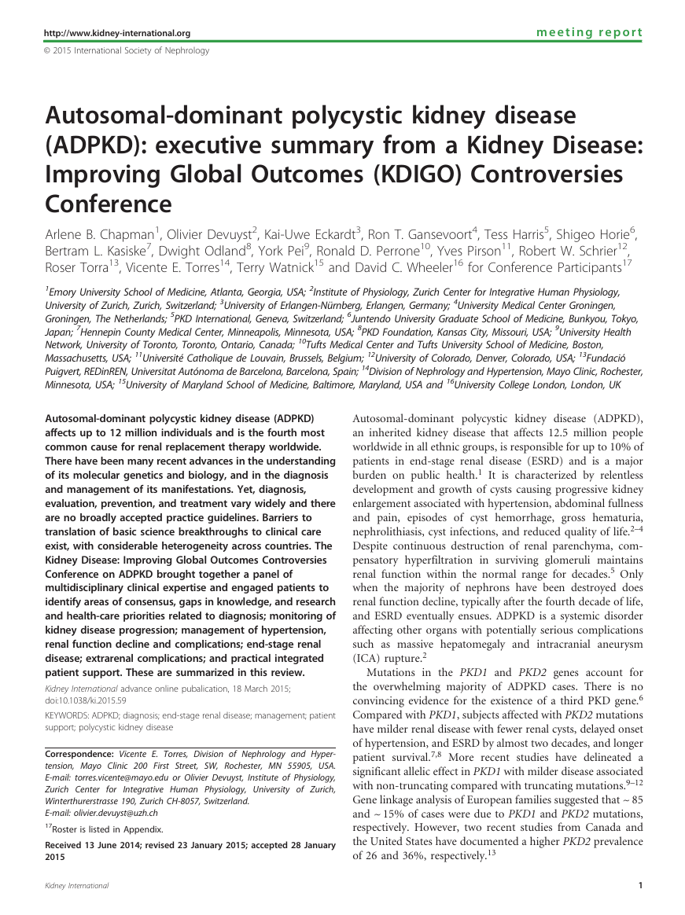

KDIGO 2014 Controversies Conference
KDIGO 2025 Guideline
Notes:
Autosomal dominant polycystic kidney disease(ADPKD) is a major genetic disorder affecting millions of people worldwide, and the fourth most common global cause for kidney replacement therapy.
The Kidney Disease: Improving Global Outcomes (KDIGO) Controversies Conference on ADPKD was held in Edinburgh in 2014.
Since then, the genetic and clinical landscapes of ADPKD have evolved; distinct imaging patterns and prognostic tools have been identified; results of randomized controlled trials (RCTs) of tolvaptan, somatostatin analogues, levels of blood pressure (BP) targets, renin–angiotensin blockade, and other potential treatments for ADPKD have been published; and tolvaptan has been approved for the treatment of rapidly progressive ADPKD.
With the sustained increase in knowledge, and the expansion of the volume of information, a global KDIGO Clinical Practice Guideline for the Evaluation, Management, and Treatment of ADPKD has become timely.

Slide 5
KDIGO 2014 Controversies Conference on Autosomal Dominant Polycystic Kidney Disease (ADPKD)
January 2014 (Edinburgh, Scotland)
Topics:
  Diagnosis
  Management of Renal Manifestations
  Management of Hypertension and Renal Function Decline
  Management of ESRD in ADPKD
  Management of Extra-renal Complications
  Practical Integrated Patient Support
Report published in Kidney International (2015)

Slide 6
KDIGO 2025 Clinical Practice Guideline for the Evaluation, Management, and Treatment of ADPKD
Published January 2025 as a Supplement to Kidney International
Chapters:
  Chapter 1. Nomenclature, Diagnosis, Prognosis and Prevalence
  Chapter 2. Kidney Manifestations
  Chapter 3. CKD Management and Progression, Kidney Failure,
  and Kidney Replacement Therapy (KRT)
  Chapter 4. Therapies to Delay Progression of Kidney Disease
  Chapter 5. Polycystic Liver Disease
  Chapter 6. Intracranial Aneurysms and other Extrarenal Manifestations
  Chapter 7. Lifestyle and Psychosocial Aspects
  Chapter 8. Pregnancy and Reproductive Issues
  Chapter 9. Pediatric Issues
  Chapter 10. Approaches to the Management of People with ADPKD
Executive Summary published in January issue
of Kidney International
Notes:
The KDIGO 2025 Clinical Practice Guideline for the Evaluation, Management, and Treatment of ADPKD has been developed by an international, multidisciplinary Work Group with expertise in ADPKD, a dedicated Evidence Review Team, and the KDIGO staff.
The guideline includes 10 chapters addressing the whole scope of ADPKD diagnosis and management.

Slide 7

The Beginning – January 2021

Slide 8
Aim
The aim of this project was to develop an evidence-based clinical practice guideline for the diagnosis, prognosis, monitoring, prevention of disease progression, and treatment in people with ADPKD.

Slide 9
Overview of Process
This guideline adhered to international best practices for guideline development (Supplementary Tables S2–S4) and has been reported in accordance with the Institute of Medicine and Appraisal of Guidelines for Research & Evaluation (AGREE) II reporting checklists.
Notes:
The development of this guideline followed an explicit process of evidence review and appraisal, based on a rigorous, formal systematic literature review.

Slide 10
Overview of Process
The processes undertaken for the development of the KDIGO 2025 Clinical Practice Guideline for the Evaluation, Management, and Treatment of Autosomal Dominant Polycystic Kidney Disease are as follows:
appointing Work Group members and the ERT;
finalizing guideline development methodology;
defining the scope and the topics of interest for the guideline; developing and refining topics for systematic evidence review;
formulating clinical questions—identifying population, intervention or predictors, comparator, outcomes of interest, and other study design eligibility criteria (PICOD);
developing and implementing literature search strategies; screening abstracts and retrieving full-text articles on the basis of predefined eligibility criteria; creating data extraction forms;
extracting data and performing critical appraisal of the literature;
grading the methodology and outcomes in individual studies;
Notes:
The KDIGO 2025 Clinical Practice Guideline for the Evaluation, Management, and Treatment of ADPKD has been developed by an international, multidisciplinary Work Group with expertise in ADPKD, a dedicated Evidence Review Team, and the KDIGO staff.
The guideline targets a broad audience of healthcare providers, people living with ADPKD, and stakeholders involved in the various aspects of ADPKD care.

Slide 11
Overview of Process (Continued)
The processes undertaken for the development of the KDIGO 2025 Clinical Practice Guideline for the Evaluation, Management, and Treatment of Autosomal Dominant Polycystic Kidney Disease are as follows:
tabulating data from individual studies into summary tables and performing meta-analysis as appropriate; grading the certainty of evidence for each outcome across studies, and assessing the overall certainty of evidence across outcomes with the aid of evidence profiles;
determining the strength of recommendations on the basis of the grade of certainty of evidence and other considerations;
convening a public review in October 2023;
updating the evidence review and recommendation statements based on the current evidence and other considerations; and
finalizing and publishing the guideline.
Notes:
The strength of recommendations follows the Grading of Recommendations Assessment, Development, and Evaluation (GRADE) approach.
The guideline also provides practice points serving to direct clinical care or activities relating to areas for which a systematic review was not conducted.
Limitations of the evidence are discussed.
Research recommendations to address gaps in knowledge, and implications for policy and payment, are provided.

Slide 12

Work Group
Diverse expertise
Worldwide scope
Deep experience
Patients
Evidence Review Team
Notes:
The KDIGO 2025 Clinical Practice Guideline for the Evaluation, Management, and Treatment of ADPKD has been developed by an international, multidisciplinary Work Group with expertise in ADPKD, a dedicated Evidence Review Team, and the KDIGO staff.
The guideline has been developed with patient partners, clinicians, and researchers around the world, with the goal to generate a useful resource for healthcare providers and patients by providing actionable recommendations.

Slide 13
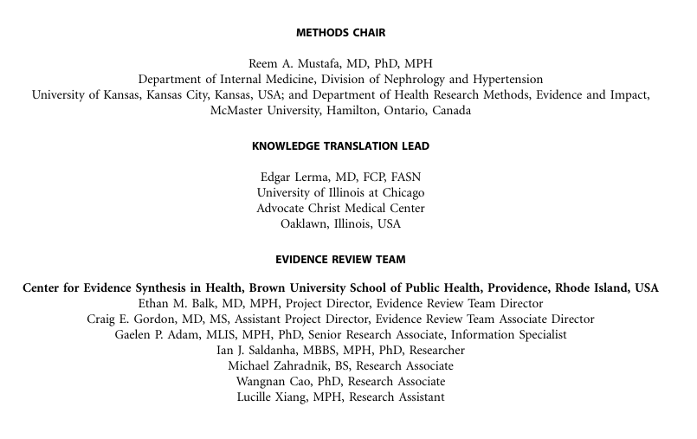
Work Group
Diverse expertise
Worldwide scope
Deep experience
Patients
Evidence Review Team

Slide 14
Defining the Scope and Formulating Key Clinical Questions
The guideline Work Group, with assistance from the ERT, defined the overall scope and the goals of the guideline, and drafted a preliminary list of topics and key clinical questions.
This process included making a determination about which topics the ERT would address via systematic review.
Issues that were considered when determining topics to be systematically reviewed included the following:
the specificity of the topic to ADPKD (e.g., tolvaptan treatment vs. prevention of kidney stones or management of dialysis);
the importance of the topic to the majority of patients, families, and healthcare providers;
prioritization of medications and imaging interventions;
the likelihood that sufficient evidence exists to inform recommendations; time requirements; and available ERT resources.
Notes:
The focus is on clinical management questions based on high certainty scientific evidence collected by the Evidence Review Team.

Slide 15
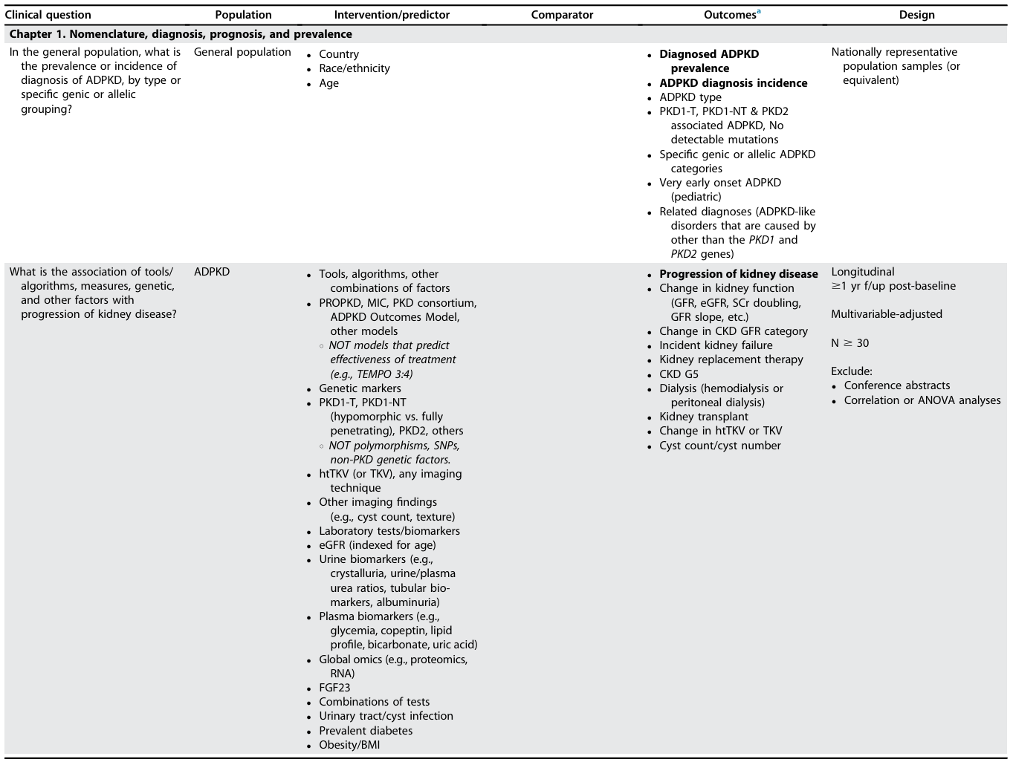
Clinical questions and SR topics in PICOD format

Slide 16
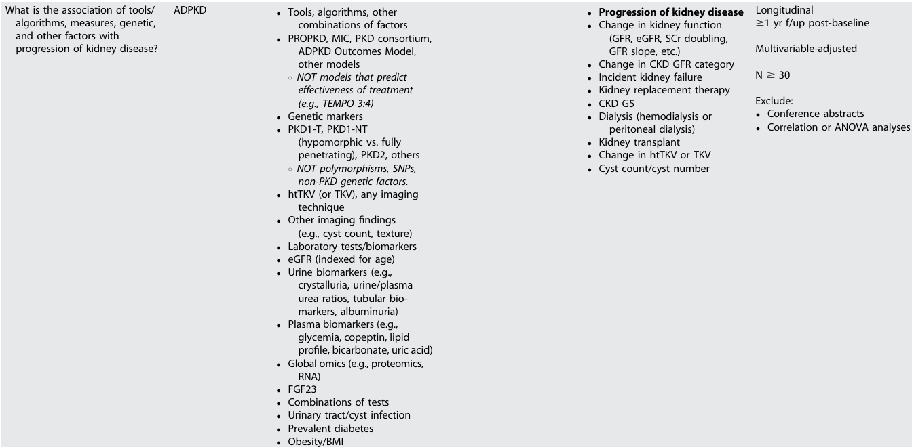
Clinical questions and SR topics in PICOD format

Slide 17
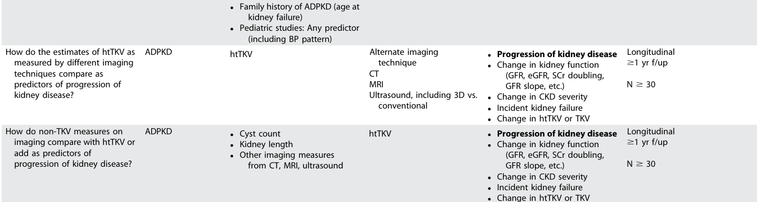
Clinical questions and SR topics in PICOD format

Slide 18
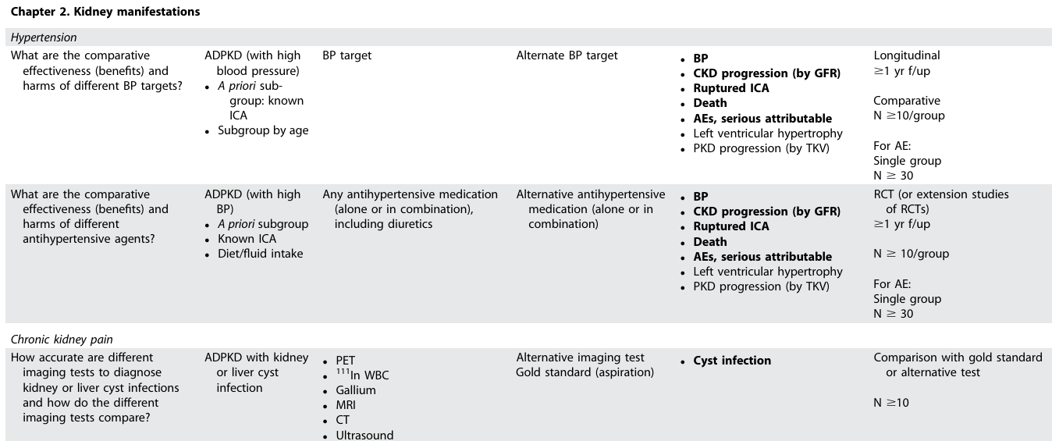
Clinical questions and SR topics in PICOD format

Slide 19
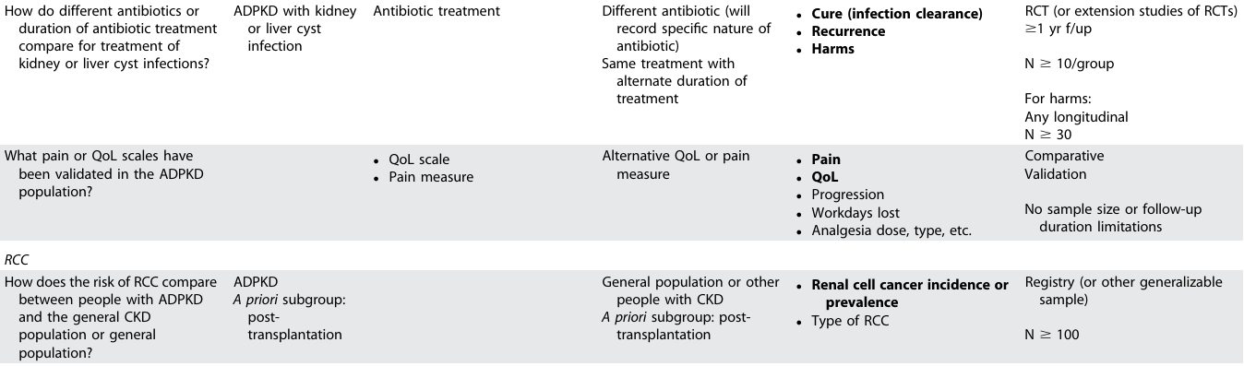
Clinical questions and SR topics in PICOD format

Slide 20
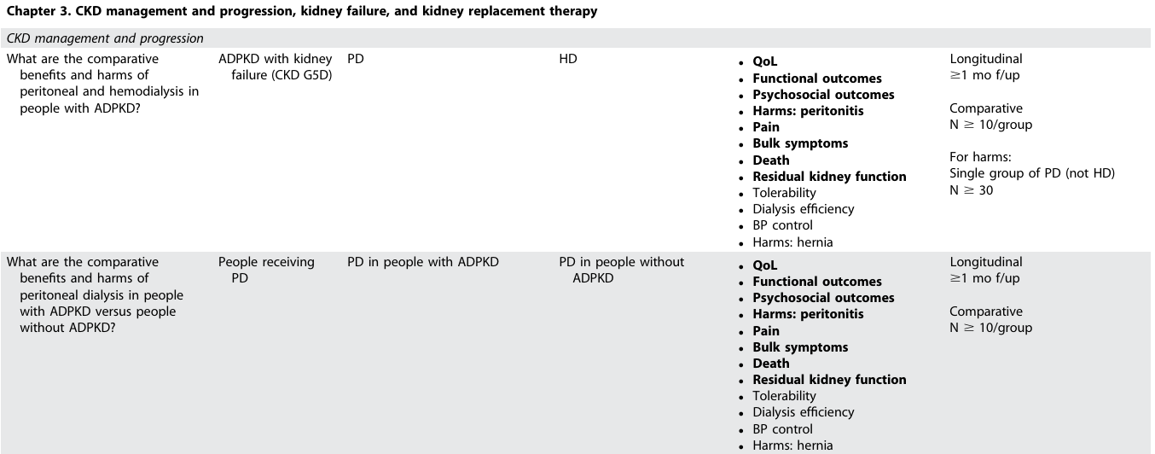
Clinical questions and SR topics in PICOD format

Slide 21
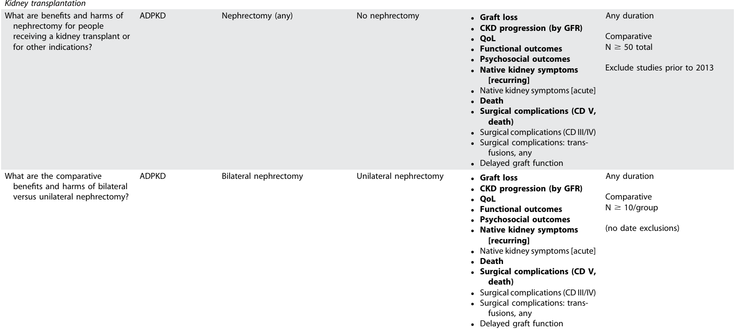
Clinical questions and SR topics in PICOD format

Slide 22
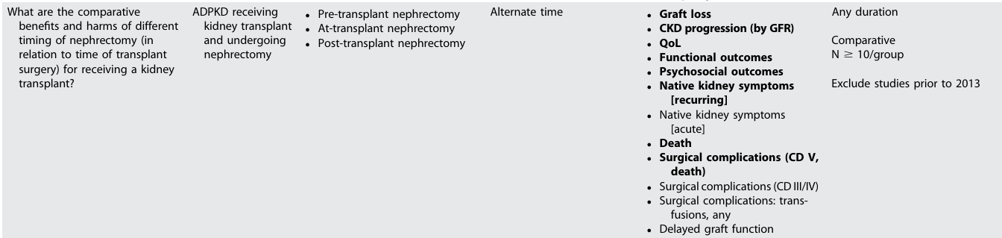
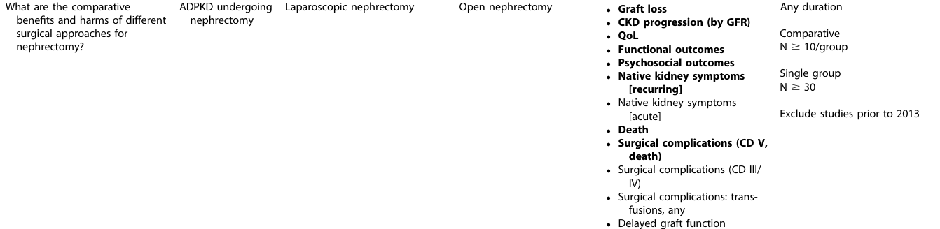
Clinical questions and SR topics in PICOD format

Slide 23
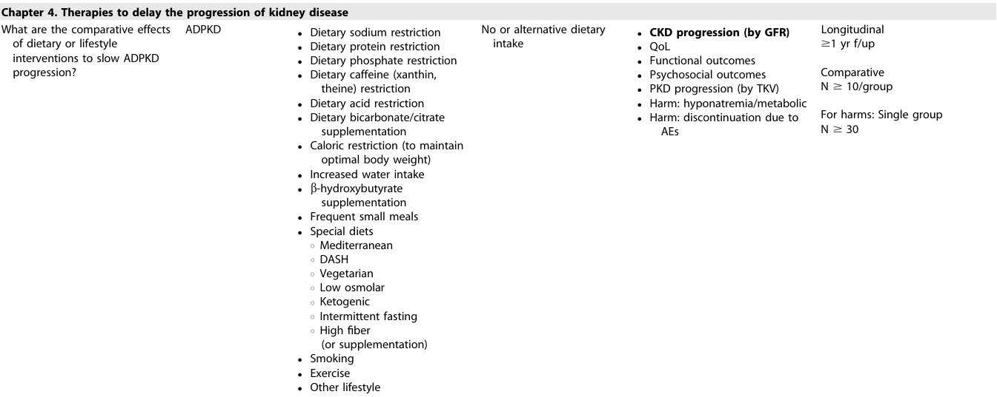
Clinical questions and SR topics in PICOD format

Slide 24
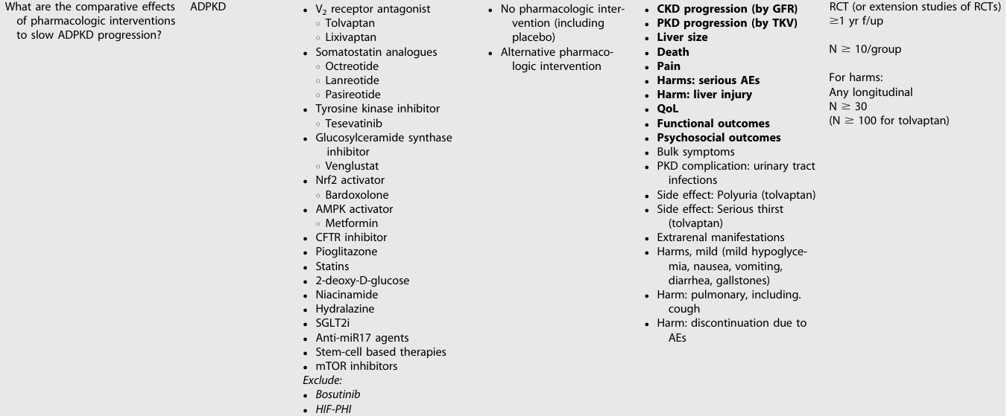
Clinical questions and SR topics in PICOD format

Slide 25
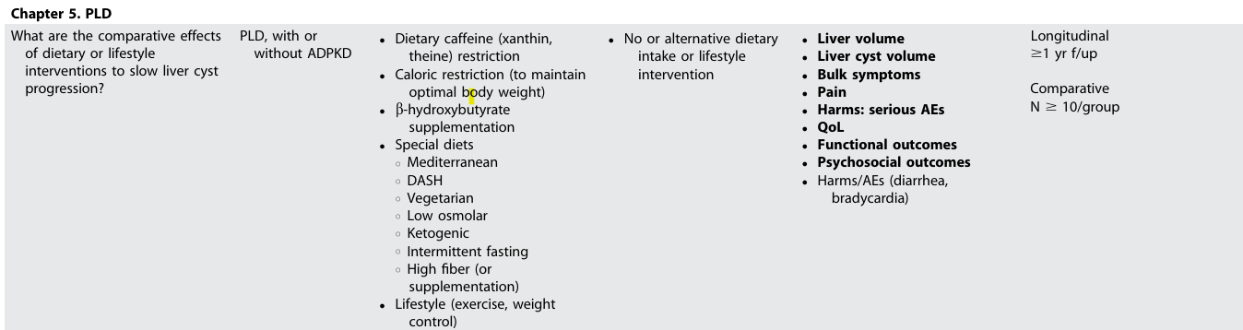
Clinical questions and SR topics in PICOD format

Slide 26
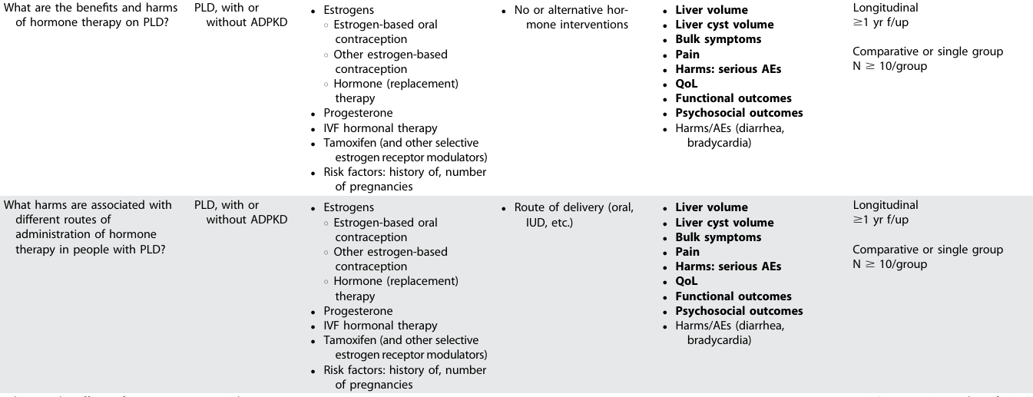
Clinical questions and SR topics in PICOD format

Slide 27
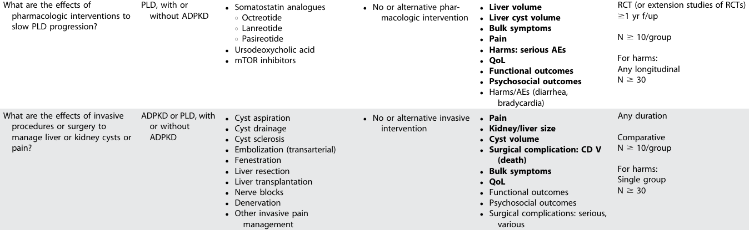
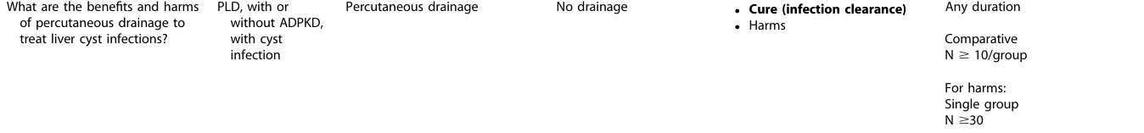
Clinical questions and SR topics in PICOD format

Slide 28
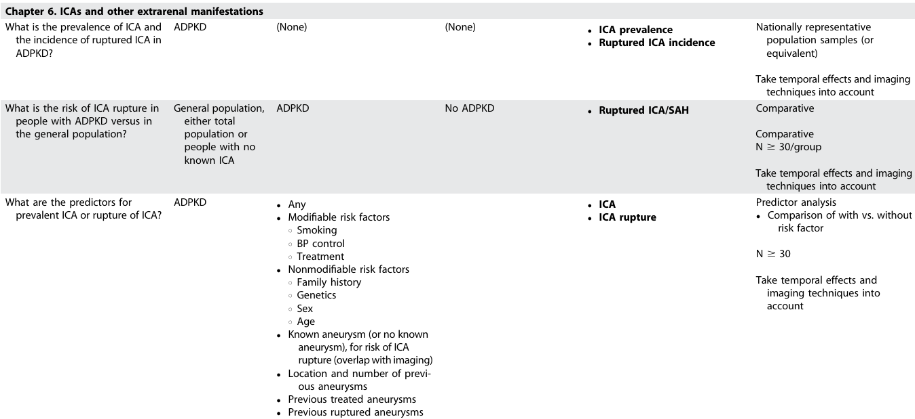
Clinical questions and SR topics in PICOD format

Slide 29
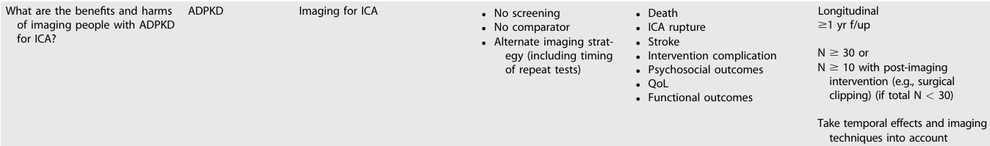
Clinical questions and SR topics in PICOD format

Slide 30
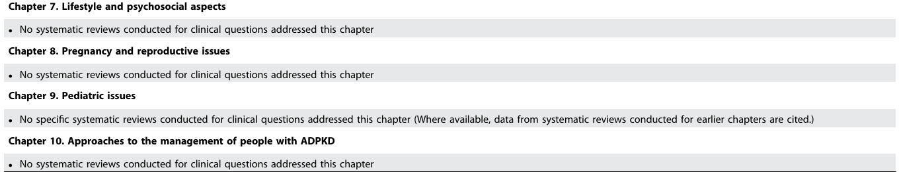
Clinical questions and SR topics in PICOD format

Slide 31
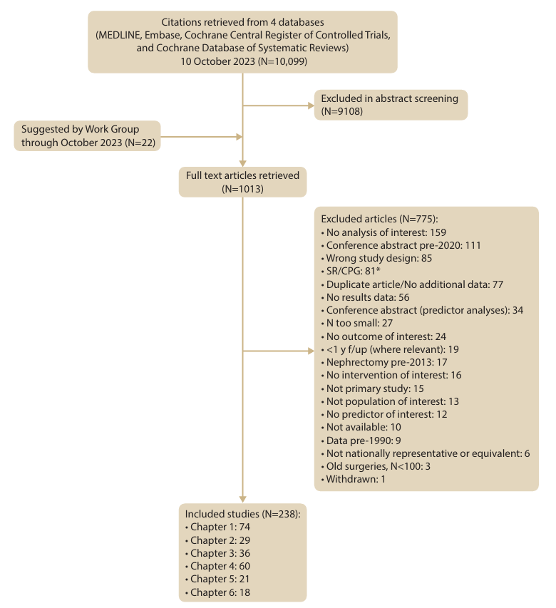
Literature search
Last Updated October 2023

Slide 32
Guideline format
  KDIGO guidelines continue to use GRADE methodology, but we have strengthened the link between the recommendation statements and underlying evidence base.
  Guidelines are now a mix of recommendations and practice points to help clinicians better evaluate and implement the guidelines from the Work Group.
  All recommendations follow a consistent and structured format and are similar in style to previous KDIGO recommendations.
  Practice points are may be formatted as text, a table, a figure, or an algorithm to make them easier to use in clinical practice.
Notes:
The guideline includes graded recommendations, based on the “Grading of Recommendations Assessment, Development and Evaluation” (GRADE) criteria and supported by systematic reviews, and ungraded practice points, based on expert opinion or limited evidence serving to direct clinical activities, for which a systematic review was not conducted.

Slide 33
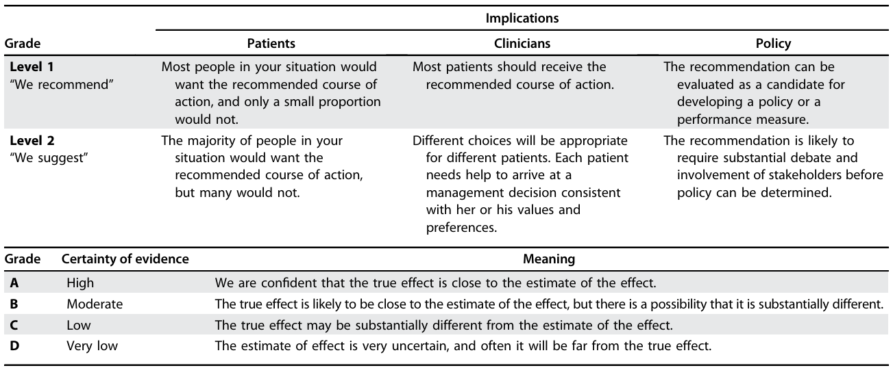
Nomenclature and Description for Rating Guideline Recommendations
Notes:
The strength of recommendations follows the Grading of Recommendations Assessment, Development, and Evaluation (GRADE) approach.

Slide 34
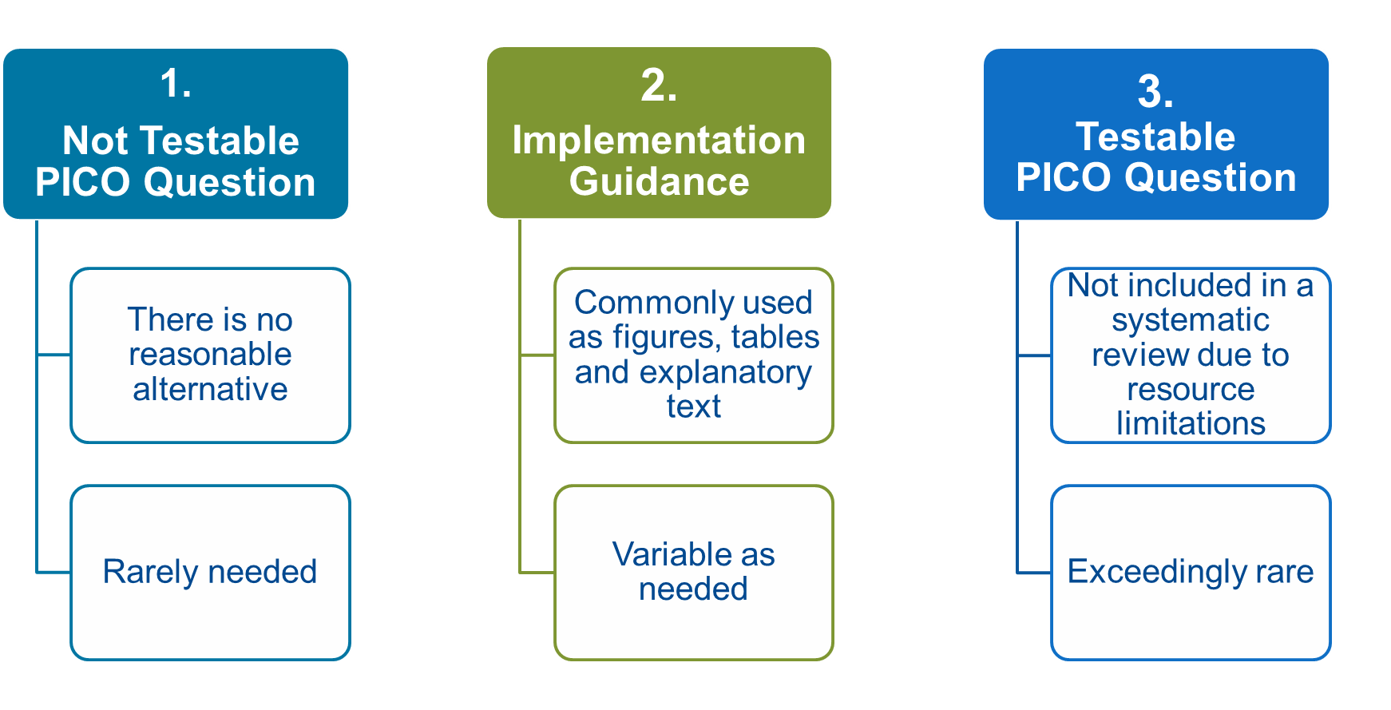
Situations when Practice Points Can/Should Be Used
Notes:
The guideline also provides practice points serving to direct clinical care or activities relating to areas for which a systematic review was not conducted.

Slide 35
How Should Practice Points Be Used When Caring for Patients?
  Practice points are consensus statements about a specific aspect of care and supplement graded recommendations for which a systematic evidence review was conducted.
  Note that practice points represent the expert judgment of the guideline Work Group but may also be based on limited evidence.
  Unlike recommendations, practice points are not graded for strength of recommendation or certainty of the evidence.
  Users should consider practice points as expert guidance and use them as they see fit to inform the care of patients.
New guideline disseminated
Start with recommendations
Consider relevant practice points
Notes:
Both recommendations and practice points are intended to help guide clinical practice and to aid in decision-making.
The KDIGO 2025 ADPKD Guideline has considered disparities in available resources, as well as possible cultural differences in different parts of the world.

Slide 36
Chapter 1. Nomenclature, Diagnosis, Prognosis and Prevalence

Slide 37
Nomenclature, Diagnosis, Prognosis and Prevalence
1.1.1 Definition and nomenclature
Practice Point 1.1.1: In people with autosomal dominant polycystic kidney disease (ADPKD) or autosomal dominant polycystic liver disease (ADPLD) with a known genetic cause, a common nomenclature should include the disease name followed by the gene name.
Practice Point 1.1.2: People who have an ADPKD or ADPLD spectrum phenotype but have not been genetically tested will continue to be termed as having ADPKD or ADPLD.
Practice Point 1.1.3: People with clinical ADPKD or ADPLD who have been genetically tested but in whom a genetic diagnosis was not established will continue to be termed as having ADPKD or ADPLD.
Practice Point 1.1.4: For people who are genetically tested, ADPKD will be employed as the name of the disease resulting from a pathogenic variant to the major ADPKD genes, PKD1 or PKD2, and the minor genes when pathogenicity is well supported.
Notes:
Definition and nomenclature.
The term ADPKD comprises a group of dominantly inherited disorders associated with kidney cysts and extrarenal manifestations caused by a pathogenic variant in one gene associated with ADPKD.
The usual phenotype of ADPKD includes multiple, bilateral kidney cysts causing progressive kidney enlargement, commonly associated with hypertension and liver cysts.
Complications may include abdominal fullness and pain, cyst hemorrhage, gross hematuria, nephrolithiasis, cyst infections, and reduced quality of life. Kidney function decline typically occurs in adulthood, resulting in kidney failure (KF), usually after the fourth decade of life.

Slide 38
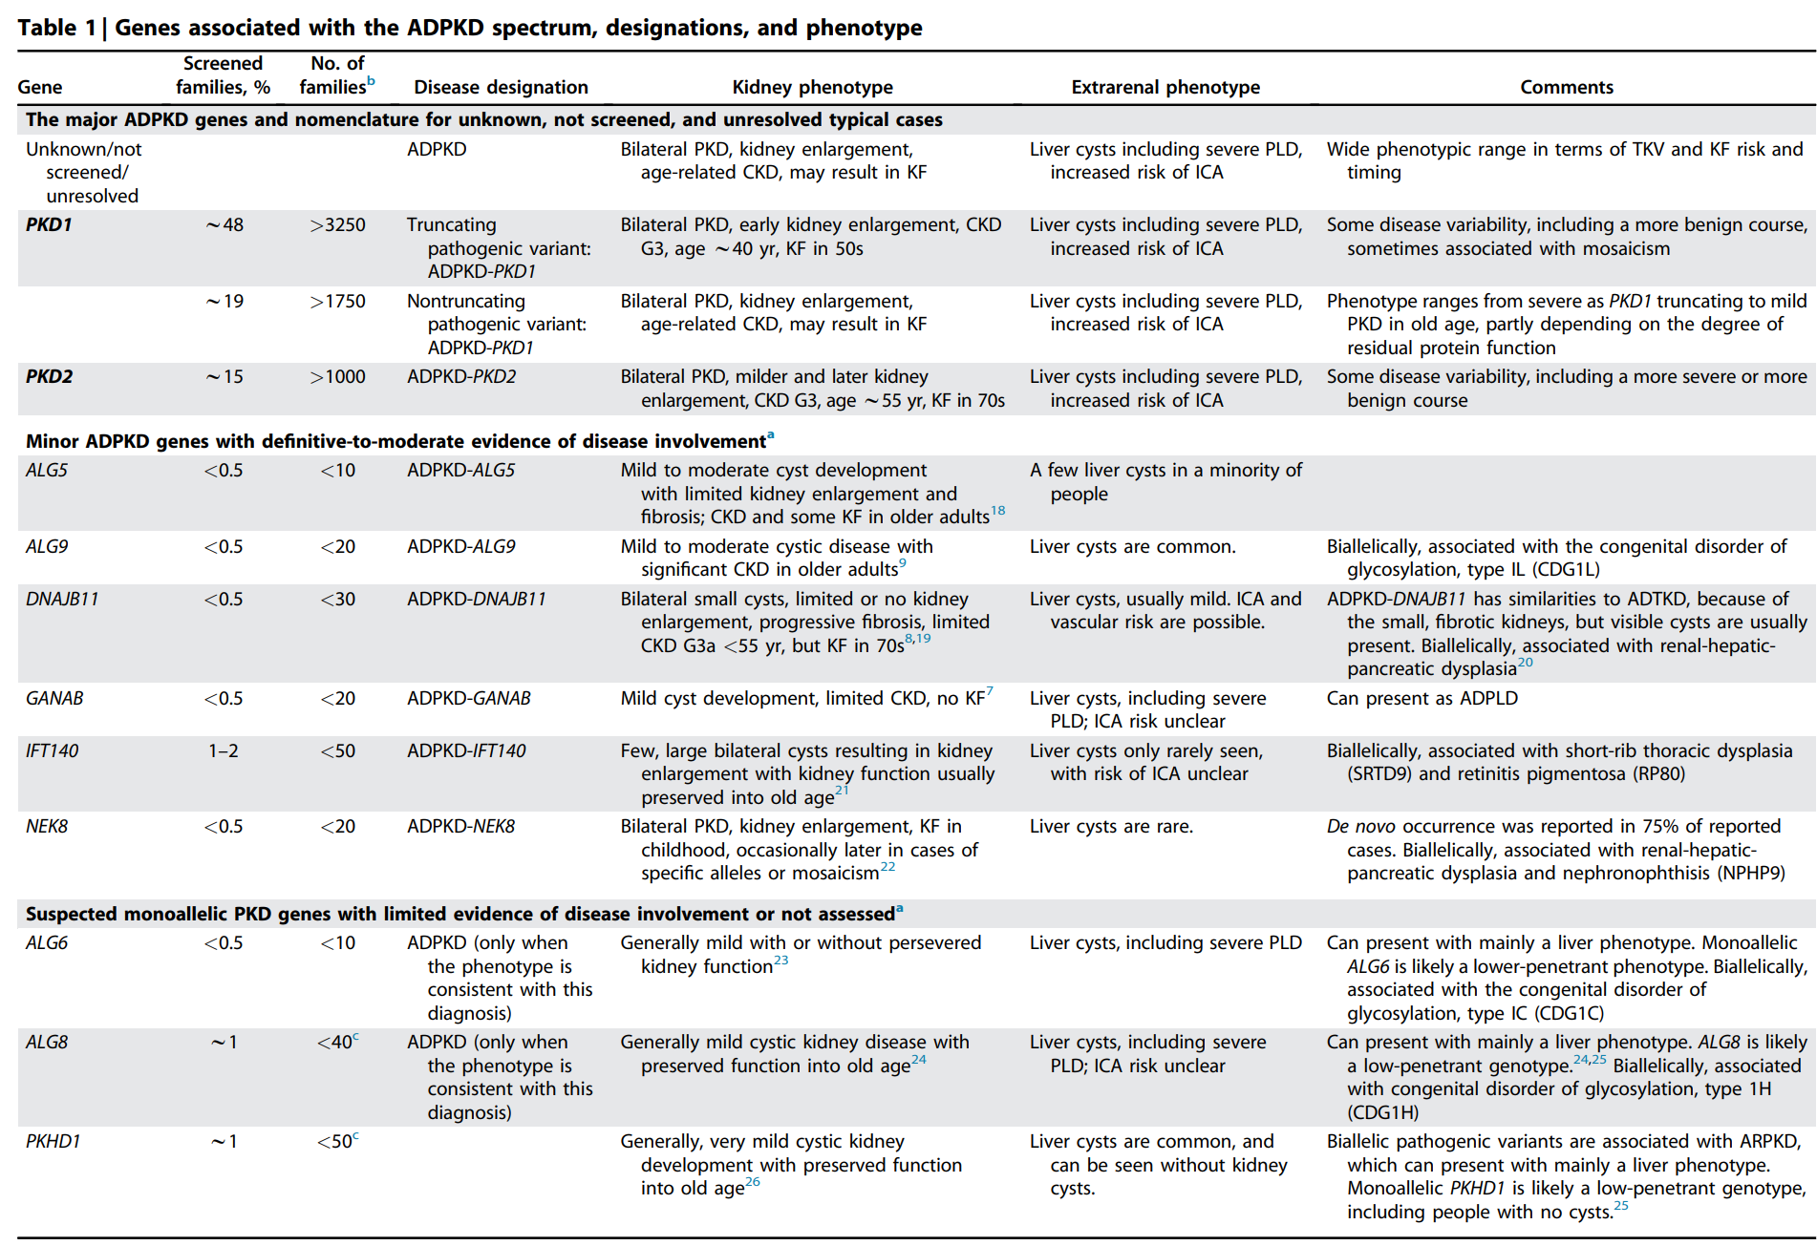
Nomenclature, Diagnosis, Prognosis and Prevalence
Notes:
The major ADPKD genes are PKD1 and PKD2, accounting for >90% of diagnosed families.
Several minor genes account for a small percentage of affected families.

Slide 39
Nomenclature, Diagnosis, Prognosis and Prevalence
1.1.1 Definition and nomenclature
Practice Point 1.1.5: For people who are genetically tested, ADPLD will be employed as the disease name for the major ADPLD genes, PRKCSH and SEC63, and the minor gene when pathogenicity is well supported.
Practice Point 1.1.6: Designation of PKD1 pathogenic variants as truncating (T) or nontruncating (NT) should be noted, but not incorporated into the nomenclature.
Practice Point 1.1.7: People with ADPKD, families, healthcare providers, insurance companies, and others dealing with the welfare of the person with ADPKD need to be educated about the significance of the ADPKD and ADPLD nomenclature.
Notes:
To address the genetic complexity of ADPKD, we suggest a naming format that uses a descriptor of the disease followed by the causal gene.
In people with ADPKD and a pathogenic variant in either PKD1, PKD2, or a minor gene for which pathogenicity is well supported (IFT140, ALG5, ALG9, GANAB, DNAJB11, NEK8), the nomenclature should include ADPKD followed by the gene name (e.g., ADPKD-PKD1;Table 1).
People who have an ADPKD-spectrum phenotype and have not been genetically tested or had genetic testing, with no pathogenic variant in an ADPKD gene identified, or who have a variant in a minor gene for which pathogenicity remains uncertain(ALG6,ALG8,PKHD1), should continue to be termed as having ADPKD.
The designation of ADPKD should not be based on the finding of a likely pathogenic variant in a minor gene when a clinical diagnosis of ADPKD is uncertain.
This nomenclature allows maintenance of the familiar disease name and may imply characteristics associated with the specific causal gene (e.g., many minor ADPKD genes confer a very low risk of KF), whereas PKD1 and PKD2 (and DNAJB11) are associated with a substantial risk of KF.
Polycystic liver disease (PLD) is the most frequent extrarenal manifestation of ADPKD. Autosomal dominant polycystic liver disease (ADPLD) is a different monoallelic disease causing PLD, but with no or few kidney cysts, linked to PRKCSH and SEC63 and a few additional genes.
We suggest a naming format similar to that for ADPKD for autosomal dominant polycystic liver disease.

Slide 40
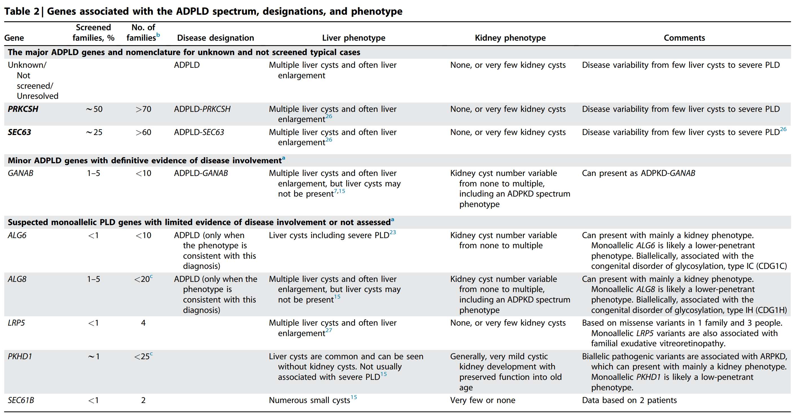
Nomenclature, Diagnosis, Prognosis and Prevalence

Slide 41
Nomenclature, Diagnosis, Prognosis and Prevalence
1.2 Prevalence
1.2.1: Prevalence of ADPKD in kidney failure populations
[No recommendations or practice points]
Notes:
Prevalence.
The estimated prevalence of ADPKD in population-based studies, and of pathogenic PKD1 or PKD2 mutations in the general population (1 per 1000), is higher than the point prevalence of diagnosed ADPKD in large databases (2–4 per 10,000).
Cystic kidneys are the cause of KF in ~5% of people receiving kidney replacement therapy in Europe and North America, whereas very few prevalence studies have been performed in populations from Asia and Africa.

Slide 42
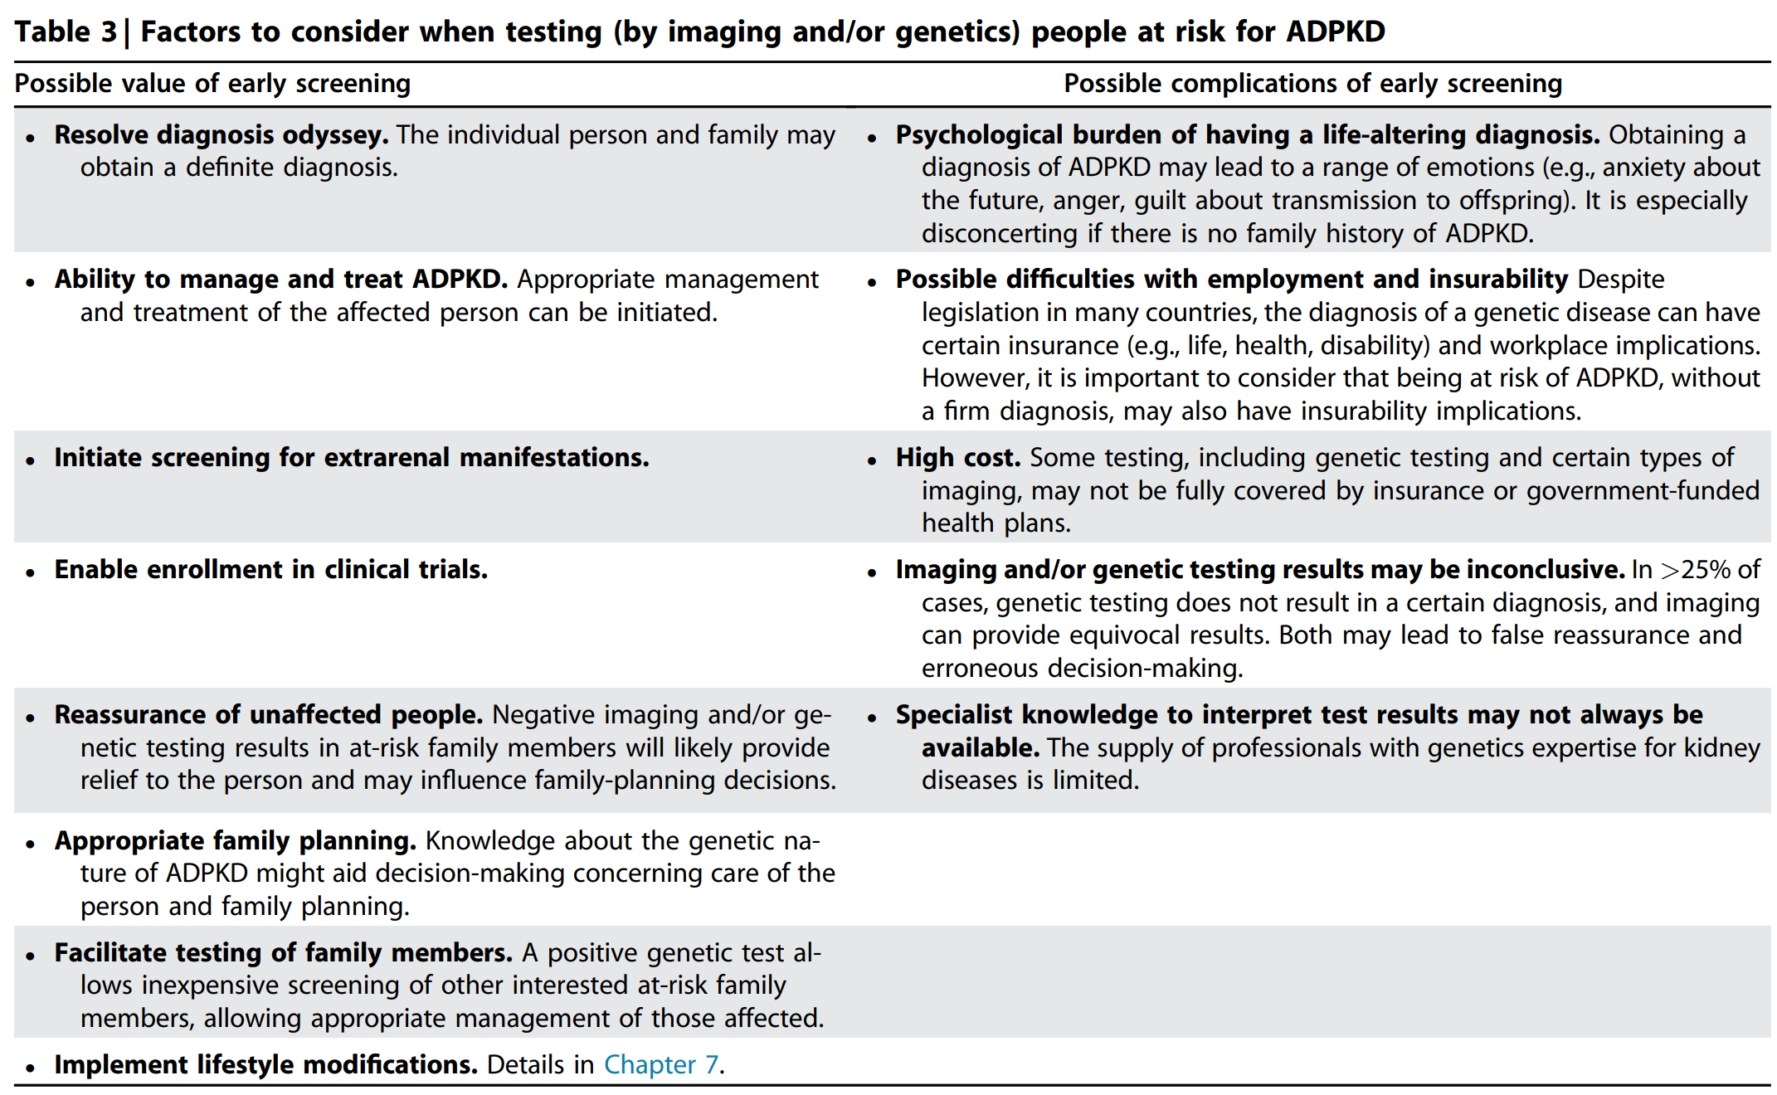
Nomenclature, Diagnosis, Prognosis and Prevalence
1.3 Diagnosis
Practice Point 1.3.1: The values and preferences of the person with ADPKD should be central when discussing issues related to diagnosing ADPKD in individual people and families.
Notes:
Diagnosis.
Appropriate counseling about the possible benefits and risks should be provided to people at risk of ADPKD, before imaging or genetic screening is scheduled, and after screening, to help interpret the results and plan next steps.
The values and preferences of the person should be central to these discussions.

Slide 43
Nomenclature, Diagnosis, Prognosis and Prevalence
1.3 Diagnosis
Practice Point 1.3.2: A multidisciplinary team may be helpful when discussing issues related to diagnosing people with ADPKD and families with complex disease.
Practice Point 1.3.3: Appropriate counseling about the possible value and complications before scheduling of imaging or genetic screening should be provided to people at risk. Additional counseling should be provided after screening to help interpret the results and plan next steps.
Recommendation 1.3.1: For screening adults at risk of ADPKD, we recommend first using abdominal imaging by ultrasound, in the context of the family history, kidney function, and comorbidities (1B).
Practice Point 1.3.4: Follow-up magnetic resonance imaging (MRI), computed tomography (CT) imaging, and/or genetic testing may clarify the diagnosis and further characterize the disease.
Notes:
We recommend abdominal imaging by ultrasound to screen adults at risk.
Age-specific numbers of cysts have been described to diagnose or exclude ADPKD in people with a positive family history.

Slide 44
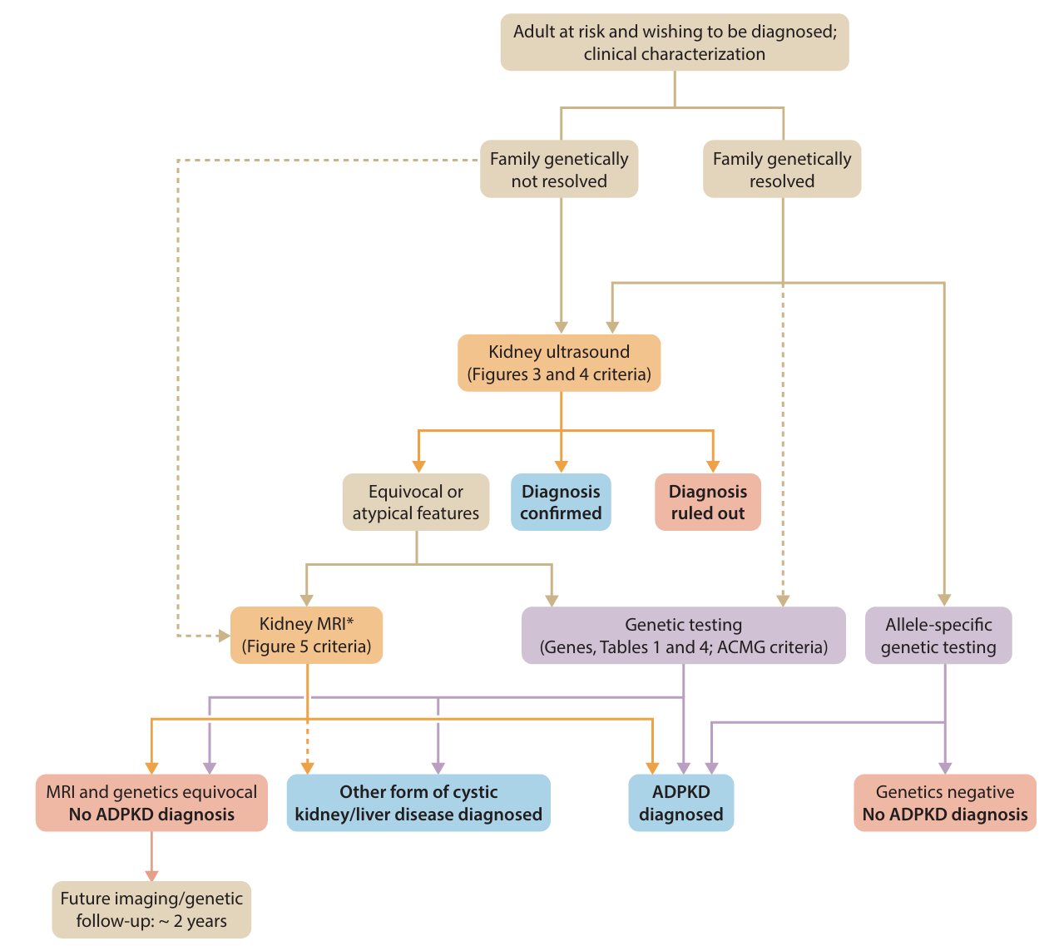
Nomenclature, Diagnosis, Prognosis and Prevalence
Figure 1 | Diagnosis algorithm in at-risk adults (positive family history) for autosomal dominant polycystic kidney disease (ADPKD)

Slide 45
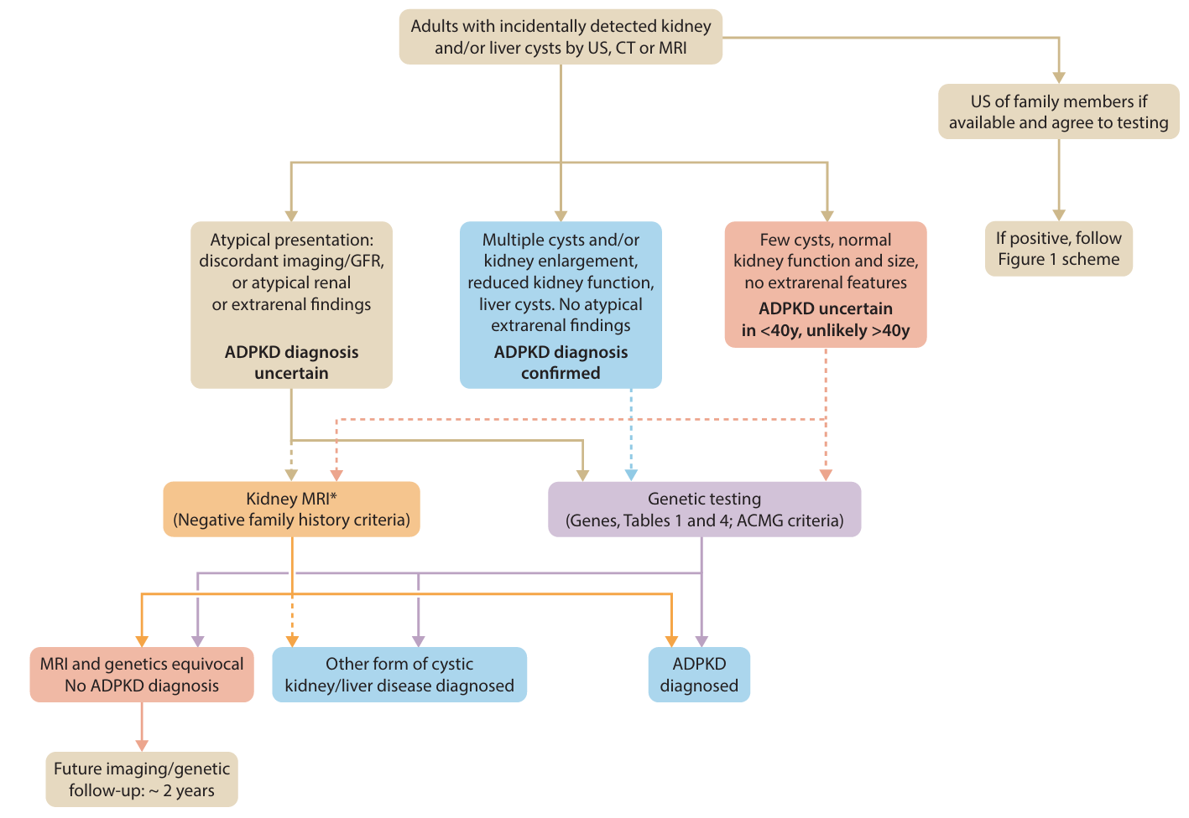
Nomenclature, Diagnosis, Prognosis and Prevalence
Figure 2 | Diagnosis algorithm in adults with incidentally detected kidney and/ or liver cysts in absence of known family history of autosomal dominant polycystic kidney disease (ADPKD)
Notes:
For people with detected kidney cysts, but no known family history of ADPKD, kidney imaging and genetic testing may help to make a diagnosis.
Genetic testing is particularly helpful in cases involving few kidney cysts; variable intrafamilial disease severity, including very-early-onset ADPKD; discordant imaging and glomerular filtration rate; negative family history; young (aged <30 years) living-related kidney donors at risk of ADPKD, based on family history; and family planning and preimplantation diagnosis.

Slide 46
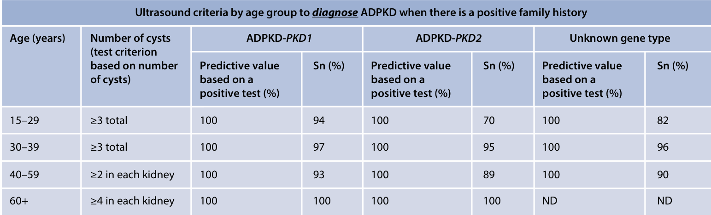
Nomenclature, Diagnosis, Prognosis and Prevalence
1.3 Diagnosis
Practice Point 1.3.5: For people with a positive family history of ADPKD, age-specific numbers of cysts seen on ultrasound have been described to diagnose or exclude ADPKD (Figures 3 and 4).
Figure 3 | Ultrasound criteria by age group to exclude autosomal dominant polycystic kidney disease (ADPKD) in people with a positive family history based on a positive predictive value of the test
Notes:
For people with a positive family history of ADPKD aged 16-40 years, the cutoff of >10 cysts on magnetic resonance imaging (MRI) has been used to diagnose ADPKD, and the cutoff of <5 cysts has been used to exclude ADPKD.
These ultrasound and MRI criteria apply to only families with pathogenic variants of PKD1 or PKD2, and not to those with pathogenic variants to minor genes.

Slide 47
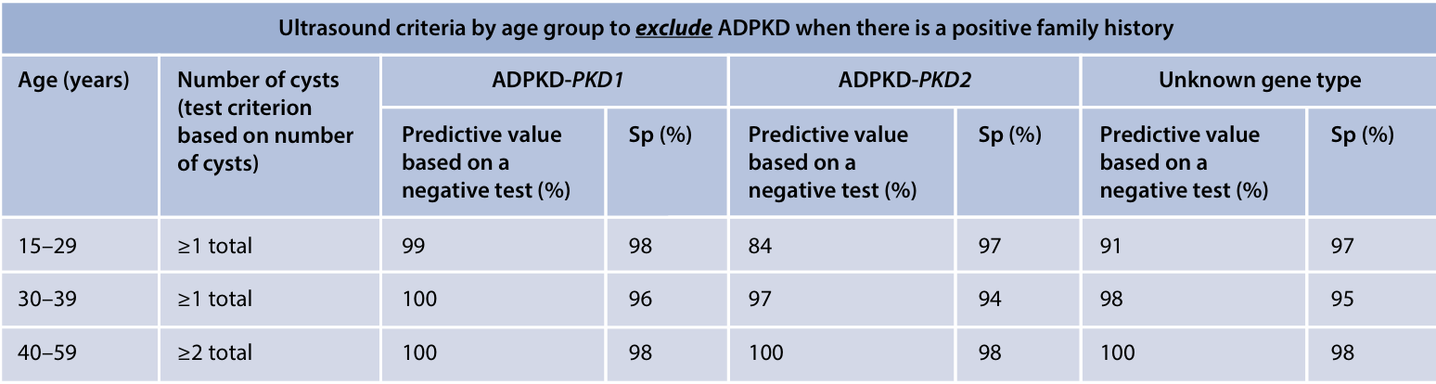
Nomenclature, Diagnosis, Prognosis and Prevalence
1.3 Diagnosis
Practice Point 1.3.5: For people with a positive family history of ADPKD, age-specific numbers of cysts seen on ultrasound have been described to diagnose or exclude ADPKD (Figures 3 and 4).
Figure 4 | Ultrasound criteria by age group to exclude autosomal dominant polycystic kidney disease (ADPKD) in people with a positive family history based on a negative predictive value of the test
Notes:
For people with a positive family history of ADPKD aged 16-40 years, the cutoff of >10 cysts on magnetic resonance imaging (MRI) has been used to diagnose ADPKD, and the cutoff of <5 cysts has been used to exclude ADPKD.
These ultrasound and MRI criteria apply to only families with pathogenic variants of PKD1 or PKD2, and not to those with pathogenic variants to minor genes.

Slide 48
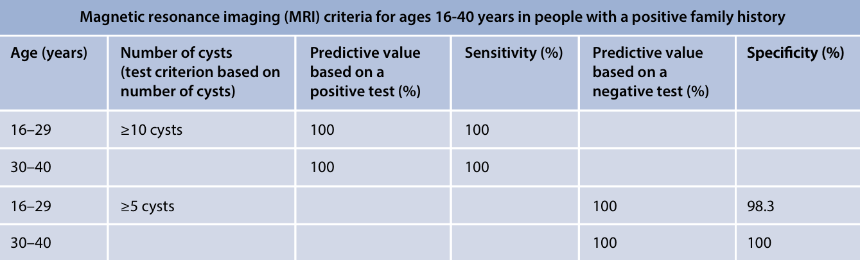
Nomenclature, Diagnosis, Prognosis and Prevalence
1.3 Diagnosis
Practice Point 1.3.6: For people with a positive family history of ADPKD aged 16–40 years, the numbers of cysts seen on MRI to diagnose or exclude ADPKD have been described (Figure 5).
Figure 5 | Magnetic resonance imaging (MRI) criteria for ages 16–40 years in people with a positive family history
Notes:
For people with a positive family history of ADPKD aged 16-40 years, the cutoff of >10 cysts on magnetic resonance imaging (MRI) has been used to diagnose ADPKD, and the cutoff of <5 cysts has been used to exclude ADPKD.
These ultrasound and MRI criteria apply to only families with pathogenic variants of PKD1 or PKD2, and not to those with pathogenic variants to minor genes.

Slide 49
Nomenclature, Diagnosis, Prognosis and Prevalence
1.3 Diagnosis
Practice Point 1.3.7: For people with no known family history of ADPKD but with incidentally detected kidney cysts, kidney imaging can help to make a diagnosis.
Practice Point 1.3.8: Genetic testing can diagnose ADPKD in people with or without a known family history and provide prognostic information. However, genetic testing is not required to make an initial diagnosis of ADPKD in a person with a typical presentation (Figure 1).
Practice Point 1.3.9: In a family with a known pathogenic variant, targeted screening for the specific variant (Sanger sequencing) is usually sufficient to diagnose or exclude ADPKD.
Notes:
In a family with a known pathogenic variant, targeted screening for the specific variant is usually sufficient to diagnose or exclude ADPKD.
For people with detected kidney cysts, but no known family history of ADPKD, kidney imaging and genetic testing may help to make a diagnosis.

Slide 50
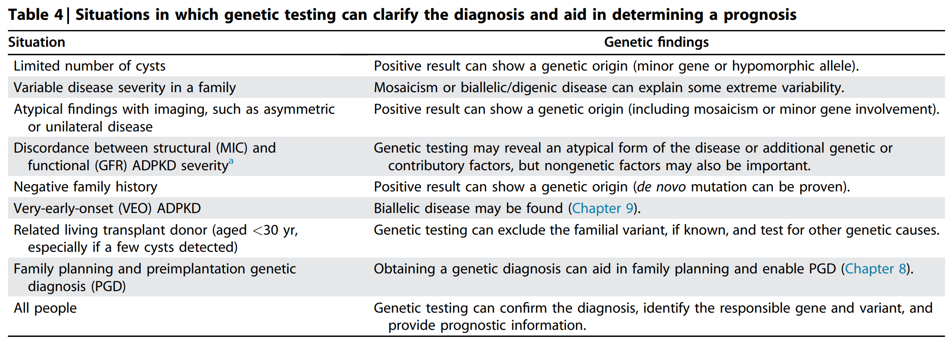
Nomenclature, Diagnosis, Prognosis and Prevalence
1.3 Diagnosis
Practice Point 1.3.10: Genetic testing is particularly informative for people with an equivocal diagnosis based on kidney imaging and in those with a negative or unknown family history (Figure 4).
Notes:
Genetic testing is particularly helpful in cases involving few kidney cysts; variable intrafamilial disease severity, including very-early-onset ADPKD; discordant imaging and glomerular filtration rate; negative family history; young (aged <30 years) living-related kidney donors at risk of ADPKD, based on family history; and family planning and preimplantation diagnosis.

Slide 51
Nomenclature, Diagnosis, Prognosis and Prevalence
1.3 Diagnosis
Practice Point 1.3.11: Genetic testing is often useful for the selection of a living related donor for transplantation, especially if imaging results are equivocal.
Practice Point 1.3.12: Genetic testing is helpful in families with marked phenotypic variability, including very early onset (VEO)-ADPKD or a suspected de novo mutational event.
Practice Point 1.3.13: Some proven and suspected ADPKD genes are also associated with recessive disorders, with significance for variant carriers. For these genes, people with a detected pathogenic variant should be counseled about the risk, and carrier testing should be offered to partners if they are considering having a family.
Notes:
Genetic testing is particularly helpful in cases involving few kidney cysts; variable intrafamilial disease severity, including very-early-onset ADPKD; discordant imaging and glomerular filtration rate; negative family history; young (aged <30 years) living-related kidney donors at risk of ADPKD, based on family history; and family planning and preimplantation diagnosis.

Slide 52
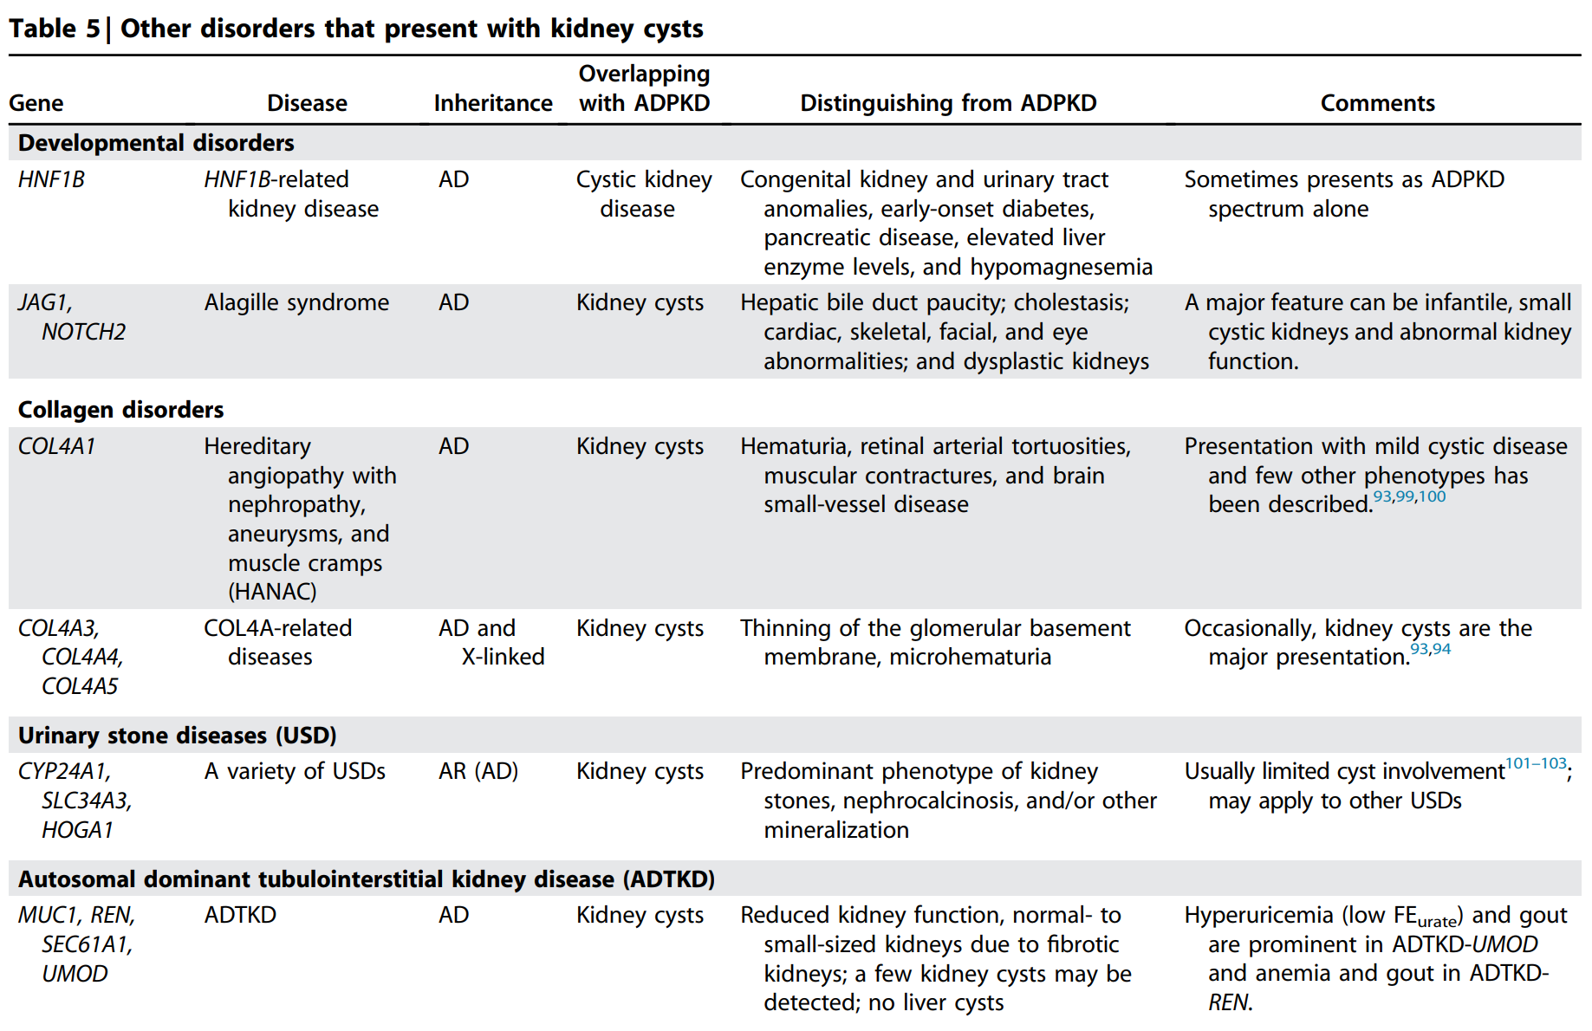
Nomenclature, Diagnosis, Prognosis and Prevalence
1.3 Diagnosis
Practice Point 1.3.14: Several inherited diseases can clinically mimic ADPKD or ADPLD with kidney and/ or liver cysts as part of their phenotype (Table 5).
Notes:
Several inherited diseases may mimic ADPKD with kidney and/or liver cysts as part of their phenotype

Slide 53
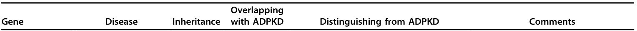
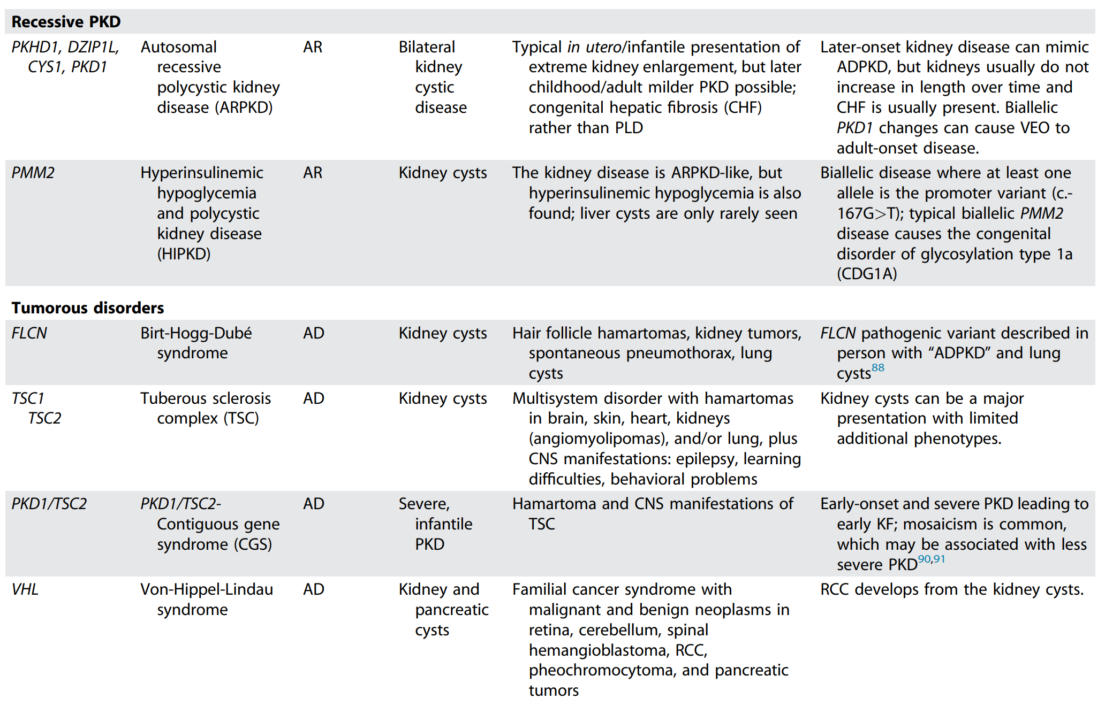
Nomenclature, Diagnosis, Prognosis and Prevalence
Notes:
Several inherited diseases may mimic ADPKD with kidney and/or liver cysts as part of their phenotype

Slide 54
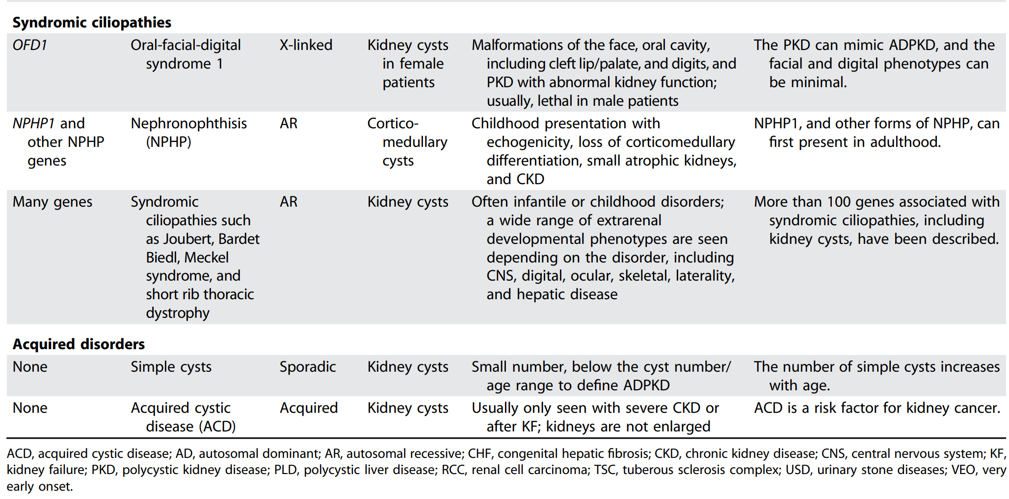
Nomenclature, Diagnosis, Prognosis and Prevalence
Notes:
Several inherited diseases may mimic ADPKD with kidney and/or liver cysts as part of their phenotype

Slide 55
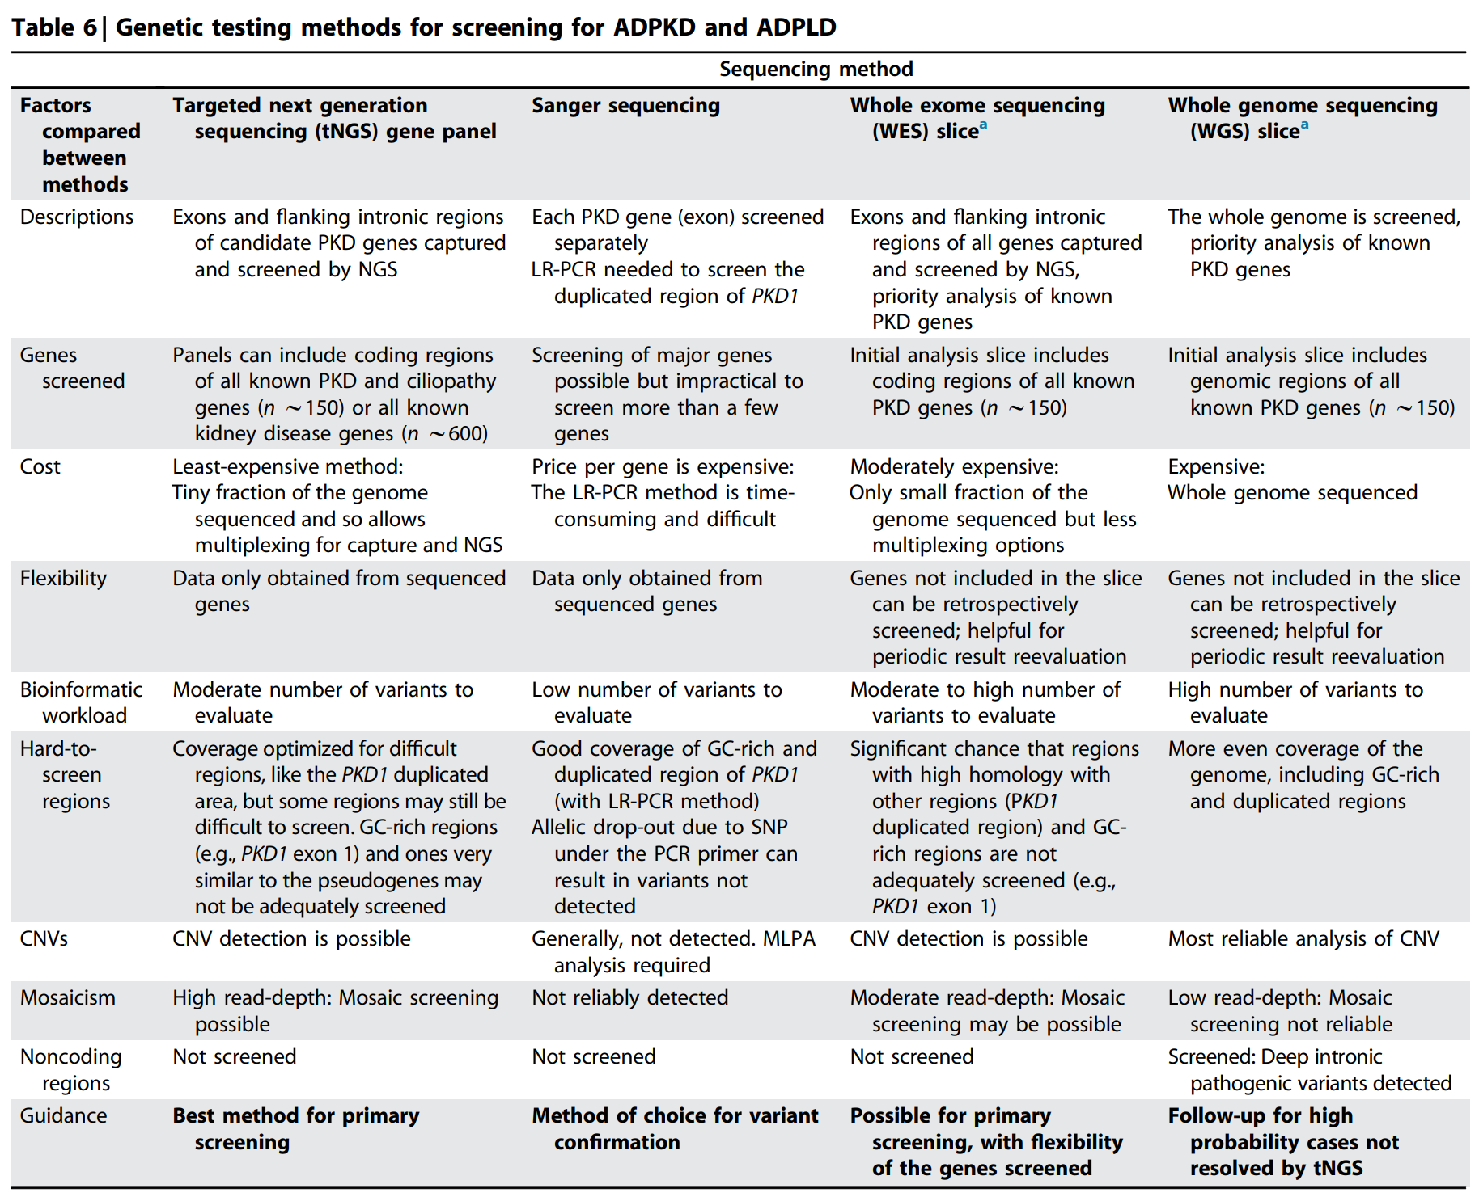
Nomenclature, Diagnosis, Prognosis and Prevalence
1.3 Diagnosis
Practice Point 1.3.15: A targeted next-generation sequencing (tNGS) panel or other clinically accredited genetic or genomic test should be employed when performing genetic testing for ADPKD.
https://pubmed.ncbi.nlm.nih.gov/36766834/

Slide 56
Nomenclature, Diagnosis, Prognosis and Prevalence
1.3 Diagnosis
Practice Point 1.3.16: Clinical genetic testing results should be classified according to the American College of Medical Genetics and Genomics (ACMG) guidelines.
Practice Point 1.3.17: Genetic testing is not always definitive in ADPKD. Disease-causing variants in PKD1 or PKD2 are not always detected, because of the testing method employed, and some variants are not classified in a pathogenic category using the ACMG guidelines.
Practice Point 1.3.18: In a person with atypical clinical presentation of ADPKD, negative or uncertain genetic results do not exclude an inherited form of ADPKD.
Practice Point 1.3.19: In a person with cystic kidneys and imaging or another unusual presentation not typical for ADPKD, negative or uncertain genetic results do not exclude an inherited form of PKD.

Slide 57
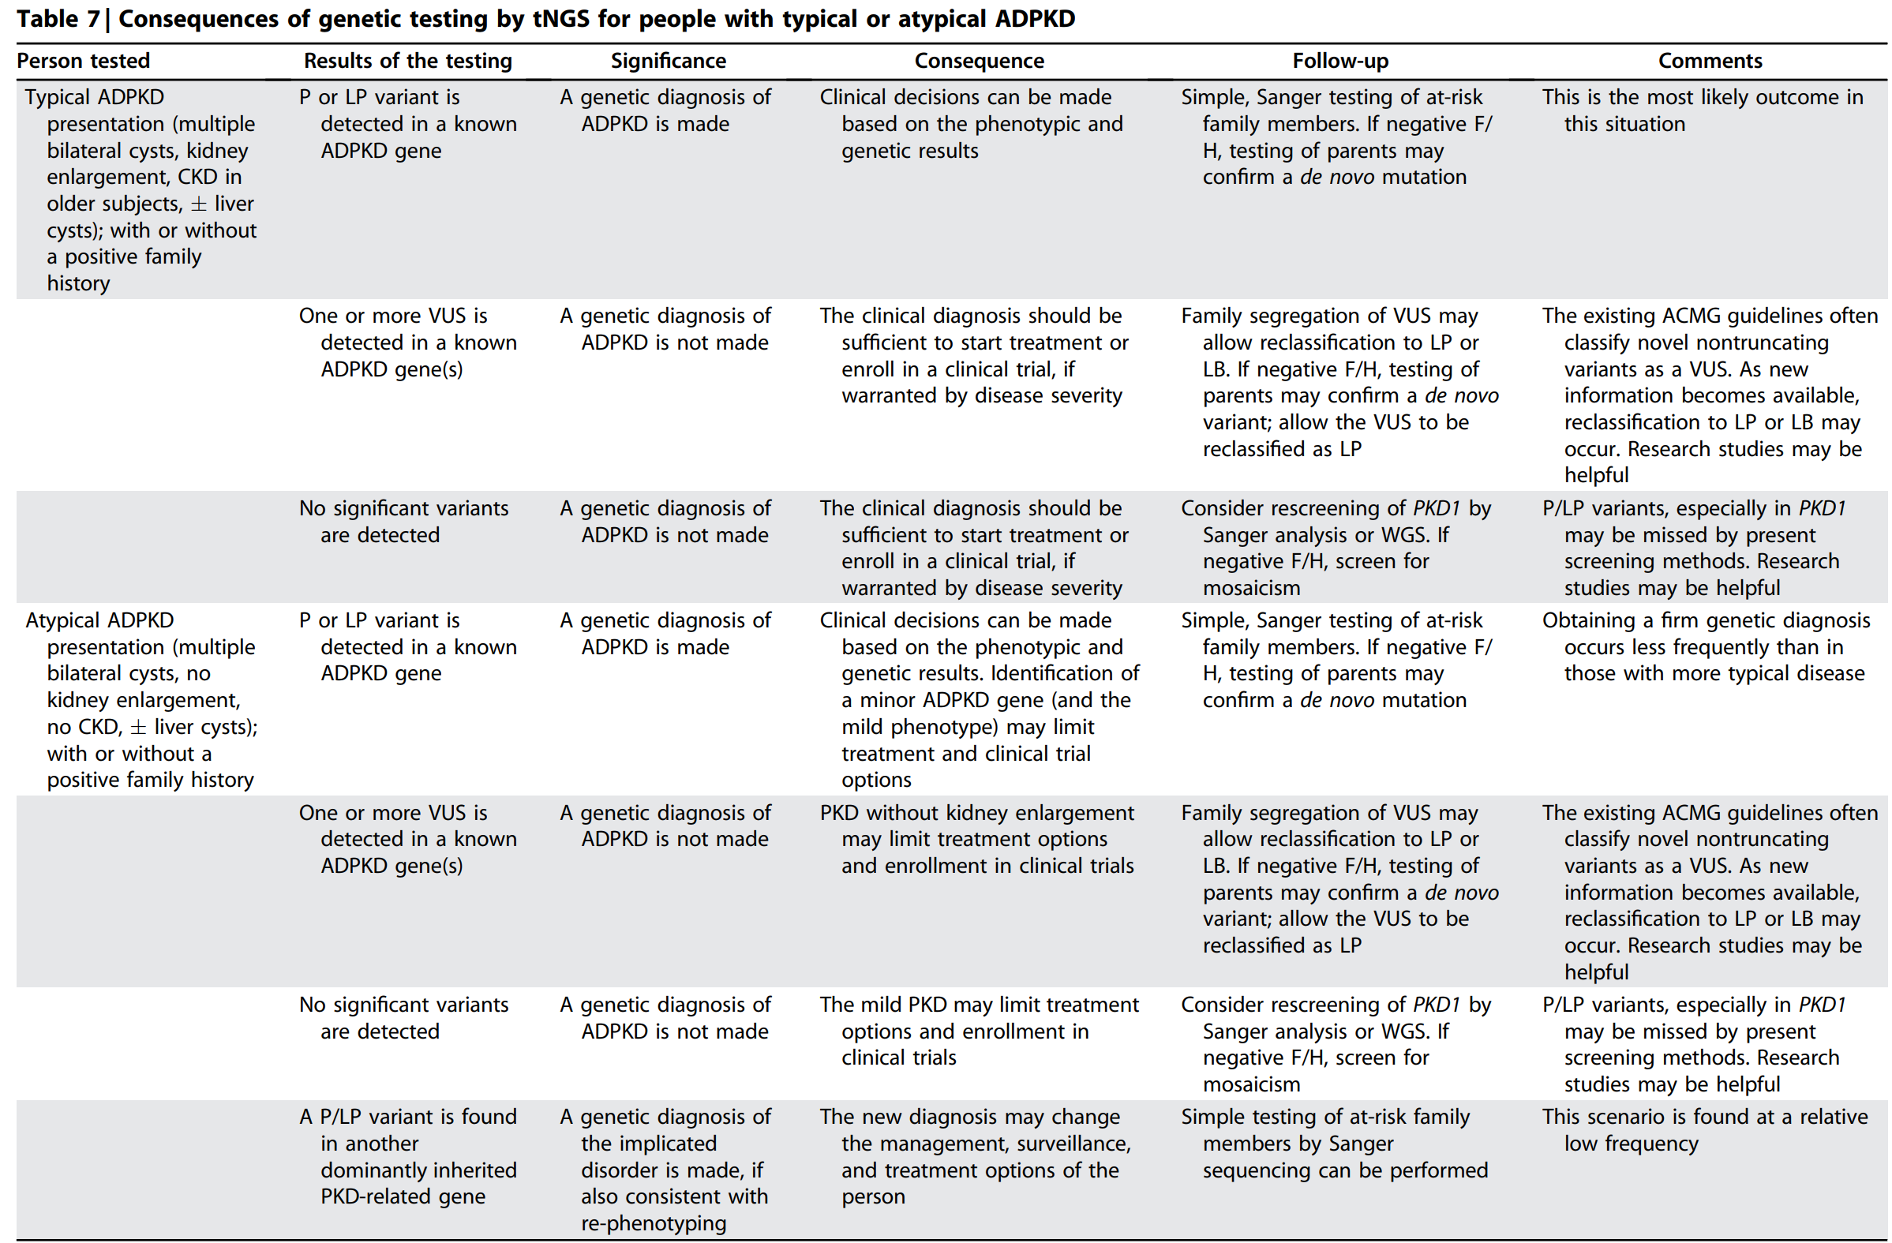
Nomenclature, Diagnosis, Prognosis and Prevalence

Slide 58
Nomenclature, Diagnosis, Prognosis and Prevalence
1.4 Prognostics
1.4.1 Factors associated with the severity of kidney disease in ADPKD
Practice Point 1.4.1.1: The disease-causing gene influences the severity of kidney disease in ADPKD.
Practice Point 1.4.1.2: In ADPKD-PKD1, the type of PKD1 pathogenic variant influences the severity of kidney disease.
Practice Point 1.4.1.3: The severity of kidney disease progression in the family can provide a guide to likely outcomes in other affected family members.
Practice Point 1.4.1.4: Male sex is a possible prognostic factor of more severe disease in ADPKD.
Notes:
Prognosis.
The causal gene (PKD1 > PKD2 or minor genes), type of PKD1 mutation (truncating > nontruncating), sex (male > female), and environmental factors (obesity, salt intake) are associated with the severity of ADPKD.

Slide 59
Nomenclature, Diagnosis, Prognosis and Prevalence
1.4 Prognostics
1.4.1 Factors associated with the severity of kidney disease in ADPKD
Practice Point 1.4.1.5: Overweight and obesity are likely risk factors for faster progression of kidney disease in ADPKD.
Practice Point 1.4.1.6: A higher salt-intake level is associated with faster progression of ADPKD.

Slide 60
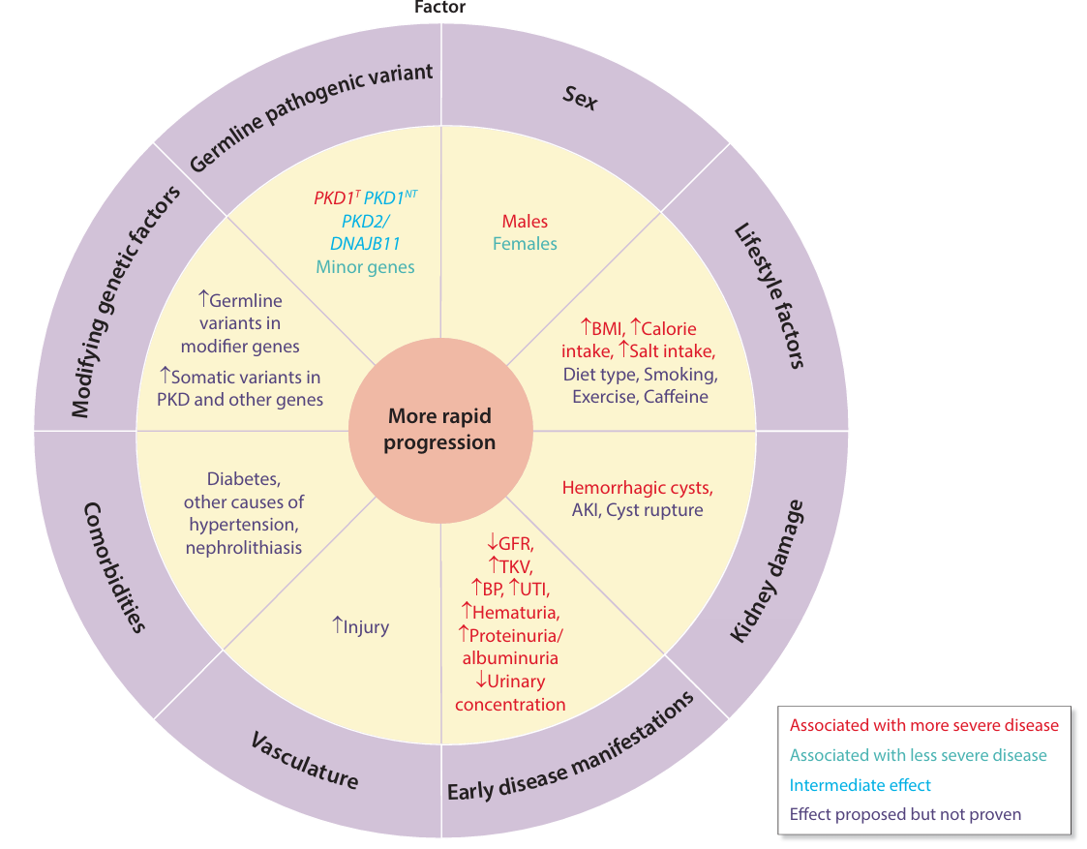
Nomenclature, Diagnosis, Prognosis and Prevalence
Figure 6 | Factors associated with the rate of disease progression in autosomal dominant polycystic kidney disease (ADPKD)

Slide 61
Nomenclature, Diagnosis, Prognosis and Prevalence
1.4 Prognostics
1.4.2 Ways to assess the severity of kidney disease progression
Practice Point 1.4.2.1: Height-adjusted total kidney volume (htTKV) for prognostics is most accurately measured by MRI or CT scan, calculated using an automated tool or semi-automated tool, but the ellipsoid equation is also an option to estimate htTKV.
Practice Point 1.4.2.2: htTKV predicts future decline in kidney function.
Practice Point 1.4.2.3: Ultrasound-determined TKV and kidney-length measurements also have prognostic value, but they are less precise than measurements using MRI or CT.
Recommendation 1.4.2.1: We recommend employing the Mayo Imaging Classification (MIC) to predict future decline in kidney function and the timing of kidney failure (1B).
Notes:
We recommend employing the Mayo Imaging Classification (MIC) to predict future decline in kidney function and the timing of KF.
The height-adjusted total kidney volume is measured most accurately by MRI or computed tomography (CT) scan, using an automated or semiautomated tool, or alternatively, it can be estimated using the ellipsoid equation.
Ultrasound determined total kidney volume and kidney length are less precise but have prognostic value.

Slide 62
Nomenclature, Diagnosis, Prognosis and Prevalence
Figure 7 | Methods to assess the rate of kidney disease progression in autosomal dominant polycystic kidney disease (ADPKD)

Slide 63
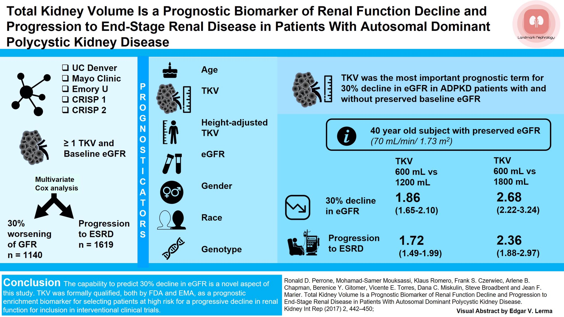
aHR 1.86
(95% CI 1.65-2.10)
aHR 2.68
(95% CI 2.22-3.24)
HR 1.72
(95% CI 1.49-1.99)
HR 2.36
(95% CI 1.88-2.97)

Slide 64
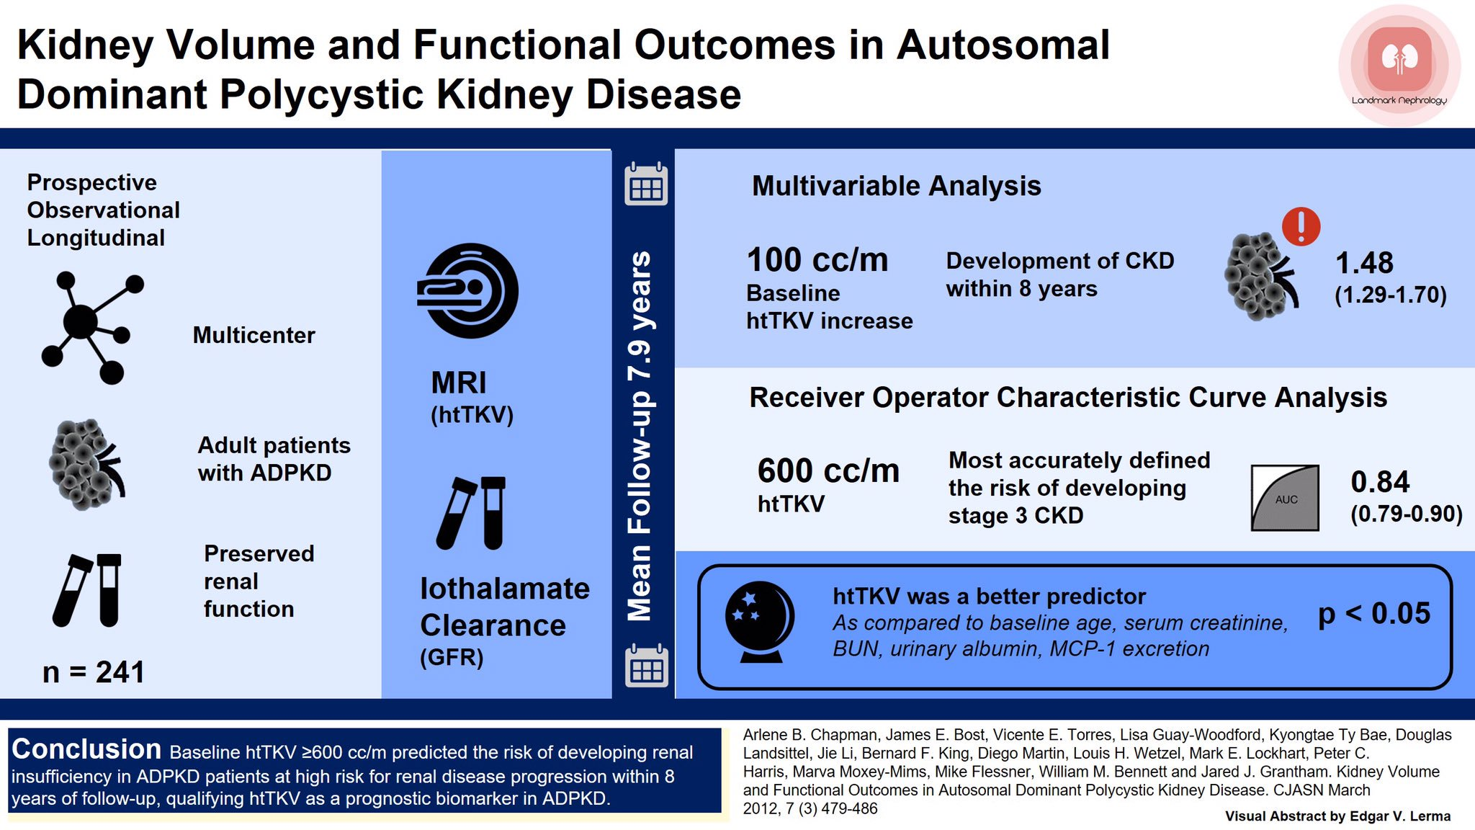
OR 1.48
(95% CI 1.29-1.70)
OR 0.84
(95% CI 0.79-0/90)

Slide 65
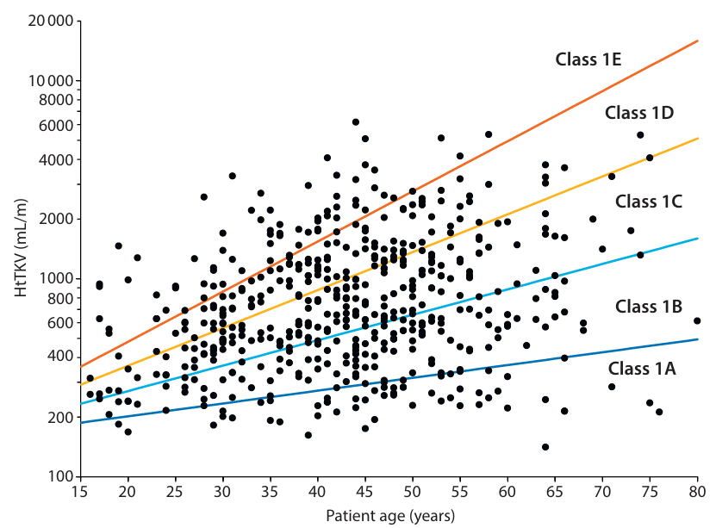
Nomenclature, Diagnosis, Prognosis and Prevalence
Figure 8 | The Mayo Imaging Classification divides height-adjusted total kidney volume (htTKV)/age into 5 different classes
Notes:
The MIC uses height-adjusted total kidney volume, adjusted for age, to stratify people with typical imaging into 5 groups (1A–1E), indicating accelerating decline in kidney function.

Slide 66
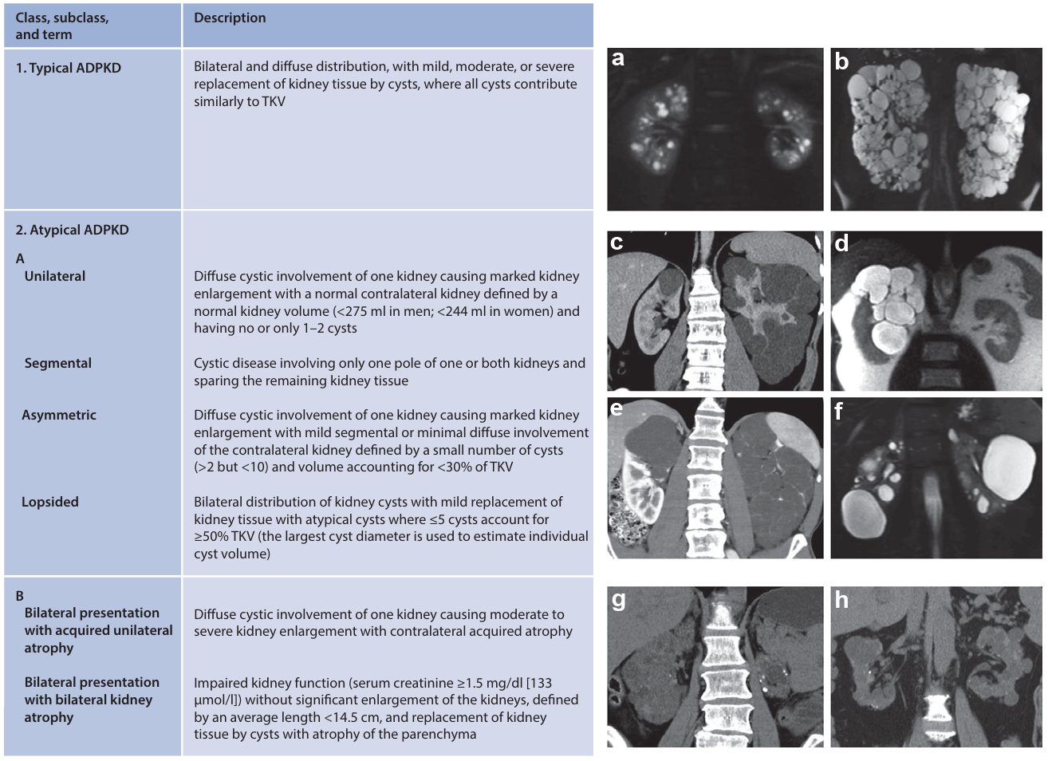
Nomenclature, Diagnosis, Prognosis and Prevalence
Figure 9 | The Mayo Imaging Classification (MIC) of autosomal dominant polycystic kidney disease (ADPKD; left panel) with examples (right panel) of (a,b) MIC subclass 1A and 1E, (c–f) MIC subclass 2A, and (g,h) MIC subclass 2B.
Notes:
The MIC is divided into typical (class 1) and atypical (class 2) ADPKD. Prognostic information is valid for only class 1 patients with typical imaging findings.
The MIC uses height-adjusted total kidney volume, adjusted for age, to stratify people with typical imaging into 5 groups (1A–1E), indicating accelerating decline in kidney function.

Slide 67
Nomenclature, Diagnosis, Prognosis and Prevalence
Figure 10 | Predicted glomerular filtration rate (GFR) values, slopes, and paired differences between predicted and observed GFR at different ages, using a polynomial model.

Slide 68
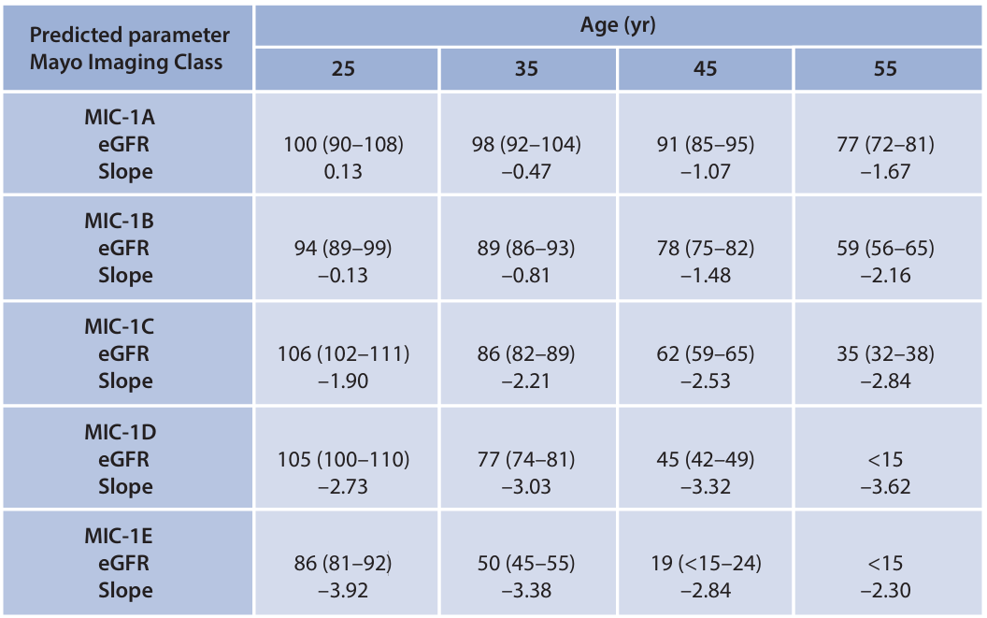
Nomenclature, Diagnosis, Prognosis and Prevalence
Figure 11 | Predicted estimated glomerular filtration rate (eGFR) values and slopes by Mayo Imaging Classification (MIC) at different ages, using a polynomial model.

Slide 69
Nomenclature, Diagnosis, Prognosis and Prevalence
1.4 Prognostics
1.4.2 Ways to assess the severity of kidney disease progression
Practice Point 1.4.2.4: When using the MIC for prognostics, exclude people with atypical imaging patterns (subclass 2A and 2B), as htTKV does not predict kidney outcomes in these people.
Practice Point 1.4.2.5: When using the MIC for prognostics, exclude people who have pathogenic variants in genes other than PKD1 or PKD2 (if genetic information is available), as the predictions are likely unreliable in these people.
Practice Point 1.4.2.6: The Predicting Renal Outcome in Polycystic Kidney Disease (PROPKD) score can aid in the identification of people with rapidly progressive disease.
Practice Point 1.4.2.7: Advanced MRI-based biomarkers may provide additional prognostic value.
Notes:
The MIC should not be used in people with pathogenic variants in genes other than PKD1 or PKD2.

Slide 70
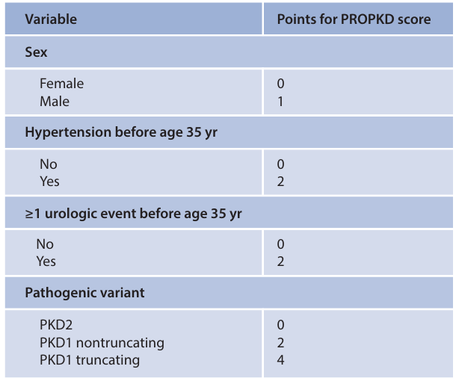
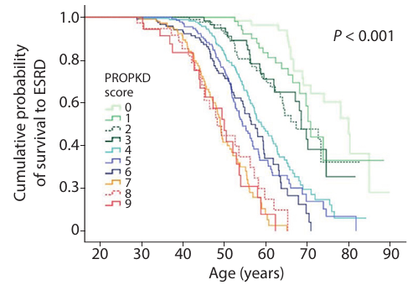
Nomenclature, Diagnosis, Prognosis and Prevalence
Figure 13 | The Predicting Renal Outcome in Polycystic Kidney Disease (PROPKD) score enables stratification of risk of progression to kidney failure in people with autosomal dominant polycystic kidney disease
Figure 12 | The Predicting Renal Outcome in Polycystic Kidney Disease (PROPKD) algorithm
Notes:
The Predicting Renal Outcome in PKD score, and estimated GFR (eGFR) in relation to age and/ or longitudinal eGFR slope, can aid in the identification of people who have rapidly progressive ADPKD.

Slide 71
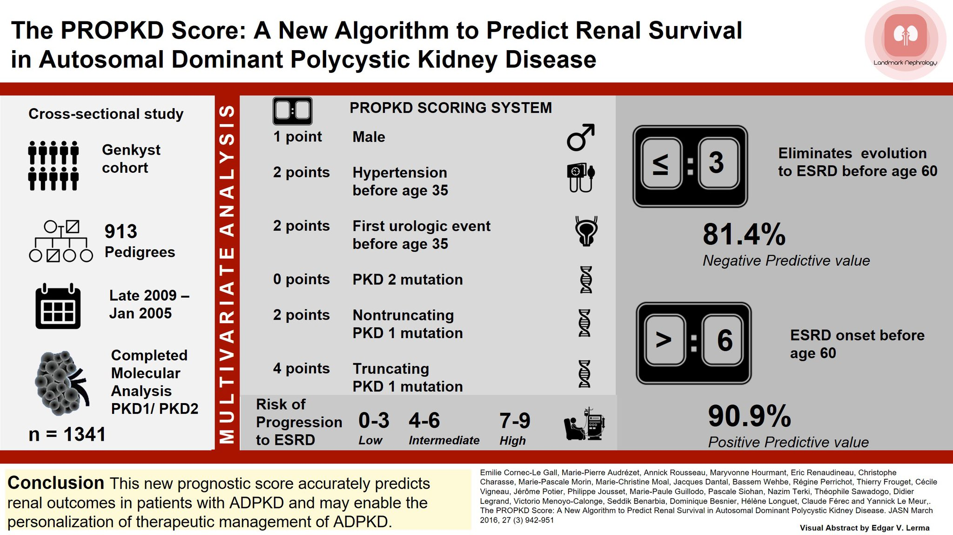
Late 2009
to Jan 2015

Slide 72
Nomenclature, Diagnosis, Prognosis and Prevalence
1.4 Prognostics
1.4.2 Ways to assess the severity of kidney disease progression
Practice Point 1.4.2.8: Assessment of kidney function as eGFR in relation to age and/or longitudinal eGFR slope data can aid in the identification of people with rapidly progressive ADPKD.
Practice Point 1.4.2.9: Urine and serum measured biomarkers are potentially useful to assess prognosis and monitor treatments in ADPKD.

Slide 73
Chapter 2. Kidney Manifestations

Slide 74
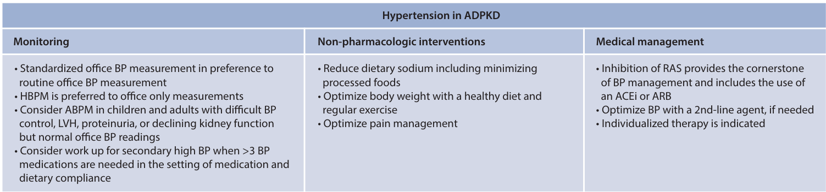
Kidney Manifestations
2.1 High Blood Pressure
Practice Point 2.1.1: Management of high blood pressure (BP) in people with ADPKD should include regular BP monitoring, preferably with home BP measurements (HBPM), dietary and lifestyle modifications, and pharmacotherapy, if indicated (Figure 14).
Figure 14 | Blood pressure (BP) management in autosomal dominant polycystic kidney disease (ADPKD)
Notes:
High blood pressure (BP).
Management of high BP in people with ADPKD should include regular BP monitoring, dietary and lifestyle modifications and pharmacotherapy when indicated.

Slide 75
Kidney Manifestations
2.1 High Blood Pressure
Recommendation 2.1.1: We recommend standardized office BP measurement in preference to routine office BP measurement for the management of high BP in adults (1B).
Practice Point 2.1.2: An oscillometric BP device may be preferable to a manual BP device for standardized office BP measurement; however, standardization emphasizes adequate patient preparation for BP measurement, not the type of equipment.
Recommendation 2.1.2: We suggest that out-of-office BP measurements with home BP monitoring (HBPM) or ambulatory BP monitoring (ABPM) be used to complement standardized office BP readings for the management of high BP (2B).
Practice Point 2.1.3: Healthy dietary and lifestyle interventions should be incorporated into the management of BP in all people with ADPKD.
Notes:
As in all people with chronic kidney disease (CKD), we recommend standardized office BP measurement in people with ADPKD, regardless of kidney function.
We suggest that out-of-office BP measurements with home BP-monitoring or ambulatory BP-monitoring be used to complement standardized office BP readings.
Use of ambulatory BP monitoring should be considered with difficult-to-control BP or left ventricular hypertrophy, proteinuria, or declining kidney function but normal office BP readings.

Slide 76
Kidney Manifestations
2.1 High Blood Pressure
Recommendation 2.1.3: For people with ADPKD aged 18–49 years with chronic kidney disease (CKD) G1-G2 and high BP (>130/85 mmHg), we recommend a target BP of ≤110/75 mmHg, as measured by HBPM, if tolerated (1D).
Practice Point 2.1.4: For people with ADPKD aged 18–49 years with CKD G1–G2 and BP <130/85 mm Hg and >110/75 mm Hg, use an individualized approach to BP control, incorporating shared decision-making between individual patients and their healthcare providers.
Notes:
Based on available RCT results, we recommend a target BP of </=110/75 mm Hg, as measured by home BP-monitoring, if tolerated, for people aged 18–49 years with CKD G1–G2 and BP >130/85 mm Hg.
For those aged 18–49 years with CKD G1–G2 and BP <130/85 mm Hg but >110/75 mm Hg, we suggest using an individualized approach to BP control, incorporating shared decision-making between the healthcare provider(s) and the patient.
For those aged >/=50 years and/or with CKD G3–G5, we recommend a target mean systolic blood pressure of <120 mm Hg, if tolerated, assessed using standardized office BP measurement.

Slide 77
Kidney Manifestations
2.1 High Blood Pressure
Recommendation 2.1.4: For people with ADPKD aged ≥50 years with any stage of CKD (CKD G1-G5), we suggest a target mean systolic blood pressure (SBP) of <120 mm Hg, if tolerated, as assessed using standardized office BP measurement (2C).
Recommendation 2.1.5: For people with ADPKD and high BP, we recommend using renin-angiotensin system inhibitors (RASi) (angiotensin-converting enzyme inhibitor [ACEi] or angiotensin II receptor blocker [ARB]) as first-line treatment to achieve the recommended target BP (1C).
Recommendation 2.1.6: We recommend avoiding any combination of ACEi, ARB, and direct renin inhibitor (DRI) therapy in patients with ADPKD, with or without diabetes (1B).
Notes:
For those aged >/=50 years and/or with CKD G3–G5, we recommend a target mean systolic blood pressure of <120 mm Hg, if tolerated, assessed using standardized office BP measurement.
We recommend using renin–angiotensin system inhibitors—that is, angiotensin-converting enzyme inhibitor (ACEi) or angiotensin II receptor blocker (ARB), as the first line treatment to achieve the target BP.
We recommend avoiding any combination of ACEi, ARB, and direct renin inhibitor therapy.
The appropriate choice of second-line antihypertensive agents will depend on assessing the benefits and risks for individual people.

Slide 78
Kidney Manifestations
2.1 High Blood Pressure
Practice Point 2.1.5: Resistant high BP requiring ≥3 drugs should be investigated for causes of hypertension other than ADPKD.
Practice Point 2.1.6: High-grade proteinuria in people with ADPKD should be investigated for a coexisting kidney disease.
Notes:
Resistant high BP requiring ≥3 drugs should be investigated for patient compliance or other causes of hypertension.
High-grade proteinuria should be investigated for a coexisting kidney disease.

Slide 79
Kidney Manifestations
2.2 Chronic Kidney Pain
Practice Point 2.2.1: Chronic flank, abdominal, or lumbar pain in people with ADPKD should be investigated to rule out causes other than ADPKD (e.g., mechanical or spinal back pain or malignancy in older people) or complications from ADPKD (e.g., chronic low-grade infection or stones).
Practice Point 2.2.2: Refractory chronic kidney pain in people with ADPKD is best managed by a multidisciplinary team as indicated, including nephrology, radiology, algology, psychology or psychiatry, physiotherapy, urology, and hepatology.
Practice Point 2.2.3: Shared decision-making between the healthcare provider and the person with ADPKD or their caregiver should guide pain management strategies in ADPKD.
Practice Point 2.2.4: Nonpharmacologic, noninvasive interventions generally should be considered as the initial treatment of chronic kidney pain in people with ADPKD.
Notes:
Kidney pain.
Flank, abdominal, or lumbar pain in people with ADPKD should be investigated, to determine whether it is kidney-related or not.
Refractory kidney pain is best managed by a multidisciplinary team, and pain-management strategies guided by shared decision-making.
Nonpharmacologic, noninvasive interventions generally should be considered initially, followed by pharmacologic treatment if they do not relieve pain, referral to a center of expertise should be made when invasive intervention is considered.

Slide 80
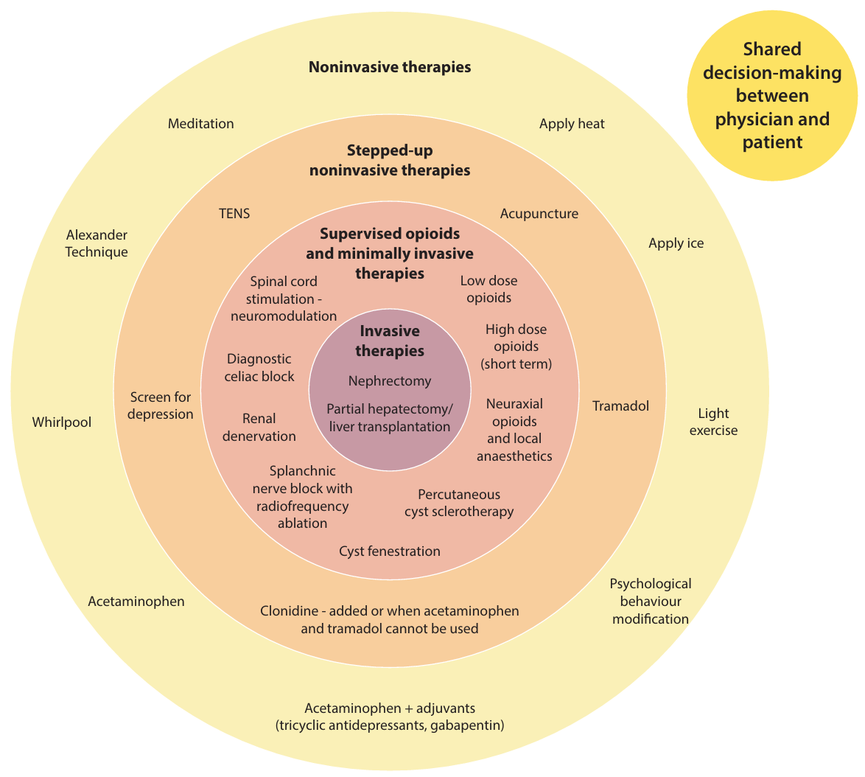
Kidney Manifestations
2.2 Chronic Kidney Pain
Practice Point 2.2.5: Stepwise pharmacologic treatment for chronic kidney pain in people with ADPKD should be implemented when nonpharmacologic, noninvasive interventions do not adequately relieve pain.
Figure 15 | Shared decision-making in management
of chronic kidney pain in autosomal
dominant polycystic kidney disease (ADPKD)
Notes:
Cyst aspiration or aspiration sclerotherapy may be considered when pain can be attributed to a single or several dominant cysts.

Slide 81
Kidney Manifestations
2.2 Chronic Kidney Pain
Practice Point 2.2.6: The sequential approach and best choice of invasive intervention for chronic kidney pain in people with ADPKD depend on cyst characteristics and on the local expertise of the surgeon/interventional radiologist. Referral to a center of expertise should be made whenever possible.
Practice Point 2.2.7: Minimally invasive interventions to relieve chronic kidney pain may be considered for people in whom noninvasive management was ineffective and whose pain can be attributed to a single or to multiple dominant cysts, depending on the expertise of individual centers.

Slide 82
Kidney Manifestations
2.2 Chronic Kidney Pain
Practice Point 2.2.8: Celiac plexus block, isolated or followed by major splanchnic nerve block, and percutaneous renal denervation may be effective in the treatment of selected people with refractory chronic visceral pain caused by cyst enlargement.
Practice Point 2.2.9: Spinal-cord stimulation may provide significant pain relief in specific cases of moderate-to-severe refractory mechanical or visceral pain.
Practice Point 2.2.10: Nephrectomy is a treatment option reserved for severe intractable chronic kidney pain in selected people, typically with advanced kidney disease or after kidney failure, who have failed to respond to other modalities.
Notes:
Celiac plexus block, either in isolation or followed by major splanchnic nerve block, and percutaneous renal denervation, may be effective in the treatment of selected people with refractory chronic visceral pain caused by cyst enlargement.
Spinal-cord stimulation may provide significant pain relief in specific cases of moderate-to-severe refractory mechanical or visceral pain.
Nephrectomy is reserved for severe intractable pain, typically with advanced kidney disease or after KF, in those who have failed to respond to other modalities.

Slide 83
Kidney Manifestations
2.3 Nephrolithiasis
Practice Point 2.3.1: People with ADPKD should be asked about their prior history of kidney stones, and their medical records should be reviewed.
Practice Point 2.3.2: Screening for kidney stones in people with ADPKD who have no history of kidney stones should be individualized.
Practice Point 2.3.3: People with ADPKD and known kidney stones should undergo 24-hour urinary testing for lithogenic risk factors, serial kidney imaging studies to assess their stone burden, and analysis of their kidney stones if feasible.
Notes:
Nephrolithiasis.
Medical treatment of nephrolithiasis in people with ADPKD should be the same as that used in the general population.

Slide 84
Kidney Manifestations
2.3 Nephrolithiasis
Recommendations from the Canadian Urological Association Guideline: Evaluation and Medical Management of Kidney Stones
Recommendation 2.3.1: All stone formers should be counselled to achieve a daily urine output of 2.5 L (2B).
Recommendation 2.3.2: Stone disease highly correlates with obesity, diabetes, and metabolic syndrome; patients should be counselled that
proper management of these conditions may
reduce their future stone risk (2D).
Recommendation 2.3.3: When possible, specific dietary assessments and recommendations should
be made with the involvement of a registered dietitian (3C).
Notes:
The Work Group agrees that the following statements from the Canadian Urological Association Guideline: Evaluation and Medical Management of Kidney Stones for the general population apply to people with ADPKD.252 Although the Work Group agrees with the statements below, this is not a formal endorsement of the Canadian Urological Association guideline. Please refer to local guidelines for your region or setting, where available.

Slide 85
Kidney Manifestations
2.3 Nephrolithiasis
Practice Point 2.3.4: Medical treatment of recurrent kidney stones in people with ADPKD should be the same as in the general population.
Practice Point 2.3.5: Because obstructing kidney stones are more challenging to treat in people with ADPKD, they should be managed by centers of expertise.
Notes:
Nephrolithiasis.
Obstructing kidney stones should be managed by centers of expertise, as they are more challenging in ADPKD.

Slide 86
Kidney Manifestations
2.4 Gout
Recommendations from the 2020 American College of Rheumatology Guideline for the Management of Gout
Recommendation 2.4.1: For patients experiencing their first flare, we conditionally recommend against initiating urate-lowering therapy (ULT) over no ULT, with the following exceptions.
Recommendation 2.4.2: For patients experiencing their first flare and CKD stage ≥3, serum urate (SU) >9mg/dl (540 mmol/l), or urolithiasis, we conditionally recommend initiating ULT.
Notes:
The Work Group agrees that the following statements from the 2020 American College of Rheumatology Guideline for the Management of Gout for the general population apply to people with ADPKD.262 Although the Work Group agrees with the statements below, this is not a formal endorsement of the American College of Rheumatology guideline. Please refer to local guidelines for your region or setting, where available.

Slide 87
Kidney Manifestations
2.4 Gout
Recommendations from the 2020 American College of Rheumatology Guideline for the Management of Gout
Recommendation 2.4.3: For patients with asymptomatic hyperuricemia (SU >6.8 mg/dl or 408 mmol/l with no prior gout flares or subcutaneous tophi), we conditionally recommend against initiating any pharmacologic ULT (allopurinol, febuxostat, probenecid) over initiation of pharmacologic ULT.
Recommendation 2.4.4: For patients starting any ULT, we strongly recommend allopurinol over all other ULT as the preferred first-line agent for all patients, including those with CKD stage ≥3.
Notes:
The Work Group agrees that the following statements from the 2020 American College of Rheumatology Guideline for the Management of Gout for the general population apply to people with ADPKD.262 Although the Work Group agrees with the statements below, this is not a formal endorsement of the American College of Rheumatology guideline. Please refer to local guidelines for your region or setting, where available.

Slide 88
Kidney Manifestations
2.4 Gout
Recommendations from the 2020 American College of Rheumatology Guideline for the Management of Gout
Recommendation 2.4.5: For allopurinol and febuxostat, we strongly recommend starting at a low dose with subsequent dose titration to target over starting at a higher dose (e.g., ≤100 mg/ d [and lower in patients with CKD] for allopurinol or ≤40 mg/d for febuxostat).
Recommendation 2.4.6: We conditionally recommend testing HLA-B*5801 prior to starting allopurinol for patients of Southeast Asian descent (e.g., Han Chinese, Korean, Thai) and African American patients, who have a higher prevalence of HLA-B*5801
Notes:
The Work Group agrees that the following statements from the 2020 American College of Rheumatology Guideline for the Management of Gout for the general population apply to people with ADPKD.262 Although the Work Group agrees with the statements below, this is not a formal endorsement of the American College of Rheumatology guideline. Please refer to local guidelines for your region or setting, where available.

Slide 89
Kidney Manifestations
2.4 Gout
Practice Point 2.4.1: Practice Point 2.4.1: People with ADPKD should not be
treated pharmacologically for asymptomatic hyperuricemia. However, lifestyle and dietary modification may be beneficial (see 2020 American College of Rheumatology
Guideline for the Management of Gout).
Practice Point 2.4.2: People with ADPKD and gout should be evaluated and treated in a manner accounting for their level of kidney function.
Practice Point 2.4.3: People with onset of hyperuricemia and gout in childhood or adolescence should be tested for autosomal dominant tubulointerstitial kidney disease (ADTKD).
Notes:
Gout.
No evidence shows that gout is more common in ADPKD than in other forms of CKD.
People with ADPKD should not receive routine pharmacologic treatment for asymptomatic hyperuricemia.
People with ADPKD and gout should be evaluated and treated taking into account their level of kidney function.
People with onset of hyperuricemia and gout in childhood or adolescence should receive genetic testing for autosomal dominant tubulointerstitial kidney disease.

Slide 90
Kidney Manifestations
2.5 Hematuria
Practice Point 2.5.1: Healthcare providers should be aware of the causes and natural history of hematuria in people with ADPKD to provide proper guidance and, if appropriate, reassurance.
Practice Point 2.5.2: Healthcare providers should discuss the possibility of gross hematuria with patients at the time of diagnosis of ADPKD to avoid unnecessary worry if it happens.
Notes:
Hematuria.
Healthcare providers should discuss the possibility of, causes of, and natural history of gross hematuria with patients at the time of diagnosis of ADPKD, to avoid unnecessary worry when it happens.

Slide 91
Kidney Manifestations
2.6 Urinary Tract Infections
Recommendations from the American Urological Association (AUA)/Canadian Urological Association (CUA)/Society of Urodynamics, Female Pelvic Medicine and Urogenital Reconstruction (SUFU)
Recommendation 2.6.1: Clinicians should not treat asymptomatic bacteriuria (ASB) in patients (1B).
Recommendation 2.6.2: Clinicians should use first-line therapy (i.e., nitrofurantoin, trimethoprim sulfamethoxazole [TMP-SMX], fosfomycin) dependent on the local antibiogram for the treatment of symptomatic urinary tract infections (UTIs) in women (1B).
Notes:
Urinary tract infections.
We agree that the recommendations for the general population from the American Urological Association, the Canadian Urological Association, and the Society of Urodynamics, Female Pelvic Medicine and Urogenital Reconstruction, for female pelvic medicine and urogenital reconstruction, also apply to people with ADPKD.
Healthcare providers should do the following: not treat asymptomatic bacteriuria; use first-line therapy (i.e., nitrofurantoin, trimethoprim-sulfamethoxazole, fosfomycin), dependent on the local antimicrobial susceptibility profiles, for the treatment of uncomplicated, symptomatic urinary tract infections (UTIs) in women; obtain a urine culture before antibiotics are started; and treat people with recurrent UTIs experiencing acute cystitis episodes with as short a duration of antibiotics as is reasonable, generally no longer than 7 days.
Following discussion with patients of risks, benefits, and alternatives, healthcare providers may prescribe antibiotic prophylaxis to decrease the risk of future UTIs in women previously diagnosed with UTIs.

Slide 92
Kidney Manifestations
2.6 Urinary Tract Infections
Recommendations from the American Urological Association (AUA)/Canadian Urological Association (CUA)/Society of Urodynamics, Female Pelvic Medicine and Urogenital Reconstruction (SUFU)
Recommendation 2.6.3: Clinicians should treat recurrent UTI (rUTI) patients experiencing acute cystitis episodes with as short a duration of antibiotics as reasonable, generally no longer than seven days (2B).
Recommendation 2.6.4: Following discussion of risks, benefits, and alternatives, clinicians may prescribe antibiotic prophylaxis to decrease the risk of future UTIs in women of all ages previously diagnosed with UTIs (2B).
Notes:
Urinary tract infections.
We agree that the recommendations for the general population from the American Urological Association, the Canadian Urological Association, and the Society of Urodynamics, Female Pelvic Medicine and Urogenital Reconstruction, for female pelvic medicine and urogenital reconstruction, also apply to people with ADPKD.
Healthcare providers should do the following: not treat asymptomatic bacteriuria; use first-line therapy (i.e., nitrofurantoin, trimethoprim-sulfamethoxazole, fosfomycin), dependent on the local antimicrobial susceptibility profiles, for the treatment of uncomplicated, symptomatic urinary tract infections (UTIs) in women; obtain a urine culture before antibiotics are started; and treat people with recurrent UTIs experiencing acute cystitis episodes with as short a duration of antibiotics as is reasonable, generally no longer than 7 days.
Following discussion with patients of risks, benefits, and alternatives, healthcare providers may prescribe antibiotic prophylaxis to decrease the risk of future UTIs in women previously diagnosed with UTIs.

Slide 93
Kidney Manifestations
2.6 Urinary Tract Infections
Practice Point 2.6.1: Recurrent UTIs in people with ADPKD should be investigated for a possible underlying predisposition.
Practice Point 2.6.2: A urine culture should be obtained before antibiotics are started for UTI, especially for upper UTI and/or suspected kidney cyst infection. Blood cultures should be obtained if an upper UTI or kidney cyst infection is suspected.
Practice Point 2.6.3: UTIs in people with ADPKD need to be differentiated from noninfectious processes such as cyst hemorrhage or kidney stone.
Notes:
Recurrent UTIs in people with ADPKD should be investigated for an underlying predisposition.
Blood cultures should be obtained if an upper UTI or kidney cyst infection is suspected.
UTIs in people with ADPKD should be differentiated from cyst hemorrhage or kidney stone.

Slide 94
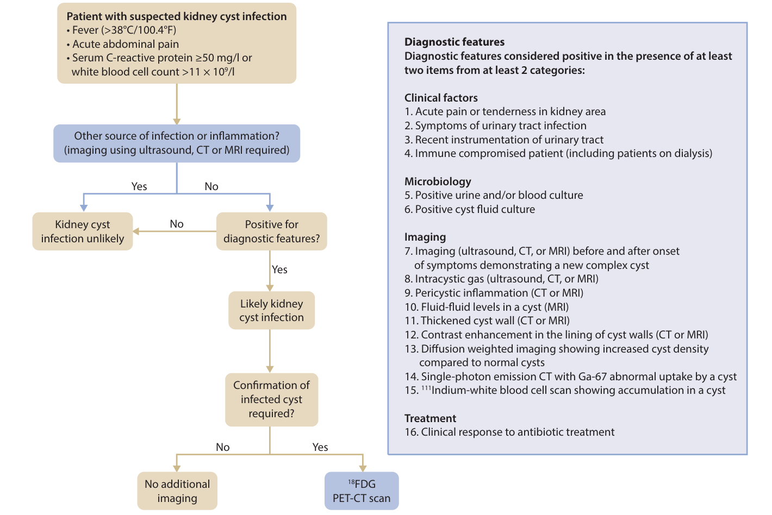
Kidney Manifestations
2.6 Urinary Tract Infections
Practice Point 2.6.4: People with ADPKD who present with fever, acute abdominal or flank pain, and increased white blood cells and/or C-reactive protein (CRP) should be worked up for kidney cyst infection (Figure 16).
Figure 16 | Diagnostic algorithm for an infected kidney cyst in autosomal
dominant polycystic kidney disease
Notes:
People with ADPKD who present with fever, acute abdominal or flank pain, and an increased white blood cell count and/or C-reactive protein level should undergo workup for kidney cyst infection.
We recommend 4–6 weeks of antibiotic therapy in people with ADPKD and kidney cyst infection.

Slide 95
Kidney Manifestations
2.6 Urinary Tract Infections
Recommendation 2.6.5: In people with ADPKD and kidney cyst infection, we suggest treatment with 4–6 weeks of antibiotic therapy rather than a shorter course (2D).
Practice Point 2.6.5: A lipid-soluble antibiotic (e.g., fluoroquinolones, trimethoprim-sulfamethoxazole) should be used to treat kidney cyst infection in people with ADPKD, if possible.
Notes:
A lipid-soluble antibiotic (e.g., trimethoprim-sulfamethoxazole, fluoroquinolone) may have better penetration into the cysts, and should be used if possible.
However, the use of fluoroquinolones has been associated with an increased risk for tendinopathies and aortic aneurysms and dissections.

Slide 96
Kidney Manifestations
2.7 Renal Cell Carcinoma
Practice Point 2.7.1: There is no clear association between ADPKD and an increased risk of renal cell carcinoma (RCC).
Practice Point 2.7.2: Healthcare providers should be aware of atypical presentation of RCC in people with ADPKD.
Notes:
Renal cell carcinoma.
No clear association exists between ADPKD and an increased risk of renal cell carcinoma. However, healthcare providers should be aware of atypical presentation of renal cell carcinoma in people with ADPKD.

Slide 97
Chapter 3. Chronic kidney disease (CKD) management and progression, kidney failure, and kidney replacement therapy (KRT)

Slide 98
CKD management and progression, kidney failure, and KRT
3.1 CKD Management and Progression
Practice Point 3.1.1: In general, management of CKD in ADPKD is similar to management of other kidney diseases.
Practice Point 3.1.2: People with ADPKD should receive optimal management of their anemia to avoid transfusions that may result in sensitization and may limit access to kidney transplantation.
Practice Point 3.1.3: Hypoxia-inducible factor-prolyl hydroxylase inhibitors (HIF-PHIs) should not be used to manage anemia in people with ADPKD who are not receiving dialysis.
Practice Point 3.1.4: Management of diabetes in people with ADPKD should be the same as that for people with other forms of CKD, with the possible exception that sodium-glucose cotransporter-2 inhibitors (SGLT2i) are not recommended at this time for people with ADPKD.
Figure 17 | Measures for chronic kidney disease management in people with autosomal dominant polycystic kidney disease, with reference to specific sections of the guideline
Notes:
CKD management and progression.
In general, the management of CKD in ADPKD is similar to that in other kidney diseases.
People with ADPKD tend to have a higher hemoglobin level, compared to that of people with other forms of CKD, due to regional hypoxia driving production of hypoxia-inducible transcription factors.
Erythrocytosis (hematocrit level >51% or hemoglobin level >17 g/dl [170 g/l]) may occur in people with ADPKD, rarely before KF, and more frequently following kidney transplantation.
Administration of an ACEi or an ARB is usually the initial treatment for posttransplant erythrocytosis, with hematocrit and hemoglobin targets of <51% and <17 g/dl [170 g/l], respectively.
Therapeutic phlebotomy is indicated when an ACEi or an ARB is contraindicated or is ineffective at a maximal-tolerated dose.
Management of diabetes in people with ADPKD should be the same as that for people with other forms of CKD.
Due to lack of evidence, use of sodium-glucose cotransporter-2 inhibitors is not advised at this time.
Preferred glycemic management strategies are use of metformin when eGFR is <30 ml/min per 1.73 m2, or a glucagon-like peptide-1 receptor agonist when eGFR is <30 ml/min per 1.73 m2, when metformin is not tolerated, or when treatment with metformin alone is not sufficient for optimal glycemic control.
For the primary prevention of cardiovascular disease, lipid-lowering therapy should be initiated, in line with the KDIGO Clinical Practice Guideline for Lipid Management in Chronic Kidney Disease.

Slide 99

CKD management and progression, kidney failure, and KRT
3.1 CKD Management and Progression
Practice Point 3.1.5: For the primary prevention of cardiovascular disease (CVD) in adults with ADPKD not treated with chronic dialysis or kidney transplantation, lipid-lowering therapy should be initiated in line with the KDIGO Clinical Practice Guideline for Lipid Management in Chronic Kidney Disease.
Practice Point 3.1.6: Voluntary participation in clinical trials of interventions to slow progression of ADPKD should be offered to all eligible people with ADPKD.
Figure 18 | Recommendations from the KDIGO Clinical Practice Guideline for Lipid Management in Chronic Kidney Disease
Notes:
For the primary prevention of cardiovascular disease, lipid-lowering therapy should be initiated, in line with the KDIGO Clinical Practice Guideline for Lipid Management in Chronic Kidney Disease.

Slide 100

CKD management and progression, kidney failure, and KRT
3.2 Kidney Transplantation
Practice Point 3.2.1: Kidney transplantation is the preferred treatment for kidney failure in people with ADPKD.
Figure 19 | Post-transplant complications that are more common with autosomal dominant polycystic kidney disease (ADPKD) than they are in people with other forms of chronic kidney disease (CKD)
Notes:
Kidney transplantation.
Kidney transplantation, preferably preemptive, living-donor kidney transplantation, is the preferred treatment for KF for people with ADPKD.

Slide 101
CKD management and progression, kidney failure, and KRT
3.2 Kidney Transplantation
Practice Point 3.2.2: A kidney transplant from a living donor provides lower risk of rejection and longer allograft survival.
Practice Point 3.2.3: Preemptive living donor kidney transplantation is the optimal therapy for people with ADPKD.
Practice Point 3.2.4: Transplantation between blood type or human leukocyte antigen (HLA)-incompatible donors may be facilitated by kidney exchange.
Practice Point 3.2.5: People with ADPKD should be treated with the same immunosuppressive protocols as other transplant recipients.
Notes:
Kidney transplantation.
Kidney transplantation, preferably preemptive, living-donor kidney transplantation, is the preferred treatment for KF for people with ADPKD.

Slide 102
CKD management and progression, kidney failure, and KRT
3.2 Kidney Transplantation
Practice Point 3.2.6: Excluding the diagnosis of ADPKD in potential living-related kidney donors is an important consideration.
Practice Point 3.2.7: During the pretransplantation work-up for candidates with ADPKD, the total kidney and liver weight derived from total kidney and liver volumes should be calculated and subtracted from the patient’s total body weight for a more accurate assessment of weight and body mass index (BMI).
Figure 20 | Calculations for adjusted body mass index (BMI) in people with autosomal dominant polycystic kidney disease (ADPKD)
Notes:
During the pretransplantation workup, estimated total kidney and liver weights derived from total kidney and liver volumes should be subtracted from the body weight, for an accurate assessment of body mass index.
Pretransplant evaluation should consider performing imaging of the kidneys within 1 year prior to the anticipated timing of transplantation, to rule out solid or complex cystic lesions. Immunosuppressive protocols should be the same as those used for other transplant recipients.

Slide 103

CKD management and progression, kidney failure, and KRT
3.2 Kidney Transplantation
Recommendation 3.2.1: We suggest that native nephrectomy in people with ADPKD receiving a kidney transplant should be performed only for specific indications when the benefit outweighs the risk (2C).
Practice Point 3.2.8: Shared decision-making with patients pretransplant and multidisciplinary case conferencing should contribute to the decision regarding performing and timing of nephrectomy
Figure 21 | Potential indications for native nephrectomy in people
with autosomal dominant polycystic kidney disease receiving a
kidney transplant
Notes:
Native nephrectomy should be performed only for specific indications and when the benefit outweighs the risk.

Slide 104

CKD management and progression, kidney failure, and KRT
Figure 22 | Potential complications of native nephrectomy in autosomal dominant polycystic kidney disease
Notes:
Potential indications include severe symptoms from massively enlarged kidneys, recurrent or severe kidney infection or bleeding, complicated nephrolithiasis, intractable pain, suspicion of renal cell carcinoma, insufficient space for the kidney graft, and severe ventral hernia.

Slide 105
CKD management and progression, kidney failure, and KRT
3.2 Kidney Transplantation
Recommendation 3.2.2: We suggest unilateral rather than bilateral native nephrectomy in people with ADPKD, when appropriate, based on clinical judgment and availability of local expertise (2D).
Recommendation 3.2.3: We suggest that kidney transplant candidates with ADPKD who require native nephrectomy undergo the procedure at the time of or after, but not before, transplantation, whenever possible (2C).
Practice Point 3.2.9: Shared decision-making regarding native nephrectomy should involve a multidisciplinary team to discuss timing, surgeon and center expertise, patient preferences, and whether the transplant will be from a living versus a deceased donor.
Notes:
Nephrectomy should occur either at the time of or after transplantation, but not before, due to the potential need for transfusion, preventing preemptive transplantation, and the increased risk of complications.

Slide 106
CKD management and progression, kidney failure, and KRT
3.2 Kidney Transplantation
Recommendation 3.2.4: When feasible, we suggest the use of hand-assisted laparoscopic nephrectomy rather than open nephrectomy in people with ADPKD (2D).
Practice Point 3.2.10: Evaluation for renal cell carcinoma prior to transplant in people with ADPKD should be individualized and imaging of the kidneys (e.g., abdominal MRI) within 1 year prior to anticipated timing of transplantation should be considered.
Notes:
The type of nephrectomy should be hand-operated laparoscopic nephrectomy, rather than open nephrectomy.
The choice between unilateral versus bilateral native nephrectomy will depend on providers’ clinical judgment and the availability of local expertise.
New-onset diabetes, erythrocytosis, worsening aortic, tricuspid, or mitral regurgitation, aortic root dilatation, subarachnoid hemorrhage, thromboembolic events, skin cancers, kidney or liver cyst infections, and colon diverticulitis were more common in some studies of kidney transplant recipients with ADPKD than they were in the general kidney transplant population.

Slide 107
CKD management and progression, kidney failure, and KRT
3.3 Kidney Replacement Therapy
Practice Point 3.3.1: Choice of dialysis modality should be determined based on shared decision-making between physician and patient.
Recommendation 3.3.1: We suggest that in people with ADPKD, selection of dialysis modality (hemodialysis [HD] or peritoneal dialysis [PD]) for treatment of kidney failure should be determined by patient-related factors, patient choice, and availability of facilities (2C).
Practice Point 3.3.2: Peritoneal dialysis should be considered as a viable kidney replacement therapy (KRT) for people with ADPKD complicated by kidney failure, with caution indicated only when massive kidney and/ or liver enlargement or other standard PD contraindications are present.
Practice Point 3.3.3: The prescription of HD and supportive therapies, such as anticoagulation, should be the same as that for people without ADPKD.
Notes:
Chronic dialysis.
Shared decision-making, prescription of hemodialysis, and supportive therapies, such as anticoagulation, should be the same as those for people without ADPKD.
Peritoneal dialysis should be considered as a viable option, with caution used when massive kidney and/or liver enlargement or abdominal wall hernias are present.

Slide 108

CKD management and progression, kidney failure, and KRT
Figure 23 | Unadjusted and adjusted all-cause death with peritoneal dialysis (PD) versus hemodialysis (HD) in autosomal dominant polycystic kidney disease

Slide 109
Chapter 4. Therapies to Delay the Progression of Kidney Disease

Slide 110

Therapies to Delay the Progression of Kidney Disease
Figure 24 | Schematic diagram
depicting the life journey and
therapeutic considerations of a
hypothetical person with rapidly
progressive autosomal dominant
polycystic kidney disease

Slide 111

Therapies to Delay the Progression of Kidney Disease
Notes:
Interventions targeting the action of the antidiuretic hormone arginine vasopressin on the vasopressin-2 receptor in the kidney cystic epithelium are presently the cornerstone of treatment in people with ADPKD at risk of rapid kidney disease progression.

Slide 112

Therapies to Delay the Progression of Kidney Disease
4.1 Tolvaptan
4.1.1 Indications for Tolvaptan in ADPKD
Recommendation 4.1.1.1: We recommend initiating tolvaptan treatment in adults with ADPKD with an estimated glomerular filtration rate (eGFR) ≥25 ml/min per 1.73 m² who are at risk for rapidly progressive disease(Figure 25) (1B).
Figure 25 | The Kidney Disease: Improving Global Outcomes algorithm to decide in whom to prescribe tolvaptan
Notes:
Tolvaptan.
We recommend initiating tolvaptan treatment in adults with ADPKD with an eGFR >/=25 ml/min/1.73 m2 who are at risk for rapidly progressive disease.
The definition of risk of rapidly progressing ADPKD was determined largely by clinical consensus.
We advise using the MIC, ideally based on MRI, as the primary method for risk prediction and consideration of tolvaptan use in clinical care. Low-dose CT is an alternative to determine the MIC.
When MRI and CT are not available or are contraindicated, employing ultrasound using the ellipsoid formula is acceptable.
The historical decline in eGFR also can be used in the absence of advanced imaging.
An annual eGFR decline ≥3 ml/min per 1.73 m2, as determined by multiple measurements of eGFR over 3–5 years, or a Predicting Renal Outcome in PKD score >6, may provide evidence for risk for rapid progression.

Slide 113

Therapies to Delay the Progression of Kidney Disease
Figure 26 | Summary of the Tolvaptan Efficacy and Safety in Management of Autosomal Dominant Polycystic Kidney Disease and Its Outcomes (TEMPO 3:4) and Replicating Evidence of Preserved Renal Function: An Investigation of Tolvaptan Safety and Efficacy in ADPKD (REPRISE) trials
Notes:
Our systematic review found 3 RCTs of tolvaptan, an antagonist of the vasopressin-2 receptor, together with 2 extension studies; a pooled, matched comparison of long-term tolvaptan-treated and untreated groups; and a post marketing analysis of harms.
Overall, the evidence review found a net difference in eGFR decline of 1.3 ml/min per 1.73 m2 per year (95% confidence interval: 1.0–1.7) and in total kidney volume growth of 2.7% (95% confidence interval:–3.3% to–2.1%), both favoring tolvaptan use.
The incidences of UTI, kidney stones, hematuria, and kidney pain events were significantly reduced in the Tolvaptan Efficacy and Safety in Management of Autosomal Dominant Polycystic Kidney Disease and Its Outcomes (TEMPO) 3:4 trial.
The effect of tolvaptan on the rate of eGFR decline is accepted as a reliable surrogate for delaying the onset of KF.

Slide 114


Slide 115
Therapies to Delay the Progression of Kidney Disease
Figure 27 | Schematic diagram summarizing the harms, benefits, and uncertainties regarding long-term treatment with tolvaptan in people with rapidly progressing autosomal dominant polycystic kidney disease

Slide 116
Therapies to Delay the Progression of Kidney Disease
4.1 Tolvaptan
4.1.1 Indications for Tolvaptan in ADPKD
Practice Point 4.1.1.1: Shared and individualized decision-making should be undertaken when determining whether to initiate tolvaptan in people aged >55 years with rapid progression.
Practice Point 4.1.1.2: The MIC, ideally based on MRI, should be used as the primary imaging method for risk prediction and consideration of tolvaptan in routine clinical care. Low-dose or ultra-low-dose CT is an alternative imaging method to determine MIC. When MRI and CT are not available or are contraindicated, it is acceptable to use ultrasound to assess kidney volume with the ellipsoid formula.
Practice Point 4.1.1.3: A PROPKD score >6 may provide additional evidence for risk for rapid progression in ADPKD when the historical rate of eGFR decline or MIC is indeterminate.
Practice Point 4.1.1.4: Before concluding that a person has rapid progression and initiating tolvaptan treatment, other acute or chronic causes of eGFR decline should be assessed.
Notes:
We advise using the MIC, ideally based on MRI, as the primary method for risk prediction and consideration of tolvaptan use in clinical care. Low-dose CT is an alternative to determine the MIC.
When MRI and CT are not available or are contraindicated, employing ultrasound using the ellipsoid formula is acceptable.
The historical decline in eGFR also can be used in the absence of advanced imaging.
An annual eGFR decline >/=3 ml/min per 1.73 m2, as determined by multiple measurements of eGFR over 3–5 years, or a Predicting Renal Outcome in PKD score >6, may provide evidence for risk for rapid progression.

Slide 117

Therapies to Delay the Progression of Kidney Disease
4.1 Tolvaptan
4.1.2 Precautions for Tolvaptan Use in ADPKD
Practice Point 4.1.2.1: Contraindications to tolvaptan should be reviewed in all eligible people with ADPKD before treatment is initiated.
Practice Point 4.1.2.2: Tolvaptan may raise uric acid level and should be used with caution in people with preexisting gout.
Notes:
Contraindications to tolvaptan use should be considered before initiating such treatment.
Absolute contraindications include the following: a planned pregnancy; pregnancy; breastfeeding; medical conditions associated with a high risk of volume depletion; inability to respond to or perceive thirst; hypernatremia; urinary tract obstruction; strong cytochrome P450, family 3, subfamily A inhibitors; and significant liver disease, unless due to PLD.
Relative contraindications to be considered include the following: an eGFR at initiation of <25 ml/min per 1.73 m2; a history of gout or hyperuricemia; cytochrome P450, family 3, subfamily A inhibitors; P-glycoprotein inhibitors; grapefruit and Seville orange consumption; and urinary incontinence.
We suggest using shared decision-making when deciding to initiate tolvaptan use in people aged >55 years who have rapid kidney disease progression.
Physicians should be educated on the adverse effects, contraindications, and drug interactions of tolvaptan.
The aquaretic effects of tolvaptan require the need to drink enough water to replace urinary losses, to ensure long-term tolerability.
Tolvaptan treatment should be interrupted in situations causing volume depletion or an inability to compensate for the aquaresis.
Tolvaptan causes a small, reversible reduction in eGFR, likely reflecting its impact on compensatory hyperfiltration.
People with ADPKD should have a “sick-day plan” and be advised to skip doses of tolvaptan in situations in which they are at risk of volume depletion, such as those with limited access to water, those with increased fluid losses, and activities in warm weather.
Individual adjustments should include adapting the schedule, timing, and doses of tolvaptan to the person’s activities.
Patients should be counseled to drink liquids without sugar or fat, and to adopt a low-sodium intake, because low osmolar intake reduces polyuria.
Tolvaptan should be initiated with a daily dose of 45 mg upon waking, and of 15 mg 8 hours later; this should be titrated gradually by the treating physician to permit adequate adaptation to the aquaresis (Figure 6).
Monitoring through uptitration should include kidney function, blood electrolyte (sodium), and liver function test (LFT) levels in morning blood samples should be obtained before the dose of tolvaptan is taken.
Serum sodium levels provide insight into the adequacy of water intake.
Tolvaptan use can be continued in people aged >55 years and/or when the eGFR falls below 25 ml/min/1.73 m2, if it is well tolerated.
Tolvaptan use is associated with an increased risk for idiosyncratic drug-induced liver injury.
Approximately 5% of people with ADPKD treated with tolvaptan, compared to 1% of people receiving placebo, in RCTs displayed an increase in transaminase levels that was above 3-fold the upper limit of normal.
The increases in alanine transaminase level occurred most often during the first 18 months of treatment and resolved within 1–4 months after tolvaptan cessation.
Frequent monitoring (monthly for the first 18 months, and then every 3 months until drug discontinuation) of LFTs is mandatory in people treated with tolvaptan for ADPKD.
Following regulatory approval by the United States (U.S.) Food and Drug Administration, all physicians prescribing tolvaptan for ADPKD in the U.S. must be trained and certified to appropriately apply the Risk Evaluation and Mitigation Strategies (REMS) program, whereas the European Medicines Agency has implemented a risk-management plan that includes education of both prescribing physicians and people with ADPKD.
The management of abnormal LFTs detected during tolvaptan treatment should be conducted according to local regulatory guidelines and product information (Figure 7).
The administration of tolvaptan should be held, other possible etiologies considered, and LFTs rechecked within 48–72 hours if an elevation occurs in alanine transaminase or aspartate aminotransferase levels to >2 the upper limit of normal or >2 baseline values.
Rechallenge after the LFTs return to normal can be considered, with increased monitoring in people who had mild transaminase-levels elevations.
Per the U.S. label, tolvaptan should not be restarted in people who have had signs or symptoms consistent with hepatic injury or an alanine transaminase or aspartate aminotransferase level that is >3 the upper limit of normal, unless another explanation accounts for the liver injury.
Additional side effects of tolvaptan include hyperuricemia, and rarely gout.
Water intake in the absence of tolvaptan.
We suggest adapting water intake, spread throughout the day, to achieve an intake of at least 2–3 liters of water per day in people with ADPKD, and an eGFR $30 ml/min per 1.73 m2, without contraindications, such as medication use that may increase the risk of hyponatremia (e.g., serotonin reuptake inhibitors, tricyclic antidepressants, thiazide diuretics).21,22 Other pharmacologic interventions.
We recommend not using mammalian target of rapamycin inhibitors, or metformin (in people who do not have diabetes), to slow the rate of disease progression in ADPKD.
We recommend not using statins specifically to slow kidney disease progression.
Somatostatin analogues should not be prescribed for the sole purpose of slowing eGFR decline, but their use can be considered in people with severe symptoms due to massively enlarged kidneys, to lower the growth rate of kidney cysts when no better options are available.
We suggest not using sodium glucose cotransporter-2 inhibitors or glucagon-like peptide-1 receptor agonists to slow the rate of eGFR decline, until further research determines their efficacy and safety.
We suggest not using ketogenic interventions to slow the progression of ADPKD, without further evidence of their efficacy and safety in long-term trials.
Complementary medicines or supplements should not replace standard medical treatments in people with ADPKD and should be discussed with the healthcare team.

Slide 118

Therapies to Delay the Progression of Kidney Disease
Figure 28 | Commencement of and titration approach to tolvaptan use in autosomal dominant polycystic kidney disease
4.1 Tolvaptan
4.1.3 Dosage of Tolvaptan
Practice Point 4.1.3.1: Tolvaptan should be initiated at the lowest recommended split-dosage regimen and titrated gradually at an interval determined by the treating physician to permit adequate adaptation to aquaretic adverse events.
Practice Point 4.1.3.2: Tolvaptan should be initiated with a daily dose of 45 mg upon waking and 15 mg 8 hours later (Figure 28).
Practice Point 4.1.3.3: Uptitrating to a target daily dose of 90 mg upon waking and 30 mg 8 hours later should generally be the goal of therapy in all people with ADPKD unless this becomes intolerable or is contraindicated by drug interactions.
Notes:
Tolvaptan should be initiated with a daily dose of 45 mg upon waking, and of 15 mg 8 hours later; this should be titrated gradually by the treating physician to permit adequate adaptation to the aquaresis (Figure 6).
Monitoring through uptitration should include kidney function, blood electrolyte (sodium), and liver function test (LFT) levels in morning blood samples should be obtained before the dose of tolvaptan is taken.
Serum sodium levels provide insight into the adequacy of water intake.

Slide 119
Therapies to Delay the Progression of Kidney Disease
4.1 Tolvaptan
4.1.3 Dosage of Tolvaptan
Practice Point 4.1.3.4: Tolvaptan use should be discontinued prior to pregnancy, during lactation, and prior to the commencement of KRT.
Practice Point 4.1.3.5: In people who have already commenced tolvaptan, treatment can be continued when they reach an age >55 years or if their eGFR falls below 25 ml/min per 1.73 m².
Notes:
Tolvaptan use can be continued in people aged >55 years and/or when the eGFR falls below 25 ml/min/1.73 m2, if it is well tolerated.

Slide 120
Therapies to Delay the Progression of Kidney Disease
4.1 Tolvaptan
4.1.4 Counseling People with ADPKD who are receiving Tolvaptan
Practice Point 4.1.4.1: Physicians should be aware of and educated on adverse effects, contraindications, and drug interactions of tolvaptan. People with ADPKD should be educated on the benefits and harms of tolvaptan and receive information about drug-drug interactions.
Practice Point 4.1.4.2: Education should be provided to people with ADPKD regarding the effect of tolvaptan to increase urinary water loss (such as thirst, polyuria, nocturia, and pollakiuria), the need to drink enough water to replace urinary losses, as well as strategies to minimize and manage anticipated aquaretic effects to ensure long-term tolerability.
Practice Point 4.1.4.3: People with ADPKD and their physicians should be advised that tolvaptan treatment should be immediately interrupted in clinical situations causing volume depletion, inability to compensate for the aquaresis, or inability to properly monitor liver function tests.

Slide 121
Therapies to Delay the Progression of Kidney Disease
4.1 Tolvaptan
4.1.4 Counseling People with ADPKD who are receiving Tolvaptan
Practice Point 4.1.4.4: People with ADPKD should have a “sick-day plan” and be advised to skip doses of their tolvaptan in situations associated with risk of volume depletion and acute kidney injury (AKI), such as limited access to water (including hiking or traveling), increased fluid losses (e.g., diarrhea, vomiting, fever), and when activities in warm weather increase insensible water loss. In addition, in some situational circumstances, a temporary short-term “drug holiday” may be appropriate (e.g., on a long car journey or airline flight).
Notes:
People with ADPKD should have a “sick-day plan” and be advised to skip doses of tolvaptan in situations in which they are at risk of volume depletion, such as those with limited access to water, those with increased fluid losses, and activities in warm weather.
Individual adjustments should include adapting the schedule, timing, and doses of tolvaptan to the person’s activities.

Slide 122

Therapies to Delay the Progression of Kidney Disease
4.1 Tolvaptan
4.1.5 Management and Risk Mitigation of Adverse Effects
Practice Point 4.1.5.1: Frequent monitoring of liver function tests is mandatory in people receiving treatment with tolvaptan for ADPKD, a process that should follow the instructions depicted in Figure 29.
Figure 29 | Recommended monitoring for the early detection of drug-induced liver injury in people with autosomal dominant polycystic kidney disease on chronic treatment with tolvaptan.
Notes:
Tolvaptan use is associated with an increased risk for idiosyncratic drug-induced liver injury.
Approximately 5% of people with ADPKD treated with tolvaptan, compared to 1% of people receiving placebo, in RCTs displayed an increase in transaminase levels that was above 3-fold the upper limit of normal.
The increases in alanine transaminase level occurred most often during the first 18 months of treatment and resolved within 1–4 months after tolvaptan cessation.
Frequent monitoring (monthly for the first 18 months, and then every 3 months until drug discontinuation) of LFTs is mandatory in people treated with tolvaptan for ADPKD.

Slide 123

Therapies to Delay the Progression of Kidney Disease
Figure 30 | Algorithm summarizing recommendations for evaluation and management of potential tolvaptan-induced liver injury
Notes:
Following regulatory approval by the United States (U.S.) Food and Drug Administration, all physicians prescribing tolvaptan for ADPKD in the U.S. must be trained and certified to appropriately apply the Risk Evaluation and Mitigation Strategies (REMS) program, whereas the European Medicines Agency has implemented a risk-management plan that includes education of both prescribing physicians and people with ADPKD.
The management of abnormal LFTs detected during tolvaptan treatment should be conducted according to local regulatory guidelines and product information.
The administration of tolvaptan should be held, other possible etiologies considered, and LFTs rechecked within 48–72 hours if an elevation occurs in alanine transaminase or aspartate aminotransferase levels to >2 the upper limit of normal or >2 baseline values.
Rechallenge after the LFTs return to normal can be considered, with increased monitoring in people who had mild transaminase-levels elevations.
Per the U.S. label, tolvaptan should not be restarted in people who have had signs or symptoms consistent with hepatic injury or an alanine transaminase or aspartate aminotransferase level that is >3 the upper limit of normal, unless another explanation accounts for the liver injury.

Slide 124
Therapies to Delay the Progression of Kidney Disease
4.1 Tolvaptan
4.1.6 Management and Risk Mitigation of Aquaretic Effects
Practice Point 4.1.6.1: People with ADPKD should be instructed to respond to thirst, ideally with ingestion of water, during treatment with tolvaptan.
Practice Point 4.1.6.2: Individual adjustments to the treatment may include adapting the schedule, timing, and doses of tolvaptan to the person’s activities.
Practice Point 4.1.6.3: People with ADPKD should be counseled that healthy eating (especially lower sodium intake) may modestly reduce tolvaptan-induced polyuria.
Practice Point 4.1.6.4: There is insufficient evidence for using thiazide diuretics to mitigate aquaresis associated with tolvaptan.
Practice Point 4.1.6.5: Treatment with tolvaptan can be maintained close to the initiation of KRT, and the timing of withdrawal depends on individual patient circumstances. The withdrawal of tolvaptan may be associated with an ~5%–10% increase in eGFR.
Notes:
The aquaretic effects of tolvaptan require the need to drink enough water to replace urinary losses, to ensure long-term tolerability.
Patients should be counseled to drink liquids without sugar or fat, and to adopt a low-sodium intake, because low osmolar intake reduces polyuria.

Slide 125

Therapies to Delay the Progression of Kidney Disease
4.2 Water Intake in the Absence of Tolvaptan
4.2.1 General Advice Regarding Water Intake
Recommendation 4.2.1.1: We suggest adapting water intake, spread throughout the day, to achieve at least 2-3 liters of water intake per day in people with ADPKD and an eGFR ≥30 ml/min per 1.73 m² without contraindications to excreting a solute load (2D).
Practice Point 4.2.1.1: People with ADPKD should be provided individualized advice and education on how to maintain hydration, what behaviors achieve this, what fluids to drink, and how to recognize signs of dehydration.

Slide 126

Therapies to Delay the Progression of Kidney Disease
4.2 Water Intake in the Absence of Tolvaptan
4.2.2 Precautions Regarding Increasing Water Intake
Practice Point 4.2.2.1: A clinical assessment should be performed to identify risk factors for fluid retention and/ or dilutional hyponatremia prior to advising people with ADPKD to increase water intake.
Practice Point 4.2.2.2: People with CKD G4–G5 (eGFR <30 ml/min per 1.73 m²) or who have a clinical contraindication to high water intake should drink to thirst and/or follow individualized clinical advice.

Slide 127
Therapies to Delay the Progression of Kidney Disease
4.2 Water Intake in the Absence of Tolvaptan
4.2.3 Counseling Regarding Increased Water Intake
Practice Point 4.2.3.1: Screen people with ADPKD to estimate habitual daily fluid intake during their initial evaluation and to enhance counseling and education.

Slide 128
Therapies to Delay the Progression of Kidney Disease
4.3 Mammalian Target of Rapamycin (mTOR) inhibitors
Recommendation 4.3.1: We recommend not using mammalian target of rapamycin (mTOR) inhibitors to slow kidney disease progression in people with ADPKD (1C).
4.4 Statins
Recommendation 4.4.1: We suggest not using statins specifically to slow kidney disease progression in people with ADPKD (2D).
4.5 Metformin
Recommendation 4.5.1: We recommend not using metformin specifically to slow the rate of disease progression in people with ADPKD who do not have diabetes (1B).

Slide 129
Therapies to Delay the Progression of Kidney Disease
4.6 Somatostatin analogues
Recommendation 4.6.1: We suggest that somatostatin analogues should not be prescribed for the sole purpose of decreasing eGFR decline in people with ADPKD (2B).
Practice Point 4.6.1: Somatostatin analogues can be considered in people with ADPKD with severe symptoms due to massively enlarged kidneys to lower the growth rate of kidney cysts when no better options are available.
Notes:
Somatostatin analogues should not be prescribed for the sole purpose of slowing eGFR decline, but their use can be considered in people with severe symptoms due to massively enlarged kidneys, to lower the growth rate of kidney cysts when no better options are available.

Slide 130
Therapies to Delay the Progression of Kidney Disease
4.7 Sodium-glucose co-transporter-2 inhibitors (SGLT2i)
Practice Point 4.7.1: Sodium-glucose cotransporter-2 inhibitors (SGLT2i) should not be used to slow eGFR decline in people with ADPKD.
4.8 Ketogenic interventions
Practice Point 4.8.1: Ketogenic interventions should not be implemented in people with ADPKD without further evidence from controlled clinical trials.
4.9 Complementary medicines
Practice Point 4.9.1: Complementary medicines or supplements should not replace standard medical treatments in people with ADPKD.
Notes:
We suggest not using sodium glucose cotransporter-2 inhibitors or glucagon-like peptide-1 receptor agonists to slow the rate of eGFR decline, until further research determines their efficacy and safety.
We suggest not using ketogenic interventions to slow the progression of ADPKD, without further evidence of their efficacy and safety in long-term trials.
Complementary medicines or supplements should not replace standard medical treatments in people with ADPKD and should be discussed with the healthcare team.

Slide 131
Chapter 5. Polycystic Liver Disease

Slide 132

Polycystic Liver Disease (PLD)
5.1 Diagnosis and Staging of PLD
Practice Point 5.1.1: When CT scan or MRI is performed for patients with ADPKD, liver images should be evaluated to characterize the severity of PLD.
Notes:
Although in the majority of people with ADPKD, the number of liver cysts increases with
age, most people will not develop clinically symptomatic PLD. Liver cysts, even in advanced
PLD, do not usually impact the synthetic or secretory capacity of the liver. However,
symptoms can ensue due to the mass effect of a large cystic liver exerting pressure on the
diaphragm and abdominal wall, compressing other abdominal organs and vascular
structures.
Diagnosis and staging of PLD.
The liver should be included in abdominal imaging, using MRI, CT scan, or if these are not available, ultrasonography, to obtain LV and characterize the severity of PLD.

Slide 133
Polycystic Liver Disease (PLD)
5.1 Diagnosis and Staging of PLD
Practice Point 5.1.2: When people with ADPKD are informed about the presence of liver cysts found on imaging, they should be advised of the likely outcomes and possible symptoms.
Practice Point 5.1.3: People with ADPKD who are symptomatic due to possible hepatomegaly should have abdominal imaging performed to evaluate both liver and kidney volume.

Slide 134

Polycystic Liver Disease (PLD)
5.1 Diagnosis and Staging of PLD
Practice Point 5.1.4: Symptoms of PLD should be captured with the disease-specific symptom questionnaires Polycystic Liver Disease Questionnaire (PLD-Q) and Polycystic Liver Disease Complaint-specific Assessment (POLCA).
Figure 31 | Symptoms of polycystic liver disease
Notes:
People should be advised of the likely outcomes and possible symptoms of PLD. Symptoms of PLD should be captured with specific questionnaires such as PLD-Q and POLCA.

Slide 135
Polycystic Liver Disease (PLD)
5.2 Risk Factors
5.2.1 Female Sex Hormones
Practice Point 5.2.1.1: Women with ADPKD, particularly those with PLD, should be counseled about the benefits and potential harms of sex hormone therapy.
Notes:
Risk factors.
PLD occurs at earlier ages and with moreaggressive cyst growth in women than in men.
Women with ADPKD, particularly those with PLD, should be counseled about the benefits and potential harms of receiving sex hormone therapy.
Exposure to estrogen-containing oral contraceptives, as well as estrogen-replacement therapy, was associated with a greater LV, and an annual increase in LV, in several studies of women with ADPKD.

Slide 136

Polycystic Liver Disease (PLD)
5.2 Risk Factors
5.2.2 Nutrition and Lifestyle
Practice Point 5.2.2.1: People should be advised that no specific diets are available to treat PLD, and that they should follow the dietary recommendations and lifestyle advice for people with ADPKD and CKD G1–G5.
Practice Point 5.2.2.2: People should be advised that no specific diets are available to treat PLD, and that they should follow the dietary recommendations and lifestyle advice for people with ADPKD and CKD G1–G5.
Practice Point 5.2.2.3: People with PLD and sarcopenia or malnutrition should be provided with intensive nutrition counseling and exercise rehabilitation.
Notes:
Nutrition and lifestyle.
People with symptomatic PLD should be assessed for sarcopenia and malnutrition. People with sarcopenia or malnutrition should be provided with intensive nutrition counseling and exercise rehabilitation.

Slide 137

Polycystic Liver Disease (PLD)
5.2 Risk Factors
5.2.3 Management
Practice Point 5.2.3.1: Treatment for PLD should be performed in centers of expertise.
Practice Point 5.2.3.2: People with ADPKD and PLD should receive treatment (i.e., medical and/ or surgical including minimally invasive treatments) if they experience cyst-related symptoms or complications that negatively impact their quality of life (QoL). Determination of treatment type should be based on symptoms, liver cyst characteristics, total liver volume (TLV), and treatment availability.
Notes:
Management of PLD.
Treatment for PLD should be performed in centers of expertise.
People with cyst-related symptoms or complications that impact their quality of life should be treated.
The type of treatment should be based on symptoms, liver cyst characteristics, total LV, and available expertise.

Slide 138
Polycystic Liver Disease (PLD)
5.2 Risk Factors
5.2.3 Management
Recommendation 5.2.3.1: We recommend prescribing long-acting somatostatin analogues in people with ADPKD and markedly enlarged polycystic livers with severe volume-related symptoms (1B).
Practice Point 5.2.3.3: The administration of long-acting somatostatin analogues is usually well tolerated. Prescribing physicians should be aware of possible side effects (gastrointestinal symptoms, gallstones, hyperglycemia, bradycardia).
Practice Point 5.2.3.4: When long-acting somatostatin analogues are prescribed, the effect on symptom burden and/or volume of polycystic livers and kidneys should be evaluated after 6–12 months. If beneficial effects of therapy are not observed, somatostatin analogues should be discontinued.
Practice Point 5.2.3.5: Ursodeoxycholic acid, mTOR inhibitors, and vasopressin-2 (V2) receptor antagonists should not be used to slow liver growth in people with PLD.
Notes:
Long-acting somatostatin analogues (e.g., octreotide, lanreotide, pasireotide) reduced 3’,5’-cyclic adenosine monophosphate levels in cystic cholangiocytes, and inhibited cholangiocyte cell proliferation and fluid secretion.
Four RCTs assessed the effect of somatostatin analogues on PLD, with a follow-up period of ≥1 year. They all reported a significant reduction in the rate of LV growth.
The effect on symptom burden and/or volume of polycystic liver and kidneys should be evaluated after 6–12 months. When beneficial effects of therapy are not observed, use of somatostatin analogues should be discontinued.

Slide 139

Polycystic Liver Disease (PLD)
5.2 Risk Factors
5.2.3 Management
Practice Point 5.2.3.6: People with PLD should be referred for liver transplantation in the event of massive PLD in the absence of contraindications or alternative treatment options.
Practice Point 5.2.3.7: People with PLD should be referred for combined kidney–liver transplantation when an indication for liver transplantation is present and the person has severely impaired kidney function (eGFR of <30 ml/min per 1.73 m²).
Figure 32 | Polycystic liver disease (PLD)-specific pitfalls in liver transplantation

Slide 140

Polycystic Liver Disease (PLD)
5.3 Liver Cyst Infections
5.3.1 Diagnosis
Practice Point 5.3.1.1: Diagnosis of liver cyst infections should utilize culture data, advanced imaging, and clinical signs and symptoms (Figure 33).
Practice Point 5.3.1.2: Imaging studies should be performed to determine the severity and location of a liver cyst infection.
Practice Point 5.3.1.3: Empirical antibiotics should not be used to treat people with localized liver pain without fever who have normal white blood cell counts and CRP levels. Other causes such as cyst hemorrhage should be considered.
Figure 33 | Diagnostic algorithm to diagnose liver cyst infections in autosomal dominant polycystic kidney disease
Notes:
Liver cyst infections.
Diagnosis of liver cyst infections should utilize clinical signs and symptoms, microbiology, and advanced imaging such as MRI or 2-deoxy-2-fluorine18-fluoro-D-glucose positron emission tomography computed tomography.
Pain and tenderness over the liver, and history of biliary instrumentation, help to differentiate it from kidney cyst infection.
Imaging studies should be performed to determine the severity and location of a liver cyst infection. Fever >38 °C, abdominal pain, an elevated serum C-reactive protein level of ≥50 mg/l, and elevated white blood cell counts are highly suggestive of a liver cyst infection.

Slide 141

Polycystic Liver Disease (PLD)
5.3 Liver Cyst Infections
5.3.2 Management
Practice Point 5.3.2.1: Empirical antibiotic treatment of liver cyst infections should target gram-negative bacteria in the Enterobacteriaceae family.
Practice Point 5.3.2.2: Empirical antibiotic treatment of liver cyst infections should be initiated with a third-generation intravenous (i.v.) cephalosporin with or without a fluoroquinolone. After clinical stabilization, i.v. therapy can be switched to an oral fluoroquinolone, with adjustment according to culture results when available.
Figure 34 | Management of liver cyst infections in autosomal dominant polycystic kidney disease
Notes:
Empiric antibiotic treatment of liver cyst infections should target gram-negative Enterobacteriaceae bacteria, using a third-generation i.v. cephalosporin, with or without a fluoroquinolone.
After clinical stabilization, i.v. therapy can be switched to an oral fluoroquinolone, with adjustment according to culture results when available.

Slide 142
Polycystic Liver Disease (PLD)
5.3 Liver Cyst Infections
5.3.2 Management
Practice Point 5.3.2.3: Duration of antibiotic therapy should be ≥4 weeks for liver cyst infection. Longer treatment periods may be required based on the response to therapy.
Practice Point 5.3.2.4: Percutaneous drainage of infected liver cysts <48 hours after initiation of antibiotics may be reasonable in the presence of the following:
isolation of pathogens that are unresponsive to antibiotic therapy from a cyst aspirate;
immunocompromise in the patient;
large infected hepatic cysts (>8 cm); or
hemodynamic instability and/or signs of sepsis.
Practice Point 5.3.2.5: Infected liver cysts that do not respond to 48–72 hours of antibiotic treatment should be evaluated further. Placement of a percutaneous drain should be considered for failure to improve, worsening symptoms, or presence of the risk factors listed, and the drain should be kept in place until drainage stops. In the case of deep cysts for which percutaneous drainage is not feasible, surgical drainage may be necessary.
Notes:
An approach that may be reasonable is to perform percutaneous drainage of infected liver cysts when pathogens unresponsive to antibiotic therapy are isolated from a cyst aspirate, in cases of the following: isolation from a cyst aspirate of pathogens that are unresponsive to antibiotic therapy; immunocompromise; large infected hepatic cysts (>8 cm); hemodynamic instability, and/or signs of sepsis.
The percutaneous drain should be kept in place until drainage stops. In the case of deep cysts for which percutaneous drainage is not feasible, surgical drainage may be necessary.
Infected liver cysts that do not respond to 48–72 hours of antibiotic treatment should be evaluated further.

Slide 143
Chapter 6. Intracranial Aneurysms and other Extracranial Manifestations

Slide 144

Intracranial Aneurysms and Other Extracranial Manifestations
6.1 Intracranial Aneurysms
Recommendation 6.1.1: We recommend informing adults with ADPKD about the increased risk for intracranial aneurysms (ICAs) and subarachnoid hemorrhage (SAH; Figure 35) (1C).
Figure 35 | Prevalence of unruptured intracranial aneurysms (ICAs) and incidence of subarachnoid hemorrhage (SAH) in the general and autosomal dominant polycystic kidney disease (ADPKD) populations, overall and in the presence of a family history of ICA or SAH
Notes:
Chapter 6: Intracranial aneurysms (ICAs) and other extrarenal manifestations ICAs.
People with ADPKD have an increased risk for ICAs and aneurysmal subarachnoid hemorrhage (SAH), compared to the general population. The vast majority of aneurysms in people with ADPKD do not rupture.

Slide 145

Intracranial Aneurysms and Other Extracranial Manifestations
Figure 36 | Percentage of people with a diagnosis of autosomal dominant polycystic kidney disease (ADPKD) with intracranial aneurysms (ICAs) at the time of presymptomatic screening

Slide 146

Intracranial Aneurysms and Other Extracranial Manifestations
Figure 37 | Incidence rate of people with a diagnosis of autosomal dominant polycystic kidney disease (ADPKD) with ruptured intracranial aneurysms (ICAs)
Notes:
The potential benefit of presymptomatic screening and preemptive intervention to prevent aneurysmal rupture depends on the following: the prevalence of ICA; the risk of rupture with medical therapy alone; the yield and risk of the screening technique; the rate of complications associated with strategies employed for preventive occlusion, as well as their technical success rate; and the risk of aneurysm recurrence and de novo aneurysm development and rupture.
Potential implications of detecting an intracranial vascular abnormality on imaging (e.g., eligibility for life insurance), as well as anxiety, notably when preventive occlusion is not indicated, should be considered. Ethnic and local differences and possible effects of improved BP control and reduction in smoking on the declining incidence of SAH in the general population also need to be considered.

Slide 147

Intracranial Aneurysms and Other Extracranial Manifestations
6.1 Intracranial Aneurysms
Practice Point 6.1.1: All people with ADPKD should be educated to recognize thunderclap headache, characterized by a severe sudden-onset headache that reaches its maximum intensity within seconds to a minute (Figure 38). Recognition of such symptoms should prompt immediate medical attention.
Practice Point 6.1.2: A detailed personal history of SAH and a family history of ICA, SAH, and unexplained sudden death should be obtained to identify people with ADPKD who are at higher risk for ICA.
Figure 38 | Specific presentation of thunderclap headache and suggested actions
Notes:
Signs of an aneurysmal rupture should prompt immediate medical attention.

Slide 148

Intracranial Aneurysms and Other Extracranial Manifestations
6.1 Intracranial Aneurysms
Practice Point 6.1.3: Because smoking is a strong modifiable factor for ICA development and rupture, healthcare providers should ask all people with ADPKD about their tobacco use, advise them to stop using tobacco, and provide behavioral interventions and approved pharmacotherapy for cessation, if needed (Chapter 7).
Practice Point 6.1.4: Because uncontrolled hypertension is a moderate modifiable factor for ICA development and rupture, early diagnosis and adequate treatment of hypertension is indicated in people at risk of or diagnosed with ADPKD, particularly those at an increased risk for ICA (Chapter 2).

Slide 149

Intracranial Aneurysms and Other Extracranial Manifestations
6.1 Intracranial Aneurysms
Practice Point 6.1.5: People with ADPKD should be informed of the implications of ICA screening, as highlighted in Table 16.
Notes:
The potential benefit of presymptomatic screening and preemptive intervention to prevent aneurysmal rupture depends on the following: the prevalence of ICA; the risk of rupture with medical therapy alone; the yield and risk of the screening technique; the rate of complications associated with strategies employed for preventive occlusion, as well as their technical success rate; and the risk of aneurysm recurrence and de novo aneurysm development and rupture.
Potential implications of detecting an intracranial vascular abnormality on imaging (e.g., eligibility for life insurance), as well as anxiety, notably when preventive occlusion is not indicated, should be considered. Ethnic and local differences and possible effects of improved BP control and reduction in smoking on the declining incidence of SAH in the general population also need to be considered.

Slide 150

Intracranial Aneurysms and Other Extracranial Manifestations
6.1 Intracranial Aneurysms
Recommendation 6.1.2: We recommend screening for ICA in people with ADPKD and a personal history of SAH or a positive family history of ICA, SAH, or unexplained sudden death in those eligible for treatment and who have a reasonable life expectancy (1D).
Figure 39 | Incidence rate of ruptured intracranial aneurysm (ICA) in people with autosomal dominant polycystic kidney disease with a diagnosis of ICA under imaging surveillance and in people with autosomal dominant polycystic kidney disease in whom no ICA was detected on imaging

Slide 151
Intracranial Aneurysms and Other Extracranial Manifestations
6.1 Intracranial Aneurysms
Practice Point 6.1.6: Screening for unruptured ICA also should be discussed for people with de novo ADPKD, those with unknown familial history or a small number of ADPKD-affected relatives, and those with personal or familial history of extracerebral vascular phenotype.
Practice Point 6.1.7: Screening for unruptured ICA also can be discussed in specific clinical settings, such as in the context of evaluation for kidney and/or liver transplantation or before major elective surgery.
Practice Point 6.1.8: People with ADPKD who are not considered at increased risk for ICA and who, after comprehensive information, prefer being screened for ICA should be given access to screening.

Slide 152
Intracranial Aneurysms and Other Extracranial Manifestations
6.1 Intracranial Aneurysms
Practice Point 6.1.9: In women with ADPKD and either a family history of ICA, SAH, or unexplained sudden death; de novo ADPKD; unknown familial history; or a small number of ADPKD-affected relatives, screening for unruptured ICA should precede pregnancy planning.
Practice Point 6.1.10: Time-of-flight magnetic resonance angiography (MRA) without gadolinium enhancement should be the method of imaging when screening is to be pursued for ICA in people with ADPKD. High-resolution computed tomography angiography (CTA) can be used as an alternative.
Practice Point 6.1.11: If the screening is negative in people with a high risk of ICA, timing of rescreening should be individualized, possibly every 5–10 years, based on risk factors, age, and life expectancy.
Practice Point 6.1.12: When one or several ICAs are identified, treatment options, such as conservative management and microvascular or endovascular repair, should be assessed within a multidisciplinary setting at centers of expertise with high ICA case volumes.
Notes:
In women in whom screening is indicated or considered for the reasons stated above, screening for ICA should be discussed before pregnancy.

Slide 153
Intracranial Aneurysms and Other Extracranial Manifestations
6.2 Other Vascular Associations
Practice Point 6.2.1: Routine screening of vascular abnormalities of non-intracranial large arteries has no role in people with ADPKD and no familial history of vascular aneurysms or dissections.
Practice Point 6.2.2: People with ADPKD and their first-degree relatives who have a family history of aortic root or thoracic aortic aneurysms should be screened for aortic aneurysms.
Practice Point 6.2.3: In people with ADPKD and dilatation of the aortic root or thoracic aortic aneurysm, therapeutic measures to limit aortic expansion should be offered; these include smoking cessation, statin therapy, and antihypertensive therapy including a beta-blocker and an ACEi or ARB.
Notes:
Other vascular associations.
Routine screening of vascular abnormalities of non-intracranial large arteries has no role in people with ADPKD and no familial history of vascular aneurysms or dissections.
In cases of familial history of aortic root or thoracic aortic aneurysms in people with ADPKD, screening of first-degree relatives should be performed. In people with ADPKD and dilatation of the aortic root or thoracic aortic aneurysm, therapeutic measures to limit aortic expansion should include smoking cessation, statin therapy, and antihypertensive therapy, including a beta-blocker and/or an ACEi or ARB.

Slide 154
Intracranial Aneurysms and Other Extracranial Manifestations
6.3 Cardiac Associations
Practice Point 6.3.1: Echocardiography at baseline with occasional repeat echocardiograms should be offered in people with ADPKD who have a history of severe or uncontrolled hypertension, a heart murmur, signs or symptoms of cardiac dysfunction, other cardiovascular manifestations, or a familial history of thoracic aortic aneurysm (TAA) or nonischemic cardiomyopathy.

Slide 155
Intracranial Aneurysms and Other Extracranial Manifestations
6.4 Abdominal Wall Hernia
Practice Point 6.4.1: In people with ADPKD and asymptomatic abdominal wall hernias, nonsurgical management should be discussed because of the increased risk for complications and hernia recurrence after surgical repair, especially in people with kidney and/or liver enlargement.
Practice Point 6.4.2: People with ADPKD who are managed expectantly for abdominal wall hernia should be educated to recognize symptoms of hernia incarceration or strangulation (e.g., acute pain, nausea, vomiting), which should lead to prompt surgical evaluation.
Practice Point 6.4.3: Surgical repair of abdominal wall hernias should be discussed in people with ADPKD who elect PD as a mode of KRT, as increased abdominal pressure is a known risk factor for enlargement and complications of hernias.
Notes:
Abdominal wall hernias.
In people with asymptomatic abdominal wall hernias and severe kidney enlargement and/or KF, non-surgical management should be discussed, because of the increased risk for complications associated with repair and because of potential hernia recurrence.
Surgical repair of abdominal wall hernias should be considered in people with ADPKD who elect peritoneal dialysis as a mode of kidney replacement therapy.

Slide 156

Intracranial Aneurysms and Other Extracranial Manifestations
6.5 Other Extrarenal Manifestations
Table 17 outlines some of the central nervous system, cardiovascular, hepatic, gastrointestinal, and other extrarenal manifestations of ADPKD.
Notes:
Other extrarenal manifestations.
ADPKD is a systemic disorder with additional manifestations in multiple tissues

Slide 157

Intracranial Aneurysms and Other Extracranial Manifestations
Notes:
Other extrarenal manifestations.
ADPKD is a systemic disorder with additional manifestations in multiple tissues

Slide 158
Intracranial Aneurysms and Other Extracranial Manifestations
Notes:
Other extrarenal manifestations.
ADPKD is a systemic disorder with additional manifestations in multiple tissues

Slide 159

Intracranial Aneurysms and Other Extracranial Manifestations
Notes:
Other extrarenal manifestations.
ADPKD is a systemic disorder with additional manifestations in multiple tissues

Slide 160
Chapter 7. Lifestyle and Psychosocial Aspects

Slide 161

Lifestyle and Psychosocial Aspects
Figure 40 | Lifestyle and psychosocial care for improved outcomes in people with autosomal dominant polycystic kidney disease (ADPKD)
Notes:
Healthcare professionals need to provide people with ADPKD with advice and guidance
regarding nutrition, lifestyle, physical activity, and management of psychosocial issues. Care
can be provided by the core multidisciplinary team or by referral to dedicated services.

Slide 162

Lifestyle and Psychosocial Aspects
7.1 Nutrition Intake
Practice Point 7.1.1: People with ADPKD should follow general recommendations for a healthy diet, consistent with World Health Organization (WHO) and CKD guidelines (Table 18).
Notes:
Nutrition.
People with ADPKD should follow the general advice for a healthy diet, consistent with World Health Organization and CKD guidelines.

Slide 163
Lifestyle and Psychosocial Aspects
7.1 Nutrition Intake
Practice Point 7.1.2: Healthcare providers should work with accredited nutrition providers or registered dietitians to provide individualized nutrition counseling to people with ADPKD, particularly people with CKD G4–G5 and those with or at high risk of urinary stones.
Practice Point 7.1.3: People with ADPKD who either have or have an increased risk of developing urinary stones should make dietary adjustments to prevent stone formation. The dietary strategy will depend on the composition of the stones or the concentration of lithogenic molecules in the urine.
Practice Point 7.1.4: People with ADPKD should maintain a healthy body weight, taking into account the additional weight due to enlarged kidneys and liver.
Practice Point 7.1.5: Total kidney and liver weight derived from total kidney and liver volumes should be calculated and subtracted from the patient’s total body weight for a more accurate assessment of weight and BMI (see Figure 20).
Notes:
Nutrition.
People with ADPKD should work with accredited nutrition providers or registered dietitians to receive individualized counseling, particularly people with CKD G4–G5, those at high risk of urinary stones, those who are overweight (body mass index, 25–29.9 kg/m2) or obese (body mass index, >30 kg/m2), and those with malnutrition or sarcopenia.
The estimated weight of cystic kidneys should be taken into consideration when calculating the body mass index.

Slide 164
Lifestyle and Psychosocial Aspects
7.1 Nutrition Intake
Practice Point 7.1.6: Healthcare providers should work with accredited nutrition providers or registered dietitians to help people with ADPKD who are overweight (adjusted BMI 25–29.9 kg/m²) or obese (adjusted BMI >30 kg/m²) lose weight.
Practice Point 7.1.7: People with ADPKD with poor oral intake due to organomegaly or advanced CKD (CKD G4–G5) should be evaluated for malnutrition and sarcopenia.

Slide 165

Lifestyle and Psychosocial Aspects
7.2 Physical Activity
Practice Point 7.2.1: Adults with ADPKD should be encouraged to undertake moderate-intensity physical activity for a cumulative duration of at least 150 minutes per week or to a level compatible with their cardiovascular and physical tolerance. In addition, strength training should be undertaken for at least 1 hour, twice per week.
Figure 41 | Suggested approach to address physical inactivity and sedentary behavior in chronic kidney disease (CKD)

Slide 166
Lifestyle and Psychosocial Aspects
7.2 Physical Activity
Practice Point 7.2.2: People with large kidneys and/or liver should be advised of the possibility of incurring direct injury to these organs during physical activity and exercise.
Practice Point 7.2.3: Consultation from specialists, such as an exercise therapist where available, is advisable in prescribing exercise for people with ADPKD with a high risk of adverse events, such as those with CVD, frailty, bone disease, or risk of falling, and those on dialysis or those who are post-transplantation.
Notes:
People with large kidneys and/ or liver should be advised of the possibility of direct injury during physical activity and exercise. Expert consultation is advisable in prescribing exercise for people with cardiovascular disease, frailty or risk of falling, bone disease, or who are on dialysis or are post-transplantation.

Slide 167

Lifestyle and Psychosocial Aspects
Notes:
Lifestyle management.
All people with ADPKD should be asked about the following: their use of tobacco products, all of which should be avoided; their use of alcohol, with the recommendation that they consume ≤1 alcoholic drink per day, for females, and ≤2 drinks per day, for males; caffeine intake, with advice to avoid excessive caffeine intake, particularly during pregnancy; cannabis products, with counseling about the potential dangers of acute kidney injury related to product contamination and synthetic versions; and recreational drugs and anabolic steroids, with advice to refrain from these drugs.

Slide 168
Lifestyle and Psychosocial Aspects
7.3 Lifestyle Management
7.3.1 Tobacco
Practice Point 7.3.1.1: All people with ADPKD should be asked about their use of tobacco products and should avoid use of all tobacco products.
7.3.2 Alcohol
Practice Point 7.3.2.1: All people with ADPKD should be asked about their use of alcohol and should consume ≤1 alcoholic drink per day if female and ≤2 drinks per day if male.
7.3.3 Caffeine
[No recommendations or practice points]
7.3.4 Cannabis Products
Practice Point 7.3.4.1: All people with ADPKD should be asked about their use of cannabis products and should be counseled about potential dangers of AKI related to product contamination and synthetic versions.

Slide 169
Lifestyle and Psychosocial Aspects
7.3 Lifestyle Management
7.3.1 Tobacco
Practice Point 7.3.1.1: All people with ADPKD should be asked about their use of tobacco products and should avoid use of all tobacco products.
7.3.2 Alcohol
Practice Point 7.3.2.1: All people with ADPKD should be asked about their use of alcohol and should consume ≤1 alcoholic drink per day if female and ≤2 drinks per day if male.
7.3.3 Caffeine
[No recommendations or practice points]
7.3.4 Cannabis Products
Practice Point 7.3.4.1: All people with ADPKD should be asked about their use of cannabis products and should be counseled about potential dangers of AKI related to product contamination and synthetic versions.

Slide 170
Lifestyle and Psychosocial Aspects
7.3 Lifestyle Management
7.3.4 Cannabis Products
Practice Point 7.3.4.1: All people with ADPKD should be asked about their use of cannabis products and should be counseled about potential dangers of AKI related to product contamination and synthetic versions.
7.3.5 Nephrotoxins
Practice Point 7.3.5.1: All people with ADPKD should be asked about their use of recreational drugs and anabolic steroids and should refrain from using these drugs.

Slide 171

Lifestyle and Psychosocial Aspects
7.4 Psychosocial Care
Practice Point 7.4.1: Healthcare providers should monitor a patient’s psychological health and social needs during consultations (Figure 42). Healthcare providers should screen and conduct periodic assessment of psychosocial issues in people with ADPKD (Figure 43).
Figure 42 | Stressors associated with psychosocial issues in people
with autosomal dominant polycystic kidney disease (ADPKD).
Notes:
Psychosocial care.
Healthcare professionals should screen for and conduct periodic assessment of psychosocial issues. Key stressors related to ADPKD include those that are physical, social, related to family members, and related to the inherited nature of the disease.

Slide 172

Lifestyle and Psychosocial Aspects
Figure 43 | Psychosocial manifestations, screening, and approach
Notes:
Psychosocial care.
Healthcare providers should screen for and conduct periodic assessment of psychosocial issues. Education programs to promote self-management should be implemented to provide comprehensive and practical information to people and their families. People should be informed about patient organizations dealing with PKD or kidney disease in general, and other support and advice services.

Slide 173

Lifestyle and Psychosocial Aspects

Slide 174
Lifestyle and Psychosocial Aspects
7.4 Psychosocial Care
Practice Point 7.4.2: Education programs to promote self-management should be implemented to provide comprehensive and practical information to people with ADPKD and their families.
Practice Point 7.4.3: People should be informed about patient organizations dealing with PKD or kidney disease in general, and other support and advice services.
Practice Point 7.4.4: The healthcare team should discuss with patients and their caregivers the financial impacts of having ADPKD and try to help them avoid incurring unnecessary medical expenses.
Notes:
The healthcare team should discuss with patients and their caregivers the financial impacts of having ADPKD and try to help patients avoid unnecessary medical expenses.

Slide 175

Lifestyle and Psychosocial Aspects
Figure 44 | Information for people, caregivers, and families affected by autosomal dominant polycystic kidney disease (ADPKD)

Slide 176
Chapter 8. Pregnancy and Reproductive Issues

Slide 177

Pregnancy and Reproductive Issues
8.1 Management of Women with ADPKD
Practice Point 8.1.1: Healthcare for women with ADPKD of childbearing age includes management of hormonal therapies including contraception, preconception counseling, and pregnancy management (Figure 45).
Figure 45 | Management of women with autosomal dominant polycystic kidney disease (ADPKD) of childbearing age.
Notes:
Healthcare for women with ADPKD of childbearing age includes management of hormonal therapies, contraceptive measures, preconception counseling, and pregnancy management.

Slide 178
Pregnancy and Reproductive Issues
8.1 Management of Women with ADPKD
Practice Point 8.1.2: Women with ADPKD and liver cysts should be educated regarding their contraceptive choices, given that estrogen and possibly progesterone exposure may be associated with an increased risk of PLD progression.
Practice Point 8.1.3: Contraception in adolescents and young adults with or at risk of ADPKD should not be restricted.
Practice Point 8.1.4: When considering hormone therapy in women with ADPKD, liver imaging, ideally with MRI and/ or CT and volumetry, should be made available to inform discussion about options for contraception, hormonal replacement, and other indications (Chapter 5).
Notes:
Contraceptive measures in women. Given that estrogen, and possibly progesterone, exposure may be associated with an increased risk of PLD progression, women with ADPKD and liver cysts should be educated regarding their contraceptive choices.
Estrogen oral contraceptives may aggravate PLD, whereas the impact of combined estrogen and/or progestin oral contraceptives, patches, and vaginal rings on PLD is not known.
The impact of progestin-only methods(pills, injections, implants, and intrauterine devices) on PLD is not known, but the level of systemic exposure with levonorgestrel-releasing intrauterine devices is low (4%–13% of that with use of combined oral contraceptives). People without or with mild PLD can use combined low estrogen and/or progestin contraceptives. Progestin-only intrauterine devices are likely safe for people with moderately severe PLD. Nonhormonal methods (barrier-based and copper intrauterine devices)are safest for people with severe PLD.
Contraception in adolescents or young adults with ADPKD should not be restricted.
When hormone therapy is being considered in women with ADPKD, liver imaging should be made available to inform discussion.

Slide 179

Pregnancy and Reproductive Issues
8.2 Preconception Counseling
Practice Point 8.2.1: Preconception counseling should be offered to both men and women with ADPKD who are of reproductive age, and should be provided by a multidisciplinary team in an ADPKD referral center when possible (Figure 46).
Figure 46 | Multidisciplinary approach to preconception counseling

Slide 180

Pregnancy and Reproductive Issues
8.2 Preconception Counseling
Practice Point 8.2.2: Men and women of reproductive age with ADPKD should be offered appropriate counseling and all available reproductive options (Figure 47).
Figure 47 | Reproductive options for men and women with autosomal dominant polycystic kidney disease (ADPKD)
Notes:
The counseling should be provided by a multidisciplinary team in an ADPKD referral center when possible and should include all available reproductive options.

Slide 181
Pregnancy and Reproductive Issues
8.2 Preconception Counseling
Practice Point 8.2.3: Use of tolvaptan and other teratogenic drugs should be stopped prior to pregnancy and not restarted until the mother has completed breastfeeding. Use of RASi (i.e., ACEi or ARBs) should be stopped prior to pregnancy and can be restarted during periods when breastfeeding is taking place, if other agents are not controlling BP adequately.
Practice Point 8.2.4: Although men with ADPKD demonstrate an increased prevalence of seminal tract cysts and sperm abnormalities, these do not appear to impact fertility; therefore, systematic screening is not indicated.
Practice Point 8.2.5: Before pregnancy, screening for ICA should be considered in women with a family history of ICA, women with de novo ADPKD, those with unknown familial history or a small number of ADPKD affected relatives, and those with a personal or familial history of extracerebral vascular phenotype.
Notes:
Use of renin–angiotensin system inhibitors, tolvaptan, and any other teratogenic drug should be stopped prior to the start of pregnancy and not restarted until the mother has completed breastfeeding.
Although men with ADPKD show an increased prevalence of seminal tract cysts and sperm abnormalities, these do not appear to impact fertility.

Slide 182
Pregnancy and Reproductive Issues
8.3 Pregnant Women with ADPKD
Practice Point 8.3.1: Care for a pregnant woman with ADPKD should be provided by a multidisciplinary team in an expert center.
Practice Point 8.3.2: During pregnancy, BP, kidney function, soluble fms-like tyrosine kinase-1-to-placental growth factor ratio (sFlt-1/PlGF), and proteinuria should be monitored in women with ADPKD, as they should in women with CKD.
Practice Point 8.3.3: Pregnant women with ADPKD should undergo monthly urinalyses to test for asymptomatic bacteriuria. If a patient has a confirmed positive urine culture, even when asymptomatic, she should be treated with appropriate antibiotics, as done in the general population.
Practice Point 8.3.4: Women with ADPKD can perform vaginal delivery safely.
Practice Point 8.3.5: When a pregnant woman with ADPKD experiences acute abdominal pain, imaging can be performed safely with either ultrasound or MRI.

Slide 183
Pregnancy and Reproductive Issues
8.4 Hypertension in Pregnancy
Practice Point 8.4.1: More frequent BP-monitoring, preferably weekly HBPM, is advised in all women with ADPKD who become pregnant, and, most importantly, in those with preexisting hypertension or hypertension diagnosed during their pregnancy.
Practice Point 8.4.2: Antihypertensive medications to control BP during pregnancy have been studied extensively for efficacy and safety in the general population and can be used, when indicated, in women with ADPKD.
Notes:
The BP target in pregnant women with ADPKD is ≤130/85 mm Hg.

Slide 184

Pregnancy and Reproductive Issues
8.5 Preeclampsia
Practice Point 8.5.1: Women with ADPKD are at an increased risk of preeclampsia and preterm delivery and should be monitored carefully throughout their pregnancy and in the postpartum period. Assessment of the sFlt-1/PlGF ratio in plasma, from 24 weeks of gestation and every 4–6 weeks, should be done to rule out preeclampsia.
Practice Point 8.5.2: Low-dose aspirin (75–150 mg daily) should be prescribed from week 12 to week 36 in pregnant women with ADPKD.
Figure 48 | Diagnostic criteria for preeclampsia from the American College of Obstetricians and Gynecologists (ACOG) Practice Bulletin No. 222
Notes:
Pregnant women with ADPKD should be monitored, because of an increased risk of preeclampsia and preterm delivery.
Assessment of the soluble fms-like tyrosine kinase1-to-placental growth factor ratio in plasma, from 24 weeks of gestation (earlier in patients with history of early preeclampsia in a previous pregnancy), and every 4–6 weeks, should be done for prediction of and to rule out preeclampsia.
Low-dose aspirin should be prescribed from week 12 to week 36 in pregnant women with ADPKD.

Slide 185
Pregnancy and Reproductive Issues
8.6 Fetal Evaluation for ADPKD
Practice Point 8.6.1: Mild radiographic abnormalities in the fetus, observed prenatally or during routine follow-up of pregnancy, do not necessarily predict severe ADPKD in the child. In this setting, shared decision making regarding the value and short- and long-term implications of confirmatory genetic testing is advised.
Practice Point 8.6.2: Severe fetal bilateral structural kidney cystic disease and/or oligohydramnios portend a higher risk of poor neonatal outcome or early-onset childhood kidney dysfunction.
Practice Point 8.6.3: Parents should be counseled that a normal fetal ultrasound does not exclude the diagnosis of ADPKD in an at-risk child.
Notes:
Mild radiographic kidney abnormalities in the fetal kidneys do not necessarily predict a severe outcome. Shared decision making regarding the value and implications of confirmatory genetic testing is advised.

Slide 186

Pregnancy and Reproductive Issues
8.7 Postpartum Care
Practice Point 8.7.1: Women with ADPKD should be seen by a nephrologist <6 months after delivery for a postpartum kidney review (Figure 49). The precise timing will depend on the woman’s eGFR and any pregnancy or delivery complications,
Practice Point 8.7.2: Women with ADPKD may have bladder instability or urinary incontinence after delivery and should be offered pelvic floor physical therapy, especially if tolvaptan will be prescribed.
Figure 49 | Postpartum kidney review

Slide 187
Chapter 9. Pediatric Issues

Slide 188

Pediatric Issues
9.1 Diagnosis of ADPKD in Children
Practice Point 9.1.1: ADPKD may begin in early childhood or antenatally, although clinical symptoms rarely are seen early in life. Very-early-onset (VEO)-ADPKD and early-onset (EO)-ADPKD forms of ADPKD are rare and distinct sub-entities of ADPKD (Table 21).
Notes:
Currently, no validated stratification models have been developed to identify children at risk of rapid progression, and no approved therapies are available for specifically this population.

Slide 189

Pediatric Issues
9.1 Diagnosis of ADPKD in Children
Practice Point 9.1.2: Discussion of potential benefits and harms related to diagnosis in children who are at risk for ADPKD should employ a family-centered approach with shared decision-making, including the parents and/or legal guardians and mature child (Chapter 1; Figure 50).
Figure 50 | Diagnosis of children at risk of autosomal dominant polycystic kidney
disease (ADPKD), which should be performed by a pediatrician with expertise in ADPKD.
Notes:
Shared decision-making should be undertaken when discussing the benefits and harms related to the screening and/or diagnosis of at-risk children in families with ADPKD, including the parents and/or legal guardians and the mature child.

Slide 190
Pediatric Issues
9.1 Diagnosis of ADPKD in Children
Practice Point 9.1.3: Offer expert counseling about potential diagnostic options to the parents and/or legal guardians and the mature child by a multidisciplinary team including a pediatric nephrologist and a geneticist with expertise in ADPKD.
Practice Point 9.1.4: Use ultrasound as the preferred imaging method when diagnosis of ADPKD in children is desired.
Notes:
Expert counseling about diagnostic options, delivered by a team that includes a pediatric nephrologist and a geneticist, should be offered.

Slide 191

Pediatric Issues
9.1 Diagnosis of ADPKD in Children
Practice Point 9.1.5: Inform people and families that the presence of a single kidney cyst in a child (aged <15 years) with a positive familial history of ADPKD is highly suspicious for the diagnosis of ADPKD (Figure 51).
Practice Point 9.1.6: Inform people at risk and their families that ultrasound examination without detection of cysts does not rule out ADPKD in at-risk children and adolescents (Figure 51).
Practice Point 9.1.7: Perform ultrasound of the parents (or grandparents if the parents are aged <40 years) to help clarify diagnosis in children with kidney cysts and negative family history for ADPKD who seek further diagnosis (Figure 51).
Figure 51 | Diagnosis of children with clinical consideration of autosomal
dominant polycystic kidney disease (ADPKD).
Notes:
Ultrasound should be the preferred imaging method.
People and families should be informed that the presence of a single kidney cyst in an at-risk child (aged <15 years) is highly suspicious for the diagnosis of ADPKD, but that the absence of cysts does not rule out ADPKD.
Ultrasound of the parents (or the grandparents, if the parents are aged <40 years) should be considered when seeking a diagnosis in children with incidentally detected kidney cysts and negative family history for ADPKD, with the goal of detecting an unknown family history.

Slide 192
Pediatric Issues
9.1 Diagnosis of ADPKD in Children
Practice Point 9.1.8: Benign simple cyst should be considered in the differential diagnosis of children with an isolated cyst, negative family history, and negative ultrasound work-up of the parents (or grandparents, if the parents are aged <40 years).
Practice Point 9.1.9: Offer genetic testing for children with VEO-ADPKD or atypical presentation of ADPKD.
Practice Point 9.1.10: Offer genetic testing for children with cystic kidneys and a negative familial history of ADPKD.
Notes:
The possibility of a benign simple cyst should be included in the differential diagnosis of children with an isolated cyst, a negative family history, and a negative workup of the parents or grandparents.
Genetic testing should be offered for children with very-early-onset ADPKD or an atypical presentation of ADPKD, or with cystic kidneys and a negative familial history of ADPKD, or in the context of screening at-risk children after a shared decision has been made.

Slide 193
Pediatric Issues
9.2 BP Control in Children and Adolescents with ADPKD
Practice Point 9.2.1: Assess standardized office BP annually from birth, in children and adolescents with and at risk for ADPKD.
Practice Point 9.2.2: Perform annual 24-hour ABPM in accordance with recommendations on BP targets in pediatric CKD for children and adolescents (aged ≥5 years; height ≥120 cm) with ADPKD and office BP ≥75th percentile for age, sex, and height.
Practice Point 9.2.3: Perform annual 24-hour ABPM in children and adolescents (aged ≥5 years; height ≥120 cm) with VEO-ADPKD or EO-ADPKD.
Practice Point 9.2.4: If ABPM is not available, routine in-office BP-monitoring and HBPM are acceptable alternatives.
Practice Point 9.2.5: Evaluation of high BP in children and adolescents with or at risk for ADPKD should consider the possibility of primary or other secondary causes of high BP.
Notes:
BP control in children and adolescents with ADPKD.
Standardized office BP measurement should be performed annually in children (aged ≥5 years) and adolescents with or at risk for ADPKD.
Annual 24-hour ambulatory BP-monitoring should be performed in children and adolescents (aged ≥5 years; height ≥120 cm) with very-early-onset ADPKD or early-onset ADPKD, and in children and adolescents with or at risk for ADPKD with BP at ≥75th percentile.
If ambulatory BP monitoring is not available, routine in-office or home BP monitoring are acceptable alternatives.
Evaluation of high BP in children and adolescents with or at risk for ADPKD should include consideration of the possibility of primary or other secondary causes of hypertension.

Slide 194
Pediatric Issues
9.2 BP Control in Children and Adolescents with ADPKD
Practice Point 9.2.6: Perform echocardiography to exclude left ventricular hypertrophy (LVH) in children and adolescents with ADPKD and high BP.
Recommendation 9.2.1: We recommend targeting BP to ≤50th percentile for age, sex, and height or ≤110/70 mmHg in adolescents in the setting of ADPKD and high BP (1D).
Recommendation 9.2.2: We recommend use of RASi (i.e., ACEi or ARBs) as the first-line pharmacologic therapy for high BP in children and adolescents with ADPKD (1D).
Practice Point 9.2.6: High BP should be managed by a pediatric nephrologist or other local expert.
Notes:
Echocardiography to exclude left ventricular hypertrophy should be performed in children and adolescents with ADPKD and high BP.
High BP should be managed by a pediatric nephrologist.

Slide 195

Pediatric Issues
9.3 Follow-up Assessment in Children with ADPKD
Practice Point 9.3.1: Monitoring of kidney disease progression in children with ADPKD should be tailored based on clinical indications such as BP, kidney function, urine studies, and ultrasound (Figure 52).
Practice Point 9.3.2: Do not perform routine screening for extrarenal manifestations including liver, pancreas, or spleen cysts; cardiac valvular disease; or ICA in children and adolescents with ADPKD (Figure 52). Apply screening recommendations from adulthood (Chapter 6).
Practice Point 9.3.3: Assess for extrarenal manifestations only when concerning symptoms are present or to differentiate the findings from other cystic kidney diseases (Figure 52). Apply assessment of extrarenal manifestations from adulthood (Chapter 6).
Figure 52 | Follow-up of children with autosomal dominant polycystic kidney disease (ADPKD), which should be performed by a pediatrician or pediatric nephrologist.
Notes:
Routine screening for extrarenal manifestations is not advised, but screening should be performed when concerning symptoms are present.

Slide 196
Pediatric Issues
9.3 Follow-up Assessment in Children with ADPKD
Practice Point 9.3.4: Manage UTI in children with ADPKD, according to local standards for children without ADPKD.
Practice Point 9.3.5: Perform diagnostic assessment with an ultrasound examination to rule out cyst infection in children with atypical courses of UTIs.
Practice Point 9.3.6: Evaluate abdominal pain in children with ADPKD, with consideration for kidney cyst complication in addition to other common causes of abdominal pain in childhood. Minimize the use of nonsteroidal anti-inflammatory drugs (NSAIDs) due to underlying kidney disease.
Practice Point 9.3.7: Manage nephrolithiasis in children with ADPKD the same as for children without ADPKD. Frequent use of NSAIDs should be avoided.
Notes:
UTI in children with ADPKD should be managed the same as UTI in children without ADPKD.
Ultrasound examination should be performed with atypical courses of UTIs, to rule out cyst infection.
Abdominal pain, nephrolithiasis, and proteinuria in children with ADPKD should be managed the same as those in children without ADPKD.
Vasopressin analogues should not be used to treat nocturnal enuresis in children with or at risk of ADPKD.

Slide 197
Pediatric Issues
9.3 Follow-up Assessment in Children with ADPKD
Practice Point 9.3.8: Evaluation and treatment of proteinuria in children with or at risk of ADPKD should be the same as those for children with other underlying kidney diseases.
Practice Point 9.3.9: Do not use vasopressin analogues to treat nocturnal enuresis in children with or at risk of ADPKD.
Practice Point 9.3.10: Wait and watch in children with a single kidney cyst with normal BP and urine findings, negative family history for ADPKD, and negative ultrasound findings in parents.

Slide 198

Pediatric Issues
9.4 Diet and Lifestyle in Children with ADPKD
Practice Point 9.4.1: Encourage and implement healthy lifestyle measures in children with and at risk for ADPKD (Figures 52 and 53).
Practice Point 9.4.2: Children with ADPKD should follow general recommendations for a healthy diet, consistent with WHO guidelines, and should maintain a healthy body weight.
Practice Point 9.4.3: Children with ADPKD and hypertension or CKD should follow the same diets and physical activities recommended for all children with hypertension or CKD.
Figure 53 | Follow-up of children at risk for autosomal dominant polycystic kidney disease (ADPKD), which can be performed by a general practitioner, pediatrician, or pediatric nephrologist.
Notes:
Diet and lifestyle in children with ADPKD.
Children with ADPKD should follow general recommendations for a healthy diet, consistent with World Health Organization guidelines, and should maintain a healthy body weight and levels of physical activity.
Children with ADPKD and hypertension or CKD should follow the same recommendations for diets and physical activities as those for all children with hypertension or CKD.

Slide 199

Pediatric Issues
9.5 Optimal Models of Care for Children with ADPKD
Practice Point 9.5.1: As children enter young adulthood, a formal transition process should be developed for all children diagnosed with or at risk for ADPKD. Assessment for extrarenal manifestations should be recommended as stated in Chapter 6.
Practice Point 9.5.2: Nephrologists can empower parents and grandparents affected by ADPKD to discuss the condition with affected or at-risk children and grandchildren.
Practice Point 9.5.3: There is currently insufficient evidence to support use of targeted or disease-modifying therapies for ADPKD in children beyond antihypertensive treatment.
Figure 54 | Suggested transition scheme for autosomal dominant polycystic kidney disease (ADPKD)
Notes:
Optimal models of care for children with ADPKD.
Currently, the evidence is insufficient to support use of disease modifying therapies for ADPKD in children, beyond antihypertensive treatment.
A formal transition process for entering young adulthood should be developed for all children diagnosed with or at risk for ADPKD.

Slide 200
Chapter 10. Approaches to the Management of People with ADPKD

Slide 201

Approaches to the Management of People with ADPKD
Practice Point 10.1: Shared decision-making should be the cornerstone of patient-centered management in people with ADPKD.
Figure 55 | The SHARE approach for shared decision-making

Slide 202

Approaches to the Management of People with ADPKD
Practice Point 10.2: The lifelong management of people with ADPKD should follow a comprehensive, multidisciplinary, and holistic care pathway (Figure 56).
Figure 56 | A proposed autosomal dominant polycystic kidney disease (ADPKD) care pathway

Slide 203
Approaches to the Management of People with ADPKD
Practice Point 10.3: People with ADPKD should be encouraged and enabled to participate in registries, cohort studies, and clinical trials testing novel diagnostic or therapeutic approaches (including novel agents, repurposed drugs, or combinations of agents).
Practice Point 10.4: Physicians caring for people with ADPKD should be educated about the benefits and harms of genetic testing in ADPKD and should have relevant literacy.
Practice Point 10.5: Healthcare systems should provide care coordination or patient navigation for people with ADPKD to ensure holistic care along their care pathways.

Slide 204

Approaches to the Management of People with ADPKD
Practice Point 10.6: Healthcare systems should implement a structured self-management program for people with ADPKD, taking into consideration local context, variable cultures among their patients, and availability of resources.
Practice Point 10.7: Healthcare systems should promote the participation of people with ADPKD in registries that gather outcome data using standardized data definitions.
Practice Point 10.8: ADPKD-focused patient organizations, national kidney federations, and patient support groups can help enhance the care of people with ADPKD and their families through provision of general information and peer support.
Figure 57 | Principles of effective self-management
Notes:
Healthcare systems should provide care coordination and/or patient navigation for people with ADPKD along their care pathways, and implement a self-management program for people with ADPKD, taking into consideration the local and cultural context, and the availability of resources.
Healthcare systems should promote participation in registries for people with ADPKD, so that outcome data using standardized data definitions can be gathered.

Slide 205
Key Takeaways

Slide 206



Slide 207



Slide 208



Slide 209



Slide 210



Slide 211
Thank you

